Slide 1
On the Power of Adaptivity in Sparse Recovery
Piotr Indyk
MIT
Joint work with Eric Price and David Woodruff, 2011.

Slide 2
Sparse recovery (approximation theory, statistical model selection, information-based complexity, learning Fourier coeffs, linear sketching, finite rate of innovation, compressed sensing...)
Setup:
Data/signal in n-dimensional space : x
Compress x by taking m linear measurements of x, m << n
Typically, measurements are non-adaptive
We measure Φx
Goal: want to recover a s-sparse approximation x* of x
Sparsity parameter s
Informally: want to recover the largest s coordinates of x
Formally: for some C>1
L2/L2:
||x-x*||₂ ≤ C min_{s-sparse x”} ||x-x”||₂
L1/L1, L2/L1,…
Guarantees:
Deterministic: Φ works for all x
Randomized: random Φ works for each x with probability >2/3
Useful for compressed sensing of signals, data stream algorithms, genetic experiment pooling etc etc….
Notes:
Notes:
Sparsity in different basis
-

Slide 3
Known bounds (non-adaptive case)
Best upper bound: m=O(s log(n/s))
L1/L1, L2/L1 [Candes-Romberg-Tao’04,…]
L2/L2 randomized [Gilbert-Li-Porat-Strauss’10]
Best lower bound: m= Ω(s log(n/s))
Deterministic: Gelfand width arguments (e.g., [Foucart-Pajor-Rauhut-Ullrich’10])
Randomized: communication complexity [Do Ba-Indyk–Price-Woodruff‘10]

Slide 4
Towards O(s)
Model-based compressive sensing
[Baraniuk-Cevher-Duarte-Hegde’10, Eldar-Mishali’10,…]
m=O(s) if the positions of large coefficients are “correlated”
Cluster in groups
Live on a tree
Adaptive/sequential measurements [Malioutov-Sanghavi-Willsky, Haupt-Baraniuk-Castro-Nowak,…]
Measurements done in rounds
What we measure in a given round can depend on the outcomes of the previous rounds
Intuition: can zoom in on important stuff

Slide 5
Our results
First asymptotic improvements for the sparse recovery
Consider L2/L2: ||x-x*||₂ ≤ C min_{s-sparse x”} ||x-x”||₂
(L1/L1 works as well)
m=O(s loglog(n/s)) (for constant C)
Randomized
O(log#s loglog(n/s)) rounds
m=O(s log(s/ε)/ε + s log(n/s))
Randomized, C=1+ε, L2/L2
2 rounds
Matrices: sparse, but not necessarily binary

Slide 6
Outline
Are adaptive measurements feasible in applications ?
Short answer: it depends
Adaptive upper bound(s)

Slide 7
Are adaptive measurements feasible in applications ?

Slide 8
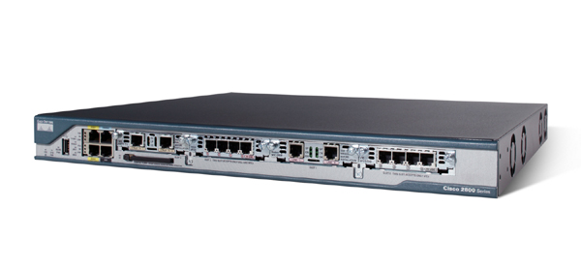
Application I: Monitoring Network Traffic Data Streams [Gilbert-Kotidis-Muthukrishnan-Strauss’01, Krishnamurthy-Sen-Zhang-Chen’03, Estan-Varghese’03, Lu-Montanari-Prabhakar-Dharmapurikar-Kabbani’08,…]
Would like to maintain a traffic
matrix x[.,.]
Easy to update: given a (src,dst) packet, increment x_{src,dst}
Requires way too much space! (2³² x 2³² entries)
Need to compress x, increment easily
Using linear compression we can:
Maintain sketch Φx under increments to x, since
Φ(x+Δ) = Φx + ΦΔ
Recover x* from Φx
Are adaptive measurements feasible for network monitoring ?
NO – we have only one pass, while adaptive schemes yield multi-pass streaming algorithms
However, multi-pass streaming still useful for analysis of data that resides on disk (e.g., mining query logs)
destination
source
x

Slide 9
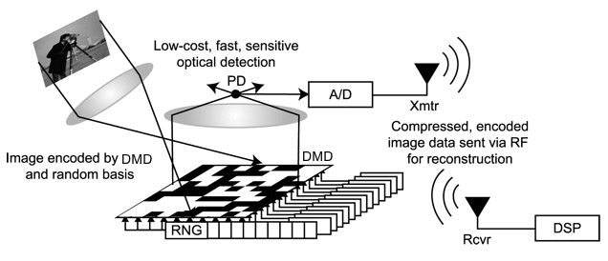






Applications, ctd.
Single pixel camera
[Duarte-Davenport-Takhar-Laska-Sun-Kelly-Baraniuk’08,…]
Are adaptive measurements feasible ?
YES – in principle, the measurement process can be sequential
Pooling Experiments
[Hassibi et al’07], [Dai-Sheikh, Milenkovic, Baraniuk],, [Shental-Amir-Zuk’09],[Erlich-Shental-Amir-Zuk’09], [Bruex- Gilbert-Kainkaryam-Schiefelbein-Woolf]
Are adaptive measurements feasible ?
YES – in principle, the measurement process can be sequential

Slide 10
Result: O(s loglog(n/s)) measurements
Approach:
Reduce s-sparse recovery to 1-sparse recovery
Solve 1-sparse recovery

Slide 11
s-sparse to 1-sparse
Folklore, dating back to [Gilbert-Guha-Indyk-Kotidis-Muthukrishnan-Strauss’02]
Need a stronger version of [Gilbert-Li-Porat-Strauss’10]
For i=1..n, let h(i) be chosen uniformly at random from {1…w}
h hashes coordinates into “buckets” {1…w}
Most of the s largest entries entries are hashed to unique buckets
Can recover a unique bucket j by using 1-sparse recovery on x_{h}-1_{(i)}
Then iterate to recover non-unique buckets
j

Slide 12
1-sparse recovery
Want to find x* such that
||x-x*||₂ ≤ C min_{1-sparse x”} ||x-x”||₂
Essentially: find coordinate x_{j} with error ||x_{[n]-{j}}||₂
Consider a special case where x is 1-sparse
Two measurements suffice:
a(x)=Σ_{i} i*x_{i}*r_{i}
b(x)=Σ_{i} x_{i}*r_{i}
where r_{i} are i.i.d. chosen from {-1,1}
We have:
j=a(x)/b(x)
x_{j}=b(x)*r_{i}
Can extend to the case when x is not exactly k-sparse:
Round a(x)/b(x) to the nearest integer
Works if ||x_{[n]-{j}}||₂ < C’ |x_{j}| /n (*)
j

Slide 13
Iterative approach
Compute sets
[n]=S₀ ≥ S₁ ≥ S₂≥ …≥ S_{t}={j}
Suppose ||x_{Si-{j}}||₂ < C’ |x_{j}| /B²
We show how to construct S_{i+1}≤S_{i} such that
||x_{Si+1-{j}}||₂ < ||x_{Si-{j}}||₂ /B < C’ |x_{j}| /B³
and
|S_{i+1}|<1+|S_{i}|/B²
Converges after t=O(log log n) steps

Slide 14
Iteration
For i=1..n, let g(i) be chosen uniformly at random from {1…B²}
Compute y_{t}=Σ _{l∈Si:g(l)=t} x_{l} r_{l}
Let p=g(j)
We have
E[y_{t}²] = ||x_{g}-1_{(t)}||₂²
Therefore
E[Σ_{t:p≠t} y_{t}²] <C’ E[y_{p}²] /B⁴
and we can apply the two-measurement scheme to y to identify p
We set S_{i+1}=g⁻¹(p)
j
y
p
B²

Slide 15
Conclusions
For sparse recovery, adaptivity provably helps
(sometimes even exponentially)
Questions:
Lower bounds ?
Measurement noise ?
Deterministic schemes ?

Slide 16
General references
Survey:
A. Gilbert, P. Indyk, “Sparse recovery using sparse matrices”, Proceedings of IEEE, June 2010.
Courses:
“Streaming, sketching, and sub-linear space algorithms”, Fall’07
“Sub-linear algorithms” (with Ronitt Rubinfeld), Fall’10
Blogs:
Nuit blanche: nuit-blanche.blogspot.com/

