Slide 1
DCSP-3: Minimal Length Coding
Jianfeng Feng
Department of Computer Science Warwick Univ., UK
Jianfeng.feng@warwick.ac.uk
http://www.dcs.warwick.ac.uk/~feng/dcsp.html

Slide 2
This Week’s Summary:
Information theory
Huffman coding: code events as economic as possible
Fourier Transform

Slide 3
Information sources
X = {x₁, x₂, … , x_{N}} with a known probability
P(x_{i}) = p_{i,} i=1,2,…,N
Example 1:
X = ( x₁ = lie on bed at 12 noon today
x₂ = in university at 12 noon today
x₃ = attend a lecture at 12 noon today )
= (B, U, L)
p = (1/2,1/4,1/4),
H(X) = .5*1+2*1/4+2*1/4=1.5 (Entropy)
B=0, U=1, L=01 (coding)
L_{s}=0.5*1+0.25*1+0.25*2=1.25 (average coding length)

Slide 4
Information sources
Example 2. Left: information source p(x_{i}), i = 1, ….,27
right: codes
To be, or not to be, that is the question—Whether 'tis Nobler in the mind to suffer. The Slings and Arrows of outrageous Fortune, Or to take Arms against a Sea of troubles, And by opposing end them? To die, to sleep—
As short as possible
01110 00001111111
1111110000000000
1111000000011000
100010000010000
1011111111100000

Slide 5
Information source coding
Replacement of the symbols (naked run/office in PM
example) with a binary representation is termed
source coding.
In any coding operation we replace the symbol with a codeword.
The purpose of source coding is to reduce the number of bits required to convey the information provided by the information source:
minimize the average length of codes.
Conjecture: an information source of entropy H
needs on average only H binary bits
to represent each symbol.

Slide 6
Shannon's first theorem
An instantaneous code can be found that encodes a source of entropy H(X) with an average number L_{s} (average length)
such that
L_{s} >= H(X)

Slide 7
How does it work?
Like many theorems of information theory, the
theorem tells us nothing of how to find the code.
However, it is useful results.
Let us have a look how it works

Slide 8
Example
Look at the activities of PM in three days with P(O)=0.9
Calculate probability
Assign binary codewords to these grouped outcomes.
code length

Slide 9
Example
Table 1 shows such a code, and the probability of each code word occurring.
Entropy is
H(X) = -0.729log₂(0.729)-0.081log₂(0.081)*3
-0.009*log₂(0.009)*3-0.001*log₂(0.001)
= 1.4070
The average length of coding is given by
L_{s} = 0.729*1+0.081*1+2*0.081*2+2*0.009*2
+3*0.009+3*0.001
= 1.2

Slide 10
Example
Moreover, without difficulty, we have found a code that has an average bit usage less than the source entropy.

Slide 11
Example
However, there is a difficulty with the code in Table 1.
Before a code word can be decoded, it must be parsed.
Parsing describes that activity of breaking the message string into its component codewords.

Slide 12
Example
After parsing, each codeword can be decoded into its symbol sequence.
An instantaneously parsable code is one that can be parsed as soon as the last bit of a codeword is received.

Slide 13
Instantaneous code
An instantaneous code must satisfy the prefix condition: that no codeword may be a prefix of any other code.
For example: in the codeword, we should not
use 1 11 to code two events
When we receive 11, it could be ambiguous
This condition is not satisfied by the code in Table 1.

Slide 14
Huffman coding
The code in Table 2, however, is
an instantaneously parsable code.
It satisfies the prefix condition.
Huffman developed a coding scheme which satisfies Shannon’s Thm

Slide 15
My most favourite story (History)
In 1951,David A Huffman and his MIT information theory classmates were given the choice of a term paper or a final exam.
The Professor, Robert M Fano, assigned a term paper on the problem of finding the most efficient binary code.
Huffman, unable to prove any codes were the most efficient, was about to give up when he hit upon the idea of using a frequency-sorted binary tree and quickly proved this method the most efficient.
In doing so, the student outdid his professor, who had worked with information theory inventor Clude Shannon to develop an optimal code.
By building the tree from the bottom up instead of the top down, Huffman avoided the major flaw of the suboptimal Shannon-Fano coding.

Slide 16
Huffman coding
code length
L_{s} = 0.729*1+0.081*3*3+0.009*5*3+0.001* 5
= 1.5980 (remember entropy is 1.4)

Slide 17
Huffman coding
Decoding
1 1 1 0 1 1 0 1 0 1 1 0 0 0 0 0 0 0 0 0 1

Slide 18
Huffman coding
Decoding
1 1 1 0 1 1 0 1 0 1 1 0 0 0 0 0 0 0 0 0 1
1 1 1 0 1 1 0 1 0 1 1 0 0 0 0 0 0 0 0 0 1

Slide 19
Huffman coding
The derivation of the Huffman code tree is shown in the following Figure and the tree itself is shown in the next Figure
In both these figures, the letter A to H have be used in replace of the sequence in Table 2 to make them easier to read.

Slide 20
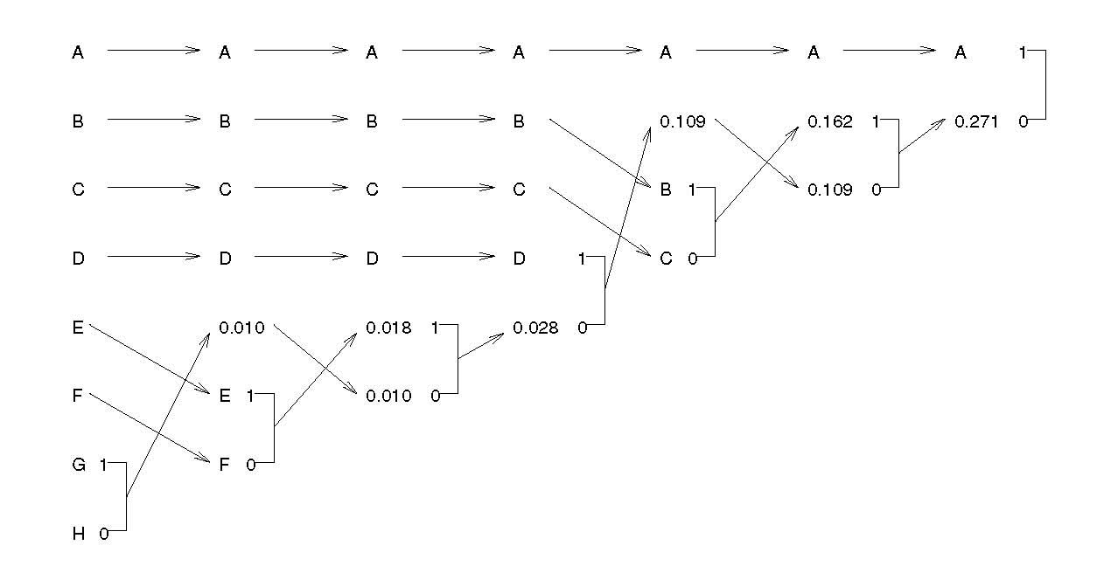
Huffman coding

Slide 21
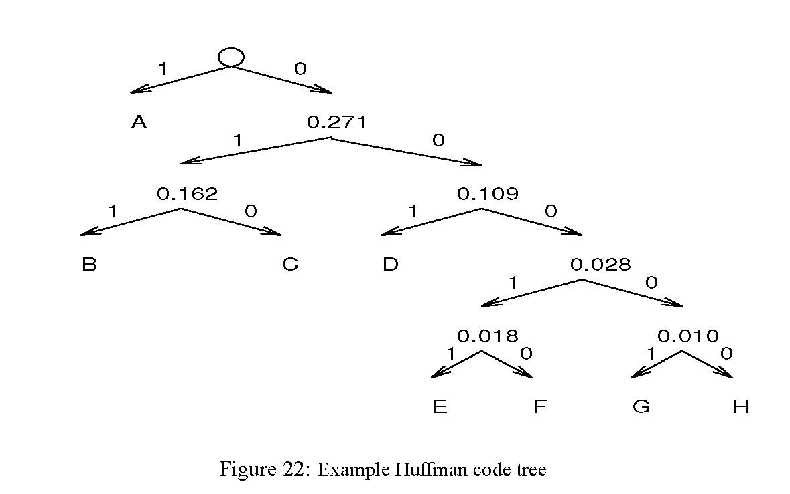
Huffman coding
Prefix condition is obviously satisfied since in the tree above, each branch codes one alphabetic.

Slide 22
Huffman coding
For example, the code in Table 2 uses 1.6 bits/symbol which is only 0.2 bits/symbol more bits per sequence than the theorem tells us is the best we can do.
We might conclude that there is little point in expending the effort in finding a code less satisfying the inequality above.

Slide 23
Another thought
How much have we saved in comparison with the most naïve idea?
i.e. O=1, N=0
L_{s}=3 [ P(OOO)+…+P(NNN)] = 3, halving it

Slide 24
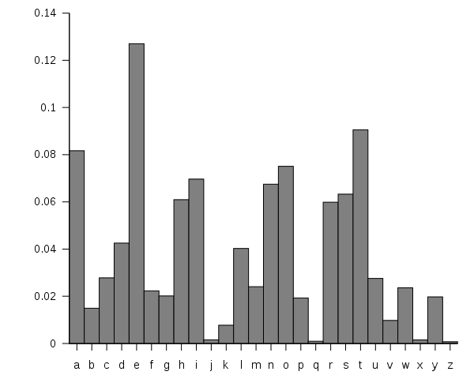
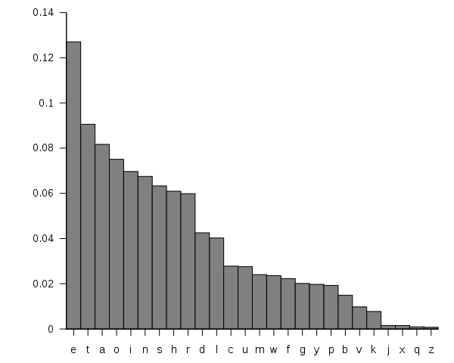
Frequency for alphabetics
Coding English: Huffman Coding

Slide 25
Coding in a more general framework
It is a very old topic

Slide 26
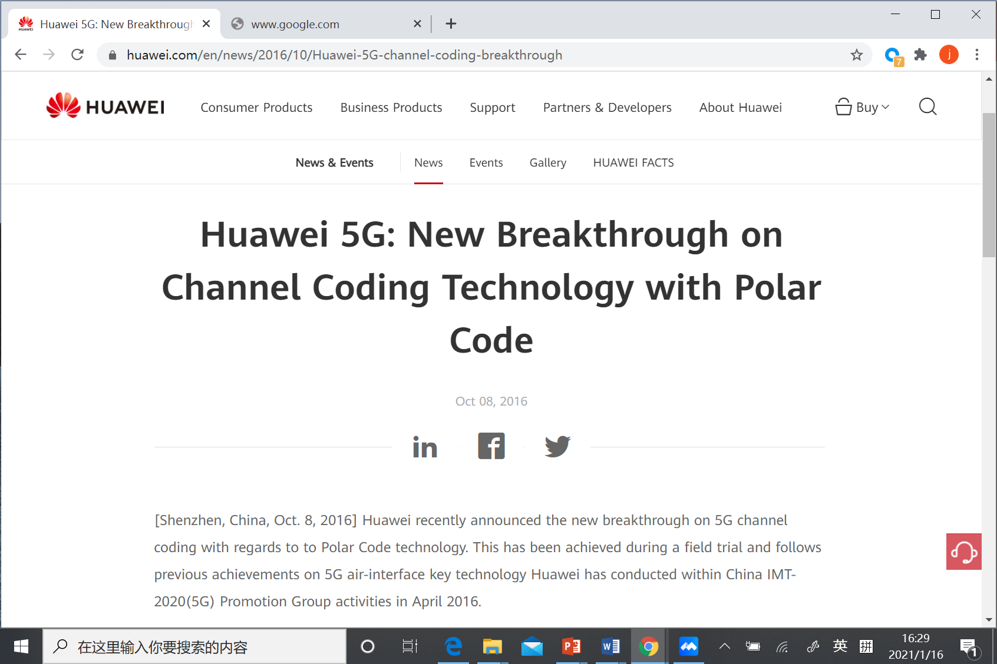

Slide 27
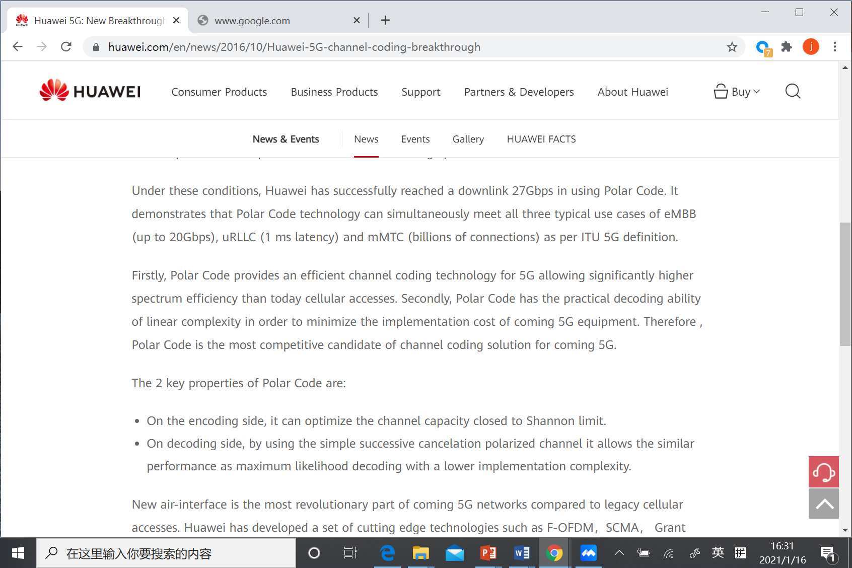

Slide 28
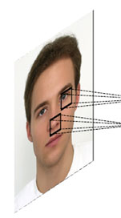
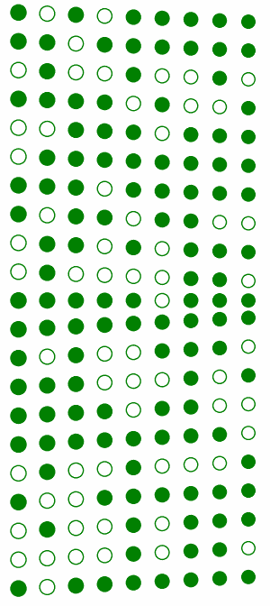
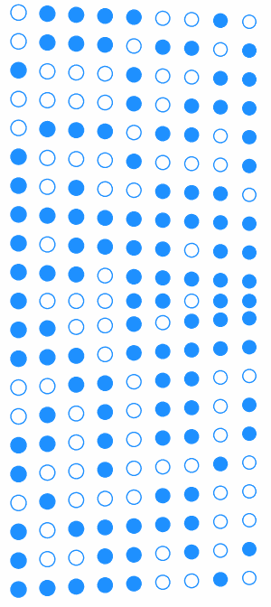
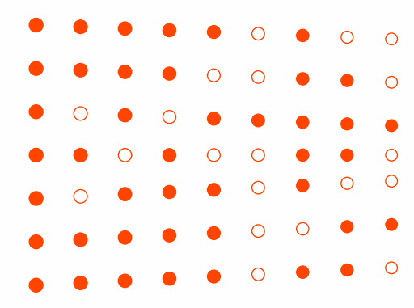
The largest Mysterious ?
人工智能背后机理
IT
retina
LGN
V1
V2
V3
IT
T(·)
T(·)
T(·)
T(·)
T(·)
A neuronal network inspired by brain vision systems

Slide 29
Summary of this week
It is an old topic, but it is still under development and is an amazing topic
Please read around
Tomorrow, we will start another exciting topic:
Signal Representation = Fourier Transform

Slide 30
Fourier's Song

