Slide 1
DCSP-4: Fourier Transform
Jianfeng Feng
Department of Computer Science Warwick Univ., UK
Jianfeng.feng@warwick.ac.uk
http://www.dcs.warwick.ac.uk/~feng/dcsp.html

Slide 2
Coding
Ls(X) > H(X)
Data transmission
Channel characteristics,
Signaling methods (ADC)
Interference and noise
Fourier transform
Data compression and encryption

Slide 3
Bandwidth
The range of frequencies occupied by the signal is called its bandwidth.
Power
0 B Frequency

Slide 4
Nyquist-Shannon Theorem
The ADC process is governed by an important la
(will be discussed in Chapter 3)
An analogue signal of bandwidth B can be completely recreated from its sampled form provided its sampled at a rate equal to at least twice it bandwidth.
That is
S > 2 B

Slide 5
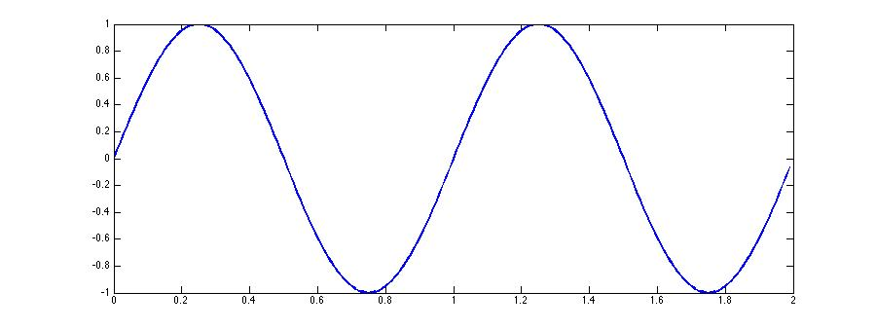
Example
I will guess that B = 1 Hz
Sample at 2B = 2 Hz: x[n] = [ 0 0 0 0 ]
Intuitively, I would say it will not work

Slide 6
Example
I will guess that B = 1 Hz
Sample at 2B < 4 Hz: x[n] = [ 1 0 -1 0 1 0 -1 0 ]
According to N-S Thm, we can fully recover the original signal

Slide 7
Example
I will guess that B = 1 Hz
Sample at 2B < 4 Hz: x[n] = [ 1 0 -1 0 1 0 -1 0 ]
According to N-S Thm, we can fully recover the original signal
Well, the blue line has the identical frequency, and x[n]. What is wrong?

Slide 8
Noise in a channel

Slide 9
Noise in a channel
Attenuation

Slide 10
Noise in a channel

Slide 11
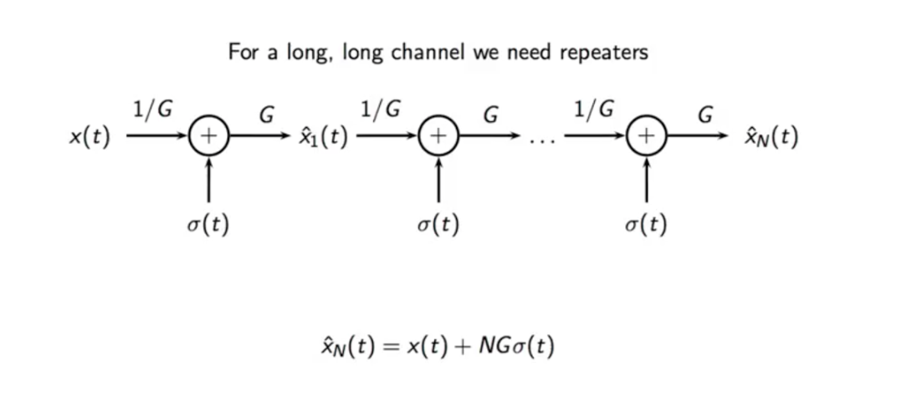
Noise in a channel

Slide 12
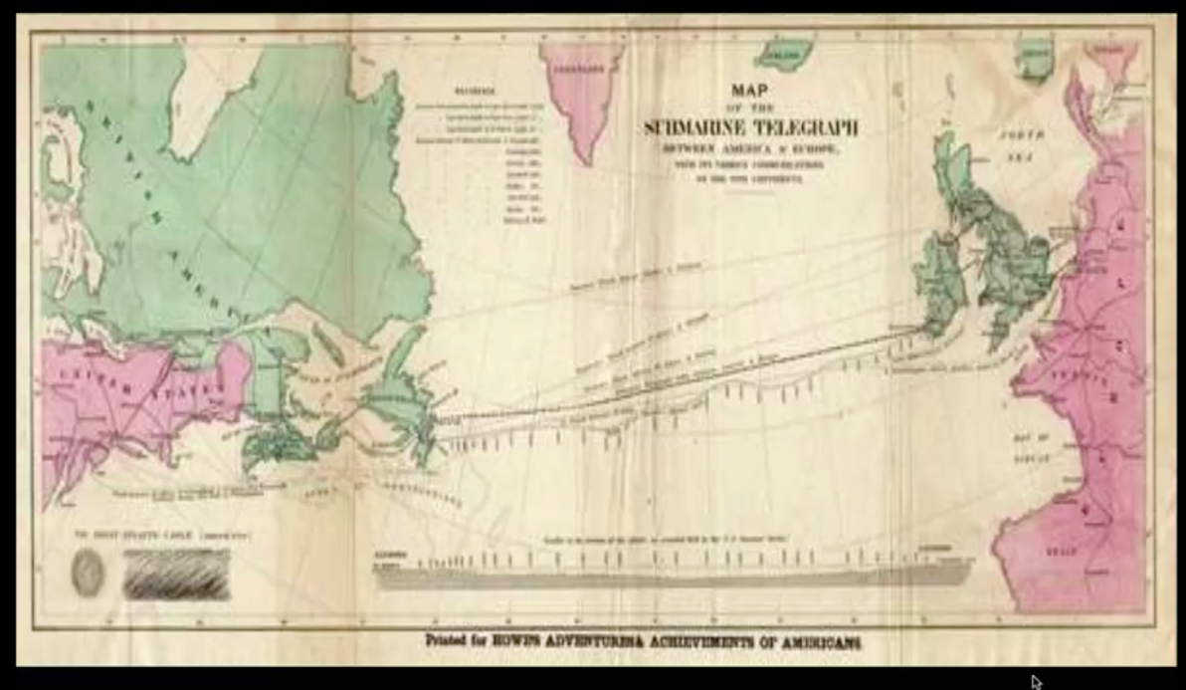
Noise in a channel

Slide 13
Noise therefore places a limit on the channel at which we can transfer information
Obviously, what really matters is the signal to noise ratio (SNR).
This is defined by the ratio signal power S to noise power N, and is often expressed in deciBels (dB):
SNR=10 log₁₀ (S/N) dB
SNR

Slide 14
Noise sources
Input noise is common in low frequency circuits and arises from electric fields generated by electrical switching.
It appears as bursts at the receiver, and when present can have a catastrophic effect due to its large power.
Other peoples signals can generate noise: cross-talk is the term give to the pick-up of radiated signals from adjacent cabling.

Slide 15
Noise sources
When radio links are used, interference from other transmitters can be problematic.
Thermal noise is always present. It is due to the random motion of electric charges present in all media. It can be generated externally, or internally at the receiver.
How to tell signal from noise?

Slide 16
Communication Techniques I
Time frequency
Fourier Transform
bandwidth
noise power

Slide 17
Communication Techniques I
Time frequency
Fourier Transform
bandwidth
noise power

Slide 18
Communication Techniques II
Time, frequency and bandwidth
We can describe a signal in two ways.
The
One way is to describe its evolution in time domain,
as we usually do.
The other way is to describe its frequency content,
in frequency domain: what we will learn

Slide 19
Your heartbeat
Ingredients: a frequency ω (units: radians)
an initial phase φ (units: radians) an amplitude A (units depending on underlying measurement)
a trigonometric function
e.g. x[n]= A cos(ωn+φ)
cosine wave, x(t), has a single frequency,
ω =2 π/T
where T is the period i.e. x(t+T)=x(t).

Slide 20
What do we expect?
Power
1 Hz
Time
Fre

Slide 21
What do we expect?
Power
1 Hz
Time
Fre

Slide 22
What do we expect?
Power
1 Hz
Time
Fre

Slide 23
What do we expect?
Power
1 Hz
Time
Fre

Slide 24
What do we expect?
Power
1 Hz
Time
Fre

Slide 25
Fourier Transform I
This representation is quite general.
In fact we have the following theorem due to Fourier.
Any signal x(t) of period T can be
represented as the sum of a set of
cosinusoidal and sinusoidal waves of
different frequencies and phases

Slide 26
Fourier Transform II
In mathematics, the continuous Fourier transform is one of the specific forms of Fourier analysis.
As such, it transforms one function into another, which is called the frequency domain representation of the original function (which is often a function in the time-domain).
In this specific case, both domains are continuous and unbounded.
The term Fourier transform can refer to either the frequency domain representation of a function or to the process/formula that "transforms" one function into the other.

Slide 27
Fourier Transform III

Slide 28
Fourier Transform IV
Continuous time (analogous signals): FT (Fourier transform)
it is in theory (in Warwick, we need it)
Discrete time: DTFT (infinity digital signals)
it is in theory (discrete version)
DFT: Discrete Fourier transform (finite digital signals
what we can use, one line in Matlab (fft))

Slide 29
History of FT I
Gauss computes trigonometric series efficiently in 1805
Fourier invents Fourier series in 1807
People start computing Fourier series, and develop tricks Good comes up with an algorithm in 1958
Cooley and Tukey (re)-discover the fast Fourier transform algorithm in 1965 for N a power of a prime
Winograd combined all methods to give the most efficient FFTs

Slide 30
Gauss
History of FT II

Slide 31
Fourier
History of FT III

Slide 32
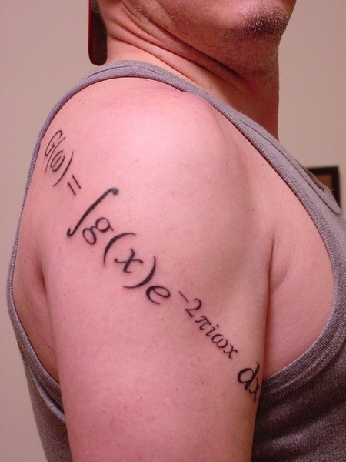
Jianfeng Feng
History of FT IV

Slide 33
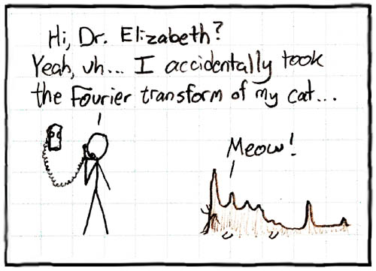
History of FT V
Prof Feng

Slide 34
Complex Numbers

Slide 35
Exp(j a) = cos a + j sin a
Euler Formular

Slide 36
The complex eponential
the trigonometric function of choice in DSP is the complex exponential:
x[n] = Aexp(j(ωn+φ))
= A[cos(ωn + φ) + j sin(ωn + φ)]

Slide 37
The complex eponential

Slide 38
Most beautiful Math Formula
exp ( j π ) + 1 = 0
Where e is Euler's number
J is the imaginary unit

Slide 39
Fourier's Song

Slide 40
Example
Frequency-space
Image space
y
IFT
k1
k2
x
FT

Slide 42
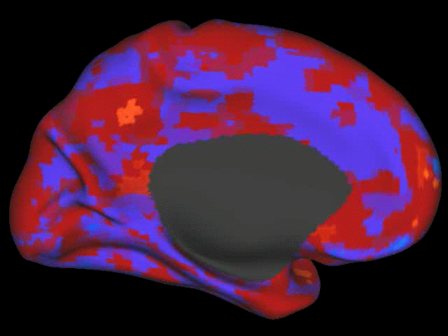
Fun: Decoding dream (Horikawa et al. Science, 2013)

Slide 43
Fun

