Slide 1
Seminar 1 Digital Communication and Signal Processing
How to use Matlab
Ruohan Zhang
Ruohan.Zhang.1@warwick.ac.uk
Department of Computer Science, University of Warwick
15/01/2024

Slide 2
Layout of Matlab
https://uk.mathworks.com/

Slide 3
Matlab as calculator
1. basic arithmetic operator + - * / ^ ()
e.g. 2+3/4*5
3^2*4
3-4/4-2
2. extended arithmetic - accidental error
1/0 Inf
-1/0 Inf
0/0 NaN
1/Inf 0
we know 1/(1/x) = x, then try 1/(1/0) = ? 0
complex number 1+i , -1+3*i

Slide 4
Numbers and formats
1. Different kind of numbers
Integer: e.g. 123, -218
Real : e.g. 1.234, - 10.9
complex : e.g. 3.21-3.4*i (i = sqrt(-1)).
Inf : Infinity (dividing by 0)
NaN: Not a number (0/0)
e: notation for very large or small number, e.g. 1.34e+03 = ? , 1.34e-03 = ?

Slide 5
2. Calculation: 15 significant figures
The 'format' tells how MATLAB prints numbers.
Type 'help format' in command window for full list.
e.g. pi = ?? usually 3.1416
format long
pi = ??
format short e
pi = ??
format short
pi = ??
If want to switch back to default format, type: format

Slide 6
3. finite accuracy consequences
Matlab limits accuracy (enough for most cases): 64 bits, store number as large as 2*10^308, as small as 2*10^(-308)
Store any number with 15 significant figures:
e.g. 1.23456789023456 (14 figures, can handle)
1.23456789023456789012 (20 digits, truncated to 15 figures)
round off cannot be avoided.
e.g. what is sin(pi) = ?
input: sin(pi)
ans =
1.2246e-16
NB: The result is a slight round-off error, we can regard it as zero, as long as it is small like 10^(-15).

Slide 7
Variables
1. combination of letter and number, case sensitive
e.g. a , x1, z2453, A, t = 2+3-9, 2*t-2
Not allowed: Net-c, 2p, %x, @sign
NB: avoid using space
2. Avoid some special names: eps (= 2^(-54)), pi
3. complex numbers : i, j = sqrt(-1), unless you change them

Slide 8
Build-in function
1. sin, cos, tan, sec = 1/sin, cosec = 1/cos, cotan
e.g. work out the coordinate of a point on a circle of radius 5 centred at origin, having an elevation 30 degree = pi/6 radians.
2. inverse trig function
e.g. asin, acos, atan--> answer returned in radians, so asin(1) = pi/2
3. exponent
exp : $exp⁡(x) = e^{x}$
logarithm: log: log to base e/ log10 to base 10
square root: sqrt().
e.g. x = 9; sqrt(x), exp(x), log(sqrt(x)), log10(x^2+6)

Slide 9
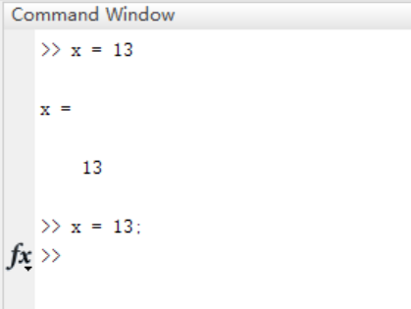
Some useful tips: (1) If you don’t want to show the output in the command window, you can use a semicolon in the end of a command to suppress the output. E.g.

Slide 10
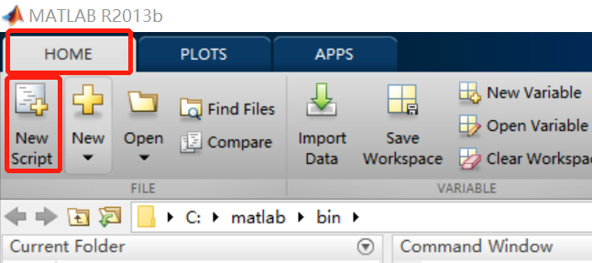
(2) Scripts If you want to record all of the commands or run a lot of commands together, it is highly recommended to create a script to write down all the commands first, and then run them step by step. ① To create a script: click “Home → New script”

Slide 11
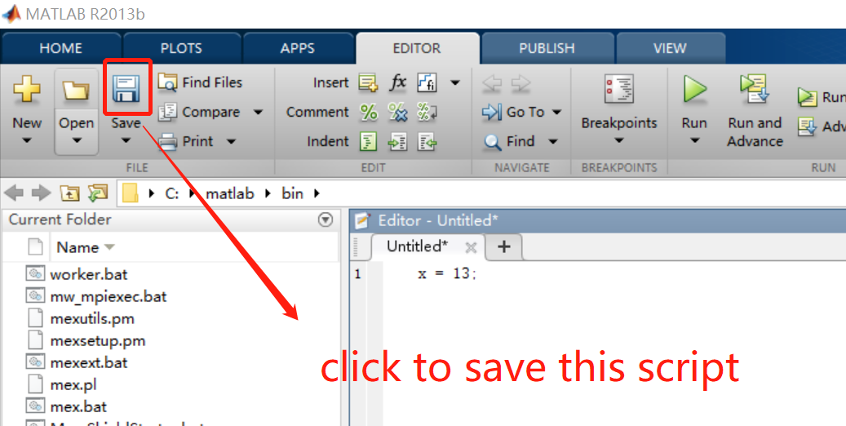
② To save a script:
Click “save” → choose a save path → name the script
NB: when name scripts, it is recommended to only use letters, numbers, underlines and avoid spaces.

Slide 12
Vectors
row vector
(1) Create row vectors
a = [1 2 3] or a = [1, 2, 3]
(2) Insert function into a vector
b = [1 3 sqrt(25) 1+2]
(3) Length of a vector
length(a)

Slide 13
(4) Vector basic arithmetic operations
c = a + b
d = a*3
e = a*3 + b
NB: the dimension of vector a and b must agree
e.g. f = [1 2 3 4] using a + f is wrong
(5) It is worth noting that space of a vector is very important.
e.g. v1 = [3+ 4 5] = [7 5]
v2 = [3 +4 5] = [3 4 5]
(6) Addressing vector elements
v3 = [6 5 9 1 2 7]
v3(2) = ?
if we sort(v3) (default is ascending order)
v4 = sort(v3) = ? v3 = ?
if we set v3(2) = 100, then v3 = ?

Slide 14
2. column vector
(1) Create column vectors
a = [4; 5; 6] or a = [3 return 4 return 5]
(2) Basic knowledge of column vector is the same as row vector.
3. shortcut for producing row vectors
command:
start_number : length of step (default is 1) : end_num
e.g. 1:20 (The step length of this vector is 1 by default.)
5:0.1:6
-1:0.2:1
NB: if the start number is larger than the end number and we don’t set the length of step, we can only get an empty vector
e.g. 1:-1

Slide 15
4. Vector operations
(1) scalar product
The scalar product of two real vectors of length n is equal to
e.g. A = [4 -1 2];
B = [2 -2 -1];
input: C = dot(A,B) or C = A * B’
ans =
8
The result is 8 since C = A(1)*B(1) + A(2)*B(2) + A(3)*B(3)

Slide 16
(2) Element-wise multiplication
e.g. A = [4 -1 2];
B = [2 -2 -1];
input: A .* B
ans =
8 2 -2
The result is [4*2 -1*(-2) 2*(-1)]
ex.: x = 0,0.25,..., 1, compute y = x.*sin(pi*x)
input: x = 0:.25:1;
y = x .* sin(pi*x);
We will often use this operation to create a time-dominant signal.

Slide 17
(3) Similarly, there are some other operations in element-wise in MATLAB.
.^ element-wise power
e.g. A .^ 2
./ element-wise division
e.g. A ./ 2

Slide 18
Matrix
1.Create a matrix:
list its elements between [ ], and use semicolons to separate rows.
e.g.
A = [1 2 3; 4 5 6; 7 8 9]
ans =
1 2 3
4 5 6
7 8 9

Slide 19
2. Addressing elements in a matrix
e.g. A= [1 2 3; 4 5 6; 7 8 9]
input: A(2,3)
ans =
6 a single matrix element
input: A(2:3,1:2)
ans =
4 5
7 8 a portion of the matrix

Slide 20
3. sum matrices of same size
e.g.
A= [1 2; 4 5];
B = A’;
Input: C = A + B
ans =
2 6
6 10
NB: The apostrophe (‘) indicates transpose operation,
i.e. A’ is the transpose of A.

Slide 21
4. multiply a matrix by a scalar
e.g.
D = [1 2; 4 5];
k = pi;
Input: E = D*k
ans =
3.1416 6.2832
12.5664 15.7080
All the matrix elements get multiplied by k.

Slide 22
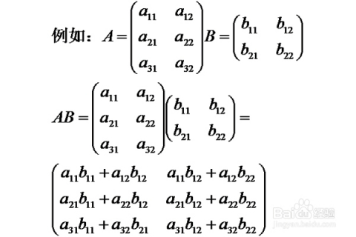
4. multiply a matrix by a matrix
Matrix A and B can be multiplied together, provided the number of columns of matrix A is equal to the number of rows of matrix B.
input: A = rand(3,2)
B = rand(2,2)
C = A * B
C =
0.7264 1.6614
0.5981 1.4775
0.0887 0.2157
e.g.
NB: The function rand(n,m) returns an $n × m$matrix of random numbers uniformly distributed between 0 and 1.
It is worth noting that the result of matrix C is not unique.

Slide 23
5. take powers of a matrix
(1) square matrix
e.g. D = rand(2,2)
E = D ^ 2
E =
0.7841 0.6930
0.2313 0.3025
F = D ^ 3
F =
0.7646 0.7689
0.2566 0.2302
Likewise, the results of D and F are not unique, because we use the function rand() to create matrix D.
NB: we can only use ^ to compute power of a square matrix, because D^2 = D*D and D^3 = D*D*D, and these computations should follow the principle of matrix multiplication

Slide 24
(2) non-square matrix
If we want to take power of a matrix which is not square matrix, we can use .^ to compute element-wise power.
e.g. D = rand(3,2)
E = D .^ 2
E =
0.1925 0.6323
0.1456 0.0349
0.5860 0.2399
F = D .^ 3
F =
0.0845 0.5028
0.0555 0.0065
0.4486 0.1175

Slide 25
6. Some useful matrices
A = zeros(n,m) all zeros
A = ones(n,m) all ones
A = rand(n,m) uniformly distributed [0,1]
A = randn(n, m) normally distributed (mean=0, SD=1)
Here, n represents the number of rows of the matrix you create, and m represents columns.

Slide 26
Plotting
Use plot(x, y) to plot vector y vs. vector x.
NB: x and y should have the same size
Example:
t = 0:0.001:0.6;
x = sin(2*pi*50*t)+sin(2*pi*120*t);
y = x + 2*randn(size(t));
plot(1000*t(1:50),y(1:50))
title('Signal Corrupted with Zero-Mean Random Noise')
xlabel('time (milliseconds)')

Slide 27
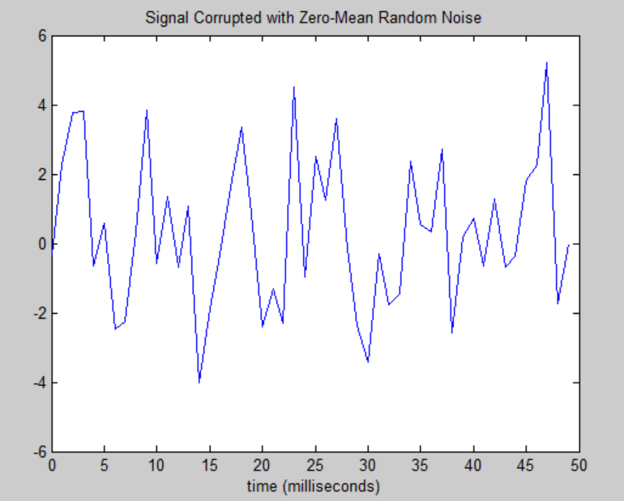

Slide 28
Plotting power spectra
Y = fft(y,512);
Pyy = Y.* conj(Y) / 512;
f = 1000*(0:256)/512;
plot(f,Pyy(1:257))
title('Frequency content of y')
xlabel('frequency (Hz)')

Slide 29
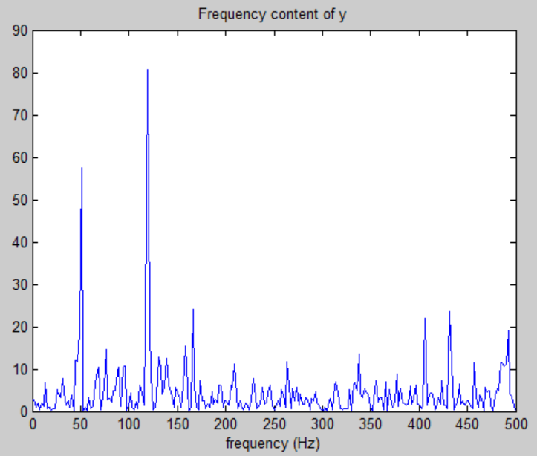

Slide 30
Functions
1. Functions are M-files that accept input arguments and return output arguments. They operate on variables within their own workspace.
Example:
%% this function aims to compute the mean of a vector elements.
function y = average(x) % average is the name of this function.
[m,n] = size(x);
% firstly, use if-end to control that the input of this function should be an vector.
if (~((m == 1) | (n == 1)) | (m == 1 & n == 1))
error('Input must be a vector')
end
% then, we can compute the average of this vector and get the output.
y = sum(x)/length(x);
NB: It is worth noting that if we want to call functions created by ourselves, we need to open the path in which the function M-files are saved, or save the function M-files in a suitable current folder.

Slide 31
2.Other useful functions & commands
for: for loop to repeat specified number of times
If: execute statements if condition is true
while: while loop to repeat when condition is true
load: load variables from file into workspace
clc & clear: clc is used to clear Command Window, and clear is used to remove variables from the workspace.
%: make comments on the command.

Slide 32
Exercise
1. Generate a random row vector of length 10 and the elements are uniformly distributed on [0,2].
a. Add 16 to each element
b. Add 3 to just the odd-index elements
c. Compute the square root of each element
d. Compute the square of each element
2. According this formula, first create a vector x with 100 elements, then add all the elements of this vector.
$$x_{n}= \frac{{(−1)}^{n+1}}{2n−1}$$

Slide 33
3. Plot the expression (determined in modelling the growth of the US population)
$$P(t) = \frac{197273000}{1+e^{−0.0313(t−1913.25)}}$$
where t is the date, in years AD, using t = 1790 to 2000. What population is predicted in the year 2021?

Slide 34
More Exercise
4. Create an M-by-N array of random numbers (use rand). Move through the array, element by element, and set any value that is less than 0.2 to 0 and any value that is greater than (or equal to) 0.2 to 1.
5. Create a function file named by Fibonacci that gives the nth element of the Fibonacci sequence.

