Slide 1
DCSP-5: Fourier Transform II
Jianfeng Feng
Department of Computer Science Warwick Univ., UK
Jianfeng.feng@warwick.ac.uk
http://www.dcs.warwick.ac.uk/~feng/dcsp.html

Slide 2
Fourier Theorem
This representation is quite general.
In fact we have the following theorem due to Fourier.
Any signal x(t) of period T can be represented as the sum of a set of cosinusoidal and sinusoidal waves of different frequencies

Slide 3
Today and next week summary
Introduce FT in layman’s language (today)
Applications (next week)

Slide 4

This week’s summary
Introduce FT in layman’s language (today)
Applications (tomorrow)
You might find the world is different !

Slide 5
summary
Introduce FT in layman’s language (today)
Talk about continuous FT since it is clean and simple
Come back to it on how to numerically calculate it later on
Intuition
Fourier theorem
Examples
Bandwidth

Slide 6
FT: Fourier Thm in terms of Sin and Cos
simply a generalization of common knowledge of the Euclidean space
{ 1, cos (nωt), sin(nωt), n=1,2…} are orthogonal and complete
they form orthogonal bases
where A₀ is the d.c. term, and T is the period of the waveform.

Slide 7
Intuition of FT
Two dimensional space (all points)

Slide 8
Intuition of FT
Two dimensional space (all points)
Two bases which are orthogonal
(1,0) (0,1)

Slide 9
Intuition of FT
Two dimensional space (all points)
(a, b) = a (1,0) + b (0,1)
First basis second basis
a: the contribution from the first basis, the load at the first basis
b:

Slide 10
Intuition of FT
Two dimensional space (all points)
(a, b) = a (1,0) + b (0,1)

Slide 11
Intuition of FT
Two dimensional space (all points)
(a, b) = a (1,0) + b (0,1)
Signal space (all functions of t)
x (t) = a sin(ω t) + b sin (2 ω t)

Slide 12
Intuition of FT
Two a point in it
(a, b) = a (1,0) + b (0,1)

Slide 13
Intuition of FT
Two a point in it
(a, b) = a (1,0) + b (0,1)
Signal = coef basis coef basis

Slide 14
Intuition of FT
Two a point in it
(a, b) = a (1,0) + b (0,1)
x(t) = ?
Signal = coef basis coef basis

Slide 15
Intuition of FT
Two a point in it
(a, b) = a (1,0) + b (0,1)
x(t) = a F1(t) +b F2(t)
Signal = coef basis coef basis

Slide 16
Intuition of FT
It is a branch of mathematics called
functional analysis: treat each function as a point in a functional space
It is the starting pointe of modern mathematics
It is also the actual power of mathematics
Branch space, Hilbert space etc.

Slide 17
Intuition of FT
How to calculate these coefficients?
o
(a, b) = a (1,0) + b (0,1)
Functional
x (t) = a cos(ω t) + b cos (2 ω t)
ω = 2 pi /T

Slide 18
Intuition of FT
Coefficient is obtained via Inner product
<(x, y), (m,n)> = xm+yn
All bases are orthogonal
<(0, 1), (1,0)> = 0, (0,1) (1, 0)
(a, b) = a (1,0) + b (0,1)
Therefore
<(a, b), (1,0)> = a <(1,0), (1,0)> + b <(0,1), (1,0)> = a
<(a, b), (0,1)> = a <(1,0), (0,1)> + b <(0,1), (0,1)> = b

Slide 19
Intuition of FT
Two dimensi coefficient is obtained via Inner product
(a, b) = a (1,0) + b (0,1)
<(a, b), (1,0)> = a <(1,0), (1,0)> + b <(0,1), (1,0)> = a
Functional coefficient is obtained via inner product
x (t) = a cos(ω t) + b cos (2 ω t)
<x (t), cos(ω t) > = <a cos(ω t), cos(ω t) > + <b cos (2 ω t), cos(ω t) > = a (?)
If cos(ω t) and cos(2 ω t) are orthogonal

Slide 20
Intuition of FT
Two dimension orthogonal basis
(a, b) = a (1,0) + b (0,1)
Functional space basis
x (t) = a cos(ω t) + b cos (2 ω t)

Slide 21
Intuition of FT
It turns out that we can define the inner product
in the signal space

Slide 22
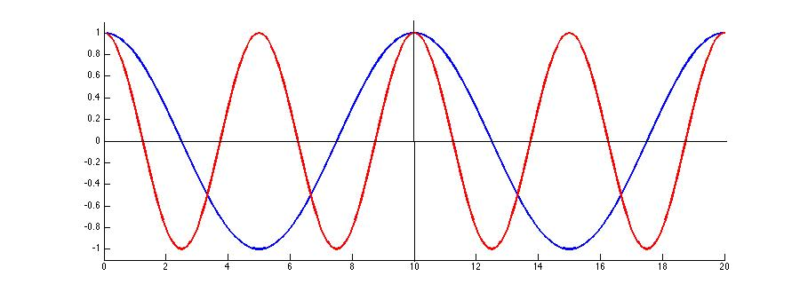
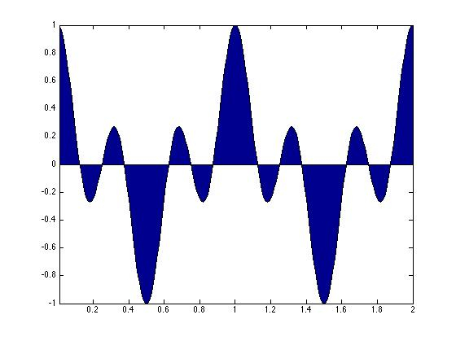
Intuition of FT
Cos ( 2 π t)
Cos ( 2*2 π t)
Cos ( 2 π t) * Cos ( 2*2 π t)

Slide 23
Intuition of FT
Cos ( 2 π t)
Cos ( 2*2 π t)
Cos ( 2 π t) * Cos ( 2*2 π t)
{ cos (n ω t ), n=1,2…} are orthogonal
they form orthogonal bases

Slide 24
Intuition of FT
It turns out that we can define the inner product
in the signal space
In particular, we have
x (t) = a cos(ω t) + b cos (2 ω t)
a = <X(t), cos(ω t)> =
b = ?

Slide 25
Intuition of FT
X
X₁
X₆
(1 0 0 0 0 0)
(0 0 0 0 0 1)
X₂
X₃
x₄
X₅
(0 0 1 0 0 0)
(0 1 0 1 0 0)
(0 1 0 0 0 0 )
(0 1 0 0 1 0)
In an n-dim Euclidean space, we decompose any vector X in terms of orthogonal bases
Coefficient is obtained by inner product between a basis and X
We sometime call x_{i} weight
X = x₁ (1 0 0 0 0 0) + x₂(0 1 0 0 0 0 ) + … + x₆ (0 0 0 0 0 1)

Slide 26

Intuition of FT
X(t)
A₆
……….
A₁
cos (ω t )
A₂
A₃
A₄
A₅

Slide 27
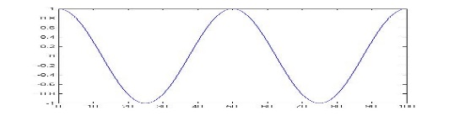
Intuition of FT
X(t)
A₆
……….
A₁
cos (ω t )
A₂
A₃
A₄
A₅
cos (2 ω t )

Slide 28
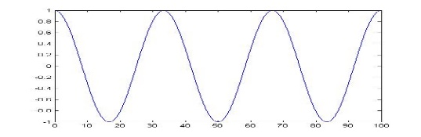
Intuition of FT
X(t)
A₆
……….
A₁
cos (ω t )
A₂
A₃
A₄
A₅
cos (3 ω t )
cos (2 ω t )

Slide 29
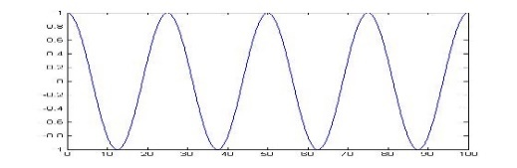
Intuition of FT
X(t)
A₆
……….
A₁
cos (ω t )
A₂
A₃
A₄
A₅
cos (3 ω t )
cos (4 ω t )
cos (2 ω t )

Slide 30
Intuition of FT
X(t)
A₆
……….
A₁
cos (ω t )
A₂
A₃
A₄
0
cos (3 ω t )
cos (4 ω t )
cos (2 ω t )

Slide 31
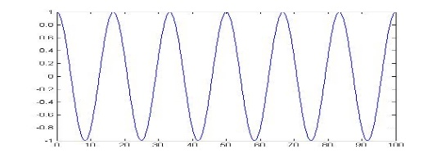
Intuition of FT
X(t)
A₆
A₁
cos (ω t )
A₂
A₃
A₄
0
cos (3 ω t )
cos (4 ω t )
cos (2 ω t )

Slide 32
Intuition of FT
X(t)
A₆
……….
A₁
cos (ω t )
A₂
A₃
A₄
0
cos (3 ω t )
cos (4 ω t )
cos (2 ω t )
In an n-dim Euclidean space, we decompose any vector X in terms of orthogonal bases
Coefficient is obtained by inner product between a basis and X
We sometime call x_{i} weight

Slide 33
FT: Fourier Thm in terms of Sin and Cos
simply a generalization of common knowledge of the Euclidean space
{ 1, cos (nωt), sin(nωt), n=1,2…} are orthogonal and complete
they form orthogonal bases

Slide 34
FT: Fourier Thm in terms of Sin and Cos
simply a generalization of common knowledge of the Euclidean space
{ 1, cos (nωt), sin(nωt), n=1,2…} are orthogonal and complete
they form orthogonal bases

Slide 35
FT: Fourier Thm in terms of Sin and Cos
simply a generalization of common knowledge of the Euclidean space
{ 1, cos (nωt), sin(nωt), n=1,2…} are orthogonal and complete
they form orthogonal bases
where A₀ is the d.c. term, and T is the period of the waveform.

Slide 36
FT: Fourier Thm in terms of Sin and Cos
simply a generalization of common knowledge of the Euclidean space
{ 1, cos (nωt), sin(nωt), n=1,2…} are orthogonal and complete
they form orthogonal bases
where A₀ is the d.c. term, and T is the period of the waveform.

Slide 37
FT: Fourier Thm in terms of Sin and Cos
simply a generalization of common knowledge of the Euclidean space
{ 1, cos (nωt), sin(nωt), n=1,2…} are orthogonal and complete
they form orthogonal bases
where A₀ is the d.c. term, and T is the period of the waveform.

Slide 38
FT: Fourier Thm in terms of Sin and Cos
simply a generalization of common knowledge of the Euclidean space
{ 1, cos (nωt), sin(nωt), n=1,2…} are orthogonal and complete
they form orthogonal bases
where A₀ is the d.c. term, and T is the period of the waveform.

Slide 39
Example I
x(t)=1, 0< t < π, 2π < t < 3π, 0 otherwise
Hence x(t) is a signal with a period of 2π
π 2π 3π 4π

Slide 40
Example I
Finally, we have

Slide 41
Example I
|X(F)|
2/π
Frequency domain
The description of a signal in terms of its constituent frequencies is called its
frequency (power) spectrum.

Slide 42
Example I
|X(F)|
2/π
=
Time domain
Frequency domain

Slide 43
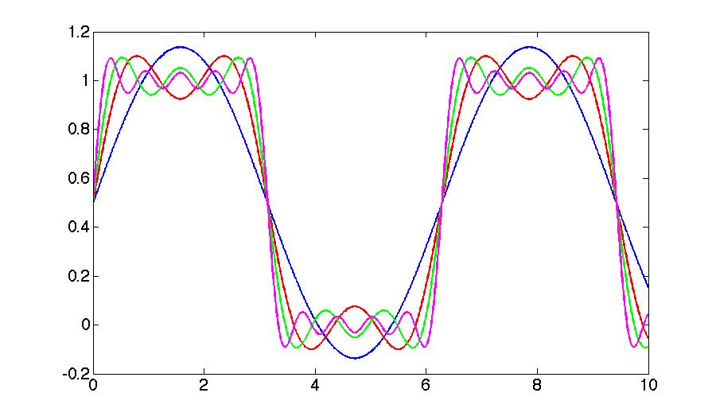
Example I
A periodic signal is uniquely determined by its coefficients {A_{n}, B_{n}}.
If we truncated the series into finite term, the signal can be approximated by a finite sines as shown below (compression, MP3, MP4, JPG, … )
one term
Two terms
Three terms
Five terms

Slide 44

Example II (understanding music)

Slide 45
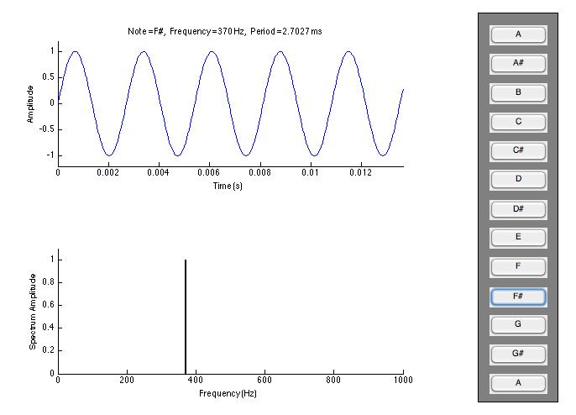
a. Pure tone: Script1_1.m
Example II
This confirms our earlier believe that it is a signal
with a finite bandwidth (N-S sampling Thm)

Slide 46

Digital Music

