Slide 1
DCSP-6: Applications
Jianfeng Feng
Department of Computer Science Warwick Univ., UK
Jianfeng.feng@warwick.ac.uk
http://www.dcs.warwick.ac.uk/~feng/dcsp.html

Slide 2
Recap
In general, a signal with T = 2π / ω can be represented as follows
This is the idea of
JPEG, MP3, MP4
Compress

Slide 3
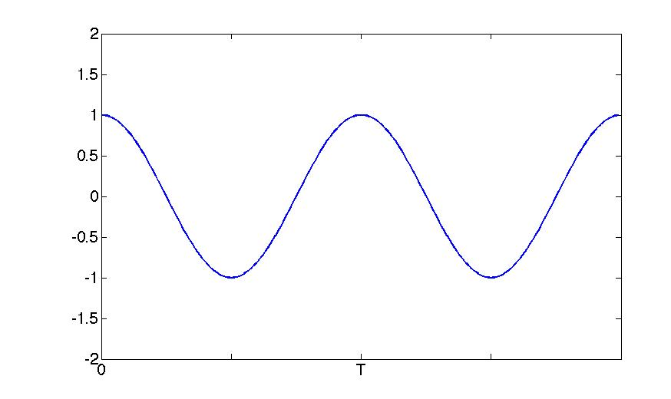
Recap
In general, a signal with T=2π/ω can be represented as follows
T 2T
X(t) ~ A₀ + A₁ cos(ω t)

Slide 4
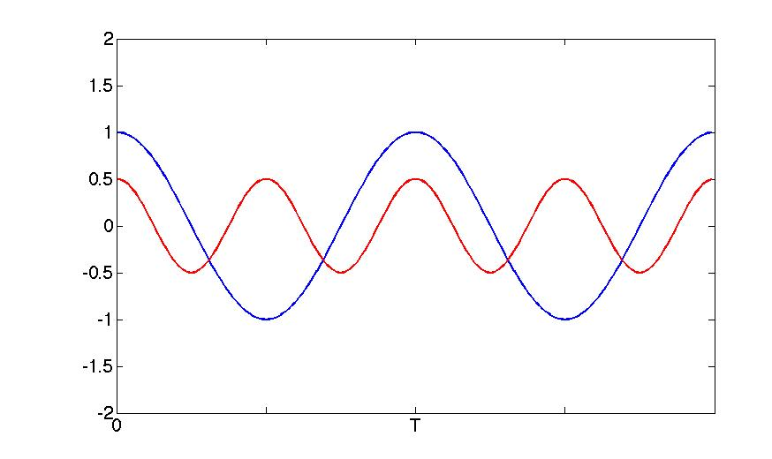
Recap
In general, a signal with T=2π/ω can be represented as follows
T 2T
X(t) ~ A₀ + A₁ cos(ω t)+A₂cos(2ωt)

Slide 5
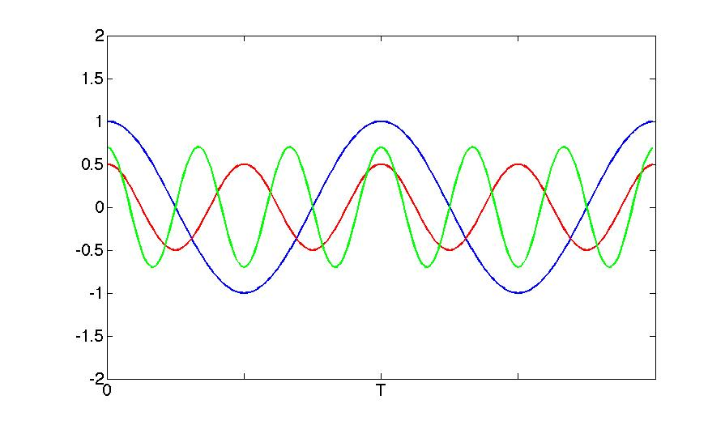
Recap
In general, a signal with T=2π/ω can be represented as follows
T 2T
X(t) ~ A₀ + A₁ cos(ω t)+A₂cos(2ωt)+A₃cos(3ωt)

Slide 6
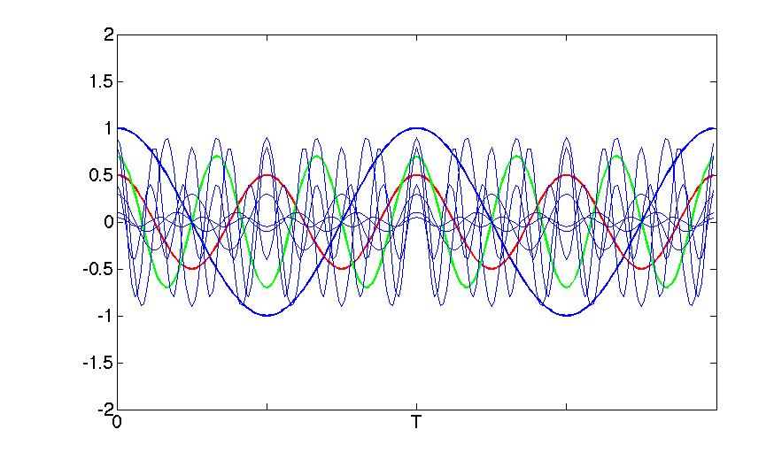
Recap
In general, a signal with T=2π/ω can be represented as follows
T 2T
X(t) ~ A₀ + A₁ cos(ω t)+A₂cos(2ωt)+A₃cos(3ωt)
+ A₄cos(4ωt)+A₅cos(5ωt)+A₆cos(6ωt)
+ A₇cos(7ωt)+A₈cos(8ωt)+A₉cos(9ωt)

Slide 7
Recap
In general, a signal with T=2π/ω can be represented as follows
T 2T
X(t) = A₀ + A₁ cos(ω t)+A₂cos(2ωt)+A₃cos(3ωt)
+ A₄cos(4ωt)+A₅cos(5ωt)+A₆cos(6ωt)
+ A₇cos(7ωt)+A₈cos(8ωt)+A₉cos(9ωt)
+ …

Slide 8
Recap
In general, a signal with T=2π/ω can be represented as follows
A₃
A₁
A₂
T 2T
X(t) = A₀ + A₁ cos(ω t)+A₂cos(2ωt)+A₃cos(3ωt)
+ A₄cos(4ωt)+A₅cos(5ωt)+A₆cos(6ωt)
+ A₇cos(7ωt)+A₈cos(8ωt)+A₉cos(9ωt)
+ …

Slide 9
Recap
In general, a signal with T=2π/ω can be represented as follows
A3
A₁
FREQUENCY
TIME
A₂
T 2T
X(t) = A₀ + A₁ cos(ω t)+A₂cos(2ωt)+A₃cos(3ωt)
+ A₄cos(4ωt)+A₅cos(5ωt)+A₆cos(6ωt)
+ A₇cos(7ωt)+A₈cos(8ωt)+A₉cos(9ωt)
+ …

Slide 10
Recap
In general, a signal with T=2π/ω can be represented as follows
The more terms we have, the more accurate: compression
The plot of {A_{n}, B_{n}} against { n} is called frequency spectrum

Slide 11
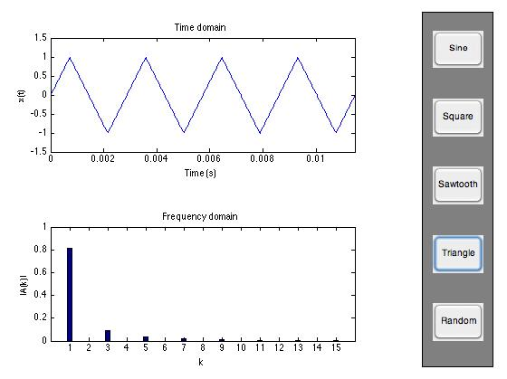
b. Different waveforms Script1_2.m
Example II
This confirms our earlier believe that it is a signal
without bandlimit (N-S sampling Thm)

Slide 12
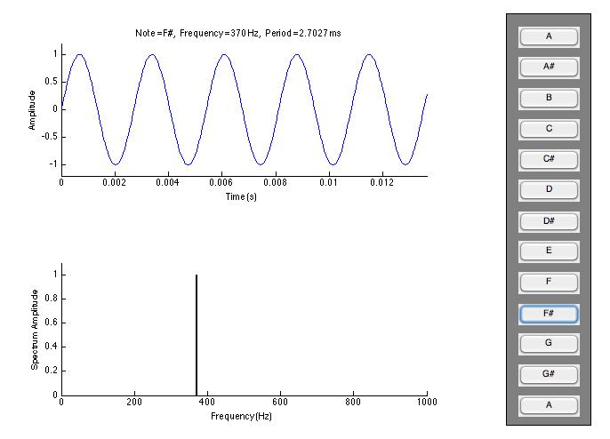
Bandwidth can be properly defined
Bandwidth is the difference between the upper and lower frequencies in a set of frequencies. It is typically measured in hertz

Slide 13
Bandwidth can be properly defined
Power
0 B Frequency
Bandwidth is the difference between the upper and lower frequencies in a continuous set of frequencies. It is typically measured in hertz

Slide 14
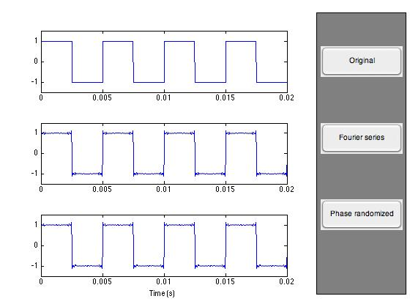
C. Approximation (compression) Script1_3.m
Example II
Without doing much, we can compress the original data now,
as in Example I.

Slide 15

In detail

Slide 16
Today’s Summary
General form of FT
A few applications (6 more precisely)
Noise

Slide 17
FT: Neat Form; to remember easily
In general, a signal can be represented as follows

Slide 18
FT: Neat Form
In general, a signal can be represented as follows
C_{-n}
C_{n}

Slide 19
FT : Neat Form
Which is the exponential form of the Fourier series.
In this expression the values C_{n} are complex number, we have
x(t) {C_{n ,}n=…,-1,0,1,2,…, }
FT
TIME
T 2T
FREQUENCY

Slide 20
FT : Neat Form
Which is the exponential form of the Fourier series.
In this expression the values C_{n} are complex number, we have
x(t) {C_{n ,}n=…,-1,0,1,2,…, }
FT
IFT
where ω = (2 π) / T

Slide 21
FT in complex exponential
If the periodic signal is replace with an aperiodic signal (general case)
FT is given by
Is that deadly simple?

Slide 22
Example I
Consider the case of a rectangular pulse. In particular, let us define
Its FT is given by
Which is called the Sinc function.

Slide 23
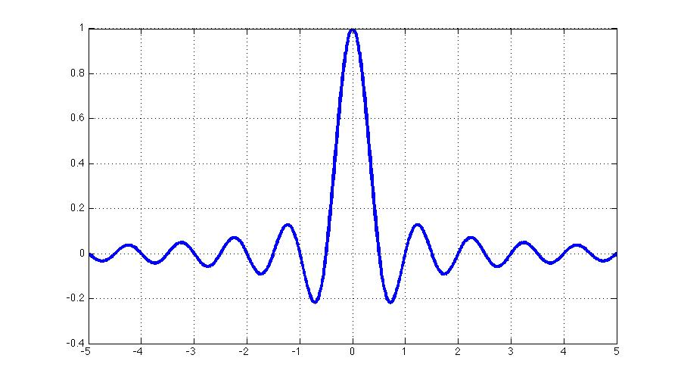
Example I
There are a number of features to note:
The bandwidth of the signal is only approximately finite.
Most of the energy is contained in a limited regions
called the main-lobe.
However, some energy is found at all frequencies.
The spectrum has positive and negative
frequencies.
These are symmetric about the origin.
This may seem non-intuitive, but can be seen
from equations in periodic case
Note that the spectrum is continuous now:
power
Frequency
X(F)= Sinc function

Slide 24

Fourier's Song

Slide 25

The world has changed
Frequency eye
This module and a few following ones will make use of the frequency information

Slide 26
This module is about practical applications
How to use this idea?

Slide 27
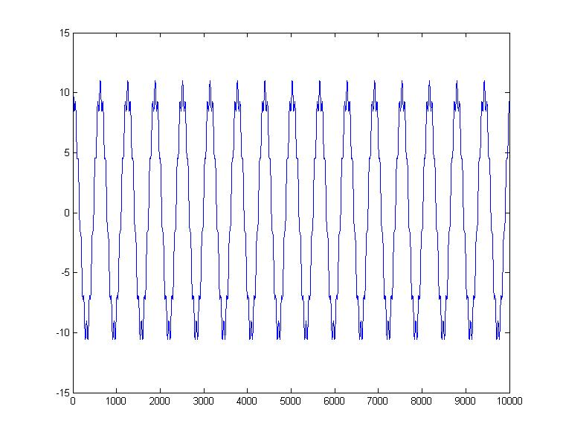
App I
1 10
Time domain
Frequency domain
S₁(t)= 10 cos(2πt) + cos(10*2πt)
for i=1:10000
x(i)=10*cos(i*0.01)+cos(i*10*0.01);
End
Sound(x)

Slide 28
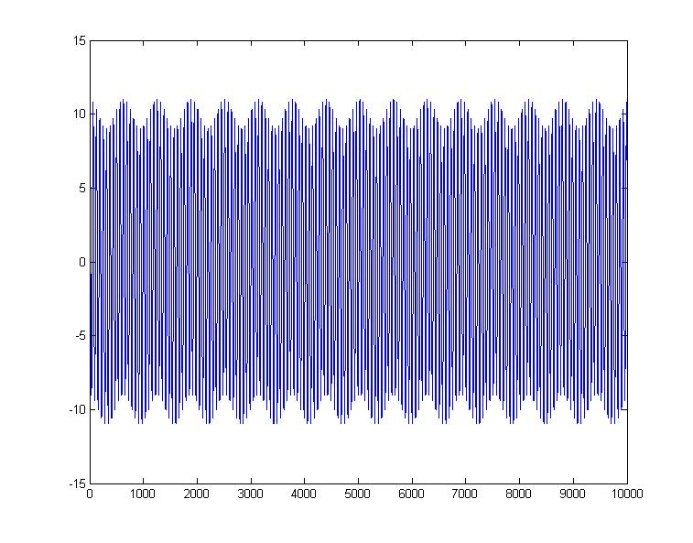
App I
Time domain
Frequency domain
S₂(t)= cos(2πt) + 10 cos(10*2πt)
for i=1:10000
x(i)=1*cos(i*0.01)+10*cos(i*10*0.01);
End
Sound(s)

Slide 29
App I
In frequency domain, the height of the spectrum indicates the energy of the corresponding signal.
For example,
for S₁, energy concentrating on the signal cos(2πt),
a low frequency signal
for S₂, energy concentrating on the signal cos(10*2πt),
a high frequency signal

Slide 30
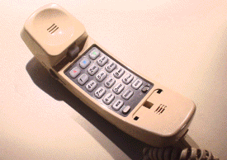
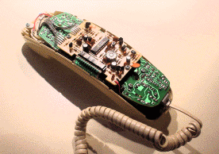
App II: Touch-tone dialing

Slide 31
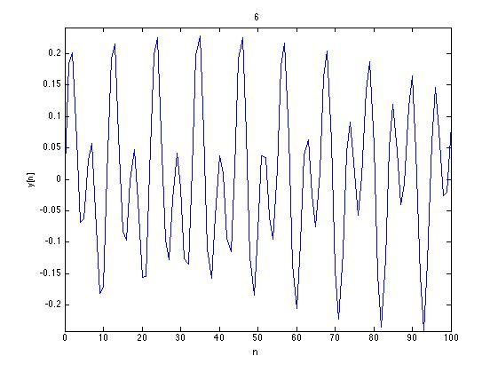
App II: Touch-tone dialing
Freqs 1209 Hz 1336 Hz 1477 Hz 1633 Hz
697 Hz 1 2 3 A
770 Hz 4 5 6 B
852 Hz 7 8 9 C
941 Hz * 0 # D
touch_tone.m
(1)=A_{n1} cos(n1 ω₀t) +A_{n2}cos(n2ω₀t)
1 Hz = ω₀
Your phone is a section (two terms)
of a FT

Slide 32
APP III: Spread spectrum techniques
In bluetooth, for example, to improve resistance to radio frequency interference by avoiding using crowded frequencies in the hopping sequence.
In military use, it is a simple idea (radio guided torpedo, for example)

Slide 33
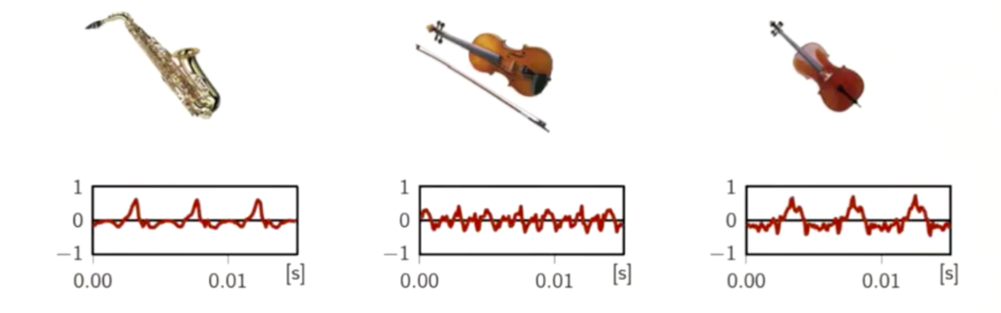
App IV: instruments
We all know about pitch…
It is really about frequency, or cycles per seconds
How about harmonics?
This is what gives the timbre of an instrument!

Slide 34
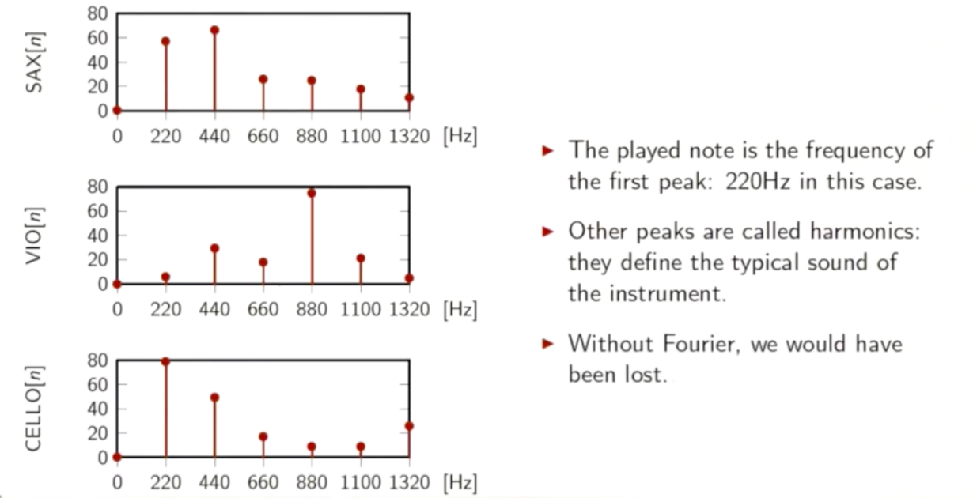
App IV: instruments
The played note is the frequency of
the first peak: 220Hz (note A) in this case
Other peaks are called harmonics:
they define the typical sound of
the instrument
Without Fourier, we could have
been lost
When you play an instrument,
It is a section of a FT

Slide 35
App V: MP3+MP4
How can an MP3 song sound so well,
while being so compressed?
Compression in a sense introduces noise.
a combination of our hearing system + FT

Slide 36

App V: MP3+MP4
Original noiseless music
Original musie + noise 2 → SNR =13 dB
Same amount of noise
Impressive difference of sound
What is the secret?
>> r = audiorecorder(22050, 16, 1);
>> record(r)
>> stop(r)
>> mySpeech = getaudiodata(r, 'int16'); % get data as int16 array
>> audiowrite('compress_3.wav',mySpeech,Fs);
load handel.mat
filename = 'handel.wav';
audiowrite(filename,y,Fs);
clear y Fs

Slide 37
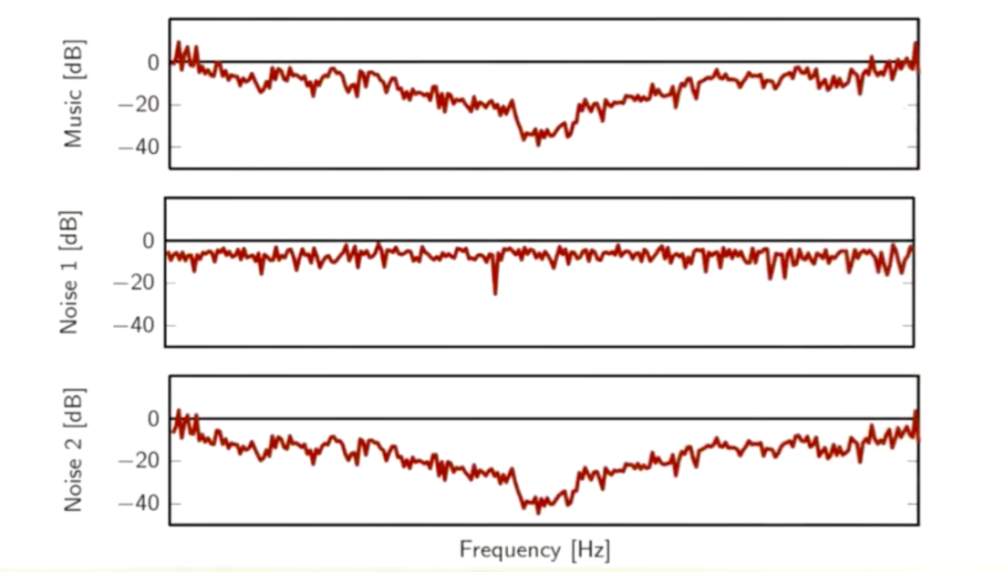
App V: MP3+MP4

Slide 38
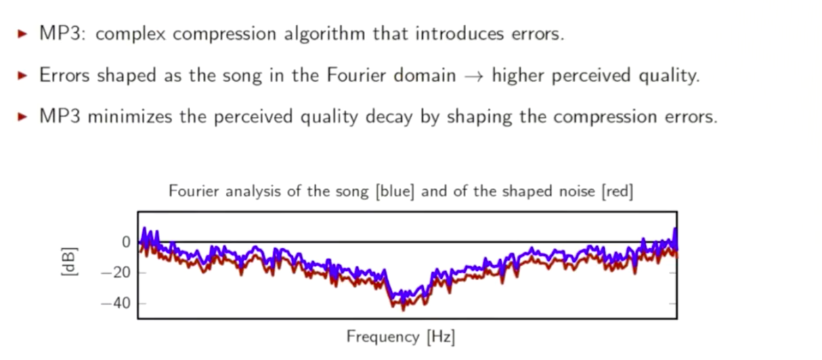
App V: MP3+MP4
MP3: complex compression algorithm that introduces errors
MP3 minimizes the perceived quality decay by shaping the compression errors

Slide 39
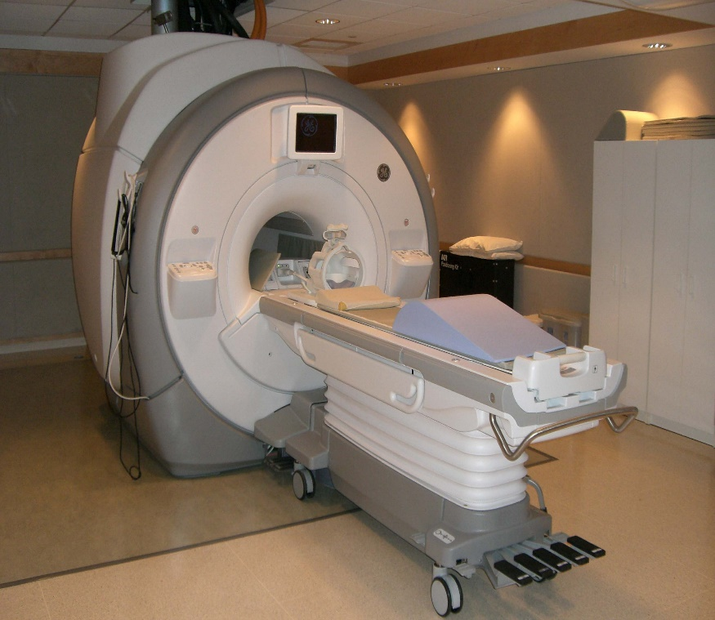
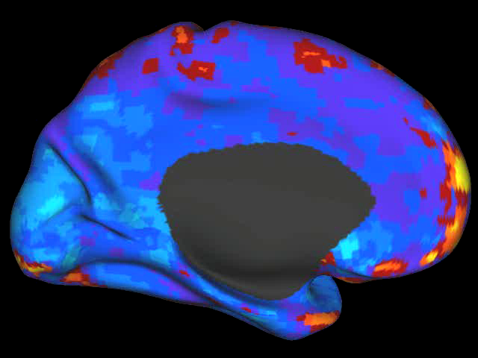
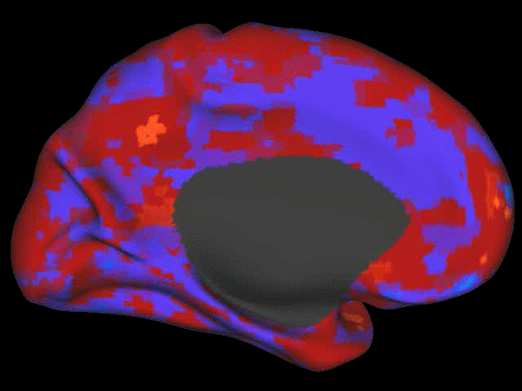
App VI: Mind Reading
MRI is a medical imaging technique
to visualize your internal body
structure and/or activity in detail
Using a physics term: it measures the
oscillations of hydrogen nuclei when
stimulated by different radio-frequency
magnetic fields
Reading you mind with FT
My
brain
activity
during
one
scan

Slide 40
App VI: Mind Reading
MRI is a medical imaging technique
to visualize your internal body
structure and/or activity in detail
Using a physics term: it measures the
oscillations of hydrogen nuclei when
stimulated by different radio-frequency
magnetic fields
Reading you mind with FT
It is not about
sex
My
brain
activity
during
one
scan

Slide 41
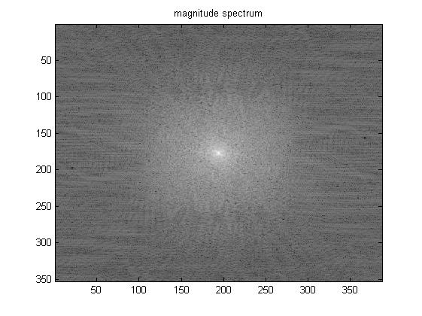
App VI: Mind Reading
Using a DCSP term: it measures the FT of the internal structure
and/or activity of interest
How does the collected data looks like?
img=(T1_Image(:,:,50));
img = fftshift(img(:,:));
F = fft2(img);
figure;
imagesc(100*log(1+abs(fftshift(F)))); colormap(gray);
title('magnitude spectrum');
figure;
imagesc(angle(F)); colormap(gray);
title('phase spectrum');

Slide 42
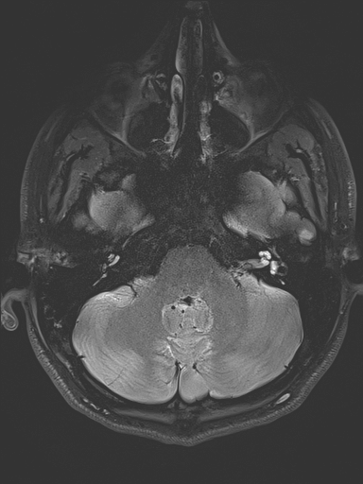
App VI: Mind Reading
Little information about the subject can be gathered in the original picture
An inverse Fourier transform of the data reveals the slice of a human head activity

Slide 43
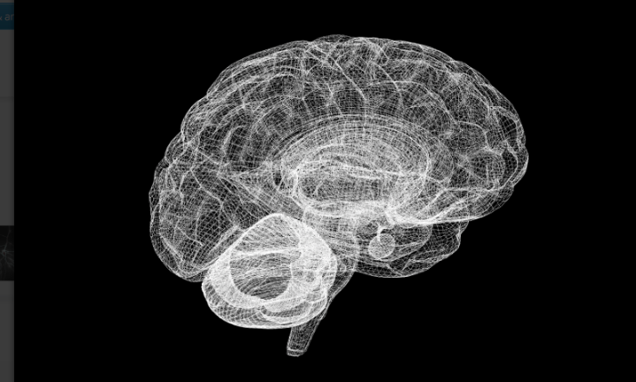
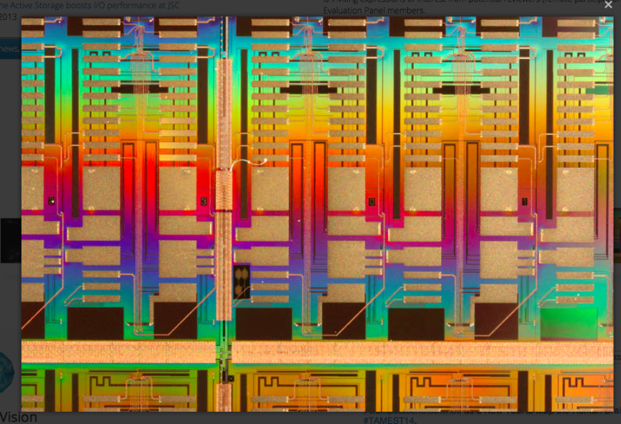
App VI: Mind Reading
Human Brain Project was one of the two projects with a budge of 1B Euros for ten years each
(another is graphene) in 2013
The main purpose is to simulate the Brain
=
USA matched with a 4.5 B US Dollars in 2014
China will do as well

Slide 44
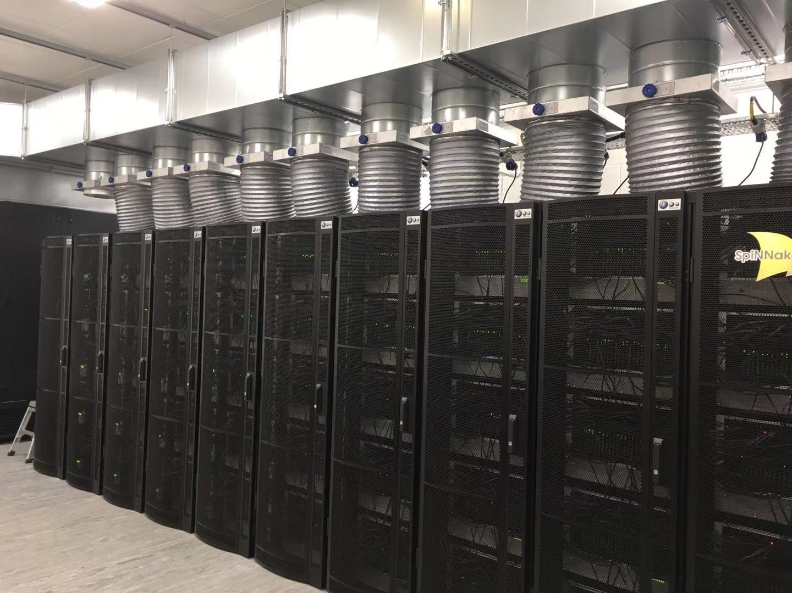
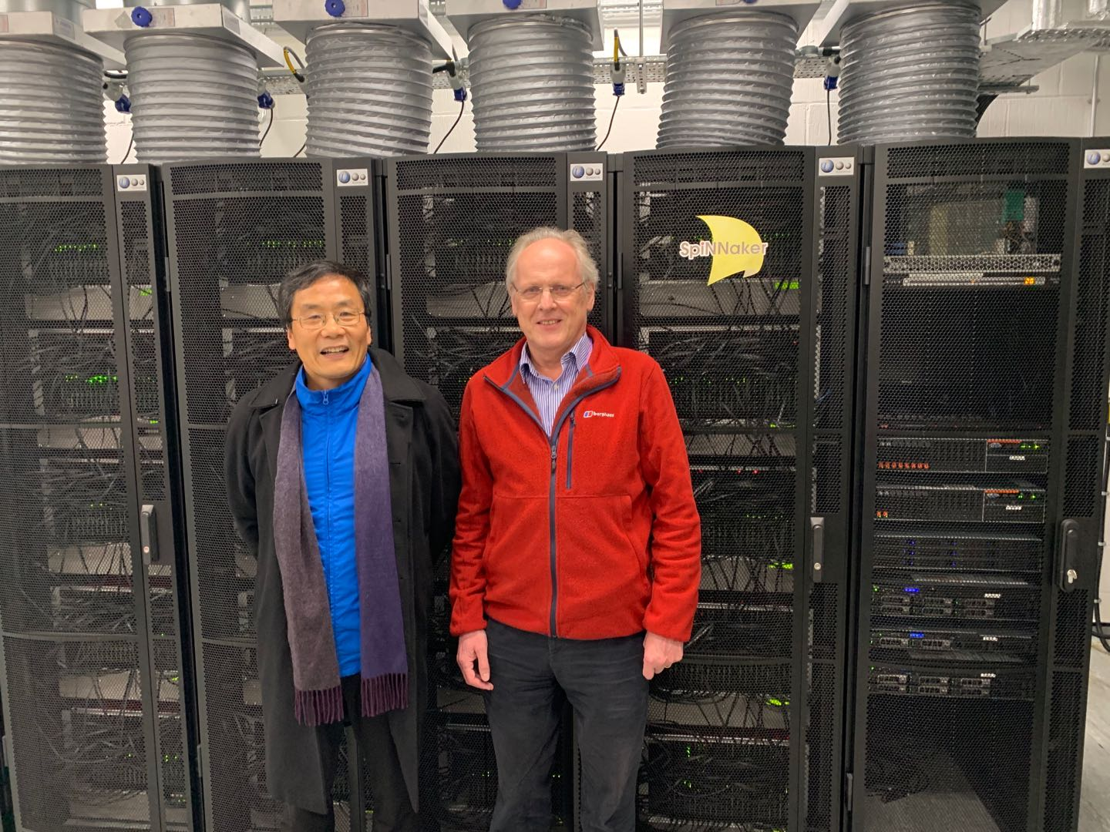
App VI: Mind Reading
Spinnaker can simulate 1% of our human brain cells (Steve Furber 21st Jan 2020)

Slide 45
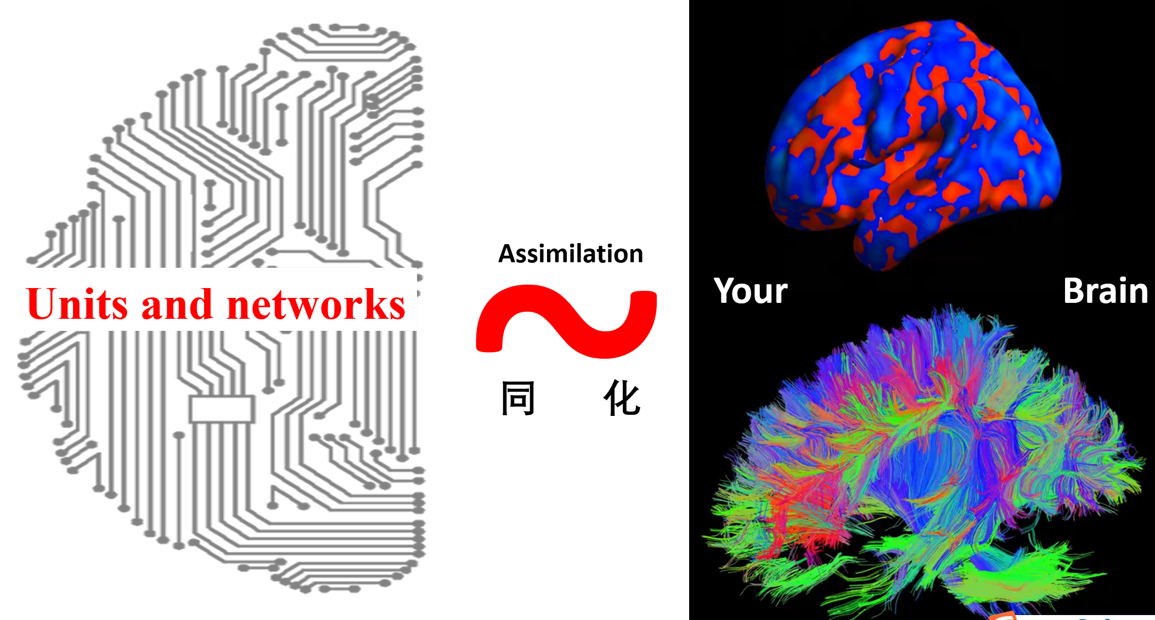
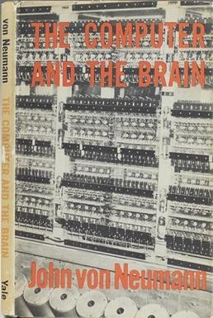
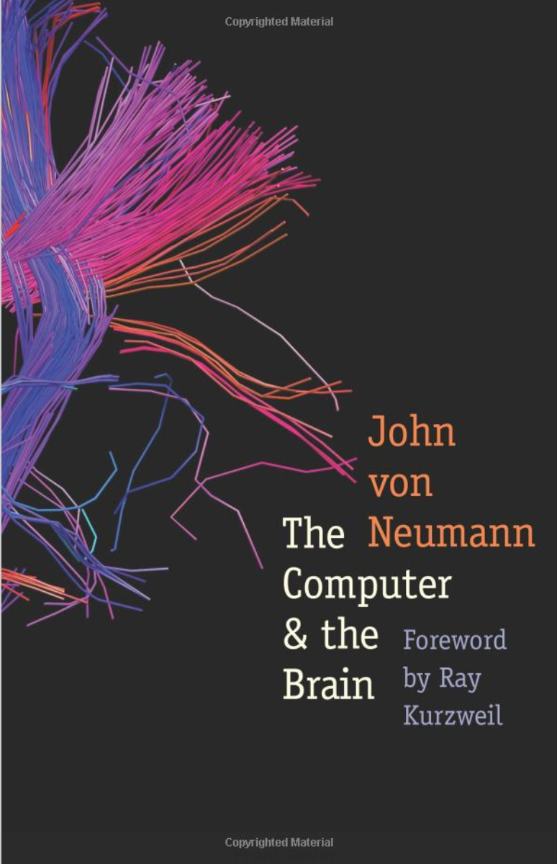
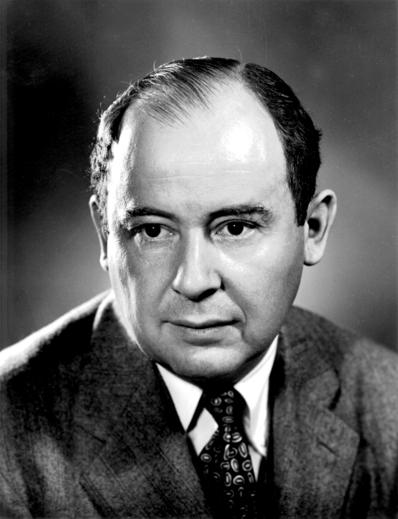
Brain inspired AI (digital)
von Neumann

Slide 46
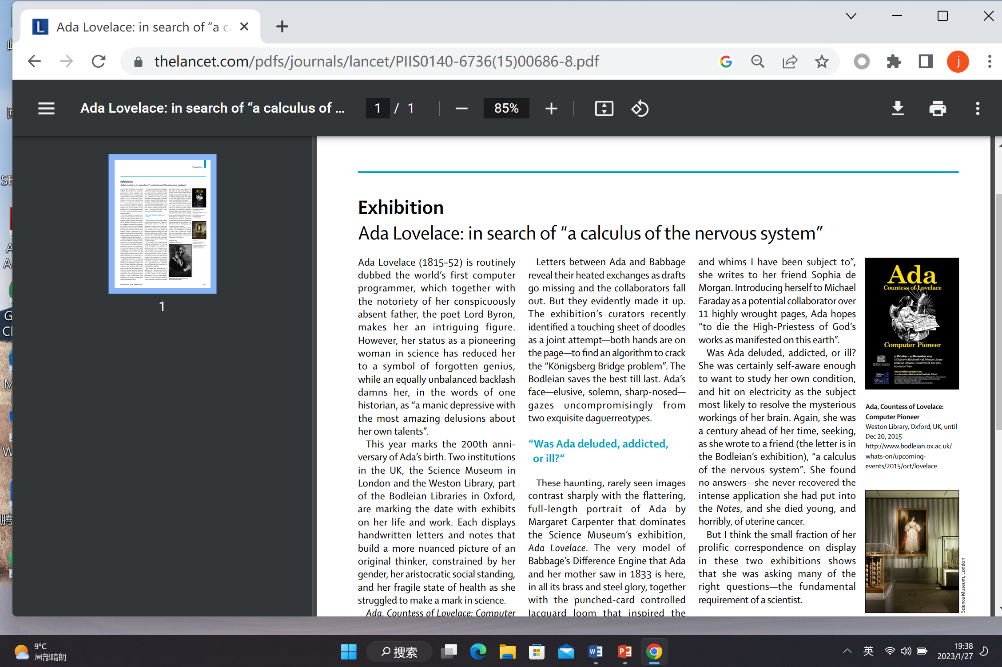

Slide 47
