Slide 1
DCSP-8: Signal Representation
Jianfeng Feng
Department of Computer Science Warwick Univ., UK
Jianfeng.feng@warwick.ac.uk
http://www.dcs.warwick.ac.uk/~feng/dcsp.html

Slide 2
Correlation or covariance
Cov(X,Y) = E(X-EX)(Y-EY)
correlation coefficient is normalized covariance
Coef(X,Y) = E(X-EX)(Y-EY) / [σ(X)σ(Y)]
Positive correlation, Negative correlation
No correlation (independent)

Slide 3
Stochastic process = signal
A stochastic process is a collection of random variables x[n], for each fixed [n], it is a random variable
Signal is a typical stochastic process
To understand how x[n] evolves with n, we will look at auto-correlation function (ACF)
ACF is the correlation between k steps

Slide 4
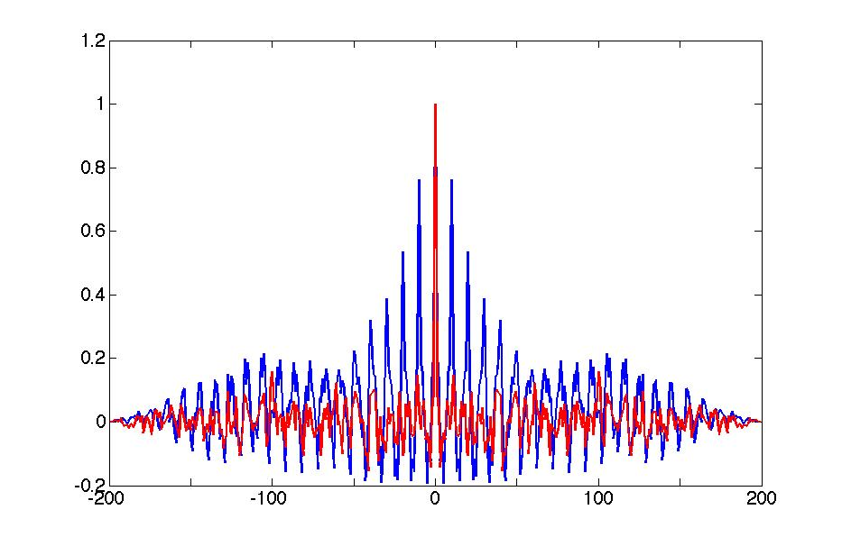
Stochastic process
>> clear all
close all
n=200;
for i=1:10
x(i)=randn(1,1);
y(i)=x(i);
end
for i=1:n-10
y(i+10)=randn(1,1);
x(i+10)=.8*x(i)+y(i+10);
end
plot(xcorr(x)/max(xcorr(x)));
hold on
plot(xcorr(y)/max(xcorr(y)),'r')
two signals are generated: y (red) is simply randn(1,200)
x (blue) is generated x[i+10]=.8*x[i] + y[i+10]
For y, we have γ(0)=1, γ(n)=0, if n is not 0 : having no memory
For x, we have γ (0)=1, and γ (n) is not zero, for some n: having memory

Slide 5
white noise w[n]
White noise is a random process we can not predict at all (independent of history)
In other words, it is the most ‘violent’ noise
White noise draws its name from white light which will become
clear in the next few lectures

Slide 6
white noise w[n]
The most ‘noisy’ noise is a white noise since its autocorrelation is zero, i.e.
corr(w[n], w[m])=0 when
Otherwise, we called it colour noise since we can predict some outcome of w[n], given w[m], m<n

Slide 7
DCSP-8: Signal Representation
Jianfeng Feng
Department of Computer Science Warwick Univ., UK
Jianfeng.feng@warwick.ac.uk
http://www.dcs.warwick.ac.uk/~feng/dcsp.html

Slide 8
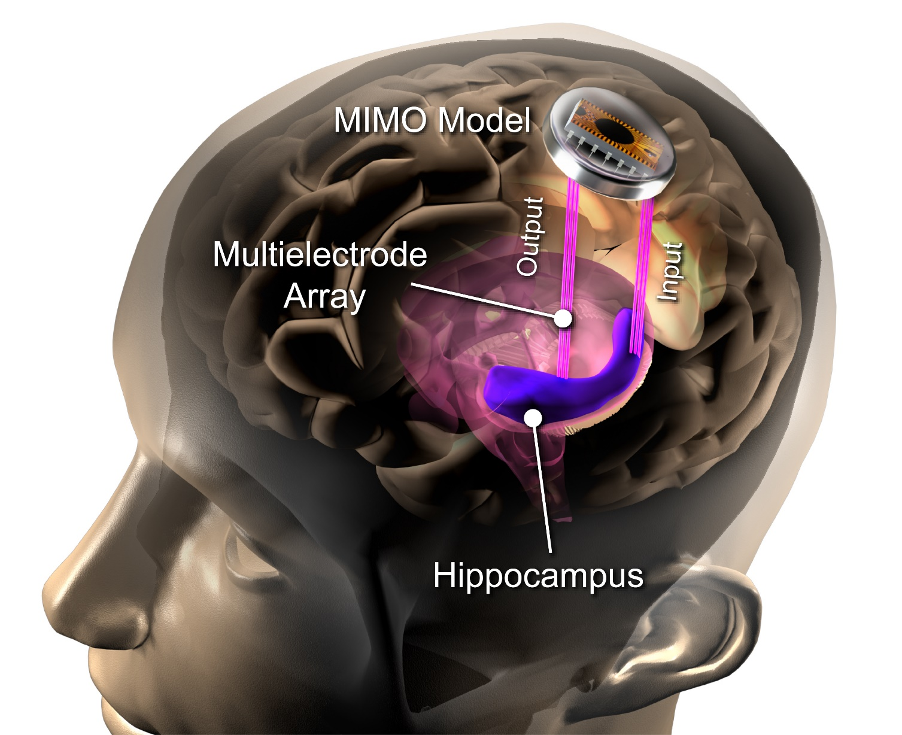
Restoring Memory
MIMO Biomimetic device mimics signal processing function of hippocampal neural circuits
Interface with the hippocampus using multi-electrode arrays
Transform upstream hippocampal signals into downstream hippocampal signals using a computational model
By-pass damaged hippocampal region
Restore episodic memory functions
short-term memory
long-term memory

Slide 9
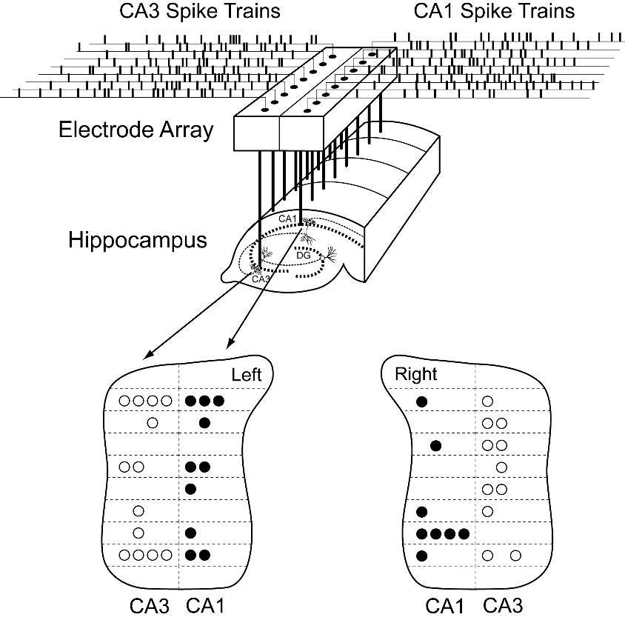
Restoring Memory
Memories
short-term memory
long-term memory

Slide 10
NeuralLink (Elon Musk)

Slide 11
Spectrogram: real life example

Slide 12
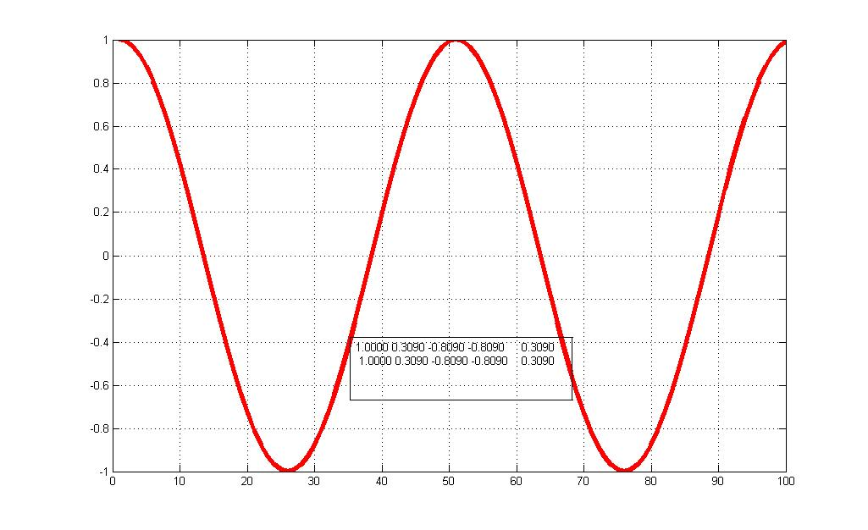
Sequences and their representation
A sequence is an infinite series of real numbers { x[n] }
{ x[n] } = {…, x[-1], x[0], x[1], x[2], … , x[n], … }
Represent a sampled signal, i.e. x[n] = x(nT),
where x(t) is continuous function of time

Slide 13
Sequences and their representation
A sequence is an infinite series of real numbers { x[n] }
{ x[n] } = {…, x[-1], x[0], x[1], x[2], … , x[n], … }

Slide 14
Discrete Time Fourier Transform (DTFT)
The basic tool of signal analysis is
the Fourier transform or DTFT

Slide 15
Definition and properties:
DTFT gives the frequency representation of a discrete time sequence with infinite length.

Slide 16
Definition and properties:
DTFT gives the frequency representation of a discrete time sequence with infinite length.
Define ( ω = 2πF)
Note that X(ω) has a period of 2π

Slide 17
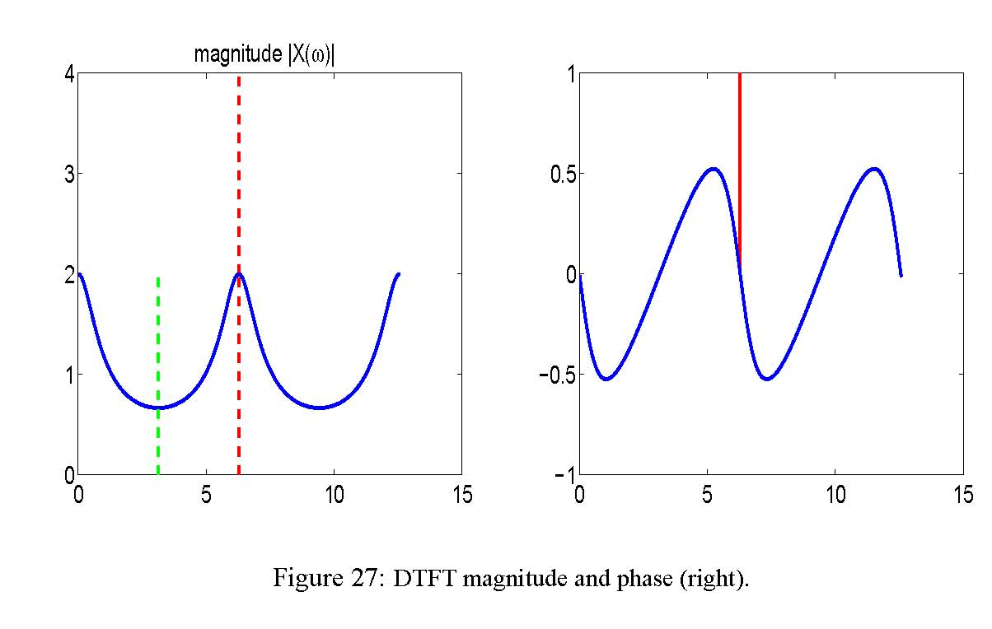
Definition and properties:
Visualize X(ω)
Plot it in the magnitude and phase plane
π 2π
π 2π

Slide 18
Definition and properties:
The DTFT gives the frequency representation of a discrete time sequence with infinite length.
X(ω): frequency domain
x [n]: time domain

Slide 19
Example I
Consider the delta (impulse) function x[n]=δ[n], we have
x[n]=δ[n],
the unit impulse

Slide 20
Example I
Consider the delta (impulse) function x[n]=δ[n], we have
amplitude
the unit impulse
-π π
phase
-π π

Slide 21
Example I
Consider the delta (impulse) function x[n]=δ[n], we have
amplitude
the unit impulse
-π π
phase
-π π

Slide 22
Example II
Consider the signal
x[n]=0.5^{n}, n=0,1,2,…
Then

Slide 23
Example II
Consider the signal
x[n]=0.5^{n}, n=0,1,2,…
Then

Slide 24
Example II
Consider the signal
x[n] = 0.5^{n}, n = 0,1,2,…
Then

Slide 25
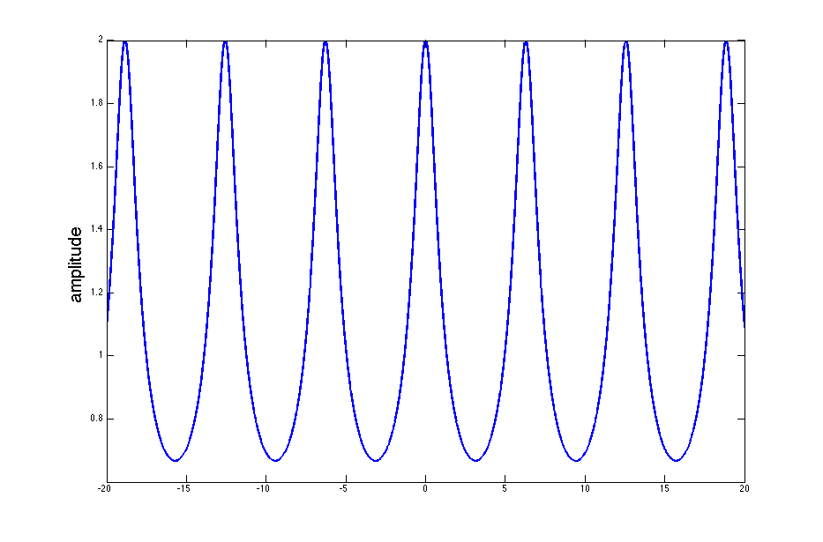
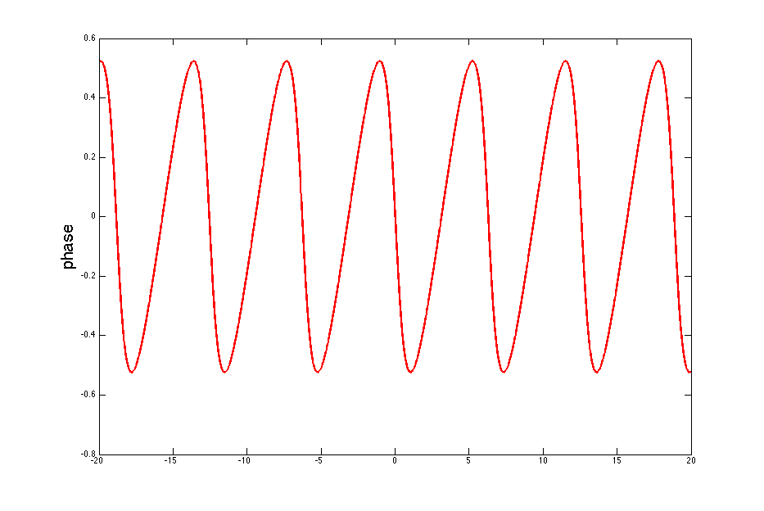
Example II
h=0.01;
N=4000;
for i=1:N
t(i)=(i-N/2)*h;
x(i)=1/(1-0.5*exp(-j*t(i)));
end
figure(1)
plot(t,abs(x));
figure(2)
plot(t,phase(x));

Slide 26
Computation of the DTFT
Fourier approach to signal analysis is based on
the expansion of a signal in terms of sinusoids
or, more precisely, complex exponentials.
Analyzing a signal by determining the
frequencies contributing to its spectrum in terms
of magnitudes and phases.

Slide 27
Computation of the DTFT
In practice, we do not have infinite memory, we
do not have infinite time, and signal does not
have infinite duration.
In addition, the spectrum of the signal changes
with time, just as music is composed of different
notes that change with time.

Slide 28
Computation of the DTFT
Consequently, the DTFT generally is not
computable unless we have an analytical
expression for the signal we analyze, in which
case we can compute it symbolically.

Slide 29
Computation of the DTFT
But most of the time this is not the case,
especially when we want to determine the
frequency spectrum of a signal measured from
an experiment.
In this situation, develop an algorithm that can
be computed numerically in a finite number of
steps, such as the discrete Fourier transform
(DFT), a special case of DTFT.

Slide 30
DFT and DTFT
For a given data set
{x[1], …x[N]},
it is equivalent to
{…,0, x[1], …, x[N], 0, 0,…}.
Using DTFT, we have

Slide 31
DFT and DTFT
It turns out that we can sample it (computable with computer),
at ω = 2π k / N, k = 0,1,…,N-1

Slide 32
DFT
Definition: The discrete Fourier transform (DFT) and its own
inverse DFT (IDFT) associated with a vector
X = ( X[0], X[1], … , X[N-1] )
to a vector
x = ( x[0], x[1], …, x[N-1] )
of N data points, is given by

Slide 33
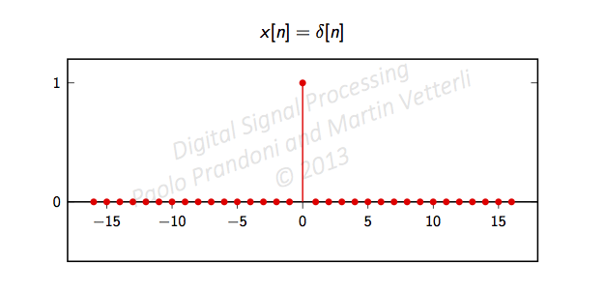
Example I
Consider the delta (impulse) function x[n]=δ[n], we have
amplitude
0 2π
phase
0 2π

Slide 34
Example I
sample it (computable with computer), at ω = 2π k / N, k = 0,1,…,N-1
amplitude
0 2π
phase
0 2π

Slide 35
Example I
sample it (computable with computer), at ω = 2π k / N, k = 0,1,…,N-1
amplitude
For example, we have N = 4
2π 0/N= 0
2π 1/N = π/2
2π 2/N = π
2π 3/N = 3π/4
0 2π
phase
0 2π

Slide 36
Example I
sample it (computable with computer), at ω = 2π k / N, k = 0,1,…,N-1
amplitude
For example, we have N = 4
2π 0/N= 0
2π 1/N = π/2
2π 2/N = π
2π 3/N = 3π/4
(X [0] X[1] X[2] X[3] ) = (1 1 1 1) = DTFT((x[0] x[1] x[2] x[3])) = DFT((1 0 0 0))
0 2π
phase
0 2π

Slide 37
DFT I (Essential facts)
k=0
Remembering that the data is
x[0], x[1], …, x[N-1]
We have N (complex plane ) points in the frequency domain
X[0], X[1], …, X[N-1]

Slide 38
DFT I (Essential facts)
k=0
k=1
Remembering that the data is
x[0], x[1], …, x[N-1]
We have N (complex plane ) points in the frequency domain
X[0], X[1], …, X[N-1]

Slide 39
DFT I (Essential facts)
k=0
k=2
k=1
Remembering that the data is
x[0], x[1], …, x[N-1]
We have N (complex plane ) points in the frequency domain
X[0], X[1], …, X[N-1]

Slide 40
DFT I (Essential facts)
Rewritten it in matrix form, assume the data is x[0], x[1], …, x[N-1]

Slide 41
DFT I (Essential facts)
Rewritten it in matrix form, assume the data is x[0], x[1], …, x[N-1]
DFT
DATA

