Slide 1
Seminar 3 Digital Communication and Signal Processing
Fourier Transform
Ruohan Zhang
Ruohan.Zhang.1@warwick.ac.uk
Department of Computer Science, University of Warwick
25/01/2024

Slide 2
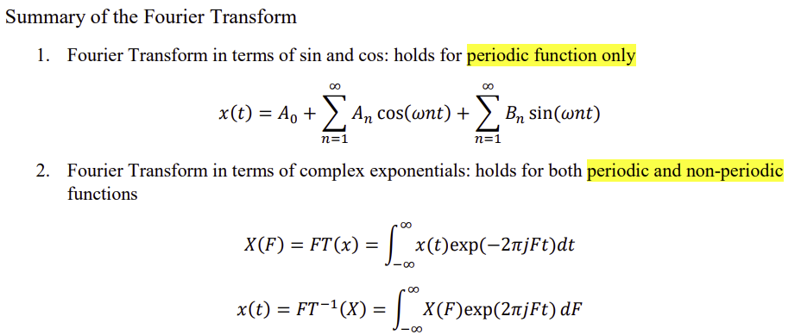

Slide 3
FT: Fourier Thm in terms of Sin and Cos
simply a generalization of common knowledge of the Euclidean space
{ 1, cos (nωt), sin(nwt), n=1,2…} are orthogonal and complete
they form orthogonal bases
where A₀ is the d.c. term, and T is the period of the waveform.

Slide 4
Exercises
Work out the Fourier Transform function of the given 𝑓(𝑥).

Slide 5
Key point:
Periodic function with T = 2π
$a_{0}= \frac{1}{2π}\int_{−π}^{π}{f\left(x\right)dx}$ = 0 (∵ $f\left(x\right)$ is an odd function)
$a_{n}= \frac{1}{π}\int_{−π}^{π}{f\left(x\right)\cos{x}dx}$ = 0
(∵ an odd function times an even function equals an odd function)
$b_{n}= \frac{1}{π}\int_{−π}^{π}{f\left(x\right)\sin{nx}dx}$
k
$=$ $\frac{1}{π}(\int_{−π}^{0}{−k\sin{nx}dx+ \int_{0}^{π}{k\sin{nx}dx})}$
-π
0
π
2π
$=$ $\frac{1}{π}\left({[\frac{k}{n}\cos{nx]}}_{−π}^{0} +{[−\frac{k}{n}\cos{nx]}}_{0}^{π}\right)$
-2π
$=$ $\frac{1}{π}[\frac{k}{n} − \frac{k}{n}\cos\left(−nπ\right)+(−\frac{k}{n}\cos\left(nπ\right))−(− \frac{k}{n})]$
-k
$=$ $\frac{1}{π}[\frac{k}{n} − \frac{k}{n}\cos\left(−nπ\right)−\frac{k}{n}\cos\left(nπ\right))+\frac{k}{n}]$
$= \left\{\begin{aligned}\frac{4k}{nπ} when n is odd \\ 0 when n is even\end{aligned}\right.$
∴ $f\left(x\right)= \frac{4k}{π}(\sin{x}+ \frac{1}{3}\sin{3x}+ \frac{1}{5}\sin{5x}+ ⋯)$

Slide 7
Key point:
Periodic function with T = 4
$a_{0}= \frac{1}{4}\int_{−2}^{2}{f(x)ⅆx}$ = $\frac{1}{4}\int_{−1}^{1}{kdx}= \frac{1}{4}{[kx]}_{−1}^{1}= \frac{k}{2}$
$$a_{n}= \frac{2}{4}\int_{−2}^{2}{f(x)\cos{n\frac{2π}{4}xⅆx}}$$
$$b_{n}= \frac{2}{4}\int_{−2}^{2}{f(x)\sin{n\frac{2π}{4}xⅆx}}$$
$$= \frac{1}{2}\int_{−1}^{1}{k\cos{n\frac{π}{2}xⅆx}}$$
$$= \frac{1}{2}\int_{−1}^{1}{k\sin{n\frac{π}{2}xⅆx}}$$
k
$$= \frac{1}{2}{[\frac{2k}{nπ}\sin{n\frac{π}{2}x}]}_{−1}^{1}$$
$$= \frac{1}{2}{[−\frac{2k}{nπ}\cos{n\frac{π}{2}x}]}_{−1}^{1}$$
-2
-1
0
1
2
$$= \frac{1}{2}×\frac{2k}{nπ}[sin{n\frac{π}{2} − }\sin{(−n\frac{π}{2}})]$$
$$=−\frac{1}{2}×\frac{2k}{nπ}[cos{n\frac{π}{2} − }\cos{(−n\frac{π}{2}})]$$
-k
$$= \frac{2k}{nπ}sin{\frac{nπ}{2} }$$
$=$ 0
∴ $f\left(x\right)= \frac{k}{2}+ \frac{2k}{π}(\cos{\frac{π}{2}x−\frac{1}{3}\cos{\frac{3π}{2}x+\frac{1}{5}\cos{\frac{5π}{2}}}}x+⋯)$

Slide 9
Key point:
Non-periodic function
In the general Fourier Transform formula, $F = \frac{ω}{2π}$ .
Here, $F$ represents frequency and $ω$ represents angular velocity.
$$X\left(F\right)=FT\left(f\right)= \int_{−∞}^{+∞}{f(x)e^{−2πjFx}dx}$$
$$= \int_{−1}^{1}{e^{−2πjFx}dx}$$
$$when F ≠0$$
$$when F=0$$
1
$$X\left(F\right)= \int_{−1}^{1}{dx}=2$$
$$X(F)= {[−\frac{e^{−2πjFx}}{2πjF}]}_{−1}^{1}$$
-2
-1
0
1
2
$$= \frac{{e^{2πjF}−e}^{−2πjF}}{2πjF}$$
-k

Slide 10
Knowledge point expansion:
We can also use another form of Fourier Transform formula (using $ω$ as an integral variable).
Here, $F$ represents frequency and $ω$ represents angular velocity.
$$X\left(ω\right)=FT\left(x\right)=\int_{−∞}^{∞}{x\left(t\right)e^{−iωt}dt}$$
$$x\left(t\right)={FT}^{−1}\left(X\right)=\frac{1}{2π}\int_{−∞}^{∞}{X(ω)e^{iωt}dt}$$

