Slide 1
DCSP-10: Applications
Jianfeng Feng
Department of Computer Science Warwick Univ., UK
Jianfeng.feng@warwick.ac.uk
http://www.dcs.warwick.ac.uk/~feng/dcsp.html

Slide 2
Applications
Power spectrum estimate
Image
Sampling theorem

Slide 3
X’ = A x’

Slide 4
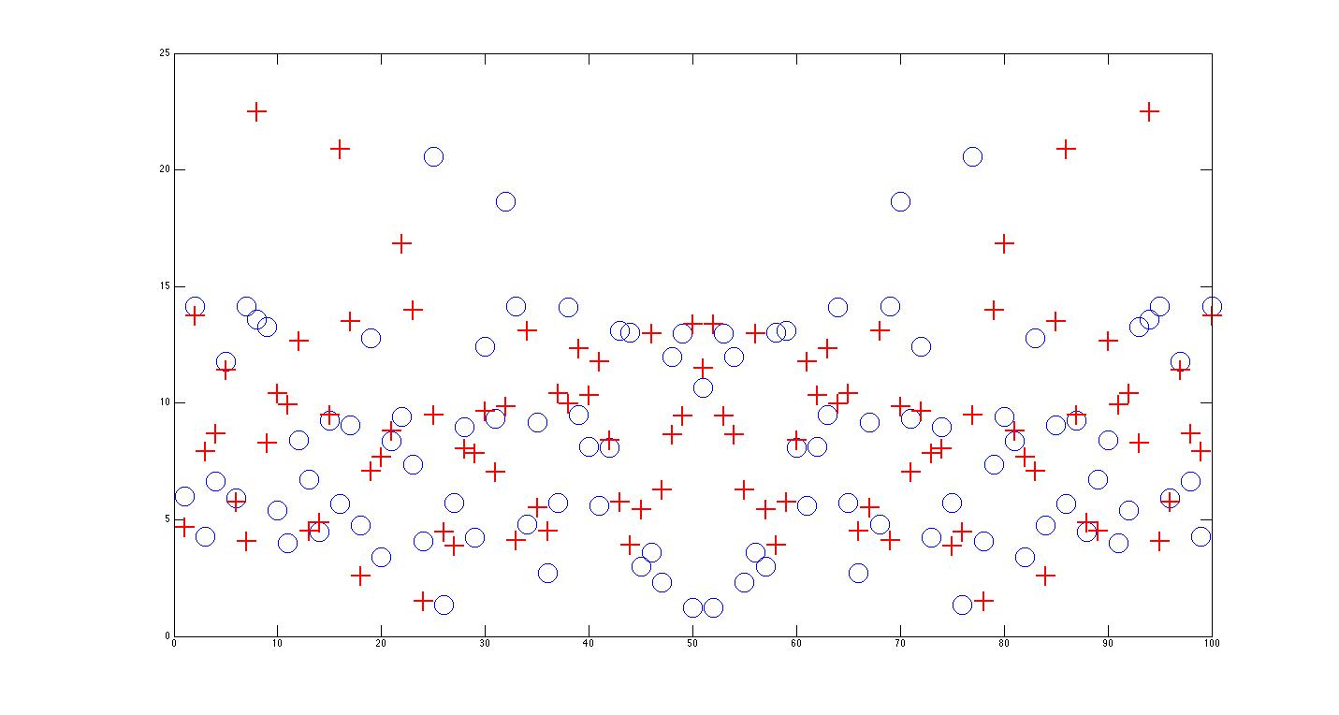
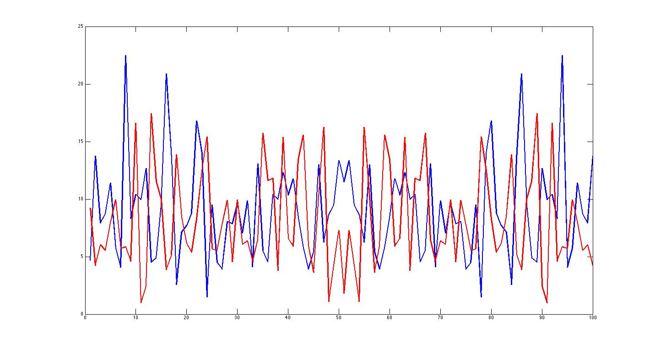
Issues on noise
Two sets of random noise (100 points each, upper panel)
Power Spectrum (bottom panel)
Make sense?

Slide 5
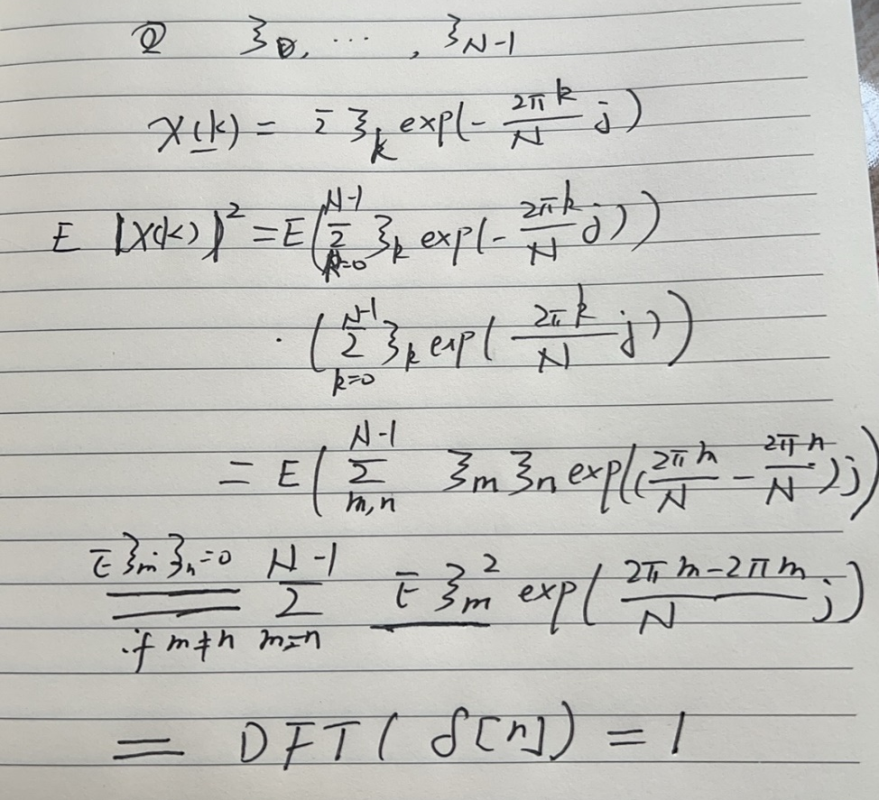
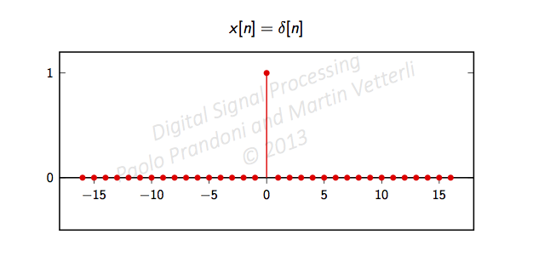
Issues on noise
When N is large
abs (DFT ( {x[n], n=0, …, N-1} ) ) → DFT ( {γ [n] } )
where γ [n] is the auto-correlation function (ACF)
Remember that the ACF of white noise is

Slide 6
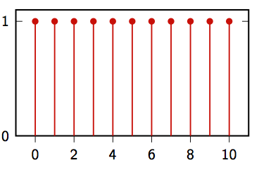
Issues on noise
Remember that the ACF of white noise is
Powers are equally distributed at each frequency
Hence the name of ‘white noise’
Colour noise: not equally distributed (ACF is not delta)

Slide 7
Issues on noise
White light passes a prism
White light goes through a prism
Remember that the ACF of white noise is
Powers are equally distributed at each frequency
Hence the name of ‘white noise’
Colour noise: not equally distributed (ACF is not delta)

Slide 8
Spectrogram: real life example

Slide 9
Math
T
W_{T}[n]
W_{T}[n-1]
W_{T}[n-m]
1
T
1
1 T+1
1
m+1 T+m
You can certainly choose many ‘windows’ here: triangle, Gaussian, Hamming etc.

Slide 10
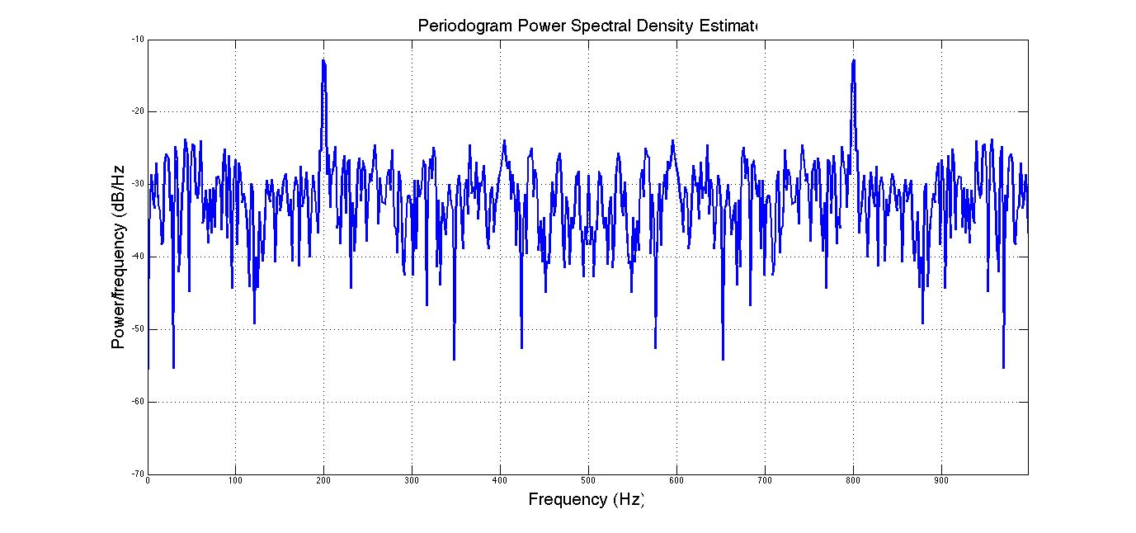
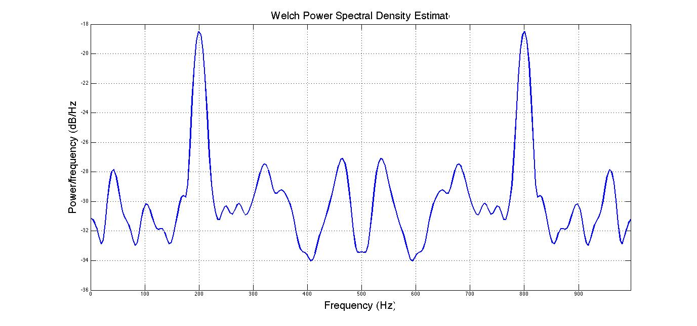
Matlab
A few words on Matlab
periodogram pwelch
It is essentially fft
Fs = 1000; t = 0:1/Fs:.3;
% Fs is the sampling rate
x = cos(2*pi*t*200)+randn(size(t));
% A cosine of 200Hz plus noise
periodogram(x,[],'twosided',512,Fs);
% The default window is used
Fs = 1000; t = 0:1/Fs:.296;
%Fs is the sampling rate
x = cos(2*pi*t*200)+randn(size(t));
% A cosine of 200Hz plus noise
pwelch(x,[],[],[],Fs,'twosided');
% Uses default window, overlap & NFFT.
It is slightly advanced

Slide 11
Matlab
A few words on Matlab
periodogram pwelch
It is essentially fft
Fs = 1000; t = 0:1/Fs:.3;
% Fs is the sampling rate
x = cos(2*pi*t*200)+randn(size(t));
% A cosine of 200Hz plus noise
periodogram(x,[],'twosided',512,Fs);
% The default window is used
Fs = 1000; t = 0:1/Fs:.296;
%Fs is the sampling rate
x = cos(2*pi*t*200)+randn(size(t));
% A cosine of 200Hz plus noise
pwelch(x,[],[],[],Fs,'twosided');
% Uses default window, overlap & NFFT.
Abs(fft(x))
It is slightly advanced

Slide 12
Matlab
A few words on Matlab
periodogram pwelch
It is essentially fft
Fs = 1000; t = 0:1/Fs:.3;
% Fs is the sampling rate
x = cos(2*pi*t*200)+randn(size(t));
% A cosine of 200Hz plus noise
periodogram(x,[],'twosided',512,Fs);
% The default window is used
Fs = 1000; t = 0:1/Fs:.296;
%Fs is the sampling rate
x = cos(2*pi*t*200)+randn(size(t));
% A cosine of 200Hz plus noise
pwelch(x,[],[],[],Fs,'twosided');
% Uses default window, overlap & NFFT.
In Welch, essentially the signals are divided into many segments
For each segments, an FFT is carried
The summation of FFT is plotted and hence the noise is averaged out
Abs(fft(x))
It is slightly advanced

Slide 13
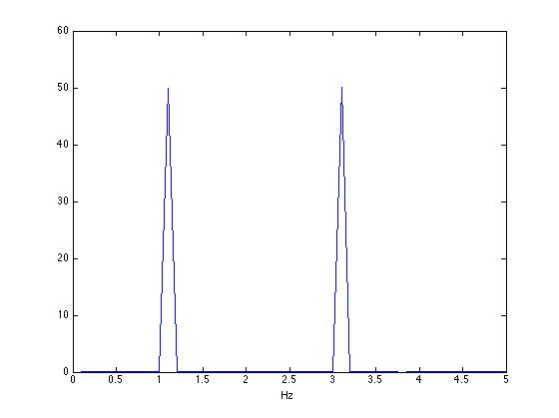
Understanding the plot
Sampling rate is F_{s,} the largest (fastest) frequency from the data is then F_{s}/2
Remembering that our frequency domain is in [0 2π] which matches to [0 F_{s}]
Divide [0 F_{s}] into N intervals and plot abs X[k] against kF_{s}/N which gives power against frequency
Since it is symmetric, we sometime only plot out [0, F_{s/}/2]
Here F_{s} =1 0 Hz

Slide 14
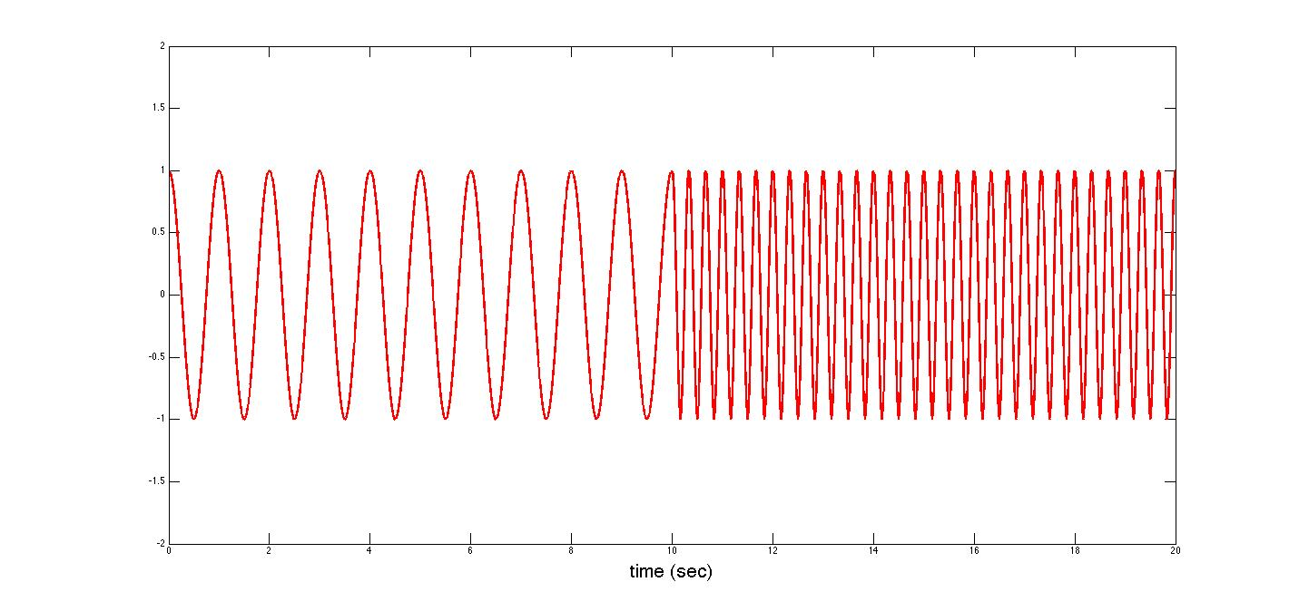
Spectrogram
It is called STFT (short time Fourier transform)
The obtained results are plotted using colour map as in the next figure: spectrogram

Slide 15
Math
T
W_{T}[n]
1
T
You can certainly choose many ‘windows’ here: triangle, Gaussian, Hamming etc.

Slide 16
Matlab
A few words on Matlab
periodogram pwelch
It is essentially fft
Fs = 1000; t = 0:1/Fs:.3;
% Fs is the sampling rate
x = cos(2*pi*t*200)+randn(size(t));
% A cosine of 200Hz plus noise
periodogram(x,[],'twosided',512,Fs);
% The default window is used
Fs = 1000; t = 0:1/Fs:.296;
%Fs is the sampling rate
x = cos(2*pi*t*200)+randn(size(t));
% A cosine of 200Hz plus noise
pwelch(x,[],[],[],Fs,'twosided');
% Uses default window, overlap & NFFT.
It is slightly advanced

Slide 17
Matlab
A few words on Matlab
periodogram pwelch
It is essentially fft
Fs = 1000; t = 0:1/Fs:.3;
% Fs is the sampling rate
x = cos(2*pi*t*200)+randn(size(t));
% A cosine of 200Hz plus noise
periodogram(x,[],'twosided',512,Fs);
% The default window is used
Fs = 1000; t = 0:1/Fs:.296;
%Fs is the sampling rate
x = cos(2*pi*t*200)+randn(size(t));
% A cosine of 200Hz plus noise
pwelch(x,[],[],[],Fs,'twosided');
% Uses default window, overlap & NFFT.
Abs(fft(x))
It is slightly advanced

Slide 18
Matlab
A few words on Matlab
periodogram pwelch
It is essentially fft
Fs = 1000; t = 0:1/Fs:.3;
% Fs is the sampling rate
x = cos(2*pi*t*200)+randn(size(t));
% A cosine of 200Hz plus noise
periodogram(x,[],'twosided',512,Fs);
% The default window is used
Fs = 1000; t = 0:1/Fs:.296;
%Fs is the sampling rate
x = cos(2*pi*t*200)+randn(size(t));
% A cosine of 200Hz plus noise
pwelch(x,[],[],[],Fs,'twosided');
% Uses default window, overlap & NFFT.
In Welch, essentially the signals are divided into many segments
For each segments, an FFT is carried
The summation of FFT is plotted and hence the noise is averaged out
Abs(fft(x))
It is slightly advanced

Slide 19
Spectrogram
In real life examples, all signals change with time (music for example)

Slide 20
Spectrogram
In real life example, all signals change with time (music for example)
Using sliding window to sample signals and calculate PSD

Slide 21
Spectrogram
In real life example, all signals change with time (music for example)
Using sliding window to sample signals and calculate PSD

Slide 22
Spectrogram
In real life example, all signals change with time (music for example)
Using sliding windows to sample signals and calculate PSD

Slide 23
Spectrogram
Frequency
3 Hz
1 Hz
Time (sec)

Slide 24
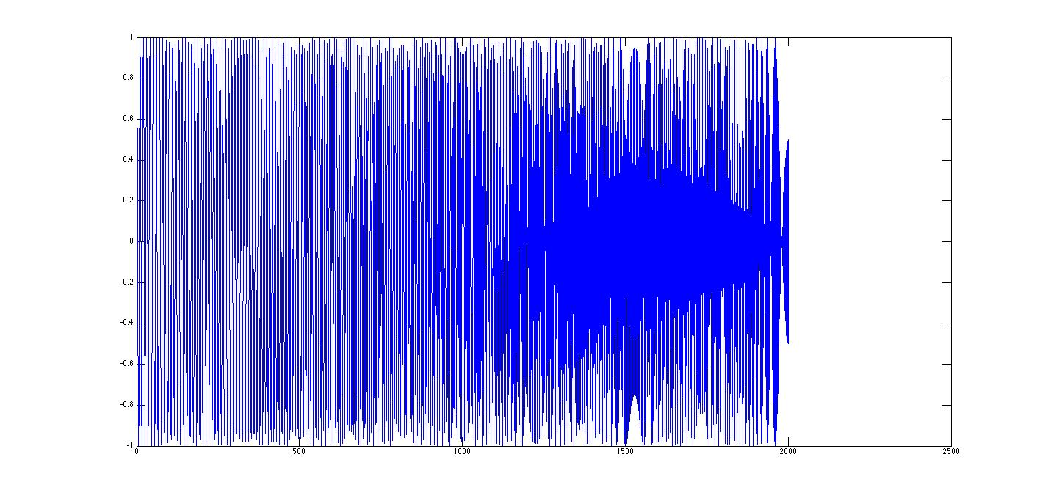
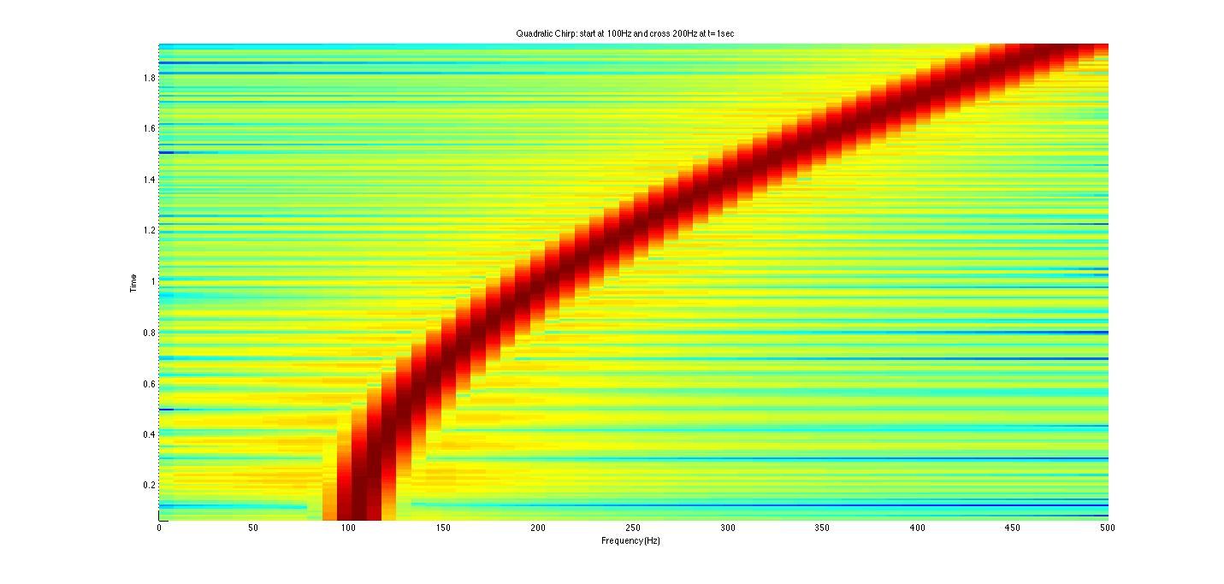
Example I
t=0:0.001:2; % 2 secs @ 1kHz sample rate
y=chirp(t,100,1,200,'q'); % Start @ 100Hz, cross 200Hz at t=1sec
spectrogram(y,128,120,128,1E3); % Display the spectrogram
title('Quadratic Chirp: start at 100Hz and cross 200Hz at t=1sec');
sound(y)
y=chirp(t,100,1,200,'q'); % Start @
Fs=5000;
filename = 'h.wav';
audiowrite(filename,y,Fs);
Frequency
Time (sec)

Slide 25
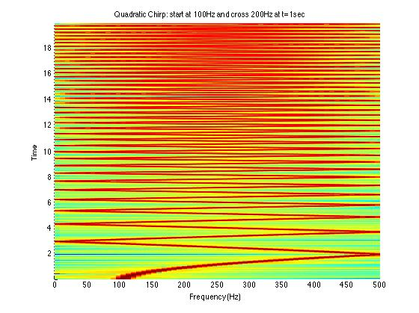
Example II
t=0:0.001:20; % 2 secs @ 1kHz sample rate
y=chirp(t,100,1,200,'q'); % Start @ 100Hz, cross 200Hz at t=1sec
spectrogram(y,128,120,128,1E3); % Display the spectrogram
title('Quadratic Chirp: start at 100Hz and cross 200Hz at t=1sec');
Fs=6000;
filename='h.wav';
audiowrite(filename,y,Fs);
Frequency
);
sound(y)
Time (sec)

Slide 26
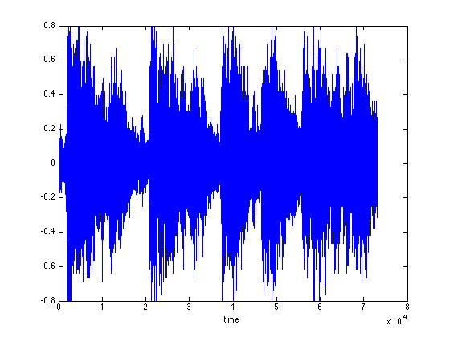
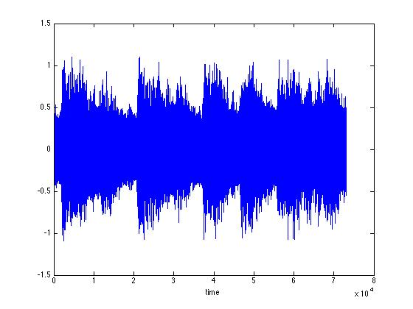
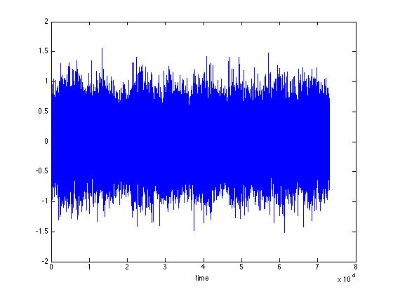
A Matlab Example
close all
clear all
load handel;
figure(1)
plot(y);
xlabel('time')
T=size(y);
for i=1:T(1,1)
fre_x(i)=i*Fs/T(1,1);
end
figure(2)
plot(fre_x, abs(fft(y)))
xlabel('Hz')
figure(3)
spectrogram(y,128,120,[],Fs);
T1=floor(T(1,1)/2);
omega1=1000;
for i=1:T(1,1)-T1;
z(i,1)=y(i,1)+.3*cos(2*pi*omega1*i/Fs);
end
omega2=2000;
for i=T-T1+1:T(1,1);
z(i,1)=y(i,1)+.3*cos(2*pi*omega2*i/Fs);
end
figure(5)
plot(z);
xlabel('time')
figure(6)
plot(fre_x,abs(fft(z)))
xlabel('Hz')
figure(7)
spectrogram(z,128,120,[],Fs);
for i=1:T(1,1);
zn(i,1)=y(i,1)+.3*randn(1,1);
end
figure(8)
plot(zn);
xlabel('time')
figure(9)
plot(fre_x,abs(fft(zn)))
xlabel('Hz')
figure(10)
spectrogram(zn,128,120,[],Fs);
;
Three signals

Slide 27
A Matlab Example
close all
clear all
load handel;
figure(1)
plot(y);
xlabel('time')
T=size(y);
for i=1:T(1,1)
fre_x(i)=i*Fs/T(1,1);
end
figure(2)
plot(fre_x, abs(fft(y)))
xlabel('Hz')
figure(3)
spectrogram(y,128,120,[],Fs);
T1=floor(T(1,1)/2);
omega1=1000;
for i=1:T(1,1)-T1;
z(i,1)=y(i,1)+.3*cos(2*pi*omega1*i/Fs);
end
omega2=2000;
for i=T-T1+1:T(1,1);
z(i,1)=y(i,1)+.3*cos(2*pi*omega2*i/Fs);
end
figure(5)
plot(z);
xlabel('time')
figure(6)
plot(fre_x,abs(fft(z)))
xlabel('Hz')
figure(7)
spectrogram(z,128,120,[],Fs);
for i=1:T(1,1);
zn(i,1)=y(i,1)+.3*randn(1,1);
end
figure(8)
plot(zn);
xlabel('time')
figure(9)
plot(fre_x,abs(fft(zn)))
xlabel('Hz')
figure(10)
spectrogram(zn,128,120,[],Fs);
;
Original signal
+ disturbance
+ noise

Slide 28
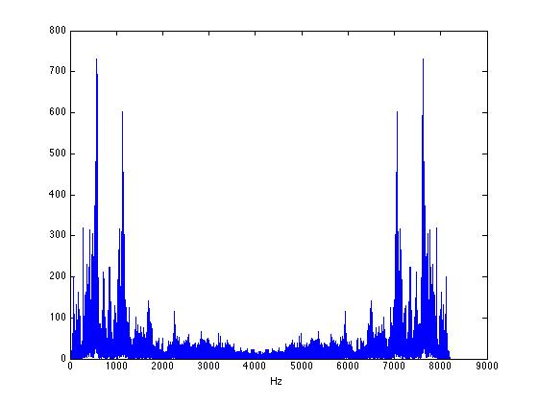
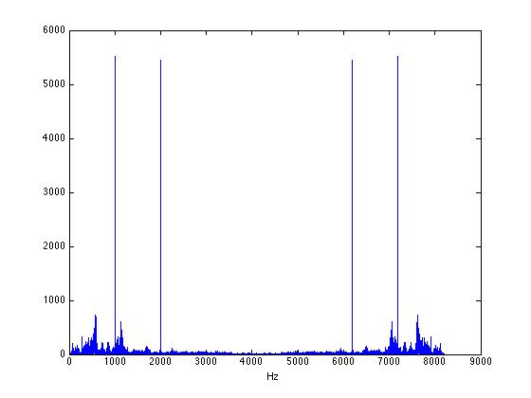
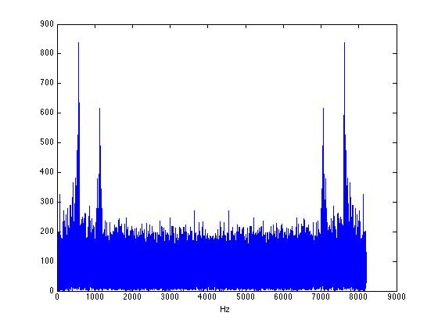
A Matlab Example
close all
clear all
load handel;
figure(1)
plot(y);
xlabel('time')
T=size(y);
for i=1:T(1,1)
fre_x(i)=i*Fs/T(1,1);
end
figure(2)
plot(fre_x, abs(fft(y)))
xlabel('Hz')
figure(3)
spectrogram(y,128,120,[],Fs);
T1=floor(T(1,1)/2);
omega1=1000;
for i=1:T(1,1)-T1;
z(i,1)=y(i,1)+.3*cos(2*pi*omega1*i/Fs);
end
omega2=2000;
for i=T-T1+1:T(1,1);
z(i,1)=y(i,1)+.3*cos(2*pi*omega2*i/Fs);
end
figure(5)
plot(z);
xlabel('time')
figure(6)
plot(fre_x,abs(fft(z)))
xlabel('Hz')
figure(7)
spectrogram(z,128,120,[],Fs);
for i=1:T(1,1);
zn(i,1)=y(i,1)+.3*randn(1,1);
end
figure(8)
plot(zn);
xlabel('time')
figure(9)
plot(fre_x,abs(fft(zn)))
xlabel('Hz')
figure(10)
spectrogram(zn,128,120,[],Fs);
;
Abs(fft) vs Frequency

Slide 29
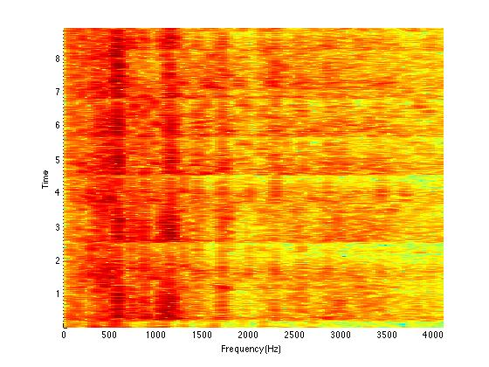
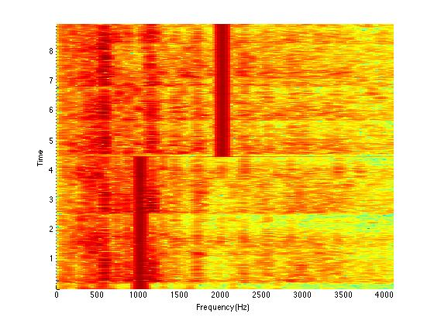
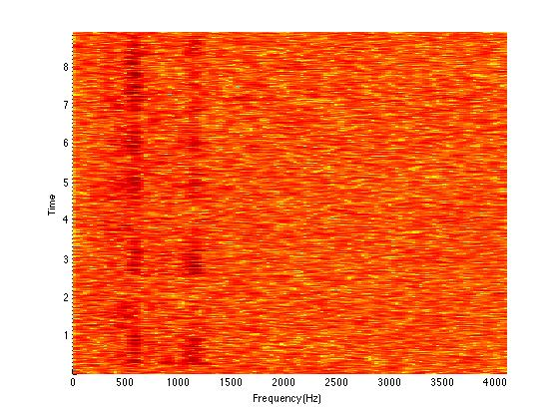
A Matlab Example
close all
clear all
load handel;
figure(1)
plot(y);
xlabel('time')
T=size(y);
for i=1:T(1,1)
fre_x(i)=i*Fs/T(1,1);
end
figure(2)
plot(fre_x, abs(fft(y)))
xlabel('Hz')
figure(3)
spectrogram(y,128,120,[],Fs);
T1=floor(T(1,1)/2);
omega1=1000;
for i=1:T(1,1)-T1;
z(i,1)=y(i,1)+.3*cos(2*pi*omega1*i/Fs);
end
omega2=2000;
for i=T-T1+1:T(1,1);
z(i,1)=y(i,1)+.3*cos(2*pi*omega2*i/Fs);
end
figure(5)
plot(z);
xlabel('time')
figure(6)
plot(fre_x,abs(fft(z)))
xlabel('Hz')
figure(7)
spectrogram(z,128,120,[],Fs);
for i=1:T(1,1);
zn(i,1)=y(i,1)+.3*randn(1,1);
end
figure(8)
plot(zn);
xlabel('time')
figure(9)
plot(fre_x,abs(fft(zn)))
xlabel('Hz')
figure(10)
spectrogram(zn,128,120,[],Fs);
;

Slide 30
A Matlab Example
close all
clear all
load handel;
figure(1)
plot(y);
xlabel('time')
T=size(y);
for i=1:T(1,1)
fre_x(i)=i*Fs/T(1,1);
end
figure(2)
plot(fre_x, abs(fft(y)))
xlabel('Hz')
figure(3)
spectrogram(y,128,120,[],Fs);
T1=floor(T(1,1)/2);
omega1=1000;
for i=1:T(1,1)-T1;
z(i,1)=y(i,1)+.3*cos(2*pi*omega1*i/Fs);
end
omega2=2000;
for i=T-T1+1:T(1,1);
z(i,1)=y(i,1)+.3*cos(2*pi*omega2*i/Fs);
end
figure(5)
plot(z);
xlabel('time')
figure(6)
plot(fre_x,abs(fft(z)))
xlabel('Hz')
figure(7)
spectrogram(z,128,120,[],Fs);
for i=1:T(1,1);
zn(i,1)=y(i,1)+.3*randn(1,1);
end
figure(8)
plot(zn);
xlabel('time')
figure(9)
plot(fre_x,abs(fft(zn)))
xlabel('Hz')
figure(10)
spectrogram(zn,128,120,[],Fs);
;

Slide 31
A Matlab Example
Will come back to it in the next few weeks
after we learn how to design filters

Slide 32
Image Processing
two-dimensional signal x[n₁,n₂], n₁,n₂∈Z
indices locate a point on a grid → pixel
grid is usually regularly spaced
values x[n₁,n₂] refer to the pixel’s appearance

Slide 33
Image Processing
Gray scale images: scalar pixel values
color images: multidimensional pixel values in a color space (RGB for example)
we can consider the single components separately:

Slide 34
DFT for image
DFT for x
IDFT for X
X = A _{N1 x N1} x _{N1 x N2} B _{N2 x N2}

Slide 35
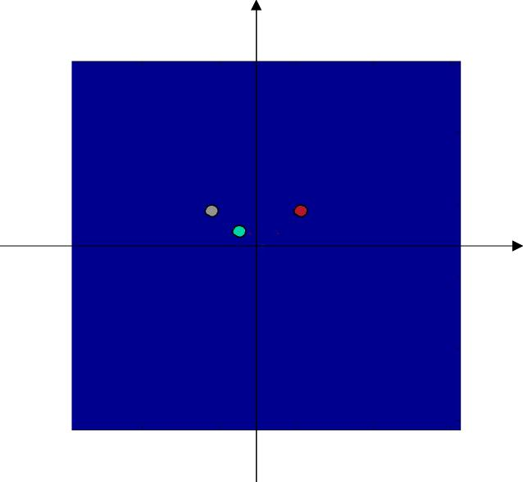
2

Slide 36
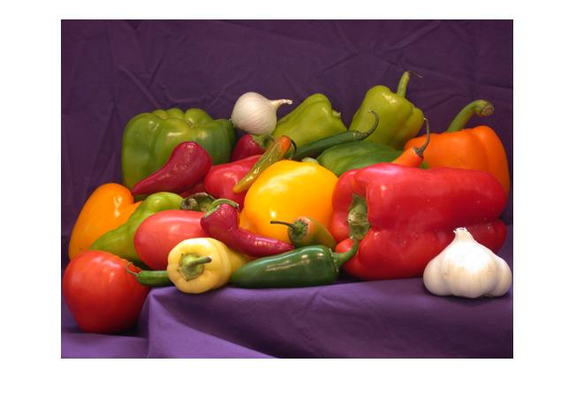
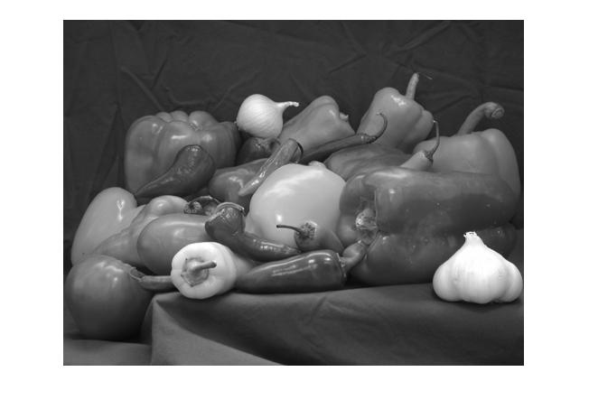
clear all close all figure(1) I = imread('peppers.png'); imshow(I); K=rgb2gray(I); figure(2) F = fft2(K); figure; imagesc(100*log(1+abs(fftshift(F)))); colormap(gray); title('magnitude spectrum'); figure; imagesc(angle(F)); colormap(gray)
Example I
Original picture Gray scale picture

Slide 37
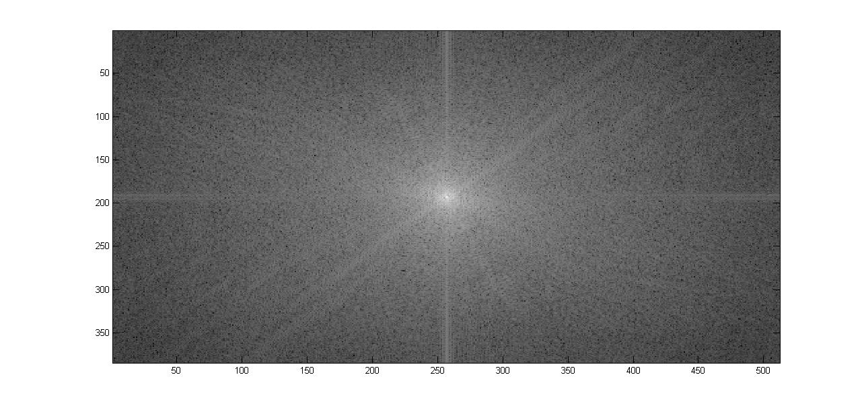
Example I

Slide 38
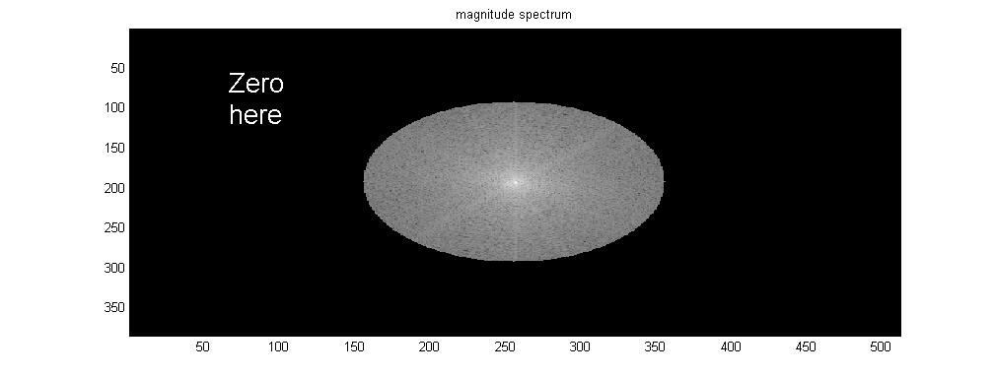
Example I
FF=(100*log(1+abs(fftshift(F))));
for i=1:384
for j=1:512
ss=sqrt((i-192)*(i-192)+(j-256)*(j-256));
if(ss>100)
FF(i,j)=0;
end
end
end
figure; imagesc(FF); colormap(gray);
title('magnitude spectrum'); figure; imagesc(angle(FF)); colormap(gray)
All low frequency information is here

Slide 39
Example I
FF=(100*log(1+abs(fftshift(F))));
for i=1:384
for j=1:512
ss=sqrt((i-192)*(i-192)+(j-256)*(j-256));
if(ss>100)
FF(i,j)=0;
end
end
end
figure; imagesc(FF); colormap(gray);
title('magnitude spectrum'); figure; imagesc(angle(FF)); colormap(gray)
All low frequency information is here

Slide 40
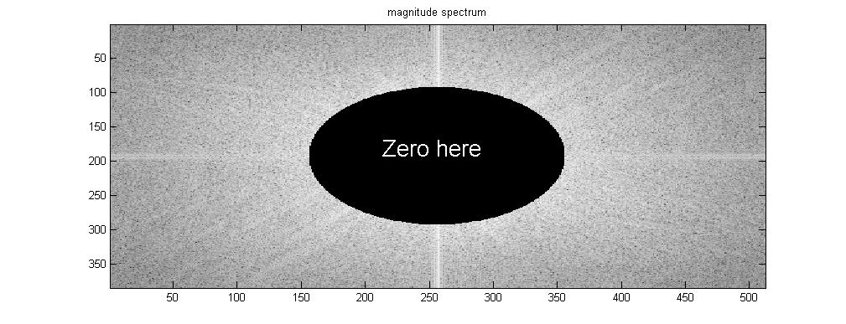
Example I
?
FF=(100*log(1+abs(fftshift(F))));
for i=1:384
for j=1:512
ss=sqrt((i-192)*(i-192)+(j-256)*(j-256));
if(ss>100)
FF(i,j)=0;
end
end
end
figure; imagesc(FF); colormap(gray);
title('magnitude spectrum'); figure; imagesc(angle(FF)); colormap(gray)
All high frequency information is here

Slide 41
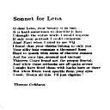
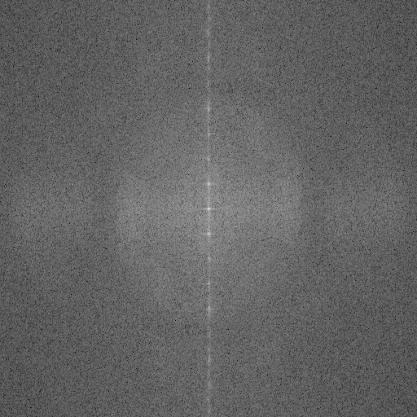
Image processing
Example II

Slide 42
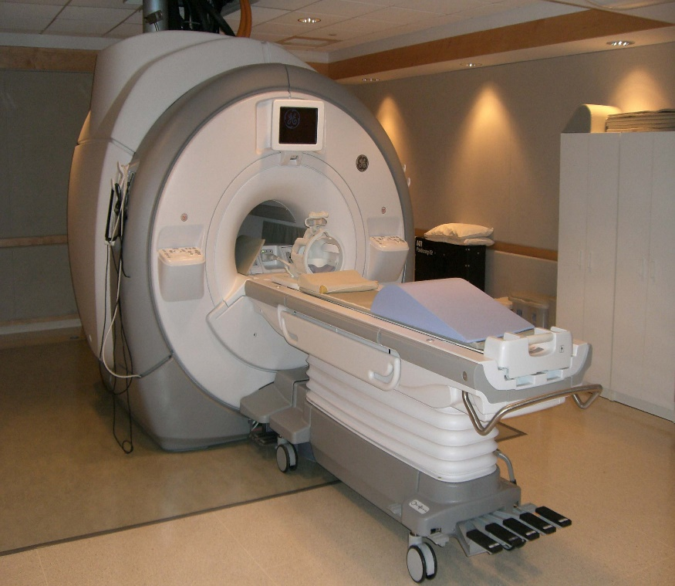
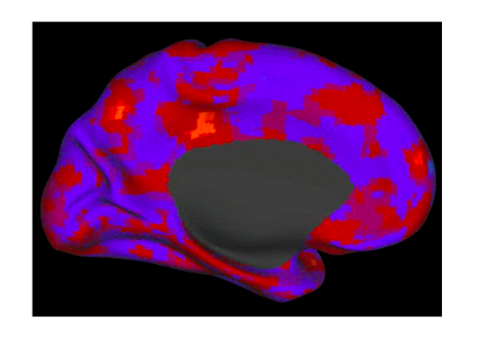
Example III: mind reading
IDFT2

Slide 43
Sampling and reconstruction
The question we consider here is under
what conditions we can completely
reconstruct the original signal
x(t)
from its discretely sampled signal
x[n].

Slide 44
Sampling and reconstruction
Theorem (Nyquist-Shannon sampling thm)
Exact reconstruction of a continuous-time signal from its samples is possible
if the signal is bandlimited and the sampling frequency is greater than twice
the signal bandwidth
Proof. The proof is again an application of FT, but we will not go through it here
Please read around. It is based upon the sinc function.

Slide 45
Summary of FT
At the end of the day, FT for signal x is only fft(x)
it is deadly easy
Hopefully and I am sure it will be useful for your
future career

Slide 46
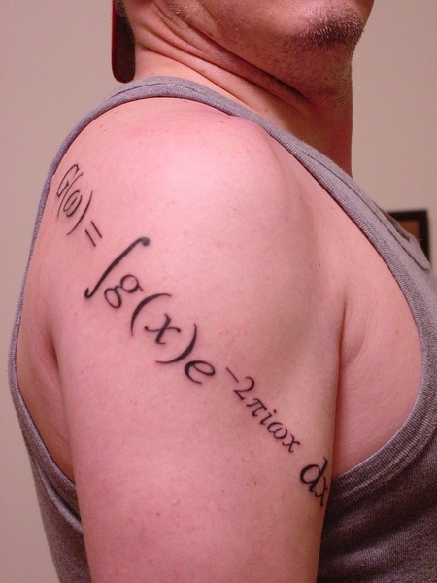
Summary of FT
At the end of the day, FT for signal x is only fft(x)
it is deadly easy
Hopefully it will be useful for your future career
I am proud of this

Slide 47
Remaining Issues?
Will you try to use FT to approximate them?

Slide 48
Wavelet approach: 1980’s
Wavelet
Will you try to use FT to approximate them?

Slide 49
Recap

Slide 50
Wavelet: intuition

Slide 51
Orthogonal bases

Slide 52
One example
S[n]=(56 40 8 24 48 48 40 16)’
S= 35h₀-3h₁+16 h₂+10 h₃+8 h₄ – 8h₅+ 0 h₆ +12 h₇
_{Where h is the Haar wavelet}
h₀= (1 1 1 1 1 1 1 1)’, h₁=(1 1 1 1 -1 -1 -1 -1)’
……..

