Slide 1
DCSP-9: DFT and PSD
Jianfeng Feng
Department of Computer Science Warwick Univ., UK
Jianfeng.feng@warwick.ac.uk
http://www.dcs.warwick.ac.uk/~feng/dcsp.html

Slide 2
DFT and DTFT
For a given data set
{x[1], …x[N]},
it is equivalent to
{…,0, x[1], …, x[N], 0, 0,…}.
Using DTFT, we have

Slide 3
DFT and DTFT
It turns out that we can sample it (computable with computer),
at ω = 2π k / N, k = 0,1,…,N-1

Slide 4
DFT
Definition: The discrete Fourier transform (DFT) and its own
inverse DFT (IDFT) associated with a vector
X = ( X[0], X[1], … , X[N-1] )
to a vector
x = ( x[0], x[1], …, x[N-1] )
of N data points, is given by

Slide 5
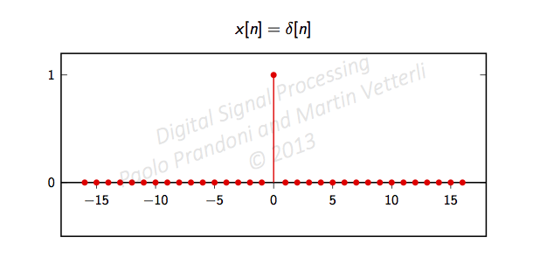
Example I
Consider the delta (impulse) function x[n]=δ[n], we have
amplitude
0 2π
phase
0 2π

Slide 6
Example I
sample it (computable with computer), at ω = 2π k / N, k = 0,1,…,N-1
amplitude
0 2π
phase
0 2π

Slide 7
Example I
sample it (computable with computer), at ω = 2π k / N, k = 0,1,…,N-1
amplitude
For example, we have N = 4
2π 0/N= 0
2π 1/N = π/2
2π 2/N = π
2π 3/N = 3π/4
0 2π
phase
0 2π

Slide 8
Example I
sample it (computable with computer), at ω = 2π k / N, k = 0,1,…,N-1
amplitude
For example, we have N = 4
2π 0/N= 0
2π 1/N = π/2
2π 2/N = π
2π 3/N = 3π/4
(X [0] X[1] X[2] X[3] ) = (1 1 1 1) = DTFT((x[0] x[1] x[2] x[3])) = DFT((1 0 0 0))
0 2π
phase
0 2π

Slide 9
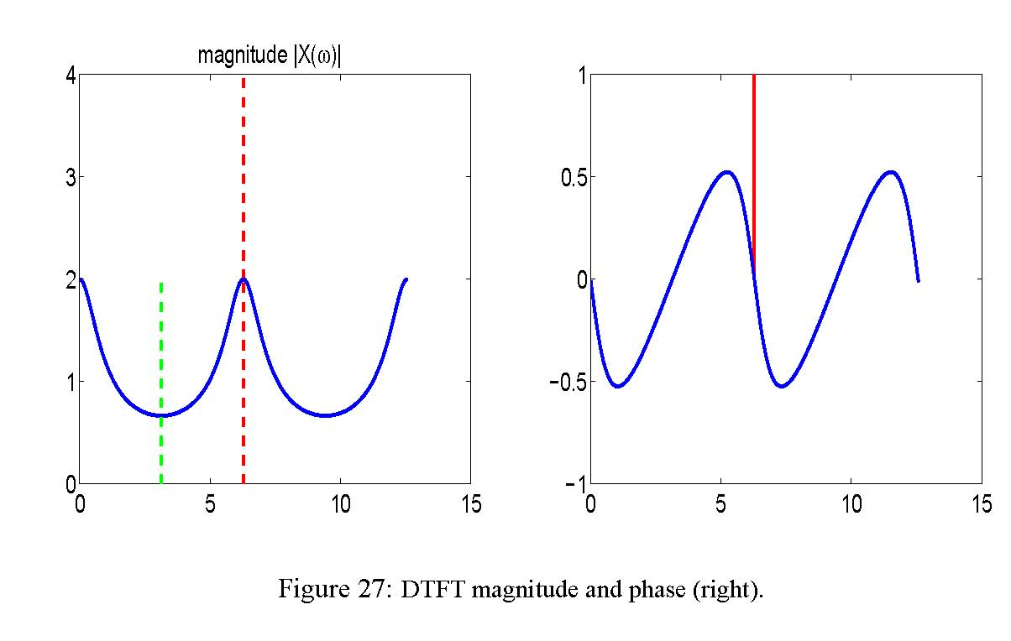
DFT I (Essential facts)
k=0
Remembering that the data is
x[0], x[1], …, x[N-1]
We have N (complex plane ) points in the frequency domain
X[0], X[1], …, X[N-1]

Slide 10
DFT I (Essential facts)
k=0
k=1
Remembering that the data is
x[0], x[1], …, x[N-1]
We have N (complex plane ) points in the frequency domain
X[0], X[1], …, X[N-1]

Slide 11
DFT I (Essential facts)
k=0
k=2
k=1
Remembering that the data is
x[0], x[1], …, x[N-1]
We have N (complex plane ) points in the frequency domain
X[0], X[1], …, X[N-1]

Slide 12
DFT I (Essential facts)
Rewritten it in matrix form, assume the data is x[0], x[1], …, x[N-1]
A

Slide 13
DFT I (Essential facts)
Rewritten it in matrix form, assume the data is x[0], x[1], …, x[N-1]
DFT
DATA

Slide 14
DFT II
A*

Slide 15
DFT II

Slide 16
DFT II

Slide 17
DFT III
Definition: The discrete Fourier transform (DFT) and its own
inverse DFT (IDFT) associated with a vector
X = ( X[0], X[1], … , X[N-1] )
to a vector
x = ( x[0], x[1], …, x[N-1] )
of N data points, is given by

Slide 18
Modern version: graphic representation
x[0]
X[0]
1
1
1
1
x[1]
X[1]
x[N-2]
X[N-2]
x[N-1]
X[N-1]

Slide 19
Modern version: graphic representation
x[0]
1
Exp(-j2pi/N)
Exp(-j2pi (N-2)/N)
Exp(-j2pi (N-1)/N)
X[0]
x[1]
X[1]
x[N-2]
X[N-2]
x[N-1]
X[N-1]

Slide 20
Modern version: graphic representation
x[0]
1
Exp(-j2pi(N-2)/N)
Exp(-j2pi (N-2)(N-2)/N)
Exp(-j2pi (N-1)(N-2)/N)
X[0]
x[1]
X[1]
x[N-2]
X[N-2]
x[N-1]
X[N-1]

Slide 21
Modern version: graphic representation
x[0]
X[0]
x[1]
1
Exp(-j2pi(N-1)/N)
Exp(-j2pi (N-2)(N-1)/N)
Exp(-j2pi (N-1)(N-1)/N)
X[1]
x[N-2]
X[N-2]
x[N-1]
X[N-1]

Slide 22
Modern version: graphic representation
A*/N:weight matrix
A:weight matrix
x[0]
X[0]
x[0]
x[1]
X[1]
x[1]
x[N-2]
X[N-2]
x[N-2]
x[N-1]
X[N-1]
x[N-1]

Slide 23
Modern version: Neural Networks
W:weight matrix
x[0]
f(x[0])
x[1]
f(x[1])
x[N-2]
x[N-1]
f(X[M-1])
The only difference is that the output is f(x[k]) and W could be any matrix

Slide 24
Modern version: Neural Networks
W:weight matrix
x[0]
f(x[0])
f(x[0])
f(x[0])
x[1]
f(x[1])
f(x[1])
f(x[1])
x[N-2]
x[N-1]
f(X[M-1])
f(X[M-1])
f(X[M-1])
The only difference is that the output is f(x[k]) and W could be any matrix

Slide 25
Summary
DFT and IDFT are simple: multiplication of matrices !!!!

Slide 26
Summary
DFT and IDFT are simple: multiplication of matrices !!!!
DFT( Data) enables us to view the data in the frequency domain
IDFT can uniquely enables us to recover the data from its frequency domain (MRI machine)

Slide 27
Example
Let (x[0], x[1], x[2], x[3]) = (1 2 -1 -1) be a data vector
of length N=4. Work out its DFT (X[0], X[1], X[2], X[3])

Slide 28
Example
Let (x[0], x[1], x[2], x[3]) = (1 2 -1 -1) be a data vector
of length N=4. Work out its DFT (X[0], X[1], X[2], X[3])

Slide 29
Example
X [ k ]
x [n]
2+3j
α
−α
2-3j
[1 2 -1 -1]
Time domain
[ 1 2+3 j -1 2-3 j ]
Complex plane

Slide 30
Example
X [ k ]
x [n]
2+3j
α
−α
2-3j
Time domain
Complex plane

Slide 31
Example
Complex plane (polar coordinate)
x [n]
Amplitude
phase
1
α
−α
Time domain
Frequency domain

Slide 32
Matlab demo
x=[1 2 -1 -1];
X=fft(x)
X =
1.0000 + 0.0000i 2.0000 - 3.0000i -1.0000 + 0.0000i 2.0000 + 3.0000i
ifft(X)
ans =
1 2 -1 -1

Slide 33
Recap
FT [ integral (x*exp) ]
DTFT [ sum (x*exp) ]
DFT [multiplication of two matrices]
Discretion
Truncation

Slide 34
FFT: Fast Fourier Transform
DFT is the basis of a number of applications.
One of the most important tools in digital signal processing.
The problem is that a brute-force implementation would hardly be feasible in real time (even for a data set of modest length).

Slide 35
FFT: Fast Fourier Transform
DFT can be computed in a very efficient way, exploiting the very structure of the algorithm.
For a data set of length N, the complexity of the
FFT grows as N log N
DFT computed by brute force grow as N².
FFT is widely used in many applications.

Slide 36
Fourier

Slide 37
Applications
cover some today and tomorrow
Essentially, the remaining of the module is its applications
Frequency eye

Slide 38
I. DFT for spectral estimation
One of the uses is to estimate the frequency spectrum of a signal.
The Fourier transform produces a spectrum from which the original
function can be reconstructed by an inverse transform.
In order to do that, it preserves not only the magnitude of each frequency component, but also its phase.
Represented as a 2-dimensional vector or a complex number, or as magnitude and phase (polar coordinates).
In graphical representations, often only the magnitude (or squared magnitude) component is shown.
Referred to as a power spectrum Density (PSD)

Slide 39
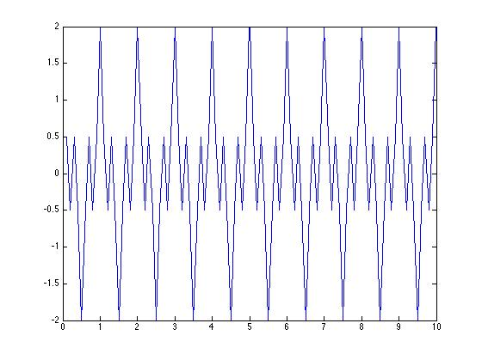
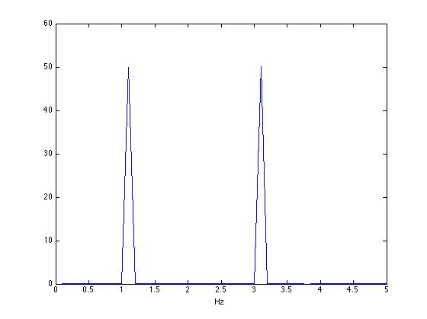
Locating tones
close all
N=10; %sampling rate N Hz
T=10; % time
d1=1; % first period
d2=3 % second period
for i=1:T*N
t(i)=i/N;
x(i)=cos(d1*2*pi*i/N)+cos(d2*2*pi*i/N);
end
figure(1)
plot(t,x)
figure(2)
plot(t*N/(T),abs(fft(x)))
xlim([0 N/2]);
xlabel('Hz')
Time domain (sec)
Frequency domain (amplitude only)

Slide 40
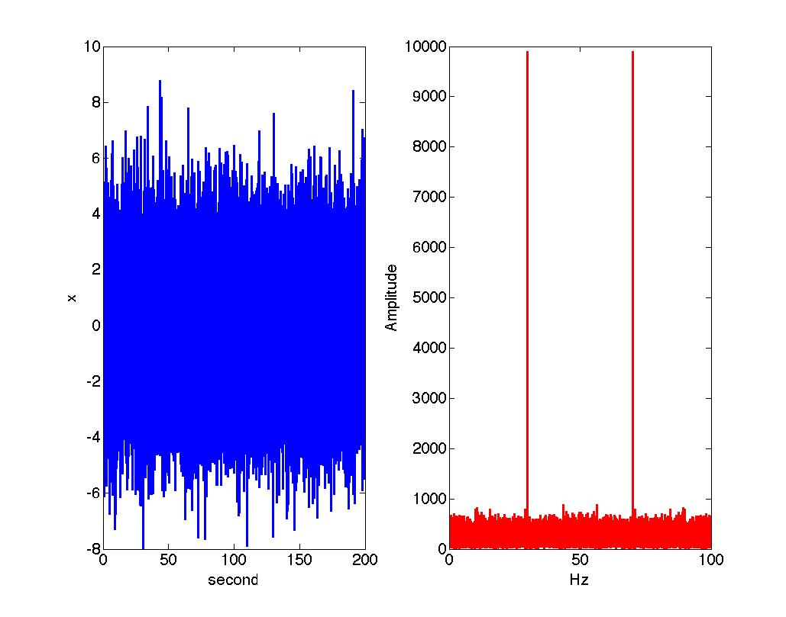
Mysterious sound
clear all
close all
sampling_rate=100;%Hz
omega=30; %signal frequecy Hz
N=20000; %total number of samples
for i=1:N
x_sound(i)=cos(2*pi*omega*i/sampling_rate); %signal
x(i)=x_sound(i)+2*randn(1,1); %signal+noise
axis(i)=sampling_rate*i/N; % for psd
time(i)=i/sampling_rate; % for time trace
end
subplot(1,2,1)
plot(time,x); %signal + noise, time trace
xlabel('second')
ylabel('x')
subplot(1,2,2)
plot(axis,abs(fft(x)),'r'); % magnitude of signal
xlabel('Hz');
ylabel('Amplitude')
sound(x_sound)
Fig. 2
Simple Matlab program is left on slides

Slide 41
Mysterious sound
clear all
close all
sampling_rate=100;%Hz
omega=30; %signal frequecy Hz
N=20000; %total number of samples
for i=1:N
x_sound(i)=cos(2*pi*omega*i/sampling_rate); %signal
x(i)=x_sound(i)+2*randn(1,1); %signal+noise
axis(i)=sampling_rate*i/N; % for psd
time(i)=i/sampling_rate; % for time trace
end
subplot(1,2,1)
plot(time,x); %signal + noise, time trace
xlabel('second')
ylabel('x')
subplot(1,2,2)
plot(axis,abs(fft(x)),'r'); % magnitude of signal
xlabel('Hz');
ylabel('Amplitude')
sound(x_sound)
Fig. 2
Simple Matlab program is left on slides

Slide 42
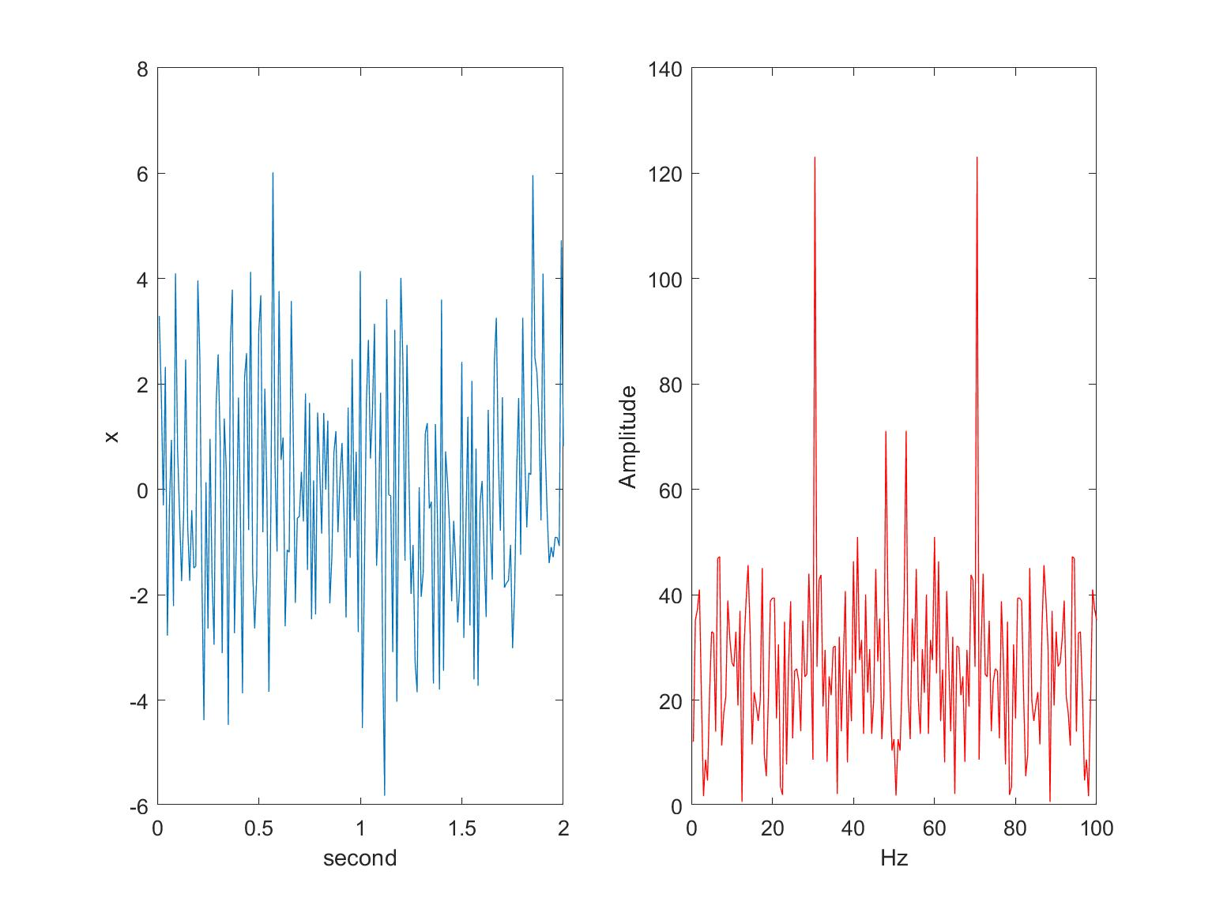
Mysterious sound: sampling window
Fig. 2
Note the magnitude of the y-axis

Slide 43
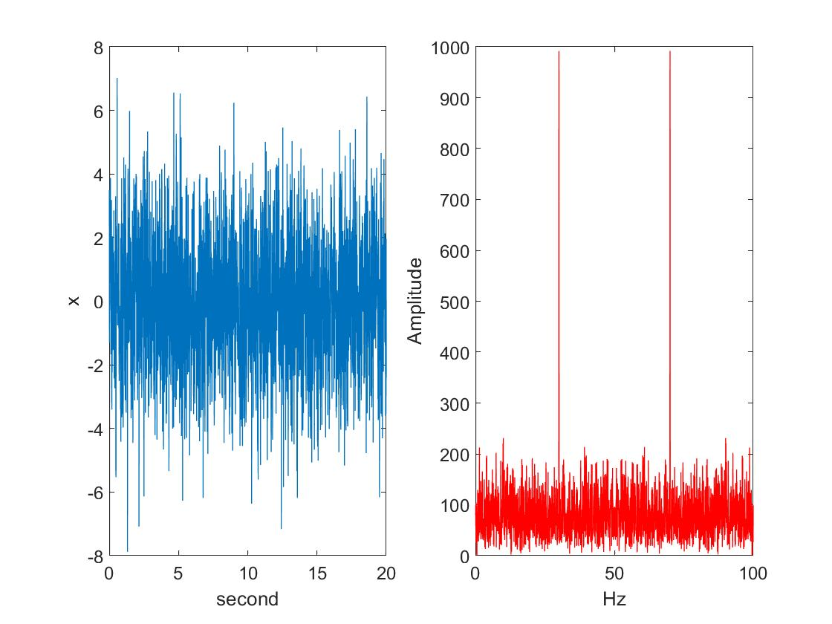
Mysterious sound: sampling window
Note the magnitude of the y-axis

Slide 44
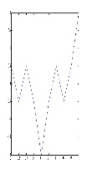
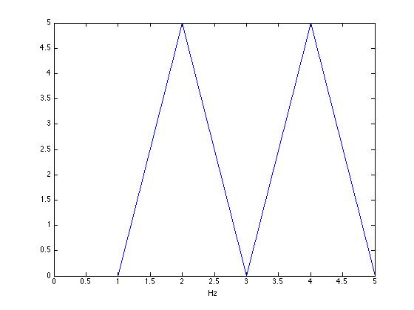
Issues on Signals
Use this signal
{x[0], …, x[N-1]}
FFT

Slide 45
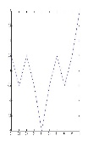
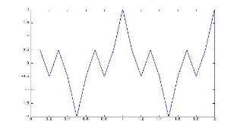
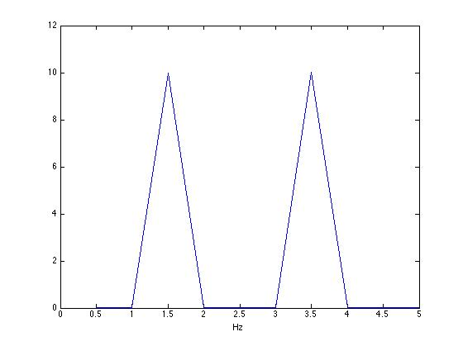
Issues on Signals
Use this signal
Use this signal
{x[0], …, x[N-1]}
{x[0], …, x[2N-1]}
FFT
FFT

Slide 46
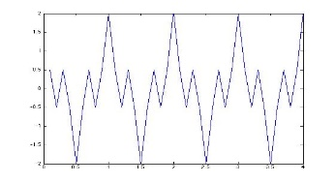
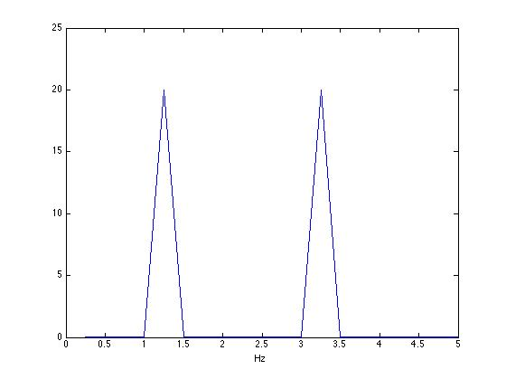
Issues on Signals
Use this signal
Use this signal
FFT
FFT
{x[0], …, x[8N-1]}
{x[0], …, x[3N-1]}

Slide 47
Issues on Signals
Use this signal
Use this signal
With the increased
signal length
The power increases
We can locate the signal more precisely
FFT
FFT

Slide 48
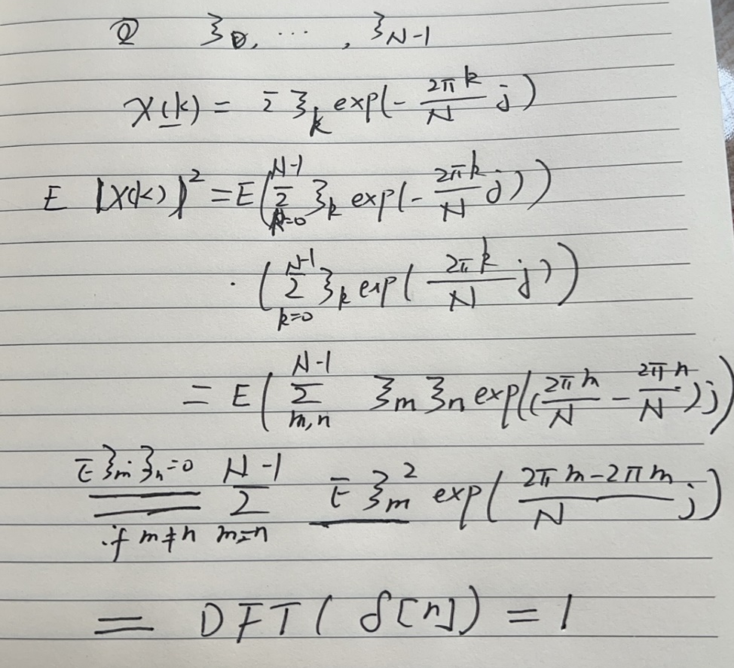
Issues on noise
When N is large
abs (DFT ( {x[n], n=0, …, N-1} ) ) → DFT ( {γ [n] } )
where γ [n] is the auto-correlation function (ACF)
Remember that the ACF of white noise is

Slide 49
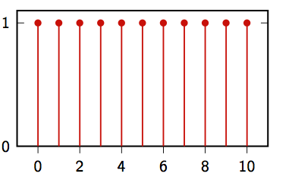
Issues on noise
When N is large
abs (DFT ( {x[n], n=0, …, N-1} ) ) → DFT ( {γ [n] } )
where γ [n] is the auto-correlation function (ACF)
Remember that the ACF of white noise is
Powers are equally distributed at each frequency
Hence the name of ‘white noise’
Colour noise: not equally distributed (ACF is not delta)

Slide 50
Issues on noise
White light passes a prism
White light goes through a prism
Remember that the ACF of white noise is
Powers are equally distributed at each frequency
Hence the name of ‘white noise’
Colour noise: not equally distributed (ACF is not delta)

Slide 51
Coming back to Mysterious sound
clear all
close all
sampling_rate=100;%Hz
omega=30; %signal frequecy Hz
N=20000; %total number of samples
for i=1:N
x_sound(i)=cos(2*pi*omega*i/sampling_rate); %signal
x(i)=x_sound(i)+2*randn(1,1); %signal+noise
axis(i)=sampling_rate*i/N; % for psd
time(i)=i/sampling_rate; % for time trace
end
subplot(1,2,1)
plot(time,x); %signal + noise, time trace
xlabel('second')
ylabel('x')
subplot(1,2,2)
plot(axis,abs(fft(x)),'r'); % magnitude of signal
xlabel('Hz');
ylabel('Amplitude')
load handel.mat
filename = 'handel.wav';
audiowrite(filename,y,Fs);
clear y Fs
sound(x_sound)
Fig. 2
noise

Slide 52
Coming back to Mysterious sound
clear all
close all
sampling_rate=100;%Hz
omega=30; %signal frequecy Hz
N=20000; %total number of samples
for i=1:N
x_sound(i)=cos(2*pi*omega*i/sampling_rate); %signal
x(i)=x_sound(i)+2*randn(1,1); %signal+noise
axis(i)=sampling_rate*i/N; % for psd
time(i)=i/sampling_rate; % for time trace
end
subplot(1,2,1)
plot(time,x); %signal + noise, time trace
xlabel('second')
ylabel('x')
subplot(1,2,2)
plot(axis,abs(fft(x)),'r'); % magnitude of signal
xlabel('Hz');
ylabel('Amplitude')
sound(x_sound)
Fig. 2
signal
noise

Slide 53
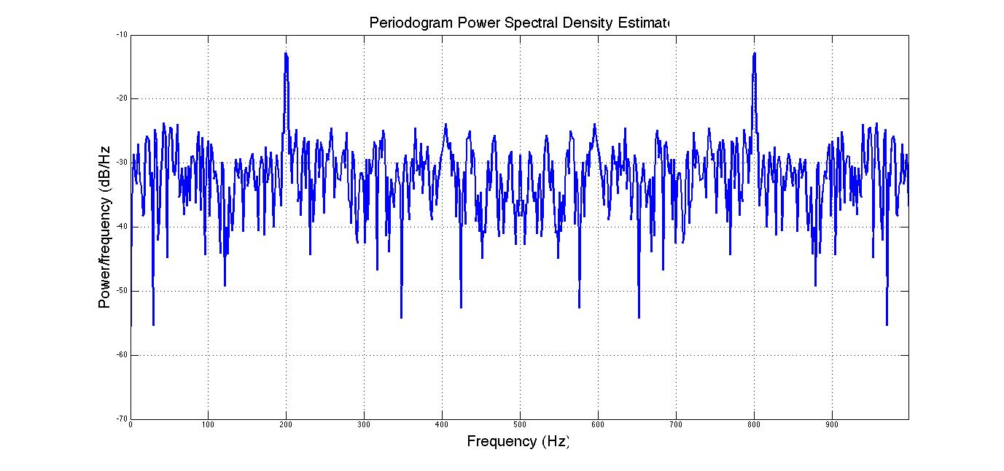
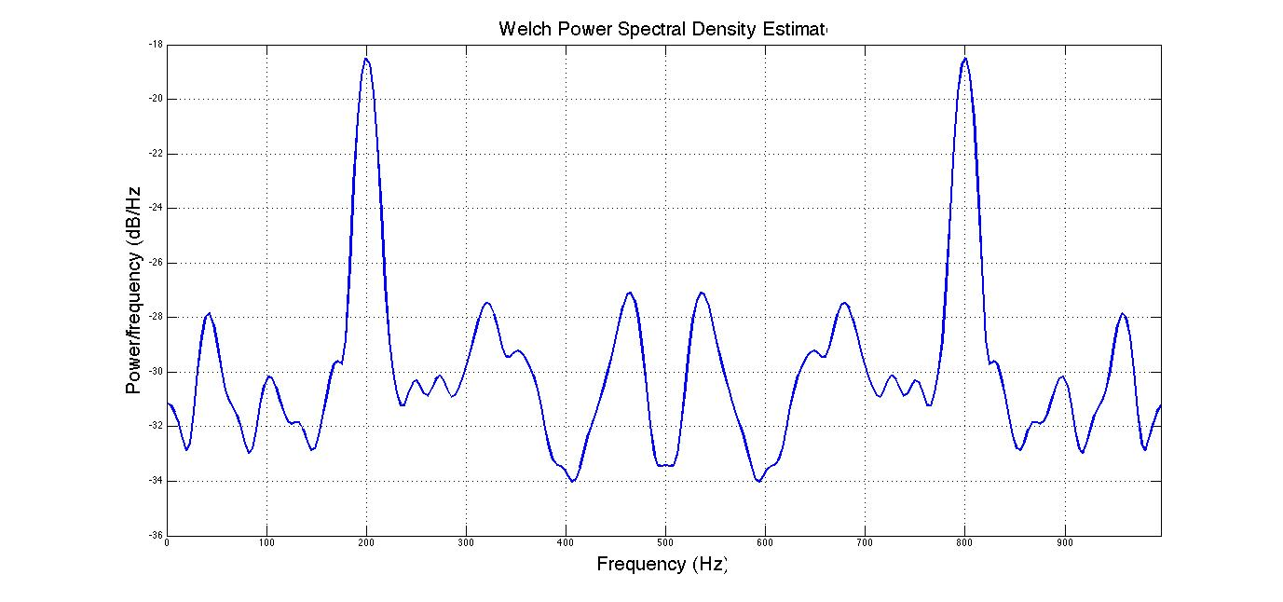
Matlab
A few words on Matlab
periodogram pwelch
It is essentially fft
Fs = 1000; t = 0:1/Fs:.3;
% Fs is the sampling rate
x = cos(2*pi*t*200)+randn(size(t));
% A cosine of 200Hz plus noise
periodogram(x,[],'twosided',512,Fs);
% The default window is used
Fs = 1000; t = 0:1/Fs:.296;
%Fs is the sampling rate
x = cos(2*pi*t*200)+randn(size(t));
% A cosine of 200Hz plus noise
pwelch(x,[],[],[],Fs,'twosided');
% Uses default window, overlap & NFFT.
It is slightly advanced

Slide 54
Matlab
A few words on Matlab
periodogram pwelch
It is essentially fft
Fs = 1000; t = 0:1/Fs:.3;
% Fs is the sampling rate
x = cos(2*pi*t*200)+randn(size(t));
% A cosine of 200Hz plus noise
periodogram(x,[],'twosided',512,Fs);
% The default window is used
Fs = 1000; t = 0:1/Fs:.296;
%Fs is the sampling rate
x = cos(2*pi*t*200)+randn(size(t));
% A cosine of 200Hz plus noise
pwelch(x,[],[],[],Fs,'twosided');
% Uses default window, overlap & NFFT.
Abs(fft(x))
It is slightly advanced

Slide 55
Matlab
A few words on Matlab
periodogram pwelch
It is essentially fft
Fs = 1000; t = 0:1/Fs:.3;
% Fs is the sampling rate
x = cos(2*pi*t*200)+randn(size(t));
% A cosine of 200Hz plus noise
periodogram(x,[],'twosided',512,Fs);
% The default window is used
Fs = 1000; t = 0:1/Fs:.296;
%Fs is the sampling rate
x = cos(2*pi*t*200)+randn(size(t));
% A cosine of 200Hz plus noise
pwelch(x,[],[],[],Fs,'twosided');
% Uses default window, overlap & NFFT.
In Welch, essentially the signals are divided into many segments
For each segments, an FFT is carried
The summation of FFT is plotted and hence the noise is averaged out
Abs(fft(x))
It is slightly advanced

Slide 56
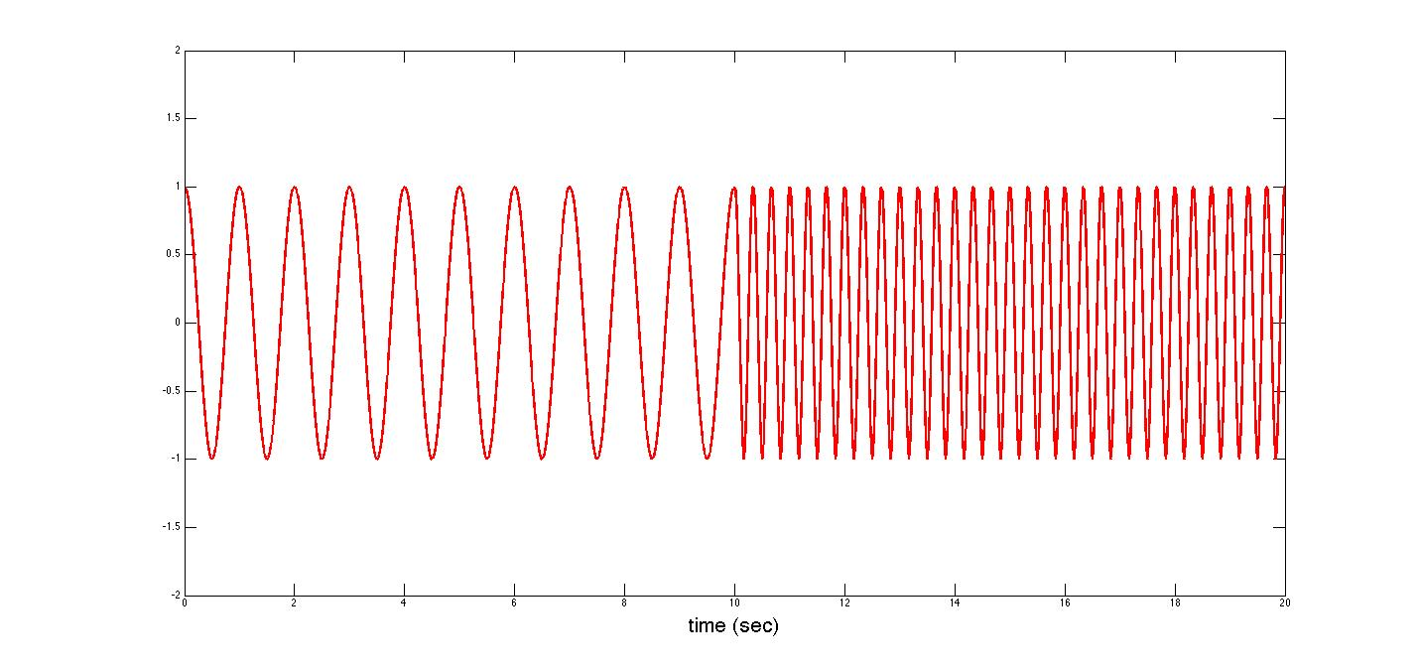
Spectrogram
In real life examples, all signals change with time (music for example)

Slide 57
Spectrogram
In real life example, all signals change with time (music for example)
Using sliding window to sample signals and calculate PSD

Slide 58
Spectrogram
In real life example, all signals change with time (music for example)
Using sliding window to sample signals and calculate PSD

Slide 59
Spectrogram
In real life example, all signals change with time (music for example)
Using sliding windows to sample signals and calculate PSD

Slide 60
Spectrogram
It is called STFT (short time Fourier transform)
The obtained results are plotted using colour map as in the next figure: spectrogram

Slide 61
Spectrogram
Frequency
3 Hz
1 Hz
Time (sec)

Slide 62
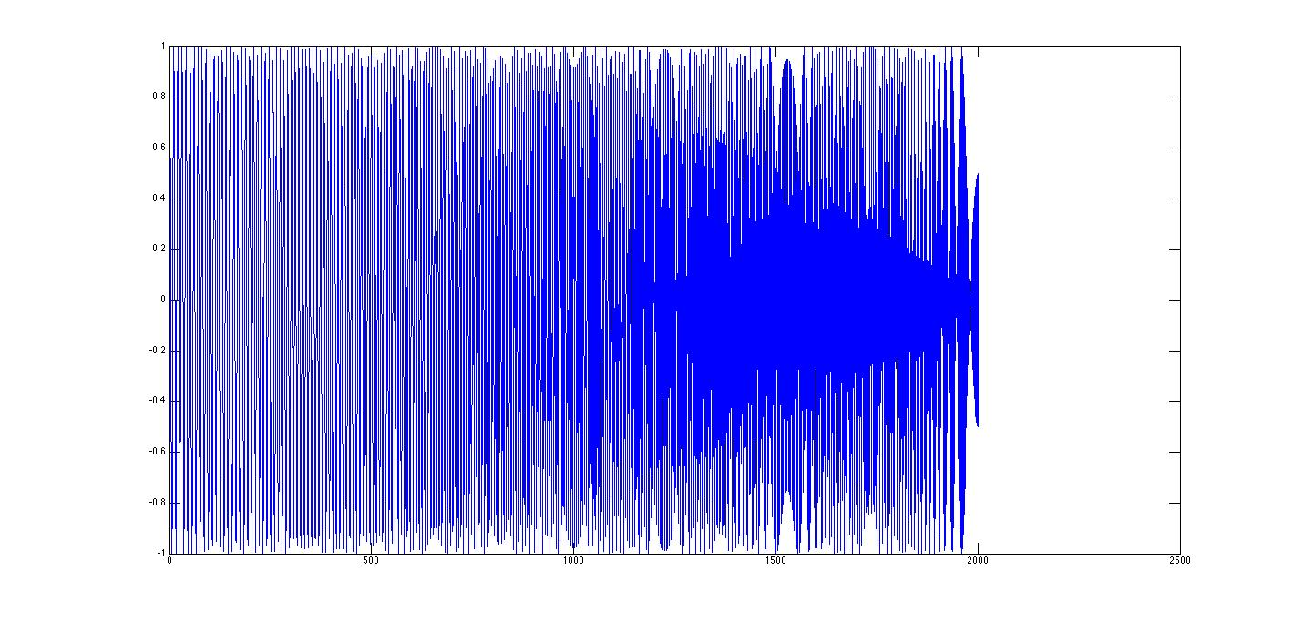
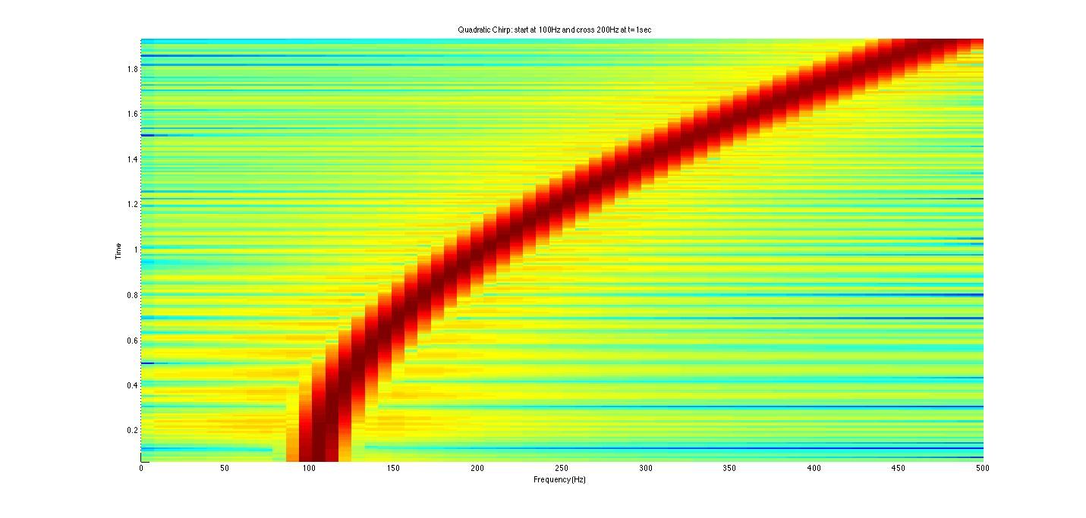
Example I
t=0:0.001:2; % 2 secs @ 1kHz sample rate
y=chirp(t,100,1,200,'q'); % Start @ 100Hz, cross 200Hz at t=1sec
spectrogram(y,128,120,128,1E3); % Display the spectrogram
title('Quadratic Chirp: start at 100Hz and cross 200Hz at t=1sec');
sound(y)
y=chirp(t,100,1,200,'q'); % Start @
Fs=5000;
filename = 'h.wav';
audiowrite(filename,y,Fs);
Frequency
Time (sec)

Slide 63
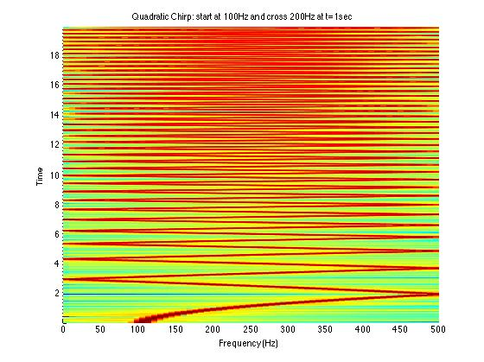
Example II
t=0:0.001:20; % 2 secs @ 1kHz sample rate
y=chirp(t,100,1,200,'q'); % Start @ 100Hz, cross 200Hz at t=1sec
spectrogram(y,128,120,128,1E3); % Display the spectrogram
title('Quadratic Chirp: start at 100Hz and cross 200Hz at t=1sec');
Fs=6000;
filename='h.wav';
audiowrite(filename,y,Fs);
Frequency
);
sound(y)
Time (sec)

Slide 64
Math
T
W_{T}[n]
1
T
You can certainly choose many ‘windows’ here: triangle, Gaussian, Hamming etc.

Slide 65
Summary
DFT
Power Spectrum Density
Spectrogram

