Slide 1
Seminar 4 Digital Communication and Signal Processing
Ruohan Zhang
Ruohan.Zhang.1@warwick.ac.uk
Department of Computer Science, University of Warwick
29/01/2024

Slide 2
Question 1
Generate a white noise vector V1 of size 1000 that has standard normal distribution. Calculate the mean, standard deviation and variance of this vector.
Key point:
White noise vector
A random vector (that is, a partially indeterminate process that produces vectors of real numbers) is said to be a white noise vector or white random vector if its components each have a probability distribution and are statistically independent: that is, their joint probability distribution must be the product of the distributions of the individual components.
https://en.wikipedia.org/wiki/White_noise

Slide 3
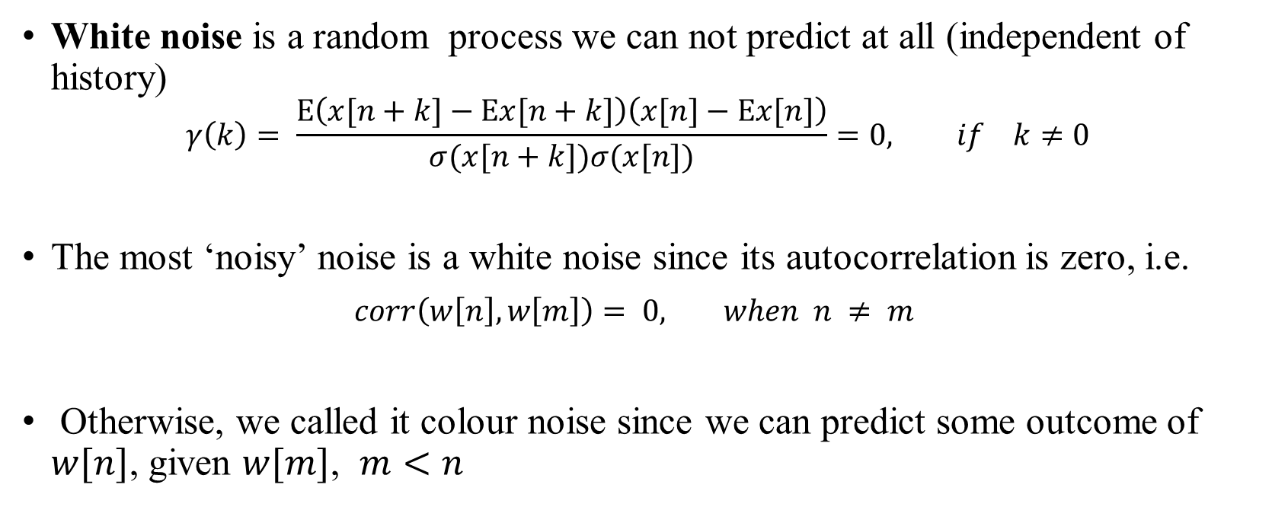
White noise is a random process we can not predict at all (independent of history)
$$γ\left(k\right)= \frac{E\left(x[n+k]−Ex[n+k]\right)\left(x[n]−Ex[n]\right)}{σ(x[n+k])σ(x[n])}=0, if k≠0$$
The most ‘noisy’ noise is a white noise since its autocorrelation is zero, i.e.
$corr\left(w\left[n\right], w\left[m\right]\right)= 0, when n ≠ m$
Otherwise, we called it colour noise since we can predict some outcome of $w[n]$, given $w[m]$, $m<n$

Slide 4
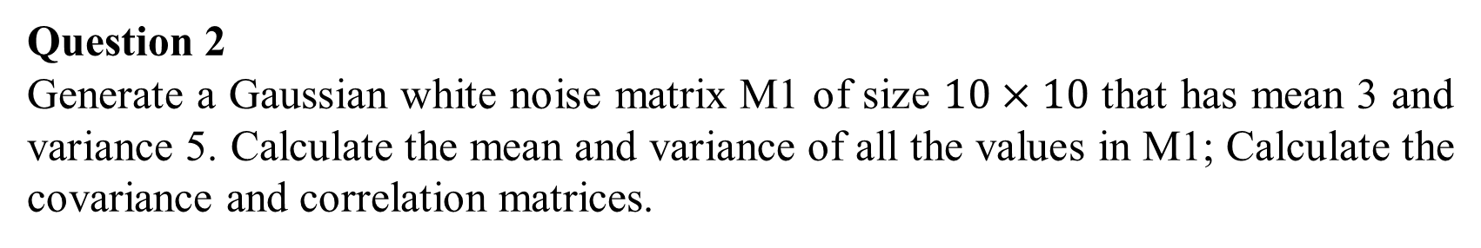
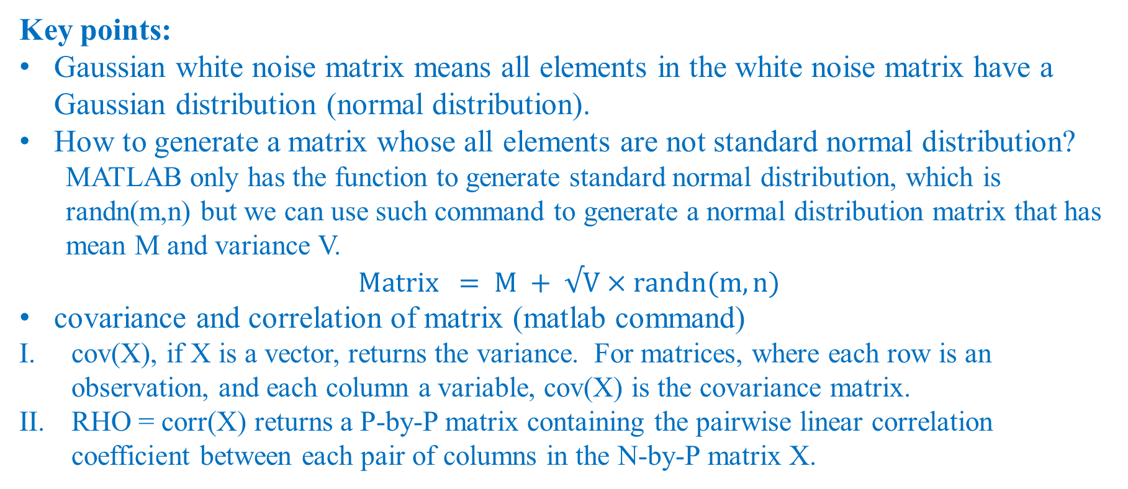
Question 2
Generate a Gaussian white noise matrix M1 of size $10×10$ that has mean 3 and variance 5. Calculate the mean and variance of all the values in M1; Calculate the covariance and correlation matrices.
Key points:
Gaussian white noise matrix means all elements in the white noise matrix have a Gaussian distribution (normal distribution).
How to generate a matrix whose all elements are not standard normal distribution?
MATLAB only has the function to generate standard normal distribution, which is randn(m,n) but we can use such command to generate a normal distribution matrix that has mean M and variance V.
$$Matrix = M + √V×randn(m,n)$$
covariance and correlation of matrix (matlab command)
cov(X), if X is a vector, returns the variance. For matrices, where each row is an observation, and each column a variable, cov(X) is the covariance matrix.
RHO = corr(X) returns a P-by-P matrix containing the pairwise linear correlation coefficient between each pair of columns in the N-by-P matrix X.

Slide 5
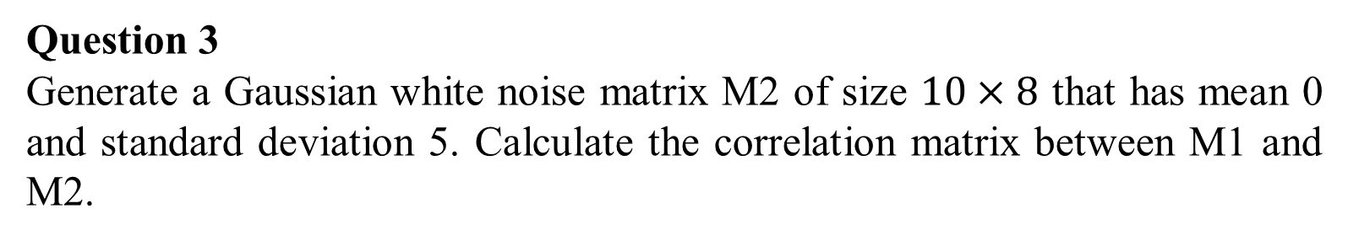
Question 3
Generate a Gaussian white noise matrix M2 of size $10×8$ that has mean 0 and standard deviation 5. Calculate the correlation matrix between M1 and M2.
Key points
Correlation of 2 matrices
RHO = corr(X,Y,...) returns a P1-by-P2 matrix containing the pairwise correlation coefficient between each pair of columns in the N-by-P1 and N-by-P2 matrices X and Y.

Slide 6
Question 4
Plot V1. Plot the histogram of all the values in V1 and M2 separately, and set bin to 20.
Key points
The bin represents how many intervals in the histogram.

