Slide 1
DCSP-12: Filter II
Jianfeng Feng
Department of Computer Science Warwick Univ., UK
Jianfeng.feng@warwick.ac.uk
http://www.dcs.warwick.ac.uk/~feng/dcsp.html

Slide 2
Nonrecursive Filters
When a filter is nonrecursive, its difference equation can be written y(n) = a₀ x(n) + a₁ x(n-1) +…+ a_{N} x(n-N)
Such filters are also called finite impulse response filters, for the obvious reason that their IR contain only finitely many nonzero terms.
Correspondingly, the TF of a nonrecursive filter can be written as

Slide 3
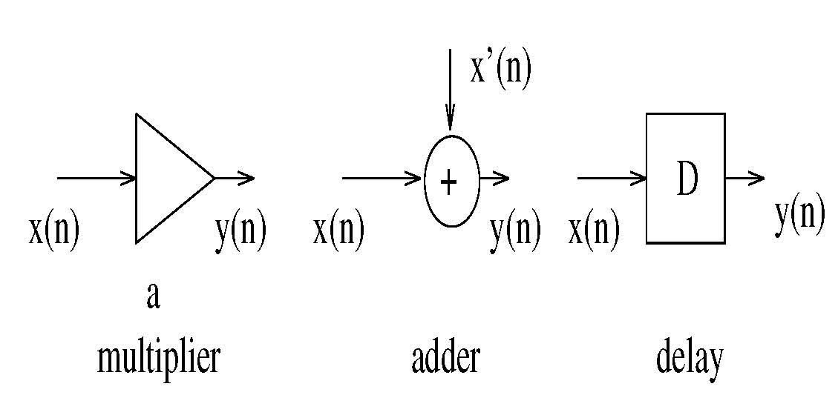
Block diagram

Slide 4
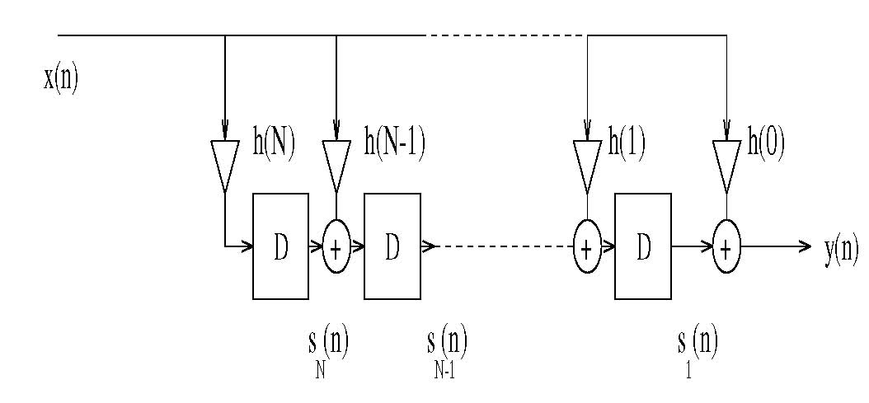
Block diagram
a_{N}
a_{N-1}
a₁
a₀
z

Slide 5
Three types of representation
Linear difference equation
Block diagram
Transfer function

Slide 6
Zeros
Trying to figure out how an MA filter will behave, is not always so simple.
Another way of looking at it is through its frequency domain behaviors.
We can make a start on this by examining the zeros of its transfer function H(z), i.e. those values of z for which
H(z)=0
since H(z) is a polynomial of order N with real
coefficients,

Slide 7
Zeros
Trying to figure out how an FIR filter will behave, is note always so simple.
Another way of looking at it is through its frequency domain behaviors.
We can make a start on this by examining the zeros of its transfer function H(z), i.e. those values of z for which
H(z)=0
H(z) is a polynomial of order N with real coefficients,
the complex conjugate root theorem states that if P is a polynomial in one variable with real coefficients, and a + bi is a root of P with a and b real numbers, then its complex conjugate a − bi is also a root of P
N =2, H(z) = a0 + a1 z⁻¹ + a2 z⁻²
the roots of this poly are

Slide 8
Zeros
We can express H(z) in terms of the roots by writing
where in general
z_{m}= |z_{m}| exp ( j arg [z_{m}] )
is the mth root, or zero of the transfer function.
The zeros of a transfer function are usually denoted graphically in the complex z-plane by circles, as shown in the following Fig.

Slide 9
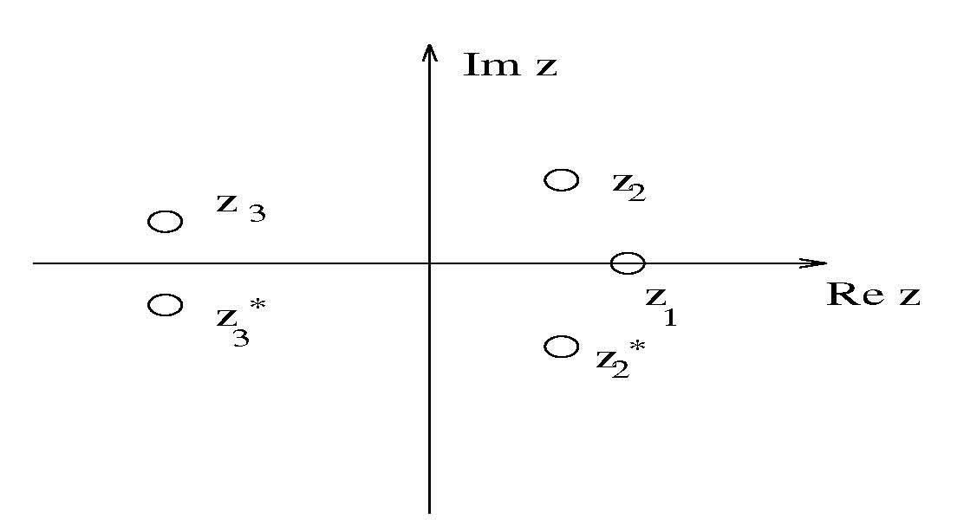
Zeros

Slide 10

Signal

Slide 11
Recursive Filters
Of the many filter transfer function which are
not MA, the most commonly use in DSP
are the recursive filters, so called because
their current output depends not only on
the last N+1 inputs but also on the last N
outputs.

Slide 12
Signal

Slide 13
Frequency Response of an MA filter
We can formally represent the frequency response of the filter by substituting
z = exp( j ω)
and obtain
H( ω) = K[(exp (-j ω) – α₁)…(exp (-j ω) – α_{N})]
Consider an example

Slide 14
What is a Filter?
For a given power spectrum of a signal

Slide 15
What is a Filter?
For a given power spectrum of a signal
Signal
Filter
1

Slide 16
What is a Filter?
For a given power spectrum of a signal
Signal
*
Filter
1
Filtered Signal

Slide 17
Ideal response function as plotted below
Find coefficients a and b
y(n) = a₀x(n)+ a₁ x(n-1) +…+ a_{N} x(n-N)
+ b₁ y(n-1) +…+ b_{N}y(n-N)
Filter
1

Slide 18
Example
H( ω)= K[(exp (-j ω) – α₁)(exp (-j ω) – α₂)]
(sampling frequency F_{s}, stop freqeuncy F₀, put zero = (F₀/F_{s}/2)π = 2π F₀/F_{s})
with α₁ = exp (-j π / 4), α₂ = exp (j π / 4), for example, then
Y(ω)= H( ω) X( ω)
and Y(ω)=0 whenever ω = π / 4.
Any signal with a frequency of F₀ will be stopped

Slide 19
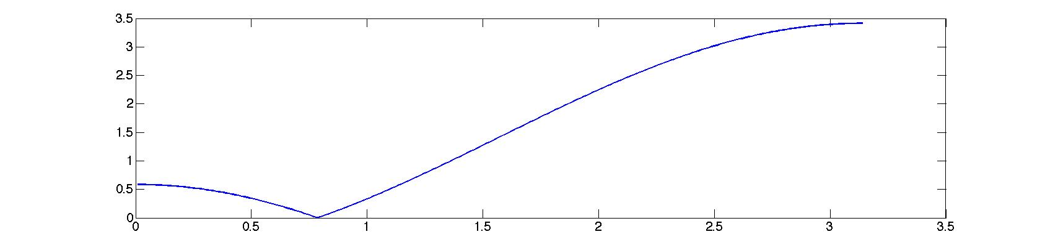
Transfer function
h=0.01;
for i=1:314
x(i)=i*h;
f(i)=(exp(-j*x(i))-exp(-j*pi/4))*(exp(-j*x(i))-exp(j*pi/4));
end
plot(x,abs(f))

Slide 20
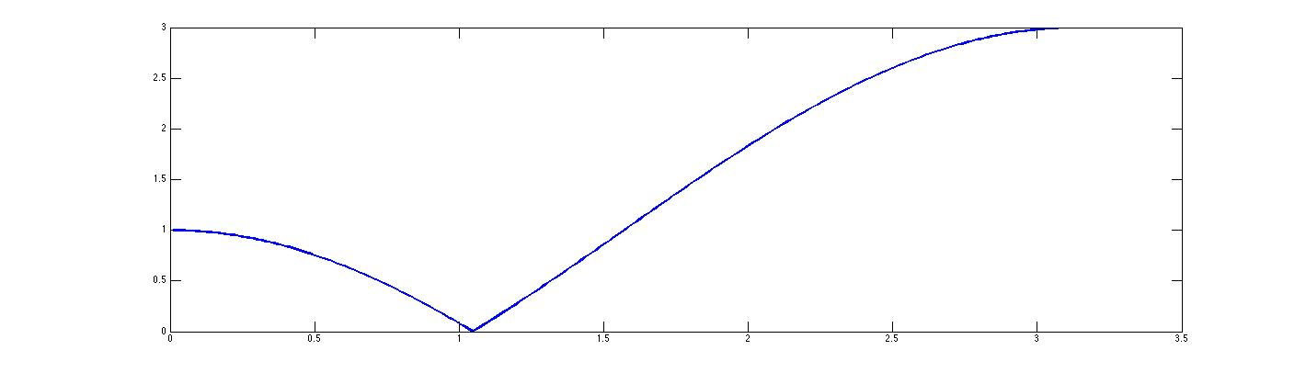
Transfer function
Moving α₁ along the circle, we are able to stop a signal with a given frequency
π/4
π/3

Slide 21
Result

Slide 22
Difference equation
The original difference expression can be recovered by
H( z ) = k [(z⁻¹ – α₁)(z⁻¹ – α₂)]
= k [z⁻² – (α₁+ α₂ ) z⁻¹ + (α₁ α₂ )]
y(n) = k [x(n-2) – (α₁+ α₂ ) x(n-1) + (α₁ α₂ )x(n)]
a₀= k (α₁ α₂ )=k, a₁= – k(α₁+ α₂ ), a₂ = k

Slide 23
Recursive Filters
Of the many filter transfer function, the most
commonly use in DSP are the recursive filters,
so called because their current output
depends not only on the last N inputs but also
on the last N outputs.
y(n) = a₀x(n)+ a₁ x(n-1) +…+ a_{N}x(n-N)
+ b₁ y(n-1) +…+ b_{N}y(n-N)

Slide 24
Transfer function

Slide 25
Block diagram
X(n)
a_{N}
a₁
a₀
a_{N-1}
y(n)
+
D
+
D
+
D
+
b_{N}
b_{N-1}
b₁

Slide 26
Poles and zeros
We know that the roots α_{n} are the zeros of the transfer function.
The roots of the equation B(z)=0 are called the poles of the transfer function.
They have greater significance for the behaviour of H(z): it is singular at the points z = β_{n}.
Poles are drawn on the z-plane as crosses, as shown in the next Fig.

Slide 27
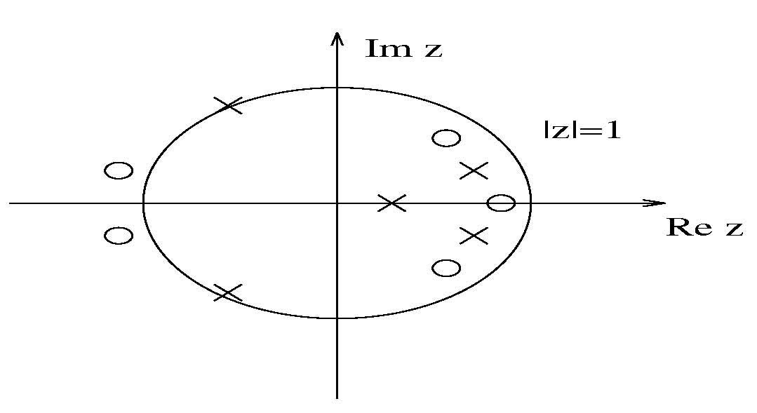
Poles and zeros

Slide 28
Poles and zeros
ON this figure, the unit circle has been shown on the z-plane.
In order for a recursive filter to be bounded input bounded output (BIBO) stable, all of the poles of its transfer function must lie inside the unit circle.
A filter is BIBO stable if any bounded input sequence gives rise to a bounded output sequence.
Now if the pole of the transfer lie insider the unit circle,
A simple case (N=1)

Slide 29
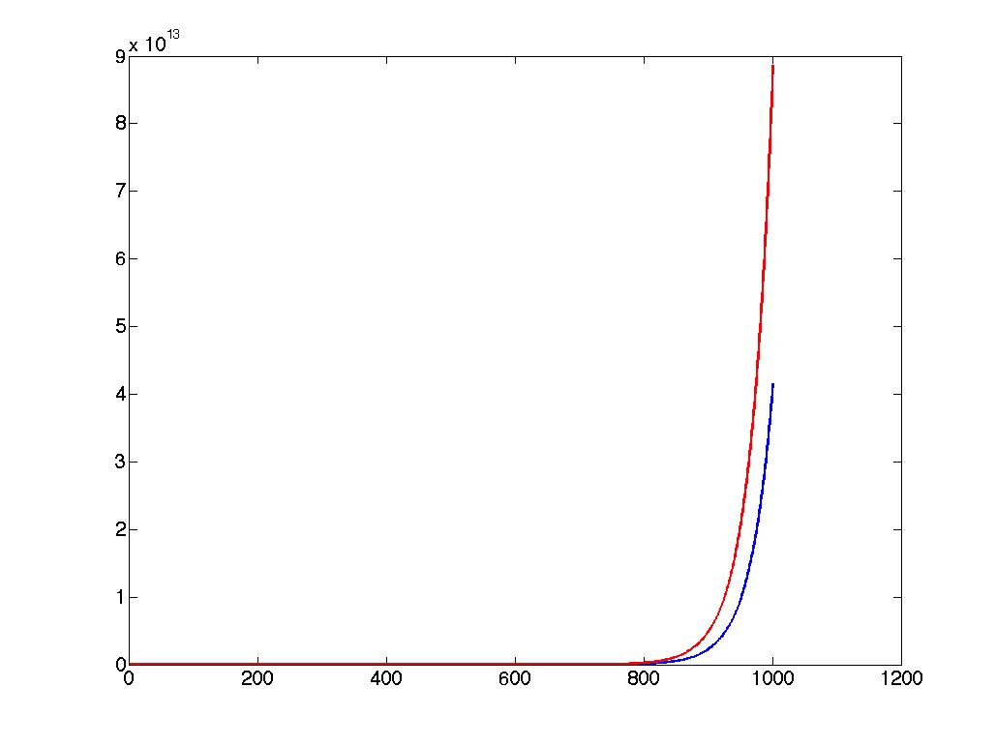
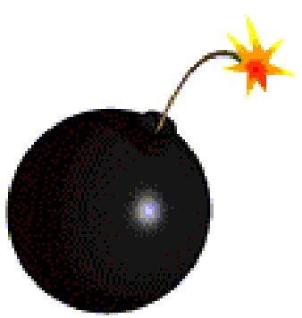
Poles and zeros
y(n) is stable if and only if the pole is inside the unit circle
|β|<1
In general, y(n) is stable is stable if and only if all poles are inside
the unit circle
|β_{i}|<1, i=1,..,N

Slide 30
Poles and zeros
If |β_{i} |=1, the filter is said to be conditionally stable:
some input sequence will lead to bounded output sequence and some will not.
Since MA filters have no poles, they are always
BIBO (bound input bound output) stable: zeros
have no effect on stability.

Slide 31
Response
Now suppose we have the transfer function of a filter
We can formally represent the frequency response of the filter by substituting
z = exp( j ω)
and obtain
H( ω)= A( ω ) / B( ω )

Slide 32
Response
Obviously, H( ω) depends on the locations of the poles and zeros of the transfer function, a fact which can be made more explicit by factoring the numerator and denominator polynomials to write

Slide 33
Response
Each factor in the numerator or denominator is a complex function of frequency, which has a graphical interpretation in the terms of the location of the corresponding roots in relation to the unit circle
Thus we can make a reasonable guess about the filter frequency response imply by looking at the pole-zero diagram.

Slide 34
Filter Types
There are four main classes of filter in widespread use:
filters.
The name are self-explanatory
This four types are shown in the next figure
Lowpass
highpass
bandpass
bandstop

Slide 35
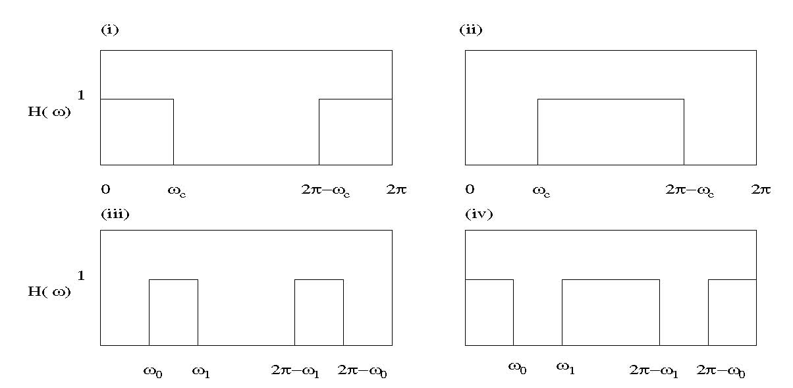
Filter Types

