Slide 1
Seminar 5 Digital Communication and Signal Processing
Ruohan Zhang
Ruohan.Zhang.1@warwick.ac.uk
Department of Computer Science, University of Warwick
19/02/2024

Slide 2
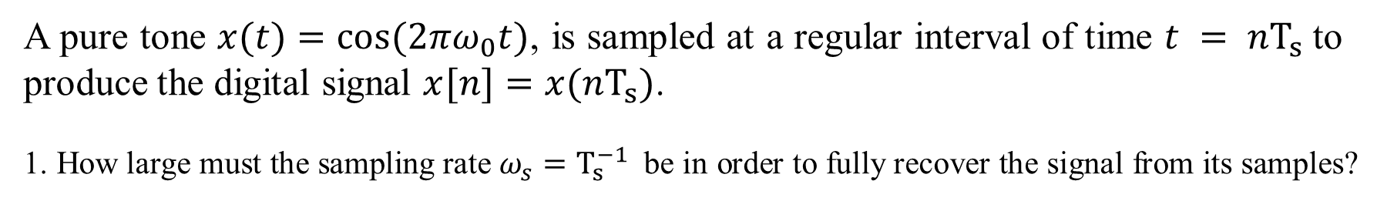
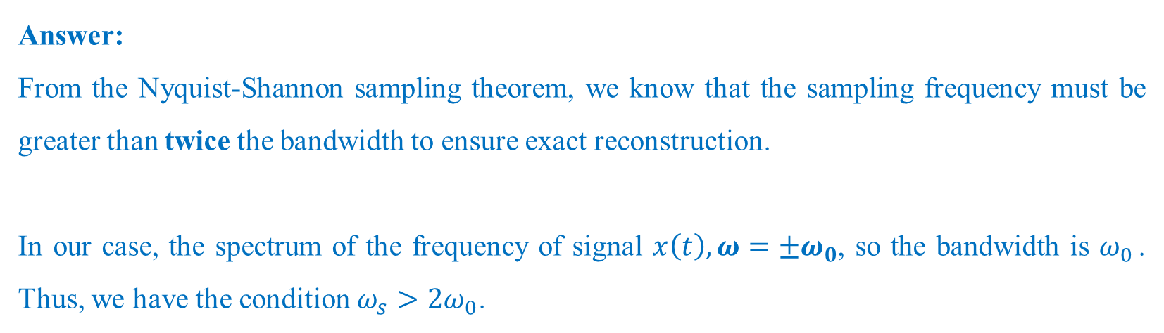
A pure tone $x(t)=cos⁡(2πω_{0}t)$, is sampled at a regular interval of time $t = nT_{s}$to produce the digital signal $x[n]=x(nT_{s})$.
1. How large must the sampling rate $ω_{s}=T_{s}^{−1}$ be in order to fully recover the signal from its samples?
Answer:
From the Nyquist-Shannon sampling theorem, we know that the sampling frequency must be greater than twice the bandwidth to ensure exact reconstruction.
In our case, the spectrum of the frequency of signal $x\left(t\right), ω=±ω_{0}$, so the bandwidth is $ω_{0 }$. Thus, we have the condition $ω_{s}>2ω_{0}$.

Slide 3
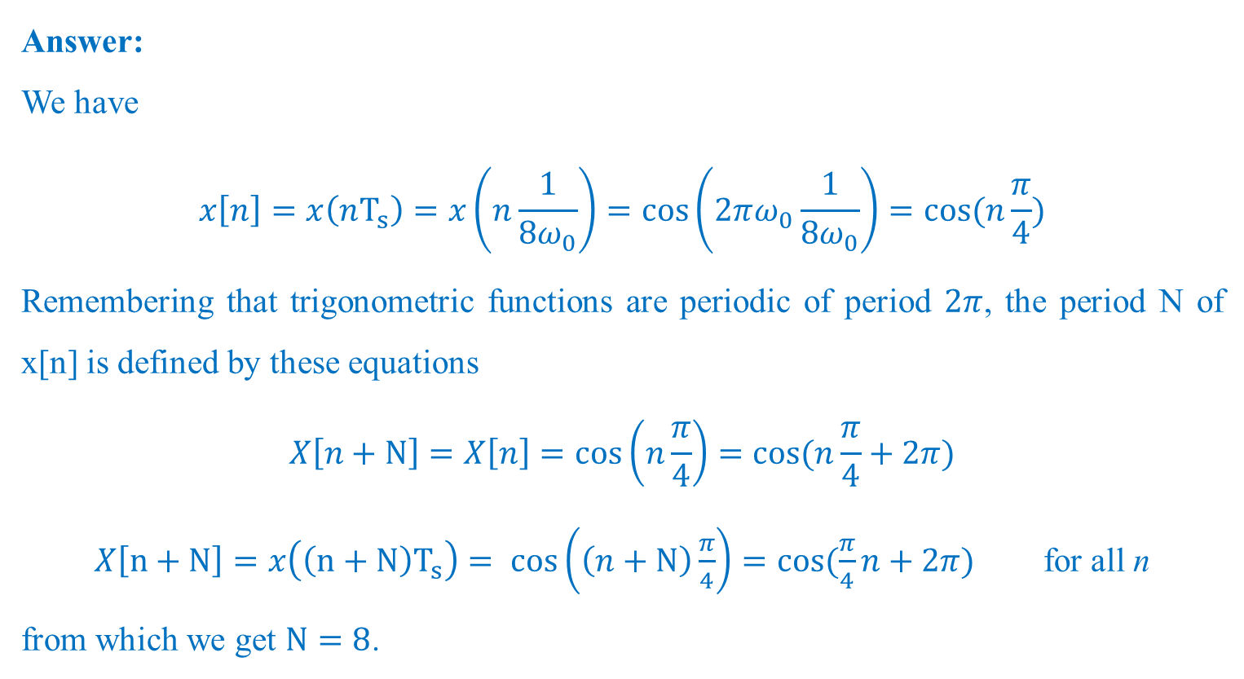
2. Assume $ω_{s}=8ω_{0}$. What is the period of $x[n]$?
Answer:
We have
$$x\left[n\right]=x\left(nT_{s}\right)=x\left(n\frac{1}{8ω_{0}}\right)=\cos\left(2πω_{0}\frac{1}{8ω_{0}}\right)=cos⁡(n\frac{π}{4})$$
Remembering that trigonometric functions are periodic of period $2π$, the period N of x[n] is defined by these equations
$$X\left[n+N\right]=X\left[n\right]=\cos\left(n\frac{π}{4}\right)=cos⁡(n\frac{π}{4}+2π)$$
$X\left[n+N\right]=x\left(\left(n+N\right)T_{s}\right)= cos\left(\left(n+N\right)\frac{π}{4}\right)=cos⁡(\frac{π}{4}n+2π)$ for all n
from which we get $N=8$.

Slide 4
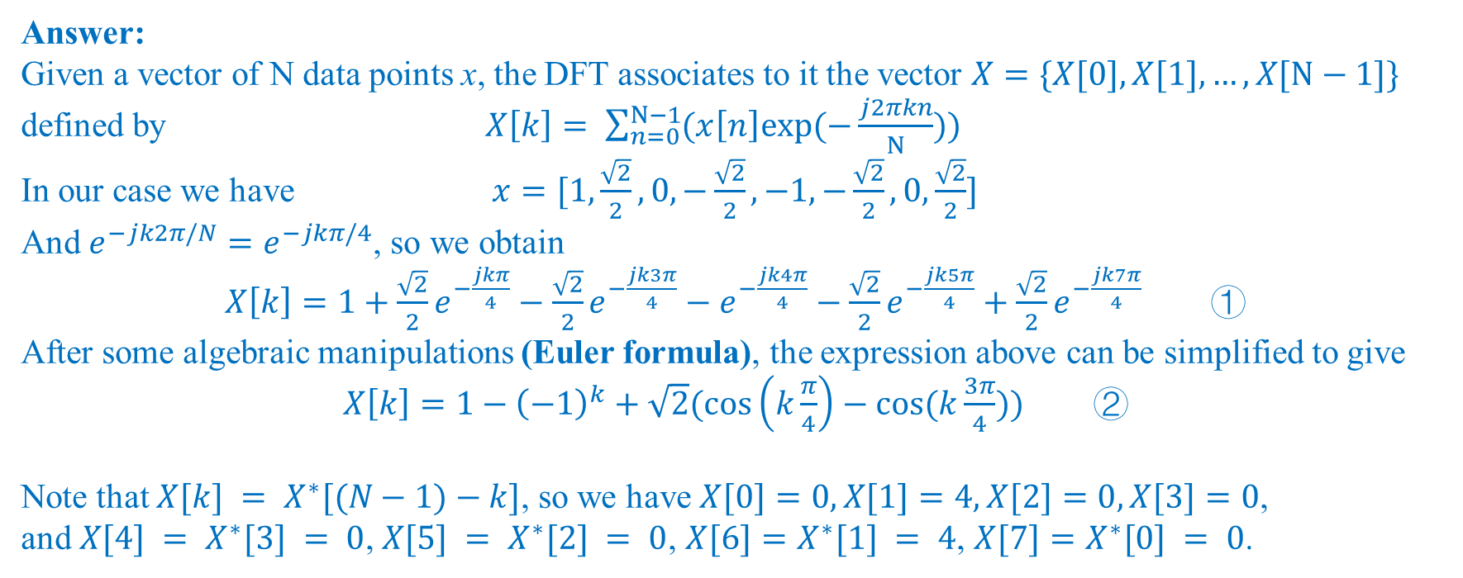
3. Recall the definition of the discrete fourier transform (DFT) of a vector. Calculate the DFT of the vector $x=\{x[0], x[1]…, x[N−1]\}$, where $N$ is the period of $x[n]$.
Answer:
Given a vector of N data points x, the DFT associates to it the vector $X=\{X[0], X[1],…, X[N−1]\}$ defined by $X\left[k\right]= \sum_{n=0}^{N−1}{(x\left[n\right]exp⁡(−\frac{j2πkn}{N}))}$
In our case we have $x=[1,\frac{\sqrt{2}}{2},0,−\frac{\sqrt{2}}{2},−1,−\frac{\sqrt{2}}{2},0,\frac{\sqrt{2}}{2}]$
And $e^{−jk2π/N}=e^{−jkπ/4}$, so we obtain
$X\left[k\right]=1+\frac{\sqrt{2}}{2}e^{−\frac{jkπ}{4}}−\frac{\sqrt{2}}{2}e^{−\frac{jk3π}{4}}−e^{−\frac{jk4π}{4}}−\frac{\sqrt{2}}{2}e^{−\frac{jk5π}{4}}+\frac{\sqrt{2}}{2}e^{−\frac{jk7π}{4}}$ ①
After some algebraic manipulations (Euler formula), the expression above can be simplified to give
$X\left[k\right]=1−{\left(−1\right)}^{k}+\sqrt{2}(\cos\left(k\frac{π}{4}\right)−cos⁡(k\frac{3π}{4}))$ ②
Note that $X[k] = X^{∗}[(N−1)−k]$, so we have $X[0]=0, X[1]=4, X[2]=0, X[3]=0$,
and $X[4] = X^{∗}[3] = 0$, $X[5] = X^{∗}[2] = 0$, $X[6]=X^{∗}[1] = 4$, $X[7]=X^{∗}[0] = 0$.

Slide 5


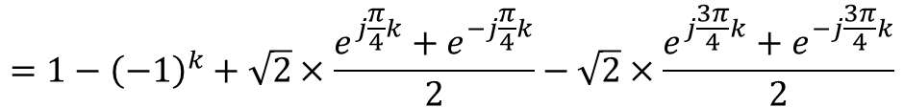
How to transform formula ① to ②?
$$X\left[k\right]= 1+\frac{\sqrt{2}}{2}e^{−j\frac{π}{4}k}−\frac{\sqrt{2}}{2}e^{−j\frac{3π}{4}k}−e^{−j\frac{4π}{4}k}−\frac{\sqrt{2}}{2}e^{−j\frac{5π}{4}k}+\frac{\sqrt{2}}{2}e^{−j\frac{7π}{4}k}$$
$$=1+\frac{\sqrt{2}}{2}e^{−j\frac{π}{4}k}−\frac{\sqrt{2}}{2}e^{−j\frac{3π}{4}k}−e^{−jπk}−\frac{\sqrt{2}}{2}e^{−j2πk}×e^{j\frac{3π}{4}k}+\frac{\sqrt{2}}{2}e^{−j2πk}×e^{j\frac{π}{4}k}$$
$=1−e^{−jπk}+\frac{\sqrt{2}}{2}e^{−j\frac{π}{4}k}$ $+\frac{\sqrt{2}}{2}e^{−j2πk}×e^{j\frac{π}{4}k} −\frac{\sqrt{2}}{2}e^{−j\frac{3π}{4}k}−\frac{\sqrt{2}}{2}e^{−j2πk}×e^{j\frac{3π}{4}k}$
$$=1−{\left(−1\right)}^{k}+\sqrt{2}×\frac{e^{j\frac{π}{4}k}+e^{−j\frac{π}{4}k}}{2}−\sqrt{2}×\frac{e^{j\frac{3π}{4}k}+e^{−j\frac{3π}{4}k}}{2}$$
Euler formula
$$=1−{\left(−1\right)}^{k}+\sqrt{2}cos⁡(\frac{π}{4}k)−\sqrt{2}cos⁡(\frac{3π}{4}k)$$
$$=1−{\left(−1\right)}^{k}+\sqrt{2}(\cos\left(k\frac{π}{4}\right)−cos⁡(k\frac{3π}{4}))$$

Slide 6
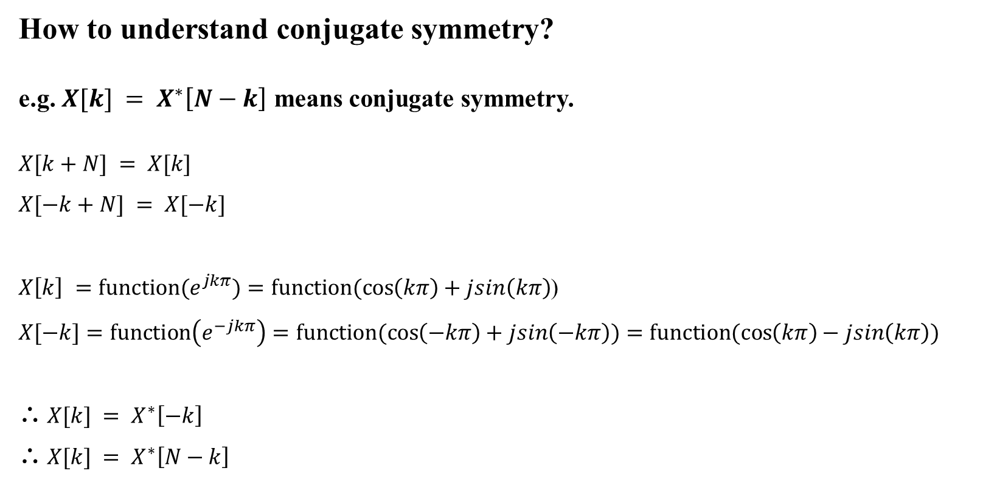
How to understand conjugate symmetry?
e.g. $X[k] = X^{∗}\left[N−k\right]$ means conjugate symmetry.
$$X[k+N] = X[k]$$
$$X[−k+N] = X[−k]$$
${X\left[k\right] =function(e}^{jkπ})=function(\cos\left(kπ\right)+jsin\left(kπ\right)$)
$$X[−k]=function\left(e^{−jkπ}\right)=function(cos\left(−kπ\right)+jsin\left(−kπ\right))=function(\cos\left(kπ\right)−jsin\left(kπ\right))$$
∴ $X[k] = X^{∗}\left[−k\right]$
∴ $X[k] = X^{∗}\left[N−k\right]$

