Slide 1
Seminar 7 Digital Communication and Signal Processing
Ruohan Zhang
Ruohan.Zhang.1@warwick.ac.uk
Department of Computer Science, University of Warwick
29/02/2024

Slide 2
The time domain representation of a second order ARMA filter is given by the difference equation
$Y[n] = a_{0}x[n] +a_{1}x[n−1]+a_{2}x[n−2]+b_{1}y[n−1]+b2 y[n−2]$ (1)
This equation expresses the output sequence $y[n]$ in terms of the input sequence, $x[n]$, and a set of real coefficients $\{a_{m}\}$, and $\{b_{m}\}$. Suppose the input is given by a signal $s(t)$ corrupted by an additive sinusoidal disturbance, that is
$$x\left(t\right)=s(t) +cos(2πF_{0}t)$$
Assume the input is sampled at $Fs=44 kHz$ and that the disturbance frequency is $F0 = Fs/4$.
Your task is to design a second order ARMA filter which stops the disturbance and whose output is a close as possible to the original signal. In order to do this:
First, write down the transfer function of such filter, $H(z)$.
Derive the correspondent time domain representation, that is find the values of the coefficients $\{a_{m}\}$, $\{b_{m}\}$.
Sketch the block diagram representation of the filter.

Slide 3
First, write down the transfer function of such filter, $H(z)$.
First, let us calculate the digital frequency of the disturbance. We have $ω_{0}=2π\left(\frac{F_{0}}{F_{s}}\right)=\frac{π}{2}$. Recall that the general transfer function of a second order filter can be written as
$$Η\left(z\right)=Κ\frac{\left(z−z_{1}\right)\left(z−z_{2}\right)}{\left(z−p_{1}\right)\left(z−p_{2}\right)}$$
Because we want to stop the disturbance, we must have $H(e^{±jω_{0}})=$0. This can be achieved by placing the two zeros at ${z_{1}=e}^{jω_{0}}=j and {z_{2}=e}^{−jω_{0}}=−j$.
We then have to choose the location of the poles and the gain $K$. The best choice for the poles is to place them close to the zeros (but within the unit circle for stability).
For instance, we can choose $p_{1}=ρe^{jω_{0}}=ρj$, $p_{2}=ρe^{−jω_{0}}=−ρj$, with $ρ≈1$ but smaller than 1. We then obtain
$$Η\left(z\right)=Κ\frac{z^{2}+1}{z^{2}+ρ^{2}}$$
The value of the gain can be determined by requiring that ${\left.H(z)\right|}_{z=1}=1$, which gives $K=\frac{1+ρ^{2}}{2}$. So we finally obtain
$Η\left(z\right)=\frac{1+ρ^{2}}{2}\frac{z^{2}+1}{z^{2}+ρ^{2}}$ (2)

Slide 4
Derive the correspondent time domain representation, that is find the values of the coefficients $\{a_{m}\}$, $\{b_{m}\}$.
By multiplying the factors in Eq. (2), we get
$Η\left(z\right)=Κ\frac{z^{2}−\left(z_{1}+z_{2}\right)z+z_{1}z_{2}}{z^{2}−\left(p_{1}+p_{2}\right)z+p_{1}p_{2}}$ $=\frac{Κ−Κ\left(z_{1}+z_{2}\right)z^{−1}+Κz_{1}z_{2}z^{−2}}{1−\left(p_{1}+p_{2}\right)z^{−1}+p_{1}p_{2}z^{−2}}$ (3)
On the other hand, by z-transforming Eq. (1), we get
$Η\left(z\right)=\frac{a_{0}+a_{1}z^{−1}+a_{2}z^{−2}}{1−b_{1}z^{−1}−b_{2}z^{−2}}$ (4)
Thus, by comparing Eq. (3) and (4), we get $a_{0}=K$, $a_{1}=−K(z_{1}+z_{2})$, $a_{2}=Kz_{1}z_{2}$, and $b_{1}=p_{1}+p_{2}$, $b_{2}={−p}_{1}p_{2}$. In our case that gives $a_{0}=\frac{1+ρ^{2}}{2}$, $a_{1}=0$, $a_{2}=\frac{1+ρ^{2}}{2}$, and $b_{1}=0$, $b_{2}=−ρ^{2}$, so
$$y\left[n\right]=\frac{1+ρ^{2}}{2}\left(x\left[n\right]+x\left[n−2\right]\right)+\left(−ρ^{2}\right)y\left[n−2\right]$$

Slide 5
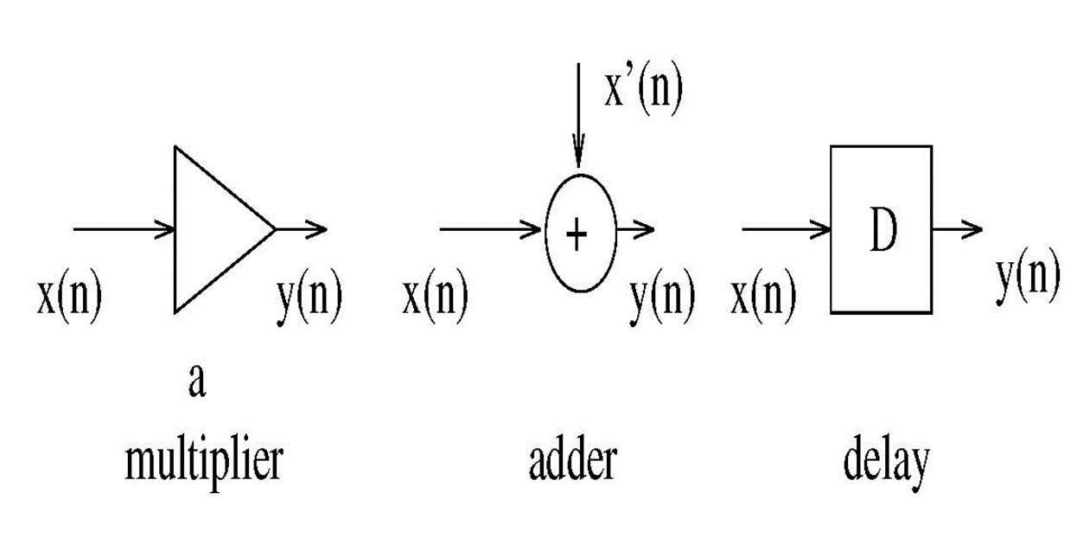
Sketch the block diagram representation of the filter.
Key points:

Slide 6
$$y\left[n\right]=\frac{1+ρ^{2}}{2}\left(x\left[n\right]+x\left[n−2\right]\right)+\left(−ρ^{2}\right)y\left[n−2\right]$$
$$χ\left[n\right]$$
$$\left(1+ρ^{2}\right)/2$$
$$\left(1+ρ^{2}\right)/2$$
$$y\left[n\right]$$
+
D
D
+
$$−ρ^{2}$$

Slide 7
How to implement the filter using Matlab?
Think about this question and finish the similar question of assignment.

