Slide 1
Seminar 8 Digital Communication and Signal Processing
Ruohan Zhang
Ruohan.Zhang.1@warwick.ac.uk
Department of Computer Science, University of Warwick
04/03/2024

Slide 2
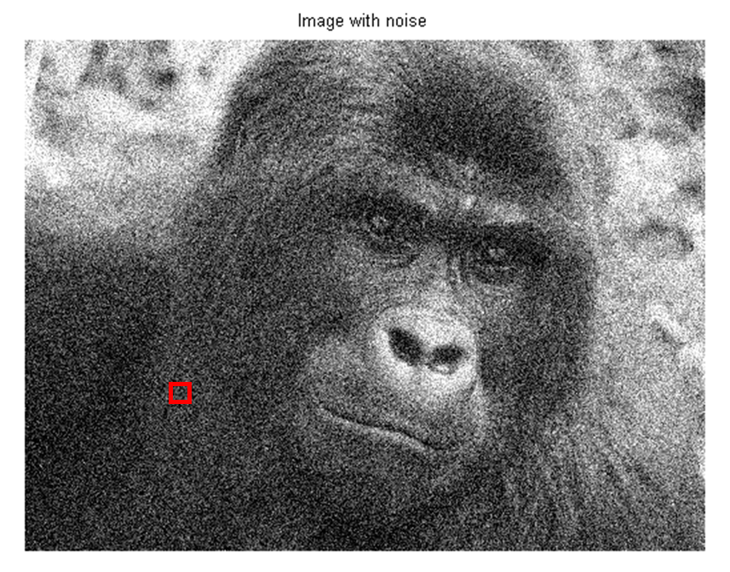
$$x\left(1,1\right)=10.3 x\left(1,2\right)=10.2 x\left(1,3\right)=10.1$$
$$x\left(2,1\right)=10.2 x\left(2,2\right)=10.3 x\left(2,3\right)=10.1$$
$$x\left(3,1\right)=10.1 x\left(3,2\right)=10.2 x\left(3,3\right)=10.3$$
Assume we have a grayscale image above, and the table denote the small region intensity. If we know that the image has been degraded by a constant power noise of 0.025, and the denote the grayscale at position $(i, j)$ by $x(i, j)$, then
(1) Design a Wiener filter to clean the image.
(2) Find the grayscale value at position $(2,2)$ after applying a 3 by 3 Wiener filter.
(3) Use wiener2 in Matlab to experiment how $N$ and $M$ affect the final outcome, where $N × M$ is the local square area we used to estimate the local mean and variance.

Slide 3
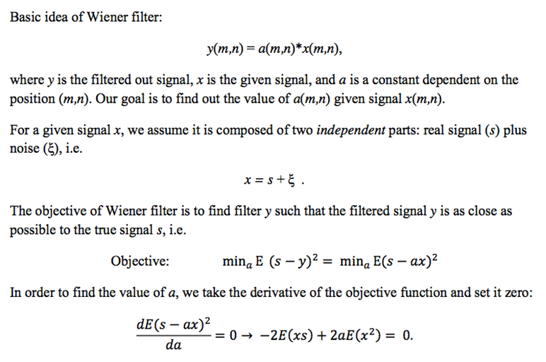
Design a Wiener filter to clean the image.

Slide 4
$(E\left(ξ^{2}\right)=0.025)$, then problem is how to get $E\left(x^{2}\right).$

Slide 5
$$E\left(x\right)=\left[x\left(1,1\right)+x\left(1,2\right)+x\left(1,3\right)+x\left(2,1\right)+x\left(2,2\right)+x\left(2,3\right)+x\left(3,1\right)+x\left(3,2\right)+x\left(3,3\right)\right]/9=10.2$$
$$E\left(ξ^{2}\right)=0.025$$
$$var\left(x\right)=\frac{1}{9}\sum_{i,j=1,2,3}{{(x\left(i,j\right)−E(x))}^{2}=\frac{1}{150}}$$
$$y=10.2+\left(1−\frac{0.025}{1/{150}}\right)\left(x−10.2\right)=10.2−2.75(x−10.2)$$

Slide 6
Find the grayscale value at position (2,2) after applying a 3 by 3 Wiener filter.
$$y\left(2,2\right)=10.2−2.75\left(x\left(2,2\right)−10.2\right)$$
$$=10.2−2.75\left(10.3−10.2\right)$$
$$=9.925$$

Slide 7
Use wiener2 from Matlab to experiment how $N$ and $M$ affect the final outcome, where $N × M$ is the local square area we used to estimate the local mean and variance.
Remove the noise using the wiener2 function.
K = wiener2(J,[3 3]);
% J is the input image with added Gaussian Noise
% [3 3] is the Neighborhood size, specified as a 2-element vector [m n] where m is the number of rows and n is the number of columns.
Large M and N reduce noise, but blur the photo.
Small M and N will not affect noise.
Optimal window size should be used.
How to seek the optimal neighbourhood size is worth thinking about.

