Slide 1
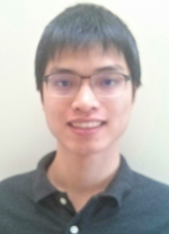
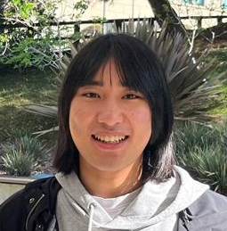
Bounded Relativization
Shuichi Hirahara
National Institute of Informatics
Zhenjian Lu
University of Oxford $→$
University of Warwick
Hanlin Ren
University of Oxford
Nov 23, 2023
Complexity Meetings
0 / 26

Slide 2
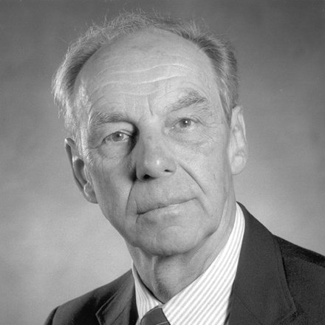
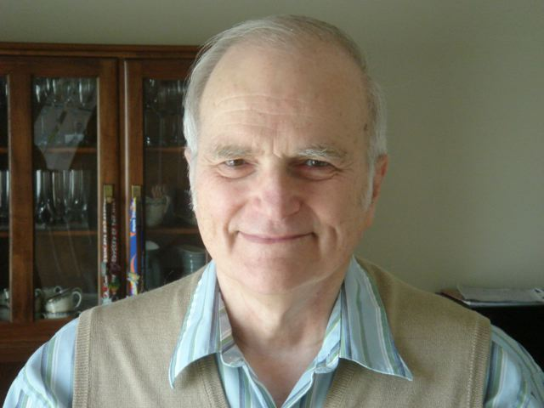
In the beginning…
God said, “Let there be time.”
J. Hartmanis and R. E. Stearns. On the computational complexity of algorithms.
Time Hierarchy Thm
If $T=o\left(\sqrt{U}\right)$, then $TIME\left[U\right]⊈TIME\left[T\right]$.
1 / 26

Slide 3
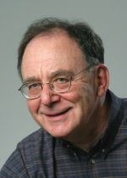
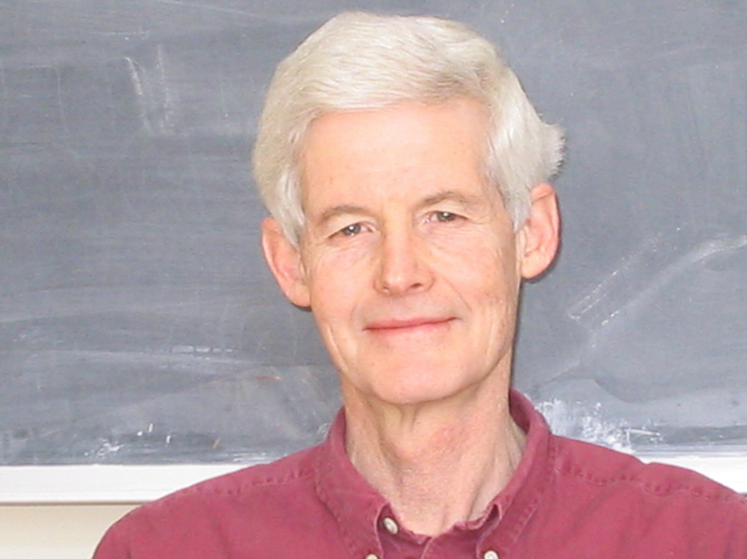
In the beginning…
And God said, “Let there be $NP$.”
$$SAT$$
Poly-time languages
Stephen A. Cook. The Complexity of Theorem-Proving Procedures.
Does $P=NP$?
Richard M. Karp. Reducibility among Combinatorial Problems.
2 / 26

Slide 4
How not to solve $P$ vs $NP$
The relativization barrier (Baker-Gill-Solovay)
Complexity classes with oracles
$P^{A}$: poly-time with $A$ oracle
${NP}^{A}$: nondeterministic poly-time with $A$ oracle
Relativizing techniques cannot resolve $P$ vs $NP$
$∃A$, $P^{A}={NP}^{A}$
$∃B,P^{B}≠{NP}^{B}$
Conclusion: any proof of $P≠NP$ (or $P=NP$) had better not separate $P^{A}$ from ${NP}^{A}$ (or collapse ${NP}^{B}$ to $P^{B}$)!
Previous* separations are “relativizing”
Simulation / diagonalization techniques
Time hierarchy theorem, $P^{O}≠{EXP}^{O}$ for every oracle $O$
*Before Baker-Gill-Solovay (1975)
3 / 26

Slide 5
Not only $P$ vs $NP$…
Relativization also pinpoints the exact place that we’re stuck!
${ZPEXP}^{NP}⊈BPP$ (easy)
${ZPP}^{NP}⊈SIZE\left[n^{2}\right]$ (known)
$NTIME\left[n^{\log{n}}\right]⊈NP$ (known)
Almost-everywhere $NTIME$ hierarchy?
${EXP}^{NP}=BPP$?
$P^{NP}⊆SIZE[n^{2}]$?
Buhrman-Torenvliet: ${EXP}^{{NP}^{O}}={BPP}^{O}$ for some $O$
Wilson: $P^{{NP}^{O}}⊆SIZE{\left[n^{2}\right]}^{O}$ for some $O$
Buhrman-Fortnow-Santhanam: ${NEXP}^{O}⊆io.{NP}^{O}$ for some $O$
4 / 26

Slide 6
Debates Around Oracles
Oracles are great!
They tell you limits of a broad family of techniques, saving your time from trying something that’s doomed to fail
They pinpoint the exact place that we’ll be stuck
Oracles are not good ☹
Anything that’s not obviously false (?) is true under some oracles
Do they provide any insight about non-relativizing classes at all???
$P^{A}={NP}^{A}$ and $P^{B}≠{NP}^{B}$. So what about $P$ vs $NP$?
5 / 26

Slide 7
$$IP=PSPACE$$
Fortnow-Sipser: ${coNP}^{O}⊈{IP}^{O}$ for some $O$
Lund-Fortnow-Karloff-Nisan, Shamir: $IP=PSPACE$!!!
The first “truly compelling” examples of theorems that doesn’t relativize
—— Eric Allender’90
The proof is non-relativizing!
It uses the following non-relativizing fact:
“Arithmetization”: every computation extends to a low-degree polynomial.
6 / 26

Slide 8
Non-relativizing techniques are everywhere…
Algorithmic method for proving lower bounds
$NP$-hardness of ${MCSP}^{∗}$
Anyway, oracle results are not relevant nowadays.
…?
PCP theorem
$$MIP=NEXP$$
$$IP=PSPACE$$
Uniform derandomization
Karp-Lipton theorems for $MA$
Pseudodeterministic constructions
Circuit lower bounds for ${BPP}^{MCSP}$
Circuit lower bounds for $MA$
7 / 26

Slide 9
Algebrization
The algebrization barrier (Aaronson-Wigderson):
Oracles $O$ and their algebraic extensions $\tilde{O}$
${PSPACE}^{O}⊆{IP}^{\tilde{O}}$ for every $O$
But, $∃A, {NP}^{\tilde{A}}⊆P^{A}$ and $∃B,{NP}^{B}⊈P^{\tilde{B}}$
One needs non-algebrizing techniques to resolve $P$ vs $NP$…
$IP=PSPACE$ is non-relativizing!
It uses the following non-relativizing fact:
“Arithmetization”: every computation extends to a low-degree polynomial.
8 / 26

Slide 10
Debates Around Algebrization
Algebrization is great!
Captures “relativization + interactive proofs” reasonably well
Explains the difficulty of resolving major open problems such as $NEXP$ vs $P/_{poly}$
Algebrization is subtle ☹
Conceptually difficult to reason about, for slightly complicated statements…
Many different versions of algebrization, each with its own pros and cons
Does ${MIP}^{∗}=RE$ algebrize?
9 / 26

Slide 11
This work
One step back: are oracle results truly useless?
Not really, if you also consider the complexity of the oracle itself!
Observation: For every oracle $O∈PSPACE$, ${IP}^{O}={PSPACE}^{O}$.
Proof
Since $IP⊆PSPACE$ is relativizing, we have ${IP}^{O}⊆{PSPACE}^{O}$.
On the other hand, since $O∈PSPACE$, we have ${PSPACE}^{O}=PSPACE=IP⊆{IP}^{O}$.
10 / 26

Slide 12
Bounded Relativization
For a complexity class $𝕮$, a statement is $𝕮$-relativizing if it is true relative to every $O∈𝕮$
$IP=PSPACE$ is $PSPACE$-relativizing
${MIP}^{∗}=RE$ is $R$- (i.e., computable-)relativizing
This captures a bunch of results proven by “relativizing techniques + interactive proofs”!
Proof in IW01: Suppose XXX. We show YYY. Hence ZZZ. Since $IP=PSPACE$, it follows that VVV and UUU holds. Hence the theorem is true.
$$EXP≠BPP$$
(uniform lb)
Impagliazzo-Wigderson’01
$$BPP⊆io.heurSUBEXP$$
(avg-case derand)
11 / 26

Slide 13
Bounded Relativization
For a complexity class $𝕮$, a statement is $𝕮$-relativizing if it is true relative to every $O∈𝕮$
$IP=PSPACE$ is $PSPACE$-relativizing
${MIP}^{∗}=RE$ is $R$- (i.e., computable-)relativizing
This captures a bunch of results proven by “relativizing techniques + interactive proofs”!
Proof in IW01: Suppose ${\text{XXX}}^{O}$. We show ${\text{YYY}}^{O}$. Hence ${\text{ZZZ}}^{O}$. Since ${IP}^{O}={PSPACE}^{O}$, it follows that ${\text{VVV}}^{O}$and ${\text{UUU}}^{O}$holds. Hence the theorem is $PSPACE$-relativizing.
$${EXP}^{O}≠{BPP}^{O}$$
(uniform lb)
IW01 is $PSPACE$-relativizing
(by simply replacing $IP=PSPACE$ with ${IP}^{O}={PSPACE}^{O}$ everywhere)
$${BPP}^{O}⊆io.heur{SUBEXP}^{O}$$
(avg-case derand)
11 / 26

Slide 14
Bounded Relativization
Suppose there is an oracle $O$ relative to which a statement $𝒮$ is false.
If the oracle $O$ is in $PSPACE$, it provides more information!
(You cannot prove $𝒮$ by combining $IP=PSPACE$ with relativizing techniques in a “black-box” way.)
Well, it may still be possible to prove $𝒮$ using arithmetization.
A classical, Baker-Gill-Solovay style relativization barrier for arithmetization / interactive proof techniques!
Simple Example
$P^{O}={NP}^{O}$ for some $O∈PSPACE$.
This means: $PSPACE$-relativizing techniques cannot separate $P$ from $NP$…
12 / 26

Slide 15
Bounded Relativization
In many cases (in fact all three cases $→$), we only get oracles in $EXPH\left(=EXP^{PH}\right)$!
Buhrman-Torenvliet: ${EXP}^{{NP}^{O}}={BPP}^{O}$ for some $O$
Wilson: $P^{{NP}^{O}}⊆SIZE{\left[n^{2}\right]}^{O}$ for some $O$
Suppose there is an oracle $O∈EXPH$ relative to which a statement $𝒮$ is false.
Buhrman-Fortnow-Santhanam: ${NEXP}^{O}⊆io.{NP}^{O}$ for some $O$
If one can use $PSPACE$-relativizing techniques to prove $𝒮$, then one can also separate $PSPACE$ from $EXPH$.
This is because $𝒮$ is true relative to every oracle $O∈PSPACE$, but is false relative to some $O∈EXPH$.
This is no easier than proving $NP≠L$…
Suppose “our current techniques” are $PSPACE$-relativizing and cannot separate $PSPACE$ from $EXPH$. Then “our current techniques” cannot prove $𝒮$!!
13 / 26

Slide 16
Let’s look at a working example!

Slide 17
Example: Pseudodeterministic Constructions
Some theorem about “pseudodeterministic constructions” [Oliveira-Santhanam 17]
Relativization:
There is an oracle $O$ relative to which the “slight improvement” is false.
[OS17] is already non-relativizing anyway…
Proof: Combine $IP=PSPACE$ and some relativizing arguments.
Algebrization:
There is a low-degree oracle $O$ relative to which the “slight improvement” is false.
Seems hard to prove the required “algebraic query complexity” lower bounds?
A “slight improvement of [OS17]”: a testbed for barrier results?
Bounded Relativization:
There is an oracle $O∈EXPH$ relative to which the “slight improvement” is false.
If what you do is just “combining $IP=PSPACE$ and relativizing techniques”, then you cannot prove the “slight improvement of [OS17]”!
(without separating $L$ from $NP$)
14 / 26

Slide 18
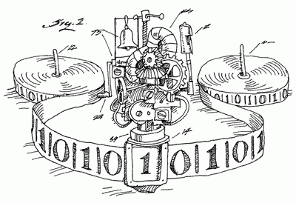
Pseudodeterministic Constructions 101
Definition: A randomized algorithm for a search problem is “pseudodeterministic” [Gat-Goldwasser 11], if it outputs the same canonical solution on most computational paths.
$$p_{1}$$
$$p_{1}$$
❌
$$p_{2}$$
$$p_{1}$$
$$p_{1}$$
$$\left|L∩{\left\{0,1\right\}}^{n}\right|≥2^{n}/poly\left(n\right)$$
Search-$L$
Given: a dense language $L∈P$
Input: a unary string of length $n$
Output: any string $x∈L∩{\left\{0,1\right\}}^{n}$
Repeat
$x←{\left\{0,1\right\}}^{n}$ randomly
Until $x∈L$
Output $x$
Runs in expected $poly\left(n\right)$ time due to $L$ being dense.
NOT pseudodeterministic!
The output highly depends on the internal randomness…
Theorem (Oliveira-Santhanam 17): Let $L$ be any dense language in $P$, then there is a pseudodeterministic subexp-time algorithm for finding strings in $L$ infinitely often.
15 / 26

Slide 19
A “Slight Improvement of OS17”?
Theorem (Oliveira-Santhanam 17): Let $L$ be any dense language in $P$, then there is a pseudodeterministic subexp-time algorithm for finding strings in $L$ infinitely often.
“Slight Improvement of [OS17]”: Can we obtain pseudodeterministic constructions on almost every $n$?
Our result:
There is an oracle $O∈EXPH$ and a dense language $L∈P^{O}$ such that any almost-everywhere pseudodeterministic construction for $L$ requires $2^{Ω\left(n\right)}$ time.
Not using $EXPH$-relativizing techniques!
Proof Outline
Direct reduction to a query complexity lower bound [GIPS21]
The oracle is trivially in $EXPH$!
Thus, also not using $PSPACE$-relativizing techniques unless you separate $L$ from $NP$…
Bounded relativization for free!
16 / 26

Slide 20
The Query Complexity Lower Bound
$$FIND1$$
Input: a string $x∈{\left\{0,1\right\}}^{N}$ with the promise that half of the bits in $x$ are one
Output: any index $i$ such that $x_{i}=1$.
Theorem (GIPS21): The pseudodeterministic query complexity of $FIND1$ is $Ω\left(\sqrt{N}\right)$.
Any pseudodeterministic oracle algorithm for finding a canonical $x∈O∩{\left\{0,1\right\}}^{n}$ needs $Ω\left(2^{n/2}\right)$ time!
GIPS21: I need $Ω\left(\sqrt{N}\right)$ queries to find a canonical 1 in this string, even with randomness!
Truth table of an oracle $$O:{\left\{0,1\right\}}^{\log{N}}→\left\{0,1\right\}$$
Input string $x∈{\left\{0,1\right\}}^{N}$
01101001111…0010110111
17 / 26

Slide 21
The Oracle Separation
Goal: dense oracle $O$ such that every pseudodeterministic construction for $O$ (itself) requires $2^{Ω\left(n\right)}$ time
For $i←1$ to $∞$ do //diagonalize against $M_{i}$, the $i$-th machine
$N_{i}←$some large enough input length where $M_{i}$ fails
Treat $O∩{\left\{0,1\right\}}^{N_{i}}$ as an input of $FIND1$ and $M_{i}$ as the query algorithm, there is an assignment of $O∩{\left\{0,1\right\}}^{N_{i}}$ such that $M_{i}$ is not a good pseudodeterministic algorithm on input length $N_{i}$
This means that either $M_{i}$ is not pseudodeterministic, or the (canonical) output of $M_{i}$ is not in $O$
Complexity of $O$
Given a pseudodeterministic algorithm $M_{i}$ (and previously fixed portions of the oracle before input length $N_{i}$), one can trivially compute the lexicographically smallest counter-example of $M_{i}$ in polynomial hierarchy.
Hence, $O∈EXPH$.
18 / 26

Slide 22
I’m enough of barrier results.
Okay, let’s prove some actual lower bounds by bounded relativization!

Slide 23
A Near-Maximum Circuit Lower Bound
Theorem: ${BPE}^{MCSP}/_{2^{0.01n}} ⊈SIZE\left[2^{n}/n\right]$.
That is, there is a language $L$ computable in probabilistic $2^{O\left(n\right)}$ time with $MCSP$ oracle and $2^{0.01n}$ bits of advice, but has near-maximum ($2^{n}/n$) circuit complexity.
What is previously known:
${ZPE}^{MCSP}⊈P/_{poly}$ (IKV18)
This is only a super-poly lower bound, not a near-maximum one!
$E/_{2^{n}} ⊈SIZE\left[2^{n}/n\right]$
Trivial, but needs $2^{n}$ bits of advice… (We only need $2^{0.01n}$)
$E^{Σ_{2}P}⊈SIZE\left[2^{n}/n\right]$ (Kannan82, MVW99)
Sounds “one level higher” than ${BPE}^{MCSP}$ (?)
$MCSP$: minimum circuit size problem
Input: the length-$2^{n}$ truth table of a Boolean function $f:{\left\{0,1\right\}}^{n}→\left\{0,1\right\}$
Output: the circuit complexity of $f$
19 / 26

Slide 24
The LOS PRG
Lu-Oliveira-Santhanam (STOC’21) (henceforth LOS):
Theorem: There is, unconditionally, a PRG
$$G:{\left\{0,1\right\}}^{n^{0.001}}→{\left\{0,1\right\}}^{n},$$
computable in pseudodeterministic $poly\left(n\right)$ time with $1$ bit of advice, that fools every uniform probabilistic $n^{10}$-time machine.
Pseudorandom generators
For every $n^{10}$-time machine $M$, there are infinitely many $n$ such that
$$\left|\underset{x}{Pr}\left[M\left(x\right)=1\right]−\underset{seed}{Pr}\left[M\left(G\left(seed\right)\right)=1\right]\right|<0.1$$
Pseudodeterministic algorithms
Randomized algorithms that output a fixed string with high probability
Although $G$ needs randomness to compute, each $G\left(x\right)$ is a fixed, well-defined string!
20 / 26

Slide 25
LOS is $PSPACE$-Relativizing
And $MCSP∈PSPACE$:
Theorem: There is, unconditionally, a PRG
$$G:{\left\{0,1\right\}}^{n^{0.001}}→{\left\{0,1\right\}}^{n},$$
computable in pseudodeterministic $poly\left(n\right)$ time with $1$ bit of advice, that fools every uniform probabilistic $n^{10}$-time machine.
Theorem: There is, unconditionally, a PRG
$$G:{\left\{0,1\right\}}^{n^{0.001}}→{\left\{0,1\right\}}^{n},$$
computable in pseudodeterministic $poly\left(n\right)$ time with $MCSP$ oracle and $1$ bit of advice, that fools every uniform probabilistic $n^{10}$-time machine with $MCSP$ oracle.
Let $M$ be the machine that gets a truth table $f$ as input, and outputs whether $\left(f,2^{n}/n\right)∈MCSP$.
$$\left|\underset{x}{Pr}\left[M\left(x\right)=1\right]−\underset{seed}{Pr}\left[M\left(G\left(seed\right)\right)=1\right]\right|<0.1$$
Our hard function
Advice: $z∈{\left\{0,1\right\}}^{2^{0.001n}}$ such that $G\left(z\right)∈{\left\{0,1\right\}}^{2^{n}}$ requires $2^{n}/n$ circuit complexity
On input $i$, output the $i$-th bit of $G\left(z\right)$.
21 / 26

Slide 26
Finally, I want to discuss an open problem…
At the intersection of:
Pseudodeterministic constructions?
Circuit lower bounds?
… and how to overcome the bounded-relativization barrier?

Slide 27
An Open Problem
Theorem (CLORS’23)
Let $L∈P$ be a dense property. Then there is a pseudodeterministic poly-time algorithm for finding strings in $L$ infinitely often.
Question: is the result statement $PSPACE$-relativizing?
Improving the subexponential-time algorithm of OS17.
That is, are there pseudodeterministic infinitely-often constructions in ${BPP}^{L}$ for every dense $L∈PSPACE$?
The proof is not $PSPACE$-relativizing! (next slide)
Motivation: If the CLORS result is $PSPACE$-relativizing (even just $NP$-relativizing), then ${BPE}^{MCSP}/_{1}⊈SIZE\left[2^{n}/n\right]$ (vastly improving the previous lower bound).
22 / 26

Slide 28
The GKR Protocol
$$T≫d$$
Theorem (Goldwasser-Kalai-Rothblum)
Let $f$ be computable by a uniform low-depth circuit (depth-$d$ width-$T$). There is an interactive protocol for proving the value of $f\left(x\right)$, with verifier* time $≈d$ and prover time $≈T$.
(Uniform) circuit of depth $d$ and width $T$
that computes a function $f:{\left\{0,1\right\}}^{n}→\left\{0,1\right\}$
$$d$$
*: verifier needs access to a low-degree extension of $x$.
Scaled-down
$IP=PSPACE$ (LFKN & Shamir)
Let $f∈PSPACE$ (uniform poly-depth exp-size circuits). There is an interactive protocol for proving the value of $f\left(x\right)$, with verifier time $poly\left(n\right)$ and prover time $\exp\left(n\right)$.
The PCP Theorem
$$∧$$
Scaled-down
$$∨$$
$$∨$$
$$MIP=NEXP$$
23 / 26

Slide 29
Using the full spectrum of GKR
Theorem (Goldwasser-Kalai-Rothblum)
Let $f$ be computable by a uniform low-depth circuit (depth-$d$ width-$T$). There is an interactive protocol for proving the value of $f\left(x\right)$, with verifier* time $≈d$ and prover time $≈T$.
The GKR Protocol
$$T=poly\left(d\right)$$
$$…$$
$$T=exp\left(d\right)$$
$IP=PSPACE$!
$$T≫d$$
While OS17 only uses the low-end GKR (i.e., $IP=PSPACE$), CLORS23 needs to use GKR for every setting of $d$ and $T$!
From $T≈\exp\left(d\right)$ all the way down to $T≈poly\left(d\right)$
(Uniform) circuit of depth $d$ and width $T$, with fanin-$d$ oracle access to $O∈PSPACE$,
that computes a function $f:{\left\{0,1\right\}}^{n}→\left\{0,1\right\}$
$$d$$
$$O_{d}$$
$$O_{d}$$
Q: What happens when we relativize OS17 & CLORS23 with an oracle $O∈PSPACE$?
$$O_{d}$$
24 / 26

Slide 30
Using the full spectrum of GKR
Theorem (Goldwasser-Kalai-Rothblum)
Let $f$ be computable by a uniform low-depth circuit (depth-$d$ width-$T$). There is an interactive protocol for proving the value of $f\left(x\right)$, with verifier* time $≈d$ and prover time $≈T$.
The GKR Protocol
$$T=poly\left(d\right)$$
$$…$$
$$T=exp\left(d\right)$$
$IP=PSPACE$!
$$T≫d$$
While OS17 only uses the low-end GKR (i.e., $IP=PSPACE$), CLORS23 needs to use GKR for every setting of $d$ and $T$!
From $T≈\exp\left(d\right)$ all the way down to $T≈poly\left(d\right)$
(Uniform) circuit of depth $d$ and width $T⋅\exp\left(d\right)$ (without further oracles),
that computes a function $f:{\left\{0,1\right\}}^{n}→\left\{0,1\right\}$
$$d$$
Width-$\exp\left(d\right)$
Width-$\exp\left(d\right)$
Width-$\exp\left(d\right)$
The low-depth function only has an interactive proof of prover time $T⋅\exp\left(d\right)$, which is comparable to $T$ only when $T≈\exp\left(d\right)$ (i.e., in the regime of $IP=PSPACE$)!
24 / 26

Slide 31
Back to the Open Problem
Somehow, by considering “scaled-down” versions of interactive proofs (GKR protocol instead of $IP=PSPACE$), it seems possible to overcome the $PSPACE$-relativization barrier…
Question: is the statement of CLORS $PSPACE$-relativizing?
If CLORS’23 is $PSPACE$-relativizing:
Strong circuit lower bounds for ${BPE}^{MCSP}/_{1}$!
That is, are there pseudodeterministic infinitely-often constructions in ${BPP}^{L}$ for every dense $L∈PSPACE$?
If CLORS’23 is not $PSPACE$-relativizing:
You can overcome the $PSPACE$-relativization barrier simply by considering the “full spectrum” of GKR protocol!
Question’:
${BPE}^{MCSP}/_{1}⊈SIZE\left[2^{n}/n\right]$?
25 / 26

Slide 32
Summary
$IP=PSPACE$ is true relative to every oracle $O∈PSPACE$, hence is “$PSPACE$-relativizing”.
On the other hand, if some statement $𝒮$ is false relative to some oracle in $EXPH$, then proving $𝒮$ using $PSPACE$-relativizing techniques would require proving breakthroughs ($L≠NP$)!
Many interesting theorems are $PSPACE$-relativizing
Negative results: Barrier oracles in $EXPH$!
Improving OS17 to almost-everywhere constructions
More in the paper…
Many interesting oracles are in $EXPH$
Open Problem: Is [CLORS23] $PSPACE$-relativizing? Can we prove near-maximum circuit lower bounds for ${BPE}^{MCSP}/_{1}$?
Positive results: near-max circuit lower bounds for ${BPE}^{MCSP}/_{2^{0.01n}}$!
By $PSPACE$-relativizing the LOS PRG
Takeaway message: Oracle results are still meaningful, if you consider the complexity of the oracles!
Thank you!
Questions are welcome! ☺
26 / 26

