Slide 1
Recent Progress on Derandomizing Space-Bounded Computation (Survey)
November 17, 2022
University of Warwick Complexity Meetings
William Hoza
Simons Institute for the Theory of Computing
University of California, Berkeley

Slide 2
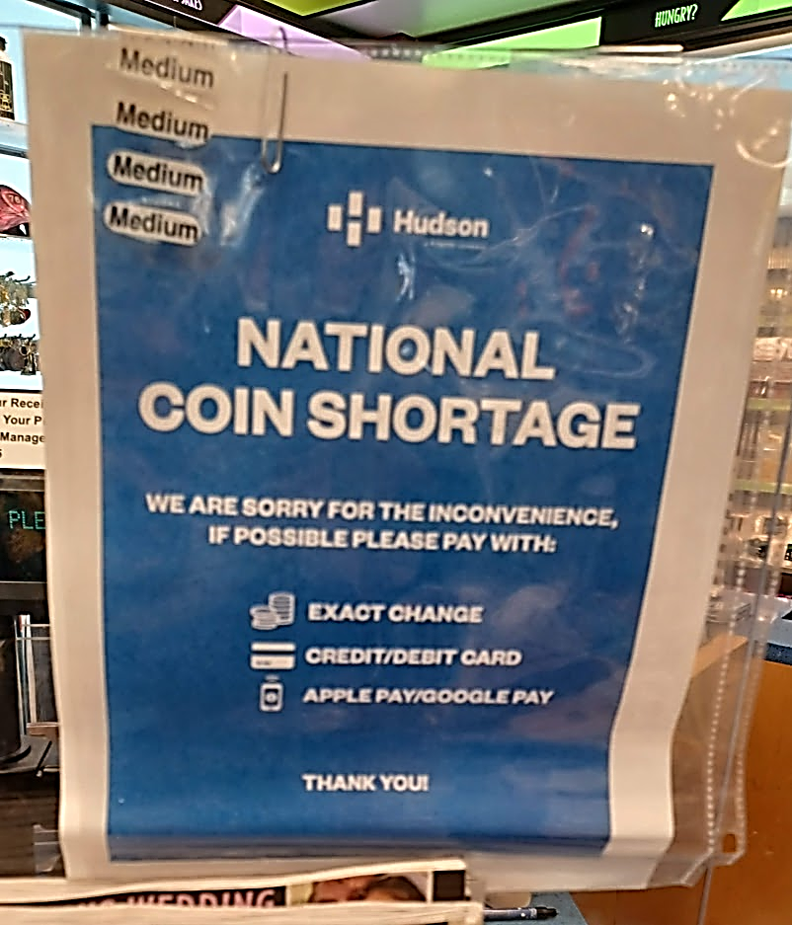
Coins are costly
Randomness is an expensive computational resource
Like time or space
Using less randomness is better than using more randomness

Slide 3
😢
🙂
😄
No known efficient algorithm
Efficient randomized algorithm
Efficient deterministic algorithm

Slide 4
Power of randomness?
$\text{BPSPACE}\left(S\right)=\{\text{languages} \text{that} \text{can} \text{be} \text{decided} \text{by}$ $\text{randomized} \text{algorithms} \text{that} \text{use} O\left(S\right) \text{bits} \text{of} \text{space}$ $\text{and} \text{always} \text{halt} \text{with} \text{two}\text{‑}\text{sided} \text{error}\}$
Conjecture: $∀S≥\log{n},$
$\text{DSPACE}\left(S\right)=\text{BPSPACE}(S)$
“Randomness is not necessary for space-efficient computation”

Slide 5
$\text{L}$ vs. $\text{BPL}$
$$\text{NP}$$
$$\text{coNP}$$
It suffices to focus on the logarithmic case: $\text{L}\overset{?}{=}\text{BPL}$
Open problem for $>40$ years
Just like $\text{P}\overset{?}{=}\text{NP}$ and $\text{L}\overset{?}{=}\text{P}$ and $\text{P}\overset{?}{=}\text{BPP}$ and …
But there are grounds for optimism, especially compared to $\text{P}$ vs. $\text{BPP}$
$$\text{P}$$
$$\text{BPL}$$
$$\text{L}$$

Slide 6
The read-once assumption
Crucial weakness of $\text{BPL}$ model: Random tape is read-once
Let $A$ be a randomized log-space algorithm, let $y$ be an input, and let
$$f\left(x\right)≝A\left(y, x\right)$$
Then $f$ can be computed by a poly-width read-once branching program (ROBP)
In fact, the ROBP reads the bits in “standard order” (first $x_{1}$, then $x_{2}$, etc.)

Slide 7
Read-once branching programs (ROBPs)
$$x=$$
$$1$$
$$0$$
$$0$$
$$1$$
$$0$$
$$1$$
0
1
$$v_{\text{acc}}$$
$$v_{\text{start}}$$
1
0
1
Computes
$$f:\{0, 1\}^{n}→\{0, 1\}$$
Width $w$
0
1
1
0
0
0
1
$n+1$ layers ($n=$ length)

Slide 8
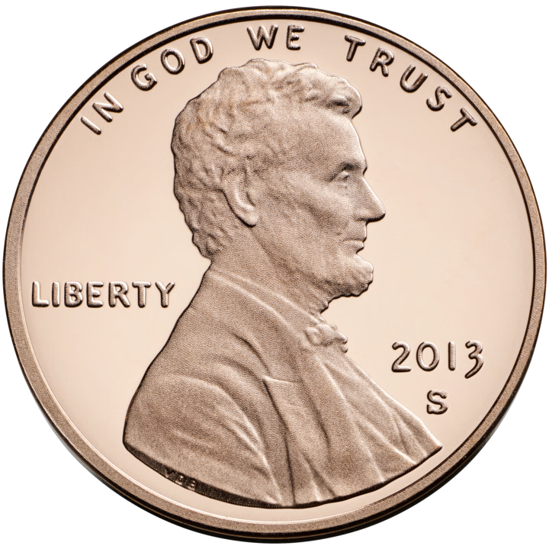
Pseudorandom generators (PRGs)
We want explicit $G:\{0, 1\}^{s}→\{0, 1\}^{n}$ such that
$$∀ \text{width}\text{‑}w \text{length}\text{‑}n \text{ROBP} f, \left|𝔼\left[f\left(G\left(U_{s}\right)\right)\right]−𝔼\left[f\left(U_{n}\right)\right]\right|≤ε$$
We want unconditional constructions
Note: In general, PRGs $⇒$ lower bounds
In some contexts (e.g., crypto), lower bounds and PRGs seem out of reach 🙁
But $\text{BPL}$ is different. Strong lower bounds for ROBPs are known (e.g., inner product mod 2), so we can hope to construct optimal PRGs in this setting 🙂

Slide 9
Unconditional PRGs for ROBPs
[Nisan 1990] $∃$ explicit PRG for ROBPs with seed length
$$O\left(\log\left(wn/ε\right)⋅\log{n}\right)$$
Nisan’s PRG is still the best PRG known for poly-width ROBPs 🙁
However, in many settings, we can do something better than Nisan’s PRG 🙂

Slide 10
Variable ordering
🔀
Strange weakness of Nisan’s PRG: Permuting the output bits does not preserve pseudorandomness [Tzur 2009]
Can we fool arbitrary-order ROBPs? I.e. functions of the form
$$f\left(x\right)=g\left(x_{π\left(1\right)},…,x_{π\left(n\right)}\right)$$
where $g$ is a standard-order ROBP and $π:\left[n\right]→[n]$ is a permutation
$$x_{5}$$
$$x_{4 }$$
$$x_{1}$$
$$x_{2}$$
$$x_{3}$$
$$x_{6}$$

Slide 11
PRGs for arbitrary-order ROBPs
Seed length | Model fooled | Reference
$$\left(1−Ω\left(1\right)\right)⋅n$$ | Exponential-width arbitrary-order ROBPs | Bogdanov, Papakonstantinou, Wan 2011
$$\tilde{O}\left(\sqrt{nw}\right)$$ | Unrestricted branching programs of size $nw$ | Impagliazzo, Meka, Zuckerman 2012 H, Hatami, Tal, Tell 2021
$$\tilde{O}\left(\log^{3}{n}\right)$$ | Width-3 arbitrary-order ROBPs | Steinke, Vadhan, Wan 2014
$$\tilde{O}(\log^{w+1}{n})$$ | Width-$w$ arbitrary-order ROBPs | Chattopadhyay, Hatami, Reingold, Tal 2018
$$\tilde{O}\left(\log{n}\right)$$ | Width-3 arbitrary-order ROBPs | Meka, Reingold, Tal 2019
$$O\left(\log^{3}{n}\right)$$ | Polynomial-width arbitrary-order ROBPs | Forbes, Kelley 2018
$$\tilde{O}\left(\log^{2}{n}\right)$$ | Constant-width arbitrary-order ROBPs | Forbes, Kelley 2018
[Forbes, Kelley 2018] building on [Reingold, Steinke, Vadhan 2013] [Haramaty, Lee, Viola 2017] [Chattopadhyay, Hatami, Reingold, Tal 2018] Theorem: $∃$ explicit $ε$-PRG for width-$w$ length-$n$ arbitrary-order ROBPs with seed length $O\left(\log\left(wn/ε\right)⋅\log^{2}{n}\right)$ or $\tilde{O}\left(w⋅\log\left(n/ε\right)⋅\log{n}\right)$.

Slide 12
Theme 1: Iterated Pseudorandom Restrictions

Slide 13
Iterated restriction framework [Ajtai, Wigderson 1985]
Want to sample pseudorandom string $X∈\{0, 1\}^{n}$
Step 1: Sample pseudorandom $X∈\{0, 1, ⋆\}^{n}$ such that
$∀f$ that we want to fool, $𝔼\left[f\right]≈𝔼\left[f\left(X∘U_{n}\right)\right]$
$$≈$$
$$⋆$$
$$⋆$$
$$⋆$$
$$⋆$$
$$⋆$$
$$≈$$
$$≈$$

Slide 14
Forbes-Kelley pseudorandom restrictions
$$⋆$$
$$⋆$$
$$⋆$$
$$⋆$$
$$⋆$$
Forbes and Kelley show that $D+T∧U$ fools (arbitrary-order) ROBPs, where $D$ and $T$ are “small-bias” distributions [Naor, Naor 1990] and $U$ is uniform random
Beautiful proof (Fourier analysis)
In the constant-width case:
Spend $\tilde{O}\left(\log\left(n/ε\right)\right)$ truly random bits
Assign values to half the variables
Apply $O(\log{n})$ restrictions $⇒$ PRG with seed length $\tilde{O}\left(\log^{2}{n}\right)$

Slide 15
Early termination [Gopalan, Meka, Reingold, Trevisan, Vadhan 2012]
In some cases, after only $\text{poly}\left(\log{\log{n}}\right)$ restrictions, we can show that the function simplifies in some sense
$⇒$ Can halt restriction process and do something else
$⇒$ Near-optimal seed length $\tilde{O}\left(\log\left(n/ε\right)\right)$ for increasingly powerful subclasses of constant-width ROBPs. Examples:
Switching lemma
Constant-width monotone ROBPs [Doron, Meka, Reingold, Tal, Vadhan 2021]
$$⊆$$
Also other classes, e.g., read-once polynomials over $\text{GF}\left(2\right)$
[Lee, Viola 2020] [Meka, Reingold, Tal 2019] [Lee 2019] [Doron, Hatami, H 2020]
Read-once ${\text{AC}}^{0}$ [Chen, Steinke, Vadhan 2015] [Doron, Hatami, H 2019]
$$⊆$$
Read-once CNFs [De, Etesami, Trevisan, Tulsiani 2010] [Gopalan, Meka, Reingold, Trevisan, Vadhan 2012] [Doron, Hatami, H 2020]

Slide 16
Monotone ROBPs [Meka, Zuckerman 2010]
0
Assumption: Each transition is monotone as a function of the state
Equivalent: $∀$ layers, $∀b∈\{0, 1\}$, the $b$-edges do not cross
Techniques designed for arbitrary-order programs are useful even for standard-order programs!
0
0
[Doron, Meka, Reingold, Tal, Vadhan 2021] Theorem: $∃$ explicit $ε$-PRG for width-$w$ length-$n$ monotone ROBPs with seed length $\tilde{O}\left(w^{2}⋅\log\left(n/ε\right)\right)$.
0
0

Slide 17
Challenge: Parity gates
If $f$ can be computed by a constant-width ROBP, then so can $f∘\text{PARITY}$
Early termination approach seems to break down here 🙁
Derandomization without PRGs?
$$∧$$
$$∨$$
$$∨$$
$$⊕$$
$$⊕$$
$$⊕$$
$$⊕$$
$$⊕$$
$$x_{3}$$
$$x_{1}$$
$${¬x}_{2}$$
$$x_{8}$$
$${¬x}_{6}$$
$$x_{5}$$
$$x_{11}$$
$${¬x}_{4}$$
$${¬x}_{9}$$
$$x_{7}$$
$$x_{10}$$

Slide 18
Theme 2: Inverse Laplacian Perspective

Slide 19
Matrix of expectations of subprograms
Suppose we are given a width-$w$ length-$n$ ROBP $f$. Our job is to estimate $𝔼\left[f\right]$
We might as well estimate $𝔼\left[f_{u→v}\right]$ for every subprogram $f_{u→v}$
Collect in $N×N$ matrix $P$ where $N=w⋅\left(n+1\right)=$ number of vertices in $f$
I.e., $P_{u,v}=𝔼\left[f_{u→v}\right]$
We want to compute $\hat{P}$ such that $\hat{P}≈P$

Slide 20
Inverse Laplacian perspective
[Ahmadinejad, Kelner, Murtagh, Peebles, Sidford, Vadhan 2020]
We can easily compute the random walk matrix $W∈ℝ^{N×N}$
$W_{u,v}=$ (probability that one random step from $u$ goes to $v$) $∈\left\{0,\frac{1}{2},1\right\}$
Then $P=W^{0}+W^{1}+W^{2}+⋯+W^{n}$ (geometric sum). Note $W^{n+1}=0$
Therefore $P=L^{−1}$ where $L=I−W$ (“directed Laplacian”)
So our job is to find $\hat{P}$ such that $\hat{P}≈L^{−1}$ (approximate inverse Laplacian)

Slide 21
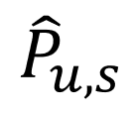
Local consistency
So our job is to find $\hat{P}$ such that $\hat{P}≈L^{−1}$ (approximate inverse Laplacian)
That suggests a way of measuring quality of a candidate $\hat{P}$
Instead of comparing $\hat{P}$ vs. $P$ directly, let’s compare $\hat{P}L$ vs. $I$. Let $E=I−\hat{P}L$
Can show probabilistic interpretation: (here we assume $v$ comes after $u$)
$$E_{u,v}=\left(\sum_{s∈\left\{\begin{matrix}the layer \\ preceding v\end{matrix}\right\}}{{\hat{P}}_{u,s}⋅P_{s,v}}\right)−{\hat{P}}_{u,v}$$
$$v$$
0.4
0.49
$≈$ 0.5 ✔
$$u$$
$$⋯$$
0.5
“Local consistency error” [Cheng, H 2020]
Two different ways of using $\hat{P}$ to estimate $P_{u,v}$
0.1

Slide 22
Application: Derandomization given a hitting set
Hitting set generator (HSG): Function $G:\{0, 1\}^{s}→\{0, 1\}^{n}$ such that $∀ \text{width}\text{‑}w \text{length}\text{‑}n \text{ROBP} f \text{with} 𝔼\left[f\right]≥ε, ∃x \text{such} \text{that} f\left(G\left(x\right)\right)=1$
PRG $⇒$ HSG. An HSG is a “one-sided PRG”. Potentially much easier to construct
Given an optimal HSG, it is straightforward to derandomize algorithms that have one-sided error ($\text{L}=\text{RL}$)
Theorem [Cheng, H 2020]: If $∃$ log-space HSG for width-$n$ length-$n$ ROBPs with seed length $O\left(\log{n}\right)$, then $\text{L}=\text{BPL}$

Slide 23
Derandomizing $\text{BPL}$ given an HSG
Theorem [Cheng, H 2020]: If $∃$ log-space HSG for width-$n$ length-$n$ ROBPs with seed length $O\left(\log{n}\right)$, then $\text{L}=\text{BPL}$
Analogous theorem for $\text{BPP}$ known previously [Andreev, Clementi, Rolim 1996]
But the known proofs for $\text{BPP}$ don’t preserve the read-once condition
Proof idea: Use HSG $G$ with output length $n^{c}$ to analyze ROBP of length $n$
Think of $G\left(x\right)$ as a long stream of random bits and use it to compute ${\hat{P}}^{\left(x\right)}$
Using the hitting property, one can show $∃x$ such that ${\hat{P}}^{\left(x\right)}≈P$
Algorithm: Find $x$ such that ${\hat{P}}^{\left(x\right)}$ has good local consistency

Slide 24
More applications of inverse Laplacian perspective
Inverse Laplacian perspective helps us get more mileage out of HSGs
Other applications come from importing techniques from literature on fast Laplacian system solvers
♻️

Slide 25
Theme 3: Error Reduction Procedures

Slide 26
Non-black-box error reduction
Problem: Given a width-$n$ length-$n$ ROBP $f$ as input, estimate $𝔼[f]$
Assume we can compute $𝔼\left[f\right]±1/\text{poly}(n)$ deterministically in space $S\left(n\right)$
[Ahmadinejad, Kelner, Murtagh, Peebles, Sidford, Vadhan 2020] strengthening [H, Zuckerman 2018]
Theorem: Can compute $𝔼\left[f\right]±ε$ deterministically in space
$$O\left(S\left(n\right)+\log{n}⋅\log{\log_{n}\left(1/ε\right)}\right)$$

Slide 27
Preconditioned Richardson iteration
[Ahmadinejad, Kelner, Murtagh,
Peebles, Sidford, Vadhan 2020]
In space $O\left(S\left(n\right)\right)$, compute $\hat{P}$ such that $\left\|P−\hat{P}\right\|≤1/\text{poly}\left(n\right)$
$\hat{P}L=I−E$ where $E$ (local consistency errors) satisfies ${\left\|E\right\|}_{∞}≤1/\text{poly}\left(n\right)$ 🚶
Define $\hat{\hat{P}}=\hat{P}+E\hat{P}+E^{2}\hat{P}+⋯+E^{m}\hat{P}$ 🏋️
$$\hat{\hat{P}}L=\left(I−E\right)+E⋅\left(I−E\right)+E^{2}⋅\left(I−E\right)+⋯+E^{m}⋅\left(I−E\right) \\ =(I−E) + \left(E−E^{2}\right) + \left(E^{2}−E^{3}\right)+⋯+\left(E^{m}−E^{m+1}\right)=I−E^{m+1}$$
For $m=O\left(\frac{\log\left(1/ε\right)}{\log{n}}\right)$, we get
$\left|{\hat{\hat{P}}}_{u,v}−P_{u,v}\right|≤{\left\|\hat{\hat{P}}LP−P\right\|}_{∞}≤{\left\|\hat{\hat{P}}L−I\right\|}_{∞}⋅{\left\|P\right\|}_{∞}≤\frac{O\left(n\right)}{n^{O\left(m\right)}}≤ε$ 💪
Low-error approximate inverse of $L$

Slide 28
Error reduction for black-box derandomization
How to estimate $𝔼\left[f\right]±ε$ when we only have query access to $f$?
An $ε$-error PRG would suffice… how about something easier to construct?

Slide 29
Weighted pseudorandom generators (WPRGs)
Pair $(G, ρ)$, where $G:\{0, 1\}^{s}→\{0, 1\}^{n}$ and $ρ:\{0, 1\}^{s}→ℝ$
Requirement: $∀$ width-$w$ length-$n$ ROBP $f$,
$$\left|𝔼_{x}\left[f\left(G\left(x\right)\right)⋅ρ(x)\right]−𝔼\left[f\right]\right|≤ε$$
Introduced recently [Braverman, Cohen, and Garg 2018]
PRG $⇒$ WPRG $⇒$ HSG
Aka “pseudorandom pseudodistribution generator”
HSG
WPRG
PRG

Slide 30
Generators for width-$n$ length-$n$ ROBPs
Seed length | Type of generator | Reference
$$\tilde{O}\left(\sqrt{n}\right)+O\left(\log\left(1/ε\right)\right)$$ | HSG | Ajtai, Komlós, Szemerédi 1987
$$2^{O\left(\sqrt{\log{n}}\right)}⋅log⁡(1/ε)$$ | PRG | Babai, Nisan, Szegedy 1989
$$O\left(\log^{2}{n}+\log{n}⋅\log\left(1/ε\right)\right)$$ | PRG | Nisan 1990, …
$$\tilde{O}\left(\log^{2}{n}+\log\left(1/ε\right)\right)$$ | WPRG | Braverman, Cohen, Garg 2018
$$O(\log^{2}{n}+\log\left(1/ε\right))$$ | HSG | H, Zuckerman 2018
$$\tilde{O}\left(\log^{2}{n}\right)+O(\log\left(1/ε\right))$$ | WPRG | Chattopadhyay, Liao 2020
$$O\left(\log^{2}{n}\right)+\tilde{O}\left(\log\left(1/ε\right)\right)$$ | WPRG | Cohen, Doron, Renard, Sberlo, Ta-Shma 2021 and Pyne, Vadhan 2021
$$O(\log^{2}{n}+\log\left(1/ε\right))$$ | WPRG | H 2021

Slide 31
Low-error WPRGs for ROBPs
[H 2021] building on [Cohen, Doron, Renard, Sberlo, Ta-Shma 2021] [Pyne, Vadhan 2021] [Ahmadinejad, Kelner, Murtagh, Peebles, Sidford, Vadhan 2020]
Theorem: $∃$ explicit WPRG for width-$n$ length-$n$ ROBPs with seed length
$$O\left(\log^{2}{n}+\log\left(1/ε\right)\right)$$
More generally, we have an error-reduction procedure:
Based on preconditioned Richardson iteration (& sampler trick)
Moderate-error PRG
Fools width-$w$ length-$n$ ROBPs
Error $1/\text{poly}\left(wn\right)$
Seed length $s$
Low-error WPRG
Fools width-$w$ length-$n$ ROBPs
Error $ε$
Seed length $O\left(s+\log\left(1/ε\right)\right)$
$$⇒$$

Slide 32
Application: Better derandomization of $\text{BPL}$
Deterministic space | Model simulated | Reference
$$O\left(S^{2}\right)$$ | $$\text{NSPACE}(S)$$ | Savitch 1969
$$O\left(S^{2}\right)$$ | Non-halting unbounded-error randomized space-$S$ | Jung 1981 and Borodin, Cook, Pippenger 1983
$$O\left(S^{3/2}\right)$$ | $$\text{BPSPACE}(S)$$ | Saks, Zhou 1995
$$O\left(S^{3/2}/\sqrt{\log{S}}\right)$$ | $$\text{BPSPACE}(S)$$ | H 2021
[H 2021] building on [Cohen, Doron, Renard, Sberlo, Ta-Shma 2021] [Pyne, Vadhan 2021] [Chattopadhyay, Liao 2020] [Armoni 1998] [Saks, Zhou 1995] Theorem: $∀S=S\left(n\right)≥\log{n}$, $\text{BPSPACE}(S)⊆\text{DSPACE}\left(S^{3/2}/\sqrt{\log{S}}\right)$
Proof uses WPRG error reduction (and other ingredients)

Slide 33
Theme 4: Expander Graphs

Slide 34
Analyzing random walks
“$\text{BPL}$-complete” problem: Given a digraph $G$, vertices $s, t$, $1^{k}$, and $1^{m}$, compute
$$\operatorname{Pr}\left[k\text{‑}\text{step} \text{random} \text{walk} \text{goes} \text{from} s \text{to} t\right]±1/m.$$
How about the undirected case?
[Reingold 2005] Deterministic log-space algorithm for connectivity ($k=∞$)
$$\left(∗\right)$$
[Ahmadinejad, Kelner, Murtagh, Peebles, Sidford, Vadhan 2020] building on [Murtagh, Reingold, Sidford, Vadhan 2017] [ — 2019]
Theorem: If $G$ is undirected, then for any $k,s,t,m,$ one can deterministically compute $\left(∗\right)$ in space $\tilde{O}\left(\log{n}\right)$

Slide 35
Derandomized squaring of graphs [Rozenman, Vadhan 2005]
Undirected graph $G$
(there is also a version for directed graphs)
True square $G^{2}$: Place clique on neighbors
Derandomized square: Place expander on neighbors
[AKMPSV20] algorithm uses derandomized square + error reduction + other tools

Slide 36
PRGs revisited
The derandomized square is closely connected to the INW generator [Impagliazzo, Nisan, Wigderson 1994]
To sample $n$ pseudorandom bits:
Recursively construct $G:\{0, 1\}^{s}→\{0, 1\}^{n/2}$
Output $G\left(X\right)∘G\left(Y\right)$, where $\left(X, Y\right)$ is a random edge in an expander graph with $2^{s}$ vertices
We are still learning more about what this PRG can do!
Works especially well for regular ROBPs & permutation ROBPs

Slide 37
Regular ROBPs & Permutation ROBPs
Permutation condition: $∀$ layers, $∀b∈\{0, 1\}$, the $b$-edges are a matching
Permutation $⇒$ “regular” (degree = 2)
0
0
0
0
0

Slide 38
Generators for regular & permutation ROBPs
Seed length | Type | Model | Reference
$$\tilde{O}\left(\log{n}⋅log⁡(w/ε)\right)$$ | PRG | Regular ROBPs | [Braverman, Rao, Raz, Yehudayoff 2010] [De 2011]
$$O(\log{n})$$ | HSG | Constant-width regular ROBPs | [Braverman, Rao, Raz, Yehudayoff 2014]
$$O\left(\log{n}⋅\log\left(1/ε\right)\right)$$ | PRG | Constant-width permutation ROBPs | [Brody, Verbin 2010] [Koucký, Nimbhorkar, Pudlák 2011] [De 2011] [Steinke 2012]
$$\tilde{O}\left(\log{n}⋅\log\left(1/ε\right)\right)$$ | PRG | Constant-width arbitrary-order permutation ROBPs | [Reingold, Steinke, Vadhan 2013] [Chattopadhyay, Hatami, Hosseini, Lovett 2018]
$$\tilde{O}\left(\log{n}⋅\log\left(1/ε\right)\right)$$ | PRG | Unbounded-width 1-accept-vertex permutation ROBPs | [H, Pyne, Vadhan 2021]
$$\tilde{O}\left(\log{n}⋅\sqrt{\log\left(n/ε\right)}+\log\left(1/ε\right)\right)$$ | WPRG | Unbounded-width 1-accept-vertex permutation ROBPs | [Pyne, Vadhan 2021]
$$\tilde{O}\left(\log{n}⋅\log\left(1/ε\right)\right)$$ | HSG | Unbounded-width 1-accept-vertex regular ROBPs | [Bogdanov, H, Prakriya, Pyne 2021]
$$\tilde{O}\left(\log{n}⋅\sqrt{\log\left(1/ε\right)}+\log\left(1/ε\right)\right)$$ | HSG | Polylog-width regular ROBPs | [Bogdanov, H, Prakriya, Pyne 2021]
For permutation ROBPs, can beat Nisan’s seed length in all parameter regimes except some extreme cases
For regular ROBPs with 1 accept vertex, can beat Nisan’s seed length in all parameter regimes except
$$\log{w}=Θ\left(\log\left(1/ε\right)\right)=Ω\left(\log{n}\right)$$

Slide 39
Why care about permutation & regular ROBPs?
ROBPs
🔧 INW generator
Permutation ROBPs
Monotone ROBPs
🔨 Iterated restrictions
🛠️ Can we combine these two sets of techniques to design a PRG for constant-width ROBPs with seed length $\tilde{O}\left(\log{n}\right)$?
For the width-3 case, the answer is yes!
[Meka, Reingold, Tal 2019]
Theorem: $∃$ explicit PRG for width-3 ROBPs with seed length $\tilde{O}\left(\log{n}⋅\log\left(1/ε\right)\right)$

Slide 40
Summary
Four themes:
Iterated pseudorandom restrictions & arbitrary-order ROBPs
Inverse Laplacian perspective & local consistency
Error reduction procedures & weighted PRGs
Expander graphs: Derandomized square & INW generator
Lots of exciting results! Steady, substantial progress!
Thanks for listening! Questions?

Slide 41
References
Nisan. Pseudorandom generators for space-bounded computation. STOC 1990, Combinatorica 1992.
Tzur. Notions of weak pseudorandomness and GF($2^{n}$)-polynomials. Master’s thesis 2009.
Bogdanov, Papakonstantinou, and Wan. Pseudorandomness for read-once formulas. FOCS 2011.
Impagliazzo, Meka, and Zuckerman. Pseudorandomness from shrinkage. FOCS 2012, JACM 2019.
Hatami, Hoza, Tal, and Tell. Fooling constant-depth threshold circuits. FOCS 2021.
Steinke, Vadhan, and Wan. Pseudorandomness and Fourier-growth bounds for width-3 branching programs. RANDOM 2014, ToC 2017.
Chattopadhyay, Hatami, Reingold, and Tal. Improved pseudorandomness for unordered branching programs through local monotonicity. STOC 2018.
Meka, Reingold, and Tal. Pseudorandom generators for width-3 branching programs. STOC 2019.
Forbes and Kelley. Pseudorandom generators for read-once branching programs, in any order. FOCS 2018.
Reingold, Steinke, and Vadhan. Pseudorandomness for regular branching programs via Fourier analysis. RANDOM 2013.
Haramaty, Lee, and Viola. Bounded independence plus noise fools products. CCC 2017, SICOMP 2018.
Ajtai and Wigderson. Deterministic simulation of probabilistic constant-depth circuits. FOCS 1985, ACR 1989.
Naor and Naor. Small-bias probability spaces: efficient constructions and applications. STOC 1990, SICOMP 1993.
Gopalan, Meka, Reingold, Trevisan, and Vadhan. Better pseudorandom generators from milder pseudorandom restrictions. FOCS 2012.
De, Etesami, Trevisan, and Tulsiani. Improved pseudorandom generators for depth 2 circuits. RANDOM 2010.
Chen, Steinke, and Vadhan. Pseudorandomness for read-once, constant-depth circuits. arXiv 2015.
Doron, Hatami, and Hoza. Log-seed pseudorandom generators via iterated restrictions. CCC 2020.
Doron, Hatami, and Hoza. Near-optimal pseudorandom generators for constant-depth read-once formulas. CCC 2019.
Doron, Meka, Reingold, Tal, and Vadhan. Pseudorandom generators for read-once monotone branching programs. RANDOM 2021.
Lee and Viola. More on bounded independence plus noise: Pseudorandom generators for read-once polynomials. ToC 2020.

Slide 42
References (continued)
Lee. Fourier bounds and pseudorandom generators for product tests. CCC 2019.
Meka and Zuckerman. Pseudorandom generators for polynomial threshold functions. STOC 2010, SICOMP 2013
Ahmadinejad, Kelner, Murtagh, Peebles, Sidford, and Vadhan. High-precision estimation of random walks in small space. FOCS 2020.
Cheng and Hoza. Hitting sets give two-sided derandomization of small space. CCC 2020.
Andreev, Clementi, and Rolim. A new general derandomization method. ICALP 1996, JACM 1998.
Hoza and Zuckerman. Simple optimal hitting sets for small-success RL. FOCS 2018, SICOMP 2020.
Braverman, Cohen, and Garg. Pseudorandom pseudo-distributions with near-optimal error for read-once branching programs. STOC 2018, SICOMP 2020.
Ajtai, Komlós, and Szemerédi. Deterministic simulation in LOGSPACE. STOC 1987.
Babai, Nisan, and Szegedy. Multiparty protocols, pseudorandom generators for logspace, and time-space trade-offs. STOC 1989, JCSS 1992
Chattopadhyay and Liao. Optimal error pseudodistributions for read-once branching programs. CCC 2020.
Cohen, Doron, Renard, Sberlo, and Ta-Shma. Error reduction for weighted PRGs against read-once branching programs. CCC 2021.
Pyne and Vadhan. Pseudodistributions that beat all pseudorandom generators. CCC 2021.
Hoza. Better pseudodistributions and derandomization for space-bounded computation. RANDOM 2021.
Savitch. Relationships between nondeterministic and deterministic tape complexities. STOC 1969, JCSS 1970.
Jung. Relationships between probabilistic and deterministic tape complexity. MFCS 1981.
Borodin, Cook, and Pippenger. Parallel computation for well-endowed rings and space-bounded probabilistic machines. Information and Control, 1983.
Saks and Zhou. ${\text{BP}}_{\text{H}}\text{SPACE}\left(S\right)⊆\text{DSPACE}\left(S^{3/2}\right)$. FOCS 1995, JCSS 1999.
Armoni. On the derandomization of space-bounded computations. RANDOM 1998.
Reingold. Undirected connectivity in log-space. STOC 2005, JACM 2008.
Murtagh, Reingold, Sidford, and Vadhan. Derandomization beyond connectivity: undirected Laplacian systems in nearly logarithmic space. FOCS 2017.

Slide 43
References (continued)
Murtagh, Reingold, Sidford, and Vadhan. Deterministic approximation of random walks in small space. RANDOM 2019, ToC 2021.
Rozenman and Vadhan. Derandomized squaring of graphs. RANDOM 2005.
Impagliazzo, Nisan, and Wigderson. Pseudorandomness for network algorithms. STOC 1994.
Braverman, Rao, Raz, and Yehudayoff. Pseudorandom generators for regular branching programs. FOCS 2010, SICOMP 2014.
De. Pseudorandomness for permutation and regular branching programs. CCC 2011.
Brody and Verbin. The coin problem and pseudorandomness for branching programs. FOCS 2010.
Koucký, Nimbhorkar, and Pudlák. Pseudorandom generators for group products. STOC 2011
Steinke. Pseudorandomness for permutation branching programs without the group theory. ECCC 2012.
Chattopadhyay, Hatami, Hosseini, and Lovett. Pseudorandom generators from polarizing random walks. CCC 2018, ToC 2019.
Hoza, Pyne, and Vadhan. Pseudorandom generators for unbounded-width permutation branching programs. ITCS 2021.
Bogdanov, Hoza, Prakriya, and Pyne. Hitting sets for regular branching programs. CCC 2022.

