Slide 1
Complexity Theory Through the Lens of Kolmogorov Complexity
Igor Carboni Oliveira
Based on joint work with Shuichi Hirahara, Rahul Ilango, Zhenjian Lu, and Mikito Nanashima

Slide 2
Overview

Slide 3
What this talk is about
Computational Complexity Theory versus Kolmogorov Complexity Theory
NP vs BPP
Theory of
Time-Bounded
Kolmogorov Complexity
DistNP vs HeurBPP
Existence of OWFs
Why? Import methods and perspectives from Kolmogorov complexity; investigate relations between main open problems from complexity theory, etc.

Slide 4
Usefulness of time-bounded Kolmogorov complexity
LEARNING THEORY:
[CIKK’16]: Quasi-poly time learning algorithm for AC⁰[2] circuits via natural property
CRYPTOGRAPHY:
[LP’20]: OWFs exists if and only if computing K^{poly} is hard on average
AVERAGE-CASE
COMPLEXITY:
[Hirahara’21]: If DistPH is contained in AvgP then PH is contained in DTIME[2^{n/log n}]

Slide 5
A different correspondence
Previous results: Consider the computational complexity of solving problems about Kolmogorov complexity (“meta-complexity”)
This talk: Structure/theory of Kolmogorov complexity (instead of computational problems)

Slide 6
Key principles of Kolmogorov complexity
Q. Do these principles survive in the time-bounded setting?
Incompressibility
Symmetry of Information (SoI)
(even predates the P vs NP problem [Levin’03])
Coding
Our Results:
Equivalences to main conjectures of complexity theory
Language Compression

Slide 7
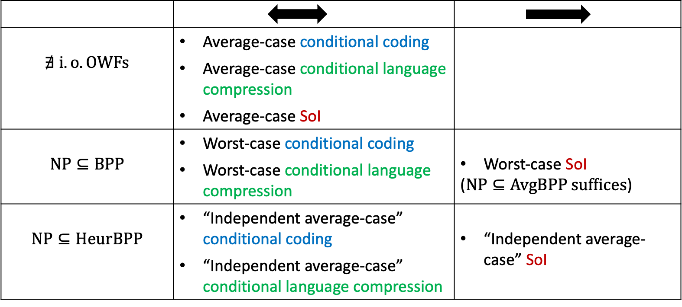
Almost complete picture, but fully understanding the role of Symmetry of Information remains a mystery

Slide 8
Background and Main Result
(Focus on Symmetry of Information and OWFs)

Slide 9





Kolmogorov Complexity
string $x$
$$\text{short} \text{encoding} \text{of} x$$
$$01001101…0111010111$$
$$010001110$$
Kolmogorov Complexity:
$K\left(x\right)=$ $\min_{M}\left\{\left|M\right| :U(M) outputs x\right\}$
$"$minimum length of a program that recovers $x$”

Slide 10
Kolmogorov Complexity
string $x$
$$\text{short} \text{encoding} \text{of} x$$
$$01001101…0111010111$$
$$010001110$$
Conditional Kolmogorov Complexity:
$K\left(x | y\right)=$ $\min_{M}\left\{\left|M\right| :U(M,y) outputs x\right\}$
$"$minimum length of a program that recovers $x$ given $y$”

Slide 11

Time-Bounded Kolmogorov Complexity
$t$-time-bounded Kolmogorov complexity:
$$K^{t}\left(x\right)=\min_{M}\left\{\left|M\right| :U(M) outputs x within t\left(\left|x\right|\right) steps\right\}$$

Slide 12

Symmetry of Information
$$K\left(x,y\right)≲K\left(x\right)+K\left(y | x\right)$$

Slide 13

Symmetry of Information
$$K\left(x,y\right)≲K\left(x\right)+K\left(y | x\right)$$
Symmetry of information (SoI) for time-unbounded Kolmogorov complexity:
$$K\left(x,y\right)≳K\left(x\right)+K\left(y | x\right)$$

Slide 14

Symmetry of Information
$$K\left(x,y\right)≲K\left(x\right)+K\left(y | x\right)$$
Symmetry of information (SoI) for time-unbounded Kolmogorov complexity:
$$K\left(x,y\right)≳K\left(x\right)+K\left(y | x\right)$$
$$K\left(x\right)+K\left(y | x\right)≈K\left(x,y\right)≈K\left(y\right)+K\left(x | y\right)$$

Slide 15


Symmetry of Information
$$K\left(x,y\right)≲K\left(x\right)+K\left(y | x\right)$$
Symmetry of information (SoI) for time-unbounded Kolmogorov complexity:
$$K\left(x,y\right)≳K\left(x\right)+K\left(y | x\right)$$
$$K\left(x\right)+K\left(y | x\right)≈K\left(x,y\right)≈K\left(y\right)+K\left(x | y\right)$$
$$K\left(x\right)−K\left(x | y\right)≈K\left(y\right)−K\left(y | x\right)$$

Slide 16

Symmetry of Information
$$K\left(x,y\right)≲K\left(x\right)+K\left(y | x\right)$$
Symmetry of information (SoI) for time-unbounded Kolmogorov complexity:
$$K\left(x,y\right)≳K\left(x\right)+K\left(y | x\right)$$
$$K\left(x\right)+K\left(y | x\right)≈K\left(x,y\right)≈K\left(y\right)+K\left(x | y\right)$$
$$K\left(x\right)−K\left(x | y\right)≈K\left(y\right)−K\left(y | x\right)$$
$$H\left(X\right)−H\left(X | Y\right)=H\left(Y\right)−H\left(Y | X\right)$$
SoI Principle in Shannon’s Information Theory

Slide 17

Symmetry of Information
$$K\left(x,y\right)≲K\left(x\right)+K\left(y | x\right)$$
Symmetry of information (SoI) for time-unbounded Kolmogorov complexity:
$$K\left(x,y\right)≳K\left(x\right)+K\left(y | x\right)$$
Does symmetry of information hold in the time-bounded setting, for $K^{t}$?
?
$$K^{t}\left(x,y\right)≥K^{poly\left(t\right)}\left(x\right)+K^{poly\left(t\right)}\left(y | x\right)−O(\log{t\left(\left|x\right|+\left|y\right|\right)})$$

Slide 18

Symmetry of Information and One-Way Functions
Theorem [Longpré-Watanabe’95]:
One-way functions exist
No symmetry of information for $K^{t}$

Slide 19
Symmetry of Information and One-Way Functions
Theorem [Longpré-Watanabe’95]:
One-way functions exist
No symmetry of information for $K^{t}$
?

Slide 20
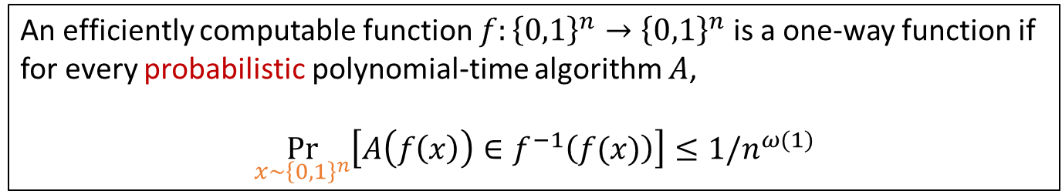
One-Way Functions
Definition (One-Way Functions):
An efficiently computable function $f:{\left\{0,1\right\}}^{n}→{\left\{0,1\right\}}^{n}$ is a one-way function if for every probabilistic polynomial-time algorithm $A$,
$$\underset{x∼{\left\{0,1\right\}}^{n}}{Pr}\left[A\left(f\left(x\right)\right)∈f^{−1}\left(f(x)\right)\right]≤1/n^{ω(1)}$$

Slide 21
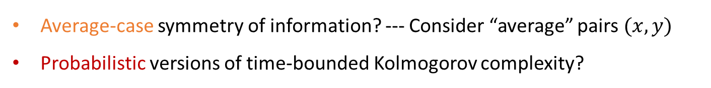
One-Way Functions
Definition (One-Way Functions):
An efficiently computable function $f:{\left\{0,1\right\}}^{n}→{\left\{0,1\right\}}^{n}$ is a one-way function if for every probabilistic polynomial-time algorithm $A$,
$$\underset{x∼{\left\{0,1\right\}}^{n}}{Pr}\left[A\left(f\left(x\right)\right)∈f^{−1}\left(f(x)\right)\right]≤1/n^{ω(1)}$$
Two key points:
Average-case symmetry of information? --- Consider “average” pairs $(x,y)$
Probabilistic versions of time-bounded Kolmogorov complexity?

Slide 22
Probabilistic Versions of Kolmogorov Complexity
Randomized $t$-time-bounded Kolmogorov complexity:
$${rK}^{t}\left(x\right)=\min_{k}\left\{ k :∃ t\left(\left|x\right|\right) time program M∈{\left\{0,1\right\}}^{k} s.t. \underset{randomness of M}{Pr}\left[M outputs x\right]≥\frac{2}{3}\right\}$$
There exists a fixed small (randomized) program that outputs $x$ w.h.p over its internal randomness

Slide 23
Probabilistic Versions of Kolmogorov Complexity
Randomized $t$-time-bounded Kolmogorov complexity:
$${rK}^{t}\left(x\right)=\min_{k}\left\{ k :∃ t\left(\left|x\right|\right) time program M∈{\left\{0,1\right\}}^{k} s.t. \underset{randomness of M}{Pr}\left[M outputs x\right]≥\frac{2}{3}\right\}$$
There exists a fixed small (randomized) program that outputs $x$ w.h.p over its internal randomness
Probabilistic $t$-time-bounded Kolmogorov complexity:
$${pK}^{t}\left(x\right)=\min_{k}\left\{ k : \underset{w∈{\left\{0,1\right\}}^{t\left(\left|x\right|\right)}}{Pr}\left[∃ M∈{\left\{0,1\right\}}^{k} s.t. M(w) outputs x within t\left(\left|x\right|\right) steps\right]≥\frac{2}{3}\right\}$$
For most $w$, there exists a small program, which can depend on $w,$ that outputs $x given w$

Slide 24

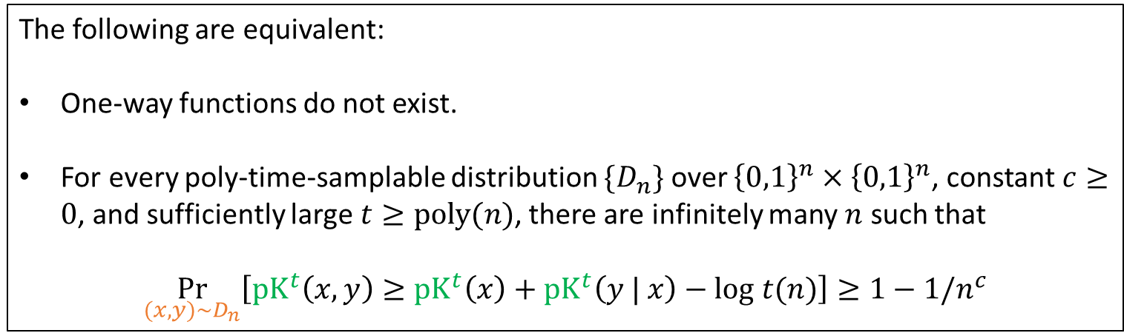
Symmetry of Information and One-Way Functions
Theorem [This Work]:
One-way functions do not exist
“Average-case” SoI for $pK^{poly}$holds
The following are equivalent:
One-way functions do not exist.
For every poly-time-samplable distribution $\{D_{n}\}$ over ${\left\{0,1\right\}}^{n}×{\left\{0,1\right\}}^{n}$, constant $c≥0$, and sufficiently large $t≥poly(n)$, there are infinitely many $n$ such that
$$\underset{(x,y)∼D_{n}}{Pr}\left[{pK}^{t}\left(x,y\right)≥{pK}^{t}\left(x\right)+{pK}^{t}\left(y | x\right)−log t(n)\right]≥1−1/n^{c}$$

Slide 25

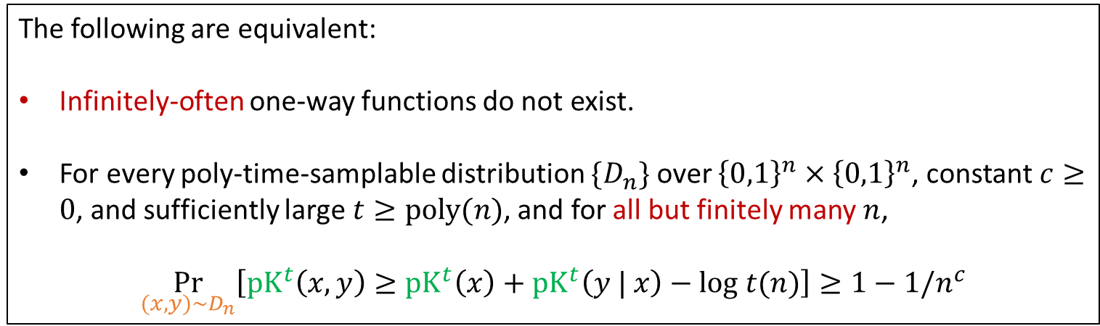
Symmetry of Information and One-Way Functions
Theorem [This Work]:
One-way functions do not exist
“Average-case” SoI for $pK^{poly}$holds
The following are equivalent:
Infinitely-often one-way functions do not exist.
For every poly-time-samplable distribution $\{D_{n}\}$ over ${\left\{0,1\right\}}^{n}×{\left\{0,1\right\}}^{n}$, constant $c≥0$, and sufficiently large $t≥poly(n)$, and for all but finitely many $n$,
$$\underset{(x,y)∼D_{n}}{Pr}\left[{pK}^{t}\left(x,y\right)≥{pK}^{t}\left(x\right)+{pK}^{t}\left(y | x\right)−log t(n)\right]≥1−1/n^{c}$$

Slide 26
Relevance to foundations of cryptography
Failure of symmetry of information
for a non-negligible fraction of pairs (x,y) of strings
produced by a samplable distribution is all we need to
construct key cryptographic primitives and protocols

Slide 27
What about rK^{poly} ?

Slide 28

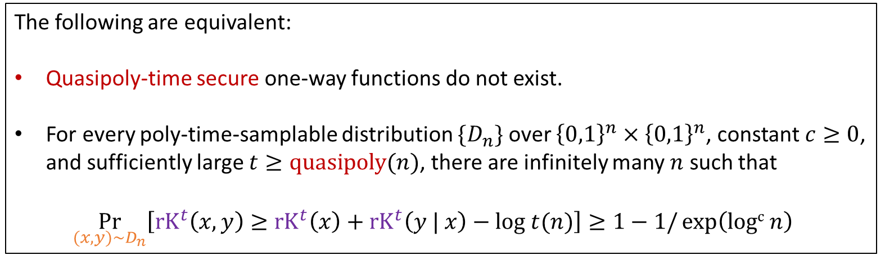
Symmetry of Information and One-Way Functions
Theorem [This Work]:
Quasipoly-time secure one-way functions do not exist
“Average-case” SoI for $rK^{quasipoly}$holds
The following are equivalent:
Quasipoly-time secure one-way functions do not exist.
For every poly-time-samplable distribution $\{D_{n}\}$ over ${\left\{0,1\right\}}^{n}×{\left\{0,1\right\}}^{n}$, constant $c≥0$, and sufficiently large $t≥quasipoly(n)$, there are infinitely many $n$ such that
$$\underset{(x,y)∼D_{n}}{Pr}\left[{rK}^{t}\left(x,y\right)≥{rK}^{t}\left(x\right)+{rK}^{t}\left(y | x\right)−log t(n)\right]≥1−1/{\exp\left(logc n\right)}^{}$$

Slide 29
Techniques (pK^{poly})

Slide 30
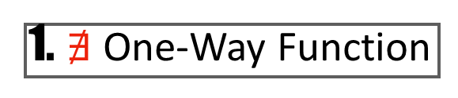
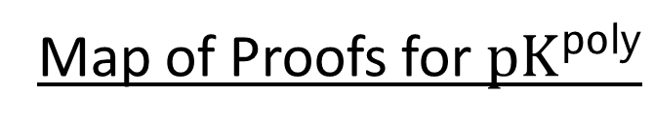
Map of Proofs for ${pK}^{poly}$
1. $∄$ One-Way Function
4. Language Compression
(average-case)
3. Conditional Coding
2. Symmetry of Information
(average-case)
(average-case)

Slide 31
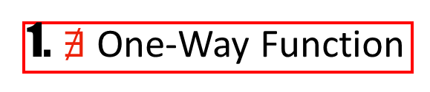
Map of Proofs for ${pK}^{poly}$
1. $∄$ One-Way Function
Similar to [LW95]
4. Language Compression
(average-case)
3. Conditional Coding
2. Symmetry of Information
(average-case)
(average-case)

Slide 32
Map of Proofs for ${pK}^{poly}$
1. $∄$ One-Way Function
4. Language Compression
(average-case)
3. Conditional Coding
2. Symmetry of Information
(average-case)
(average-case)

Slide 33
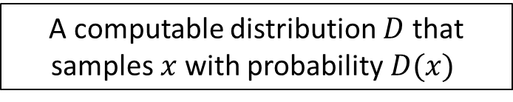
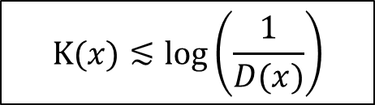
Coding Theorem
Coding theorem for time-unbounded Kolmogorov complexity:
A computable distribution $D$ that samples $x$ with probability$D(x)$
$$K(x)≲\log\left(\frac{1}{D(x)}\right)$$

Slide 34
Coding Theorem
Coding theorem for time-unbounded Kolmogorov complexity:
A computable distribution $D$ that samples $x$ with probability$D(x)$
$$K(x)≲\log\left(\frac{1}{D(x)}\right)$$
We don’t have a coding theorem for $K^{poly}$

Slide 35
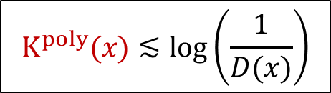
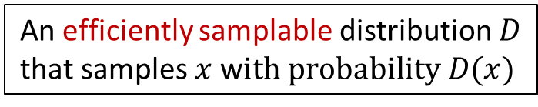
Coding Theorem
Coding theorem for time-unbounded Kolmogorov complexity:
A computable distribution $D$ that samples $x$ with probability$D(x)$
$$K(x)≲\log\left(\frac{1}{D(x)}\right)$$
We don’t have a coding theorem for $K^{poly}$
?
An efficiently samplable distribution $D$ that samples $x$ w$ith probability D(x)$
$$K^{poly}(x)≲\log\left(\frac{1}{D(x)}\right)$$

Slide 36
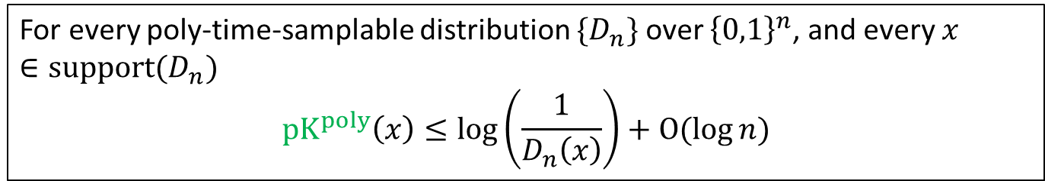
Coding Theorem
Theorem [Lu-Oliveira-Zimand’22]:
For every poly-time-samplable distribution $\{D_{n}\}$ over ${\left\{0,1\right\}}^{n}$, and every $x∈support(D_{n})$
$$pK^{poly}\left(x\right)≤\log\left(\frac{1}{D_{n}\left(x\right)}\right)+O(log{n)}$$

Slide 37
Coding Theorem
Theorem [Lu-Oliveira-Zimand’22]:
For every poly-time-samplable distribution $\{D_{n}\}$ over ${\left\{0,1\right\}}^{n}$, and every $x∈support(D_{n})$
$$pK^{poly}\left(x\right)≤\log\left(\frac{1}{D_{n}\left(x\right)}\right)+O(log{n)}$$
Incompressibility (extension of counting argument):
$K\left(x\right)≳\log\left(1/D_{n}(x)\right)$ w$.h.p over x∼D_{n}$

Slide 38
Coding Theorem
Theorem [Lu-Oliveira-Zimand’22]:
For every poly-time-samplable distribution $\{D_{n}\}$ over ${\left\{0,1\right\}}^{n}$, and every $x∈support(D_{n})$
$$pK^{poly}\left(x\right)≤\log\left(\frac{1}{D_{n}\left(x\right)}\right)+O(log{n)}$$
Incompressibility (extension of counting argument):
$K\left(x\right)≳\log\left(1/D_{n}(x)\right)$ w$.h.p over x∼D_{n}$
Corollary:
${pK}^{poly}\left(x\right)≈log\left(1/D_{n}(x)\right)$ w$.h.p over x∼D_{n}$

Slide 39
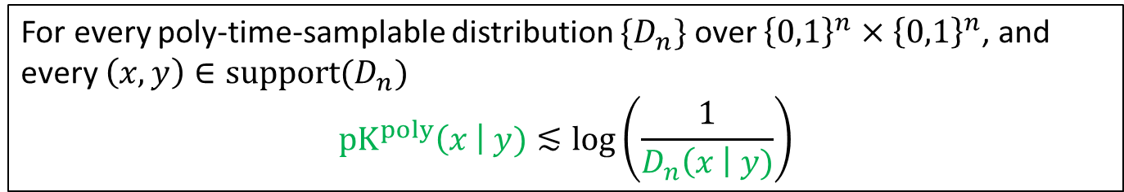
Conditional Coding
Definition (Conditional Coding for pK):
For every poly-time-samplable distribution $\{D_{n}\}$ over ${\left\{0,1\right\}}^{n}×{\left\{0,1\right\}}^{n}$, and every $\left(x,y\right)∈support(D_{n})$
$$pK^{poly}\left(x \right| y)≲\log\left(\frac{1}{D_{n}\left(x \right| y)}\right)$$

Slide 40
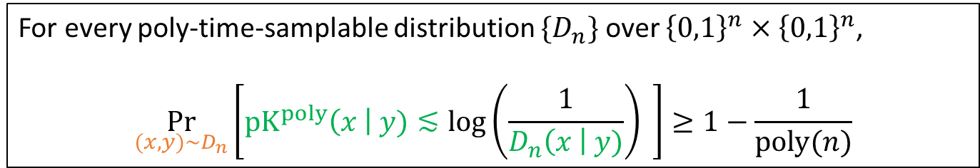
Conditional Coding
Definition (Conditional Coding for pK):
For every poly-time-samplable distribution $\{D_{n}\}$ over ${\left\{0,1\right\}}^{n}×{\left\{0,1\right\}}^{n}$, and every $\left(x,y\right)∈support(D_{n})$
$$pK^{poly}\left(x \right| y)≲\log\left(\frac{1}{D_{n}\left(x \right| y)}\right)$$
Definition (Average-Case Conditional Coding for pK):
For every poly-time-samplable distribution $\{D_{n}\}$ over ${\left\{0,1\right\}}^{n}×{\left\{0,1\right\}}^{n}$,
$$\underset{(x,y)∼D_{n}}{Pr}\left[pK^{poly}\left(x \right| y)≲\log\left(\frac{1}{D_{n}\left(x \right| y)}\right) \right]≥1−\frac{1}{poly(n)}$$

Slide 41
Conditional Coding and SoI
Lemma:
Average-case conditional coding holds
Average-case SoI holds

Slide 42
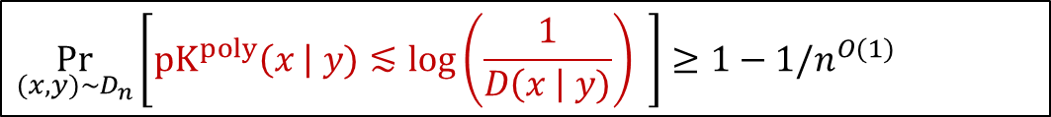
Conditional Coding and SoI
Lemma:
Average-case conditional coding holds
Average-case SoI holds
Proof:
$$\underset{(x,y)∼D_{n}}{Pr}\left[pK^{poly}\left(x \right| y)≲\log\left(\frac{1}{D\left(x \right| y)}\right) \right]≥1−1/n^{O(1)}$$
$$\underset{(x,y)∼D_{n}}{Pr}\left[{pK}^{poly}\left(x,y\right)≳{pK}^{poly}\left(y\right)+{pK}^{poly}\left(x | y\right)\right]≥1−1/n^{O(1)}$$

Slide 43
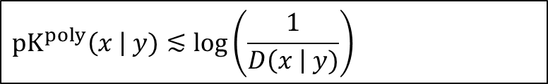

Conditional Coding and SoI
Lemma:
Average-case conditional coding holds
Average-case SoI holds
Proof:
$$\left(x,y\right)∼D$$
$$pK^{poly}\left(x \right| y)≲\log\left(\frac{1}{D\left(x \right| y)}\right)$$
$${pK}^{poly}\left(x,y\right)≳{pK}^{poly}\left(y\right)+{pK}^{poly}\left(x | y\right)$$

Slide 44
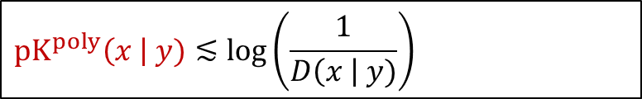
Conditional Coding and SoI
Lemma:
Average-case conditional coding holds
Average-case SoI holds
Proof:
$$\left(x,y\right)∼D$$
$$pK^{poly}\left(x \right| y)≲\log\left(\frac{1}{D\left(x \right| y)}\right)$$
$${pK}^{poly}\left(x,y\right)≳{pK}^{poly}\left(y\right)+{pK}^{poly}\left(x | y\right)$$

Slide 45
Conditional Coding and SoI
Lemma:
Average-case conditional coding holds
Average-case SoI holds
Proof:
$$\left(x,y\right)∼D$$
$$pK^{poly}\left(x \right| y)≲\log\left(\frac{1}{D\left(x \right| y)}\right)$$
$${pK}^{poly}\left(x | y\right){≲pK}^{poly}\left(x,y\right)−{pK}^{poly}\left(y\right)$$

Slide 46
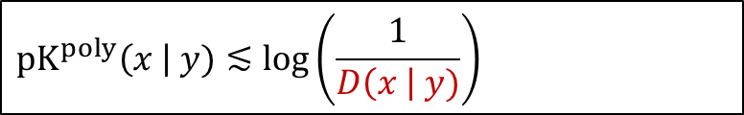

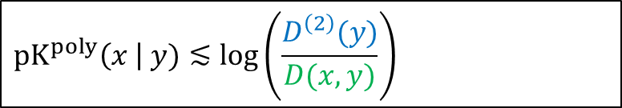
Conditional Coding and SoI
Lemma:
Average-case conditional coding holds
Average-case SoI holds
Proof:
$$\left(x,y\right)∼D$$
$$pK^{poly}\left(x \right| y)≲\log\left(\frac{1}{D\left(x \right| y)}\right)$$
$$pK^{poly}\left(x \right| y)≲\log\left(\frac{D^{\left(2\right)}(y)}{D(x,y)}\right)$$
Because $D\left(x \right| y)=\frac{D\left(x,y\right)}{D^{\left(2\right)}(y)}⋅$
$${pK}^{poly}\left(x | y\right){≲pK}^{poly}\left(x,y\right)−{pK}^{poly}\left(y\right)$$

Slide 47
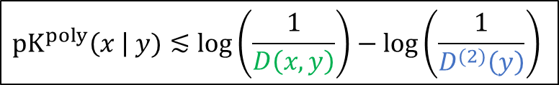
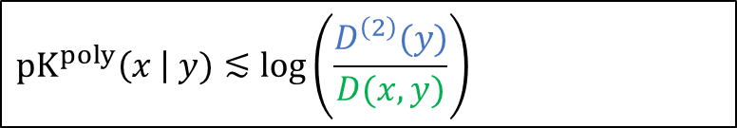
Conditional Coding and SoI
Lemma:
Average-case conditional coding holds
Average-case SoI holds
Proof:
$$\left(x,y\right)∼D$$
$$pK^{poly}\left(x \right| y)≲\log\left(\frac{1}{D\left(x \right| y)}\right)$$
$$pK^{poly}\left(x \right| y)≲\log\left(\frac{D^{\left(2\right)}(y)}{D(x,y)}\right)$$
Because $D\left(x \right| y)=\frac{D\left(x,y\right)}{D^{\left(2\right)}(y)}⋅$
$$pK^{poly}\left(x \right| y)≲\log\left(\frac{1}{D\left(x,y\right)}\right)−\log\left(\frac{1}{D^{(2)}\left(y\right)}\right)$$
$${pK}^{poly}\left(x | y\right){≲pK}^{poly}\left(x,y\right)−{pK}^{poly}\left(y\right)$$

Slide 48

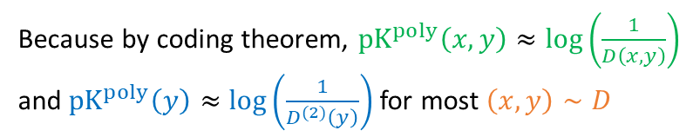
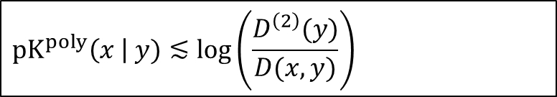
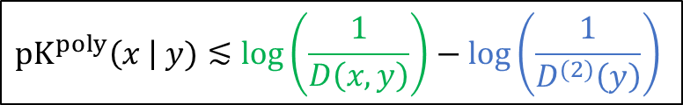
Conditional Coding and SoI
Lemma:
Average-case conditional coding holds
Average-case SoI holds
Proof:
$$\left(x,y\right)∼D$$
$$pK^{poly}\left(x \right| y)≲\log\left(\frac{1}{D\left(x \right| y)}\right)$$
$$pK^{poly}\left(x \right| y)≲\log\left(\frac{D^{\left(2\right)}(y)}{D(x,y)}\right)$$
Because $D\left(x \right| y)=\frac{D\left(x,y\right)}{D^{\left(2\right)}(y)}⋅$
$$pK^{poly}\left(x \right| y)≲\log\left(\frac{1}{D\left(x,y\right)}\right)−\log\left(\frac{1}{D^{(2)}\left(y\right)}\right)$$
Because by coding theorem, ${pK}^{poly}\left(x,y\right)≈\log\left(\frac{1}{D\left(x,y\right)}\right)$ and ${pK}^{poly}\left(y\right)≈\log\left(\frac{1}{D^{(2)}\left(y\right)}\right)$for most $\left(x,y\right)∼D$
$${pK}^{poly}\left(x | y\right){≲pK}^{poly}\left(x,y\right)−{pK}^{poly}\left(y\right)$$

Slide 49
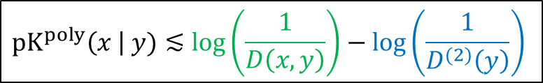
Conditional Coding and SoI
Lemma:
Average-case conditional coding holds
Average-case SoI holds
Proof:
$$\left(x,y\right)∼D$$
$$pK^{poly}\left(x \right| y)≲\log\left(\frac{1}{D\left(x \right| y)}\right)$$
$$pK^{poly}\left(x \right| y)≲\log\left(\frac{D^{\left(2\right)}(y)}{D(x,y)}\right)$$
Because $D\left(x \right| y)=\frac{D\left(x,y\right)}{D^{\left(2\right)}(y)}⋅$
$$pK^{poly}\left(x \right| y)≲\log\left(\frac{1}{D\left(x,y\right)}\right)−\log\left(\frac{1}{D^{(2)}\left(y\right)}\right)$$
Because by coding theorem, ${pK}^{poly}\left(x,y\right)≈\log\left(\frac{1}{D\left(x,y\right)}\right)$ and ${pK}^{poly}\left(y\right)≈\log\left(\frac{1}{D^{(2)}\left(y\right)}\right)$for most $\left(x,y\right)∼D$
$${pK}^{poly}\left(x | y\right){≲pK}^{poly}\left(x,y\right)−{pK}^{poly}\left(y\right)$$

Slide 50
Map of Proofs for ${pK}^{poly}$
1. $∄$ One-Way Function
4. Language Compression
(average-case)
3. Conditional Coding
2. Symmetry of Information
(average-case)
(average-case)

Slide 51
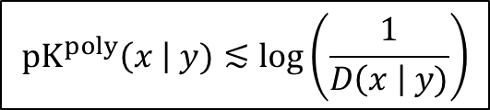
OWFs and Average-Case Conditional Coding
Lemma:
Infinitely-often one-way functions do not exist
Average-case conditional coding holds
Proof Sketch: Assume we can invert OWFs, we want to show w.h.p over $\left(x,y\right)∼D$
$$pK^{poly}\left(x \right| y)≲\log\left(\frac{1}{D\left(x \right| y)}\right)$$

Slide 52
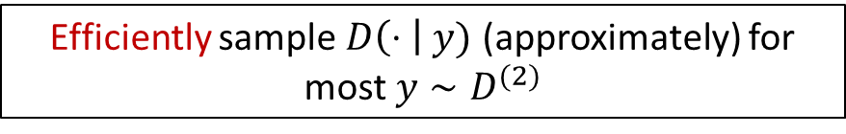
OWFs and Average-Case Conditional Coding
Lemma:
Infinitely-often one-way functions do not exist
Average-case conditional coding holds
Proof Sketch: Assume we can invert OWFs, we want to show w.h.p over $\left(x,y\right)∼D$
$$pK^{poly}\left(x \right| y)≲\log\left(\frac{1}{D\left(x \right| y)}\right)$$
Theorem (Extrapolators) [Impagliazzo-Luby’89, Impagliazzo-Levin’90]:
One-way functions do not exist
Efficiently sample $D\left(⋅ \right| y)$ (approximately) for most $y∼D^{(2)}$

Slide 53
OWFs and Average-Case Conditional Coding
Lemma:
Infinitely-often one-way functions do not exist
Average-case conditional coding holds
Proof Sketch: Assume we can invert OWFs, we want to show w.h.p over $\left(x,y\right)∼D$
$$pK^{poly}\left(x \right| y)≲\log\left(\frac{1}{D\left(x \right| y)}\right)$$
Theorem (Extrapolators) [Impagliazzo-Luby’89, Impagliazzo-Levin’90]:
One-way functions do not exist
Efficiently sample $D\left(⋅ \right| y)$ (approximately) for most $y∼D^{(2)}$
Idea:
Use the efficient extrapolator as a proxy for the conditional distribution
Apply the original coding theorem!

Slide 54
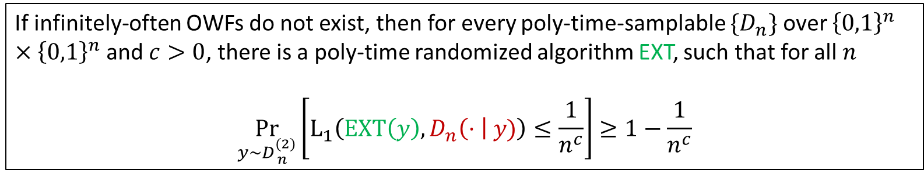

Extrapolation
Theorem [Impagliazzo-Luby’89, Impagliazzo-Levin’90]:
One-way functions do not exist
Efficient simulation of $D\left(⋅ \right| y)$ for most $y∼D^{(2)}$
If infinitely-often OWFs do not exist, then for every poly-time-samplable ${\{D}_{n}\}$ over ${\left\{0,1\right\}}^{n}×{\left\{0,1\right\}}^{n}$and $c>0$, there is a poly-time randomized algorithm EXT, such that for all $n$
$$\underset{y∼D_{ n}^{(2)}}{Pr}\left[L_{1}\left(EXT\left(y\right),D_{n}\left(⋅ \right| y)\right)≤\frac{1}{n^{c}}\right]≥1−\frac{1}{n^{c}}$$

Slide 55
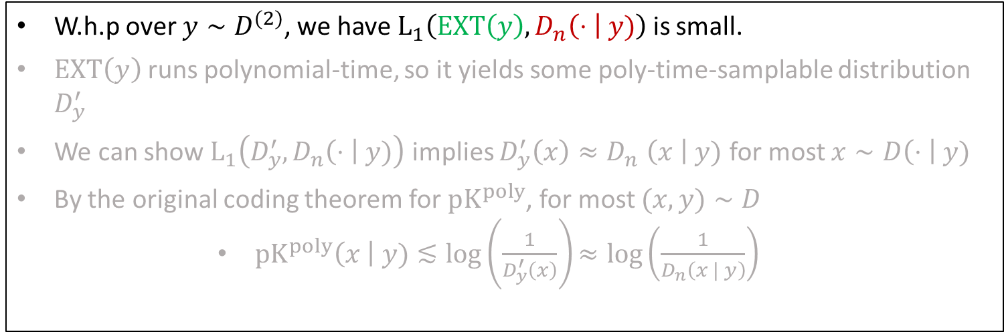
OWFs and Average-Case Conditional Coding
Lemma:
Infinitely-often one-way functions do not exist
Average-case conditional coding holds
Proof Sketch:
W.h.p over $y∼D^{(2)}$, we have $L_{1}\left(EXT\left(y\right),D_{n}\left(⋅ \right| y)\right)$ is small.
$EXT\left(y\right)$ runs polynomial-time, so it yields some poly-time-samplable distribution $D_{y}^{′}$
We can show $L_{1}\left(D_{y}^{′},D_{n}\left(⋅ \right| y)\right)$ implies $D_{y}^{′}\left(x\right){≈D}_{n}\left(x \right| y)$ for most $x∼D\left(⋅ \right| y)$
By the original coding theorem for $pK^{poly}$, for most $(x,y)∼D$
        $pK^{poly}\left(x \right| y)≲\log\left(\frac{1}{D_{y}^{′}\left(x\right)}\right)≈log\left(\frac{1}{D_{n}\left(x | y\right)}\right)$

Slide 56
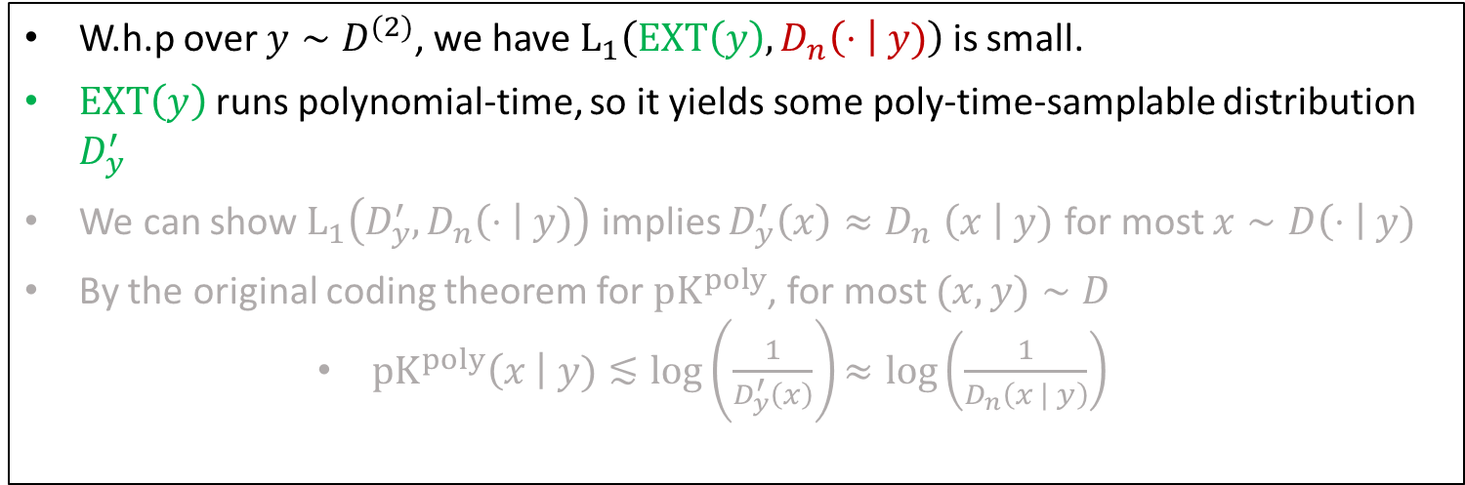
OWFs and Average-Case Conditional Coding
Lemma:
Infinitely-often one-way functions do not exist
Average-case conditional coding holds
Proof Sketch:
W.h.p over $y∼D^{(2)}$, we have $L_{1}\left(EXT\left(y\right),D_{n}\left(⋅ \right| y)\right)$ is small.
$EXT\left(y\right)$ runs polynomial-time, so it yields some poly-time-samplable distribution $D_{y}^{′}$
We can show $L_{1}\left(D_{y}^{′},D_{n}\left(⋅ \right| y)\right)$ implies $D_{y}^{′}\left(x\right){≈D}_{n}\left(x \right| y)$ for most $x∼D\left(⋅ \right| y)$
By the original coding theorem for $pK^{poly}$, for most $(x,y)∼D$
        $pK^{poly}\left(x \right| y)≲\log\left(\frac{1}{D_{y}^{′}\left(x\right)}\right)≈log\left(\frac{1}{D_{n}\left(x | y\right)}\right)$

Slide 57
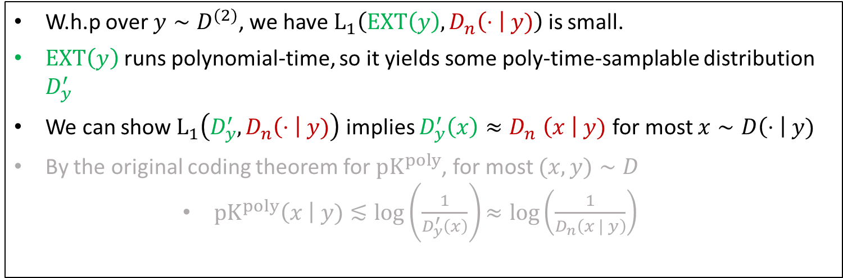
OWFs and Average-Case Conditional Coding
Lemma:
Infinitely-often one-way functions do not exist
Average-case conditional coding holds
Proof Sketch:
W.h.p over $y∼D^{(2)}$, we have $L_{1}\left(EXT\left(y\right),D_{n}\left(⋅ \right| y)\right)$ is small.
$EXT\left(y\right)$ runs polynomial-time, so it yields some poly-time-samplable distribution $D_{y}^{′}$
We can show $L_{1}\left(D_{y}^{′},D_{n}\left(⋅ \right| y)\right)$ implies $D_{y}^{′}\left(x\right){≈D}_{n}\left(x \right| y)$ for most $x∼D\left(⋅ \right| y)$
By the original coding theorem for $pK^{poly}$, for most $(x,y)∼D$
        $pK^{poly}\left(x \right| y)≲\log\left(\frac{1}{D_{y}^{′}\left(x\right)}\right)≈log\left(\frac{1}{D_{n}\left(x | y\right)}\right)$

Slide 58
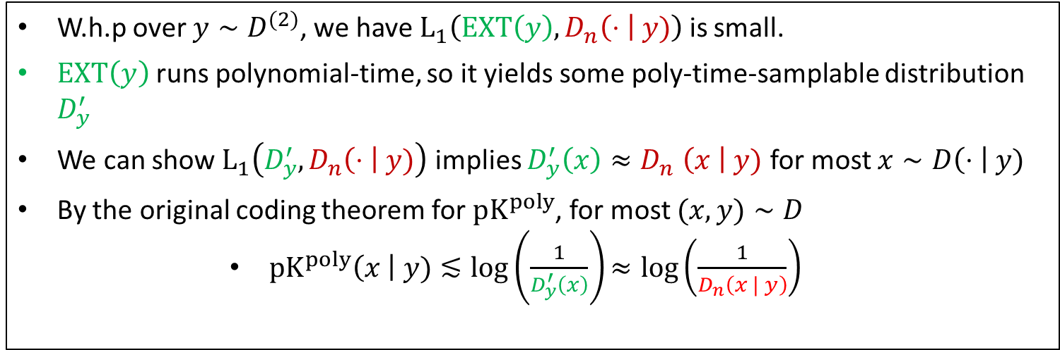
OWFs and Average-Case Conditional Coding
Lemma:
Infinitely-often one-way functions do not exist
Average-case conditional coding holds
Proof Sketch:
W.h.p over $y∼D^{(2)}$, we have $L_{1}\left(EXT\left(y\right),D_{n}\left(⋅ \right| y)\right)$ is small.
$EXT\left(y\right)$ runs polynomial-time, so it yields some poly-time-samplable distribution $D_{y}^{′}$
We can show $L_{1}\left(D_{y}^{′},D_{n}\left(⋅ \right| y)\right)$ implies $D_{y}^{′}\left(x\right){≈D}_{n}\left(x \right| y)$ for most $x∼D\left(⋅ \right| y)$
By the original coding theorem for $pK^{poly}$, for most $(x,y)∼D$
        $pK^{poly}\left(x \right| y)≲\log\left(\frac{1}{D_{y}^{′}\left(x\right)}\right)≈log\left(\frac{1}{D_{n}\left(x | y\right)}\right)$

Slide 59
Techniques (rK^{quasipoly})
Key Difficulty: We don’t have a coding theorem for rK^{poly}

Slide 60
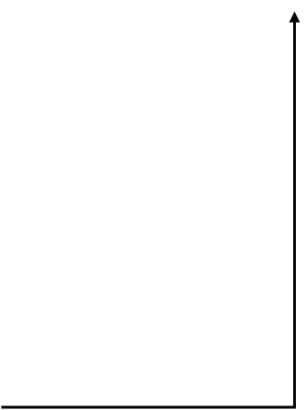
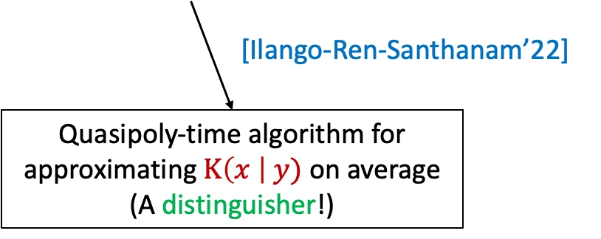
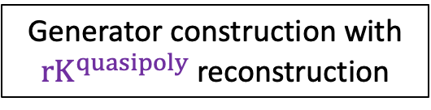
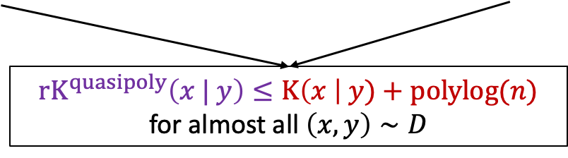
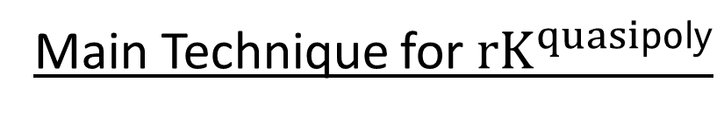
Main Technique for${ rK}^{quasipoly}$
(Key Perspective: Meta-Complexity)

Slide 61
General Theory

Slide 66
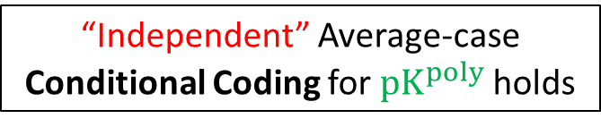
Capturing average-case complexity
Theorem [This Work]:
“Independent” Average-case Conditional Coding for $pK^{poly}$holds
DistNP ⊆ HeurBPP

Slide 67
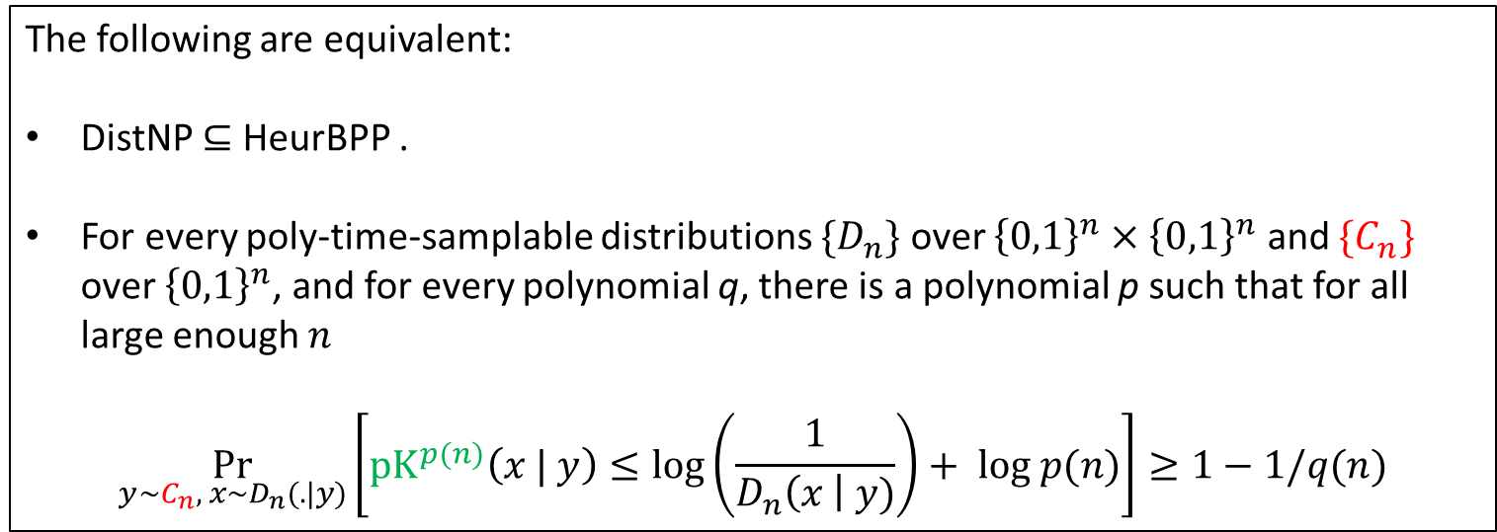
Capturing average-case complexity
Theorem [This Work]:
“Independent” Average-case Conditional Coding for $pK^{poly}$holds
DistNP ⊆ HeurBPP
The following are equivalent:
DistNP ⊆ HeurBPP .
For every poly-time-samplable distributions $\{D_{n}\}$ over ${\left\{0,1\right\}}^{n}×{\left\{0,1\right\}}^{n}$ and $\{C_{n}\}$ over ${\left\{0,1\right\}}^{n}$, and for every polynomial q, there is a polynomial p such that for all large enough $n$
$$\underset{y\sim C_{n}, x∼D_{n}(.|y)}{Pr}\left[{pK}^{p(n)}\left(x | y\right)≤\log\left(\frac{1}{D_{n}\left(x \right| y)}\right)+ log p(n)\right]≥1−1/q(n)$$

Slide 68
Open Problems

Slide 69
1. Understand the role of (worst-case) SoI in complexity theory
2. Further progress on the relation between key open problems from complexity theory?

Slide 70
Thank you
(Special thanks to Zhenjian and Mikito for several slides)

Slide 71
Appendix

Slide 72
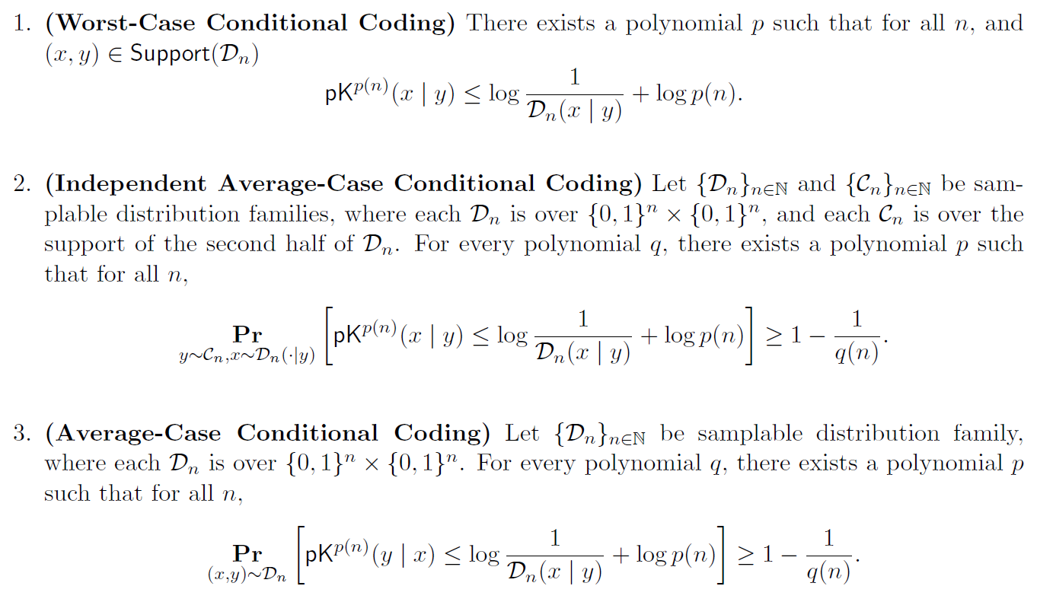
Conditional Coding

Slide 73
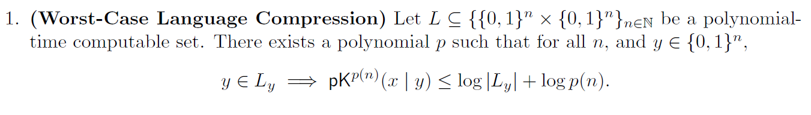
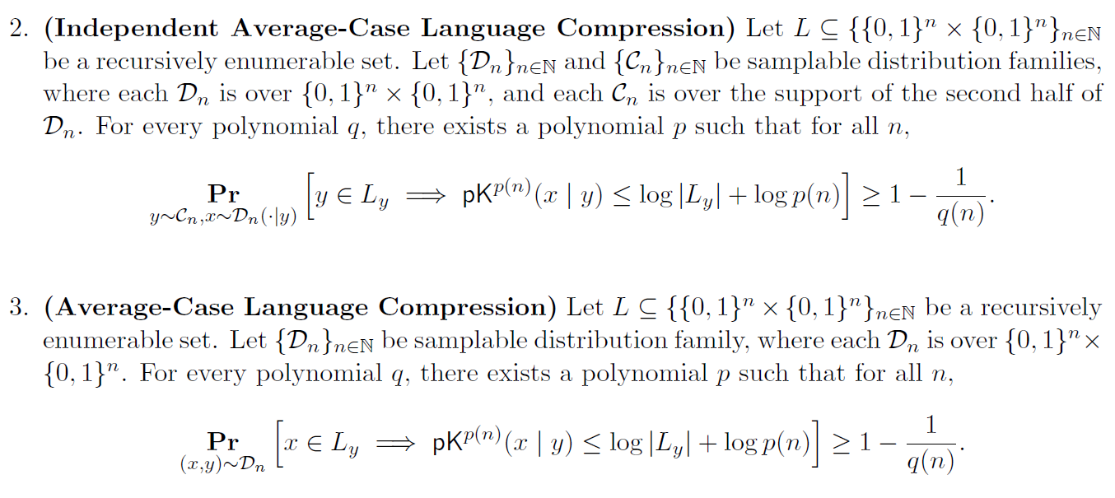
Language Compression

Slide 74
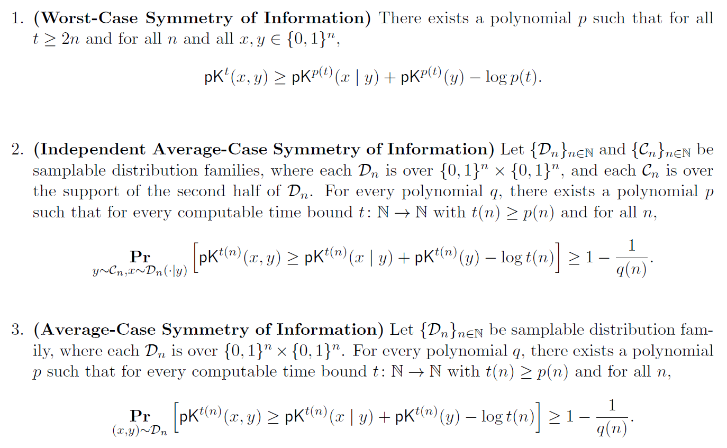
Symmetry of Information

