Slide 1


Hardness Magnification
STOC 2020 Workshop
MCSP and Hardness Magnification
Igor Carboni Oliveira
University of Warwick
Supported by a Royal Society University Research Fellowship
1

Slide 2
1. What is exciting about HM?
2

Slide 3
Some current lower bound frontiers:
- Super-linear lower bounds against unrestricted Boolean circuits.
- Cubic lower bounds against de Morgan formulas.
- Super-polynomial lower bounds against depth-2 threshold circuits.
Due to well-known barriers, investigating new approaches to LBs is crucial.
3

Slide 4
When minor advances yield major lower bounds
Positive/Negative
interpretations
Research from the last 10 years shows that:
- Minor improvements in Algorithms -> Breakthroughs in LBs
[Wil’10] Non-trivial SAT algorithms for poly-size formulas -> super-poly formula LBs!
- Maybe minor improvements in Lower Bounds -> Breakthroughs in LBs?
Yes! More systematic investigation in [AK’10] under the name “hardness amplification”.
almost-linear size TC⁰ lower bounds for some problems -> super-poly TC⁰ lower bounds!
4

Slide 5
Striking aspect of recent developments in HM:
Hardness Magnification
Recent results showing that weak lower bounds imply strong lower bounds.
What is new compared to [AK’10] and related works?
[AK’10] Required almost-linear size TC⁰ lower bounds are not known for any explicit problem.
Interesting magnification results in settings where we do have lower bounds.
5

Slide 6
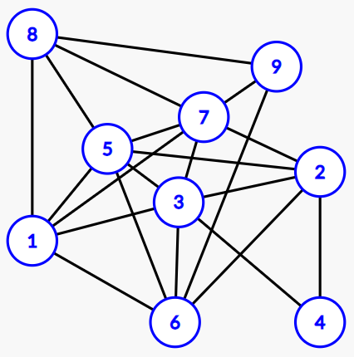
Example: Magnification from AC⁰ lbs
Consider the problem of detecting huge cliques on graphs:
[Andreev-Jukna’08]
Hardness Magnification Phenomenon
[CHOPRS’20]
6

Slide 7
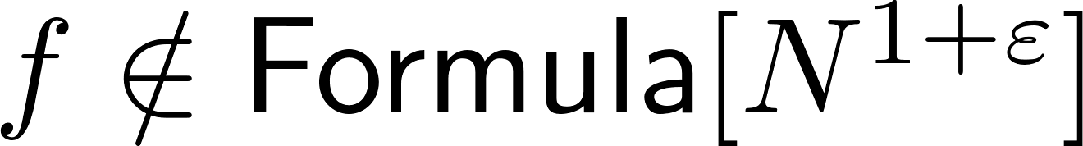
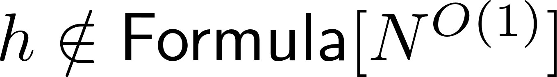
Hardness Magnification and Natural Proofs
Properties that are constructive, large, useful
Magnification applies to specific problems!
Unclear how to extract from
weak lower bound + magnification
a property showing hardness of most Boolean functions.
7

Slide 8
This seems exciting…
Are we close to getting new lower bounds?
8

Slide 9
2. A layer of parities away from a breakthrough
9

Slide 10
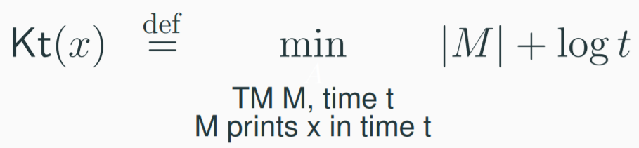

HM and String Complexity
Unconditional Lower Bounds & Hardness Magnification
Does this phenomenon hold for more problems?
Can we prove the required lower bounds?
10

Slide 11
Extensions
Does this phenomenon hold for more problems?
[CMMW’19] and [CJW’19] identified SPARSITY of languages as key property in HM.
Weak lower bounds for a SPARSE language in NP -> Breakthroughs in Complexity
11

Slide 12
MCSP and lower bounds against Formula-XOR
Can we prove the required lower bounds?
Sparsity not an issue in previous LBs:
Until recently, only known super-linear LB against Formula-XOR was [Tal’17] for Boolean InnerProduct_{N}.
Not “sparse” enough for HM…
12

Slide 13
3. Hardness Magnification Proofs and Locality
13

Slide 14
(Simplified) Structure of typical HM proof
[CHOPRS’20]
Compression Stage
Final Construction
Extremely efficient way of converting
m-bit input instance into NP-subproblems of size t = m^{o(1)} (or even smaller)
Under our easiness assumption, subproblems can be solved by small devices of size poly(t) << m^{o(1)}
14

Slide 15
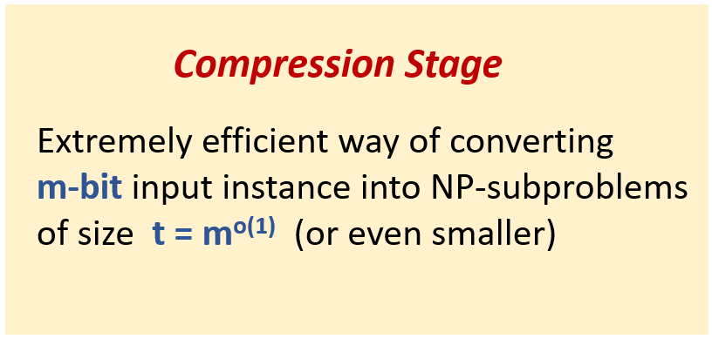
Remarks
- Most proofs go beyond compression/kernelization techniques:
easiness assumption might be needed at this stage
- HM proofs combine insights from algorithms & complexity theory.
Missing component is “combinatorial” lower bound.
- Parity gates often quite powerful in low-level efficient constructions:
Error-correcting codes and hash functions
15

Slide 16
[CHOPRS’20] A locality barrier
HM shows that weak lower bounds for some problems imply major complexity lower bounds.
Compression Stage
Final Construction
Extremely efficient way of converting
m-bit input instance into NP-subproblems of size t = m^{o(1)} (or even smaller)
Under our easiness assumption, subproblems can be solved by small devices of size poly(t) << m^{o(1)}
Almost self-defeating:
Proof strategy UNCONDITIONALLY shows that same problems admit weak circuits with small fan-in oracles (“local” oracle computations).
16

Slide 17
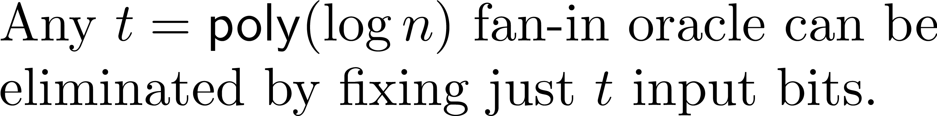
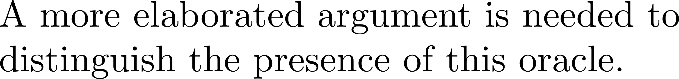

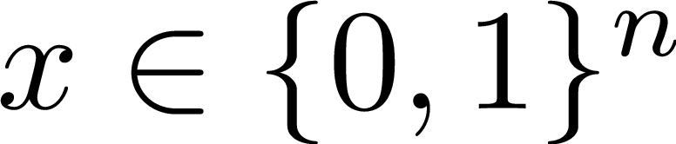
Why do lower bound proofs “localize”?
- AC⁰ and Random restrictions
- Polynomial Method
17

Slide 18
Consequences of locality
- Simple adaptations of known lower bounds won’t work.
bounded fan-in
Size parameter needed in HM
- Reductions from a “localizable” lower bound won’t work.
18

Slide 19
4. Directions for future work
19

Slide 20
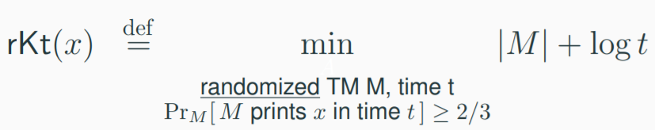

Beyond the locality barrier
Locality poses a significant challenge, but it does not capture all instantiations of HM.
MrKtP: decide rKt complexity of input string in {0,1}^{N}
Interesting to understand techniques in circuit complexity that do not extend to small fan-in oracles.
20

Slide 21
Proof complexity
The work of Muller and Pich (2017) in proof complexity inspired several recent HM results.
[MP’17] showed that (weak) constant-depth Frege lower bounds for “truth-table tautologies” imply super-poly Frege lower bounds.
Connected to the program of showing unprovability of circuit lower bounds in Propositional Proof Complexity.
Desired LBs are known for Resolution and Res(k), as shown by [Raz’02] and [Razborov’03].
Notion of locality/oracles is unclear & HM is not well understood in Proof Complexity
21

Slide 22
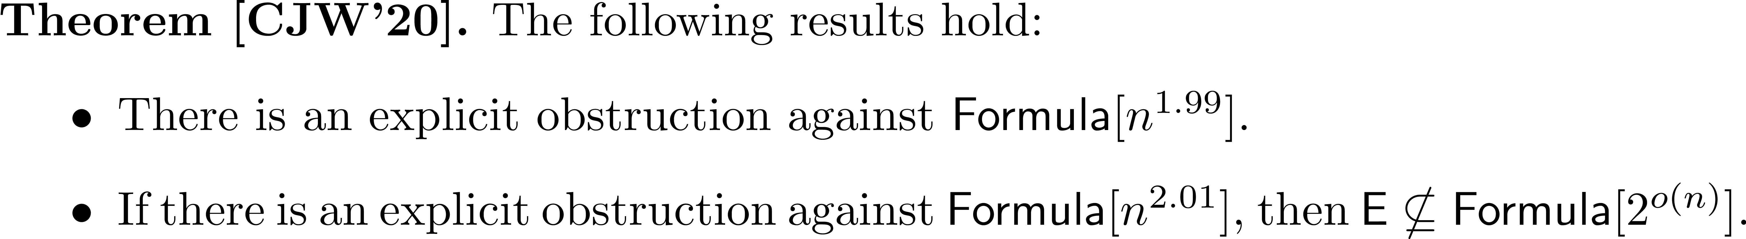
Obstructions and sharp thresholds in HM
Again, it is unclear if a locality barrier applies in this setting!
22

Slide 23
Key takeaways
Extending some known LBs by very little -> breakthroughs in complexity.
Locality barrier: most (but not all) LB techniques are not refined enough.
My personal take:
HM part of our “complexity toolbox” & new surprising results within reach.
23

Slide 24
HM references mentioned in this talk:
[AK’10] Amplifying lower bounds by means of self-reducibility (JACM’10).
[MP’17] Feasibly constructive proofs of succinct weak circuit lower bounds (Annals of Pure and Applied Logic).
[OS'18] Hardness magnification for natural problems (FOCS'18).
[OPS'19] Hardness magnification near state-of-the-art lower bounds (CCC'19).
[CMMW'19] Relations and equivalences between circuit lower bounds and Karp-Lipton theorems (CCC'19).
[MMW'19] Weak lower bounds on resource-bounded compression imply strong separations of complexity classes (STOC'19).
[O’19a] Randomness and intractability in Kolmogorov complexity (ICALP'19).
[O’19b] Advances in Hardness Magnification (Notes/Simons Talk).
[CJW'19] Hardness magnification for all sparse languages (FOCS'19).
[CHOPRS'20] Beyond natural proofs: hardness magnification and locality (ITCS'20).
[KKLMO'20] Algorithms and lower bounds for de Morgan formulas of low-communication leaf gates (CCC’20).
[CJW'20] Sharp threshold results in computational complexity (STOC’20).
24

