Slide 1
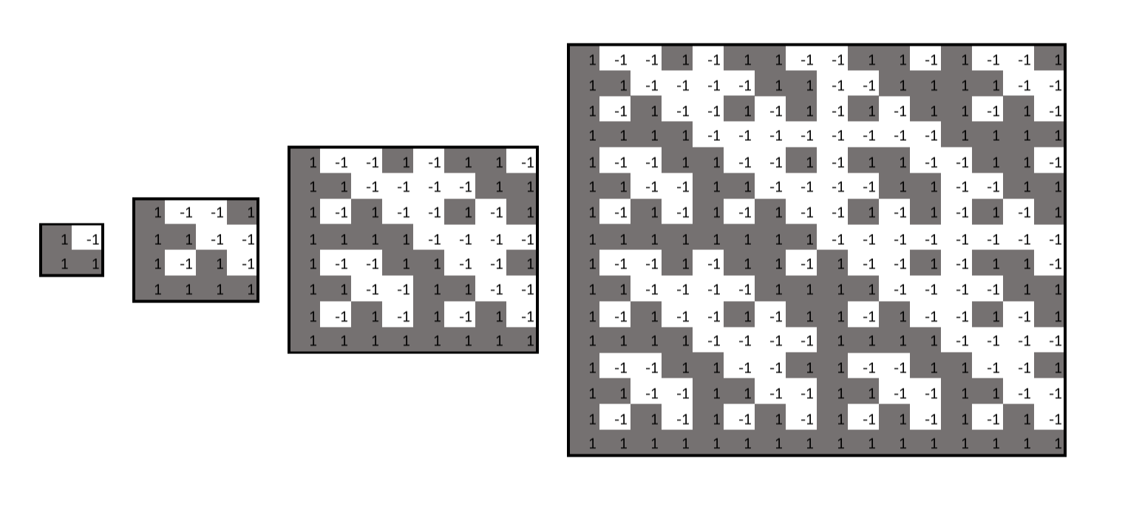
Kronecker Products, Low-Depth Circuits, and Matrix Rigidity
Josh Alman (Harvard)
Oxford-Warwick Complexity Meetings, April 2021

Slide 2
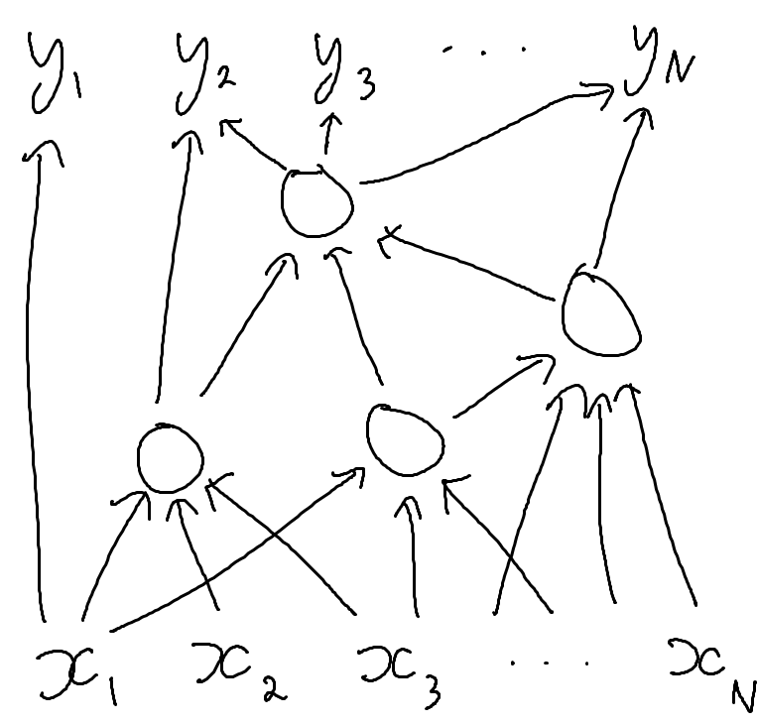
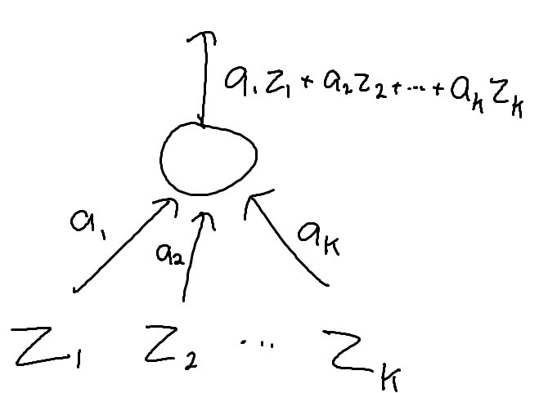
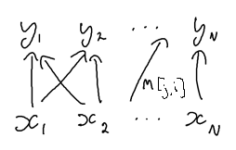
Linear Circuits
Linear circuit over a field $𝔽$ (think $𝔽=ℂ$)
Circuit with $N$ inputs and $N$ outputs
Each gate computes an $𝔽$-linear combination of its inputs
Every linear circuit computes a linear transformation $M∈𝔽^{N×N}$, i.e., $y=Mx$.
Size = # of wires
Depth = length of longest input-output path
Every $M$ has depth-1 circuit of size $nnz(M)$
When does $M$ have a smaller circuit?

Slide 3
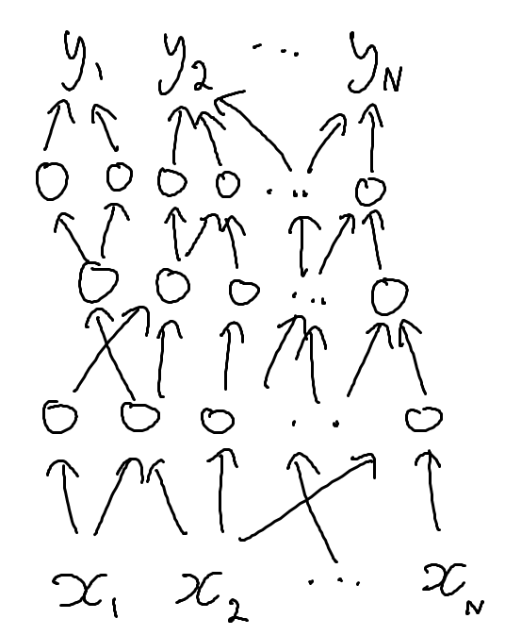
Synchronous Linear Circuits
Edges only go from one layer to the next
Depth-$d$ linear circuit can be made synchronous with size blow-up only $×d$
Depth-$d$ size $s$ synchronous linear circuit for $M$:
$$M=A_{1}×A_{2}×⋯×A_{d}$$
For matrices $A_{1},…,A_{d}$ with $\sum_{i=1}^{d}{nnz(A_{i})}=s$

Slide 4
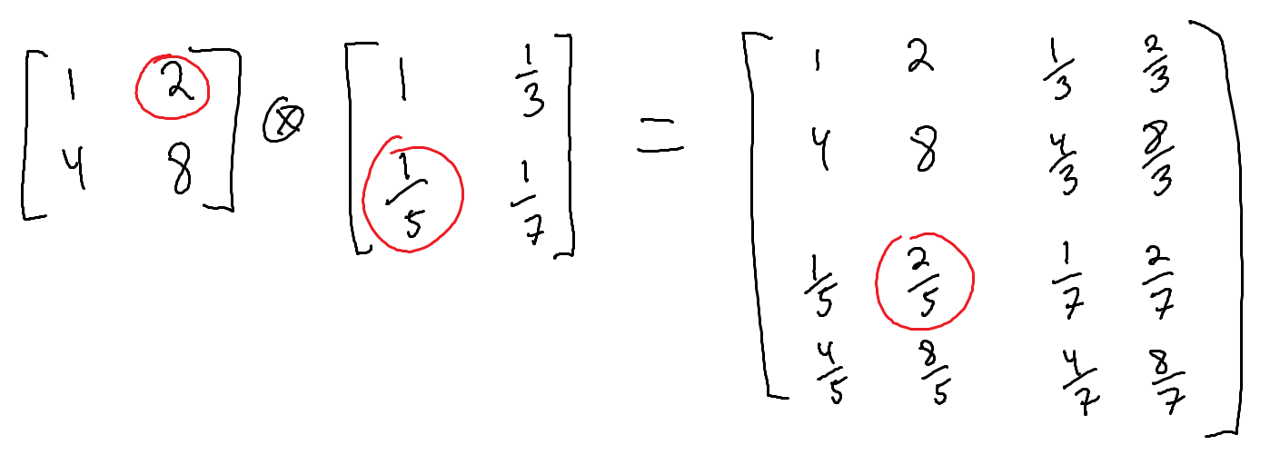
Kronecker Product
For matrices $X∈𝔽^{a×b}, Y∈𝔽^{c×d}$
The Kronecker product is a matrix $X⊗Y∈𝔽^{ac×bd}$
For $i∈\left[a\right],j∈\left[b\right],i^{′}∈\left[c\right],j^{′}∈[d]$, $X⊗Y\left[\left(i,i^{′}\right),\left(j,j^{′}\right)\right]=X\left[i,j\right]⋅Y[i^{′},j^{′}]$

Slide 5
Walsh-Hadamard Transform
$H_{1}=\left[\begin{matrix}1 & −1 \\ 1 & 1\end{matrix}\right], H_{n}=H_{1}^{⊗n}∈{\left\{−1,1\right\}}^{2^{n}×2^{n}}$
If $p\left(x_{1},…,x_{n}\right)$ is a multilinear polynomial, and $c∈𝔽^{2^{n}}$ is the vector of its coefficients, $H_{n}c$ evaluates $p$ on all points in ${\left\{−1,1\right\}}^{n}$.
“Fast Walsh-Hadamard”: $H_{n}$ has depth-$d$ synchronous linear circuit of size $O(d N^{1+\frac{1}{d}})$
Depth $O(\log{N})$ size $O(N\log{N})$
Depth 2 size $O(N^{1.5})$
Today: Smaller circuit for any depth $d$
$$N=2^{n}$$

Slide 6
New Low-Depth Circuit for $H_{n}$
New Theorem: Over any field, $H_{n}$ has depth-2 circuit of size $O(N^{1.48})$
Depth-$d$ circuit of size $O(d⋅N^{1+\frac{0.96}{d}})$
[Pudlák 2000]: Lower bound for bounded-coefficient circuits over $ℂ$ Depth-2 circuits for $H_{n}$ require size $Ω(N^{1.5})$
Depth-$d$ circuits require size $Ω(d⋅N^{1+\frac{1}{d}})$
First non-trivial upper bound circumventing a bounded-coeff. lower bound [Morgenstern ‘73, …]
Bounded-coefficient circuit over $ℂ$:
The coefficients in the linear combinations computed by each gate have magnitude $O(1)$

Slide 7
Mixed Product Property
Kronecker Product: $⊗$
(Usual) Matrix Product: $×$
$$\left(A⊗B\right)×\left(C⊗D\right)=\left(A×C\right)⊗(B×D)$$
Lemma: $H_{n}$ has depth 2 circuits of size $O(N^{1.5})$
$N=2^{n}$ $I=2^{n/2}×2^{n/2}$ identity matrix
$$H_{n} \\ =H_{n/2}⊗H_{n/2} \\ =\left(H_{n/2}×I\right)⊗\left(I×H_{n/2}\right) \\ =\left(H_{n/2}⊗I\right)×\left(I⊗H_{n/2}\right)$$
$$nnz\left(H_{n/2}⊗I\right) \\ =nnz\left(H_{n/2}\right)⋅nnz\left(I\right) \\ =N⋅\sqrt{N}=N^{1.5}$$

Slide 8
Matrix Rigidity
Matrix $M$ is rigid if it is far from any low-rank matrix (in Hamming dist)
$ℛ_{M}\left(r\right)=$minimum # of entries one needs to change in $M$ to make its rank $≤r$
E.g., if $I_{N}$ is the $N×N$ identity matrix, then for all $r$,
Random $N×N$ matrix $M_{N}∈𝔽_{2}^{N×N}$ is very rigid with high probability:
$$ℛ_{I_{N}}\left(r\right)=N−r$$
$ℛ_{M_{N}}\left(r\right)=Ω(N^{2})$ for $r=o(N)$
[L. Valiant ‘77] Every $M∈𝔽^{N×N}$ computable by $O(N)$-size $O(log N)$-depth arithmetic circuits has, for all $ε>0$,
$$ℛ_{M}\left(O\left(\frac{N}{\log{\log{N}}}\right)\right)<N^{1+ε}.$$
Today: Use Rigidity Upper Bounds for Kronecker Products to give linear circuit upper bounds

Slide 9
Rigidity & $H_{n}$
$H_{n}$ is not rigid enough to prove lower bounds using Valiant’s approach [A-Williams, 2017]
for $ε>0$, the matrix $H_{n}∈{\left\{−1,1\right\}}^{N×N}$ has $ℛ_{H_{n}}\left(N^{1−{O(ε}^{2})}\right)<N^{1+ε}$
For any $M∈𝔽^{N×N}$ and any rank $r$, $M$ has a depth-2 circuit of size $2Nr+ℛ_{M}(r)$
Can write $M=U×V+S$, where
$U∈𝔽^{N×r}$
$V∈𝔽^{r×N}$
$nnz\left(S\right)=ℛ_{M}(r)$
Thus, $H_{n}$ has a depth-2 circuit of size $O(N^{2−δ})$
Worse than $O(N^{1.5})$

Slide 10
New Depth-2 Circuit Plan
It suffices to construct a depth-2 synchronous circuit of size $2⋅{(2^{k})}^{1.48}$for $H_{k}∈{\left\{−1,1\right\}}^{2^{k}×2^{k}}$ for any fixed integer $k$
We do this for $k=8$. Key idea: a new rigidity upper bound for $H_{4}$.

Slide 11
Generalizing fixed-size circuits for $H_{n}$
Lemma: If there are fixed $c∈ℝ$ and $k∈ℕ$ and matrices $A,B$ such that $H_{k}=A×B$, $nnz\left(A\right)≤2^{c⋅k}$, and $nnz\left(B\right)≤2^{c⋅k}$,
then $H_{n}$ has a depth-2 circuit of size $O(N^{c})$ for all $n∈ℕ$.
Proof:
$$H_{n}={\left(H_{k}\right)}^{⊗n/k}={\left(A×B\right)}^{⊗n/k}=A^{⊗n/k}×B^{⊗n/k}$$
$$nnz\left(A^{⊗n/k}\right)=nnz{\left(A\right)}^{n/k}={\left(2^{c⋅k}\right)}^{n/k}=2^{c⋅n}$$

Slide 12
Constructing fixed-size circuits for $H_{8}$
New goal: Find matrices $A,B$ such that $H_{8}=A×B$ and $nnz\left(A\right),nnz\left(B\right)≤2^{1.48⋅8}$
Show new rigidity upper bound: $ℛ_{H_{4}}\left(1\right)≤96$
Use this to construct $A,B$

Slide 13
Rigidity Upper Bound for $H_{n}$
$$ℛ_{H_{2}}\left(1\right)=4$$
$$H_{2}=\left[\begin{matrix}\begin{matrix} 1 & 1 \\ 1 & −1\end{matrix} & \begin{matrix} 1 & 1 \\ 1 & −1\end{matrix} \\ \begin{matrix} 1 & 1 \\ 1 & −1\end{matrix} & \begin{matrix}−1 & −1 \\ −1 & 1\end{matrix}\end{matrix}\right]≈\left[\begin{matrix}\begin{matrix}−1 & 1 \\ 1 & −1\end{matrix} & \begin{matrix} 1 & 1 \\ −1 & −1\end{matrix} \\ \begin{matrix} 1 & −1 \\ 1 & −1\end{matrix} & \begin{matrix}−1 & −1 \\ −1 & −1\end{matrix}\end{matrix}\right]=:L$$
$$ℛ_{H_{4}}\left(1\right)=96$$
$$H_{4}=H_{2}⊗H_{2}≈L⊗L$$
Entries of $L⊗L$ correspond to pairs of entries of $L$
Equals the entry of $H_{2}⊗H_{2}$ if both are correct, or both are wrong
$$\#correct={\left(correct entries of L\right)}^{2}+{\left(wrong entries of L\right)}^{2}={12}^{2}+4^{2}=160$$
$$\#incorrect=256−160=96$$

Slide 14
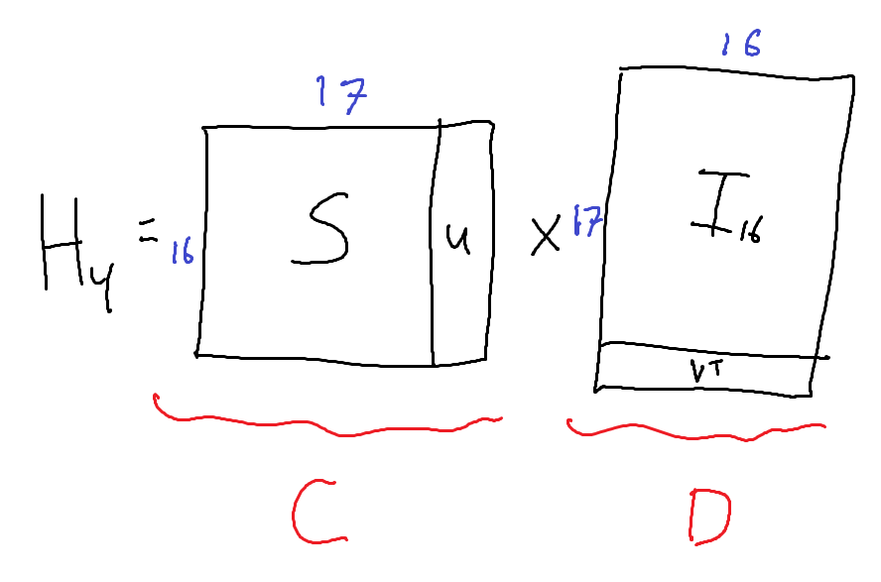
$H_{8}$ construction
Rigidity upper bound: $H_{4}=S+uv^{T}$
$nnz\left(S\right)=96$
$u,v∈{\left\{−1,1\right\}}^{16}$
Convert to synchronous circuit: $H_{4}=C×D$ with
$nnz\left(C\right)=96+16=112$
$nnz\left(D\right)=16+16=32$
(similarly $H_{4}=H_{4}^{T}=D^{T}×C$)
$$H_{8}=H_{4}⊗H_{4}=\left(C×D\right)⊗\left(D^{T}×C^{T}\right)=\left(C⊗D^{T}\right)×(D⊗C^{T})$$
$$nnz\left(C⊗D^{T}\right)=nnz\left(C\right)⋅nnz\left(D\right)=112⋅32=3584≤2^{8⋅1.48}$$

Slide 15
Extensions?
Smaller circuits from better rigidity upper bounds?
Computer search found $ℛ_{H_{k}}(r)$ for $r∈\{1,2\}$, $k∈\{1,2,3,4,5\}$
Other Kronecker powers?
Yes! Can achieve depth-2 size $O(N^{1.49})$ for $M^{⊗n}∈𝔽^{N×N}$ for any $M∈𝔽^{2×2}$
Unbounded-depth circuits?
Yes! Improve from $≈1.88 N \log_{2}N$ (fast WHT) to $≈1.81 N \log_{2}N$
Fourier transform?
Known rigidity lower bounds rule out this specific approach
Can’t rule out sparse rigidity upper bounds, or other approaches

Slide 16
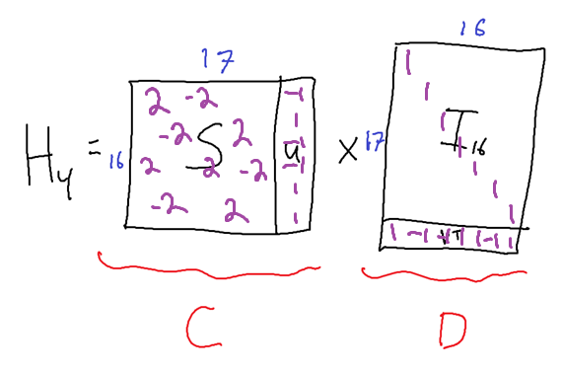
Unbounded-Coefficient Circuits
The matrices $C,D$ have entries that are $±1$ and $±2$
Circuit for $H_{n}$ has coefficients which are $±$ powers of $2$ between $1$ and $N^{O(1)}$.
Can we find a new barrier?

Slide 17
One other result
For any field $𝔽$ and function $f:{\left\{0,1\right\}}^{n}→𝔽$, define $M_{f}∈𝔽^{2^{n}×2^{n}}$ by, for $x,y∈{\left\{0,1\right\}}^{n}$, $M_{f}\left[x,y\right]=f(x∧y)$
E.g., when $f=PARITY$, then $M_{f}=H_{n}$
New Theorem: For all $f$: $ℛ_{M_{f}}\left(N^{1−O\left(ε^{2}\right)}\right)≤N^{1+ε}$, i.e., $M_{f}$ is not rigid enough to prove lower bounds using Valiant’s approach
Generalizes [A-Williams ‘17] from $H_{n}$ to $M_{f}$ for any $f$
Doesn’t use the polynomial method!

Slide 18
Thank you!

