Slide 1
Learning from Equivalence Queries and
Unprovability of Circuit Upper Bounds
Igor Carboni Oliveira
University of Warwick
Mathematical Approaches to Lower Bounds: Complexity of Proofs and Computation
ICMS, Edinburgh
July 2022
Based on joint papers with J. Krajíček, J. Bydžovský, M. Carmosino, V. Kabanets, and A. Kolokolova

Slide 2
Limited progress in understanding the limits of algorithms and Boolean circuits
Are we asking the right questions?
Complexity Theory: seeks to rule out algorithms that compute in time T
(it doesn’t consider the difficulty of proving their correctness)
Circuit Complexity Theory: seeks to rule out circuits of size S
(it doesn’t consider the difficulty of proving their existence and correctness)

Slide 3
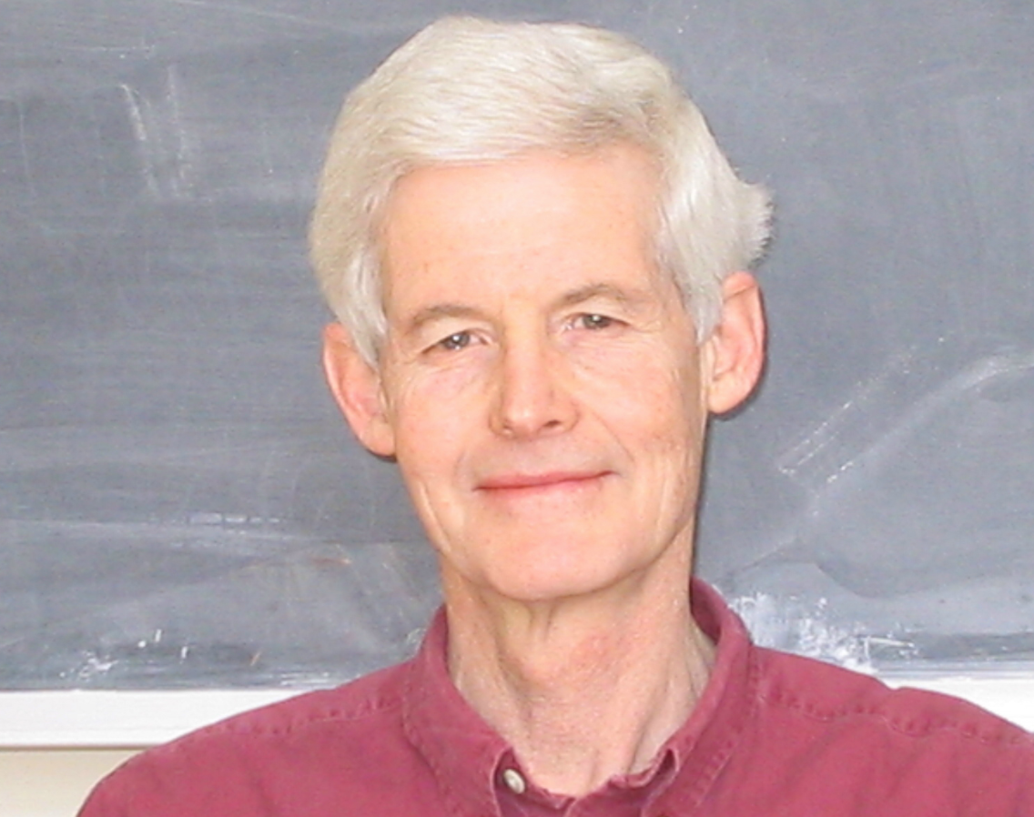
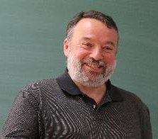
Interested in a refined complexity theory that also considers provability
Want to rule out efficient algorithms/circuits with respect to a logical theory T
Relax our goal of showing that P ≠ NP, NP ⊈ SIZE[n³], etc. to
Theory T does not prove that P = NP
Theory T does not prove that NP ⊆ SIZE[n³]
Necessary before showing corresponding lower bounds
Initiated by S. Cook and J. Krajíček:

Slide 4
Theories of Bounded Arithmetic

Slide 5
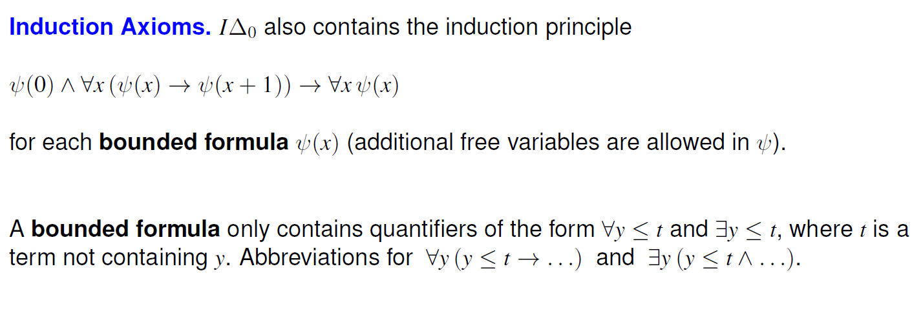

Slide 6
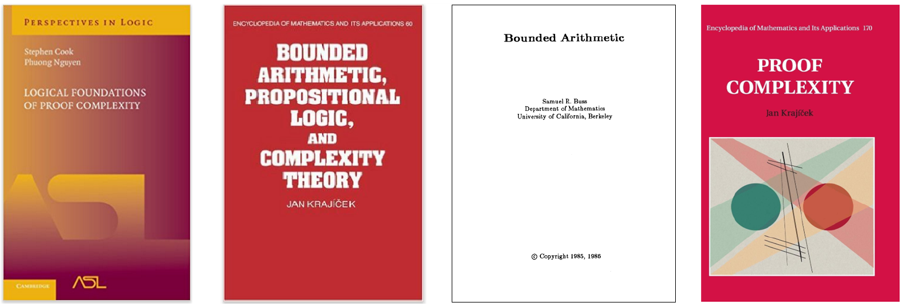
Contributions
We consider several established
theories of bounded arithmetic:
Many interesting algorithms and complexity results can be formalized in such theories.
Randomized Matching Algorithms in APC¹ [TriManLe-Cook’11]
Arnold Beckman’s survey on Friday
Azza Gaysin’s talk on formalizing Dmitriy Zhuk’s CSP algorithm in
In contrast, we show that several circuit upper bounds cannot be proved in these theories.

Slide 7
Unprovability Results
Related work:
Recent progress on unprovability of circuit lower bounds
Cook-Krajicek’07
Bydzovsky-Muller’20
[Krajicek-O’17]
[CKKO’21]
Unified approach via LEARNING
[Bydzovsky-Krajicek-O’20]
[Bydzovsky-Krajicek-O’20]
[Carmosino-Kabanets-Kolokolova-O’21]
Remarks:
Unconditional
As theories get stronger, we can only rule out stronger inclusions
APC¹: unprovability result is close to known unconditional lower bound

Slide 8
[CKKO’21]: Unprovability via Learning
We argue by contradiction
Suppose theory T can prove that a language L is contained in SIZE[$n^{k}$]
Non-uniform upper bound:
For every n, there is a small circuit C, for every input x, C(x) = L(x)
This sentence claims the existence of a sequence of small circuits for L

Slide 9
A proof of the existence of an object often provides more information about the object than just its existence.
We explore standard techniques from logic (witnessing theorems) to extract a learning algorithm from a proof in bounded arithmetic
To complete the argument:
We argue (outside T) that corresponding learning algorithm that constructs circuits for L does not exist.

Slide 10
Learning from Equivalence Queries [Angluin’87]
EQ oracle for language L:
“yes” if c $≡$ L_{n}
Learner selects circuit c of size $≤$ s
x such that c(x) $≠$ L_{n}(x) otherwise
(counterexample)
Definition. We say that L is in $LEARN^{EQ\left[q\right]}$-uniform SIZE[s] if
$∃$ efficient algorithm A(1^{n}) that outputs a circuit of size $≤$s(n) for L_{n} after making $≤$ q(n) EQs.

Slide 11
Example of learning uniformity
If PRIMES in $LEARN^{EQ\left[log n\right]}$-uniform SIZE[9$n^{3}$] then
There is an algorithm A($1^{n}$) that computes as follows:
Runs in poly time and produces EQ $c_{1}$
(receives “yes” or counterexample $x_{1}$)
$≤log n$
queries
Runs in poly time and produces EQ $c_{2}$
(receives “yes” or counterexample $x_{2}$)
…
Outputs a correct circuit of size $≤$9$n^{3}$ for PRIMES_{n}

Slide 12
Example of Formalization [KO’17]
PV cannot prove that P is contained in SIZE[n^{k}]
For a function symbol f in the language of PV (polynomial-time algorithms) and constant c in N,
:
Remark: UP_{k,c} (f) is a $∀∃∀$ $sentence$

Slide 13
From logic to learning via KPT Witnessing

Slide 14
From logic to learning via KPT Witnessing

Slide 15
From logic to learning via KPT Witnessing

Slide 16
From logic to learning via KPT Witnessing
Key point: Applying this result to UP_{k,c} (f) and PV, we get a LEARN-uniform construction of circuits of size cn^{k} for f.

Slide 17
Landscape of circuit uniformity notions
P-uniform SIZE[$n^{k}$]
LEARN^{EQ[q]}-uniform-SIZE[$n^{k}$]
SIZE[$n^{k}$]
Essentially equivalent to FZPP^{NP} uniformity w.r.t. lower bounds:
Efficiently computable from $1^{n}$
Stronger theories: corresponding learning algorithms are more expressive (more queries, randomized)
[Bsh+96]

Slide 18
Unconditional LEARN-Uniform Lower Bounds
[Carmosino-Kabanets-Kolokolova-O’21]
Q. What is the power of a polynomial number of equivalence queries?

Slide 19
Learning a SAT Solver
We consider the problem of learning a SAT Solver for formulas of bitlength n:
SAT Solver: A circuit C such that, on every SATISFIABLE Boolean formula ϕ,
C(ϕ) outputs a satisfying assignment of ϕ
We allow the LEARN-uniform construction to make Search-SAT-EQs:
Search-SAT-EQs: Given a candidate SAT Solver D, either returns CORRECT or provides a counterexample:
Pair (ψ, w) such that ψ(w) = 1 but D(ψ) is not a satisfying assignment for ψ

Slide 20
Techniques
Lower bounds for P (fewer EQs) and for NP (larger number of EQs) rely on different approaches
Indirect diagonalization
Non-trivial: learning procedure can run
in larger time than L
Builds on techniques from
[Santhanam-Williams’14]
LEARN-uniform construction implies collapse of PH to NP/o(n)
Derive non-uniform circuit lower bounds for NP, contradicting initial assumption.
Builds on techniques from
[Cook-Krajicek’07]

Slide 21
Summary of (deterministic) learning lower bounds
[Carmosino-Kabanets-Kolokolova-O’21]

Slide 22
Consequences in logic
These results imply unprovability of circuit upper bounds in theories
For APC¹, the provability of circuit upper bounds leads to RANDOMIZED learning with EQs.
Analyzing circuits constructed with RANDOMNESS + EQs becomes much more challenging.
…
P-uniform SIZE[$n^{k}$]
LEARN^{EQ[q]}-uniform-SIZE[$n^{k}$]
SIZE[$n^{k}$]
Essentially equivalent to FZPP^{NP} uniformity w.r.t. lower bounds

Slide 23
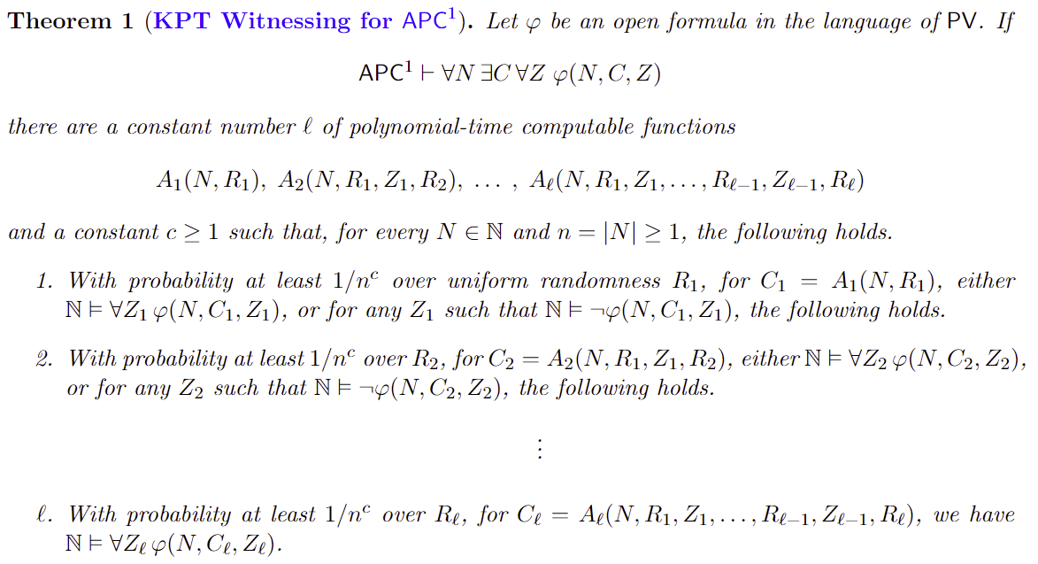

Slide 24
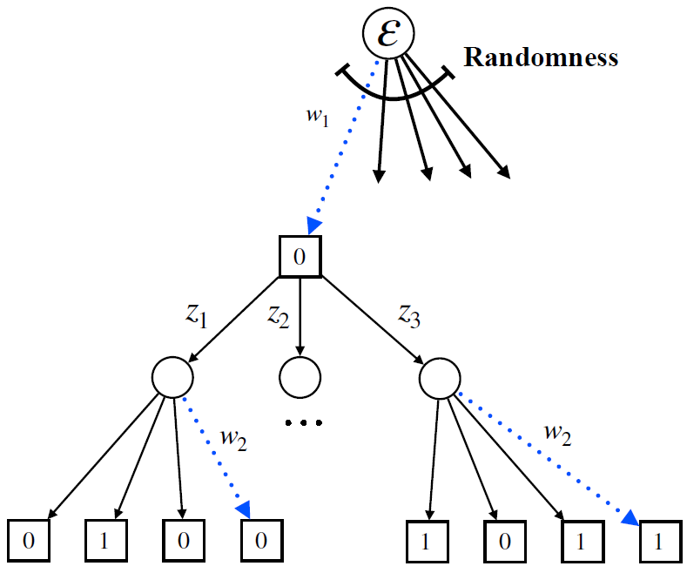
Randomized LEARN-uniformity
Definition. We say that L is in $FZPP$-$LEARN^{EQ\left[q\right]}$-uniform SIZE[s] if
$∃$ efficient randomized algorithm A(1^{n}) that outputs with probability $≥3/4$
a circuit of size $≤$s(n) for L_{n} after making $≤$ q(n) EQs.
Randomness
Our goal: Explicit lower bounds against
$FZPP$-$LEARN^{EQ\left[O(1)\right]}$-uniform SIZE[O($n^{k}$)]
EQ
RANDOMNESS + EQs
Which circuits can we construct with randomness only?

Slide 25
Randomized Uniformity
It seems we are the first to investigate the limits of randomized uniformity
Two potential definitions:
(1) The same circuit is produced with probability $≥2/3$ (pseudodeterministic)
(2) With probability $≥2/3$ a correct circuit is produced
Equivalently, the direct connection language is in ZPP or BPP
Appropriate definition in the learning setting
Much harder to analyze!

Slide 26
Lower bounds against randomized uniformity
[Carmosino-Kabanets-Kolokolova-O’21]
$FZPP$-$LEARN^{EQ\left[0\right]}$-uniform SIZE[$n^{k}$]
=
Theorem.
Main ideas:
First, we establish that
Now reduce the FZPP case to the simpler case of ZPP-uniformity:
Proof makes use of recent BPP/1 computable pseudodeterministic PRG from [Lu-O-Santhanam’21]
(To maintain zero error, we invoke Kabanets’ Easy Witness Method)

Slide 27
Randomized LEARN-uniformity
Randomness
RANDOMNESS + EQs
EQ
Goal: Explicit lower bounds against
$FZPP$-$LEARN^{EQ\left[O(1)\right]}$-uniform SIZE[O($n^{k}$)]
Theorem.
Corollary. “APC¹ does not prove that ZPP^{NP[O(1)]} is contained in SIZE[$n^{k}$]”

Slide 28
“APC¹ does not prove that ZPP^{NP[O(1)]} is contained in SIZE[$n^{k}$]”
Formally:
CK’07
KPT Witnessing for APC¹
Suppose APC¹ proves that
NP is contained in SIZE[$n^{k}$]
APC¹ proves that there is an efficient SAT solver
A SAT solver of size $n^{d}$ is learnable
from r = O(1) Search-SAT-EQs
with probability 1/poly(n)
Amplification
Lemma
Similar to deterministic learning result
Conversion Lemma
Collapse of
PH to ZPP^{NP[O(1)]}
Randomness-First Learner with r
Search-SAT-EQs
Boosted learning procedure that
maintains r Search-SAT-EQs and has
success probability 1 – 2^{-poly(n)}.
By Kannan’s Theorem, ZPP^{NP[O(1)]} is not contained in SIZE[$n^{k}$]

Slide 29
Summary
We advance a research program that combines complexity and provability:
Goal: Theory T does not establish upper bounds
(formally necessary before establishing lower bounds)
Learning vs Logic: Each theory T leads to a corresponding notion of learnability
Essentially all known results can be obtained by investigating LEARN-uniform constructions.

Slide 30
Open Problems
P is not contained in LEARN-Uniform SIZE[$n^{k}$] with O(log n) queries
NP is not contained in LEARN-Uniform SIZE[$n^{k}$] with poly(n) queries
Show that
New lower bounds against Randomized Uniformity and Randomized LEARN-Uniformity
e.g., show that promise-BPP is not contained in FBPP-uniform SIZE[$n^{k}$]
Obtain a stronger unprovability result for APC¹ ?
Thank you

Slide 31
Appendix

Slide 32
Unprovability of i.o. circuit upper bounds [BKO’20]

