Slide 1
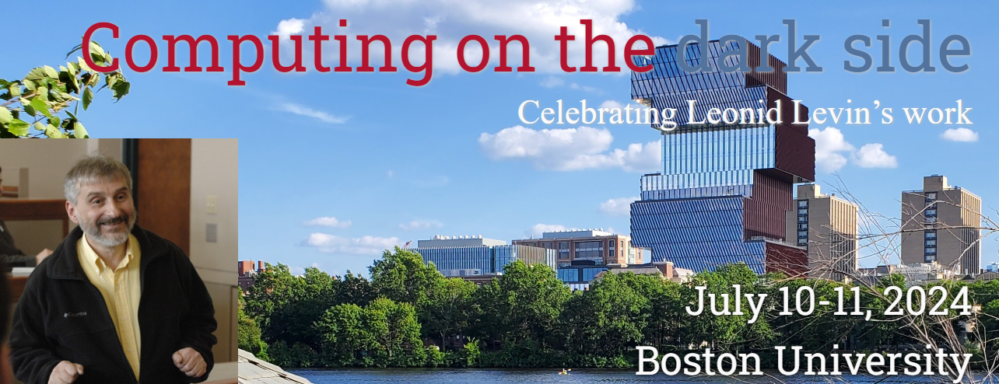
Levin Complexity and Pseudodeterministic Constructions of Primes
Igor Carboni Oliveira
University of Warwick
1

Slide 2
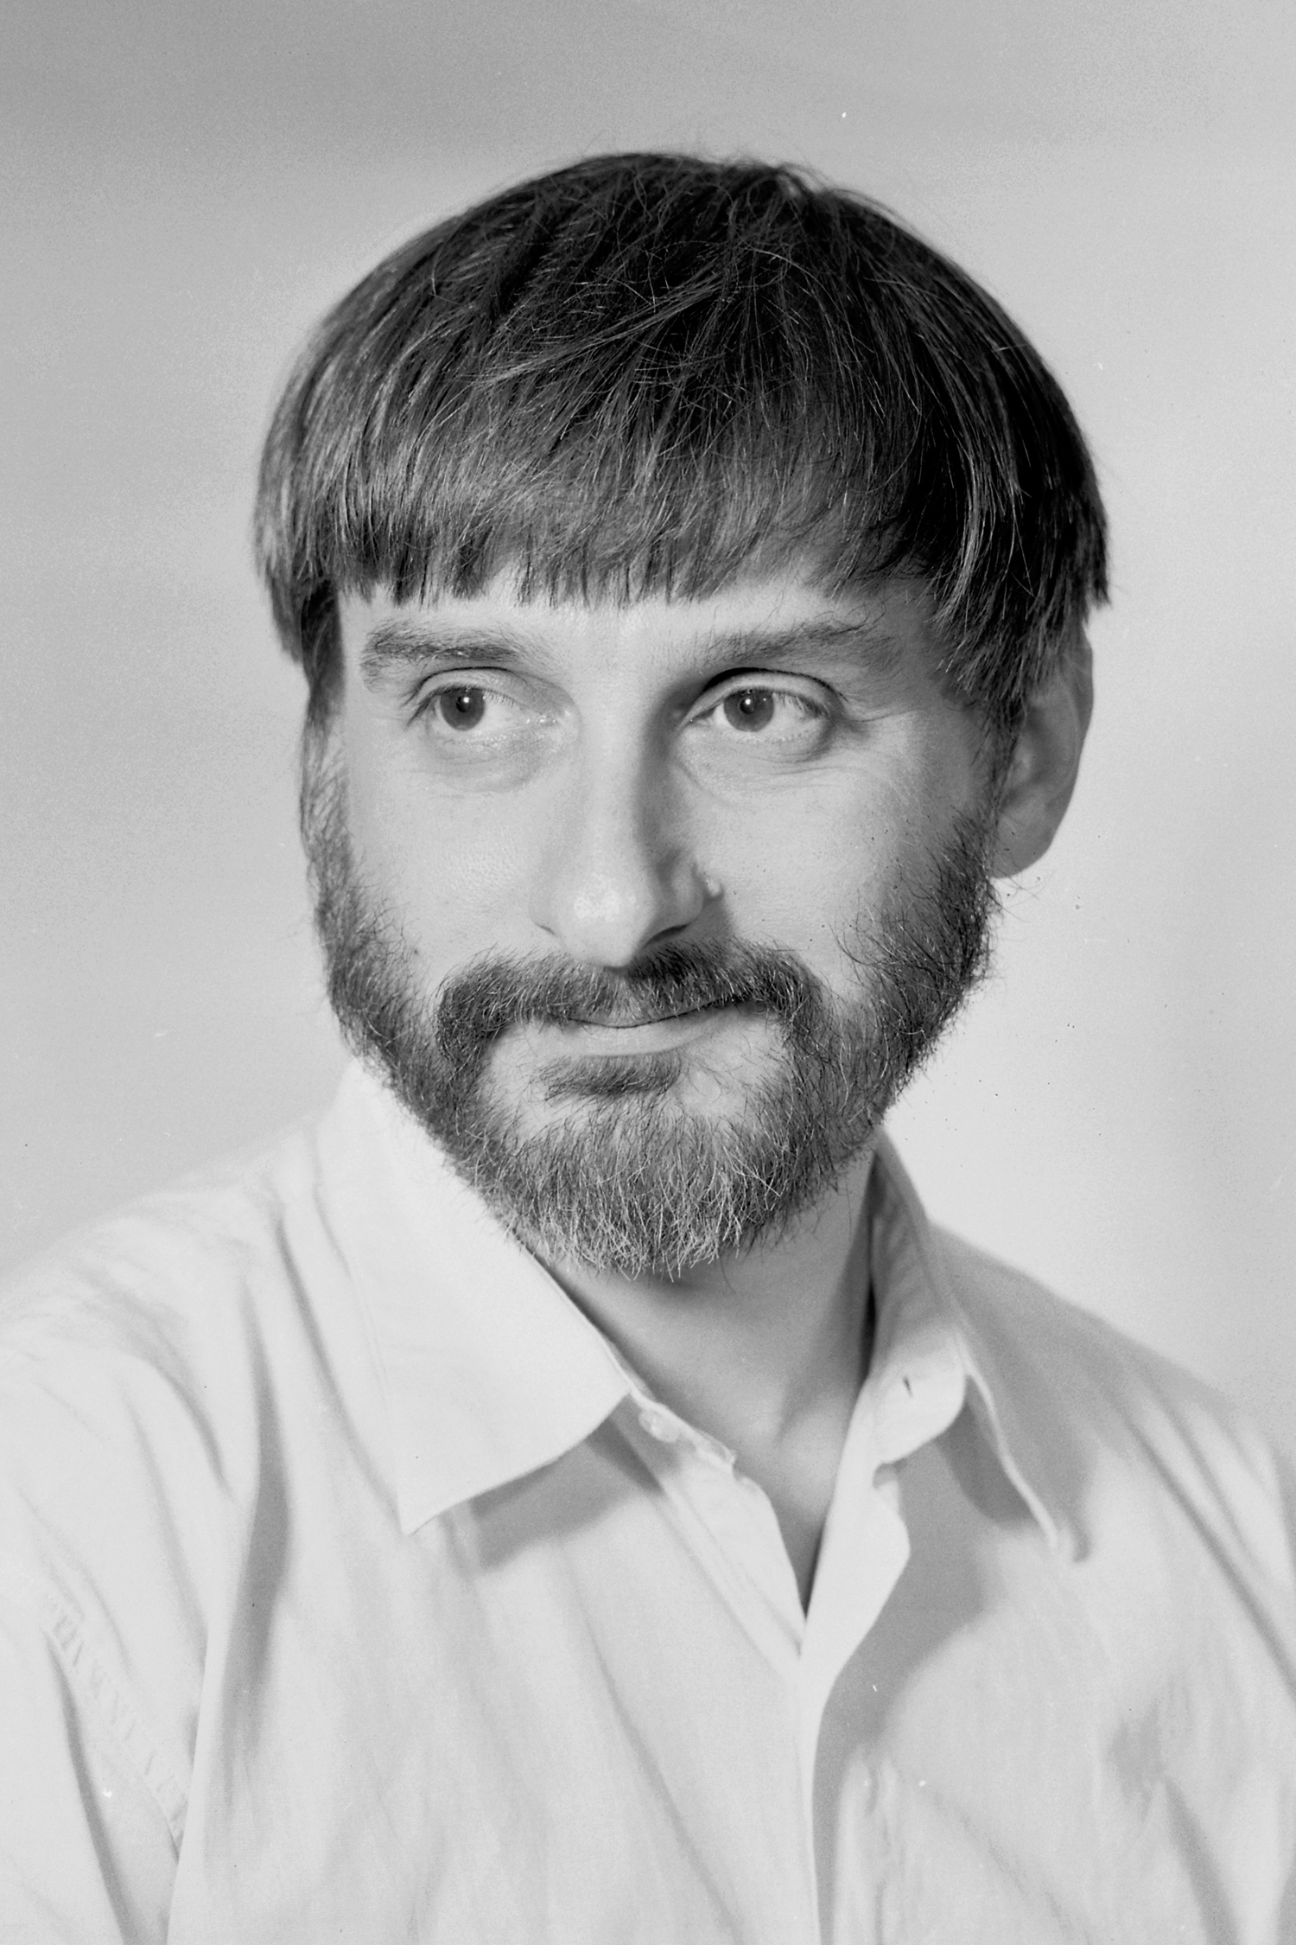
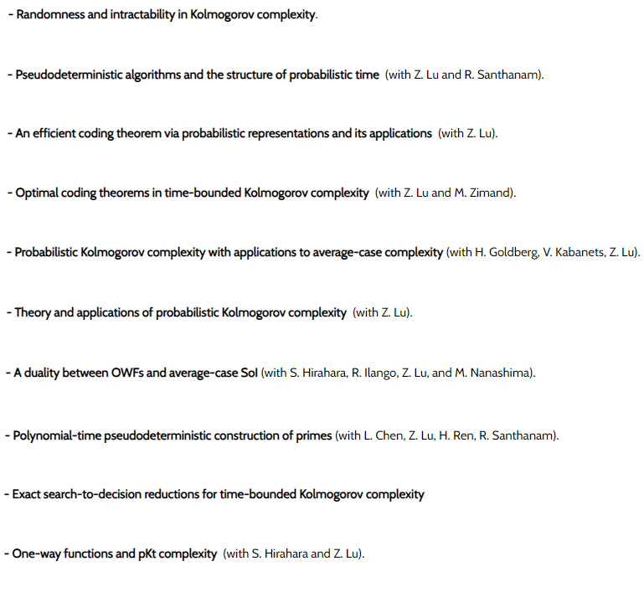
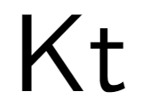
SURVEY
This talk: Some connections to the problem of constructing large primes
2

Slide 3
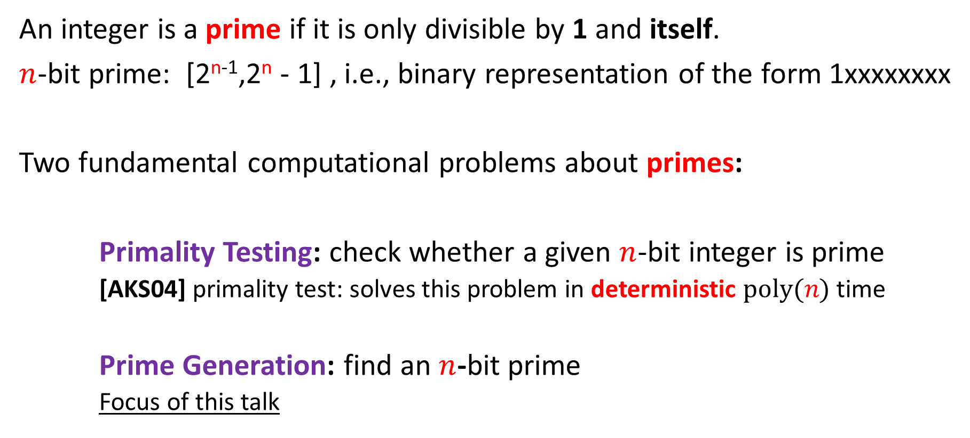
Primes
An integer is a prime if it is only divisible by 1 and itself.
$n$-bit prime: [2^{n-1},2^{n} - 1] , i.e., binary representation of the form 1xxxxxxxx
Two fundamental computational problems about primes:
Primality Testing: check whether a given $n$-bit integer is prime
  [AKS04] primality test: solves this problem in deterministic $poly(n)$ time
Prime Generation: find an $n$-bit prime
  Focus of this talk
Example: 17 = 10001
3

Slide 4
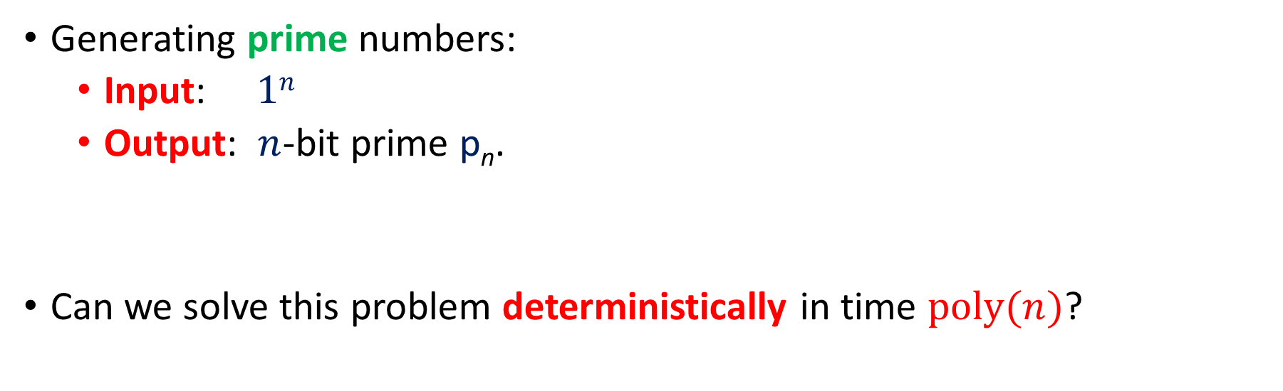
Challenge
Generating prime numbers:
  Input: $1n$
  Output: $n$-bit prime p_{n}.
Can we solve this problem deterministically in time $poly(n)$?
4

Slide 5
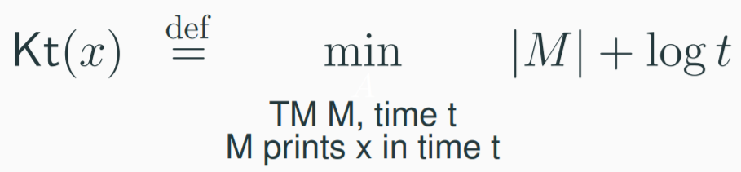
Levin Complexity
Levin (1984) proposed the following notion of complexity for strings.
short
effective
(Formal definition employs a universal machine U)
5

Slide 6
Optimal Search: Kt and Constructing Primes
6

Slide 7
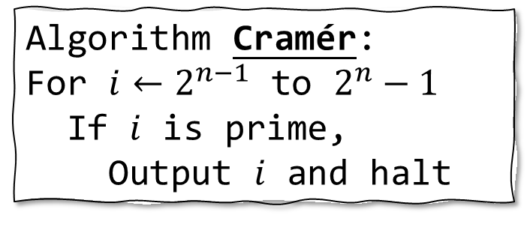
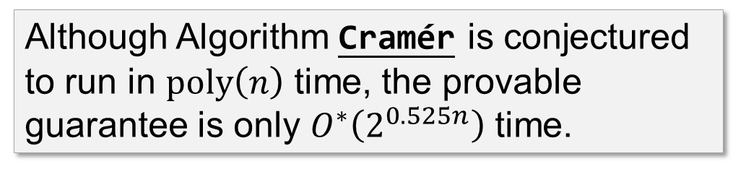
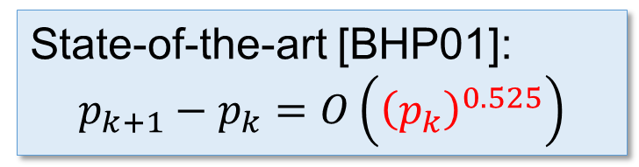
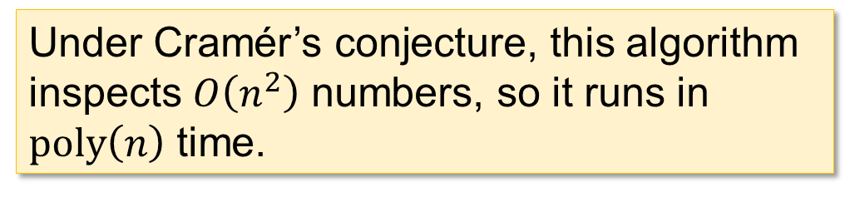
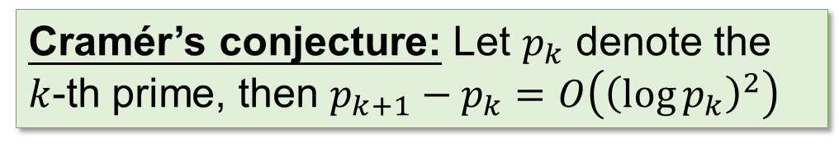
A simple approach: Cramér
Algorithm Cramér:
For $i←2^{n−1}$ to $2^{n}−1$
If $i$ is prime,
Output $i$ and halt
Cramér’s conjecture: Let $p_{k}$ denote the $k$-th prime, then $p_{k+1}−p_{k}=O\left({\left(\log{p_{k}}\right)}^{2}\right)$
Under Cramér’s conjecture, this algorithm inspects $O\left(n^{2}\right)$ numbers, so it runs in $poly\left(n\right)$ time.
Uses [AKS04] for checking primality!
State-of-the-art [BHP01]:
$$p_{k+1}−p_{k}=O\left({\left(p_{k}\right)}^{0.525}\right)$$
Although Algorithm Cramér is conjectured to run in $poly\left(n\right)$ time, the provable guarantee is only $O^{∗}\left(2^{0.525n}\right)$ time.
Best known algorithm is due to [Lagarias-Odlyzko’87] and runs in time 2^{0.5n + o(n)}.
7

Slide 8
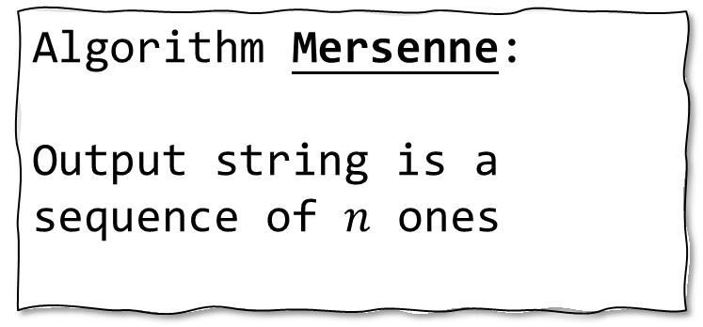
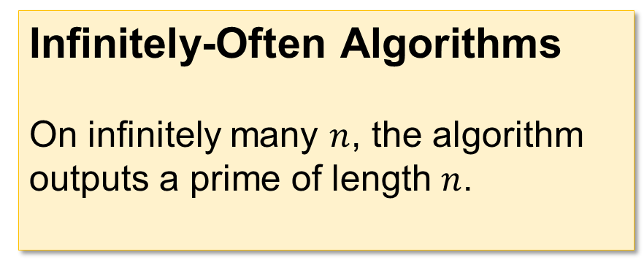
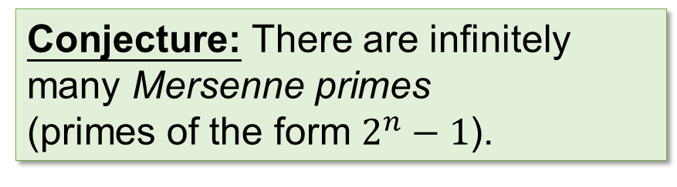
Infinitely Often
Infinitely-Often Algorithms
On infinitely many $n$, the algorithm outputs a prime of length $n$.
Algorithm Mersenne:
Output string is a sequence of $n$ ones
Under this conjecture, Mersenne is an infinitely-often polynomial-time algorithm for generating primes.
Conjecture: There are infinitely many Mersenne primes
(primes of the form $2^{n}−1$).
8

Slide 9
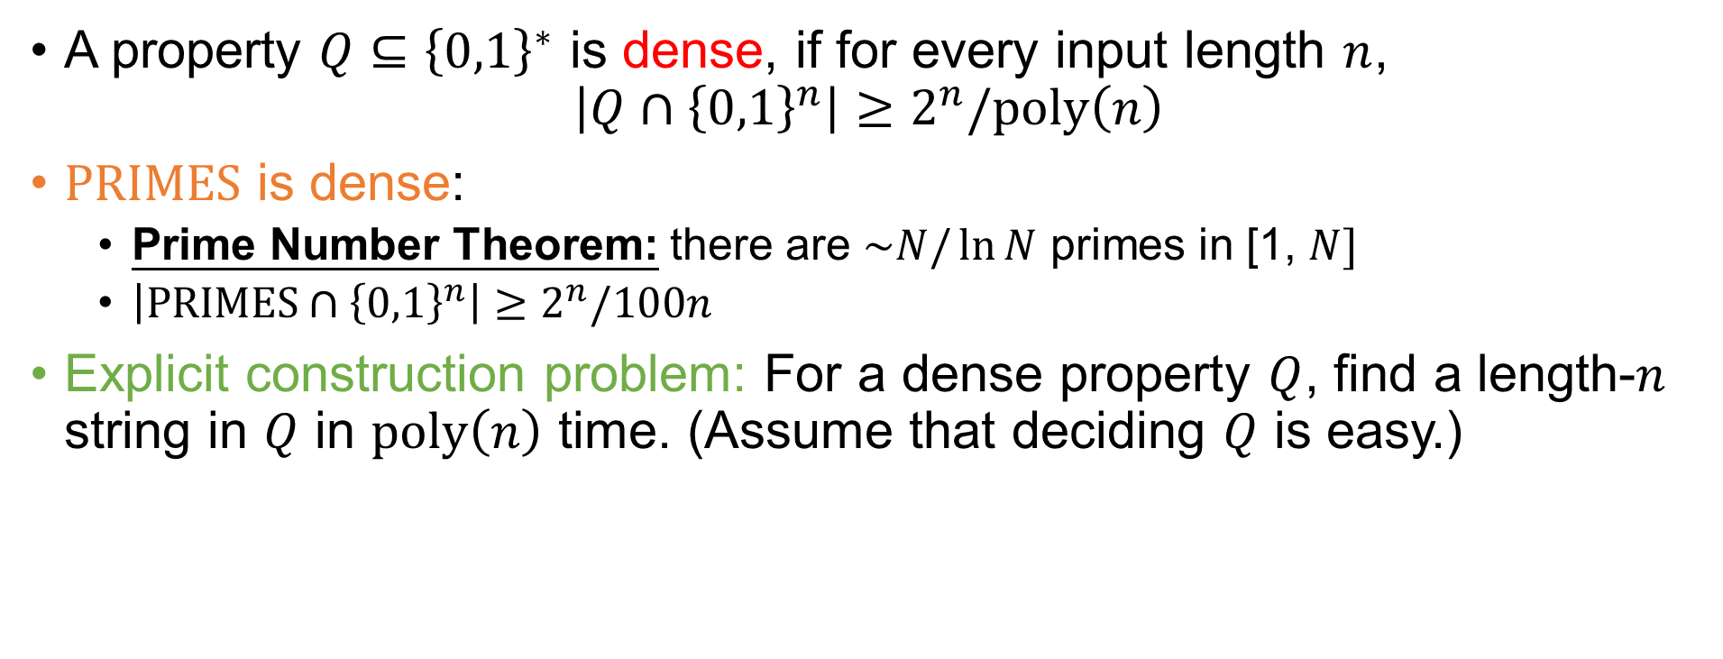
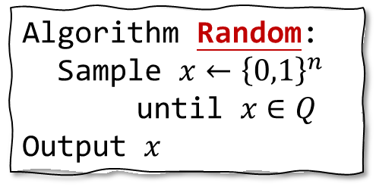
Generalization: Dense Properties
A property $Q⊆{\left\{0,1\right\}}^{∗}$ is dense, if for every input length $n$,
$\left|Q∩{\left\{0,1\right\}}^{n}\right|≥2^{n}/poly\left(n\right)$
$PRIMES$ is dense:
  Prime Number Theorem: there are $\sim N/\ln{N}$ primes in [1, $N]$
  $\left|PRIMES∩{\left\{0,1\right\}}^{n}\right|≥2^{n}/100n$
Explicit construction problem: For a dense property $Q$, find a length-$n$ string in $Q$ in $poly\left(n\right)$ time. (Assume that deciding $Q$ is easy.)
Algorithm Random:
Sample $x←{\left\{0,1\right\}}^{n}$ until $x∈Q$
Output $x$
Easy with randomness!
Deterministic algorithms are open
9

Slide 10
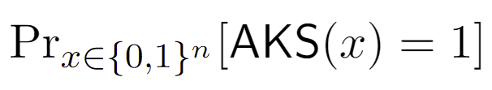

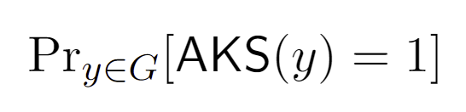



Complexity Theory and Pseudorandomness
$${\left\{0,1\right\}}^{n}$$
PRIMES / AKS
$$G$$
$G_{ }$ ${ \left\{0,1\right\}}^{n}$ is said to be a pseudorandom set of strings
$G_{ }$ is often defined by a PRG $G$: ${{\left\{0,1\right\}}^{l} \left\{0,1\right\}}^{n}$
For us, a hitting set suffices
10

Slide 11
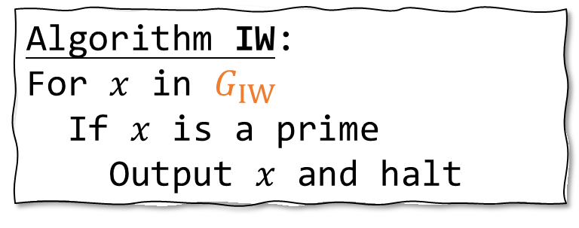

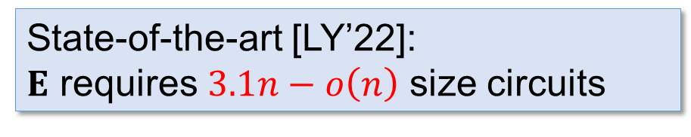
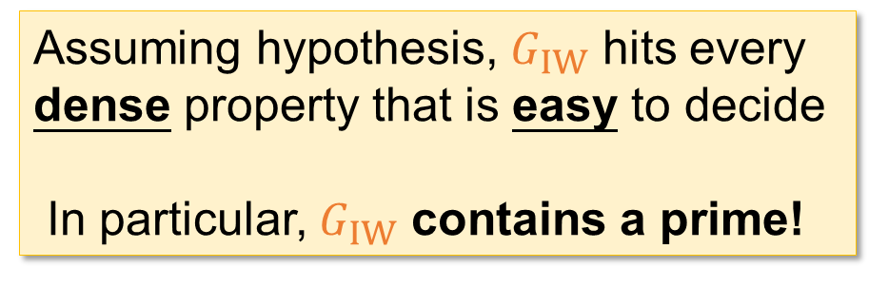
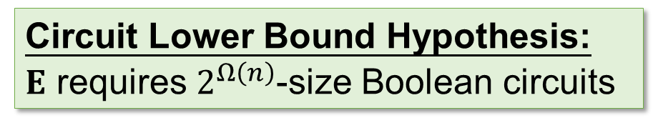
Algorithm IW
$G_{IW }$ ${ \left\{0,1\right\}}^{n}$: The generator from [IW97]
⊆
Circuit Lower Bound Hypothesis:
$E$ requires $2^{Ω\left(n\right)}$-size Boolean circuits
Algorithm IW:
For $x$ in $G_{IW}$
If $x$ is a prime
Output $x$ and halt
Assuming hypothesis, $G_{IW}$ hits every dense property that is easy to decide
In particular, $G_{IW}$ contains a prime!
Algorithm IW is conjectured to find a prime, but we seem very far from proving this hypothesis
State-of-the-art [LY’22]:
$E$ requires $3.1n−o\left(n\right)$ size circuits
11

Slide 12

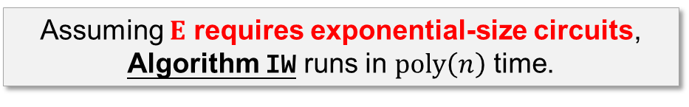
Summary
Cramer, Mersenne
Almost-everywhere / infinitely often poly-time
(under conjectures)
Algorithm IW
Assuming $E$ requires exponential-size circuits, Algorithm IW runs in $poly\left(n\right)$ time.
State of the art
Time Complexity $O\left(2^{0.5n}\right)$
Can we find a prime in $poly\left(n\right)$ time provably?
Polymath 4: Attempted to use number-theoretic techniques but did not obtain an unconditional improvement.
12

Slide 13










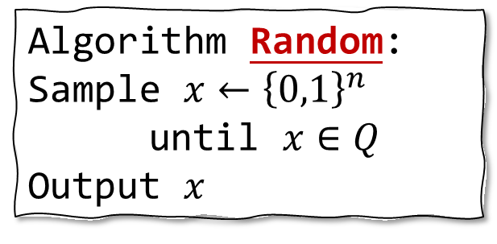

Relaxing our goal: Pseudodeterminism
Algorithm Random:
Sample $x←{\left\{0,1\right\}}^{n}$ until $x∈Q$
Output $x$
Drawback of Random:
different primes on different executions
Randomized
Pseudodeterministic
Deterministic
Algorithm
Algorithm
Algorithm
$$p_{1}$$
$$p_{2}$$
❌
$$p_{3}$$
$$p_{2}$$
$$p_{4}$$
$$p_{1}$$
$$p_{1}$$
❌
$$p_{2}$$
$$p_{1}$$
$$p_{1}$$
$$p$$
13

Slide 14
A randomized algorithm is pseudodeterministic if on most of its computational branches it outputs the same answer.
Any bounded observer thinks the algorithm is deterministic.
Randomized
Pseudodeterministic
Deterministic
Algorithm
Algorithm
Algorithm
$$p_{1}$$
$$p_{2}$$
❌
$$p_{3}$$
$$p_{2}$$
$$p_{4}$$
$$p_{1}$$
$$p_{1}$$
❌
$$p_{2}$$
$$p_{1}$$
$$p_{1}$$
$$p$$
14

Slide 15
Literature
Pseudodeterminism was first defined and studied in:
Eran Gat and Shafi Goldwasser [GG11]:
“Probabilistic search algorithms with unique answers and their cryptographic applications”.
Query complexity [GGR13], [GIPS21, CDM23]
Space complexity [GL19]
Streaming algorithms [GGMW20], [BKKS23]
Proof systems [GGH18], [GGH19]
Parallel computation [GG17], [GG21]
Computational algebra [Gro15]
Learning algorithms [OS18]
Approximation algorithms [DPV18]
Kolmogorov complexity [O19, LOS21]
and more [BB18], [Gol19], [DPWV22], [WDP+22], [CPW23], …
15

Slide 16
Gat-Goldwasser (2011):
Is there an efficient pseudodeterministic algorithm
for generating prime numbers?
More generally,
Is it the case that the generation problem
for every dense and easy property Q can be solved pseudodeterministically in polynomial time?
16

Slide 17
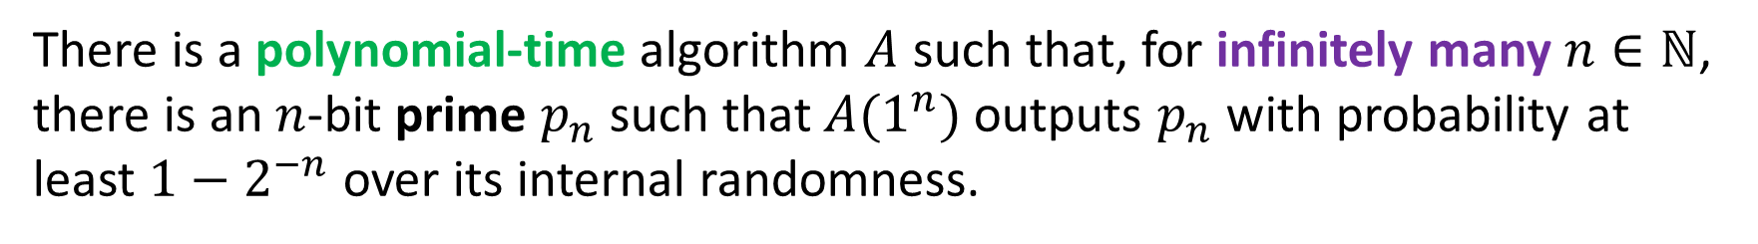
  Infinitely-often poly-time pseudodeterministic constructions
Theorem
(Joint work L. Chen, Z. Lu, H. Ren, and R. Santhanam, 2023)
There is a polynomial-time algorithm $A$ such that, for infinitely many $n∈ℕ$, there is an $n$-bit prime $p_{n}$such that $A(1^{n})$ outputs $p_{n}$ with probability at least $1−2^{−n}$ over its internal randomness.
Previously: infinitely-often sub-exponential time construction [Oliveira-Santhanam’17]
17

Slide 18
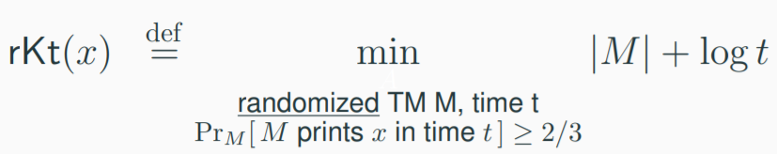
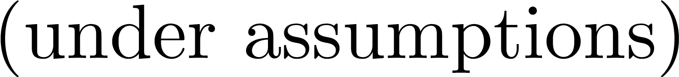
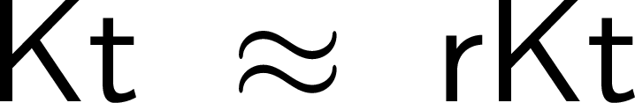
  Consequence: primes with simple descriptions
A short and effective probabilistic procedure that outputs the string.
Corollary. Infinitely many primes with succinct and efficient descriptions:
n-bit prime p with rKt(p) = O(log n)
Proof. An efficient algorithm A and its input 1^{n} serve as an encoding of the canonical n-bit prime p such that p = A(1^{n} ).
18

Slide 19
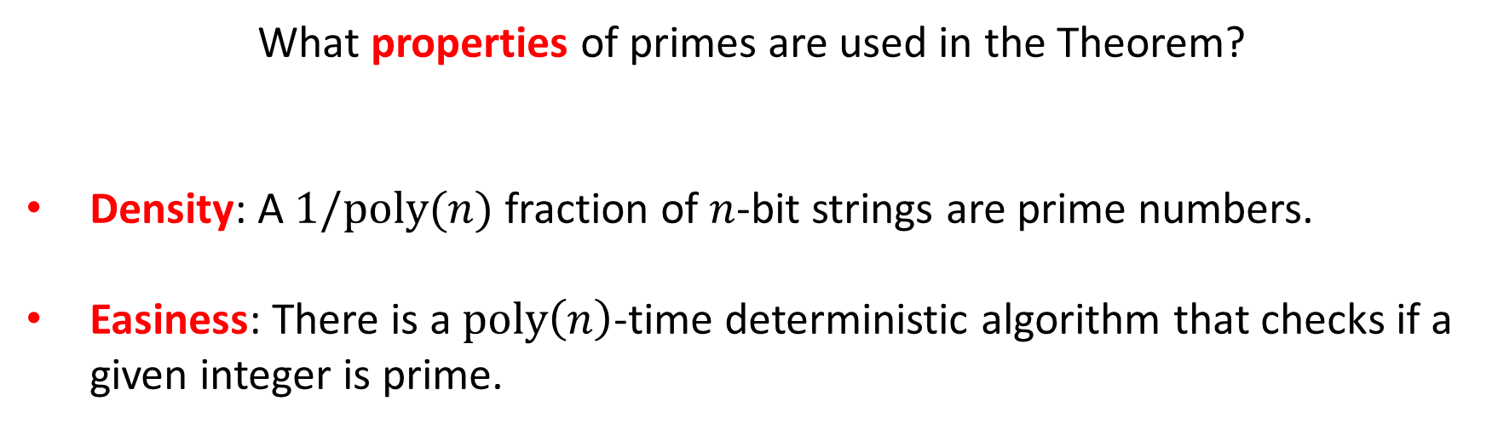
What properties of primes are used in the Theorem?
Density: A $1/poly(n)$ fraction of $n$-bit strings are prime numbers.
Easiness: There is a $poly\left(n\right)$-time deterministic algorithm that checks if a
given integer is prime.
19

Slide 20
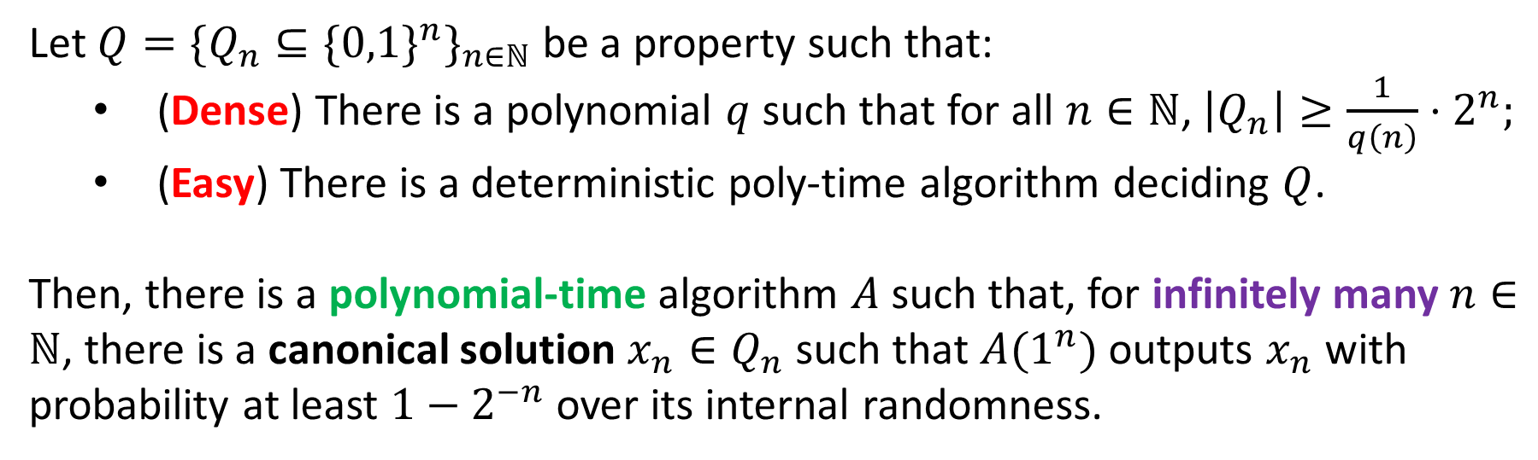
Theorem (Main Result)
Let $Q=\{Q_{n}⊆\{0,1{\}^{n}\}}_{n∈ℕ}$ be a property such that:
  (Dense) There is a polynomial $q$ such that for all $n∈ℕ$, $\left|Q_{n}\right|≥{\frac{1}{q\left(n\right)}⋅2}^{n};$
  (Easy) There is a deterministic poly-time algorithm deciding $Q$.
Then, there is a polynomial-time algorithm $A$ such that, for infinitely many $n∈ℕ$, there is a canonical solution $x_{n}∈Q_{n}$ such that $A(1^{n})$ outputs $x_{n}$ with probability at least $1−2^{−n}$ over its internal randomness.
20

Slide 21
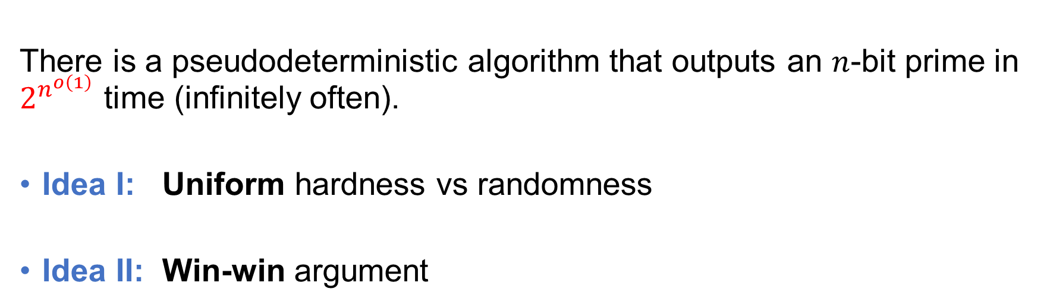
Sub-exponential time construction [OS17]
There is a pseudodeterministic algorithm that outputs an $n$-bit prime in $2^{n^{o\left(1\right)}}$ time (infinitely often).
Idea I: Uniform hardness vs randomness
Idea II: Win-win argument
21

Slide 22
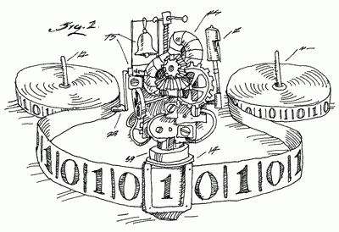


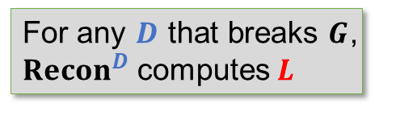


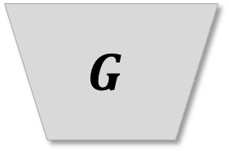
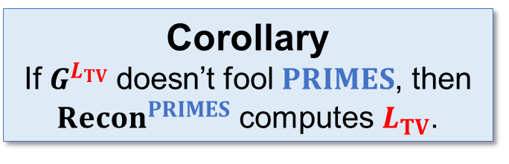
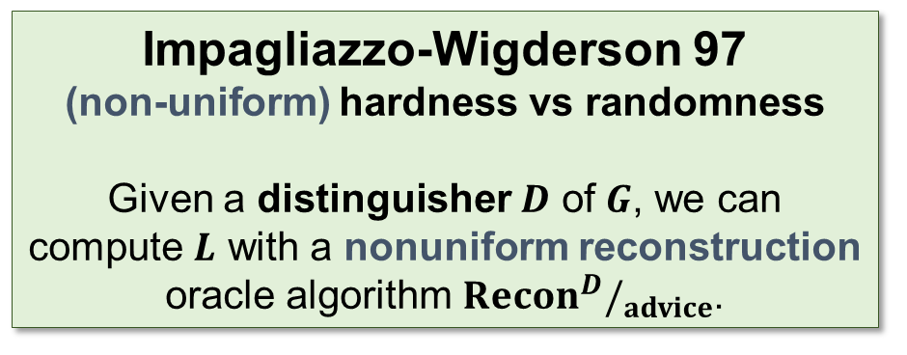

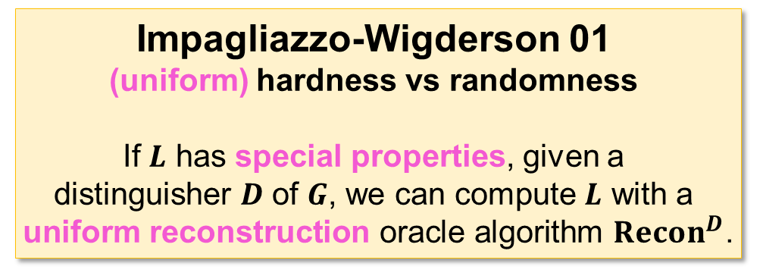
Uniform Hardness vs Randomness
y = G(x)
$$G$$
$$Recon$$
$$D$$
For any $D$ that breaks $G$, ${Recon}^{D}$ computes $L$
$$L$$
$G=G^{L}$ is a PRG
x
Trevisan-Vadhan 07
A language $L_{TV}$ with special properties that is $PSPACE$-complete
Corollary
If${ G}^{L_{TV}}$doesn’t fool $PRIMES$, then ${Recon}^{PRIMES}$ computes $L_{TV}$.
Impagliazzo-Wigderson 01
(uniform) hardness vs randomness
If $L$ has special properties, given a
distinguisher $D$ of $G$, we can compute $L$ with a
uniform reconstruction oracle algorithm ${Recon}^{D}$.
Impagliazzo-Wigderson 97
(non-uniform) hardness vs randomness
Given a distinguisher $D$ of $G$, we can compute $L$ with a nonuniform reconstruction oracle algorithm ${Recon}^{D}/_{advice}$.
22

Slide 23

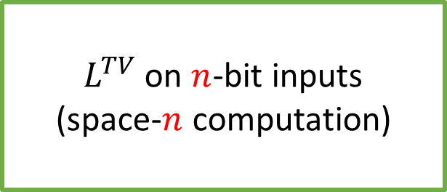
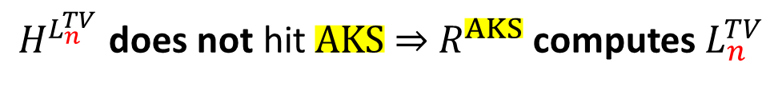
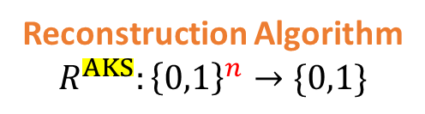
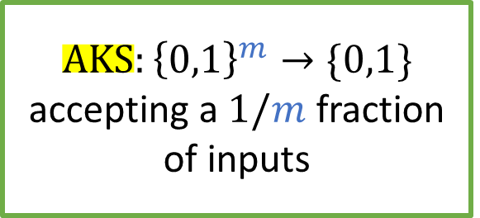
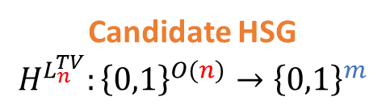
  The approach from [OS17]
$m=n^{C}$ for a large constant $C$
Candidate HSG
$$H^{L_{n}^{TV}}:{\left\{0,1\right\}}^{O(n)}→{\left\{0,1\right\}}^{m}$$
$L^{TV}$ on $n$-bit inputs
(space-$n$ computation)
$$AKS:{\left\{0,1\right\}}^{m}→\{0,1\}$$
accepting a $1/m$ fraction
of inputs
Reconstruction Algorithm
$$R^{AKS}:{\left\{0,1\right\}}^{n}→\{0,1\}$$
$H^{L_{n}^{TV}}$ does not hit $AKS$ $⇒$ $R^{AKS}$ computes $L_{n}^{TV}$
23

Slide 24
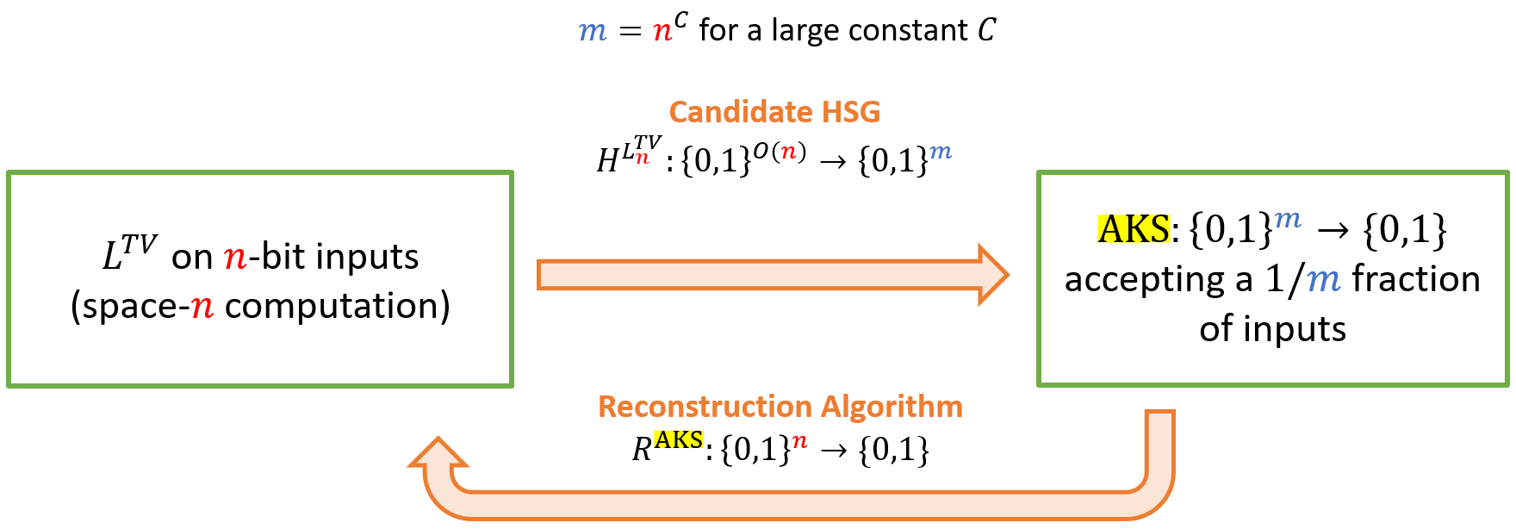
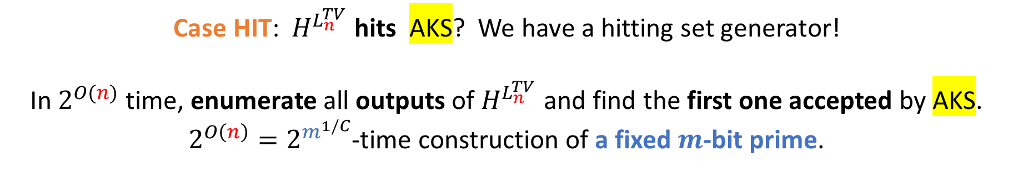
  The approach from [OS17]
Key Idea:
win-win argument
Case HIT: ${ H}^{L_{n}^{TV}}$ hits AKS? We have a hitting set generator!
In $2^{O(n)}$ time, enumerate all outputs of $H^{L_{n}^{TV}}$ and find the first one accepted by AKS.
$2^{O\left(n\right)}=2^{m^{1/C}}$-time construction of a fixed $m$-bit prime.
24

Slide 25
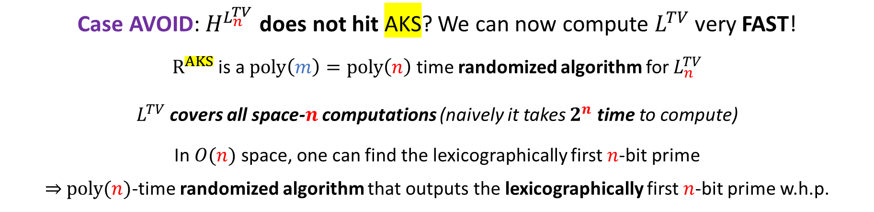
  The approach from [OS17]
Key Idea:
win-win argument
Case AVOID: $H^{L_{n}^{TV}}$ does not hit AKS? We can now compute $L^{TV}$ very FAST!
$R^{AKS}$ is a $poly\left(m\right)=poly\left(n\right)$ time randomized algorithm for $L_{n}^{TV}$
$L^{TV}$ covers all space-$n$ computations (naively it takes $2^{n}$ time to compute)
In $O(n)$ space, one can find the lexicographically first $n$-bit prime
$⇒$ $poly(n)$-time randomized algorithm that outputs the lexicographically first $n$-bit prime w.h.p.
25

Slide 26
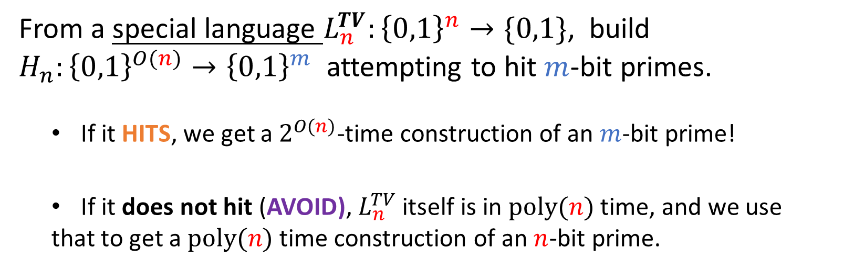


  Digest:
AVOID
HIT
$$n$$
$$m=nC$$
From a special language $L_{n}^{TV}:{\left\{0,1\right\}}^{n}→\{0,1\}$, build ${ H}_{n}:{\left\{0,1\right\}}^{O(n)}→{\left\{0,1\right\}}^{m}$ attempting to hit $m$-bit primes.
  If it HITS, we get a $2^{O(n)}$-time construction of an $m$-bit prime!
  If it does not hit (AVOID), $L_{n}^{TV}$ itself is in $poly(n)$ time, and we use
  that to get a $poly(n)$ time construction of an $n$-bit prime.
26

Slide 27
Ideas from the polynomial time algorithm [CLORS23]
27

Slide 28


AVOID
HIT
$$n$$
$$m=nC$$
Idea:
HIT case makes non-trivial progress
“Iterate”
Polynomial time?
AVOID case is FAST,
but HIT case is SLOW
28

Slide 29

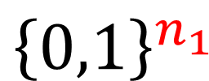




HIT case makes non-trivial progress
“Iterate”
$$n_{0}$$
$$n_{1}$$
$$n_{2}$$
$${\left\{0,1\right\}}^{n_{0}}$$
$${\left\{0,1\right\}}^{n_{1}}$$
$${\left\{0,1\right\}}^{n_{2}}$$
prime
29

Slide 30








…
…
…
…
…
(
(
(
(
(
$$n_{0}$$
$$n_{i}$$
$$n_{t}$$
$$ℕ$$
Goal: In each interval, Algorithm pseudodeterministically outputs a prime on some input length
$$T_{0}$$
At each input length n_{i}, candidate HSG H_{i} of size T_{i}
Define a function BF_{i} that attempts to find a prime in H_{i}
$$n_{0}$$
The next HSG is instantiated using BF_{i} as a hard function
$$i$$
Argument employs a new HSG construction [CT21]
30

Slide 31



The algorithm and its correctness
Algorithm CLORS23:
Let’s say $n=n_{i}$ for some $i$
If $i=t$ (recall that $T_{t}≤poly\left(n_{t}\right)$)
Find the first prime in $H_{t}$ by brute force
Else
Use ${Recon}^{{AKS}_{n_{i+1}}}$ to output a candidate $n_{i}$-bit prime
If $H_{t}$ contains a prime
We can find this prime using brute force in polynomial time!
If $H_{t}$ doesn’t contain a prime
But $H_{0}$ does…
There is some $i$ s.t. $H_{i}$ contains a prime but $H_{i+1}=H_{{BF}_{i}}$ does not.
${AKS}_{n_{i+1}}$ avoids $H_{{BF}_{i}}$, so ${Recon}^{{AKS}_{n_{i+1}}}$ computes ${BF}_{i}$ correctly!
31

Slide 32
Towards almost-everywhere bounds on rKt ?
Is the existence of succinct representations for primes a rare phenomenon?
32

Slide 33




Coding Theorems
Known to hold for Kolmogorov Complexity. Existence of a feasible version?
[Lu-Oliveira 2021]
33

Slide 34
Back to Primes
By the Coding Theorem for rKt, almost-everywhere bounds for primes reduces to
This is a significant relaxation of the Polymath problem of deterministically generating primes.
34

Slide 35


Summary
Explicit construction problem: For a property $Q$, construct a length-$n$ object satisfying $Q$ in $poly\left(n\right)$ time.
Main Result: If $Q$is in P and dense, the problem can be solved in pseudodeterministic polynomial time infinitely often.
Corollary: Infinitely many strings in Q of rKt complexity O(log n).
Challenge: Make the result work on all input lengths?
35

Slide 36
Thank You
36

Slide 37
State of the Art
Best known algorithm is due to [Lagarias-Odlyzko’87].
[LO87] employs techniques from analytic number theory to approx. count primes in an interval [a,b]. It has running time guarantee 2^{n/2+o(n)}.
[2^{n-1} , 2^{n} - 1]
Approx. # primes in each interval in time
Idea:
…
2^{n/2}
2^{n/2}

Slide 38















The (ideal) Chen-Tell generator (2021)
M bits
Uniform $f:{\{1}^{n}\}→{\left\{0,1\right\}}^{n}$
$$H$$
(Circuit of depth $d$ and width $T)$
$$f$$
$$T≫d$$
log T
Uniform circuit of depth $d$ and width $T$
that computes a function $f:{\{1}^{n}\}→{\left\{0,1\right\}}^{n}$
$$∧$$
$H=H^{f}$ is HSG
$$∨$$
$$∨$$
$$d$$
$$Recon$$
$$D$$
Chen-Tell: For any integer M such that log T < M < T:
HSG H: {0,1}^{log T} $→$ {0,1}^{M} computable in poly(T) time.
For any dense $D$ that avoids $H$, ${Recon}^{D}\left(1^{n}\right)$ computes $f\left(1^{n}\right)$ in randomized time $poly\left(d,M\right)$

Slide 39



T $=2^{O\left(n\right)}$
${BF}_{n}(1n)$: Brute Force
Enumerates all strings of length $n$, and outputs the first n-bit prime
d $=poly\left(n\right)$
…
AKS
AKS
AKS
AKS
AKS
0^{n}
00…01
11…10
1^{n}

Slide 40














Pseudodeterministic constructions from [CT21]
T $=2^{O\left(n\right)}$
Fix $M=poly\left(n\right)$
${BF}_{n}$: Brute Force
Enumerates all strings of length $n$, and outputs the first n-bit prime
d $=poly\left(n\right)$
$$H$$
$${BF}_{n}$$
Reconstruction guarantee:
If ${AKS}_{M}$ avoids $H^{{BF}_{n}}$, then one can speed-up the computation of ${BF}_{n}$ in $poly\left(d,M\right)=poly\left(n\right)$ time.
log T = O(n)
Plug in $f={BF}_{n}$ as the “hard function”
$${AKS}_{M}$$
Does ${AKS}_{M}$ avoid $H^{{BF}_{n}}$?
Iterate!
$$Recon$$
YES
NO
Compute the first length-$n$ prime in randomized (i.e. pseudodet) $poly\left(n\right)$ time
Hitting set $H^{{BF}_{n}}$ that hits ${AKS}_{M}$ and is computable in $2^{O\left(n\right)}$ time.
Use ${AKS}_{M}$ as distinguisher

Slide 41

















  The iterated win-win argument
$${\left\{0,1\right\}}^{n_{1}}$$
$$n_{i}=n_{i−1}^{β}$$
$$H^{BF_{n_{0}}}$$
$$H^{{BF}_{n_{0}}}:{\left\{0,1\right\}}^{O(log T_{0})}→{\left\{0,1\right\}}^{n_{1}}$$
$$H^{{BF}_{n_{1}}}:{\left\{0,1\right\}}^{O(log T_{1})}→{\left\{0,1\right\}}^{n_{2}}$$
$$H^{{BF}_{n_{2}}}:{\left\{0,1\right\}}^{O(log T_{2})}→{\left\{0,1\right\}}^{n_{3}}$$
$BF_{n_{0}}:\left\{1^{n_{0}}\right\}→{\left\{0,1\right\}}^{n_{0}}$ outputs the smallest
$n_{0}$-bit prime in
$T_{0}=2^{O(n_{0})}$ time
Case HIT
$H^{BF_{n_{0}}}$ HITS ${AKS}_{n_{1}}$
$BF_{n_{1}}:\left\{1^{n_{1}}\right\}→{\left\{0,1\right\}}^{n_{1}}$ outputs a fixed $n_{1}$-bit prime in $T_{1}=poly(T_{0})$time
Case HIT
$H^{BF_{n_{1}}}$ HITS ${AKS}_{n_{2}}$
$BF_{n_{2}}:\left\{1^{n_{2}}\right\}→{\left\{0,1\right\}}^{n_{2}}$ outputs a fixed $n_{2}$-bit prime in $T_{2}=poly(T_{1})$ time
Case AVOID:
$H^{BF_{n_{0}}}$DOES NOT HIT ${AKS}_{n_{1}}$
Case AVOID:
$H^{BF_{n_{1}}}$DOES NOT HIT ${AKS}_{n_{2}}$
Case AVOID: $H^{BF_{n_{2}}}$
DOES NOT HIT ${AKS}_{n_{3}}$
poly$(n_{0})$-time construction
of fixed $n_{0}$-bit prime!
poly$(n_{1})$-time construction
of fixed $n_{1}$-bit prime!
poly$(n_{2})$-time construction
of fixed $n_{2}$-bit prime!

Slide 42











A closer look at each iteration
$$T_{i}$$
$n_{i}=$ length of prime that we want to find
$H_{i}=$ HSG containing an $n_{i}$-bit prime
$T_{i}=$ size of $H_{i}$
$${BF}_{i}$$
Enumerate all strings in $H_{i}$ and output the first prime
$$d_{i}$$
$$T_{0}=2^{O\left(n_{0}\right)}$$
Next hitting set $H_{i+1}$ is${ H}^{{BF}_{i}}$
Each iteration:
$n_{i}←{\left(n_{i−1}\right)}^{β}$ for some $β$ that we set
$T_{i}←{\left(T_{i−1}\right)}^{α}$ for some $α$ depending on Chen-Tell
Hope: If we set $β$ large enough, $\left\{n_{i}\right\}$ grows faster than $\left\{T_{i}\right\}$
$$T_{i}$$
$$n_{i}$$
$$i$$

Slide 43




$\left\{n_{i}\right\}$ vs $\left\{T_{i}\right\}$
Hope: If we set $β$ large enough, $\left\{n_{i}\right\}$ will grow faster than $\left\{T_{i}\right\}$ !
$$T_{i}$$
$$n_{i}$$
$$i$$
$n_{i}={\left(n_{i−1}\right)}^{β}⇒n_{i}={\left(n_{0}\right)}^{β^{i}}$
$T_{i}={\left(T_{i−1}\right)}^{α}⇒T_{i}={\left(2^{n_{0}}\right)}^{α^{i}}$, for some $α.$
Want to find $t$ such that $T_{t}$ = poly($n_{t}$). We set $β$ = $2α.$
When $t=O\left(\log{n_{0}}\right)$, a simple computation shows that $T_{t}$ will be comparable to $n_{t}$.

Slide 44

  Omitted Technical Details
The HSG of [CT21] doesn’t apply to all uniform computations: only to low-depth uniform circuits. Luckily, the algorithms $BF_{n_{i}}$ we constructed can be implemented by low-depth uniform circuits.
The original [CT21] paper gives a HSG with $O(\frac{\log^{2} T}{\log{M}})$ seed length instead of $O\left(log T\right).$ This only gives a quasi-poly time construction instead of poly-time.
We improve Chen-Tell by combining it with the Shaltiel-Umans PRG [SU05].
This requires extra work (the original SU reconstruction algorithm is not uniform).

Slide 45


The Chen-Tell Generator

Slide 46



Slide 47

GKR – Delegation of Computation
[ Statement from the exposition in Goldreich’17 ]

