Slide 1
Lower Bounds on the Overhead of Indistinguishability Obfuscation
Igor Carboni Oliveira
University of Warwick
Joint work (in progress) with Zhenjian Lu (Warwick), Noam Mazor (Tel Aviv), and Rafael Pass (Cornell & Tel Aviv)
1

Slide 2
This talk
Crypto (obfuscation)
Meta-Complexity (variants of MCSP)
Bounded Arithmetic
Complexity of
program obfuscation
Computational tasks about estimating the complexity of a given object
Proofs in weak fragments of Peano Arithmetic
2

Slide 3
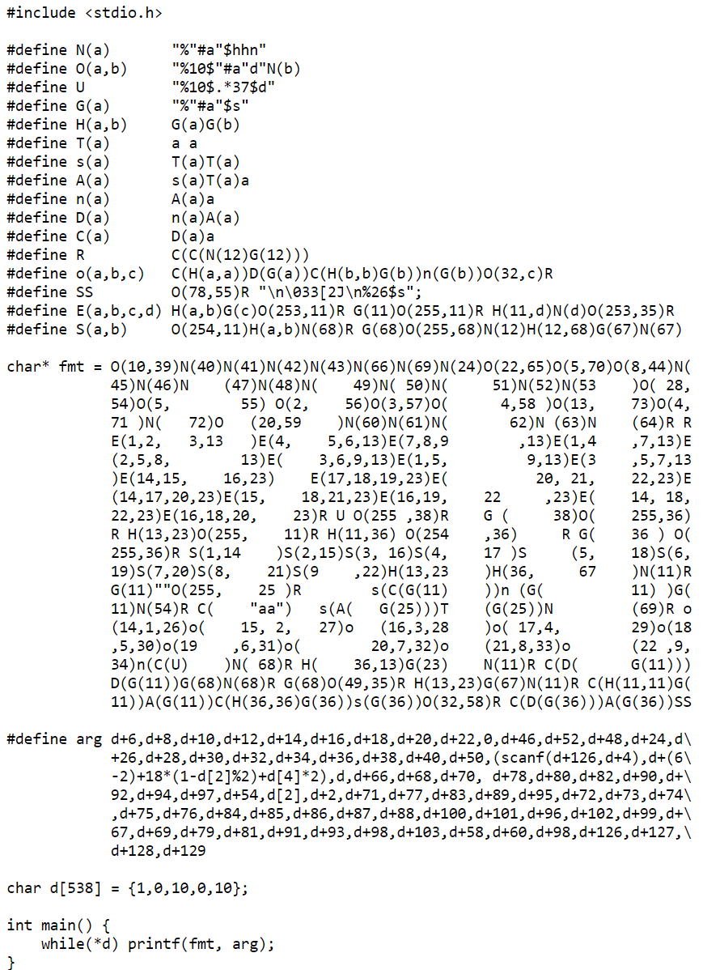
Program Obfuscation
Goal: Transform a program into an equivalent unintelligible program.
Formally investigated in the influential paper [BGIRSVY’01]
Natural notion: virtual black-box obfuscation (impossible)
They also proposed a weaker notion called Indistinguishability Obfuscation (iO)
C implementation of tic-tac-toe
Nicholas Carlini - The International Obfuscated C Code Contest
First, we need to define program.
3
Notes:
[BGIRSVY’01] - Boaz Barak, Oded Goldreich, Russell Impagliazzo, Steven Rudich, Amit Sahai, Salil P. Vadhan,
and Ke Yang

Slide 4
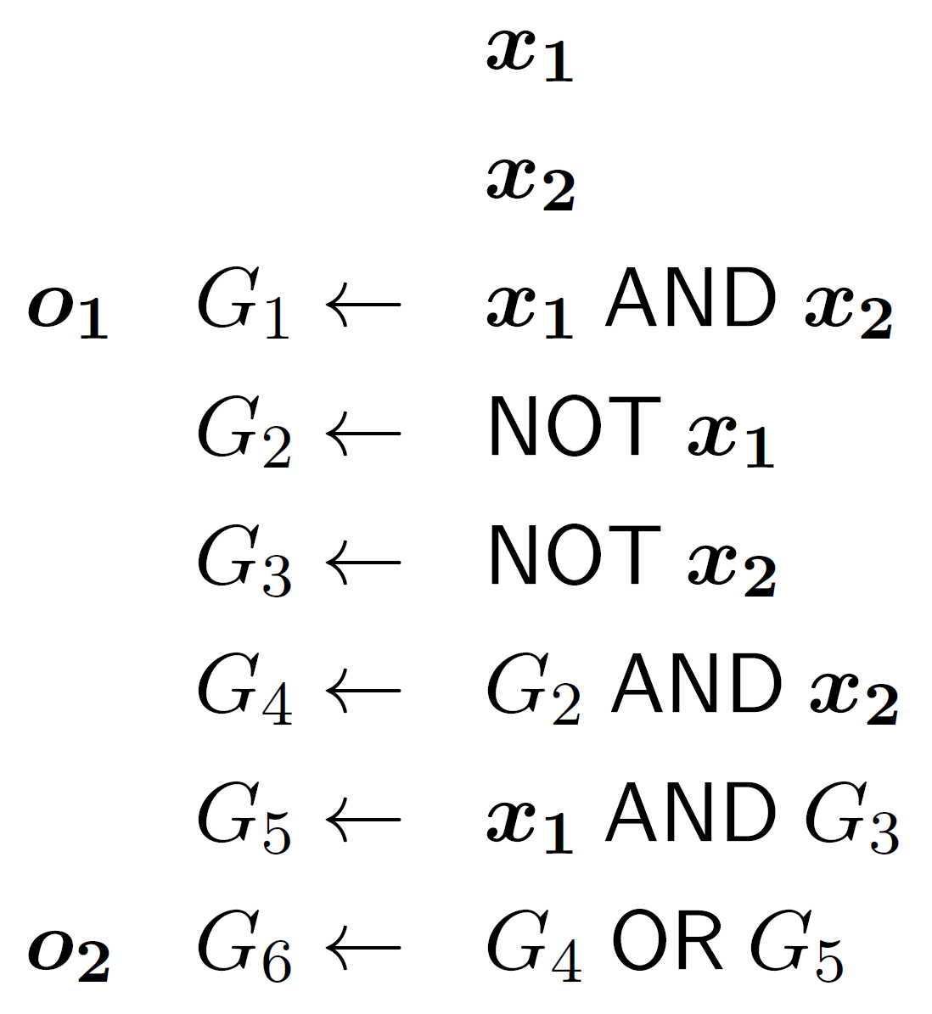

Boolean Circuits
4

Slide 5




Indistinguishability Obfuscation (iO)
Best-possible obfuscation (in a formal sense) [GR’07]
Master tool from which nearly every other crypto protocol can be built.
5
Notes:
[GR’07] – Shafi Goldwasser and Guy Rothblum
Best-Possible Obfuscation - Obfuscated program leaks as little information as any other program with the same functionality and of similar size. Any information that is not hidden by the obfuscated program is also not hidden by any other similar-size program computing the same functionality.

Slide 6



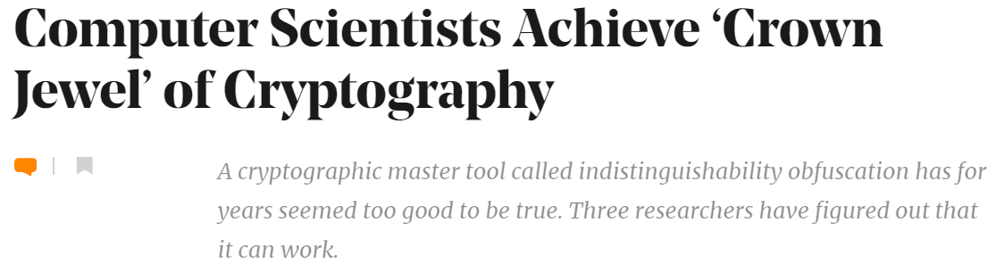

Existence of secure iO ?
First general-purpose iO candidate was proposed by [GGHRSW’13].
Construction was later shown to be insecure.
Building on a sequence of works, [JLS’21, JLS’22] introduced a construction based on 3 assumptions that have been well-studied by cryptographers.
DLIN Assumption
PRGs in NC⁰
LPN over large fields
What about the efficiency of iO ?
6
Notes:
[GGHRSW’13] = Garg-Gentry-Halevi-Raykova-Sahai-Waters
[JLS] = Jain-Lin-Sahai = Aayush Jain, Huijia Lin, and Amit Sahai

Slide 7

Circuit Size Overhead
Interested in the size of the obfuscated circuit, an important measure of efficiency for iO.
7

Slide 8
Results
8

Slide 9
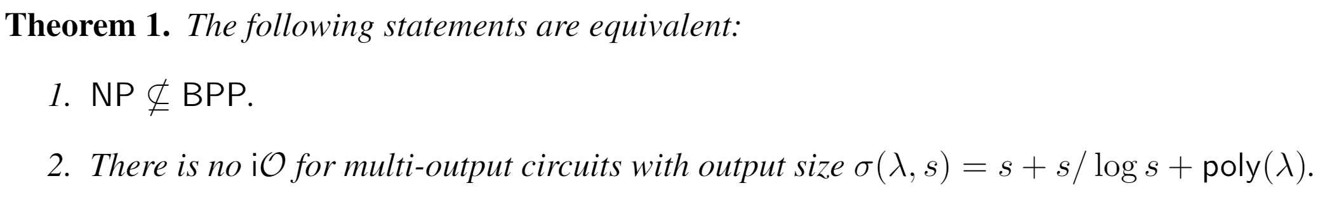
Result 1: Lower Bounds on Circuit Size
We show that any secure iO scheme must incur a non-trivial size overhead.
Result rules out near-optimal iO under a minimal hardness assumption.
9

Slide 10
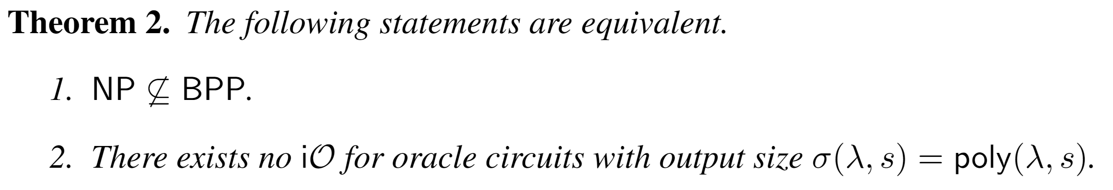
Result 2: Lower Bounds for Oracle Circuits
Setting: Circuits with access to an oracle (e.g., part of the internet)
[GR’07] Obfuscation is impossible for a random oracle.
Proof relies on the oracle being too large for the obfuscator to read in its entirety.
We extend the result to the case where the oracle can be fully read by the obfuscator.
10
Notes:
[GR’07] - Shafi Goldwasser and Guy Rothblum

Slide 11
Techniques
Crypto (obfuscation)
Meta-Complexity (variants of MCSP)
Bounded Arithmetic
11

Slide 12





Overview of the Proof (Simplified)
12

Slide 13





Overview of the Proof (Simplified)
Meta-Complexity (adapting [MP’24])
PCP Theorem
Chain of Reductions
Improvement of [ILO’20]
(indirect connection to bounded arithmetic)
[Rompel’90]
[KMNPRY’22]
12
Notes:
[MP’24] – Noam Mazor and Rafael Pass
[Rompel’90] – John Rompel
[KMNPRY’22] - Ilan Komargodski, Tal Moran, Moni Naor, Rafael Pass, Alon Rosen, and Eylon Yogev

Slide 14
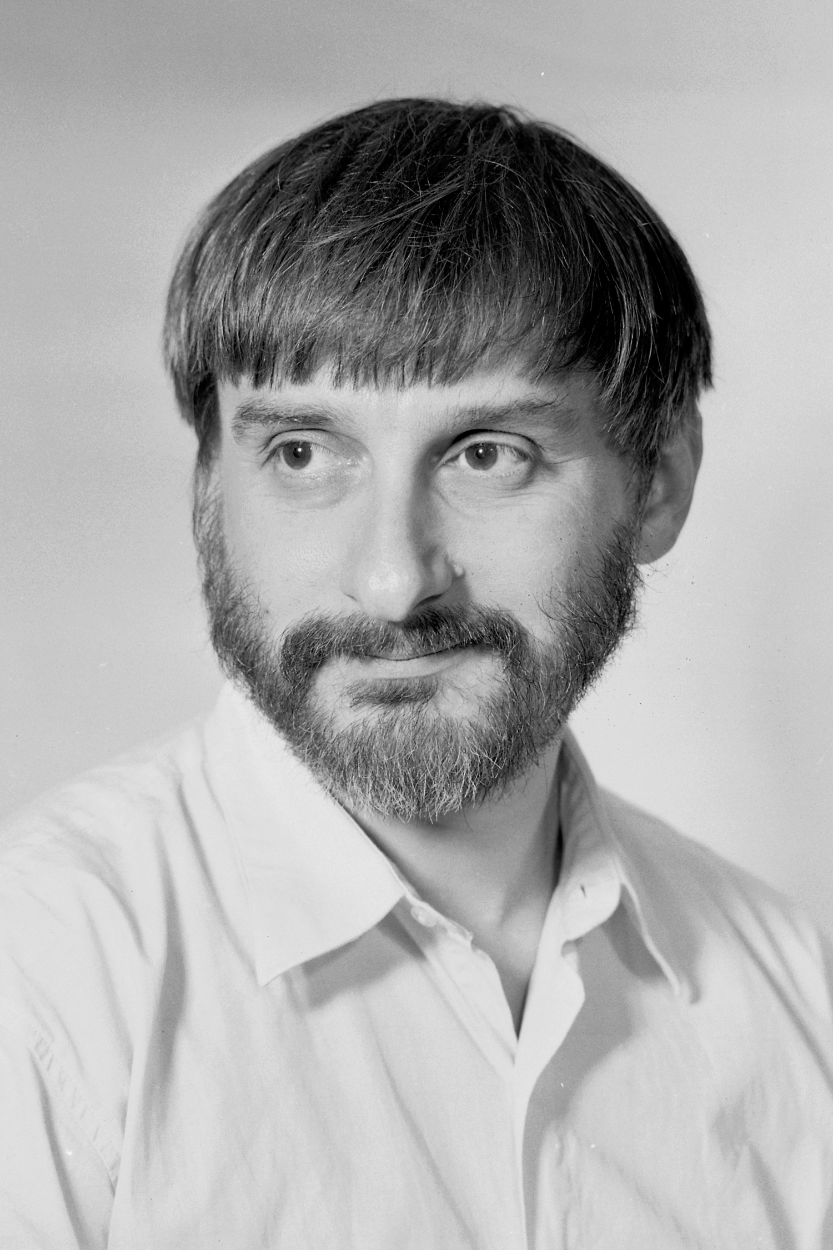
Multi-MCSP
Minimum Circuit Size Problem for Multi-Output Functions
[ILO’20]
Multi-MCSP is NP-hard under poly-time randomized many-one reductions.
GAP between YES/NO instances (hardness of approximation)
For the connection to iO, we need:
2. NP-hardness under Levin reductions
13
Notes:
[ILO’20] – Rahul Ilango, Bruno Loff, and Igor C. Oliveira

Slide 15

Stronger NP-Hardness Result for Multi-MCSP
NP-hardness of Multi-MCSP[s, s + s/log s] under randomized Levin reductions
Efficiently extracts a witness from any circuit of size < s + s/log s
14

Slide 16



From Set Cover to Gap Multi-MCSP
“Chain Rule”
15

Slide 17
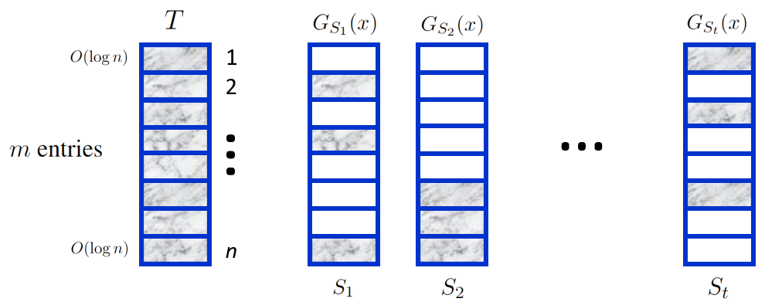
Proof employs a more elaborate construction and relies on [ILO’20]
16

Slide 18



Reduction via the PCP Theorem
GAP = Hardness of approximation
is obtained from the PCP Theorem
PCP Theorem
Gap between YES/NO
instances of k-SAT
Structured instances of k-SAT
[PY’91]
Vertex Cover
Set Cover over structured instances
(e.g., every set |T| = O(1))
Correctness of the reduction
Multi-MCSP[s, s + s/log s]
17
Notes:
[PY’91] - Christos H. Papadimitriou and Mihalis Yannakakis

Slide 19

Connection to Bounded Arithmetic
[Pich’15]
Formalization of the correctness of the PCP Theorem in Cook’s Theory PV₁
Correctness of the reduction
Using a witnessing result,
we can compute w from y in poly time
More generally, in PV₁:
NP-hardness = NP-hardness under Levin reductions
18
Notes:
[Pich’15] – Jan Pich

Slide 20
Meta-Complexity (adapting [MP’24])
PCP Theorem
Chain of Reductions
Improvement of [ILO’20]
[Rompel’90]
[KMNPRY’22]
19

Slide 21
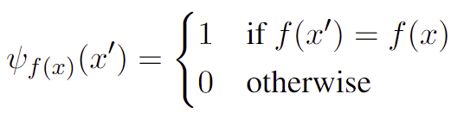







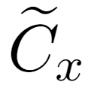


Bridge Between Obfuscation and Meta-Complexity
NP-hardness
Levin
Levin
20

Slide 22
Open Problems
1. Does program obfuscation require 1% increase in program size?
Formally, does iO need to output a circuit of size (1 + eps) s, for a constant eps > 0 ?
2. Limits of our approach?
There is currently no barrier preventing our framework from excluding iO (under NP ⊄ BPP)
Enough to show NP-hardness of Multi-MCSP[s, poly(s)] under Levin reductions
Can even assume iO to show this NP-hardness result – see [HIR’23]
Thank You
21
Notes:
[HIR’23] – Huang, Ilango, and Ren

Slide 23
Appendix

Slide 24

Further remarks about the proof
General framework that combines several tools and perspectives
(meta-complexity, hardness of Multi-MCSP, UOWHF/OWF, PCP Theorem)
What techniques/ingredients are essential?
We provide another proof that doesn’t need the PCP Theorem nor the Mazor-Pass connection
Argument builds on the ILO technique (NP-hardness of Multi-MCSP) and employs crypto primitive known as pseudorandom encryption schemes
Drawback: Streamlined proof only rules out iO with output size
21

Slide 25
Another hardness of iO result
Notes:
[LPST16] - Huijia Lin, Rafael Pass, Karn Seth, and Sidharth Telang. Indistinguishability obfuscation with
non-trivial efficiency.

Slide 26
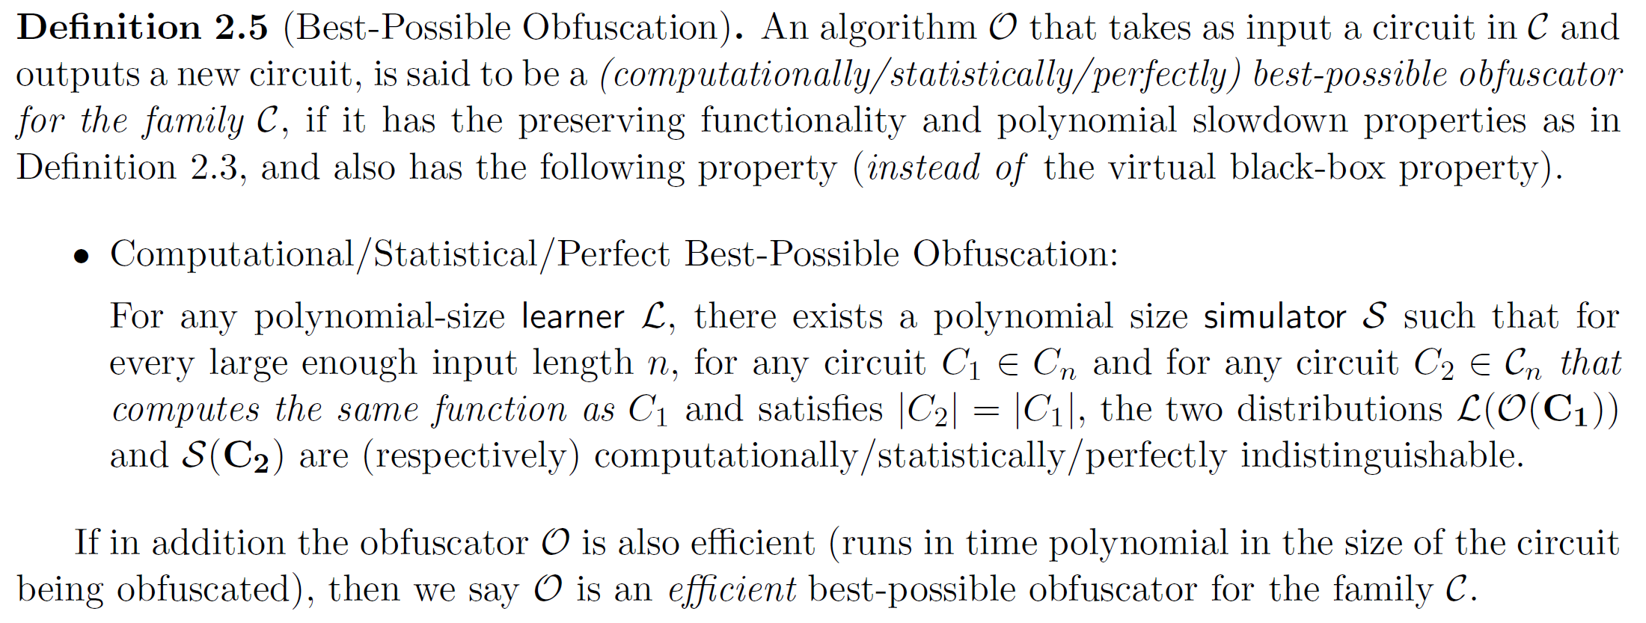
Best-Possible Obfuscation [GR’07]

Slide 27
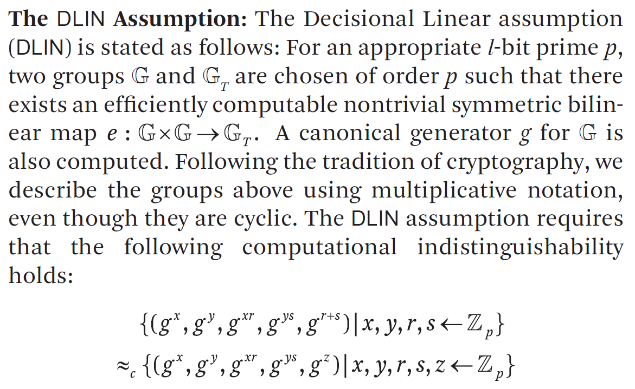
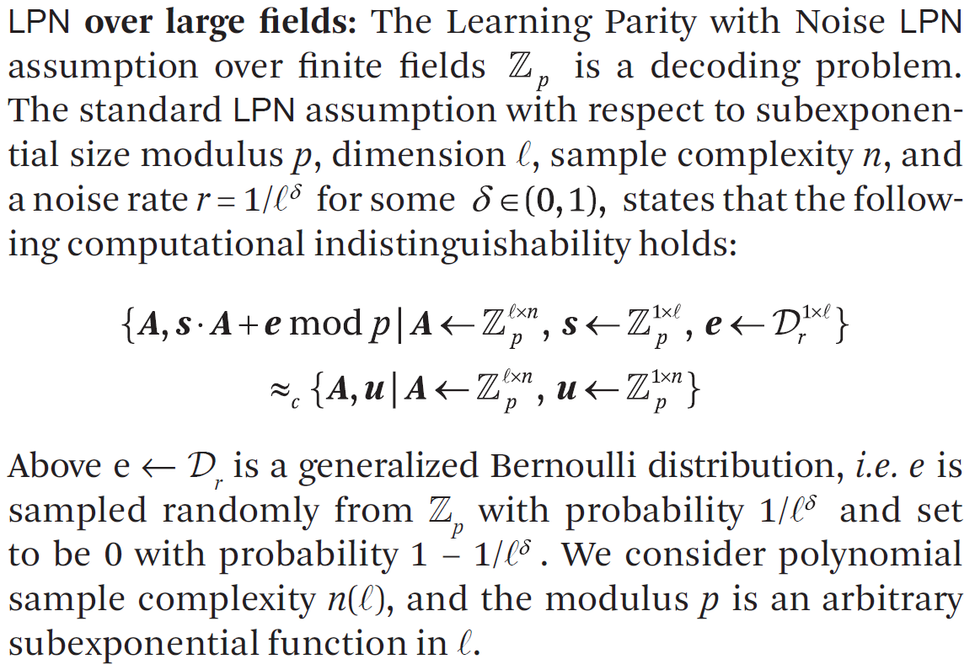
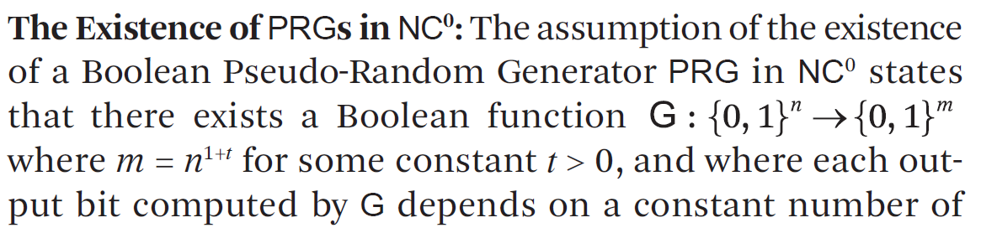
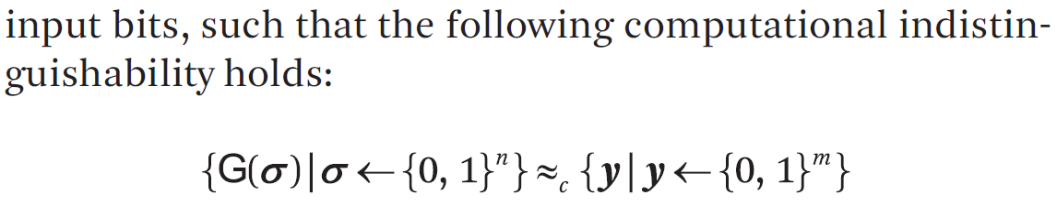
JLS Assumptions (CACM Article)

Slide 28
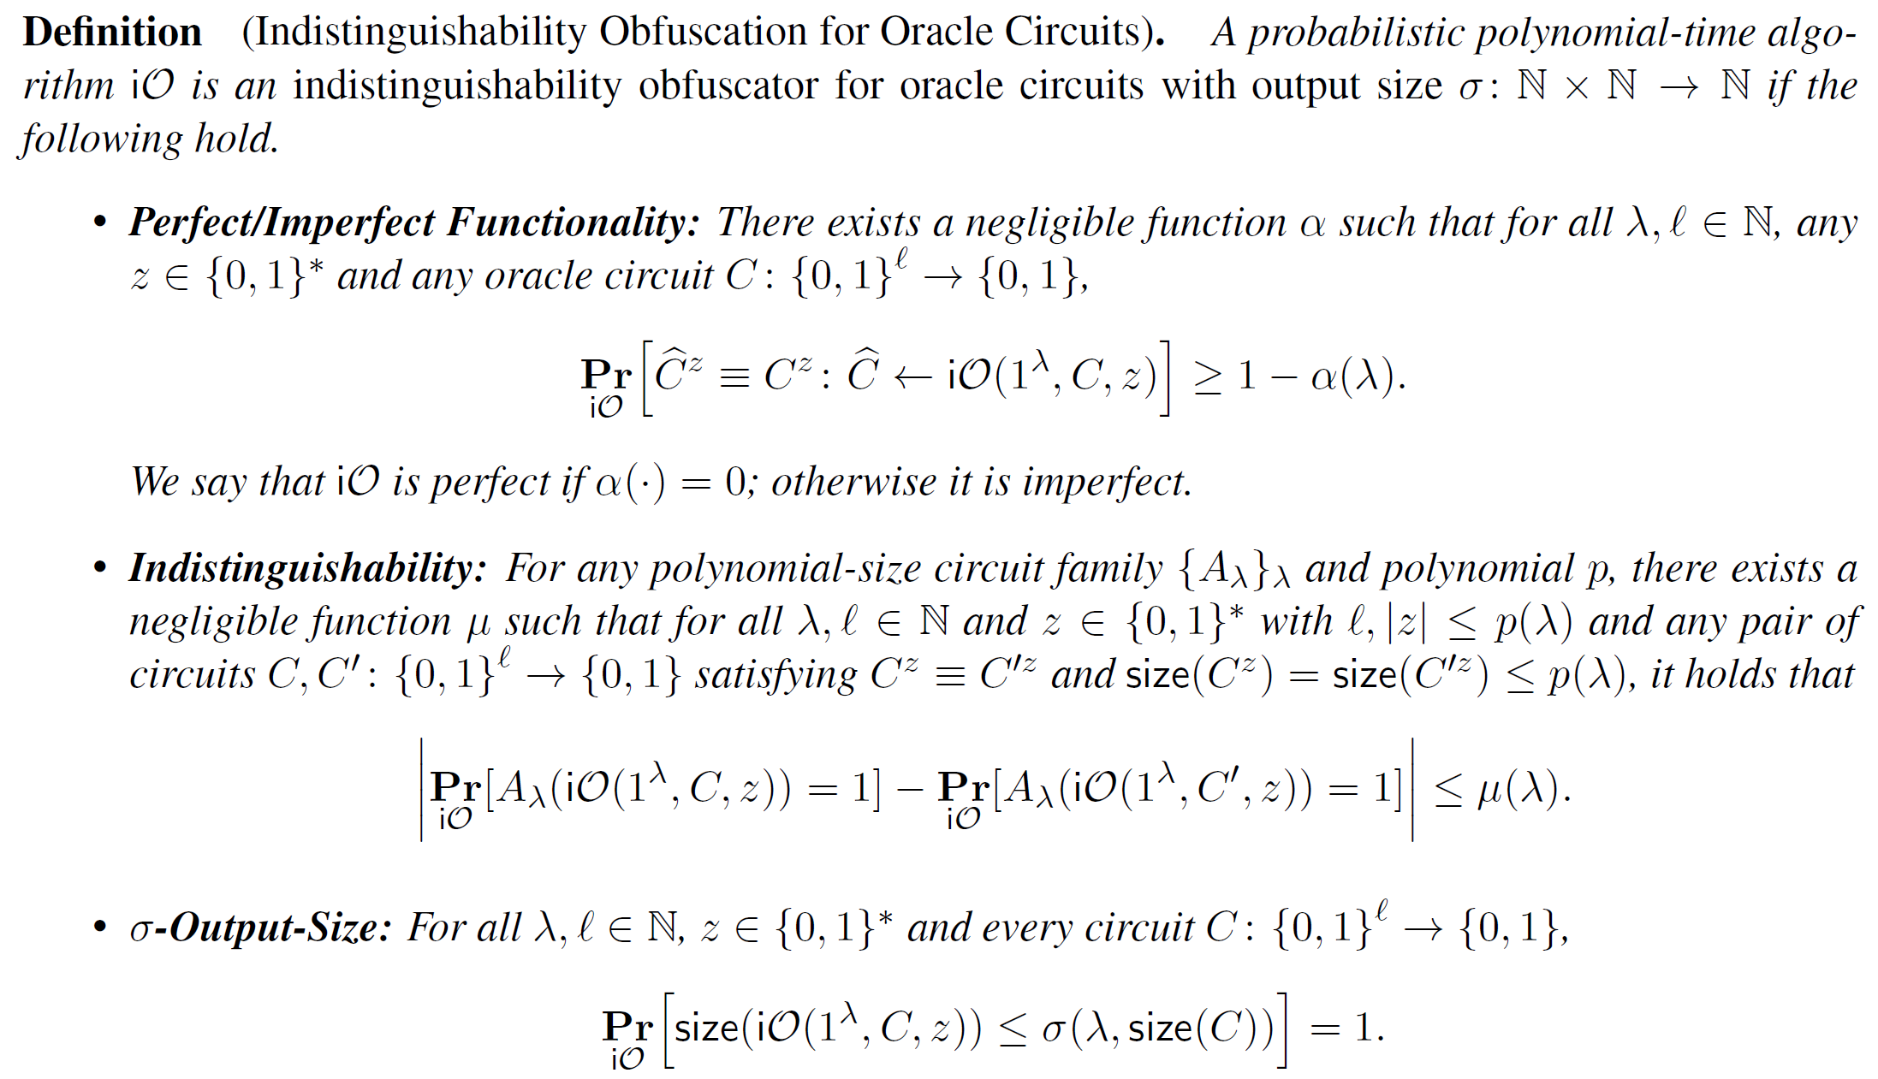
iO for Oracle Circuits

