Slide 1
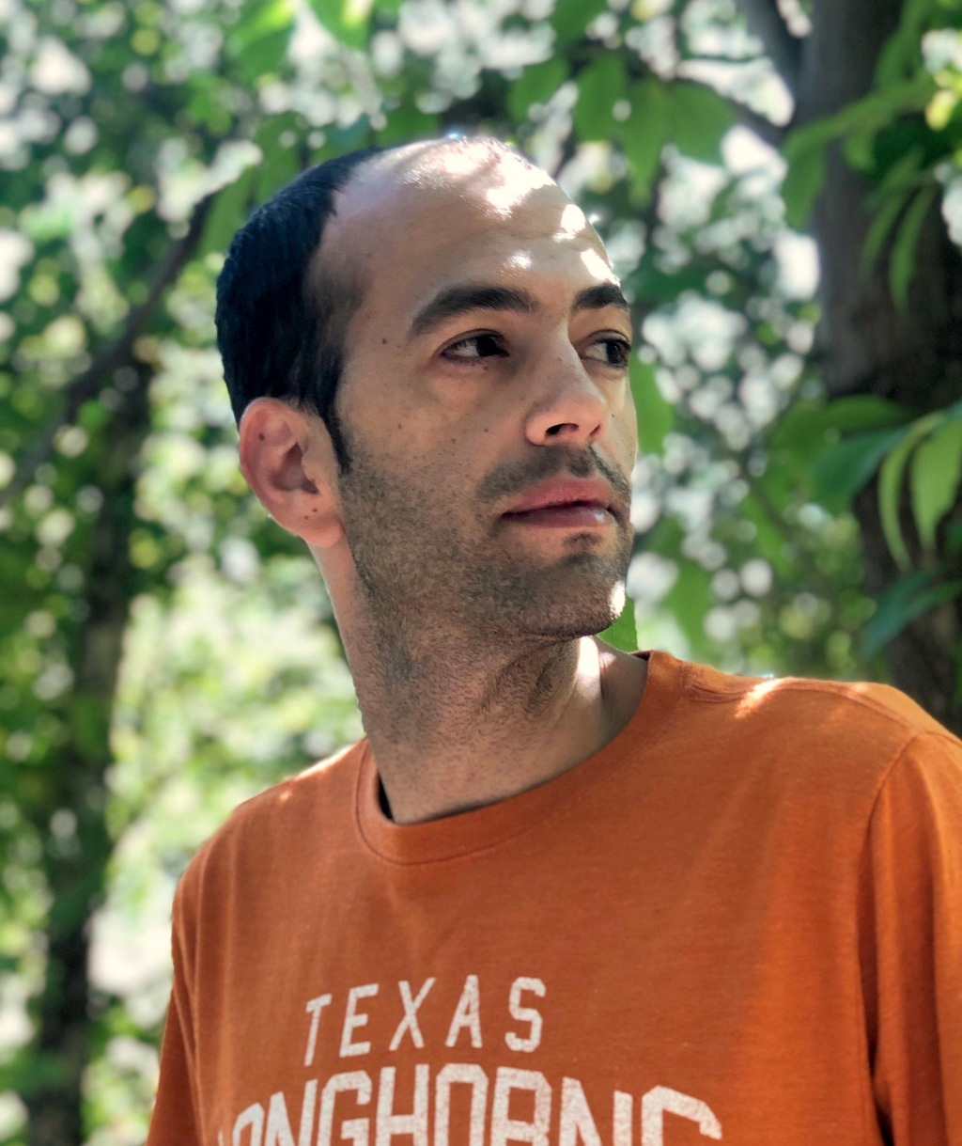
Pseudorandom Generators for Monotone Read-Once Branching Programs
Avishay Tal (UC Berkeley)
Dean Doron Raghu Meka Omer Reingold Salil Vadhan
Stanford
UCLA
Stanford
Harvard

Slide 2
Motivating Question: RL vs. L
Open Question:
Does every problem solvable by a randomized algorithm with space s, is also solvable by a deterministic algorithm with space O(s)?
Suffices to focus on s=O(log n): does RL = L?
Randomized-Log-Space
Log-Space

Slide 3
Pseudo-randomness
f
f
PRG
Def’n: a distribution $D$ over ${\left\{0,1\right\}}^{n}$ is $ε$-pseudorandom against a class of functions $𝒞$ if
$$∀f∈𝒞: E_{x\sim D}\left[f\left(x\right)\right]≈_{ε}E_{x∼U}[f\left(x\right)]$$
Def’n: a Pseudorandom Generator (PRG) for $𝒞$ is a function $G:{\left\{0,1\right\}}^{d}→{\left\{0,1\right\}}^{n}$ such that $G(U_{d})$ is pseudorandom for $𝒞$.

Slide 4
Read-Once Oblivious Branching Programs (ROBPs)
$$x_{1}$$
$$x_{2}$$
$$x_{3}$$
$$x_{n}$$
1
1
0
$$w$$ (width)
$$…$$
0
$$0$$
$$1$$
$n$ (length)
Each layer represents a time step
Each vertex represents a memory configuration
$s$ memory bits ➔ width at most $2^{s}$
Notes:
Space s ➔ width <= 2^s.
The only input to the branching program is the “random” or ”pseudorandom” string. Starting from a Turing machine with an input tape and a random tape, we fix the content of the input tape and consider the behavior of the machine wrt to the random tape, which is read-once. We thus need to fool each Turing machine with bounded space, and each fixing of the input tape.

Slide 5
PRGs for ROBPs
[Nisan’90]: a PRG for length-$n$ ROBP with seed-length:
$O\left(\log^{2}{n}\right)$ for width $poly(n)$ (i.e., Log-Space).
$O\left(\log^{2}{n}\right)$ even for constant width
Nisan’s PRG remains the state-of-the-art for width $≥4$

Slide 6
PRGs for Restricted Branching Programs
[Braverman-Rao-Raz-Yehudayoff’10]:
$\tilde{O}\left(\log{n}\right)$ seed-length for regular ROBPs.
[Koucký-Nimbhorkar-Pudlák’11, De’11, Steinke’12, Hoza-Pyne-Vadhan’21]:
$O\left(\log{n}\right)$ seed-length for permutation ROBPs.
[Lee-Viola’17]:
$\tilde{O}\left(\log{n}\right)$ seed-length for read-once polynomials. (special case of width-4 branching programs)
[Meka-Reingold-T’19]:
$\tilde{O}\left(\log{n}\right)$ seed-length for width-3 ROBPs.
Notes:
Most of these results hold for somewhat large error – say error 0.01 or 1/polylog(n). It remains open to obtain nearly logarithmic seed-length for these special cases in the low-error regime of eps=1/poly(n).
Recently, Pyne and Vadhan gave pseudorandom pseudo-distribution generators with seed-length O~( (log n)^{3/2}) that fools ordered permutation branching programs with error 1/poly(n).

Slide 7
Unordered Branching Programs (Harder)
$$x_{π\left(1\right)}$$
$$x_{π\left(2\right)}$$
$$x_{π\left(3\right)}$$
$$x_{π\left(n\right)}$$
1
1
0
$$w$$ (width)
$$…$$
0
$$0$$
$$1$$
$n$ (length)
There’s a permutation $π ∈S_{n}$.
At time step $i$, the program reads bit $x_{π(i)}$ of the input.
The PRG should fool any read-once branching program under any permutation.
Notes:
Example for the power of model vs previous model: Identifying Palindromes.

Slide 8
Unordered Branching Programs
We focus on small-width unordered branching programs.
Hope: more challenging task ➔ creative new ideas
PRGs for unordered branching programs [BPW’11, IMZ’12, RSV’13, SVW’14, HLV’17, LV’17, CHRT’18, FK’18]:
$\tilde{O}\left({w log}^{2}n\right)$ seed-length, or
$\tilde{O}\left({log\left(nw\right) log}^{2}n\right)$ seed-length
Nearly matching Nisan’s parameters, but in a more general setting.
Notes:
Tzur: Constant-width unordered distinguishes Nisan’s PRG output from uniform string.
BV: INW with less than log^2(n) seed bits is not pseudorandom against width-3.

Slide 9
Read-Once AC⁰ and Constant-Width ROBPs
Why study constant width?
Natural milestone towards $poly(n)$ width
Generalizes read-once AC⁰
depth $d$
$$\overline{x_{1}} x_{8}{ x}_{19}$$
$$x_{4} \overline{x_{7}} { x}_{57}$$
$$x_{3} x_{14}{ x}_{26}$$
$$\overline{x_{9}} \overline{x_{17}} { x}_{2}$$
Claim: Depth-$d$ read-once AC⁰ formulas can be computed by read-once branching programs of width $d+1$.

Slide 10
Read-Once AC⁰ and Constant-Width ROBPs
Claim: Depth-$d$ read-once AC⁰ formulas can be computed by read-once branching programs of width $d+1$.
Proof by Example
$$x_{1}$$
$$\overline{x_{4}}$$
$$x_{5}$$
$$x_{2}$$
$$x_{3}$$
$$x_{4}$$
$$x_{5}$$
$$x_{2}$$
$$x_{3}$$
$$x_{1}$$
accept
accept
0
1
1
1
0
1
0
1
0
0/1
0/1
0
0/1
reject
0

Slide 11
Read-Once AC⁰ and Constant-Width ROBPs
Claim: Depth-$d$ read-once AC⁰ formulas can be computed by read-once branching programs of width $d+1$.
Proof by Example
$$x_{1}$$
$$\overline{x_{4}}$$
$$x_{5}$$
$$x_{2}$$
$$x_{3}$$
$$x_{2}$$
$$x_{3}$$
$$x_{4}$$
$$x_{5}$$
0/1
0/1
$$x_{1}$$
1
1
accept
0
1
0
1
0
1
0
0/1
0/1
0
0/1
reject
0

Slide 12
Monotone Read-Once Branching Programs
$$x_{1}$$
$$x_{2}$$
$$x_{3}$$
$$x_{n}$$
1
1
0
$$w$$ (width)
$$…$$
0
$$0$$
$$1$$
$n$ (length)
Informal Def’n: a Monotone ROBP is a ROBP for which
1-edges don’t cross.
0-edges don’t cross.
Notes:
Example for the power of model vs previous model: Identifying Palindromes.

Slide 13
Simple and Crucial Fact
Trivial layer
Non-trivial layer
In a Monotone ROBP
1-edges don’t cross.
0-edges don’t cross.
$$w$$
Simple Fact: In a Monotone Branching Program any non-trivial layer is colliding, i.e., there exists $b∈\{0,1\}$ such that edges marked with $b$ collide.

Slide 14
Our Main Result
a PRG with seed-length $\tilde{O}\left(w^{2} log{n}\right)$ for unordered monotone branching programs of width $w$.
In particular:
a PRG with seed-length $\tilde{O}\left(d^{2 }log{n}\right)$ for read-once AC⁰ formulas of depth $d$.
[Forbes-Kelley’18]: a PRG with seed-length $O\left(\log^{3}{n}\right)$ for read-once formulas of any depth.
[Doron-Hatami-Hoza’19]: PRG for read-once AC⁰:
$$O\left({\left(d⋅loglog n\right)}^{2d+2}\log{n}\right)$$

Slide 15
The Construction
Based on [Ajtai-Wigderson’85] PRG for AC⁰
1985
Revived and strengthened in
[GMRTV’12]
Followed by [TX’13, RSV’13, SVW’14, GY’14, ST’17, HLV’17, LV’17, HT’18, CHRT’18, FK’18, MRT’19, DHH’19, …]
PRG

Slide 16
Restrictions Based PRG
$x_{2}$
0
1
Ajtai-Wigderson’s Paradigm:
$x_{8}$
$x_{17}$
$$f$$
-1
1
1
-1
0 | $$x_{2}$$ | $$\text{1}$$ | 1 | $$x_{5}$$ | $$x_{6}$$ | 1 | $$x_{8}$$ | 0 | … | 1
$$x_{1}$$ | $$x_{2}$$ | $$x_{3}$$ | $$x_{4}$$ | $$x_{5}$$ | $$x_{6}$$ | $$x_{7}$$ | $$x_{8}$$ | $$x_{9}$$ | … | $$x_{n}$$
indist.
indist.
indist.

Slide 17
Restrictions Based PRG
Ajtai-Wigderson’s Paradigm:
$$f$$
0 | $$x_{2}$$ | $$\text{1}$$ | 1 | $$x_{5}$$ | $$x_{6}$$ | 1 | $$x_{8}$$ | 0 | … | 1
$$x_{1}$$ | $$x_{2}$$ | $$x_{3}$$ | $$x_{4}$$ | $$x_{5}$$ | $$x_{6}$$ | $$x_{7}$$ | $$x_{8}$$ | $$x_{9}$$ | … | $$x_{n}$$
indist.
indist.
indist.

Slide 18
Random Restrictions Based PRG
Idea: [Atjai-Wigderson’85]
To fool $f∈𝒞$, Enough to fool $f$under (pseudo)-random restrictions:
Select $T⊆\left[n\right]$ pseudo-randomly, $\left|T\right|≈pn$
Select $x∼D$ a pseudo-random dist. on ${\left\{0,1\right\}}^{T}$
Select $y∼U_{\overline{T}}$ uniform dist. on ${\left\{0,1\right\}}^{\overline{T}}$ s.t.
$$E_{z\sim U_{n}}\left[f\left(z\right)\right]≈E_{T} E_{\begin{aligned}x ∼D, \\ y ∼U_{\overline{T}}\end{aligned}} \left[f\left(x∘y\right)\right]$$
To get a PRG: apply recursion $\frac{1}{p}⋅\log\left(n\right)$ times.

Slide 19
Random Restrictions Based PRG
Select $T⊆\left[n\right]$ pseudo-randomly, $\left|T\right|≈pn$
Select $x∼D$ a pseudo-random dist. on ${\left\{0,1\right\}}^{T}$
Select $y∼U_{\overline{T}}$ uniform dist. on ${\left\{0,1\right\}}^{\overline{T}}$ s.t.
$$E_{z\sim U_{n}}\left[f\left(z\right)\right]≈E_{T} E_{\begin{aligned}x ∼D, \\ y ∼U_{\overline{T}}\end{aligned}} \left[f\left(x∘y\right)\right]$$
[AW’85]: Suffices that $D$ fools $f_{y}\left(x\right)=f\left(x∘y\right)$ for most choices of $T$, $y$.
[GMRTV’12]: Suffices that $D$ fools their average $Bias_{T}(x)=E_{y∼ U_{\overline{T}}}\left[f_{y}\left(x\right)\right].$
$$E_{T} E_{\begin{aligned}x ∼U_{T}, \\ y ∼U_{\overline{T}}\end{aligned}} \left[f\left(x∘y\right)\right]$$

Slide 20
Random Restrictions Based PRG
[Ajtai-Wigderson’85]: In order to fool $f∈𝒞$, suffices to fool $f$under random restrictions.
[Gopalan-Meka-Reingold-Trevisan-Vadhan’12]:
In order to fool $f∈𝒞$, suffices to fool the average of the random restrictions of $f$.
Fooling the average is sometimes much easier.

Slide 21
Random Restriction Based PRG
An equivalent way to explain the construction:
Pseudo-randomly assign $p$ fraction of the coordinates, while approximately preserving the acceptance probability of every $f∈𝒞$.
Repeat until all coordinates are assigned.
# of iterations: $O\left(p^{−1}⋅log n\right)$
$s$ random bits per iteration➔ $O\left({s⋅p}^{−1}⋅\log{n}\right)$random bits in total.
How to get nearly-logarithmic seed length?
“Milder Restrictions”:
$$p =Ω(1)$$
Early stop: repeat until $1−1/polylog(n)$frac of the coordinates are assigned.
Last step: assign the remaining coordinates using off-the-shelf generators.
# of iterations: $O\left(\log{log n}\right)$
$$O\left(s⋅\log{log n}\right)$$

Slide 22
Milder Restrictions
[Forbes-Kelley’18]: Using $\tilde{O}\left(w log{n}\right)$ random bits, can assign half the coordinates of a width-$w$ branching program, while preserving its acceptance probability up error $1/poly(n)$.
* The choice of which variables to assign and their values is almost O(log n)-wise independent distribution.

Slide 23
Early Stop
Want to show: the program simplifies to a junta after $O(w log⁡log⁡n)$iterations.
Main Claim: width reduction – after $O(log⁡log⁡n)$iterations the width decreases by 1.
After first iteration of Forbes-Kelley: a composition of blocks, with O(log n) non-trivial layers in each block.
w
$$w−1$$
$$w−1$$
$$w−1$$
…
$$w−1$$
$$2$$
$O(log⁡n)$layers
$O(log⁡n)$layers
…
$O(log⁡n)$layers

Slide 24
Width Reduction
We show that after O(1) iterations of Forbes-Kelley:
# of layers in a block: reduces from $ℓ$ to $ℓ/2$
# of blocks btwn width $w−2$: reduces from ${100}^{ℓ}$ to ${100}^{ℓ/2}$
w
$$w−1$$
$$w−1$$
$$w−1$$
…
$$w−1$$
$$2$$
$ℓ$ layers
$ℓ$ layers
$ℓ$ layers
$ℓ$ layers
${100}^{ℓ}$ blocks

Slide 25
Larger Alphabet
We group each block of $≤ℓ$ bits to one symbol
➔ Yields a program over alphabet ${\left\{0,1\right\}}^{ℓ}$ of width $w−1$
Fact: This program is monotone as well.
$$w−1$$
$$w−1$$
w
$$w−1$$
…
$$w−1$$
…
$$w−1$$
$$2$$
layer over ${\left\{0,1\right\}}^{ℓ}$
…
layer over ${\left\{0,1\right\}}^{ℓ}$
$ℓ$ layers
$ℓ$ layers
$ℓ$ layers
$ℓ$ layers
layer over ${\left\{0,1\right\}}^{ℓ}$

Slide 26
Larger Alphabet
A layer is trivial if for all symbols $σ∈{\left\{0,1\right\}}^{ℓ}$, the edges marked by $σ$ form the identity permutation.
We can ignore trivial layers.
…
$$w−1$$
layer over ${\left\{0,1\right\}}^{ℓ}$
…
layer over ${\left\{0,1\right\}}^{ℓ}$
layer over ${\left\{0,1\right\}}^{ℓ}$
${100}^{ℓ}$ layers
width $≤w−2$
width $≤w−2$

Slide 27
Reducing the distance between width $w−2$
Recall Simple Fact: Any non-trivial layer is colliding, i.e., there exists a $σ∈{\left\{0,1\right\}}^{ℓ}$ such that edges marked in $σ$ collide.
Under a (pseudo)random restriction any non-trivial layer realizes a collision w.p. $≥\frac{1}{4^{ℓ}}$
…
$$w−1$$
layer over ${\left\{0,1\right\}}^{ℓ}$
layer over ${\left\{0,1\right\}}^{ℓ}$
layer over ${\left\{0,1\right\}}^{ℓ}$
layer over ${\left\{0,1\right\}}^{ℓ}$
${100}^{ℓ}$ layers
width $≤w−2$
width $≤w−2$
width $≤w−2$

Slide 28
Reducing the distance between width $w−2$
Under a random restriction a layer realizes a collision w.p.$≥\frac{1}{4^{ℓ}}$
Chernoff: w.p. at least $1− 1/\exp\left(\exp\left(ℓ\right)\right)$ at least one layer in a sequence of ${10}^{ℓ}$ layers will realize collision.
$ℓ≥loglog(n)$➔ whp no sequence of more than ${10}^{ℓ}$ layers btwn width $w−2$ in the entire program
…
$$w−1$$
layer over ${\left\{0,1\right\}}^{ℓ}$
…
layer over ${\left\{0,1\right\}}^{ℓ}$
layer over ${\left\{0,1\right\}}^{ℓ}$
${10}^{ℓ}={100}^{ℓ/2}$ layers
width $≤w−2$
width $≤w−2$

Slide 29
Alphabet Reduction
Suppose there are at most ${10}^{ℓ}$ layers btwn width $w−2$.
Apply a pseudo-random restriction, keeping every variable alive with probability $\frac{1}{1000}$.
The number of “surviving” bits in a layer $≥\frac{ℓ}{2}$ with $exp⁡(−ℓ)$ prob.
…
$${\left\{0,1\right\}}^{ℓ/2}$$
…
$${\left\{0,1\right\}}^{ℓ}$$
$${\left\{0,1\right\}}^{ℓ}$$
$${\left\{0,1\right\}}^{ℓ/2}$$
$${\left\{0,1\right\}}^{ℓ}$$
$${\left\{0,1\right\}}^{ℓ/2}$$
${10}^{ℓ}$ layers

Slide 30
Alphabet Reduction
The number of “surviving” bits in a block $≥\frac{ℓ}{2}$ with $exp⁡(−ℓ)$ prob.
Problem: Failure probability is not small enough to apply union bound over the entire program.
Solution: whp between every width $w−2$ there are at most $log⁡(n)$ “unruly” layers
…
$${\left\{0,1\right\}}^{ℓ/2}$$
$${\left\{0,1\right\}}^{ℓ}$$
$${\left\{0,1\right\}}^{ℓ/2}$$
$${\left\{0,1\right\}}^{ℓ/2}$$
$${\left\{0,1\right\}}^{ℓ}$$
$${\left\{0,1\right\}}^{ℓ}$$
$${\left\{0,1\right\}}^{ℓ}$$
$${\left\{0,1\right\}}^{ℓ}$$
${10}^{ℓ}$ blocks

Slide 31
Width Reduction
Overall: after O(log log n) iterations of Forbes-Kelley:
w
$$w−2$$
$$w−2$$
$$w−2$$
…
$$w−2$$
$$w−2$$
$polylog\left(n\right)$ bits
$polylog\left(n\right)$ bits
$polylog\left(n\right)$ bits
$polylog\left(n\right)$ bits
$$={10}^{ℓ}⋅ℓ$$
Applying additional O(log log n) iterations of Forbes-Kelley ➔ in each block at most $O(log⁡n)$variables survive whp.
w
$$w−2$$
$$w−2$$
$$w−2$$
…
$$w−2$$
$$w−2$$
$O(log n)$ bits
$O(log n)$ bits
$O(log n)$ bits
$O(log n)$ bits

Slide 32
Last Step
After $O(w log⁡log⁡n)$ iterations, we are left with the following program whp:
w
$$1$$
$$1$$
$$1$$
…
$$1$$
$$2$$
$O(log n)$ bits
$O(log n)$ bits
$O(log n)$ bits
$O(log n)$ bits
This is a junta on $O(log n)$ variables, ➔ any almost $O\left(log n\right)$-wise independent distribution fools it.

Slide 33
Recap: Our Main Result
a PRG with seed-length $\tilde{O}\left(w^{2} log{n}\right)$ for unordered monotone branching programs of width $w$.
In particular:
a PRG with seed-length $\tilde{O}\left(d^{2 }log{n}\right)$ for read-once AC⁰ formulas of depth $d$.

Slide 34
The Next Big Goal
Goal: Fool any constant width ROBPs with $o(\log^{2}⁡n)$seed-length.
More ambitiously: $\tilde{O}(log⁡n)$seed-length
[Forbes-Kelley’18]: Mild restrictions work for any constant width.
➔ Suffices to show that one can early stop after $o(log⁡n)$iterations. Proposes many challenges.

Slide 35
Challenging width-4 program
Tribes $∘$ XOR
Can be implemented as a width-4 ROBP.
Problem: the restricted function does not simplify enough under less than O(log m) iterations of Forbes-Kelley
Q: Does the average of restricted functions simplify?
$$2^{w}$$
$$w$$
$$m$$
$$x_{1} x_{2}{ x}_{m}$$
$$x_{m+1} x_{m+2}{ x}_{2m}$$
$$… x_{n−1} x_{n}$$

Slide 36
Open Questions
Fool read-once AC⁰[$⊕$], ACC⁰ with $o\left(\log^{2}{n}\right)$seed
Fool width-4 ROBPs with $o\left(\log^{2}{n}\right)$seed
Fool the Tribes$∘$XOR function with $o\left(\log^{2}{n}\right)$ seed
Does the AW / GMRTV generator with$O(\log{\log{n}})$ iterations fool constant-width ROBPs?
Does it fool polynomial width ROBPs?
How about just 2 iterations?

Slide 37
Thank You!

