Slide 1
Cryptographic Hardness under Projections for Time-Bounded Kolmogorov Complexity
Oxford-Warwick Complexity Meeting, Jan. 14, 2021
Joint work with John Gouwar, Shuichi Hirara, & Caleb Robelle

Slide 2
Things We Care About:
Reducibility & Completeness/Hardness
MCSP
Our results:
Greatly Improved Hardness Results for “MCSP” under m-reducibility.

Slide 3
Plan for Today
Greatly Improved Hardness Results for “MCSP” under m-reducibility.
What do I mean by “MCSP”?
Why do we care about restricted types of reducibility (especially projections)?

Slide 4
What is MCSP??
MCSP = {(f,s): f is a Boolean function (i.e., a bitstring of length 2^{n}) and f has a circuit of size ≤ s}
Undefined terms: “circuit” and “size”
Does the “circuit” have only NAND gates? Or (˄,˅,¬)? Or MAJORITY? Unbounded fan-in? Etc.

Slide 5
What is MCSP??
MCSP = {(f,s): f is a Boolean function (i.e., a bitstring of length 2^{n}) and f has a circuit of size ≤ s}
Undefined terms: “circuit” and “size”
Is the “size” the # of wires? the # of gates? The length of the description?

Slide 6
What is MCSP??
MCSP = {(f,s): f is a Boolean function (i.e., a bitstring of length 2^{n}) and f has a circuit of size ≤ s}
Undefined terms: “circuit” and “size”
These are all reasonable choices. Any theorem that has been proved for one of these choices holds for another …

Slide 7
What is MCSP??
MCSP = {(f,s): f is a Boolean function (i.e., a bitstring of length 2^{n}) and f has a circuit of size ≤ s}
Undefined terms: “circuit” and “size”
… but it’s possible that MCSP defined one way can be in P, and defined another way can be NP-complete.

Slide 8
What is MCSP??
Time-bounded Kolmogorov complexity provides yet another way to define MCSP, since KT(f) ≈ Size(f).
MKTP = {(x,s) : KT(x) ≤ s}.
All theorems that have been proved about MCSP also hold for MKTP…

Slide 9
What is MCSP??
Time-bounded Kolmogorov complexity provides yet another way to define MCSP, since KT(f) ≈ Size(f).
… but recently some theorems have been proved about MKTP that are not (yet) known to hold for MCSP:
  Graph Isomorphism is in ZPP^{MKTP}
  DET is AC⁰ m-reducible to MKTP

Slide 10
What is MCSP??
Time-bounded Kolmogorov complexity provides yet another way to define MCSP, since KT(f) ≈ Size(f).
So MKTP can be viewed as a particularly NICE version of MCSP. It’s easier to work with, and indicates what is likely to be true for (other formulations of) MCSP.

Slide 11
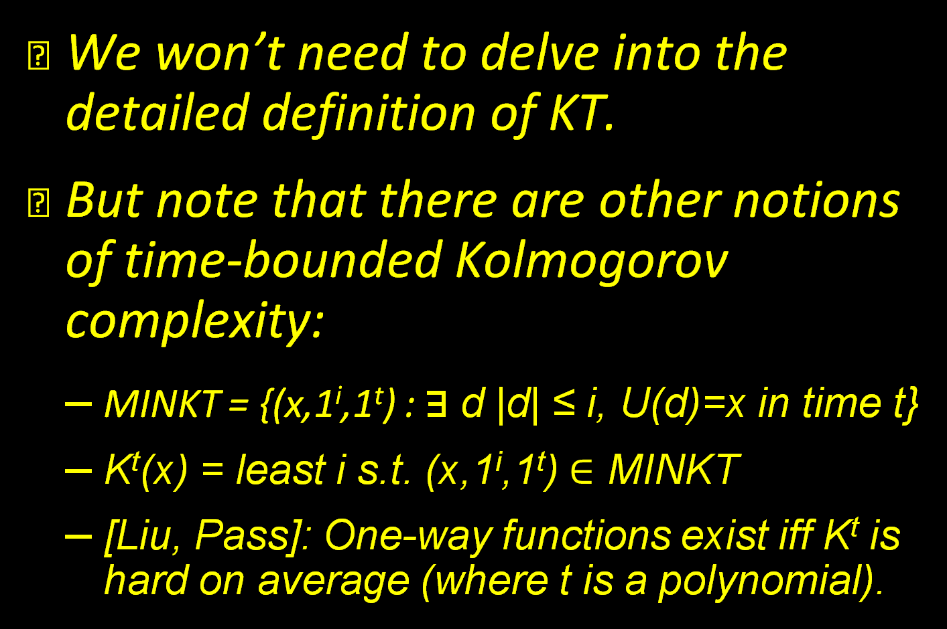
Time-Bounded K-Complexity
We won’t need to delve into the detailed definition of KT.
But note that there are other notions of time-bounded Kolmogorov complexity:
  MINKT = {(x,1^{i},1^{t}) : ⱻ d |d| ≤ i, U(d)=x in time t}
  K^{t}(x) = least i s.t. (x,1^{i},1^{t}) $∈$ MINKT
  [Liu, Pass]: One-way functions exist iff K^{t} is hard on average (where t is a polynomial).

Slide 12
Time-Bounded K-Complexity
We won’t need to delve into the detailed definition of KT.
Our hardness results for MKTP also hold for MINKT, as well as for analogous measures such as Kt, KS, K, C, etc.

Slide 13
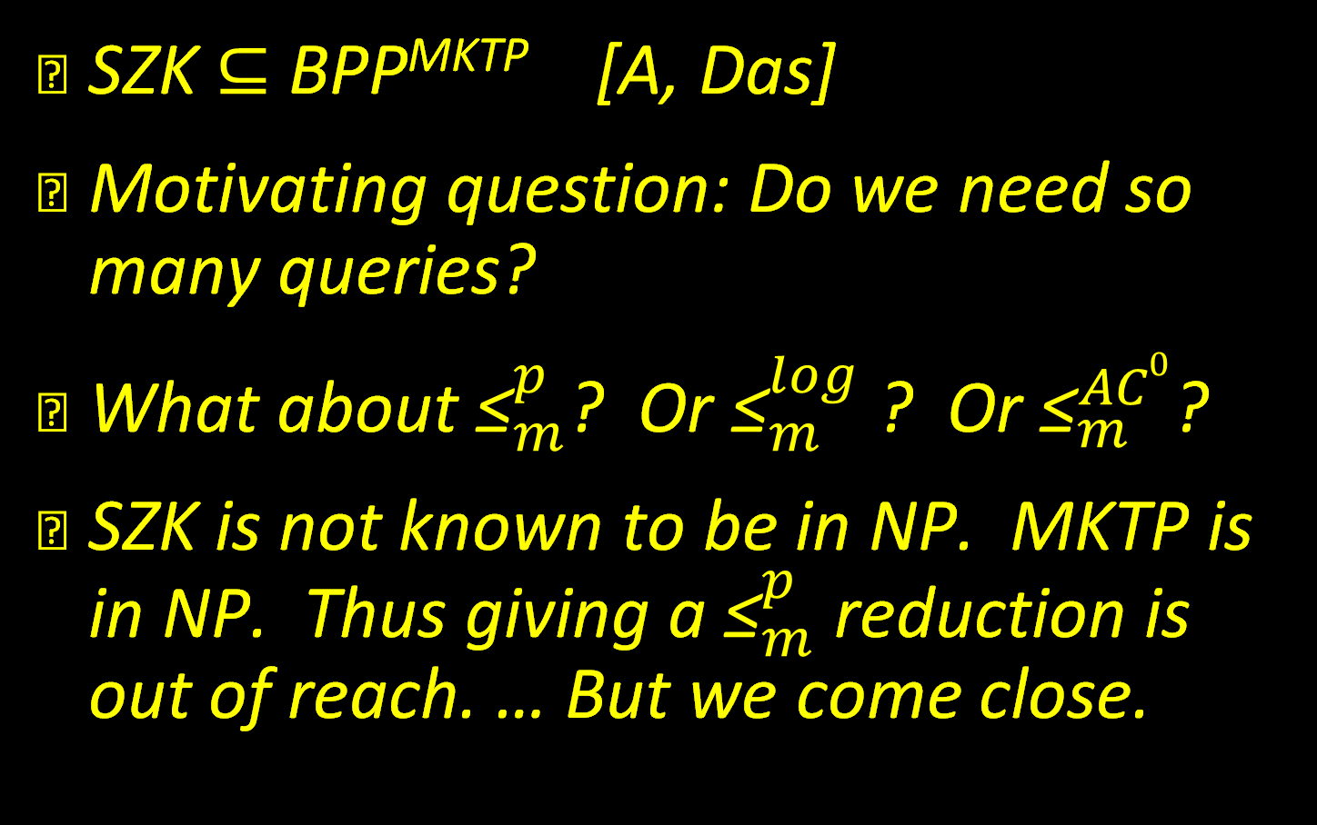
Prior Work, and Our Motivation
SZK $⊆$ BPP^{MKTP} [A, Das]
Motivating question: Do we need so many queries?
What about ${\text{≤}}_{m}^{p}$? Or ${\text{≤}}_{m}^{log}$ ? Or ${\text{≤}}_{m}^{AC0}$?
SZK is not known to be in NP. MKTP is in NP. Thus giving a ${\text{≤}}_{m}^{p}$ reduction is out of reach. … But we come close.

Slide 14
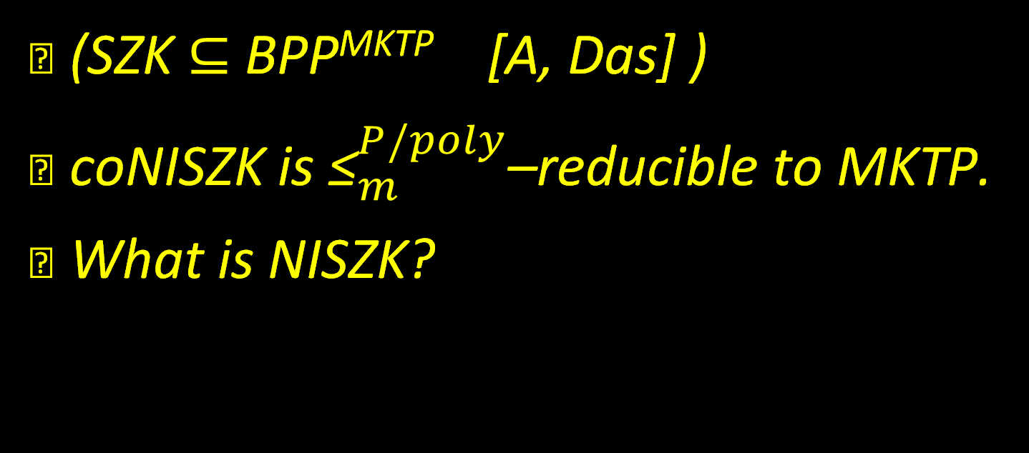
Theorem 1
(SZK $⊆$ BPP^{MKTP} [A, Das] )
coNISZK is ${\text{≤}}_{m}^{P/poly}$–reducible to MKTP.
What is NISZK?

Slide 15
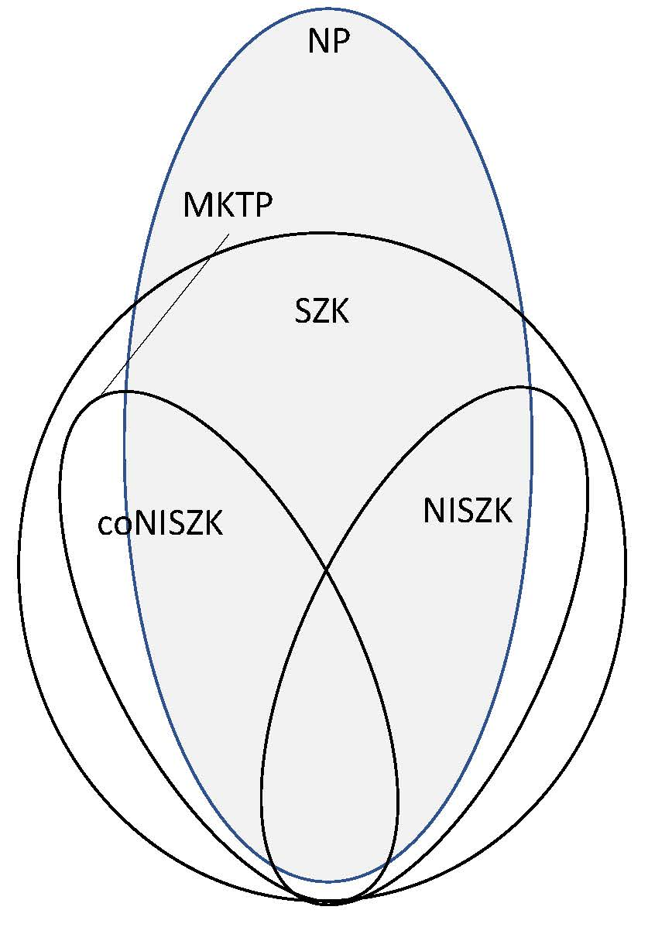
NISZK
Non-Interactive Statistical Zero Knowledge

Slide 16
NISZK
[GSV]: SZK ${\text{≤}}_{tt}^{AC0}$NISZK (so NISZK is hard iff SZK is).

Slide 17
NISZK
Compare complete problems for SZK and NISZK:
For SZK
For NISZK
ED:
Y = {(C,D) : H(C) > H(D)+1}
N = {(C,D) : H(C) < H(D)-1}
SD:
Y={(C,D): Δ(C,D) ≤ 1/n}
N={(C,D): Δ(C,D) ≥ 1-1/n}
EA:
Y = {(C,k) : H(C) > k+1}
N = {(C,k) : H(C) < k-1}
SDU:
Y={C: Δ(C,U) ≤ 1/n}
N={C: Δ(C,U) ≥ 1-1/n}

Slide 18
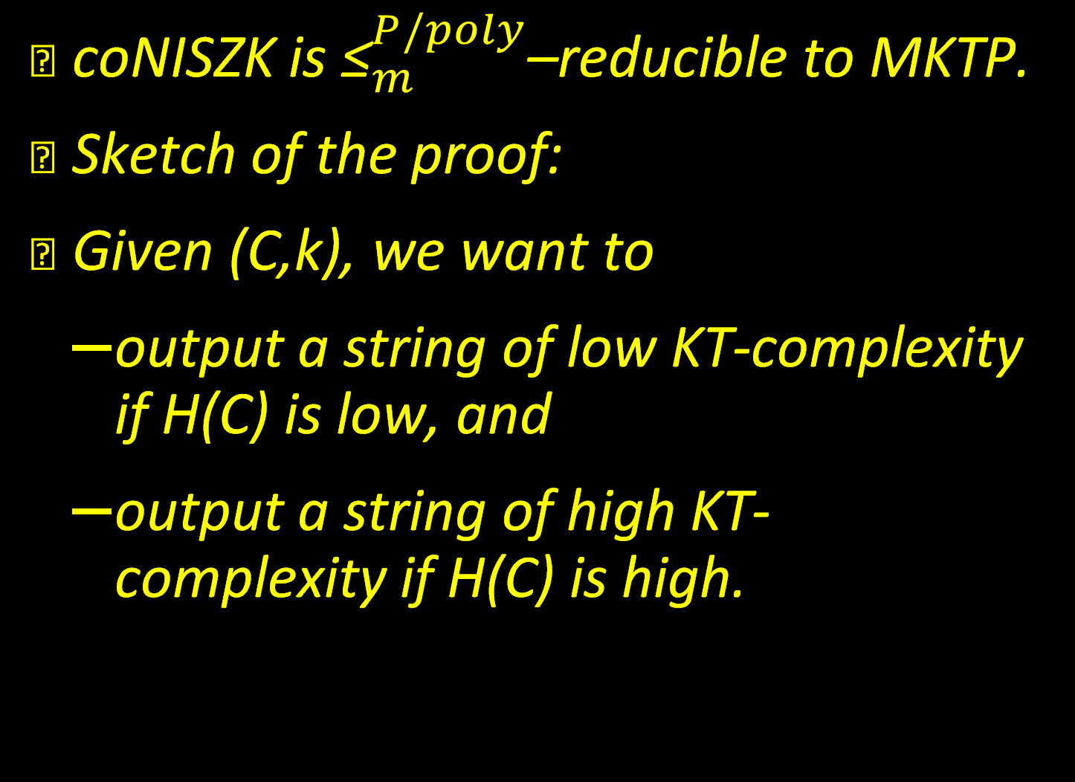
Theorem 1
coNISZK is ${\text{≤}}_{m}^{P/poly}$–reducible to MKTP.
Sketch of the proof:
Given (C,k), we want to
  output a string of low KT-complexity if H(C) is low, and
  output a string of high KT-complexity if H(C) is high.

Slide 19
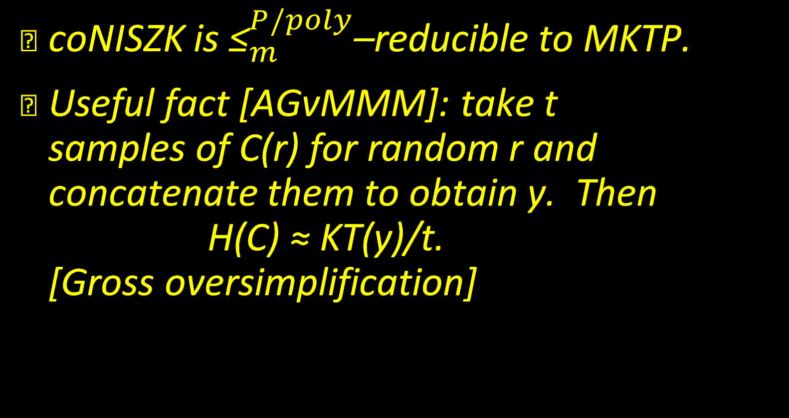
Theorem 1
coNISZK is ${\text{≤}}_{m}^{P/poly}$–reducible to MKTP.
Useful fact [AGvMMM]: take t samples of C(r) for random r and concatenate them to obtain y. Then H(C) ≈ KT(y)/t. [Gross oversimplification]

Slide 20
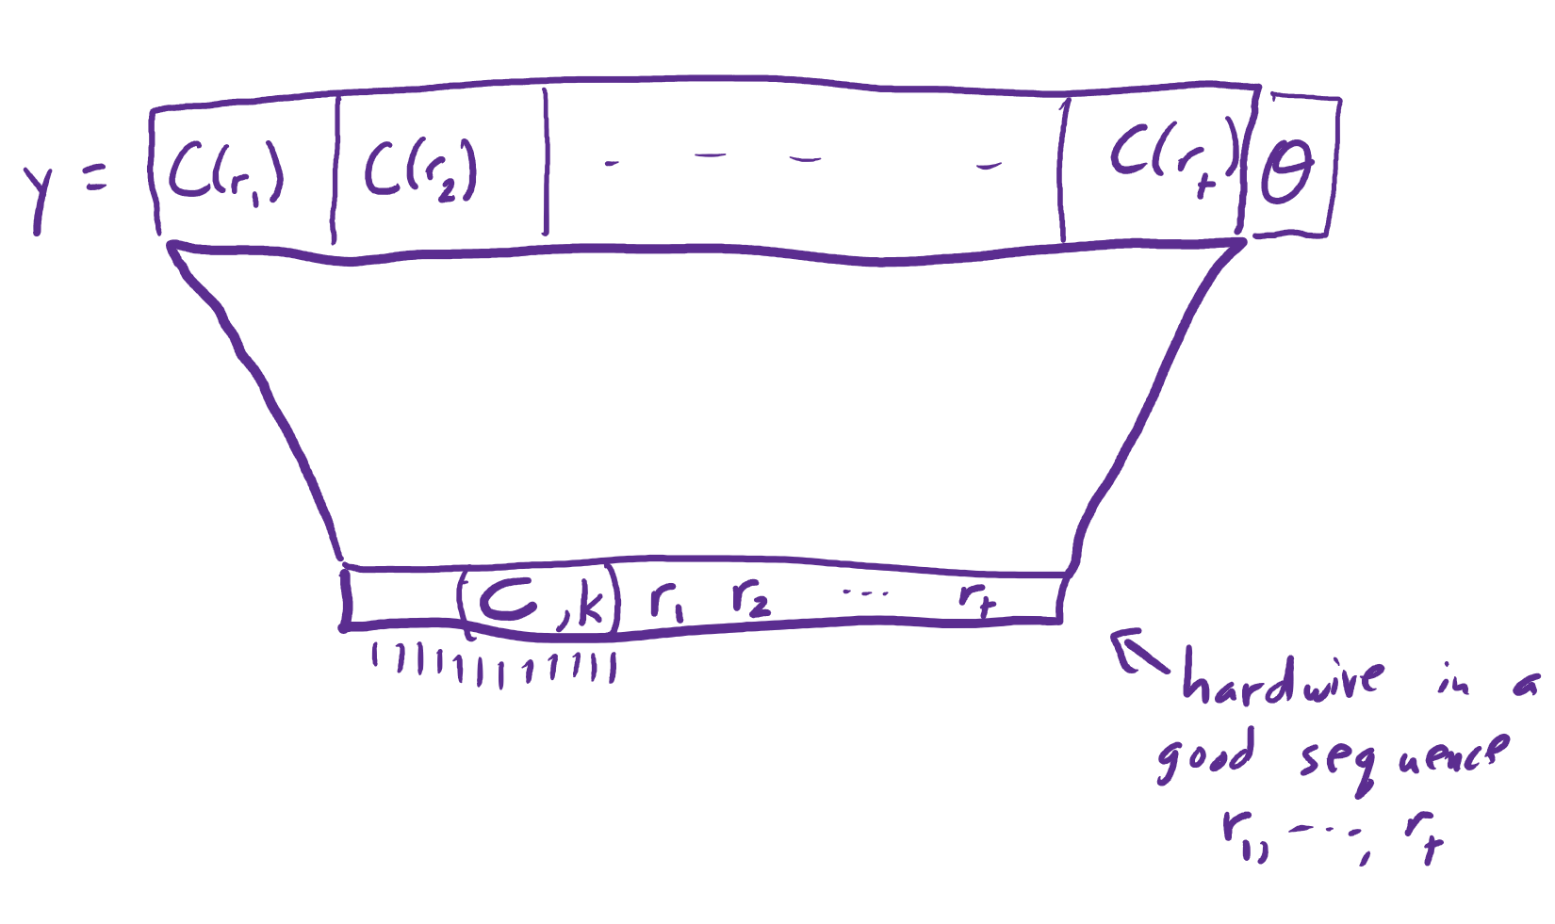
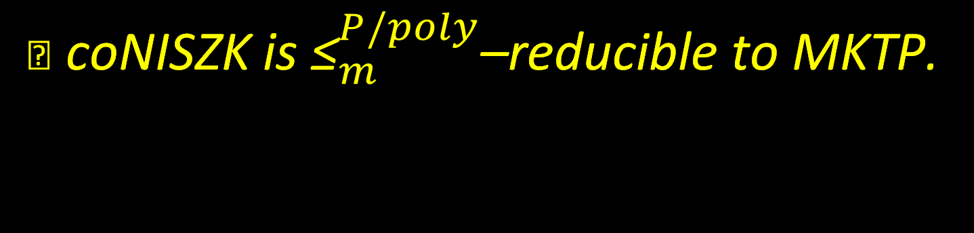
Theorem 1
coNISZK is ${\text{≤}}_{m}^{P/poly}$–reducible to MKTP.

Slide 21
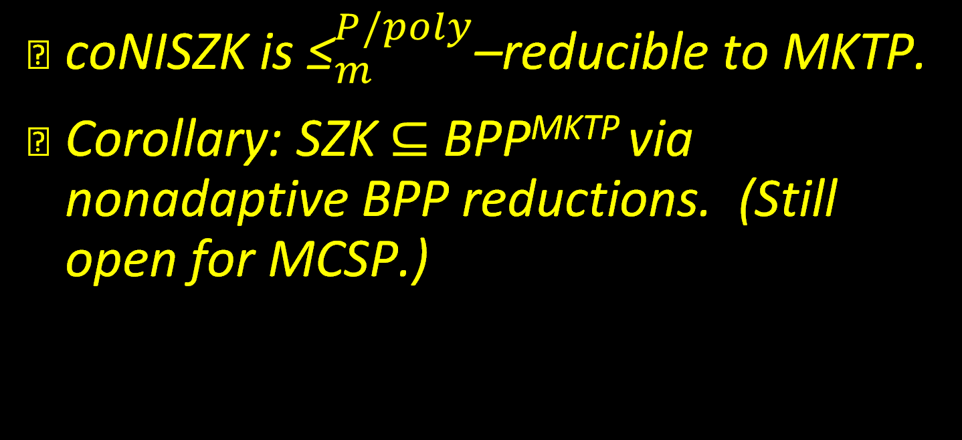
Theorem 1
coNISZK is ${\text{≤}}_{m}^{P/poly}$–reducible to MKTP.
Corollary: SZK $⊆$ BPP^{MKTP} via nonadaptive BPP reductions. (Still open for MCSP.)

Slide 22
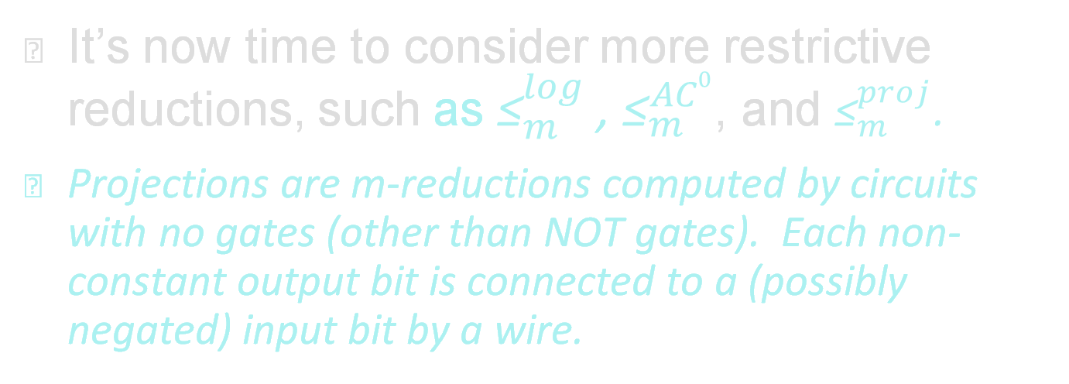
Projections
It’s now time to consider more restrictive reductions, such as ${\text{≤}}_{m}^{log}$ , ${\text{≤}}_{m}^{AC0}$, and ${\text{≤}}_{m}^{proj}$.
Projections are m-reductions computed by circuits with no gates (other than NOT gates). Each non-constant output bit is connected to a (possibly negated) input bit by a wire.

Slide 23
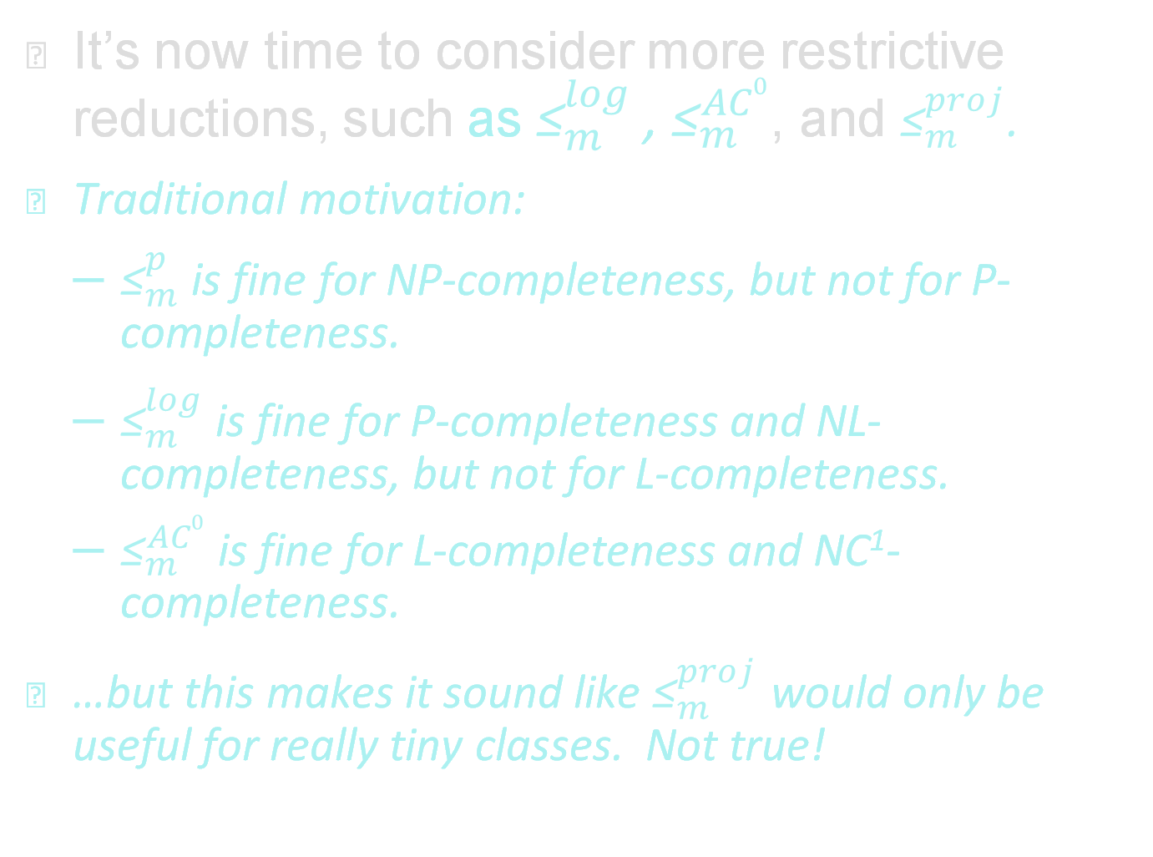
Projections
It’s now time to consider more restrictive reductions, such as ${\text{≤}}_{m}^{log}$ , ${\text{≤}}_{m}^{AC0}$, and ${\text{≤}}_{m}^{proj}$.
Traditional motivation:
  ${\text{≤}}_{m}^{p}$ is fine for NP-completeness, but not for P-completeness.
  ${\text{≤}}_{m}^{log}$ is fine for P-completeness and NL-completeness, but not for L-completeness.
  ${\text{≤}}_{m}^{AC0}$ is fine for L-completeness and NC¹-completeness.
…but this makes it sound like ${\text{≤}}_{m}^{proj}$ would only be useful for really tiny classes. Not true!

Slide 24
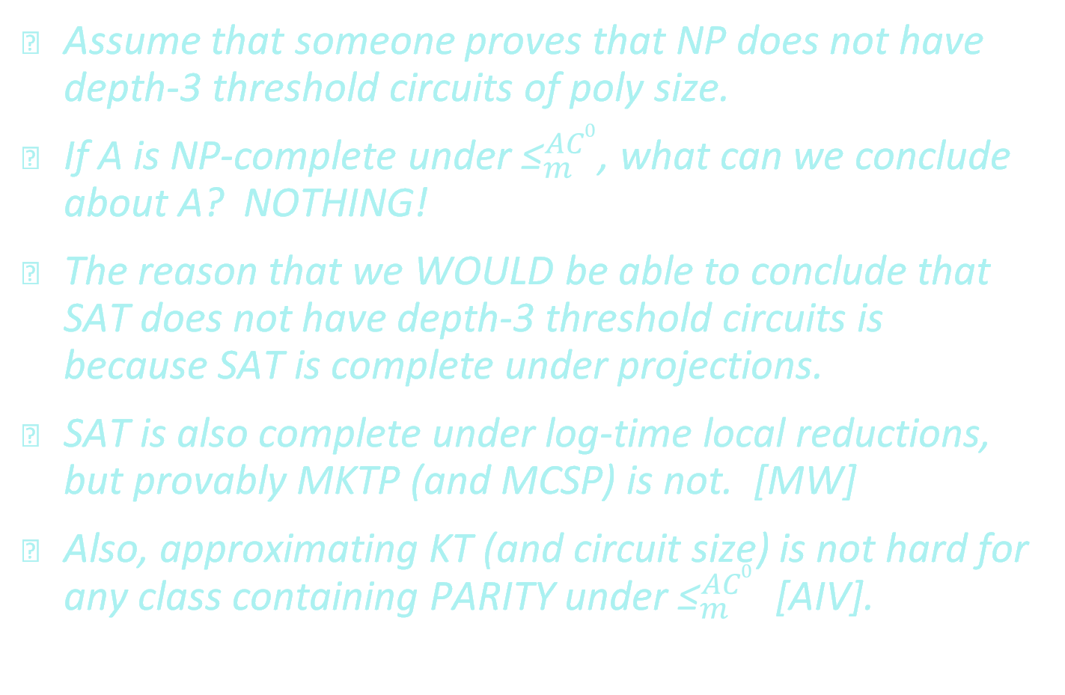
Projections: Motivation
Assume that someone proves that NP does not have depth-3 threshold circuits of poly size.
If A is NP-complete under ${\text{≤}}_{m}^{AC0}$, what can we conclude about A? NOTHING!
The reason that we WOULD be able to conclude that SAT does not have depth-3 threshold circuits is because SAT is complete under projections.
SAT is also complete under log-time local reductions, but provably MKTP (and MCSP) is not. [MW]
Also, approximating KT (and circuit size) is not hard for any class containing PARITY under ${\text{≤}}_{m}^{AC0}$ [AIV].

Slide 25
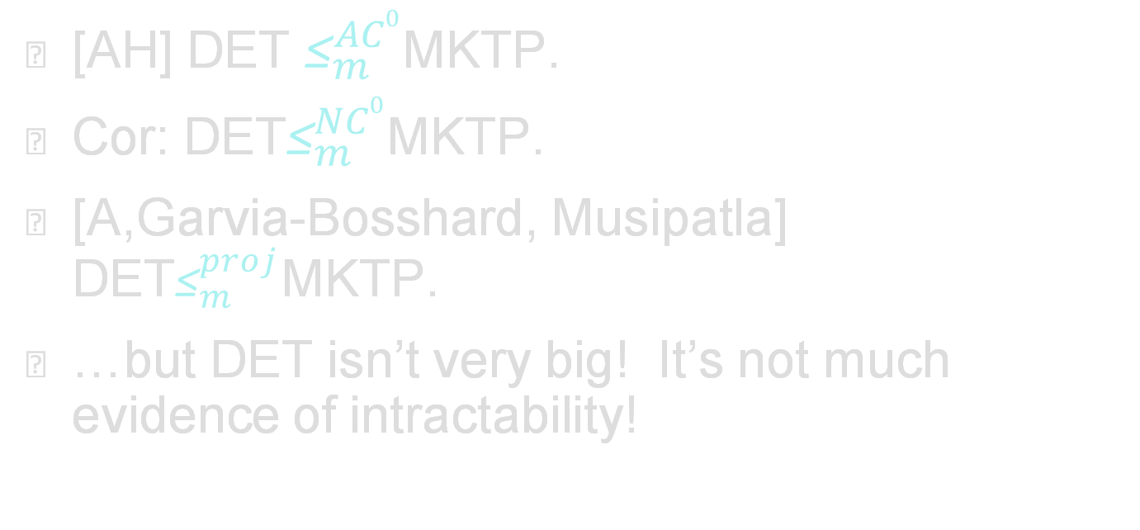
Projections, Prior Work
[AH] DET ${\text{≤}}_{m}^{AC0}$MKTP.
Cor: DET${\text{≤}}_{m}^{NC0}$MKTP.
[A,Garvia-Bosshard, Musipatla] DET${\text{≤}}_{m}^{proj}$MKTP.
…but DET isn’t very big! It’s not much evidence of intractability!

Slide 26
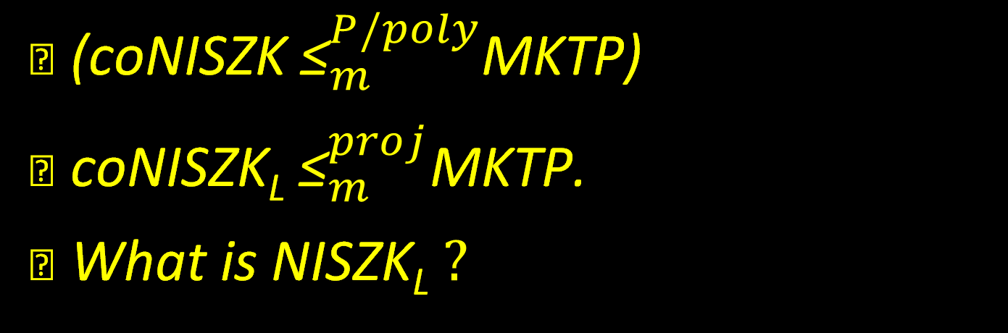
Theorem 2
(coNISZK ${\text{≤}}_{m}^{P/poly}$MKTP)
coNISZK_{L} ${\text{≤}}_{m}^{proj}$MKTP.
What is NISZK_{L} $?$

Slide 27
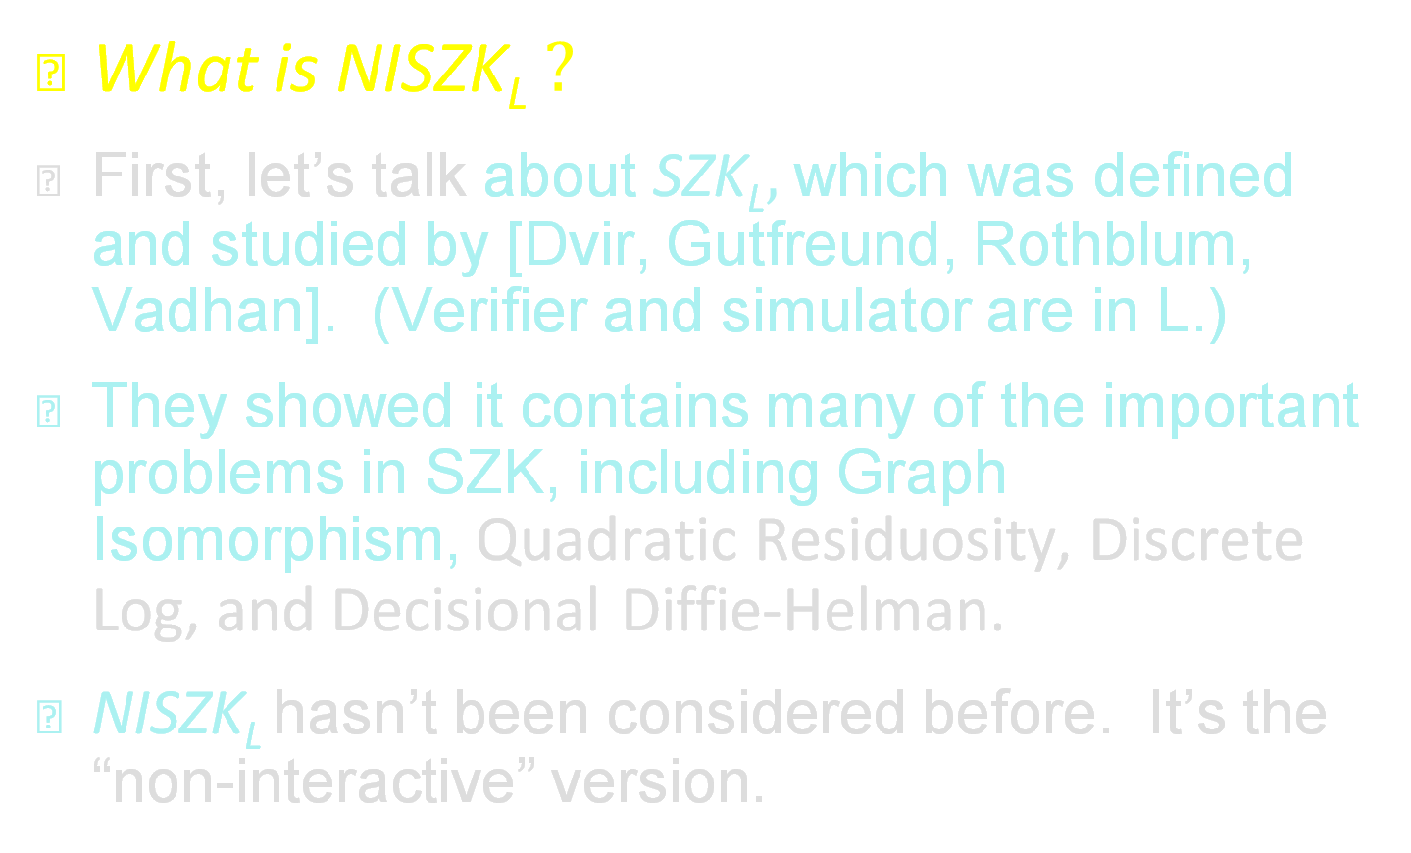
NISZK_{L}
What is NISZK_{L} $?$
First, let’s talk about SZK_{L}$,$ which was defined and studied by [Dvir, Gutfreund, Rothblum, Vadhan]. (Verifier and simulator are in L.)
They showed it contains many of the important problems in SZK, including Graph Isomorphism, Quadratic Residuosity, Discrete Log, and Decisional Diffie-Helman.
NISZK_{L} hasn’t been considered before. It’s the “non-interactive” version.

Slide 28

NISZK_{L}
NISZK_{L} is hard iff SZK_{L} is.

Slide 29
NISZK_{L}
DET $⊆$NISZK_{L}

Slide 30
NISZK_{L}
Compare complete problems for SZK_{L} and NISZK_{L}:
For SZK_{L}
For NISZK_{L}
ED_{BP}: C and D are Branching Progs
Y = {(C,D) : H(C) > H(D)+1}
N = {(C,D) : H(C) < H(D)-1}
ED_{NC}0: C and D have fan-in 4
Y = {(C,D) : H(C) > H(D)+1}
N = {(C,D) : H(C) < H(D)-1}
EA_{NC}0: C has fan-in 4
Y = {C : H(C) > n-2}
N = {C : H(C) < n-4}

Slide 31
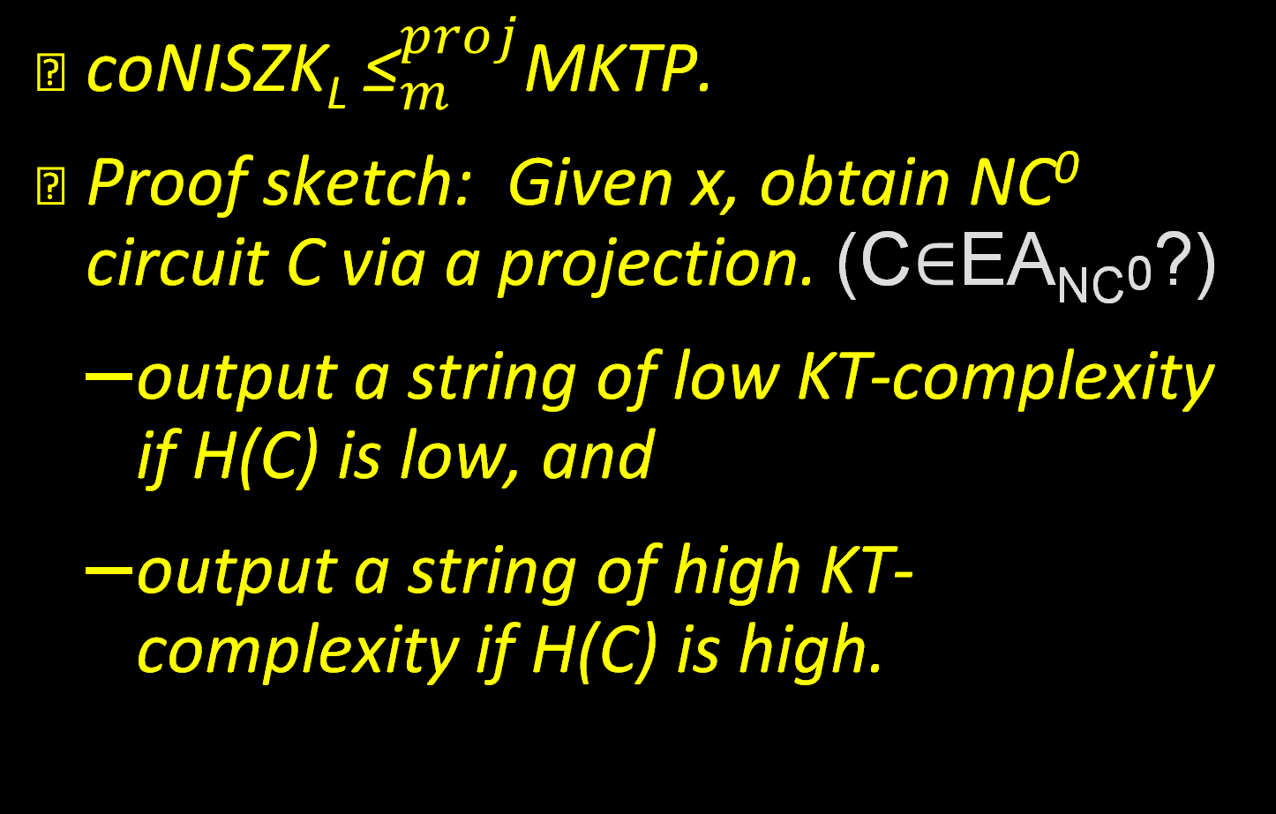
Theorem 2
coNISZK_{L} ${\text{≤}}_{m}^{proj}$MKTP.
Proof sketch: Given x, obtain NC⁰ circuit C via a projection. (C$∈$EA_{NC}0?)
  output a string of low KT-complexity if H(C) is low, and
  output a string of high KT-complexity if H(C) is high.

Slide 32
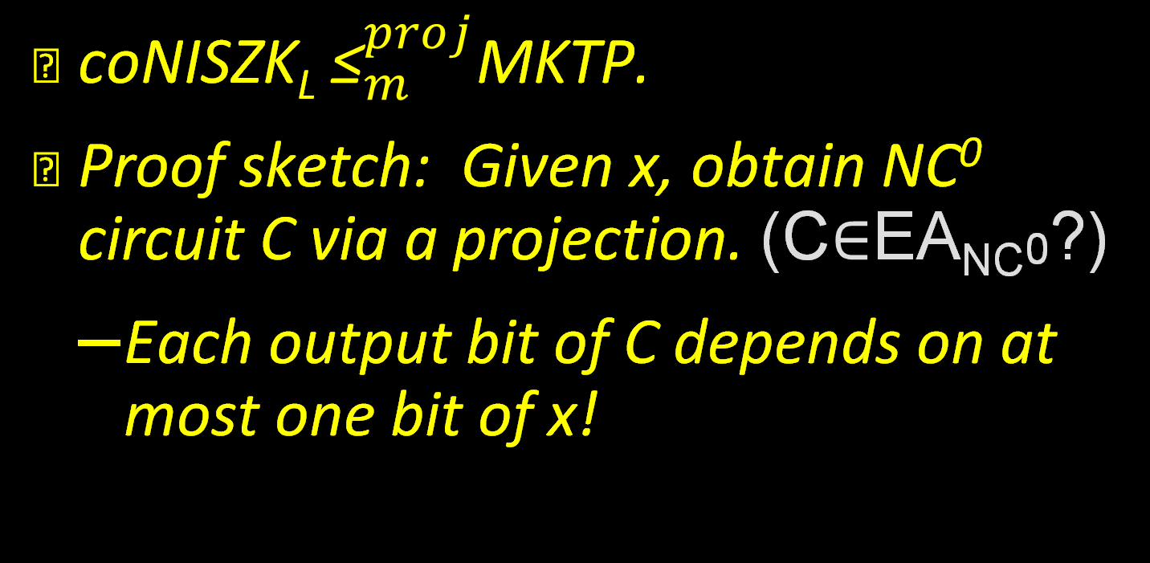
Theorem 2
coNISZK_{L} ${\text{≤}}_{m}^{proj}$MKTP.
Proof sketch: Given x, obtain NC⁰ circuit C via a projection. (C$∈$EA_{NC}0?)
  Each output bit of C depends on at most one bit of x!

Slide 33
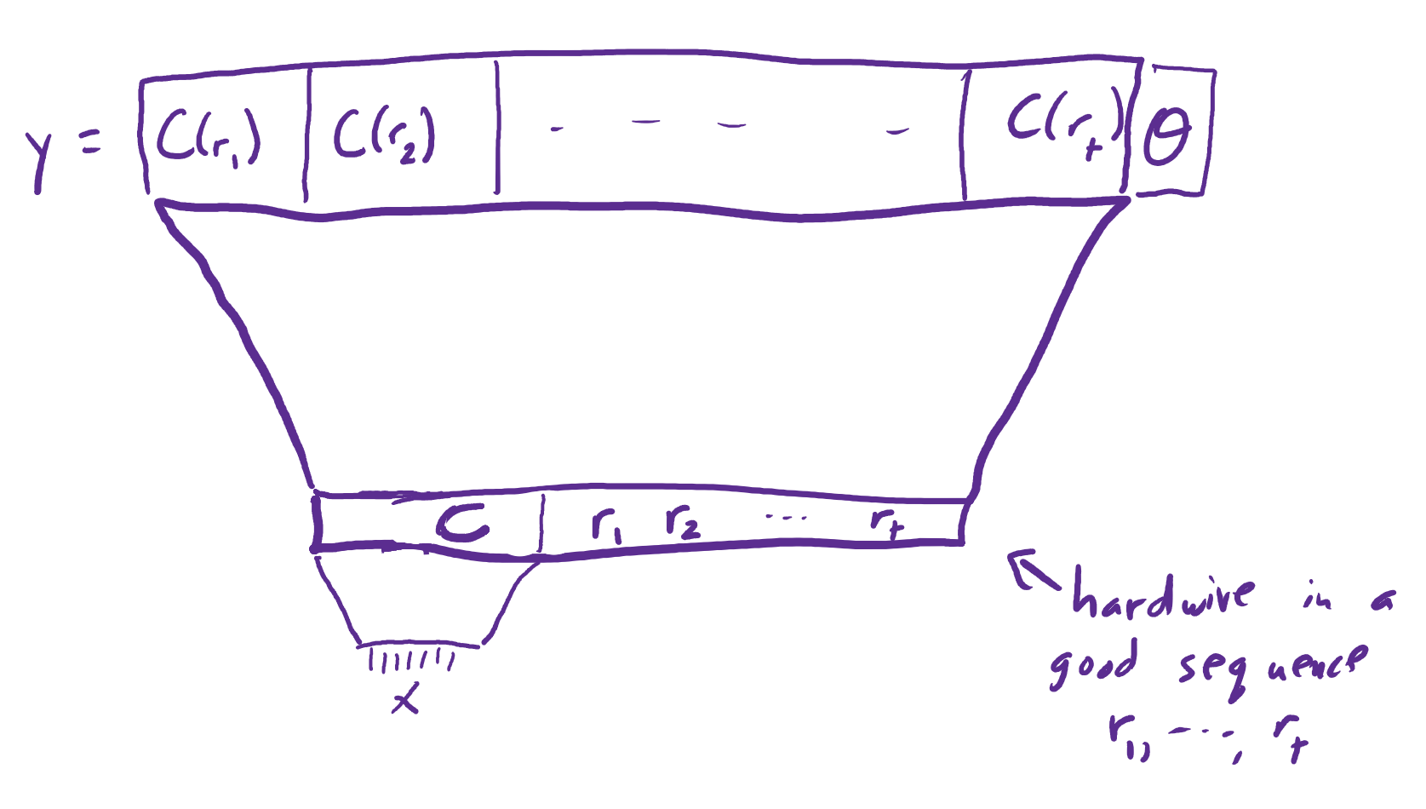
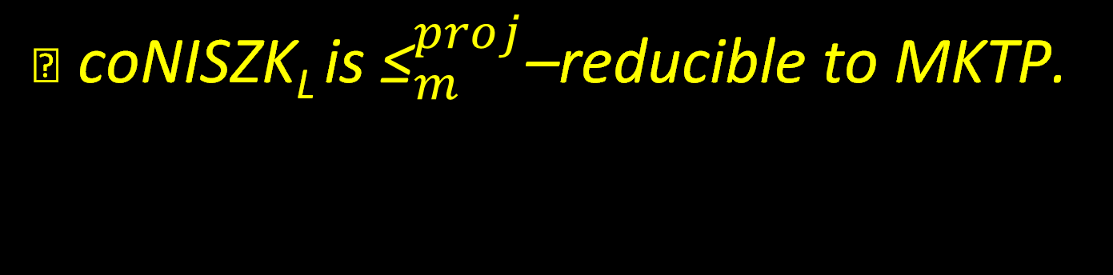
Theorem 2
coNISZK_{L} is ${\text{≤}}_{m}^{proj}$–reducible to MKTP.

Slide 34
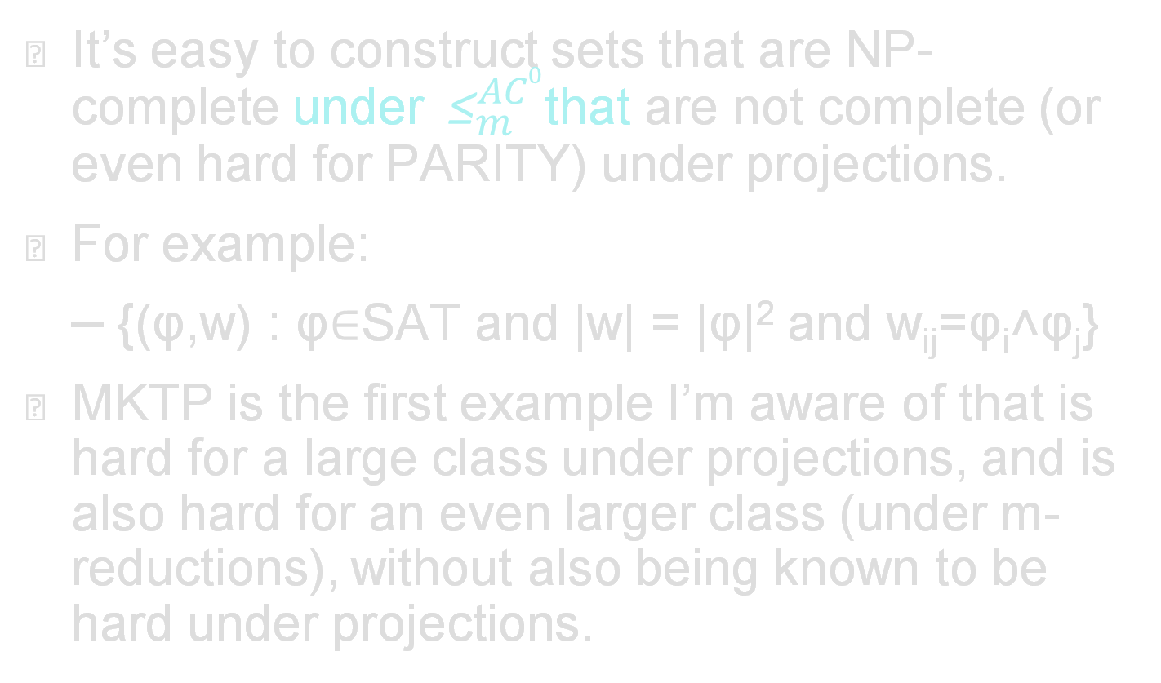
Discussion
It’s easy to construct sets that are NP-complete under ${\text{≤}}_{m}^{AC0}$that are not complete (or even hard for PARITY) under projections.
For example:
  {(φ,w) : φ$∈$SAT and |w| = |φ|² and w_{ij}=φ_{i}˄φ_{j}}
MKTP is the first example I’m aware of that is hard for a large class under projections, and is also hard for an even larger class (under m-reductions), without also being known to be hard under projections.

Slide 35
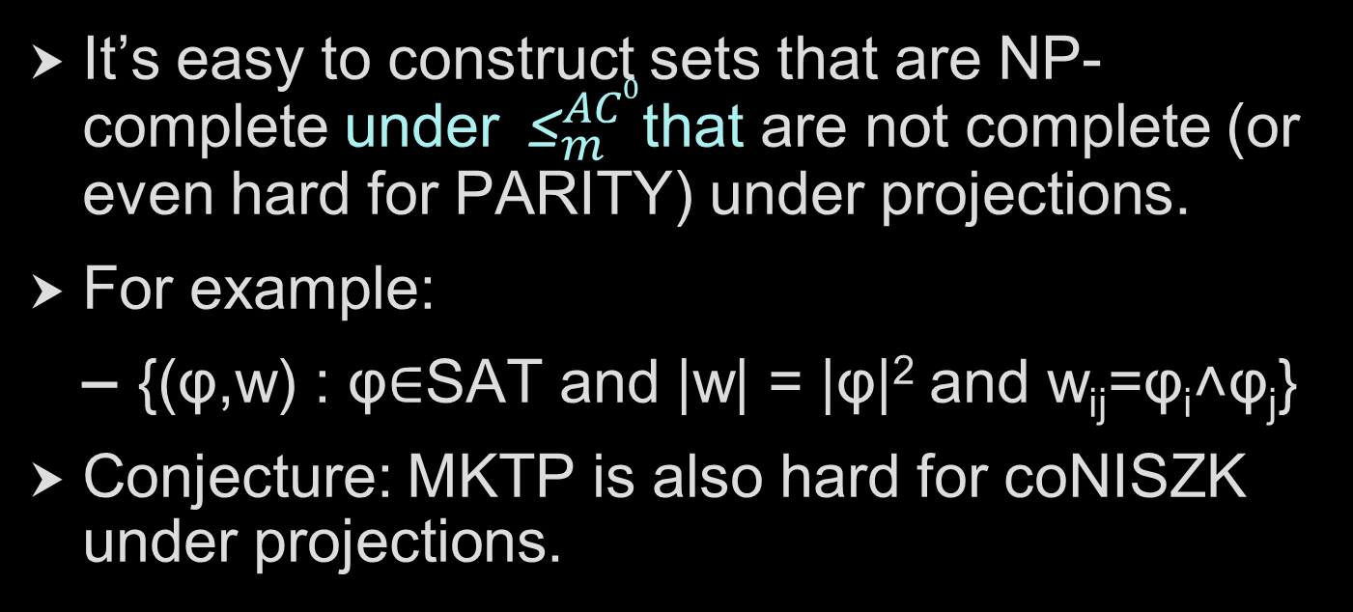
Discussion
It’s easy to construct sets that are NP-complete under ${\text{≤}}_{m}^{AC0}$that are not complete (or even hard for PARITY) under projections.
For example:
  {(φ,w) : φ$∈$SAT and |w| = |φ|² and w_{ij}=φ_{i}˄φ_{j}}
Conjecture: MKTP is also hard for coNISZK under projections.

Slide 36
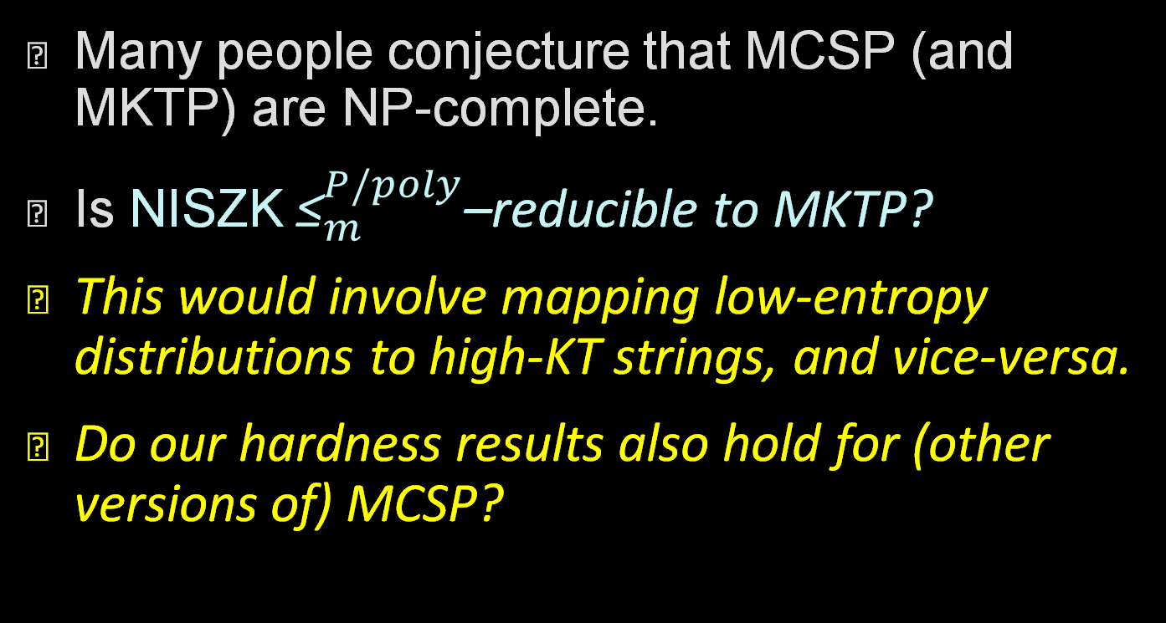
Discussion
Many people conjecture that MCSP (and MKTP) are NP-complete.
Is NISZK ${\text{≤}}_{m}^{P/poly}$–reducible to MKTP?
This would involve mapping low-entropy distributions to high-KT strings, and vice-versa.
Do our hardness results also hold for (other versions of) MCSP?

Slide 37
Thanks, Igor & Rahul!

