Slide 1



The Minimum Formula Size Problem is (ETH) Hard
Rahul Ilango

Slide 2

Background

Slide 3
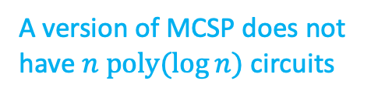





Why care about the Minimum Circuit Size Problem (MCSP)?
1. Connections to:
2. Its complexity is a mystery
Is MCSP NP-complete?
Is MCSP hard to approximate?
    Can you beat the naïve brute-force algorithm?
    Is MCSP hard on average?
Cryptography
Learning
Structural Complexity
Average Case Complexity
Circuit Complexity
X is true about MCSP
$$⇒$$
Solution to a long-standing open problem
$$⇒$$
MCSP is NP-complete
EXP $≠$ZPP
[Murray-Williams
‘15]
An approximation to MCSP is NP-complete
$$⇒$$
Computing NP “on average” is as hard as computing NP in the “worst-case”
[Hirahara ‘18]
A version of MCSP does not have $n poly(\log{n)}$ circuits
$$⇒$$
[McKay-Murray-Williams ‘19]
NP does not have polynomial-size circuits
A version of MCSP is “mildly
hard” on average
$$⇒$$
[Liu-Pass ‘20]
One-way functions exist!
Notes:
Add crypto theorem

Slide 4
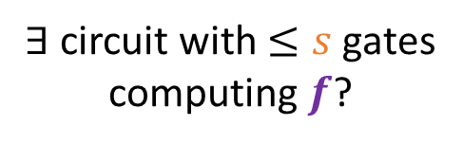

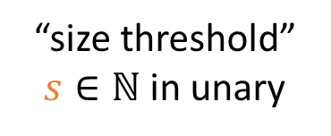
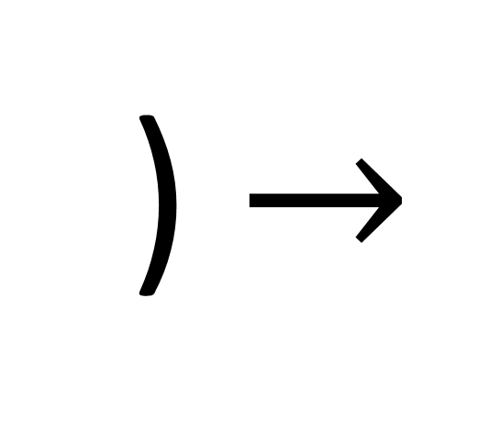
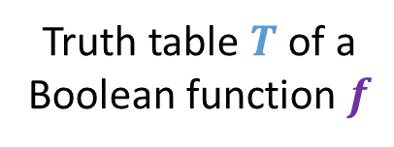
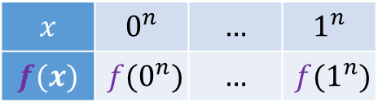
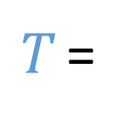
The Minimum Circuit Size Problem (MCSP)
Input
Output
(
,
) $→$
Truth table $T$ of a Boolean function $f$
“size threshold” $s∈ℕ$ in unary
$∃$ circuit with $≤s$ gates computing $f$?
$T$ =
$$x$$ | $$0^{n}$$ | $$…$$ | $$1^{n}$$
$$f(x)$$ | $$f(0^{n})$$ | $$…$$ | $$f(1^{n})$$
$${N= 2}^{n}$$
NP-complete
???
NP
Fact: If one-way functions exist, then MCSP is not in P
Complexity:
P
MCSP
[Razborov-Rudich]

Slide 5
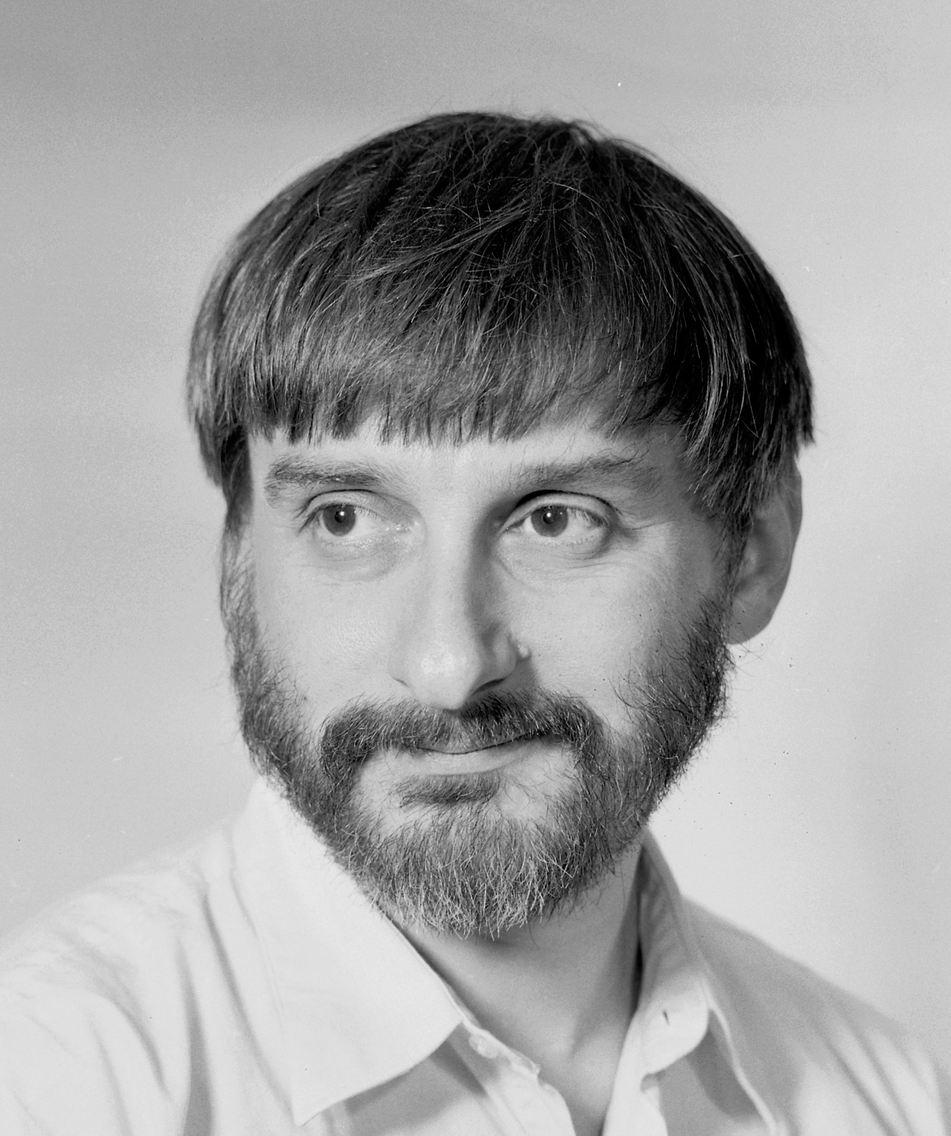


Is MCSP NP-hard?
“I thought only extending [the theory of NP-completeness] to some popular problems, like graph isomorphism circuits minimization, or (with less hope) factoring, would be worth publishing. I tried for a long time”
Longstanding Open Question
Why?
L. Levin
Difficult NO instances of MCSP
$$→$$
$$⇒$$
Deterministic poly-time reduction requires breakthrough
Functions requiring large circuits
[Kabanets-Cai ‘00,
Murray-Williams ’16,
Saks-Santhanam ‘20]
Randomized Reductions?
Subexponential-time reductions?
Sidenote:
Does MCSP have a search-to-decision reduction? [Kabanets-Cai ‘99]
Levin quote from https://www.cs.bu.edu/fac/lnd/research/hard.htm

Slide 6



Why care about proving hardness?
Proving hardness for MCSP forces us to find new circuit lower bound techniques
Circuit Complexity
Hardness of MCSP might characterize the existence of cryptography
Cryptography
I want to KNOW ☺
Curiosity

Slide 7

Results

Slide 8

Main Results (Informal)
MFSP = Minimum Formula Size Problem
1
ETH $⇒$MFSP not in P
2
MFSP has a Search to Decision Reduction

Slide 9
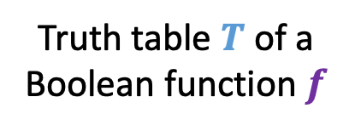
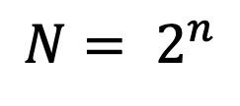

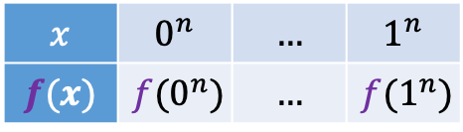


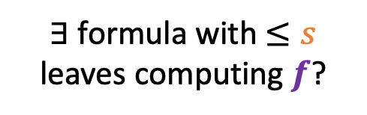

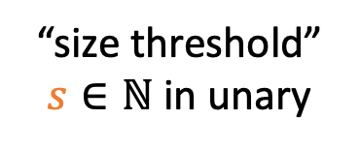

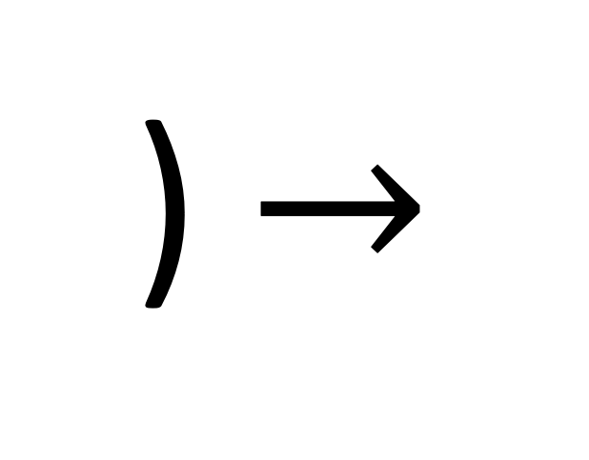
Minimum Formula Size Problem
$$∧$$
Formula Model
Rooted tree
Internal nodes labeled by AND, OR gates of fan-in two
Leaves of tree labeled by variables or their negations
Size of formula = # of leaves
V
$$∧$$
$$¬x_{110}$$
$$x_{5}$$
MFSP
(
Input
Output
,
) $→$
Truth table $T$ of a Boolean function $f$
“size threshold” $s∈ℕ$ in unary
$∃$ formula with $≤s$ leaves computing $f$?
$T$ =
$$x$$ | $$0^{n}$$ | $$…$$ | $$1^{n}$$
$$f(x)$$ | $$f(0^{n})$$ | $$…$$ | $$f(1^{n})$$
$${N= 2}^{n}$$

Slide 10

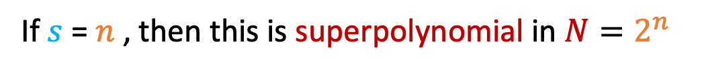
Approach for Hardness: MFSP with small thresholds
# of $n$-variable formulas of size $s$is roughly $≈2^{s log n}$
So brute force algo for MFSP runs in time $≈2^{s log n}$
If $s$ = $n$ , then this is superpolynomial in $N=2^{n}$
$$2^{s log n}=N^{log log N}$$
So if brute-force is optimal, could show MFSP not in P just by considering s = linear regime
We know cubic lower bounds for formulas!
So what’s stopping us??
We know linear lower bounds for circuits!

Slide 11
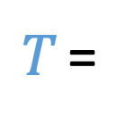
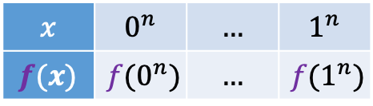
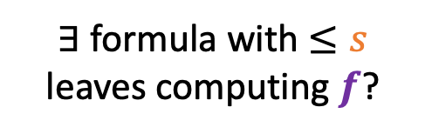
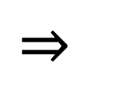


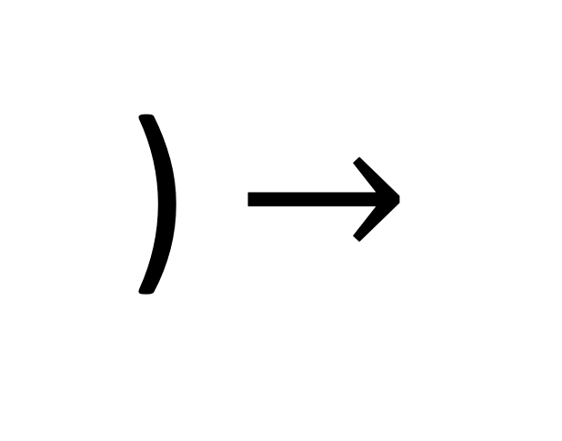

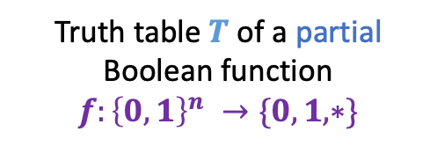
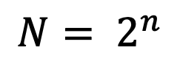
Partial-MFSP is ETH Hard
Input
Output
(
,
) $→$
Truth table $T$ of a partial Boolean function
$f:{\left\{0,1\right\}}^{n} →\{0,1,∗\}$
“size threshold” $s∈ℕ$
$∃$ formula with $≤s$ leaves computing $f$?
$T$ =
$$x$$ | $$0^{n}$$ | $$…$$ | $$1^{n}$$
$$f(x)$$ | $$f(0^{n})$$ | $$…$$ | $$f(1^{n})$$
$${N= 2}^{n}$$
Theorem [I. FOCS’20]
ETH
$$⇒$$
no $N^{o(log{\log{N)}}}$ time algorithm for Partial-MFSP
(Even on instances where $s=n=\log{N}$)

Slide 12


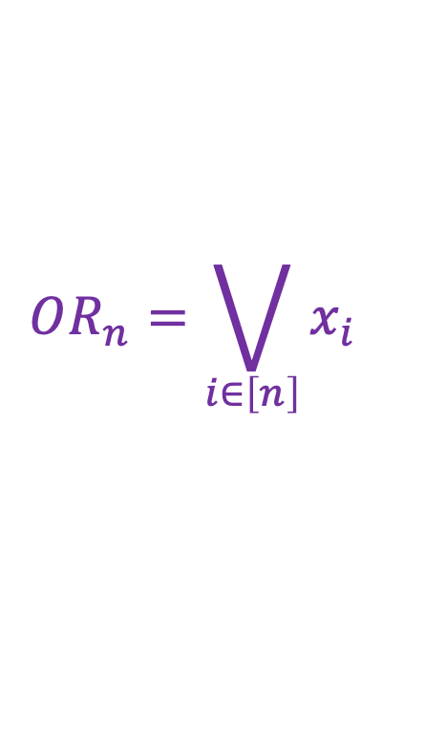
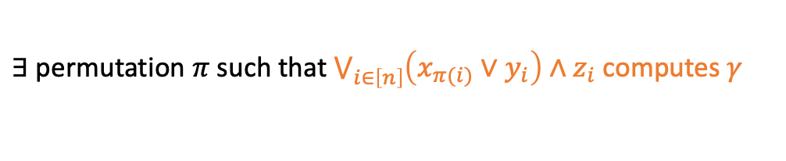


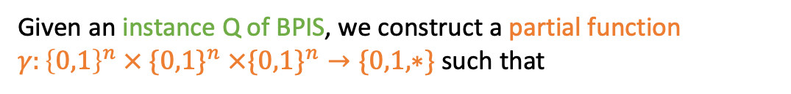
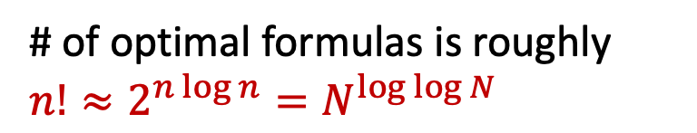

Partial-MFSP is ETH Hard: Intuition
$$OR_{n}=\bigvee_{i∈\left[n\right]}{x_{i}}$$
# of optimal formulas is roughly $n!≈2^{n\log{n}}=N^{\log{\log{N}}}$
Can we come up with a function where one needs to carefully choose which optimal OR circuit to use?
2n x 2n Bipartite Permutation Independent Set (BPIS)
Requires $2^{n\log{n}}$ time under ETH [Lokshtanov-Marx-Saurabh ‘18]
Given an instance Q of BPIS, we construct a partial function $γ:{\left\{0,1\right\}}^{n} × \{0,1\}^{n} ×\{0,1\}^{n}→\{0,1, ∗\}$ such that
Q is a YES instance of BPIS
$$⇔$$
$∃$ permutation $π$ such that $\bigvee_{i∈\left[n\right]}{\left(x_{π(i)}∨y_{i}\right)∧z_{i}}$ computes $γ$
$$⇔$$
$γ$ has a formula of size $3n$
Main Technique: ”Reverse” Gate Elimination

Slide 13
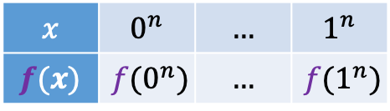



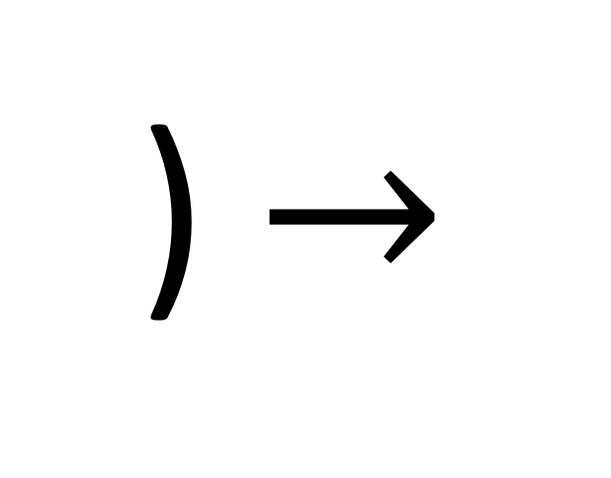

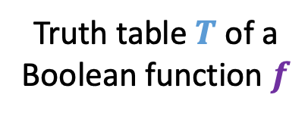
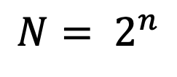
MFSP is ETH Hard
Input
Output
(
,
) $→$
Truth table $T$ of a Boolean function $f$
“size threshold” $s∈ℕ$ in unary
$∃$ formula with $≤s$ leaves computing $f$?
$T$ =
$$x$$ | $$0^{n}$$ | $$…$$ | $$1^{n}$$
$$f(x)$$ | $$f(0^{n})$$ | $$…$$ | $$f(1^{n})$$
$${N= 2}^{n}$$
Theorem [I. FOCS’21]
ETH
$$⇒$$
no $N^{o(log{\log{N)}}}$ time algorithm for MFSP
(Even on instances where $s=O\left(n^{10}\right)$)

Slide 14
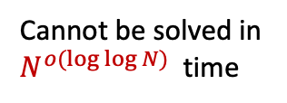
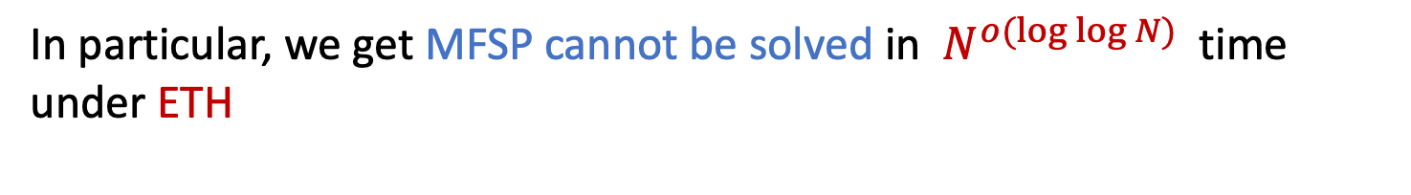
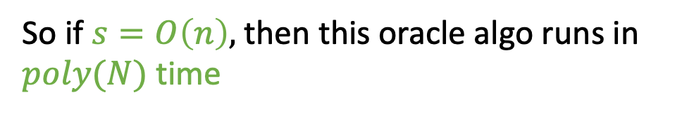
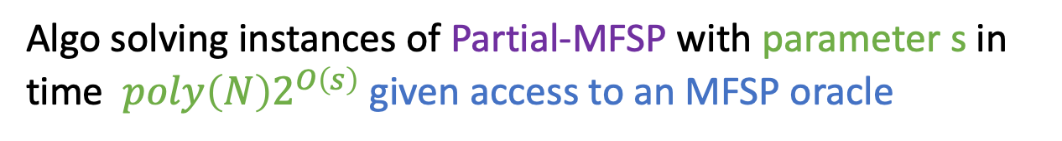
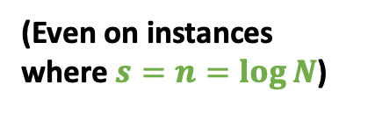
MFSP is ETH Hard: Intuition
Idea: Reduce Partial-MFSP to (total) MFSP
Cannot be solved in $N^{o(log{\log{N)}}}$ time
(Even on instances where $s=n=\log{N}$)
Algo solving instances of Partial-MFSP with parameter s in time ${poly\left(N\right)2}^{O\left(s\right)}$ given access to an MFSP oracle
We show:
So if $s=O\left(n\right),$ then this oracle algo runs in $poly(N)$ time
In particular, we get MFSP cannot be solved in $N^{o(log{\log{N)}}}$ time under ETH

Slide 15
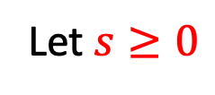

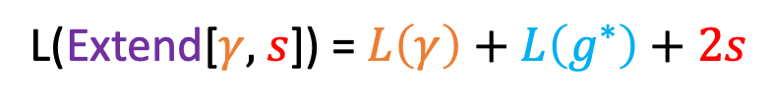


Main Technical Lemma: Connecting Partial and Total Functions
Notation:
$L(f)$= Size of smallest formula for $f$ (partial or total)
Lemma (Informal)
Let $γ:{\left\{0,1\right\}}^{n}→\{0,1,∗\}$ be a partial function
Let $s≥0$
(not defined yet)
Then the total function Extend[$γ,$ $s$]: ${\left\{0,1\right\}}^{n+2s}→\{0,1\}$ is such that
L(Extend[$γ,$ $s$]) = $L\left(γ\right)+L\left(g^{∗}\right)+2s$
(if $s$ is “large”)
Some total function associated with $γ$

Slide 16



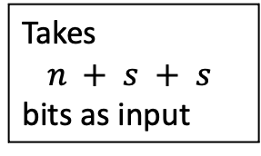



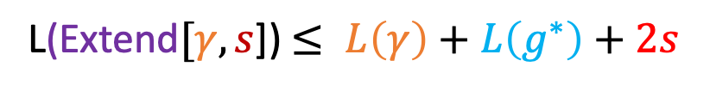
Constructing the Extend Function
Let $γ:{\left\{0,1\right\}}^{n}→\{0,1,∗\}$ be a partial function
Let g$:{\left\{0,1\right\}}^{n}→\{0,1\}$ be a total function that agrees with $γ$
Let g*$:{\left\{0,1\right\}}^{n}→\{0,1\}$ be the indicator function of the stars of $γ$
OR function on s-bits
Extend$[γ, s$] $(x,y,z)$ = $\left[\left(g\left(x\right) ∨ OR_{s}(y)\right)∧OR_{s}(z)\right]∨ g^{∗}(x)$
Takes
$$n + s + s$$
bits as input
Note: If $g^{∗}(x)$ = 1, then output is one,
so choice of $g$ doesn’t matter
Easy upper bound:
L(Extend$[γ, s$]) $≤ L\left(γ\right)+L\left(g^{∗}\right)+2s$
Lemma says: this is an equality when $s$ is large
$$s≥\min{ \{L\left(γ\right), L(g^{∗}}\text{)\}}$$

Slide 17

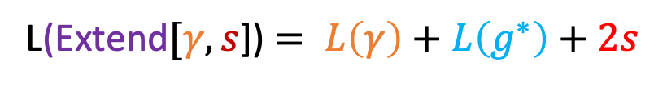
Proving Main Technical Lemma
Extend$[γ, s$] (x,y,z) = $\left[\left(g\left(x\right) ∨ OR_{s}(y)\right)∧OR_{s}(z)\right]∨ g^{∗}(x)$
L(Extend$[γ, s$]) $= L\left(γ\right)+L\left(g^{∗}\right)+2s$
1
Prove lemma in case where s=1 and y and z can only appear once in formula
2
Reduce general case to (1) using Buchfuhrer and Umans’ “variable weighting technique”

Slide 18

Search to Decision Reduction
Theorem
Given oracle access to MFSP, one can solve Search-MFSP in deterministic polynomial-time
Proof Outline
1
Show how to do with
an oracle to Partial-MFSP
2
Replace Partial-MFSP oracle with MFSP oracle using main lemma
Approach: top-down
Subtle! Need that
Find the two functions being computed as inputs to the top most gate in an optimal formula and recurse
$$s≥\min{ \{L\left(γ\right), L(g^{∗}}\text{)\}}$$
To make this polynomial time
Does not relativize!
[Ren-Santhanam ‘20]

Slide 19
Thanks! Questions?
Prove ETH hardness for MCSP?
Prove better hardness for MFSP?
Prove hardness of approximation for MFSP?
Prove search-to-decision reduction for MCSP?

Slide 20
Bonus Slides!

Slide 21


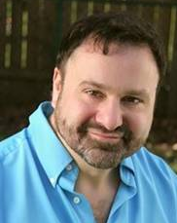
Why care if MCSP is NP-complete?
Proving hardness for MCSP forces us to find new circuit lower bound techniques
Circuit Complexity
Why?
The lower bounds we can prove are all “easy” NO instances of MCSP
A hardness result forces us to find “difficult” NO instances
Natural Proofs Barrier
[Razborov-Rudich]

Slide 22



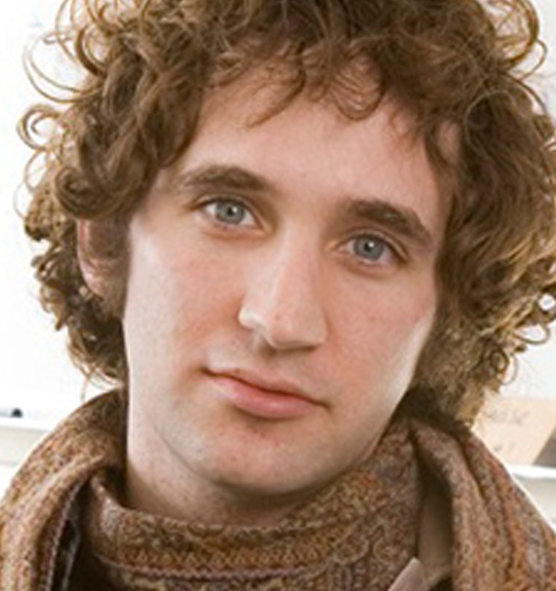


Why care if MCSP is NP-complete?
Hardness of MCSP might characterize the existence of cryptography
Cryptography
Active Line of Research
MCSP is hard in the worst-case
$⟺$?
MCSP is hard on average
$$⟺\text{?}$$
One-way functions exist!
[Hirahara FOCS ’18]
[Liu-Pass FOCS ’20]
Partial Progress:

Slide 23

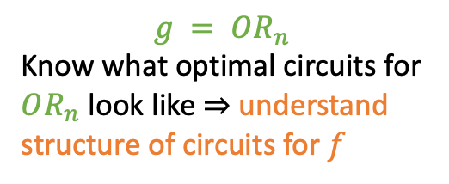


Reverse Gate Elimination
(“Reverse”) Gate Elimination
  Function g is a restriction of f
“Eliminate gate”
$$g = OR_{n}$$
Know what optimal circuits for $OR_{n}$ look like $⇒$ understand structure of circuits for $f$
$$↦$$
Size $n$ circuit for $f$
Size $n−1$ circuit for $g$
“Un-eliminate a gate”

Slide 24
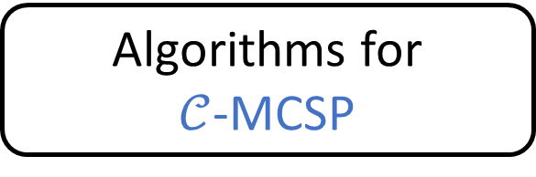
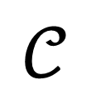

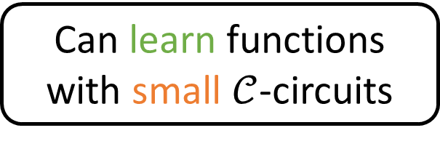
Connections
Cryptography
Learning
Average Case Complexity
Structural Complexity
Circuit Complexity
Can one “learn” functions with small $𝒞$-circuits?
“learn” = “PAC learning on the uniform distribution with membership queries”
$$𝒞$$
$$∈\{DNF, AC^{0}, AC^{0}\left[p\right], P/poly…\}$$
[Linial-Mansour-Nisan’ 93]
[Kearns-Valiant ‘93,
Goldwasser-Goldreich-Micali ’86]
$$⇒$$
Algorithms for
$𝒞$-MCSP
Can learn functions with small $𝒞$-circuits
[Carmosino-Impagliazzo-
Kabanets-Kolokolova‘16]
Even with one-sided error!

Slide 25

2n x 2n Bipartite Permutation Independent Set
Given a directed graph G=([n] x [n], E)
Does there exist a permutation P such that
  P([n]) = [n]
  P(n + [n]) = n + [n]
  If ((j,k), (j’,k’)) is an edge, then either P(j) $≠$k, or P(j’) $≠$k’

