Slide 1

Probabilistic Kolmogorov Complexity
(Tutorial - Part 1)
Igor Carboni Oliveira
University of Warwick
Computability in Europe
July/2025
1

Slide 2



Overview (Informal)
Kolmogorov complexity:
$K\left(x\right)=$ $\min_{M}\left\{\left|M\right| :M outputs x\right\}$
$K\left(x | y\right)=$ $\min_{M}\left\{\left|M\right| :M(y) outputs x\right\}$
Time-bounded Kolmogorov complexity:
$$K^{t}\left(x\right)=\min_{M}\left\{\left|M\right| :M outputs x within t steps\right\}$$
Probabilistic Extensions (Randomized Computations)
2

Slide 3
Plan for the Tutorial
key concepts and techniques
Part I (Today)
open problems
Introduction
Prime numbers & complexity lower bounds
Last 5 years or so
Advances in probabilistic Kolmogorov complexity
Part II (Tomorrow)
Adding nondeterminism to probabilistic Kolmogorov complexity
Central problems from complexity theory
Last 6 months
(upcoming papers)
NP-hardness of estimating complexity
3

Slide 4










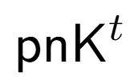


Personal View/Mental Picture
Zoo of time-bounded Kolmogorov complexity notions:
Which features of Kolmogorov complexity survive in the time-bounded setting?
Source Coding
Symmetry of
Information
Language Compression
Meta-Complexity: What is the complexity of estimating complexity?
e.g., given a string x and a time bound t, compute K^{t}(x)
Applications in Theoretical Computer Science
4

Slide 5
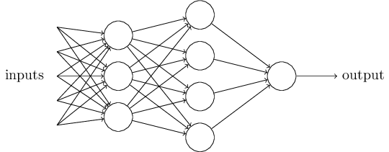
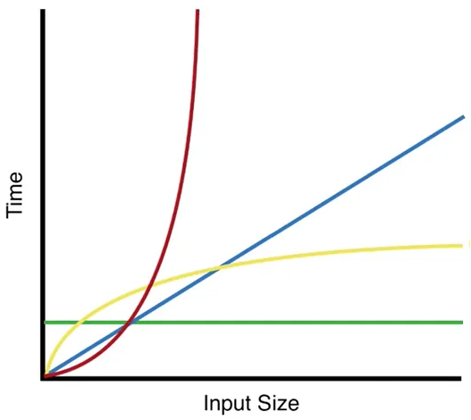
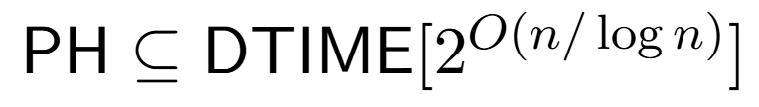

Applications in TCS
[Carmosino-Impagliazzo-Kabanets-Kolokolova 2016]
Bounded-depth Boolean circuits with AND/OR/XOR gates can be learned in quasi-polynomial time.
Learning Theory
Average-Case
Complexity
[Hirahara 2021] If PH is easy on average, then
[Lu-Mazor-Oliveira-Pass 2025]
“Obfuscating the code of computer programs requires a non-trivial overhead in program size.”
Cryptography
5

Slide 6


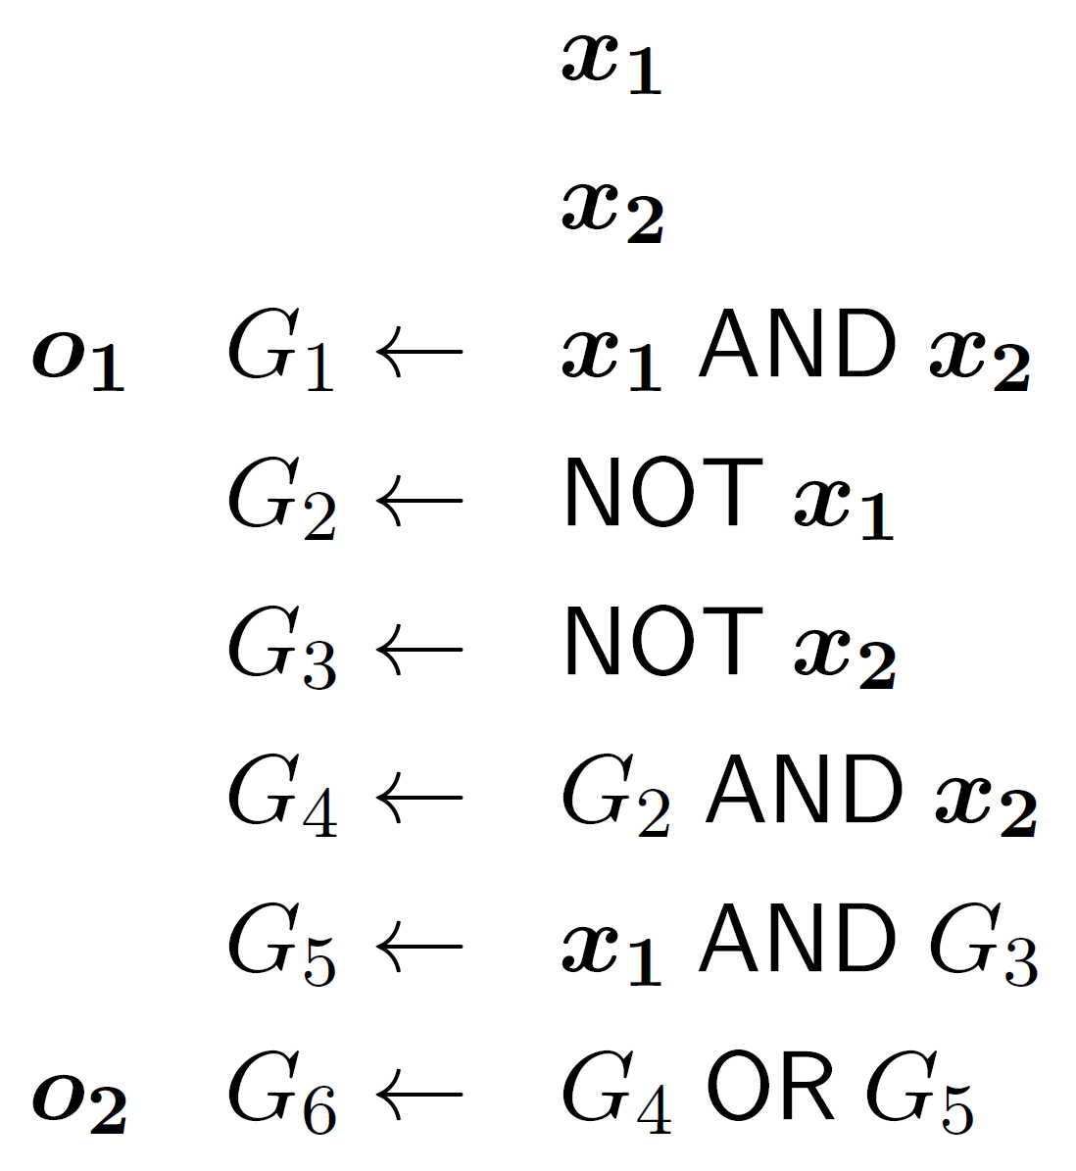


Applications in TCS
[Carmosino-Impagliazzo-Kabanets-Kolokolova 2016]
Bounded-depth Boolean circuits with AND/OR/XOR gates can be learned in quasi-polynomial time.
[Lu-Mazor-Oliveira-Pass 2025]
Learning Theory
obfuscated program
program
Average-Case
Complexity
[Hirahara 2021] If PH is easy on average, then
Cryptography
Cryptography
5

Slide 7
Applications in TCS
[Carmosino-Impagliazzo-Kabanets-Kolokolova 2016]
Bounded-depth Boolean circuits with AND/OR/XOR gates can be learned in quasi-polynomial time.
Learning Theory
Average-Case
Complexity
[Hirahara 2021] If PH is easy on average, then
[Lu-Mazor-Oliveira-Pass 2025]
“Obfuscating the code of computer programs requires a non-trivial overhead in program size.”
Cryptography
In each case, only known proof of the result goes through
resource-bounded Kolmogorov complexity
5

Slide 8
Personal View/Mental Picture
Zoo of time-bounded Kolmogorov complexity notions:
Which features of Kolmogorov complexity survive in the time-bounded setting?
Source Coding
Symmetry of
Information
Language Compression
Meta-Complexity: What is the complexity of estimating complexity?
e.g., given a string x and a time bound t, compute K^{t}(x)
Applications in Theoretical Computer Science
6

Slide 9
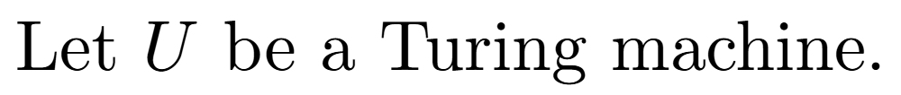
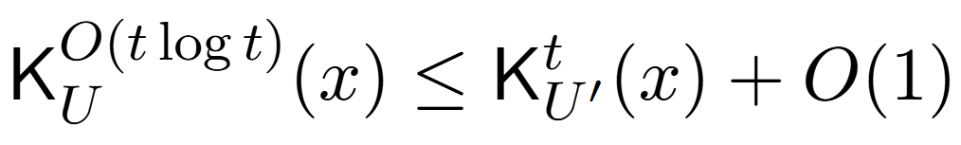
Definitions
7

Slide 10
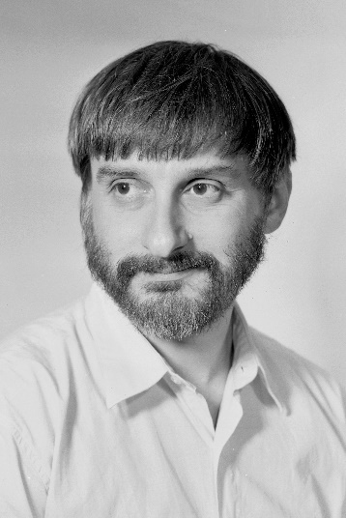
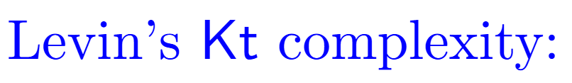
Levin Complexity
Levin (1984) proposed the following notion of complexity for strings.
short
effective
Kt has been highly influential due to its connections to algorithms and complexity.
8

Slide 11
Personal View/Mental Picture
Zoo of time-bounded Kolmogorov complexity notions:
Which features of Kolmogorov complexity survive in the time-bounded setting?
Source Coding
Symmetry of
Information
Language Compression
Meta-Complexity: What is the complexity of estimating complexity?
e.g., given a string x and a time bound t, compute K^{t}(x)
Applications in Theoretical Computer Science
9

Slide 12

Meta-Complexity
Q. What is the computational complexity of estimating complexity?
MKtP (Minimum Kt Problem): Given a string x and a bound s, is it the case that Kt(x) < s?
Easy Upper bound: The problem can be solved in time exponential in the length of x.
Longstanding Lower Bound Problem: Prove that MKtP is not in P.
- If MKtP is in P, then cryptography breaks (OWF/cryptographic PRGs do not exist).
(We can distinguish “random” strings from “structured” strings.)
- Since EXP is not contained in P, can hope to show this lower bound unconditionally.
10

Slide 13
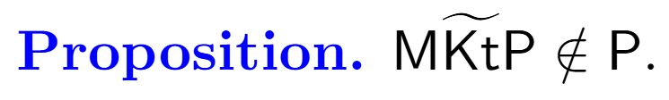

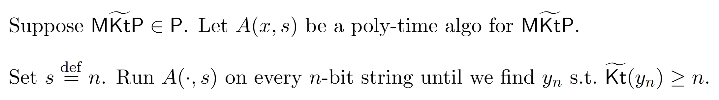
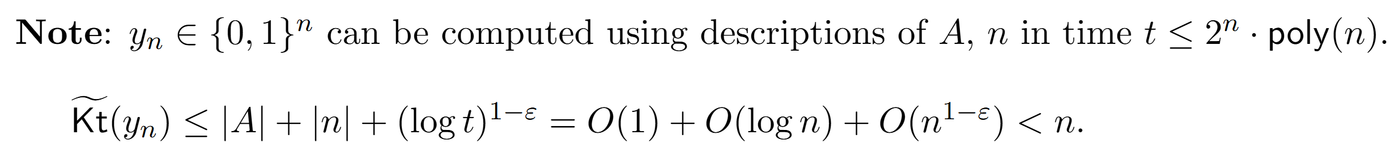

A variant of Kt and a complexity lower bound
11

Slide 14
What happens at log t and why is this term used in Kt?
12

Slide 15
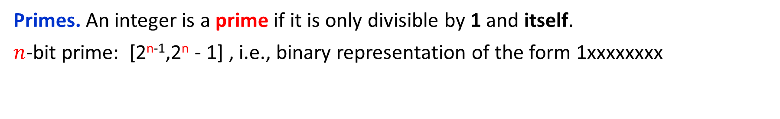
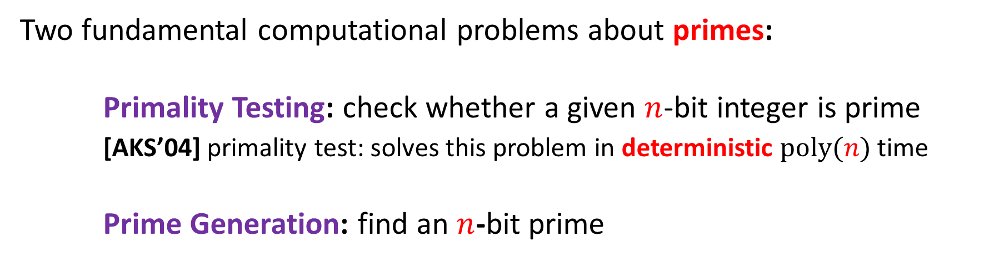
Kt and Explicit Constructions: Prime Numbers
Primes. An integer is a prime if it is only divisible by 1 and itself.
$n$-bit prime: [2^{n-1},2^{n} - 1] , i.e., binary representation of the form 1xxxxxxxx
Example: 17 = 10001
Widely used in computer science: cryptography, algorithms, computer algebra, etc.
Two fundamental computational problems about primes:
Primality Testing: check whether a given $n$-bit integer is prime
[AKS’04] primality test: solves this problem in deterministic $poly(n)$ time
Prime Generation: find an $n$-bit prime
13

Slide 16
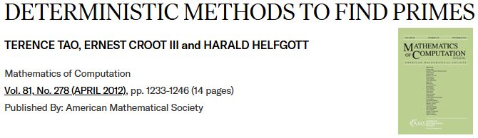
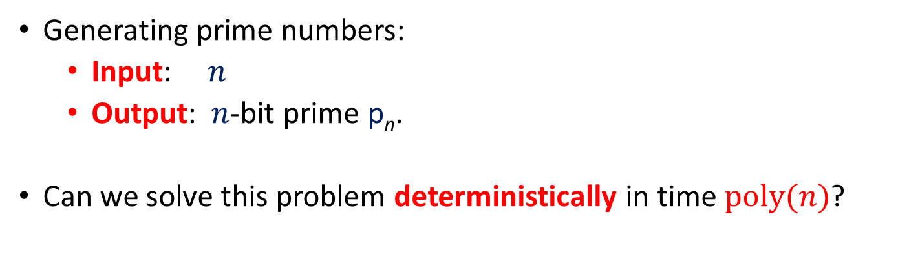
Challenge: Explicit Construction of Primes
Generating prime numbers:
Input: $n$
Output: $n$-bit prime p_{n}.
Can we solve this problem deterministically in time $poly(n)$?
Best known algorithm runs in time 2^{n/2} [Lagarias-Odlyzko 1987].
Polymath 4: Attempted to use number-theoretic techniques but did not obtain an unconditional improvement.
14

Slide 17

Levin’s Optimal Search: Kt and Primes
(Deterministic construction of primes)
(compression perspective)
15

Slide 18
NEXT:
Extending the classical theory with the power of randomness
(and how it helps)
16

Slide 19
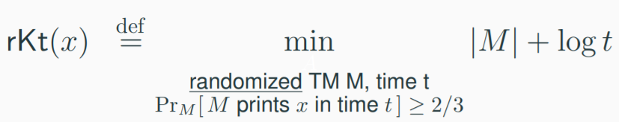
Probabilistic Kolmogorov Complexity
Key Conceptual Idea: A short randomized program that outputs the string w.h.p.
[Oliveira 2019]
In subsequent work, we studied related notions (e.g., pK^{t} complexity) and developed the groundwork for applications (e.g., coding theorem).
17

Slide 20

rKt, pK^{t} and their meta-computational problems are connected to many
(if not most) recent developments in meta-complexity and its applications:
Complexity
Cryptography
Algorithms / Learning Theory
Last 3 years:
[HLN FOCS’24]
[HLO TCC’24]
[LORS FOCS’24]
[LS ICALP’24]
[HN FOCS’23]
[Hirahara STOC’23]
[HKLO CCC’24]
[GK CCC’23]
[HILNO STOC’23]
[GK RANDOM’24]
[CLORS FOCS’23]
[Ilango FOCS’23]
[LP CRYPTO’23]
[HIR STOC’23]
[HN ’25]
[Santhanam CCC’23]
These notions offer the right framework in a computational world
where most computations are randomized.
18

Slide 21
rKt vs Kt
While the same questions remain longstanding open problems for Kt complexity, for rKt we have:
Unconditional Lower Bounds
Bounds for Primes
[Oliveira 2019], [Hirahara 2022]
[Chen-Lu-Oliveira-Ren-Santhanam 2023]
MrKtP (Minimum rKt Problem):
Given a string x and a bound s,
is it the case that rKt(x) < s?
Infinitely many primes with
short and efficient representations!
Theorem [CLORS’23]. There are infinitely many values of n such that there is an n-bit prime p with
rKt(p) = O(log n).
Theorem [O’19]. MrKtP is not in BPP.
Theorem [H’22]. MrKtP is not in BPTIME[2^{o(n)}].
Rest of the Presentation: Connections to central notions from Kolmogorov Complexity:
Symmetry of Information and Source Coding.
19

Slide 22
Personal View/Mental Picture
Zoo of time-bounded Kolmogorov complexity notions:
Which features of Kolmogorov complexity survive in the time-bounded setting?
Source Coding
Symmetry of
Information
Language Compression
Meta-Complexity: What is the complexity of estimating complexity?
e.g., given a string x and a time bound t, compute K^{t}(x)
Applications in Theoretical Computer Science
20

Slide 23





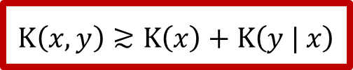
Symmetry of Information (SoI)
[Kolmogorov and Levin 1967]
$$K\left(x,y\right)≲K\left(x\right)+K\left(y | x\right)$$
up to a O(log(|x| + |y|)
additive factor
Symmetry of information (SoI) for Kolmogorov complexity:
Does SoI hold in the time-bounded setting?
$$K\left(x,y\right)≳K\left(x\right)+K\left(y | x\right)$$
$$K\left(x\right)+K\left(y | x\right)≈K\left(x,y\right)≈K\left(y\right)+K\left(x | y\right)$$
also known as the
“chain rule”
$$K\left(x\right)−K\left(x | y\right)≈K\left(y\right)−K\left(y | x\right)$$
$$H\left(X\right)−H\left(X | Y\right)=H\left(Y\right)−H\left(Y | X\right)$$
SoI Principle in Shannon’s Information Theory
21

Slide 24


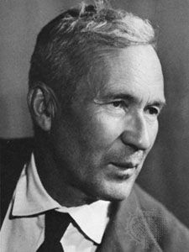
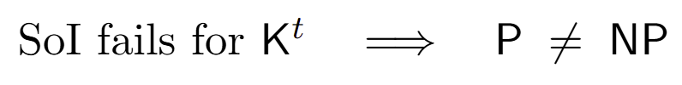
An Approach to P vs NP
(based on Shuichi’s slides)
Does SoI hold in the time-bounded setting?
According to [Levin 2003 – “The Tale of One-Way Functions”],
Kolmogorov suggested in 1967 that the symmetry of information theorem may be a good test case to prove that for some tasks exhaustive search cannot be avoided.
[Longpre and Watanabe 1995]
22

Slide 25
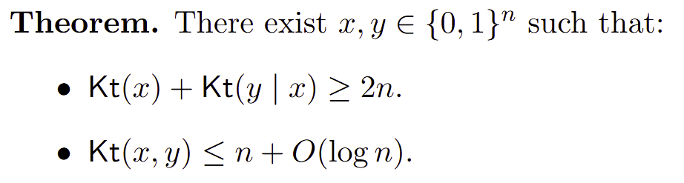


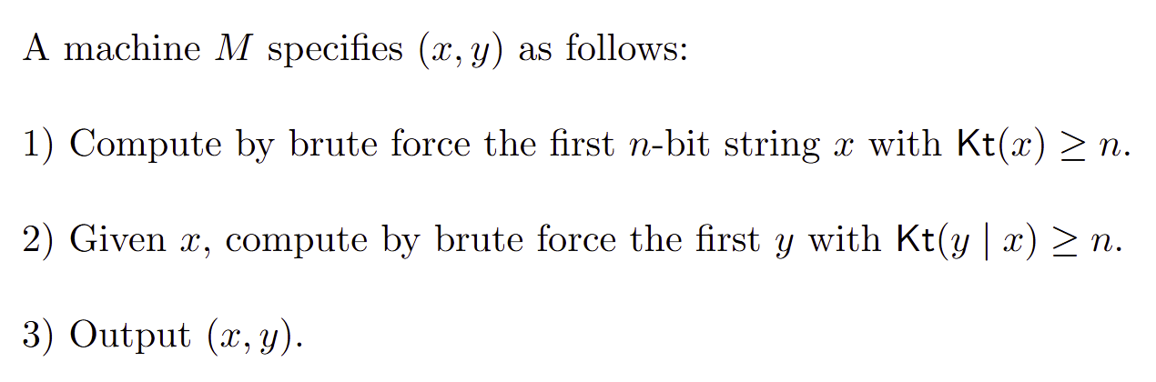
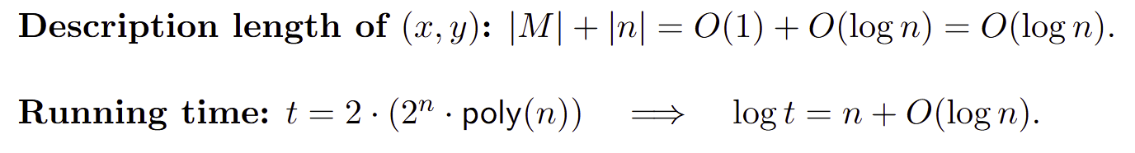
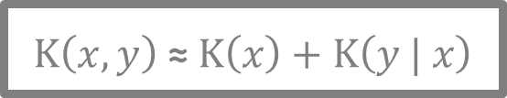
Failure of SoI for Kt
[Ronneburger 2004]
$$K\left(x,y\right) \text{≈} K\left(x\right)+K\left(y | x\right)$$
Does SoI hold in the time-bounded setting?
23

Slide 26
SoI as a Lower Bound Technique
[Hirahara 2022]
MrKtP (Minimum rKt Problem):
Given a string x and a bound s,
is it the case that rKt(x) < s?
Theorem. MrKtP is not in BPTIME[2^{o(n)}].
Symmetry of Information as a technical tool!
Two steps:
1
MrKtP is in BPTIME[2^{o(n)}]
SoI fails for rKt
Contradiction!
2
MrKtP is in BPTIME[2^{o(n)}]
SoI holds for rKt
New insight: SoI from Meta-Complexity
24

Slide 27
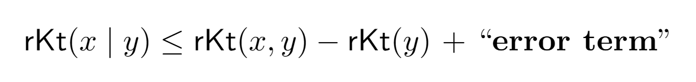
SoI from Meta-Complexity
Goal:
- We assume an algorithm computing a measure such as K^{t}, Kt, rKt, etc.
- To prove SoI, we employ a pseudorandom generator (PRG) construction.
- The quality of the SoI (error term) depends on the efficiency of the algorithm and on the PRG.
25

Slide 28







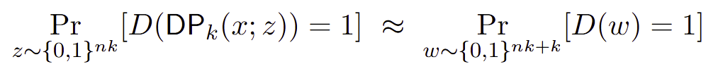
Example of PRG:
k-Wise Direct Product Generator
Observation:
Breaking pseudorandomness gives K^{t} upper bounds
26

Slide 29

SoI from Meta-Complexity via PRG (Overview)
27

Slide 30
SoI from Meta-Complexity via PRG (Overview)
27

Slide 31
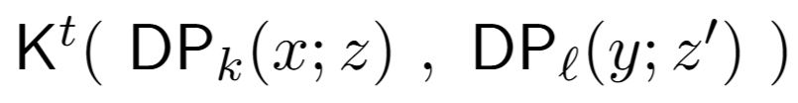


SoI from Meta-Complexity via PRG (Overview)
1
2
3
27

Slide 32


SoI from Meta-Complexity via PRG (Overview)
1
2
3
27

Slide 33



SoI from Meta-Complexity via PRG (Overview)
1
2
3
27

Slide 34

SoI from Meta-Complexity via PRG (Overview)
1
2
3
27

Slide 35

SoI from Meta-Complexity via PRG (Overview)
1
2
3
27

Slide 36
SoI from Meta-Complexity via PRG (Overview)
1
2
3
27

Slide 37

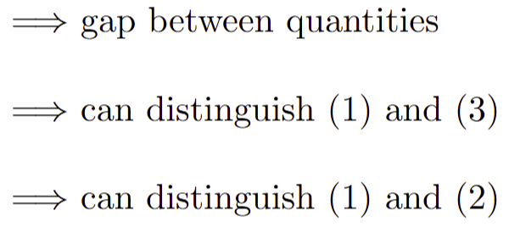
SoI from Meta-Complexity via PRG (Overview)
1
2
3
27

Slide 38
SoI from Meta-Complexity via PRG (Overview)
1
vs
2
3
27

Slide 39
SoI from Meta-Complexity via PRG (Overview)
1
vs
2
3
27

Slide 40
SoI from Meta-Complexity via PRG (Overview)
1
vs
2
3
27

Slide 41


SoI from Meta-Complexity via PRG (Overview)
1
vs
2
3
27

Slide 42
SoI from Meta-Complexity via PRG (Overview)
1
vs
2
3
27

Slide 43
Personal View/Mental Picture
Zoo of time-bounded Kolmogorov complexity notions:
Which features of Kolmogorov complexity survive in the time-bounded setting?
Source Coding
Symmetry of
Information
Language Compression
Meta-Complexity: What is the complexity of estimating complexity?
e.g., given a string x and a time bound t, compute K^{t}(x)
Applications in Theoretical Computer Science
28

Slide 44
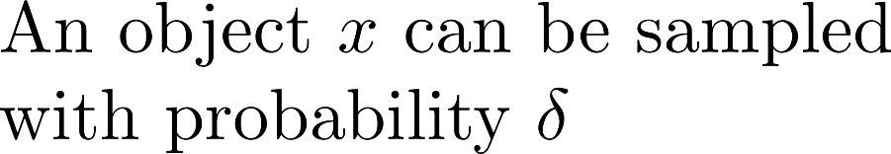
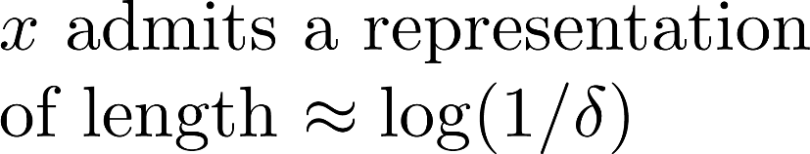


Coding Theorems
Known to hold for Kolmogorov Complexity. Existence of a feasible version?
[Lu-Oliveira 2021]
29

Slide 45
We would like to obtain almost-everywhere bounds for primes:
Back to Primes
[CLORS23] shows that there are infinitely many input lengths n with a prime of rKt complexity O(log n)
However, gap between input lengths can be exponential!
Is the existence of primes with
succinct representations a rare phenomenon?
30

Slide 46
Connection to coding
By the Coding Theorem for rKt, almost-everywhere bounds for primes follow from
(This is a significant relaxation of the Polymath problem of deterministically generating primes.)
31

Slide 47
Some of my favorite open problems
Meta-Complexity
1. Prove (unconditionally) that MKtP is not in P.
2. Prove the NP-hardness of MINKT.
Explicit Constructions
3. Show that for every large n there is an n-bit prime p with rKt(p) = o(n).
Theory of Time-Bounded Kolmogorov Complexity
4. Prove that Symmetry of Information fails for rKt.
5. Prove that Symmetry of Information fails for nKt.
32

Slide 48
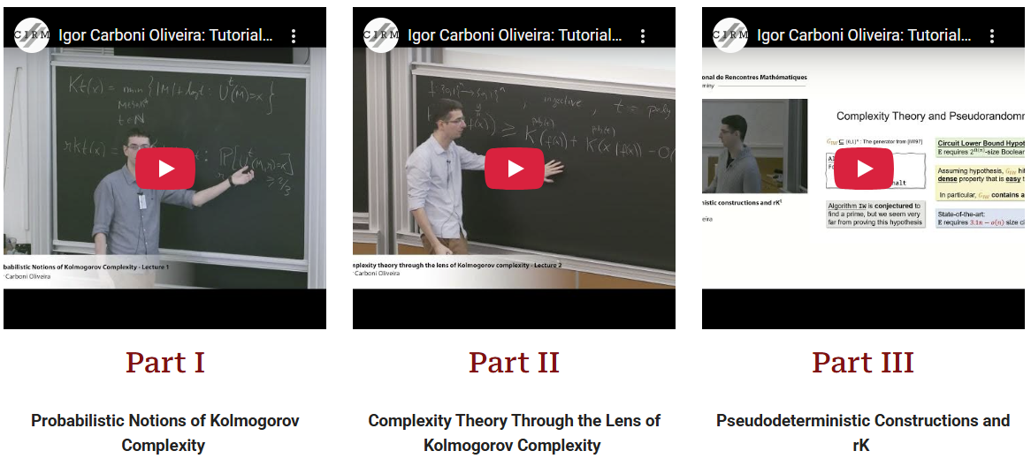
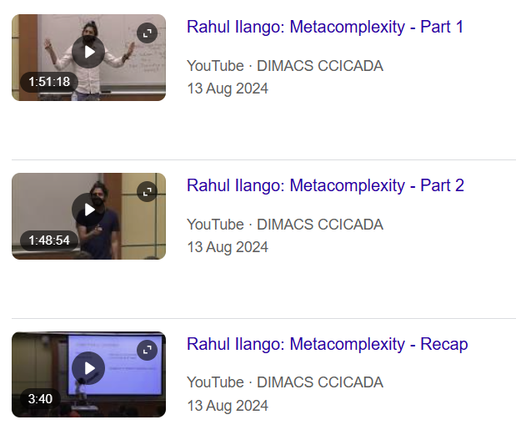

Further Resources: Probabilistic Kolmogorov Complexity
Frontiers in Complexity Theory Workshop
(Rutgers DIMACS, 2024)
EATCS Bulletin Survey:
[Lu-Oliveira 2022]: Theory and Applications
of Probabilistic Kolmogorov Complexity
33

Slide 49
Part II (Tomorrow)
- Extension of the theory to the nondeterministic setting
(+ results from the last 6 months)
- Connections to central open problems in TCS:
Cryptography, Derandomization, Lower Bounds, …
Thank You!
34

Slide 50
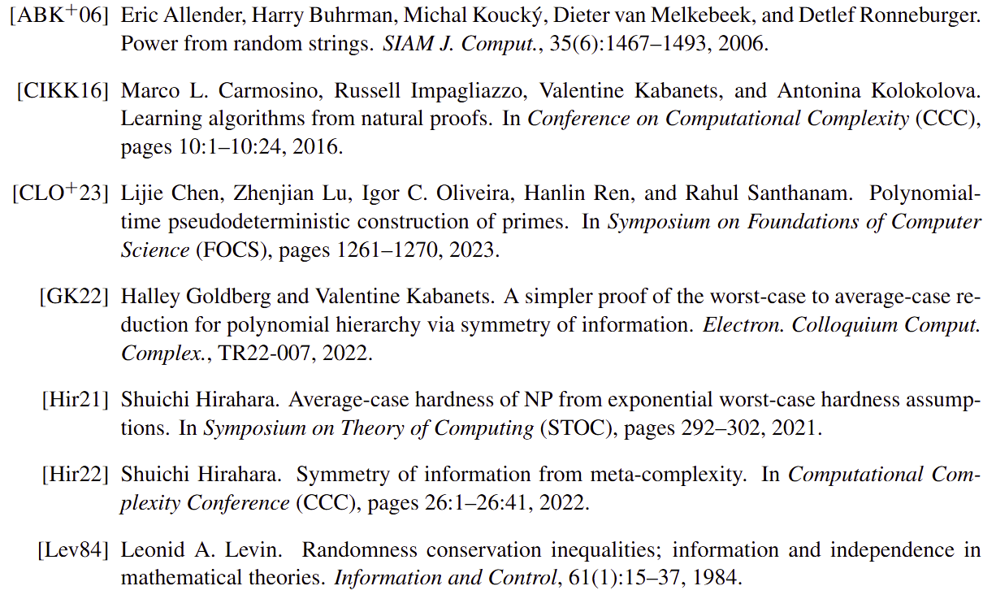
References

Slide 51
