Slide 1

Probabilistic Kolmogorov Complexity
(Tutorial - Part 2)
Igor Carboni Oliveira
University of Warwick
Computability in Europe
July/2025
1

Slide 2
Tutorial
Part I (Yesterday)
Introduction
Prime numbers & complexity lower bounds
Last 5 years or so
Advances in probabilistic Kolmogorov complexity
Part II (Today)
Central problems from complexity theory
Adding nondeterminism to probabilistic Kolmogorov complexity
Last 6 months
(upcoming papers)
NP-hardness in Meta-Complexity
2

Slide 3










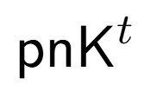


Today
Zoo of time-bounded Kolmogorov complexity notions:
Which features of Kolmogorov complexity survive in the time-bounded setting?
Source Coding
Symmetry of
Information
Language Compression
Meta-Complexity: What is the complexity of estimating complexity?
e.g., given a string x and a time bound t, compute K^{t}(x)
Applications in Theoretical Computer Science
3

Slide 4
Plan
1. Probabilistic notions of Kolmogorov Complexity
2. Central problems from complexity theory
3. A new hardness result in meta-complexity
4. Adding nondeterminism to probabilistic Kolmogorov complexity
4

Slide 5
Plan
1. Probabilistic notions of Kolmogorov Complexity
2. Central problems from complexity theory
3. A new hardness result in meta-complexity
4. Adding nondeterminism to probabilistic Kolmogorov complexity
4

Slide 6
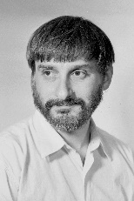


Recall $t$-time-bounded Kolmogorov complexity:
$$K^{t}\left(x\right)=\min_{M}\left\{\left|M\right| :M outputs x within t\left(\left|x\right|\right) steps\right\}$$
Today: “polynomial-time measures”
Randomized $t$-time-bounded Kolmogorov complexity:
$${rK}^{t}\left(x\right)=\min_{Randomized M}\left\{\left|M\right| :M runs in t\left(\left|x\right|\right) steps and outputs x with probability≥\frac{2}{3}\right\}$$
Probabilistic $t$-time-bounded Kolmogorov complexity [Goldberg-Kabanets-Lu-Oliveira 2022]:
$${pK}^{t}\left(x\right)=\min_{k}\left\{ k : \underset{w∈{\left\{0,1\right\}}^{t\left(\left|x\right|\right)}}{Pr}\left[K^{t}\left(x | w\right)≤k\right]≥\frac{2}{3}\right\}$$
For most $w$ there exists a small program $M$ that outputs $x$given $w$
5

Slide 7








Probabilistic Kolmogorov Complexity
$$K^{t}\left(x\right)≤k$$
Resembles NP
$$M∈{\left\{0,1\right\}}^{k}$$
$${rK}^{t}\left(x\right)≤k$$
Resembles MA
$${pK}^{t}\left(x\right)≤k$$
Sends a program $M∈{\left\{0,1\right\}}^{k}$
Runs $M$ for $t(|x|)$ steps to recover $x$
Resembles AM
6

Slide 8

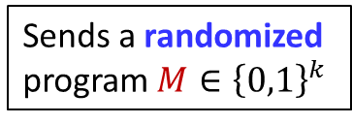

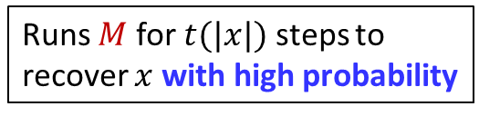
Probabilistic Kolmogorov Complexity
$$K^{t}\left(x\right)≤k$$
Resembles NP
$$M∈{\left\{0,1\right\}}^{k}$$
$${rK}^{t}\left(x\right)≤k$$
Resembles MA
$${pK}^{t}\left(x\right)≤k$$
Sends a randomized program $M∈{\left\{0,1\right\}}^{k}$
Runs $M$ for $t$(|$x$|) steps to recover $x$ with high probability
Resembles AM
6

Slide 9


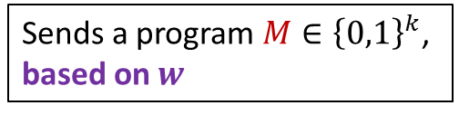
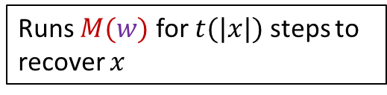
Probabilistic Kolmogorov Complexity
$$K^{t}\left(x\right)≤k$$
Shared randomness $w∈{\left\{0,1\right\}}^{t}$
Resembles NP
$$M∈{\left\{0,1\right\}}^{k}$$
$${rK}^{t}\left(x\right)≤k$$
Resembles MA
$${pK}^{t}\left(x\right)≤k$$
Sends a program $M∈{\left\{0,1\right\}}^{k}$, based on $w$
Runs $M(w)$ for $t$(|$x$|) steps to recover $x$
Resembles AM
6

Slide 10
Plan
1. Probabilistic notions of Kolmogorov Complexity
2. Central problems from complexity theory
3. A new hardness result in meta-complexity
4. Adding nondeterminism to probabilistic Kolmogorov complexity
7

Slide 11
Complexity World
“Cryptography”
(Existence of OWF?)
“Derandomization”
(Power of BPP?)
“P vs NP”
(Is NP contained in BPP?)
Symmetry of Information
Source Coding
Language Compression & Meta-Complexity
Kolmogorov Complexity World
8

Slide 12
Complexity World
“Cryptography”
(Existence of OWF?)
“Derandomization”
(Power of BPP?)
“P vs NP”
(Is NP contained in BPP?)
Symmetry of Information
Source Coding
Language Compression & Meta-Complexity
Kolmogorov Complexity World
8

Slide 13
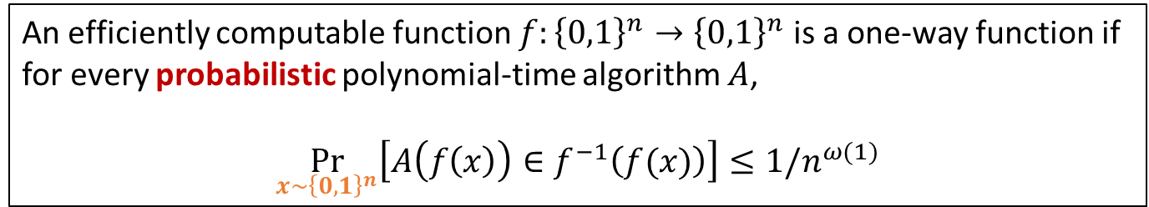
Symmetry of Information and One-Way Functions
Definition (One-Way Functions):
An efficiently computable function $f:{\left\{0,1\right\}}^{n}→{\left\{0,1\right\}}^{n}$ is a one-way function if for every probabilistic polynomial-time algorithm $A$,
$$\underset{x∼{\left\{0,1\right\}}^{n}}{Pr}\left[A\left(f\left(x\right)\right)∈f^{−1}\left(f(x)\right)\right]≤1/n^{ω(1)}$$
9

Slide 14

Symmetry of Information and One-Way Functions
Definition (One-Way Functions):
OWFs are both necessary and sufficient for:
An efficiently computable function $f:{\left\{0,1\right\}}^{n}→{\left\{0,1\right\}}^{n}$ is a one-way function if for every probabilistic polynomial-time algorithm $A$,
$$\underset{x∼{\left\{0,1\right\}}^{n}}{Pr}\left[A\left(f\left(x\right)\right)∈f^{−1}\left(f(x)\right)\right]≤1/n^{ω(1)}$$
- Private-key encryption [GM84, HILL99]
- Pseudorandom generators [HILL99]
- Authentication schemes [FS90]
- Pseudorandom functions [GGM84]
- Digital signatures [Rompel90]
- Commitment schemes [Naor90]
- Coin-tossing [Blum84]
….
9

Slide 15


Symmetry of Information and One-Way Functions
Definition (One-Way Functions):
An efficiently computable function $f:{\left\{0,1\right\}}^{n}→{\left\{0,1\right\}}^{n}$ is a one-way function if for every probabilistic polynomial-time algorithm $A$,
$$\underset{x∼{\left\{0,1\right\}}^{n}}{Pr}\left[A\left(f\left(x\right)\right)∈f^{−1}\left(f(x)\right)\right]≤1/n^{ω(1)}$$
Theorem [Longpré-Watanabe 1995]:
$$\left(x, f\left(x\right)\right)$$
One-way functions exist
No symmetry of information for $K^{t}$
?
9

Slide 16
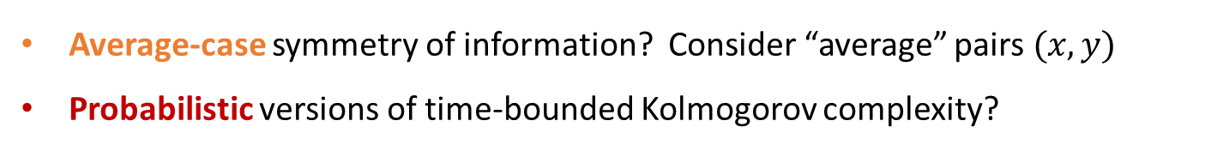
Symmetry of Information and One-Way Functions
Definition (One-Way Functions):
An efficiently computable function $f:{\left\{0,1\right\}}^{n}→{\left\{0,1\right\}}^{n}$ is a one-way function if for every probabilistic polynomial-time algorithm $A$,
$$\underset{x∼{\left\{0,1\right\}}^{n}}{Pr}\left[A\left(f\left(x\right)\right)∈f^{−1}\left(f(x)\right)\right]≤1/n^{ω(1)}$$
Two key points:
Average-case symmetry of information? Consider “average” pairs $(x,y)$
Probabilistic versions of time-bounded Kolmogorov complexity?
9

Slide 17

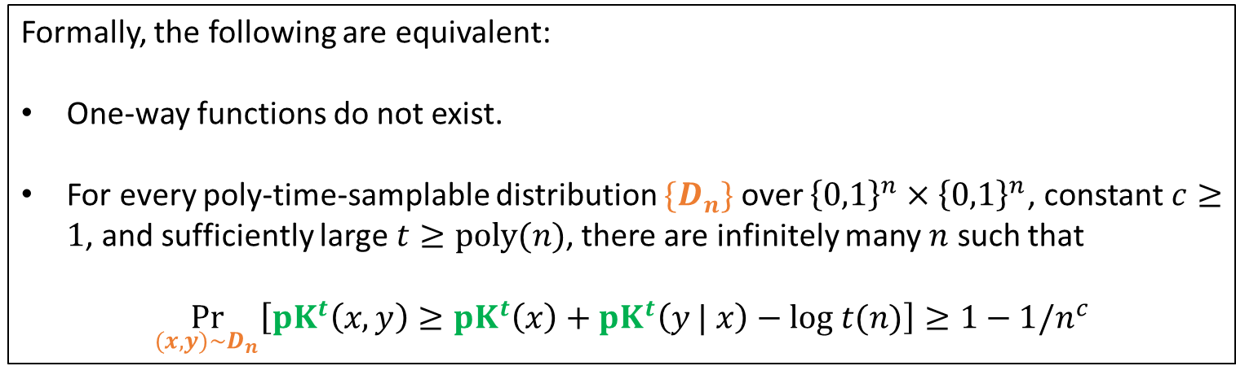
Symmetry of Information and One-Way Functions
Theorem [Hirahara-Ilango-Lu-Nanashima-Oliveira 2023]
One-way functions do not exist
“Average-case” SoI for $pK^{poly}$holds
Formally, the following are equivalent:
One-way functions do not exist.
For every poly-time-samplable distribution $\{D_{n}\}$ over ${\left\{0,1\right\}}^{n}×{\left\{0,1\right\}}^{n}$, constant $c≥1$, and sufficiently large $t≥poly(n)$, there are infinitely many $n$ such that
$$\underset{(x,y)∼D_{n}}{Pr}\left[{pK}^{t}\left(x,y\right)≥{pK}^{t}\left(x\right)+{pK}^{t}\left(y | x\right)−log t(n)\right]≥1−1/n^{c}$$
10

Slide 18

Relevance of SoI to the foundations of cryptography
Failure of symmetry of information
for a non-negligible fraction of pairs (x,y) of strings
produced by a samplable distribution is all we need to
construct key cryptographic primitives and protocols
11

Slide 19

Bigger Picture: Equivalences
[Hirahara-Ilango-Lu-Nanashima-Oliveira 2023]
1. $∄$ One-Way Function
4. Language Compression
(average-case)
3. Conditional Coding
2. Symmetry of Information
(average-case)
(average-case)
12

Slide 20
Complexity World
“Cryptography”
(Existence of OWF?)
“Derandomization”
(Power of BPP?)
“P vs NP”
(Is NP contained in BPP?)
Symmetry of Information
Source Coding
Language Compression & Meta-Complexity
Kolmogorov Complexity World
13

Slide 21
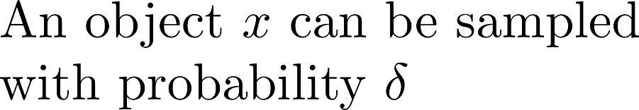
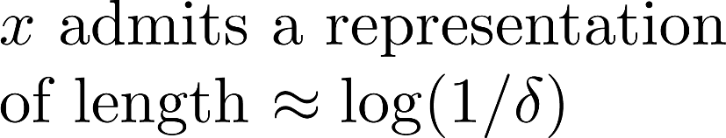

Coding Theorem
[Lu-Oliveira 2021] Near-optimal coding holds for rKt:
14

Slide 22
Does the coding theorem hold for Kt complexity?
(Is randomness essential to achieve a compressed representation?
15

Slide 23
Weaker notions of compression
16

Slide 24



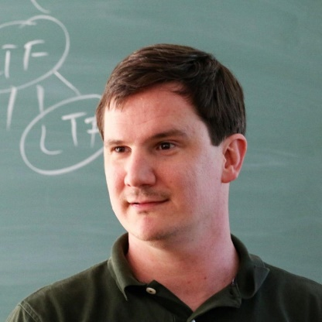


Compression and BPP
[Joint work with Jinqiao Hu and Zhenjian Lu 2025]
Ryan Williams:
“miserable state of affairs”
17

Slide 25
Complexity World
“Cryptography”
(Existence of OWF?)
“Derandomization”
(Power of BPP?)
“P vs NP”
(Is NP contained in BPP?)
Symmetry of Information
Source Coding
Language Compression & Meta-Complexity
Kolmogorov Complexity World
18

Slide 26
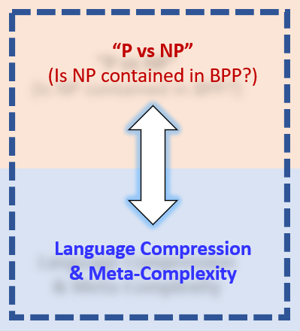
Plan
1. Probabilistic notions of Kolmogorov Complexity
2. Central problems from complexity theory
3. A new hardness result in meta-complexity
4. Adding nondeterminism to probabilistic Kolmogorov complexity
19

Slide 27



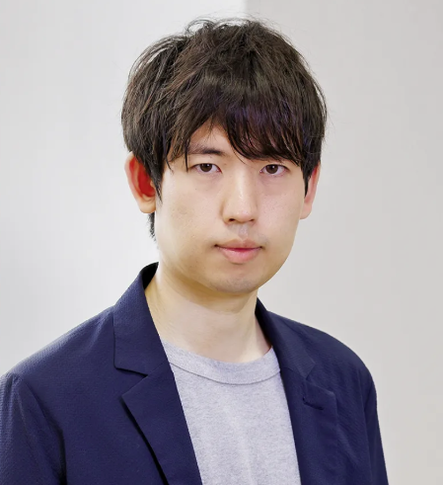

A central challenge in Meta-Complexity
Applications in cryptography and average-case complexity
20

Slide 28

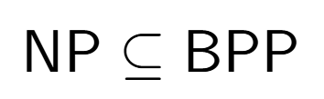
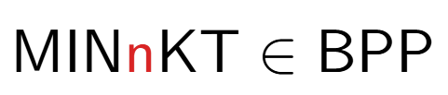
A new hardness result
[Joint work with Jinqiao Hu and Zhenjian Lu 2025]
While the result is about nK^{t}, its proof employs probabilistic Kolmogorov complexity.
21

Slide 29
Plan
1. Probabilistic notions of Kolmogorov Complexity
2. Central problems from complexity theory
3. A new hardness result in meta-complexity
4. Adding nondeterminism to probabilistic Kolmogorov complexity
22

Slide 30
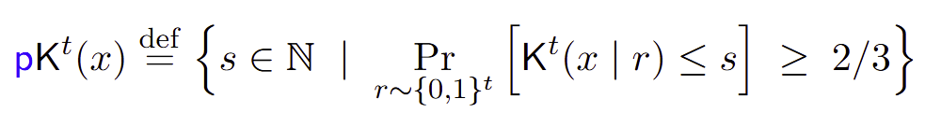
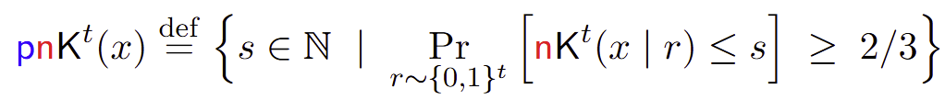
Probabilistic Nondeterministic Kolmogorov Complexity
[Joint work with Jinqiao Hu and Zhenjian Lu 2025]
As part of our proof, we show that pnK is essentially a “master” measure:
Nearly all properties of (time-unbounded) Kolmogorov complexity survive for pnK.
23

Slide 31

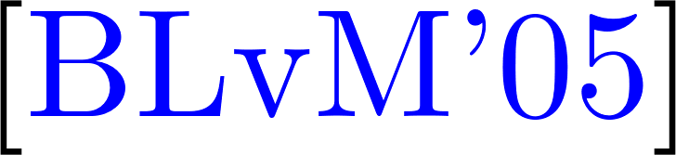
Language Compression for pnK
[Harry Buhrman, Troy Lee, and Dieter van Melkebeek 2005]
24

Slide 32
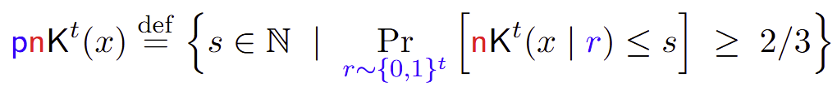


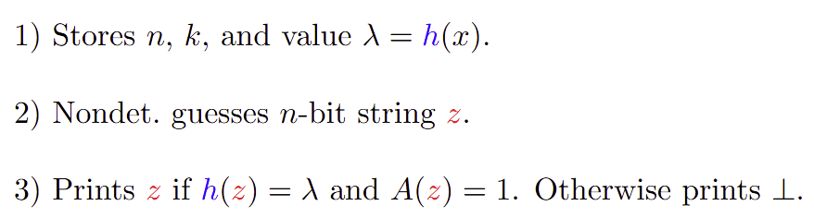
How to combine randomness and nondeterminism?
Goal:
25

Slide 33





Hardness of MINnKT via pnK (Proof Overview)
1) Compressing NP witnesses with pnK
- Language compression for pnK
- Can remove oracle access:
A_{x} in P (given x)
2) Collapsing pnK to pK (assuming MINnKT in BPP)
- Techniques from pseudorandomness
- Direct Product Generator
3) Searching for a witness in polynomial time
- Implies L in BPP
(next slide)
By (1) and (2),
26

Slide 34






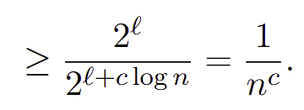

3) Searching for a witness in polynomial time
(for simplicity)
27

Slide 35

Collapsing pnK to pK under the easiness of MINnKT
Ideas related to the proof that Meta-Complexity implies Symmetry of Information
(Part I of the Tutorial)
Breaking the Direct Product Generator DP_{k} using the assumption that MINnKT is in BPP.
28

Slide 36








Collapsing pnK to pK under the easiness of MINnKT
$${pnK}^{tc}\left(x\right)$$
$${pnK}^{t}\left(x\right)$$
1
n
$$t1=tc$$
$$1$$
$${pnK}^{tc}\left(x\right)$$
$${pnK}^{t1}\left(x\right)$$
1
n
- Complexity can only decrease as we increase t: “intervals are disjoint”
- If we repeat the process n/log n times, some interval (gap) is of length at most log n.
- ISSUE: This might happen at a super-polynomial time bound of the form poly(poly(poly…)))
29

Slide 37
Collapsing pnK to pK under the easiness of MINnKT
Key technical contribution:
refined collapse
Additive gap: allows n/log n iterations while keeping all time bounds poly(n).
We don’t quite establish the inequality above, but this is the main idea.
30

Slide 38
High-Level Summary of the Tutorial
Kolmogorov complexity notions:
Which features of Kolmogorov complexity survive in the time-bounded setting?
Source Coding
Symmetry of
Information
Language Compression
Meta-Complexity: What is the complexity of estimating complexity?
e.g., given a string x and a time bound t, compute K^{t}(x)
Applications in Theoretical Computer Science
31

Slide 39
Some of my favorite open problems
Meta-Complexity
1. Prove (unconditionally) that MKtP is not in P.
2. Prove the NP-hardness of MINKT.
Explicit Constructions
3. Show that for every large n there is an n-bit prime p with rKt(p) = o(n).
Theory of Time-Bounded Kolmogorov Complexity
4. Prove that Symmetry of Information fails for rKt.
5. Prove that Symmetry of Information fails for nKt.
32

Slide 40
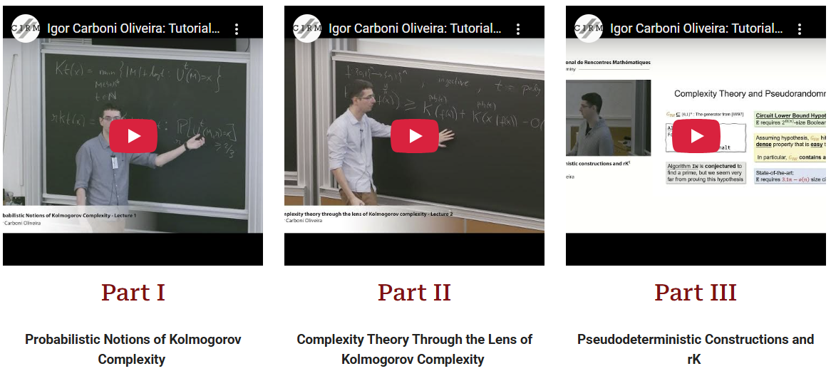
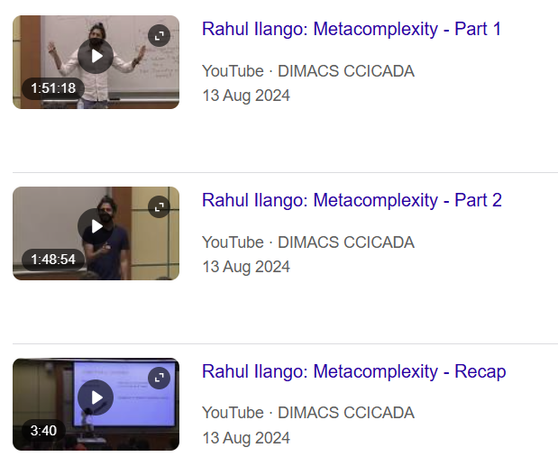

Further Resources: Probabilistic Kolmogorov Complexity
Frontiers in Complexity Theory Workshop
(Rutgers DIMACS, 2024)
EATCS Bulletin Survey:
[Lu-Oliveira 2022]: Theory and Applications
of Probabilistic Kolmogorov Complexity
33

Slide 41

Obrigado!

Slide 42
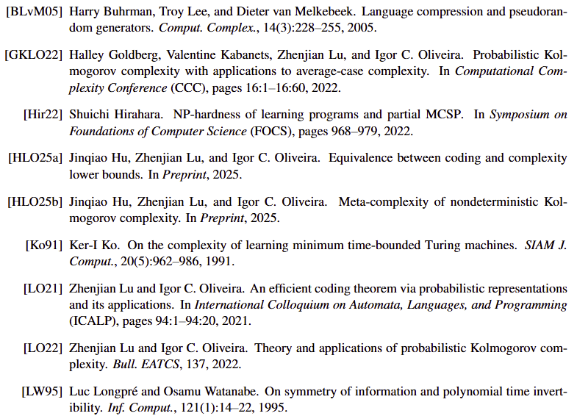
References

Slide 43
Appendix

Slide 44
