Slide 1
Meta-Mathematics of P vs NP
Igor Carboni Oliveira
University of Warwick
December/2025
UIUC Theory Seminar

Slide 2
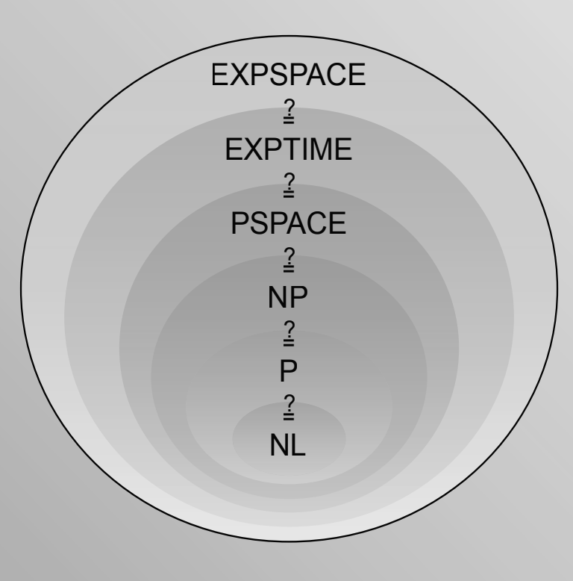
Complexity Theory:
P vs NP, NP vs coNP, …
How difficult is it to solve computational problems?
2^{n}
Best known upper bound for NP problems such as SAT
?
5n
State of the art in circuit lower bounds
CACM March/21
Meta-Mathematics of Complexity Theory
How difficult is it to prove theorems about computational complexity?
1

Slide 3
Plan
Motivation
Theories
Unprovability of Upper Bounds
Unprovability of Lower Bounds
Reverse Mathematics
2

Slide 4
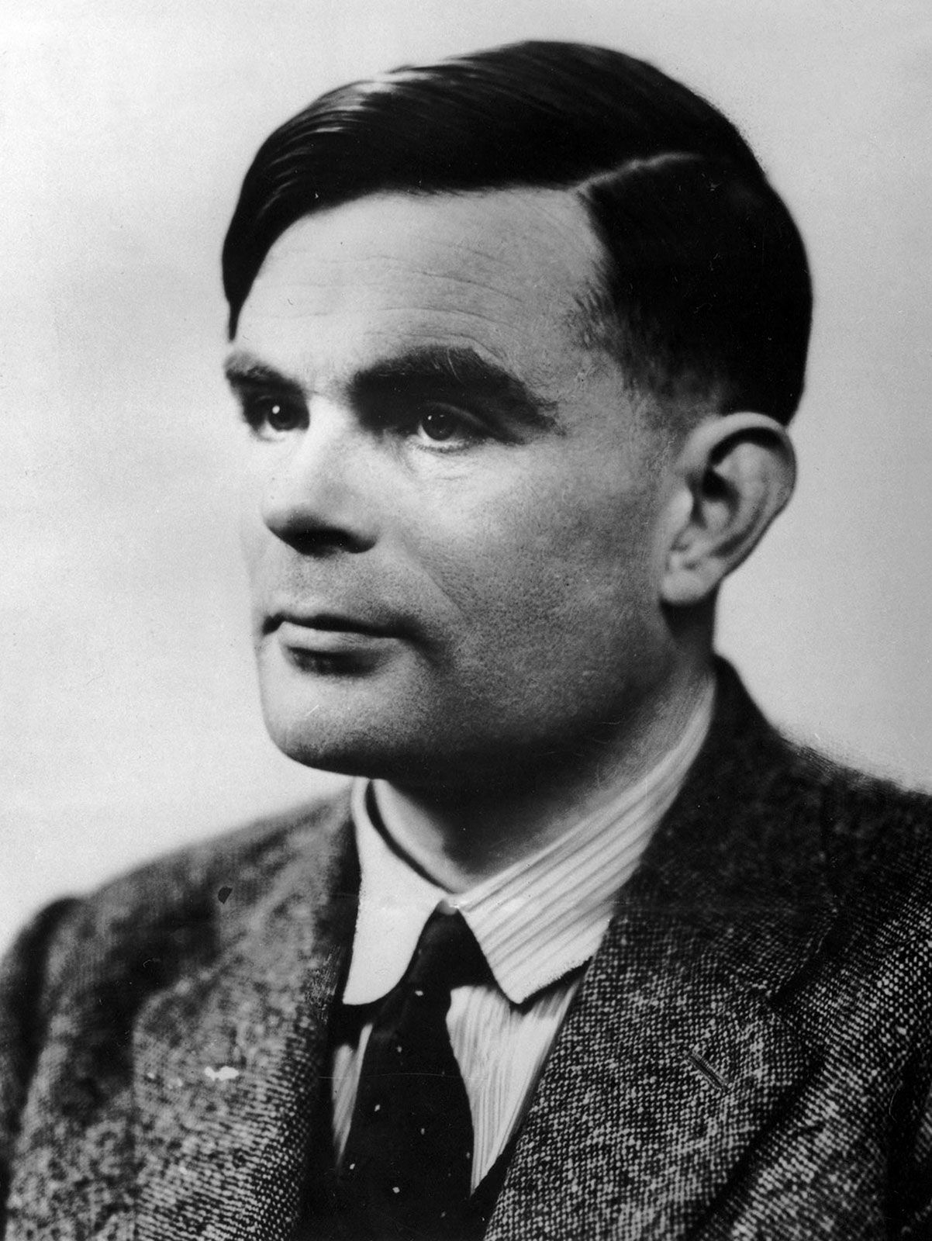
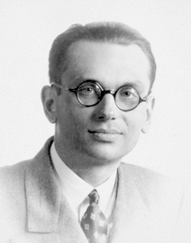
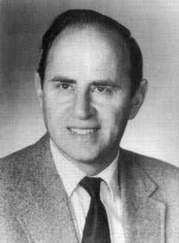
Grand Challenge
Identify a theory T able to formalize all known results from algorithms and complexity, and determine if complexity results of interest are (un)provable in T
Alan Turing
Kurt Gödel
Paul Cohen
3

Slide 5
A less ambitious goal
many
Identify a theory T able to formalize all known results from algorithms and complexity, and determine if complexity results of interest are (un)provable in T
Extensive research has identified a fragment of Peano Arithmetic called Bounded Arithmetic as a relevant theory.
…
Bounded Arithmetic
Peano Arithmetic
ZFC Set Theory
power
4

Slide 6
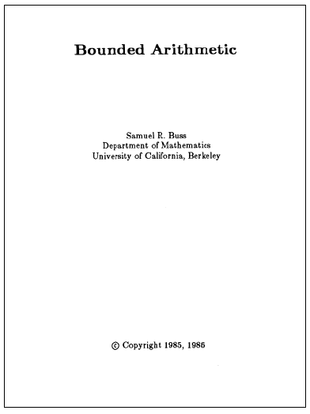
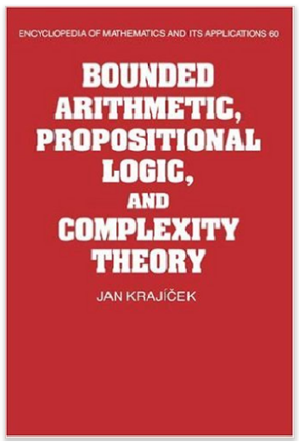
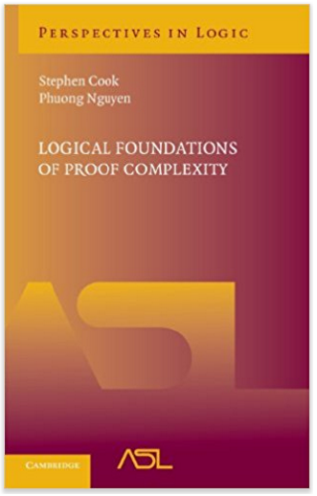

Bounded Arithmetic
Fragments of Peano Arithmetic capturing proofs that manipulate concepts from a given complexity class.
A few notable examples:
- Cook’s theory PV (1975), which formalizes poly-time reasoning
i
i
- Buss’s theories S and T (1986), corresponding to the levels of the polynomial hierarchy
2
2
- Jeřábek’s theory APC₁ (2007) for probabilistic poly-time reasoning
5

Slide 7
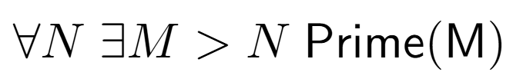
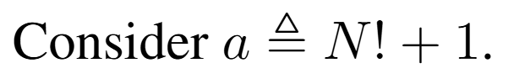
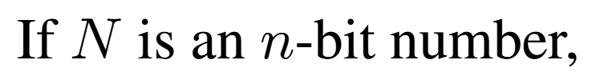

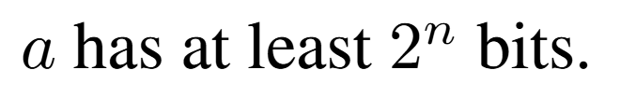
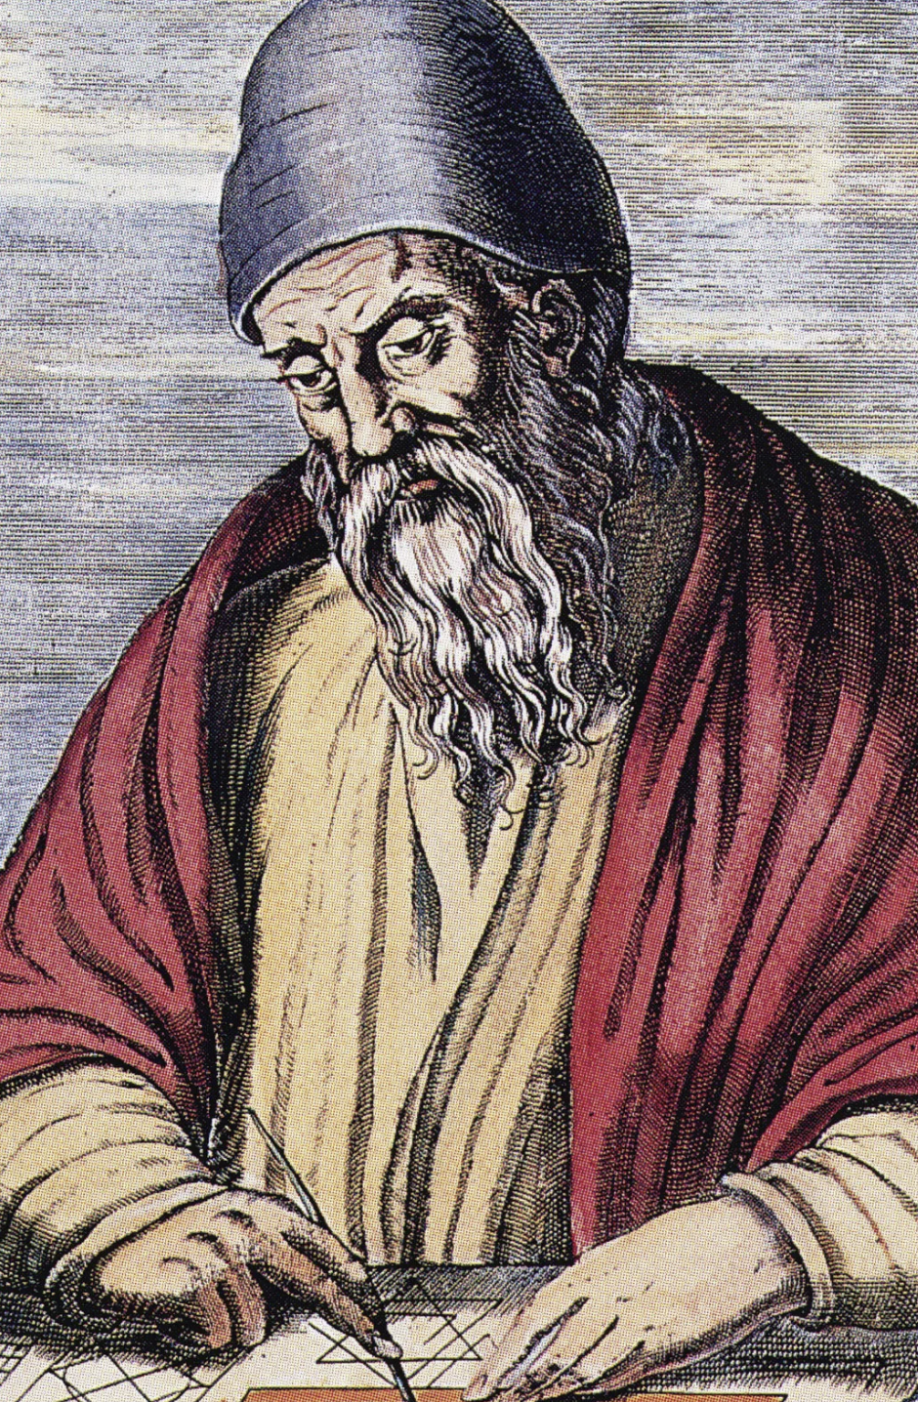
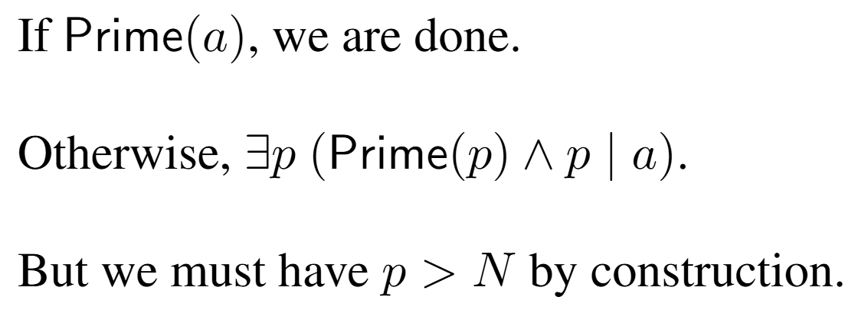


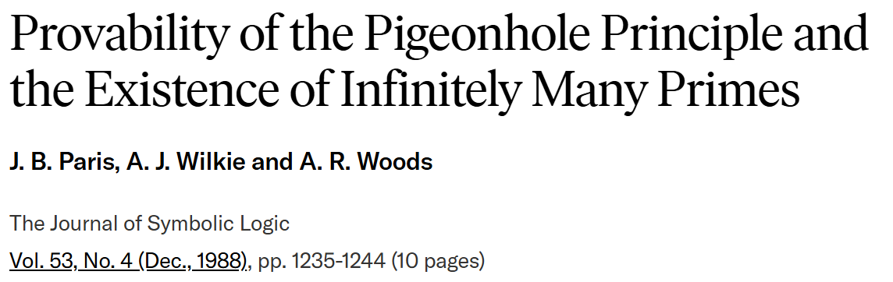
“Proofs that manipulate concepts from a given complexity class”
“the proof reasons about
an object of exponential size”
6

Slide 8

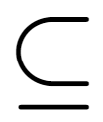







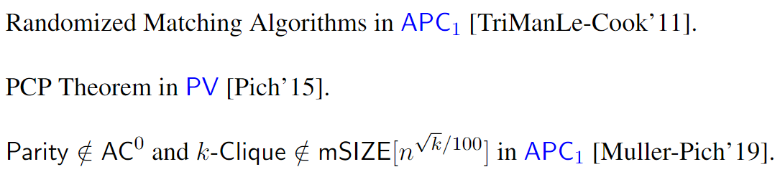
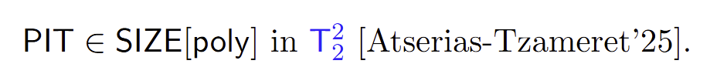
…
BA (Bounded Arithmetic)
Several results from Algorithms & Complexity can be formalized in BA:
7

Slide 9

Meta-Mathematics of P vs NP
Most researchers believe that P ≠ NP.
Can we at least rule out a proof that P = NP in BA?
(i.e., for no poly-time algorithm A, PV proves that A solves SAT)
From the perspective of “feasible mathematics”, a world where P ≠ NP !
Obtaining this result is formally necessary before we can prove that P ≠ NP.
8

Slide 10
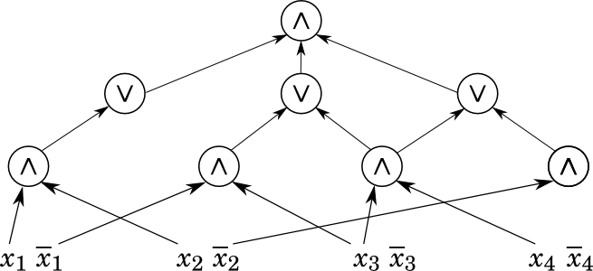
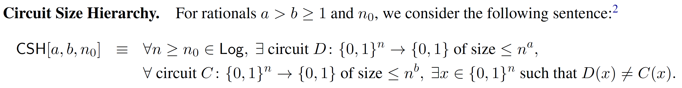
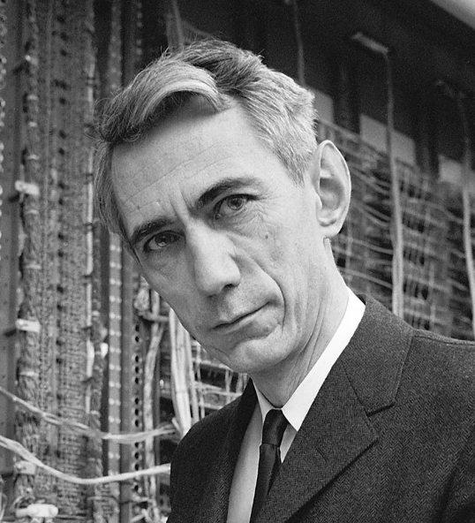
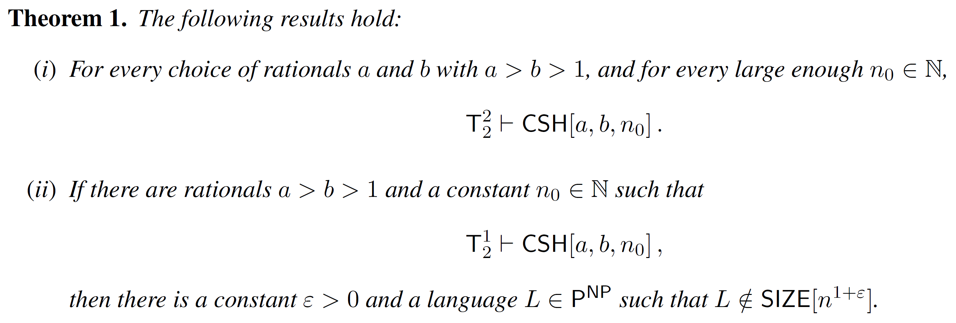
From Meta-Mathematics to Complexity Theory
Joint work with M. Carmosino, V. Kabanets, A. Kolokolova, and D. Tsintsilidas (2025)
Claude Shannon
9

Slide 11
Plan
Motivation
Theories
Unprovability of Upper Bounds
Unprovability of Lower Bounds
Reverse Mathematics
10

Slide 12









…
11

Slide 13
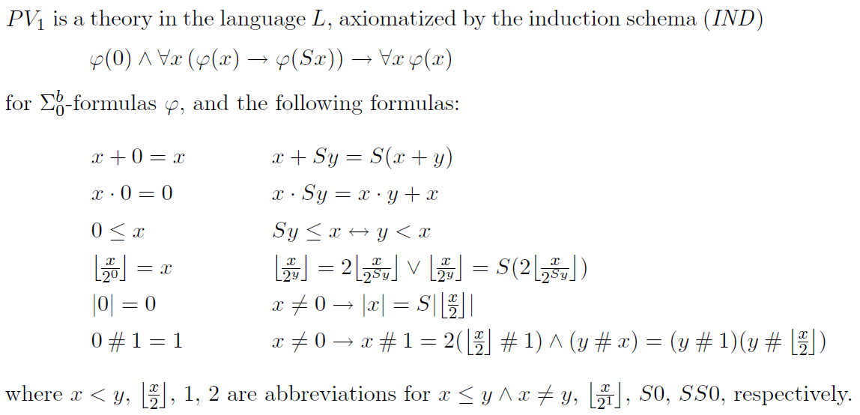






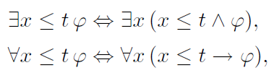
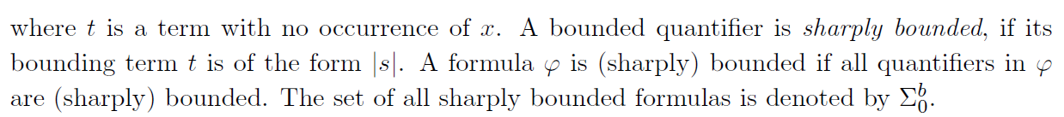
PV (Jeřábek’s Equivalent Formulation as T⁰)
2
Intended model:
Intended meaning of the symbols:
Bounded quantifiers & sharply bounded quantifiers:
12

Slide 14
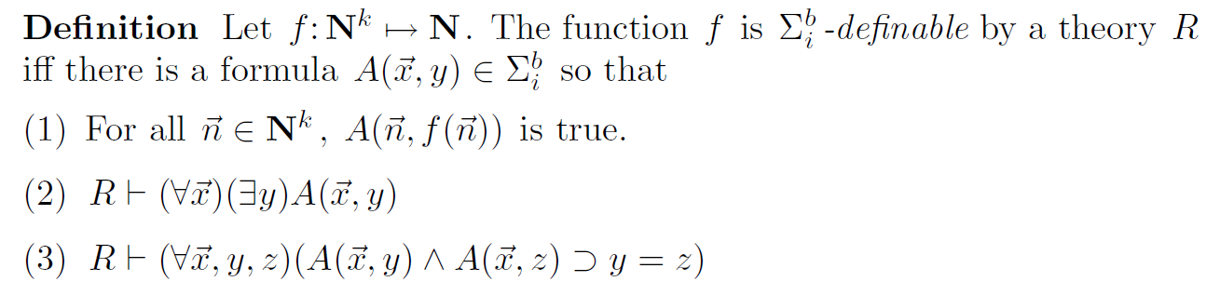
Formalization of complexity statements
Relevant Facts:
Since we can refer to any polynomial time computation in a sentence, we can capture complexity statements in a natural way.
Example. A non-uniform circuit upper bound for a language L in P:
For every N (with n=|N|), there is a circuit C with |C| < n³, for every n-bit string x, C(x) = L(x)
13

Slide 15
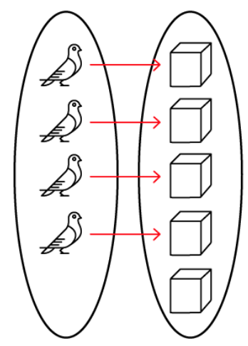



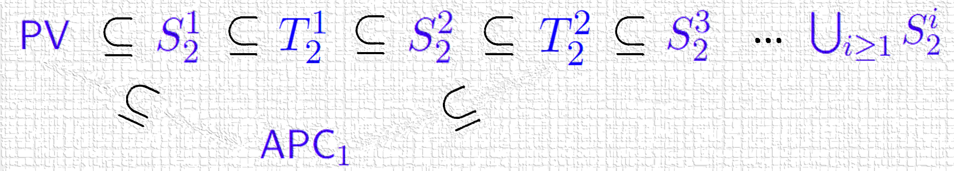
Theory APC₁
[Jeřábek 2007]
Vocabulary:
Intended Model:
Natural numbers
14

Slide 16
Plan
Motivation
Theories
Unprovability of Upper Bounds
Unprovability of Lower Bounds
Reverse Mathematics
15

Slide 17
Want to rule out efficient algorithms/circuits with respect to a logical theory T
Relax our goal of showing that P ≠ NP, NP ⊈ SIZE[n³], etc. to
Theory T does not prove that P = NP
Theory T does not prove that NP ⊆ SIZE[n³]
Systematic investigation
initiated by S. Cook and J. Krajíček:
Necessary before showing corresponding lower bounds
16

Slide 18


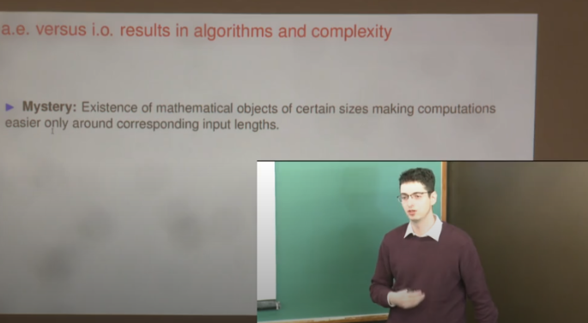
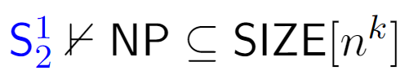
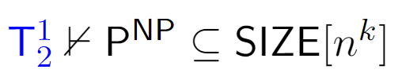
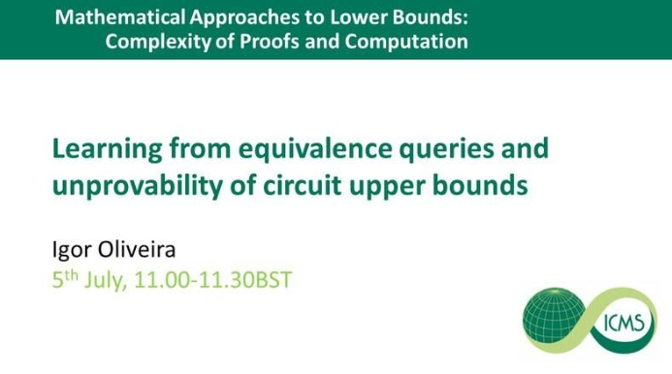
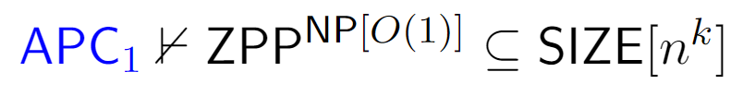
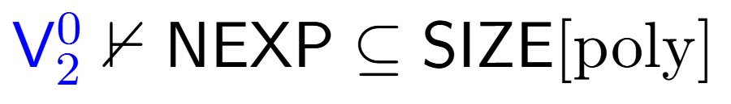
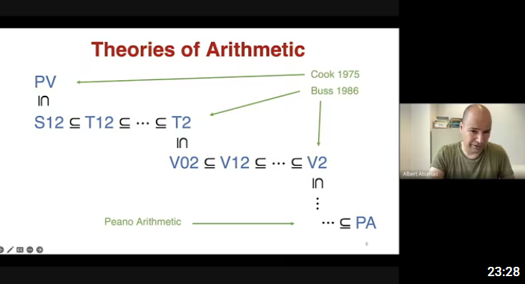
Unprovability of Upper Bounds
Fix any positive integer k. Then
[Krajicek-O’17]
Unconditional
[Bydzovsky-Müller’19]
[Bydzovsky-Krajicek-O’20]
[Carmosino-Kabanets-Kolokolova-O’21]
[Atserias-Buss-Müller’23]
[Thapen’25’]
17

Slide 19
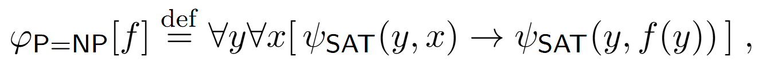

P vs NP
18

Slide 20

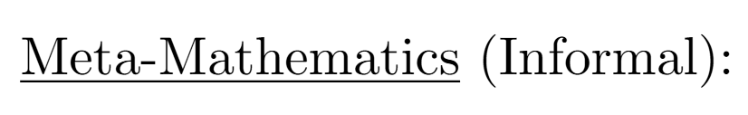

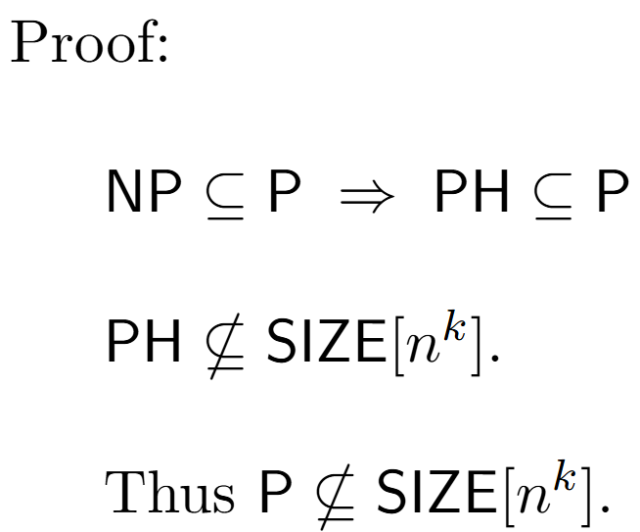
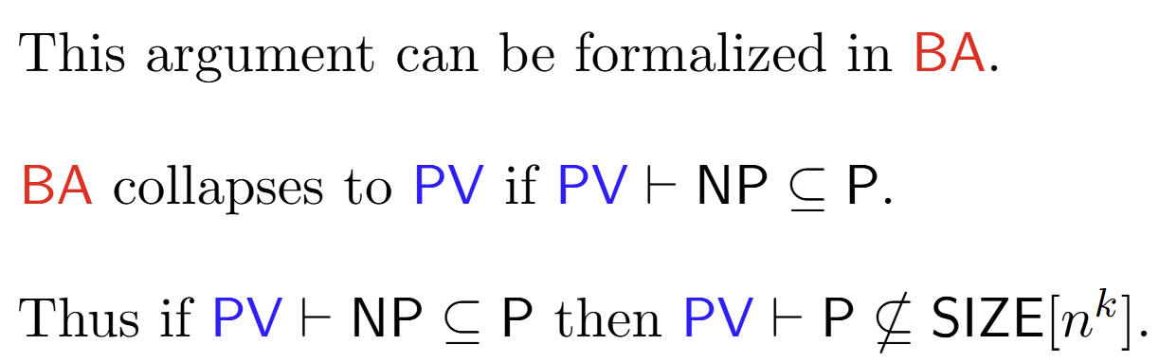

Reduction to the unprovability of lower bounds
Observation from a joint work with J. Bydzovsky and J. Krajicek (2020)
Therefore, if circuits lower bounds are unprovable, P = NP is unprovable.
19

Slide 21
Plan
Motivation
Theories
Unprovability of Upper Bounds
Unprovability of Lower Bounds
Reverse Mathematics
20

Slide 22
Unprovability of Lower Bounds
Known lower bounds: weak and distant from main goals such as P vs NP
Barriers: relativization, natural proofs, algebrization, …
Useful, but tend to be formulated in an ad-hoc way and are limited in scope
Motivates the development of a principled approach to understand the difficulty of analyzing computations (via mathematical logic)
Intriguing possibility: strong complexity lower bounds might be unprovable
21

Slide 23
Some recent unconditional results
Razborov, Krajíček (1995) initiate a systematic investigation of the formalization/(un)provability of complexity lower bounds in bounded arithmetic.
…
(subject is investigated both in bounded arithmetic and propositional proof complexity)
Pich and Santhanam (2021) show the unprovability of strong complexity lower bounds in PV
and in a fragment of APC₁
Li and Oliveira (2023) extend the techniques to APC₁ and stronger theories
(but must consider even stronger lower bound statements)
Chen, Li, and Oliveira (2025): unprovability of worst-case poly-size lower bounds in intuitionistic BA.
22

Slide 24
Pich-Santhanam (Informal)
[PS’21] considers strong complexity lower bounds separating NP from coNSIZE:
Fix a poly-time nondeterministic TM M.
[PS’21] considers a sentence S_{M} stating that
For every input length n > n₀
For every co-nondeterministic circuit D of size 2^{nε}
M and D disagree on 1% of the inputs in {0,1}^{n}.
They showed that S_{M} is not provable in PV and in a fragment of APC₁
23

Slide 25


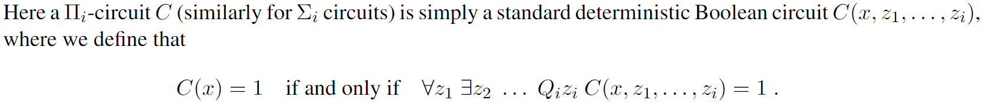
APC₁ cannot prove strong lower bounds separating the third level of the polynomial hierarchy
[Li-Oliveira, 2023]
24

Slide 26
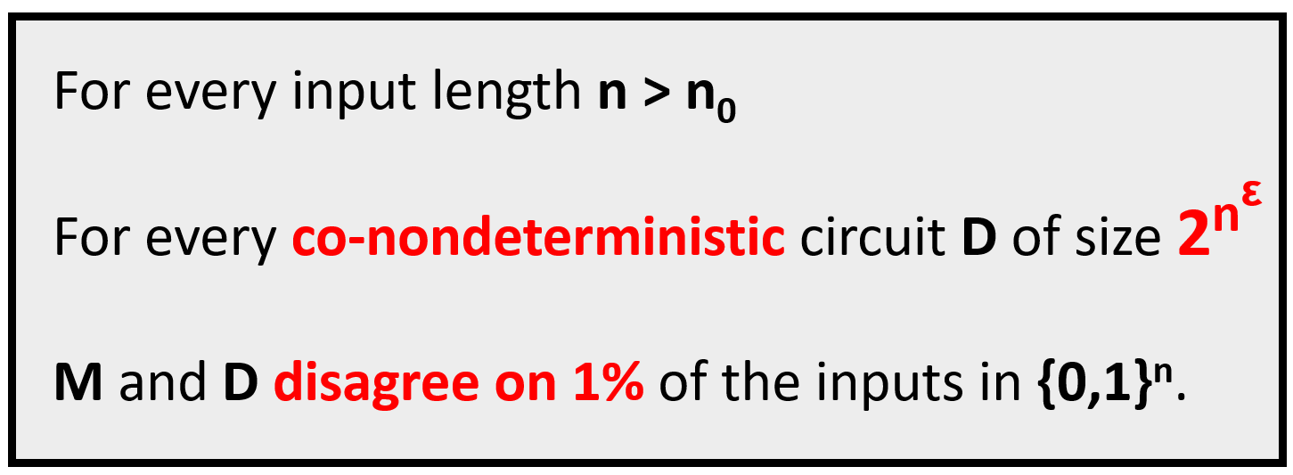
Discussion
[PS’21]
The results of [PS’21] and [LO’23] are unconditional but only apply to significantly strong lower bounds.
We’d like to understand the (un)provability of major open problems, such as showing that NP ⊈ P/poly.
For this, we need to address the following aspects for which these statements are stronger than NP ⊈ P/poly:
(1) They consider average-case instead of worst-case complexity.
We address the first two issues in the more restricted setting of intuitionistic logic.
(2) Refer to sub-exponential size instead of polynomial size lower bounds.
(3) Against co-nondeterministic instead of deterministic circuits.
25

Slide 27

Unprovability in Intuitionistic S
1
2
Joint work with L. Chen and J. Li (2025)
[S. Buss, 1986]
Able to formalize non-trivial lower bounds:
26

Slide 28

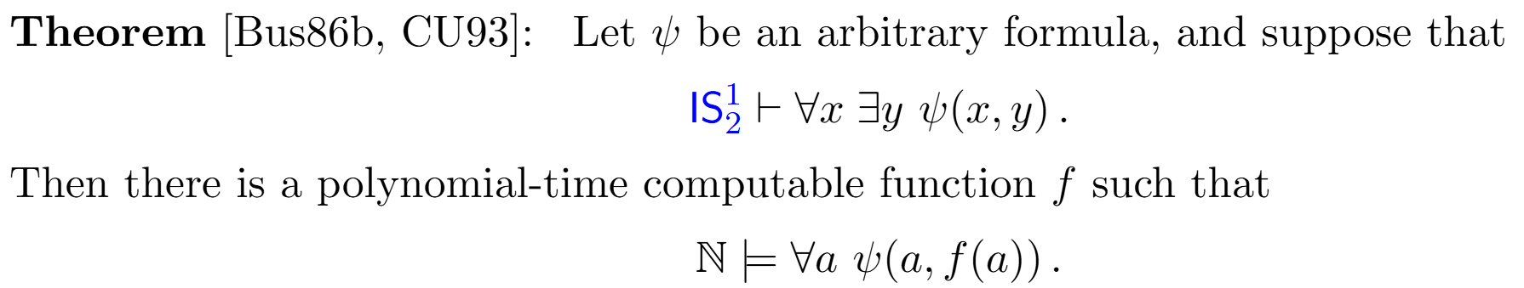
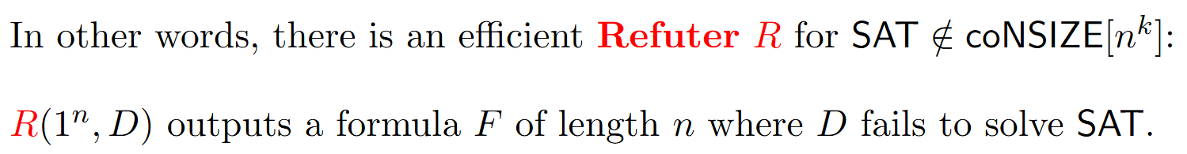
Proof Techniques
Main Technical Contribution
Solves an open problem from [Ats’06]
27

Slide 29
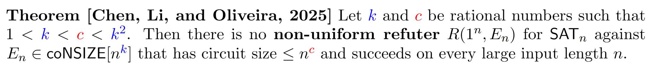
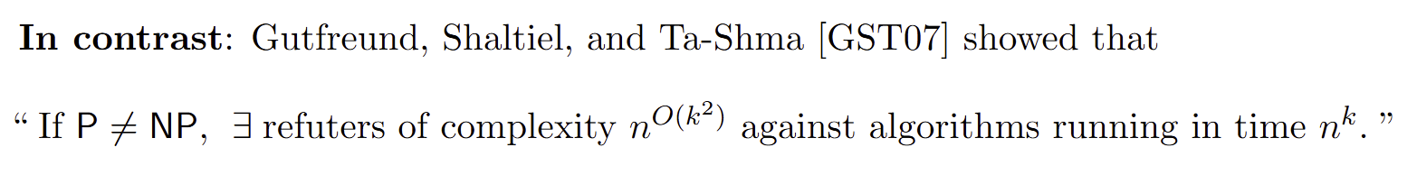
On Refuters for SAT
28

Slide 30
Plan
Motivation
Theories
Unprovability of Upper Bounds
Unprovability of Lower Bounds
Reverse Mathematics
(unprovability of very weak lower bounds, under crypto assumptions)
29

Slide 31



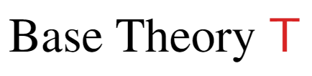
Reverse Mathematics of Lower Bounds
Joint work with L. Chen and J. Li (2024)
We aim to determine the fundamental principles needed to establish lower bounds, by showing (over a weak base theory) that the lower bound and the principle are equivalent.
30

Slide 32
Overview of Results [CLO’24]
I) Equivalences between combinatorial principles, communication complexity, and Turing machine lower bounds over PV
II) Consequences for the (un)provability of lower bounds
31

Slide 33
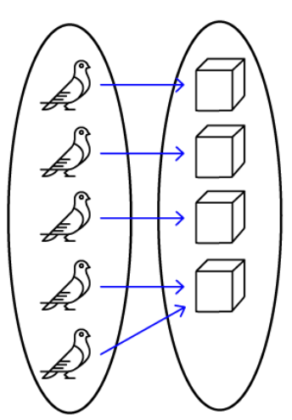
Weak Pigeonhole Principle for Polynomial Time Functions
32

Slide 34
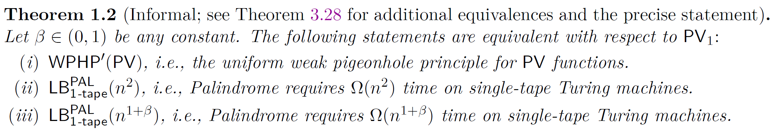
Equivalence Class for WPHP’(PV)
Suggests complexity lower bounds
can be seen as fundamental
mathematical principles.
33

Slide 35
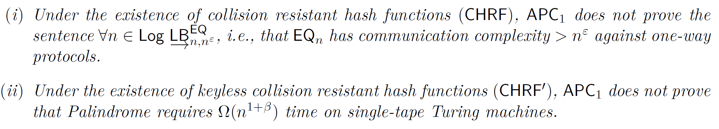
Corollary
There are simple lower bounds that cannot be proved in APC₁ (under crypto assumptions):
34

Slide 36
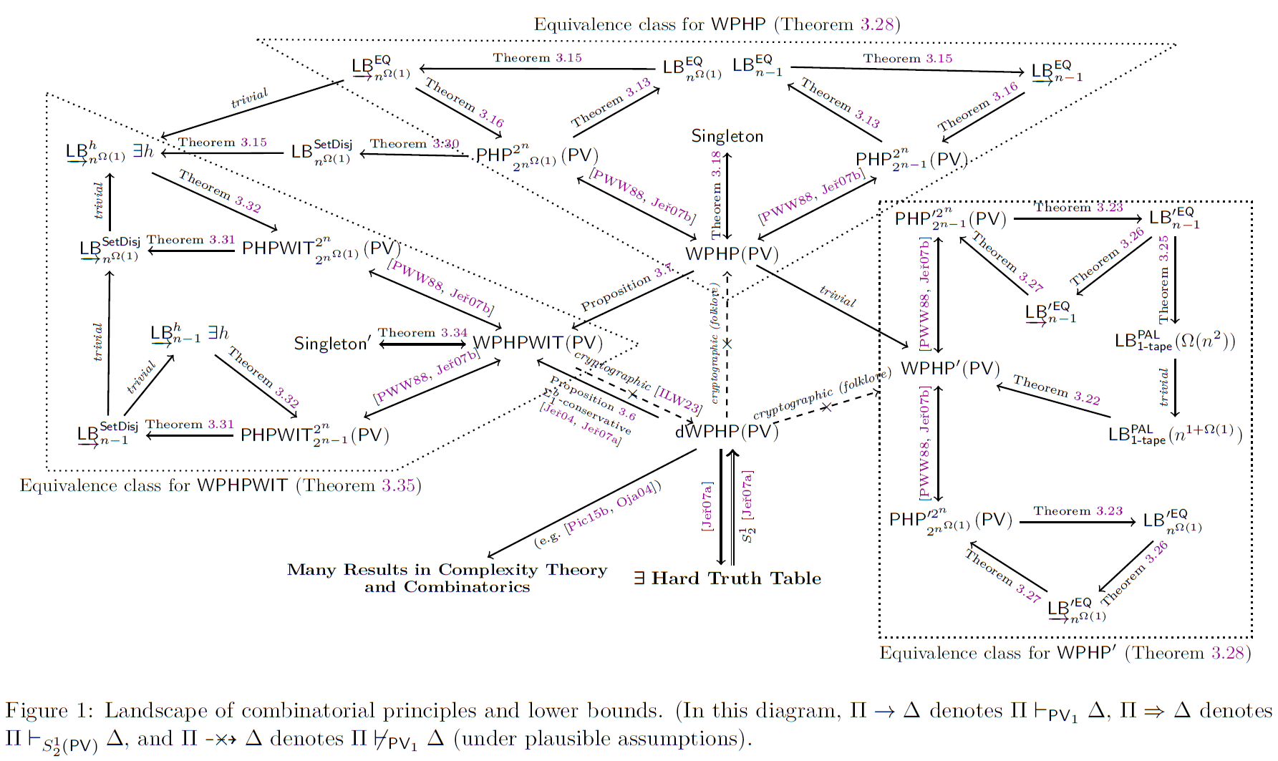
35

Slide 37
Further Consequences of Reverse Mathematics
We precisely capture the strength of different communication complexity lower bounds
APC₁ proves one-way communication lower bounds for Set Disjointness.
APC₁ is unlikely to prove one-way communication lower bounds for Equality.
rWPHP(PV)
WPHP(PV)
36

Slide 38
Concluding Remarks
37

Slide 39
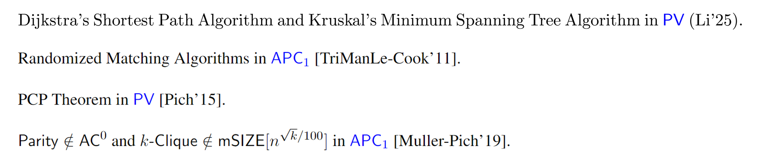
…
Bounded Arithmetic
Peano Arithmetic
ZFC Set Theory
…
power
…
38

Slide 40



…
Bounded Arithmetic
Peano Arithmetic
ZFC Set Theory
…
power
Some papers from the last 12 months
…
38

Slide 41


…
Bounded Arithmetic
Peano Arithmetic
ZFC Set Theory
…
power
More Approachable Open Problems:
…
A Fundamental Challenge:
reduction to unprovability of lower bounds
Survey
(supported by reverse mathematics)
“Meta-Mathematics of Complexity Theory”
Published March/2025
38

Slide 42
Thank You!

Slide 43



2026

Slide 44


Slide 45


Slide 46





Landscape of circuit uniformity notions
P-uniform SIZE[$n^{k}$]
LEARN^{EQ[q]}-uniform-SIZE[$n^{k}$]
SIZE[$n^{k}$]
Efficiently computable from $1^{n}$
Stronger theories: corresponding learning algorithms are more expressive (more queries, randomized)
Existential / Nonuniform
[Carmosino-Kabanets-Kolokolova-O’21]

Slide 47



Unprovability of Lower Bounds: Proof Strategy
We extend the approach employed by [PS’21], which builds on [Pich’15] and [Krajíček’11]
Main challenges: stronger theory and quantifier complexity of
Suppose that
Overview: Proof of a complexity lower bound yields a corresponding complexity upper bound
The lower bound and the upper bound contradict each other
Check online talk for more details

Slide 48

Technical Remark

Slide 49

Pigeonhole Principles for Polynomial Time Functions

Slide 50


Slide 51

Equivalence Classes for WPHP, WPHP’, WPHPWIT
WPHP(PV) [“Non-uniform” WPHP]

Slide 52
Ideas behind some “reversals”: communication complexity
(i) to (ii):
We show that the fooling set argument can be formalized in PV₁ + WPHP(PV)
We argue in the base theory PV₁
We consider a function f (with an extra parameter) such that, as we fix the extra parameter to be a candidate protocol P, f(x,P) outputs the transcript of P on (x,x).
By WPHP(f), there is a collision, i.e., distinct x and y such that f(x,P) = f(y,P).
In other words, (x,x) and (y,y) lead to the same transcript.
We now analyze P on the pair (x,y), as in the fooling set argument, to reach a contradiction. Induction available in PV₁ is enough for this.

Slide 53
Ideas behind some “reversals”: communication complexity
(ii) to (i):
We must show that the CC lower bound implies the WPHP(PV) axiom scheme.
We argue in the base theory PV₁
Fix an arbitrary PV₁ function symbol f. We argue the contrapositive.
By assumption, there is a fixed parameter a such that PHP fails for f(x,a).
In other words, f(.,a) compresses the input string by one bit.
We use f and the parameter a to design a better protocol for EQ for some n, which violates the lower bound.

Slide 54
Equivalence Class for WPHP’(PV)

Slide 55
Ideas behind some “reversals”: Turing machines
(i) to (ii):
We can show lower bounds against single-tape TM using communication complexity (CC).
We argue in the base theory PV₁
As we have seen before, WPHP(PV) is closely related to CC lower bounds.
We show that one of the existing proofs of the Palindrome TM lower bound via CC can be formalized in PV1 + WPHP’(PV).
The uniform version of WPHP (without parameters) is sufficient, as we are proving a lower bound against a uniform model of computation.

Slide 56
Ideas behind some “reversals”: Turing machines
(ii) to (i):
We argue in the contrapositive. From the failure of WPHP’(PV) for some function f, i.e., using a perfect hash function, we must design a single-tape TM that solves Palindrome in o(n²) time.
We argue in the base theory PV₁
Plan: Hash the first and second part of the input string and try to compare them.
Issue: The perfect hash function is implemented by an arbitrary poly-time computation.
Solution: Merkle-Damgård construction: a technique from cryptography that improves the shrinkage and running time of collision-resistant hash functions.

Slide 57

Equivalence Classes for WPHP, WPHP’, WPHPWIT
WPHPWIT(PV) [Witnessing WPHP]
Consequence:
APC₁ proves one-way communication lower bounds for Set Disjointness.
APC₁ is unlikely to prove one-way communication lower bounds for Equality.

