Slide 1
Kolmogorov complexity, prime numbers,
and complexity lower bounds
LMS Computer Science Colloquium
November/2020
Igor Carboni Oliveira
University of Warwick
Research funded by a Royal Society University Research Fellowship
1

Slide 2
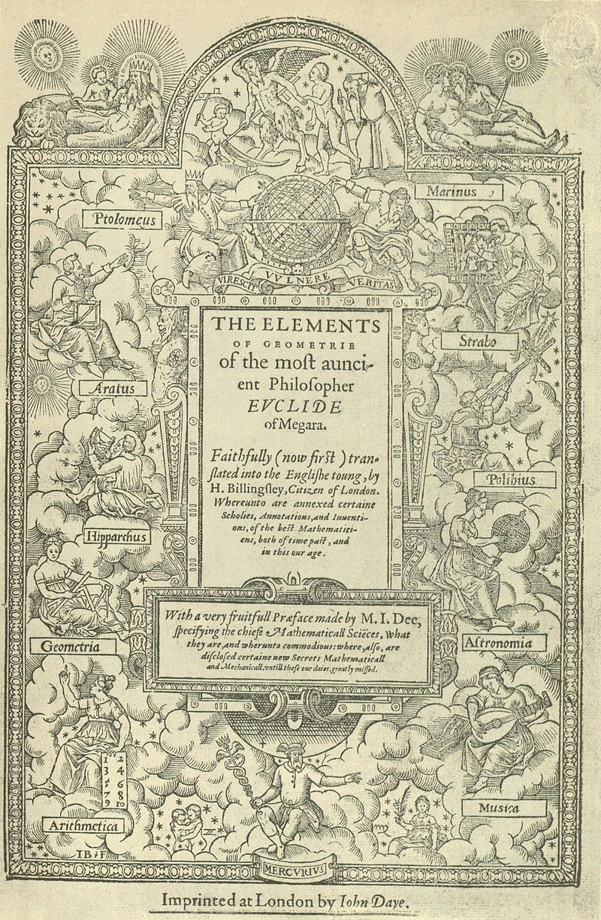
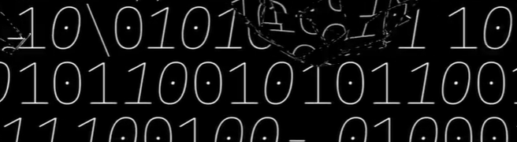
Overview
Wikipedia
Maths
Are there infinitely many prime numbers with “simple” descriptions?
2. Is it hard to detect patterns in data?
3. Is there a fast deterministic algorithm that, given n, outputs an n-bit prime?
Quanta
CS
Euclid’s Elements
Maths/CS
This talk:
New insights using a probabilistic extension of (time-bounded) Kolmogorov complexity
2

Slide 3
Background and Motivation
3

Slide 4


1. Number Theory: Mersenne Primes
“Simplest” possible representation
of an n-bit prime.
Mersenne primes admit a short and effective representation.
Q.
Q.
Are there infinitely many
primes of “minimum description length”?
Are there infinitely many Mersenne primes?
4

Slide 5
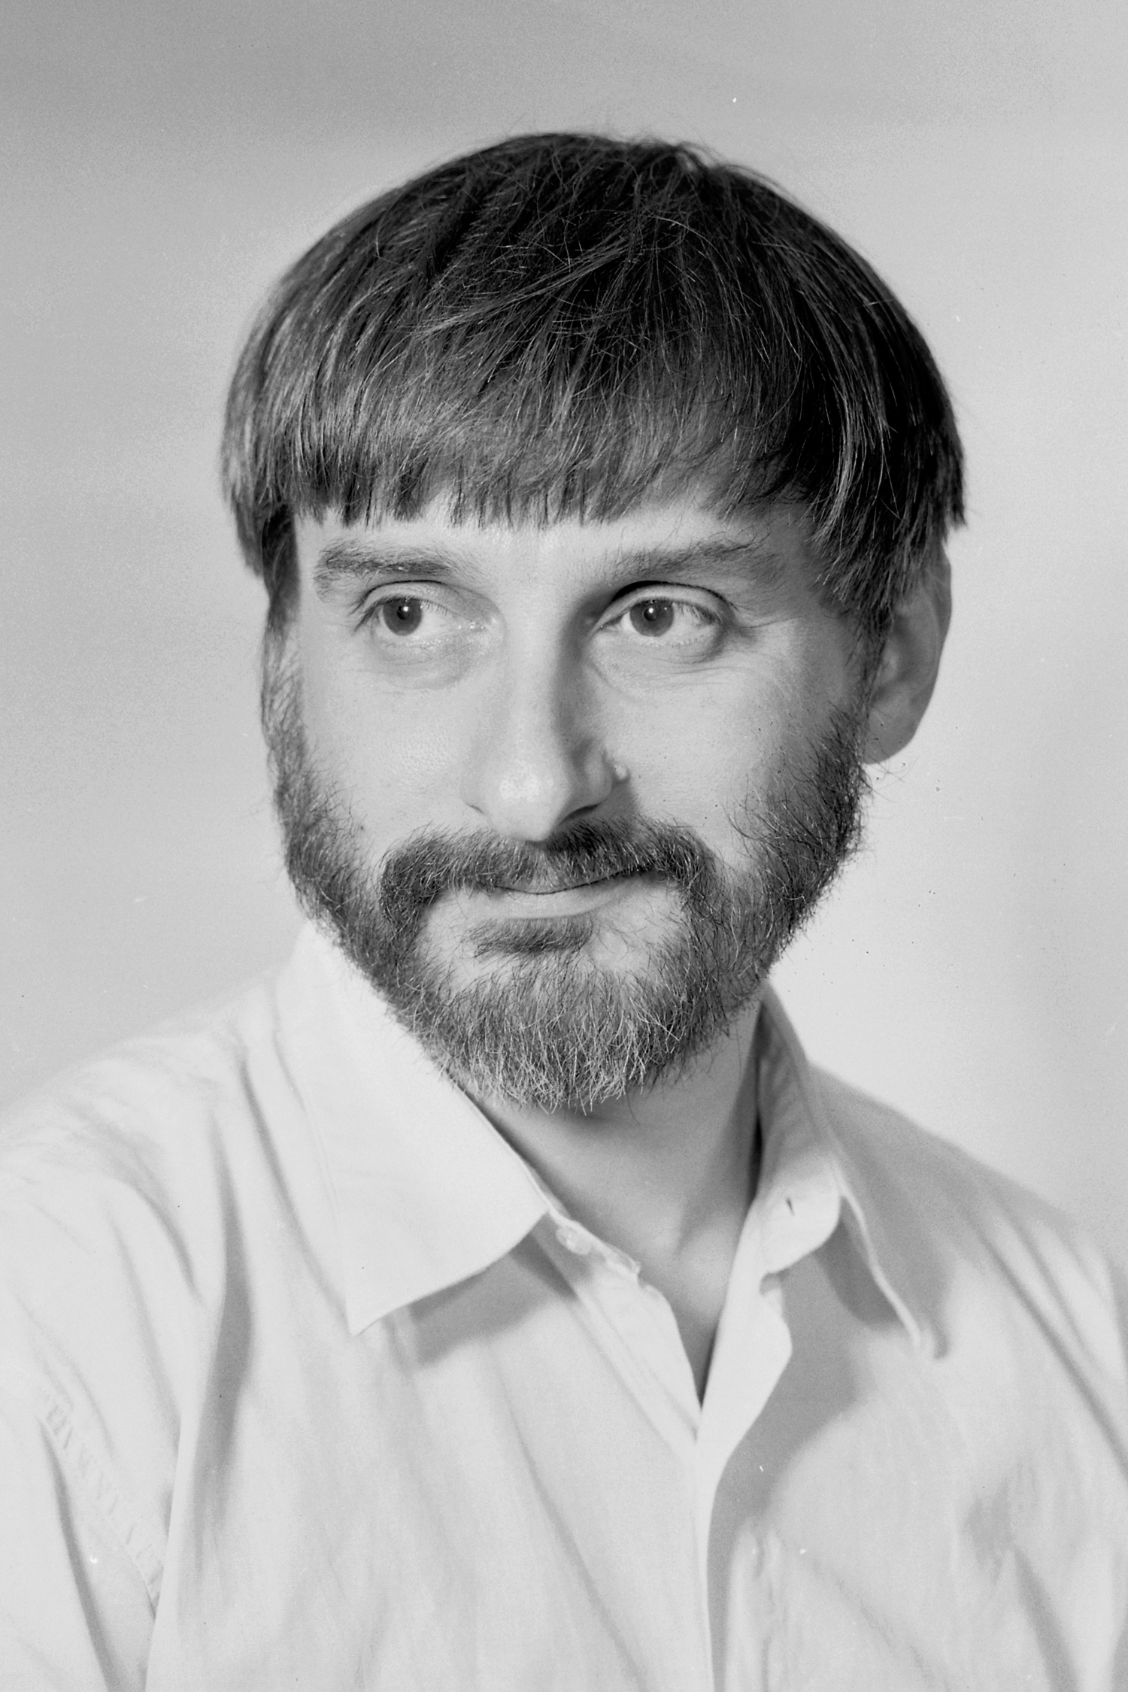
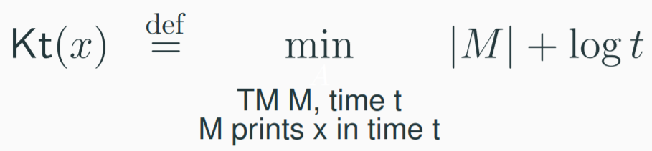
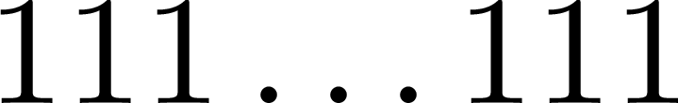
Time-bounded Kolmogorov Complexity
Mersenne primes admit a short and effective representation.
Kolmogorov Complexity?
Levin (1984) proposed the following notion of complexity for strings.
short
effective
5

Slide 6
2. Complexity Theory: Intractability
Problems about the complexity of strings play a significant role in theory of computing.
(e.g. learning & cryptography)
Undecidable
Exponential Time vs Polynomial Time
Kolmogorov complexity
Levin’s Kt complexity
Given x, estimate C(x)
Q.
Is it in polynomial time?
Given x, estimate Kt(x)
e.g. [ABKvMR’06]
6

Slide 7

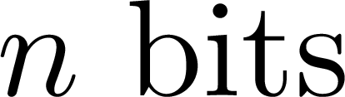
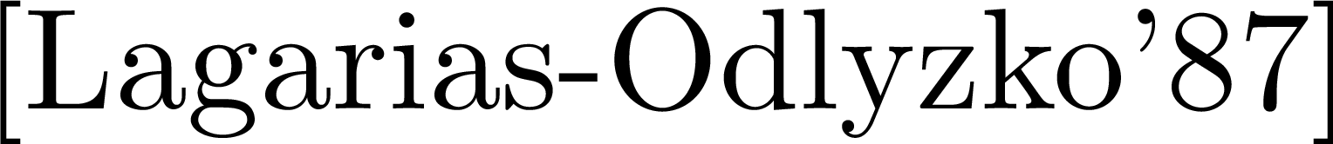
3. Algorithms: Deterministic constructions
POLYMATH 4
“Simple objects are easier to find”
7

Slide 8
Summary
“Simplicity” as bounded Kt complexity (e.g. Mersenne primes).
Connections to basic questions in Maths/CS.
Q.
Q.
Q.
These remain longstanding problems relevant to number theory, algorithms, and complexity.
8

Slide 9

A theory of probabilistic representations
[O-Santhanam’17] Pseudodeterministic constructions in subexponential time.
[O’19] Randomness and intractability in Kolmogorov complexity.
[Lu-O’20] An efficient coding theorem via probabilistic representations and its applications.
9

Slide 10
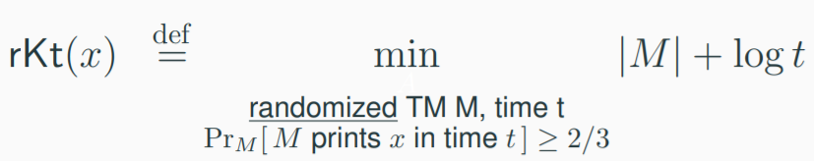
Definition of rKt complexity
[O’19] A randomized analogue of Levin’s Kt complexity:
A short and effective probabilistic procedure that is likely to generate the observed data.
10

Slide 11
Basic properties of rKt
Q.
Are there strings that admit a more succinct representation using randomness?
Proxy measure
to investigate Kt?
As far as we know, gap between rKt and Kt could be maximum.
11

Slide 12
A theory of probabilistic representations
[O-Santhanam’17] Pseudodeterministic constructions in subexponential time.
[O’19] Randomness and intractability in Kolmogorov complexity.
[Lu-O’20] An efficient coding theorem via probabilistic representations and its applications.
12

Slide 13
Probabilistic representations can see patterns in prime numbers
Informally, some primes are structured enough to admit “short” and “effective” probabilistic representations.
13

Slide 14
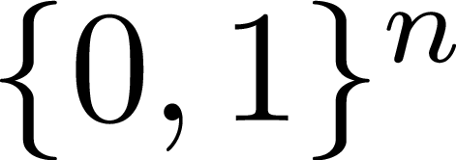
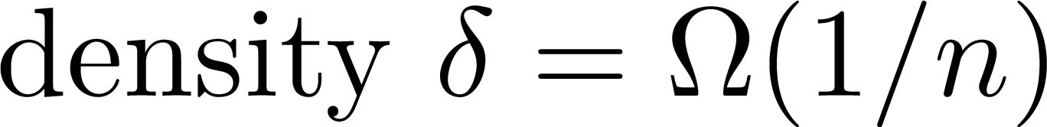
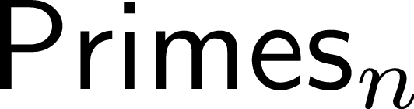



x
x
x
x
x
x
x
x
x
x
x
x
x
x
14

Slide 15
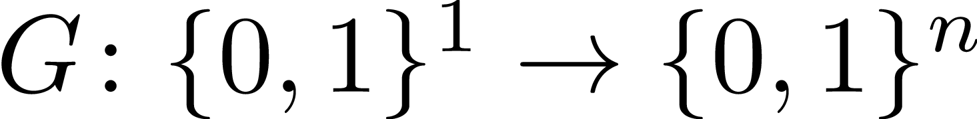
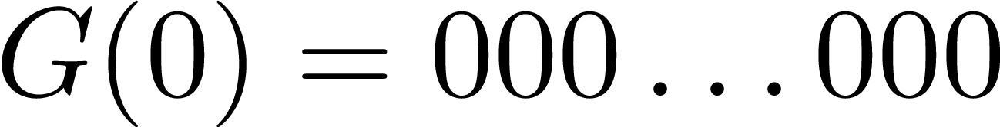
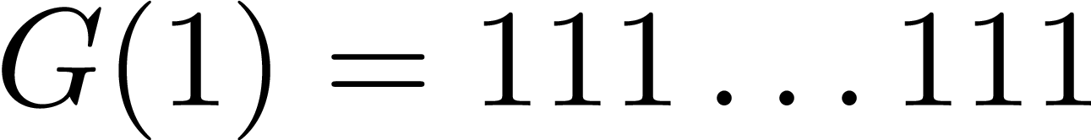
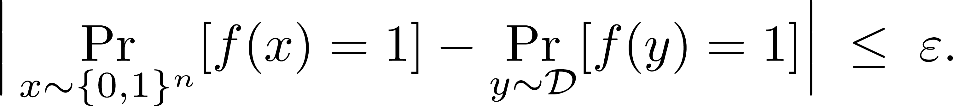
Pseudorandomness
x
x
x
x
x
x
x
x
x
x
15

Slide 16

x
x
x
x
x
x
x
x
x
x
Crucial:
Unconditional PRGs against “weak” tests.
Long list of works on PRGs in TCS:
Conditional PRGs against “expressive” tests.
Hardness Assumption
(Pseudo)Randomness
16

Slide 17

Hardness Assumption
(Pseudo)Randomness
Some primes have low rKt
17

Slide 18
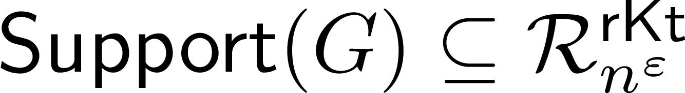
yes
no
Fact: PSPACE computations can detect first n-bit prime.
(probabilistic representation)
Infinitely many primes of bounded rKt complexity
18

Slide 19
A theory of probabilistic representations
[O-Santhanam’17] Pseudodeterministic constructions in subexponential time.
[O’19] Randomness and intractability in Kolmogorov complexity.
[Lu-O’20] An efficient coding theorem via probabilistic representations and its applications.
19

Slide 20
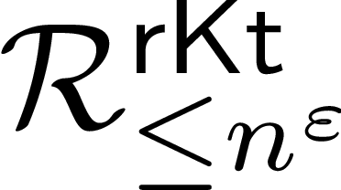
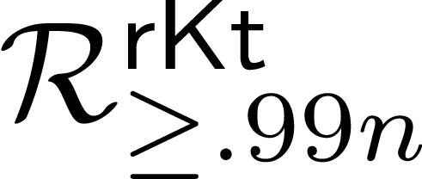
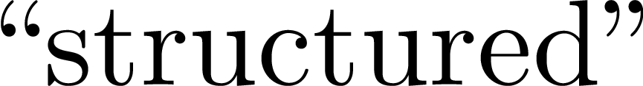
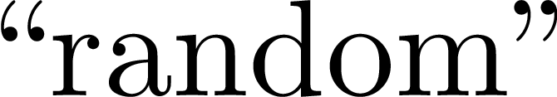
Is it hard to detect patterns?
We cannot feasibly distinguish “structured” strings from “random” strings.
20

Slide 21
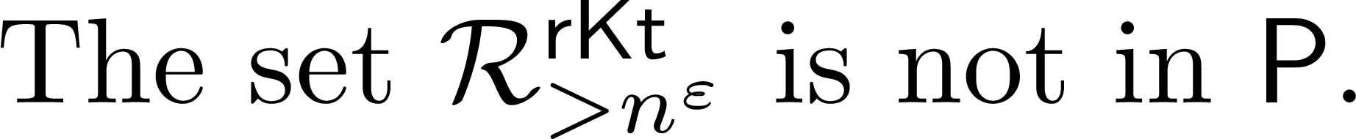
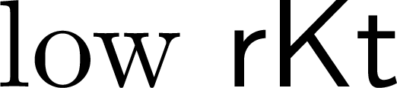
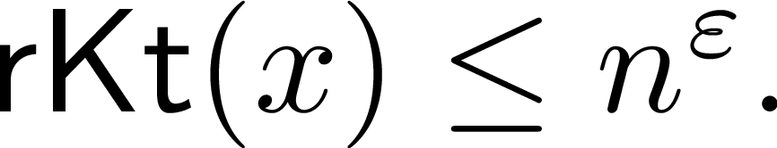

Proof of a weaker result:
x
x
x
x
x
x
x
x
x
x
x
x
x
x
21

Slide 22
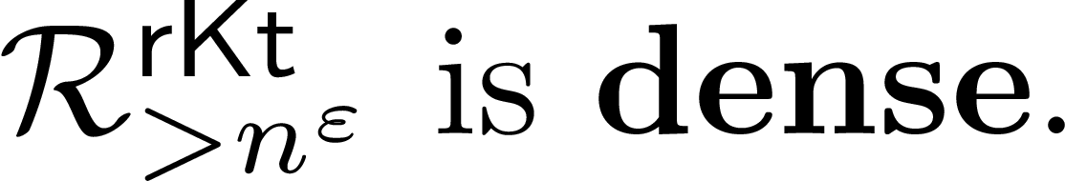
Proof of a weaker result:
A more delicate argument is used for the gap problem and against BPTIME[quasi-poly].
22

Slide 23
A theory of probabilistic representations
[O-Santhanam’17] Pseudodeterministic constructions in subexponential time.
[O’19] Randomness and intractability in Kolmogorov complexity.
[Lu-O’20] An efficient coding theorem via probabilistic representations and its applications.
23

Slide 24
Perspective
rKt has enabled results that remain intriguing questions for Levin’s Kt complexity.
existence of shorter representations
intractability of estimating rKt
Q.
Can we further advance time-bounded Kolmogorov complexity using probabilistic representations?
24

Slide 25

Pillars of Kolmogorov Complexity
Three essential results in Kolmogorov complexity:
Time-bounded version?
Language Compression Theorem
Hardness Assumption
See e.g. [Troy Lee, PhD Thesis]
Symmetry of Information
Hardness Assumption
?
Source Coding Theorem
25

Slide 26
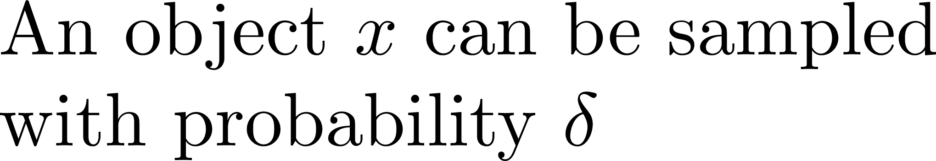
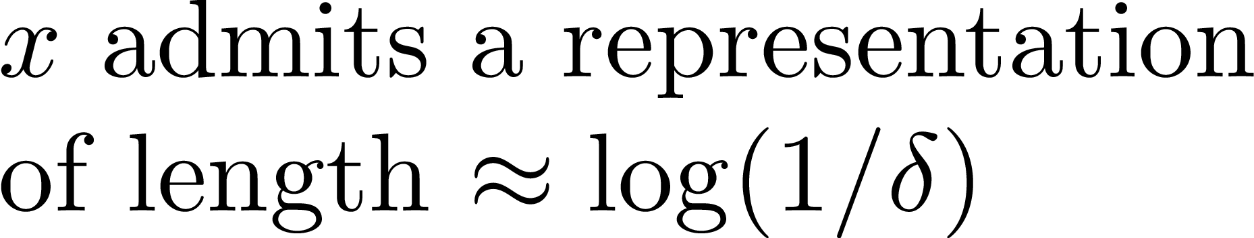
Coding Theorem
Shannon’s Information Theory
Coding Theorem in Kolmogorov Complexity
Kolmogorov Complexity
Distributions, entropy, compression, etc.
Individual strings and their complexities.
Interested in establishing an unconditional time-bounded version of the Coding Theorem.
26

Slide 27
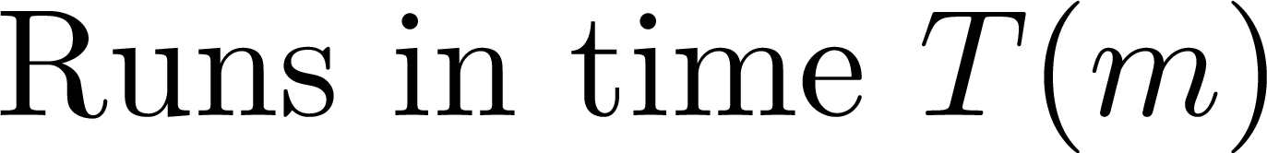
An Efficient Coding Theorem for rKt
[Zhenjian Lu-O’20]
“Samplable objects admit short and effective representations.”
Extremely useful
in applications!
27

Slide 28

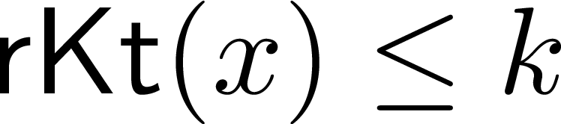
Application: Efficient universal compression
0010101000101111010010010111100010101010001010100101111010010100
“There is a way of compressing it to k bits” (in the sense of rKt).
28

Slide 29
Open Problem
Is the existence of succinct representations for primes a rare phenomenon?
By the Coding Theorem for rKt, enough to show that:
This is a relaxation of the Polymath problem of deterministically generating primes.
29

Slide 30
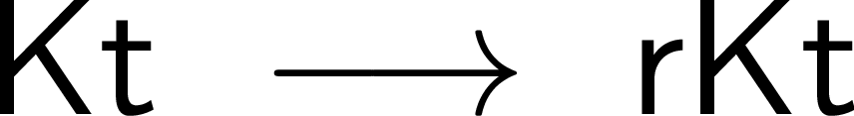
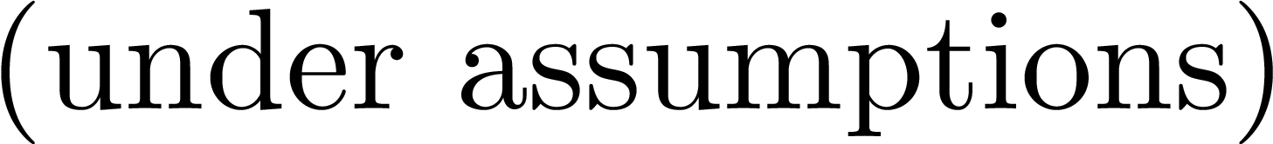
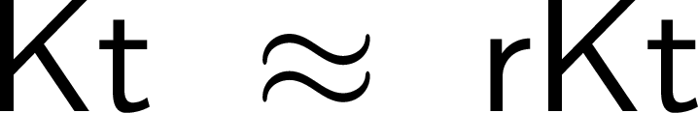
Summary: Probabilistic Data Representations
Succinct Descriptions:
Computational Hardness:
Coding Theorem:
30

Slide 31
Main References
[O-Santhanam’17] Pseudodeterministic constructions in subexponential time (STOC’2017).
[O’19] Randomness and intractability in Kolmogorov complexity (ICALP’19).
[Lu-O’20] An efficient coding theorem via probabilistic representations and its applications (preprint).
[Levin’84] Randomness conservation inequalities; information and independence in mathematical theories. Information and Control, 61(1):15-37, 1984.
[ABKvMR’06] Eric Allender, Harry Buhrman, Michal Koucky, Dieter van Melkebeek, and Detlef Ronneburger.
Power from random strings. SIAM J. Comput., 35(6):1467-1493, 2006.
[Polymath 4 - TCH12] Terence Tao, Ernest Croot, III, and Harald Helfgott. Deterministic methods to find primes.
Math. Comp., 81(278):1233-1246, 2012.
[Troy Lee, PhD Thesis] Kolmogorov complexity and formula lower bounds. University of Amsterdam, 2006.
31

Slide 32

https://www.dcs.warwick.ac.uk/~igorcarb/complexity-meetings.html
32

