Slide 1


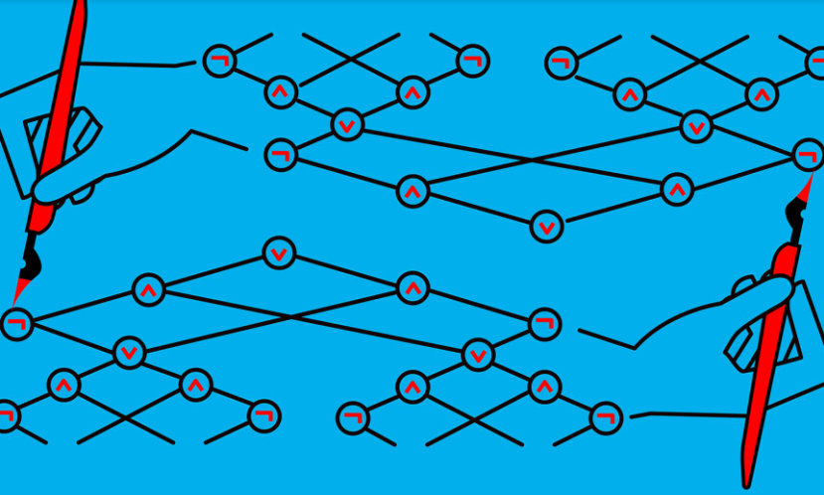
Probabilistic Kolmogorov Complexity
Igor Carboni Oliveira
University of Warwick
Meta-Complexity
January/2023

Slide 2
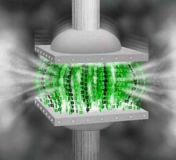




Kolmogorov Complexity
string $x$
$$\text{short} \text{encoding} \text{of} x$$
$$01001101…0111010111$$
$$010001110$$
$K\left(x\right)=$ minimum length of a program M that outputs $x$

Slide 3

(time-efficient universal machine)

Slide 4
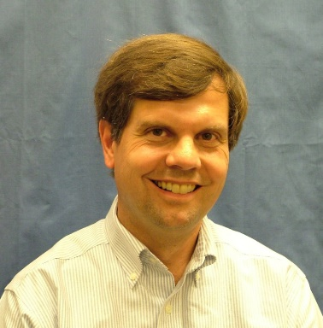
(time-efficient universal machine)

Slide 5
Time-Bounded Kolmogorov Complexity
Kolmogorov complexity:
$K\left(x\right)=$ $\min_{M}\left\{\left|M\right| :M outputs x\right\}$

Slide 6
Time-Bounded Kolmogorov Complexity
Kolmogorov complexity:
$K\left(x\right)=$ $\min_{M}\left\{\left|M\right| :M outputs x\right\}$
Levin Kolmogorov complexity:
$Kt\left(x\right)=$ $\min_{M, t }\left\{\left|M\right|+\log{t} :M outputs x within t steps\right\}$

Slide 7
Time-Bounded Kolmogorov Complexity
Kolmogorov complexity:
$K\left(x\right)=$ $\min_{M}\left\{\left|M\right| :M outputs x\right\}$
Levin Kolmogorov complexity:
$Kt\left(x\right)=$ $\min_{M, t }\left\{\left|M\right|+\log{t} :M outputs x within t steps\right\}$
$t$-time-bounded Kolmogorov complexity:
$$K^{t}\left(x\right)=\min_{M}\left\{\left|M\right| :M outputs x within t\left(\left|x\right|\right) steps\right\}$$

Slide 8
Some recent applications of K^{t} and Levin Kt
CRYPTOGRAPHY
[Liu-Pass’20]
One-way functions exist iff K^{t} is mildly hard to compute on average

Slide 9
Some recent applications of K^{t} and Levin Kt
CRYPTOGRAPHY
[Liu-Pass’20]
One-way functions exist iff K^{t} is mildly hard to compute on average
AVERAGE-CASE COMPLEXITY
[Hirahara’21]
If PH is easy on average, then PH can be solved in worst-case time 2^{O(n/log n)}

Slide 10
Some recent applications of K^{t} and Levin Kt
CRYPTOGRAPHY
[Liu-Pass’20]
One-way functions exist iff K^{t} is mildly hard to compute on average
AVERAGE-CASE COMPLEXITY
[Hirahara’21]
If PH is easy on average, then PH can be solved in worst-case time 2^{O(n/log n)}
DERANDOMIZATION
[Liu-Pass’22]
prBPP = prP iff a certain problem about weakly estimating Kt(x | z) is hard

Slide 11
Despite the usefulness of time-bounded Kolmogorov complexity, many basic questions remain open:
Is it computationally hard to compute Kt(x)?
Do classical results in Kolmogorov complexity survive in the time-bounded setting?
Do natural objects (e.g., prime numbers) have small K^{t} or Kt complexity?

Slide 12
Despite the usefulness of time-bounded Kolmogorov complexity, many basic questions remain open:
Is it computationally hard to compute Kt(x)?
Do classical results in Kolmogorov complexity survive in the time-bounded setting?
Do natural objects (e.g., prime numbers) have small K^{t} or Kt complexity?
A more recent theory of probabilistic Kolmogorov complexity provides new insights.

Slide 13


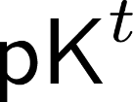

Overview of this talk
Probabilistic notions and some recent advances
Probabilistic versus deterministic
Two applications of to average-case complexity:
1. Worst-case complexity of easy-on-average problems
2. Worst-case to average-case reductions

Slide 14
Overview of this talk
Probabilistic notions and some recent advances
Probabilistic versus deterministic
Two applications of to average-case complexity:
1. Worst-case complexity of easy-on-average problems
2. Worst-case to average-case reductions

Slide 15


Probabilistic Notions of Kolmogorov Complexity

Slide 16
Probabilistic Notions of Kolmogorov Complexity
Definitions inspired by the notion of pseudodeterministic algorithm:
A randomized algorithm that produces the same output string w.h.p.

Slide 17
Probabilistic Notions of Kolmogorov Complexity
Definitions inspired by the notion of pseudodeterministic algorithm:
A randomized algorithm that produces the same output string w.h.p.
In Kolmogorov complexity terminology: probabilistic decompression

Slide 18

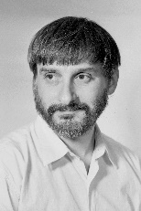

rKt complexity
Recall Levin Kolmogorov complexity:
$Kt\left(x\right)=$ $\min_{M, t }\left\{ \left|M\right|+\log{t} :M outputs x in≤t steps \right\}$

Slide 19
rKt complexity
Recall Levin Kolmogorov complexity:
$Kt\left(x\right)=$ $\min_{M, t }\left\{ \left|M\right|+\log{t} :M outputs x in≤t steps \right\}$
Randomized $Levin$ Kolmogorov complexity:
$$rKt\left(x\right)=\min_{Randomized M, t}\left\{ \left|M\right|+\log{t} :M outputs x in≤t steps with probability≥\frac{2}{3} \right\}$$

Slide 20




An unconditional lower bound
Is it hard to detect patterns?

Slide 21
An unconditional lower bound
Is it hard to detect patterns?

Slide 22
An unconditional lower bound
Is it hard to detect patterns?
Hirahara’s Recent Lower Bound

Slide 23
An unconditional lower bound
Is it hard to detect patterns?
Hirahara’s Recent Lower Bound
OPEN PROBLEM: Unify lower bounds!

Slide 24
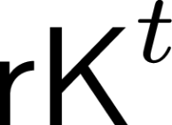
Fixed time bounds:
Recall $t$-time-bounded Kolmogorov complexity:
$$K^{t}\left(x\right)=\min_{M}\left\{\left|M\right| :M outputs x within t\left(\left|x\right|\right) steps\right\}$$

Slide 25
Fixed time bounds:
Recall $t$-time-bounded Kolmogorov complexity:
$$K^{t}\left(x\right)=\min_{M}\left\{\left|M\right| :M outputs x within t\left(\left|x\right|\right) steps\right\}$$
Randomized $t$-time-bounded Kolmogorov complexity:
$${rK}^{t}\left(x\right)=\min_{Randomized M}\left\{\left|M\right| :M runs in t\left(\left|x\right|\right) steps and outputs x with probability≥\frac{2}{3}\right\}$$

Slide 26

Succinct probabilistic representations

Slide 27
Succinct probabilistic representations

Slide 28
Succinct probabilistic representations
running time can be exponential

Slide 29
Succinct probabilistic representations
running time can be exponential
succinct and efficient representation

Slide 30
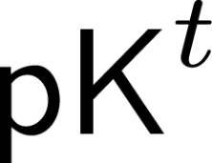

Slide 31
“Additional results are obtained for yet another variant of K. complexity.”
Anonymous reviewer

Slide 32
Probabilistic $t$-time-bounded Kolmogorov complexity [Goldberg-Kabanets-Lu-O’22]:
$${pK}^{t}\left(x\right)=\min_{k}\left\{ k : \underset{w∈{\left\{0,1\right\}}^{t\left(\left|x\right|\right)}}{Pr}\left[∃ M∈{\left\{0,1\right\}}^{k} s.t. M(w) outputs x within t\left(\left|x\right|\right) steps\right]≥\frac{2}{3}\right\}$$
For most $w$, there exists a small program, which can depend on $w,$ that outputs $x$

Slide 33
Probabilistic $t$-time-bounded Kolmogorov complexity [Goldberg-Kabanets-Lu-O’22]:
$${pK}^{t}\left(x\right)=\min_{k}\left\{ k : \underset{w∈{\left\{0,1\right\}}^{t\left(\left|x\right|\right)}}{Pr}\left[∃ M∈{\left\{0,1\right\}}^{k} s.t. M(w) outputs x within t\left(\left|x\right|\right) steps\right]≥\frac{2}{3}\right\}$$
For most $w$, there exists a small program, which can depend on $w,$ that outputs $x$
Randomized $t$-time-bounded Kolmogorov complexity:
$${rK}^{t}\left(x\right)=\min_{k}\left\{ k :∃ t\left(\left|x\right|\right) time program M∈{\left\{0,1\right\}}^{k} s.t. \underset{randomness of M}{Pr}\left[M outputs x\right]≥\frac{2}{3}\right\}$$
There exists a fixed small (randomized) program that outputs $x$ w.h.p over its internal randomness

Slide 34

Overview of this talk
Probabilistic notions and some recent advances
Probabilistic versus deterministic
Two applications of to average-case complexity:
1. Worst-case complexity of easy-on-average problems
2. Worst-case to average-case reductions

Slide 35
Overview of this talk
Probabilistic notions and some recent advances
Probabilistic versus deterministic
Two applications of to average-case complexity:
1. Worst-case complexity of easy-on-average problems
2. Worst-case to average-case reductions

Slide 36







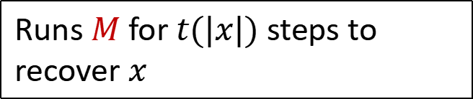
Probabilistic Kolmogorov Complexity
$$K^{t}\left(x\right)≤k$$
Resembles NP
$$M∈{\left\{0,1\right\}}^{k}$$
$${rK}^{t}\left(x\right)≤k$$
Resembles MA
$${pK}^{t}\left(x\right)≤k$$
Sends a program $M∈{\left\{0,1\right\}}^{k}$
Runs $M$ for $t(|x|)$ steps to recover $x$
Resembles AM

Slide 37

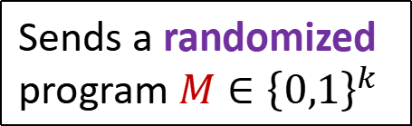


Probabilistic Kolmogorov Complexity
$$K^{t}\left(x\right)≤k$$
Resembles NP
$$M∈{\left\{0,1\right\}}^{k}$$
$${rK}^{t}\left(x\right)≤k$$
Resembles MA
$${pK}^{t}\left(x\right)≤k$$
Sends a randomized program $M∈{\left\{0,1\right\}}^{k}$
Runs $M$ for $t$(|$x$|) steps to recover $x$ with high probability
Resembles AM

Slide 38


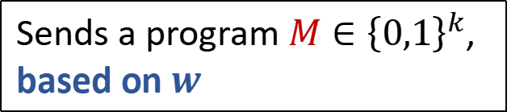

Probabilistic Kolmogorov Complexity
$$K^{t}\left(x\right)≤k$$
Shared randomness $w∈{\left\{0,1\right\}}^{t}$
Resembles NP
$$M∈{\left\{0,1\right\}}^{k}$$
$${rK}^{t}\left(x\right)≤k$$
Resembles MA
$${pK}^{t}\left(x\right)≤k$$
Sends a program $M∈{\left\{0,1\right\}}^{k}$, based on $w$
Runs $M(w)$ for $t$(|$x$|) steps to recover $x$
Resembles AM

Slide 39

Time-Bounded Kolmogorov Complexity
Proposition: For every $x$ and $t$,
$K\left(x\right)≲$ ${pK}^{t}\left(x\right)≤{rK}^{t}\left(x\right)≤K^{t}\left(x\right)$
AM$⊇$MA $⊇$NP

Slide 40
Time-Bounded Kolmogorov Complexity
Proposition: For every $x$ and $t$,
$K\left(x\right)≲$ ${pK}^{t}\left(x\right)≤{rK}^{t}\left(x\right)≤K^{t}\left(x\right)$
AM$⊇$MA $⊇$NP
Proposition: For every $x$ and $t$,
$K^{poly(t)}\left(x\right)≤{rK}^{t}\left(x\right)+O(\log{t)}$ if E $⊈i.o.SIZE\left[2^{Ω(n)}\right]$
Derandomizing MA (to NP)
$K^{poly(t)}\left(x\right)≤{pK}^{t}\left(x\right)+O(\log{t)}$if E $⊈i.o.NSIZE\left[2^{Ω(n)}\right]$
Derandomizing AM (to NP)
${rK}^{poly(t)}\left(x\right)≤{pK}^{t}\left(x\right)+O(\log{t)}$ if BPE $⊈i.o.NSIZE\left[2^{Ω(n)}\right]$
Converting AM to MA

Slide 41


Slide 42
But theory can be independently developed (unconditional results, simpler proofs, new applications, etc.)

Slide 43
Overview of this talk
Probabilistic notions and some recent advances
Probabilistic versus deterministic
Two applications of to average-case complexity:
1. Worst-case complexity of easy-on-average problems
2. Worst-case to average-case reductions

Slide 44
Overview of this talk
Probabilistic notions and some recent advances
Probabilistic versus deterministic
Two applications of to average-case complexity:
1. Worst-case complexity of easy-on-average problems
2. Worst-case to average-case reductions

Slide 45
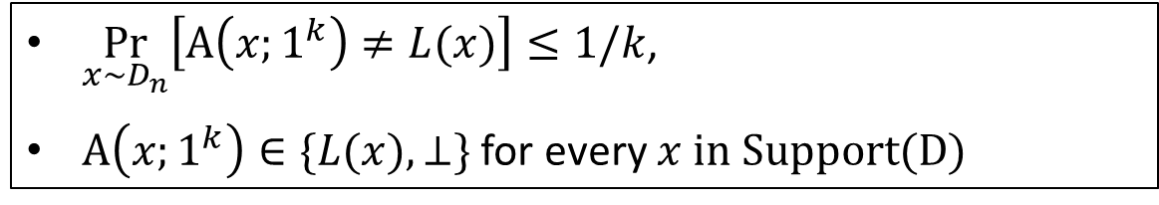

Average-case Complexity
A problem $L$ is solvable in average-case polynomial time w.r.t a distribution family $D={\{D_{n}\}}_{n} if$there is a poly-time algorithm A such that:
$\underset{x∼D_{n}}{Pr}\left[A\left(x;1^{k}\right)≠L(x)\right]≤1/k$,
$A\left(x;1^{k}\right)∈\{L(x),⊥\}$for every $x in Support(D)$
($L,D$) $∈$ AvgP

Slide 46

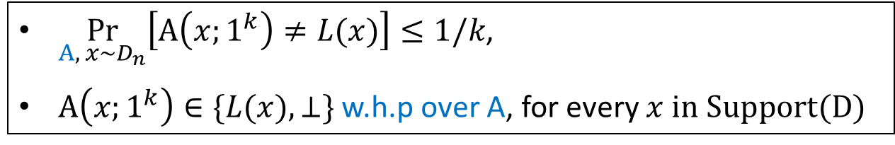
Average-case Complexity
A problem $L$ is solvable in average-case polynomial time w.r.t a distribution family $D={\{D_{n}\}}_{n} if$there is a poly-time algorithm A such that:
$\underset{x∼D_{n}}{Pr}\left[A\left(x;1^{k}\right)≠L(x)\right]≤1/k$,
$A\left(x;1^{k}\right)∈\{L(x),⊥\}$for every $x in Support(D)$
($L,D$) $∈$ AvgP
A language $L$ is solvable in randomized average-case polynomial time w.r.t a distribution family $D={\{D_{n}\}}_{n} if$ there is a poly-time randomized algorithm A such that:
$\underset{A, x∼D_{n}}{Pr}\left[A\left(x;1^{k}\right)≠L(x)\right]≤1/k$,
$A\left(x;1^{k}\right)∈\{L(x),⊥\}$ w.h.p over A, for every $x in Support(D)$
($L,D$) $∈$ AvgBPP

Slide 47
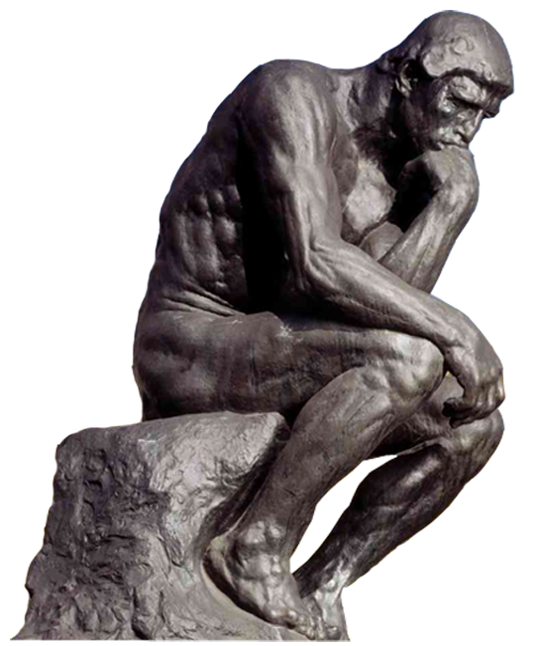
Worst-case Running Times for Average-case Problems
If L is solvable in average-case polynomial time w.r.t to all poly-time samplable distributions, what can we say about the time needed to solve L in the worst case?

Slide 48
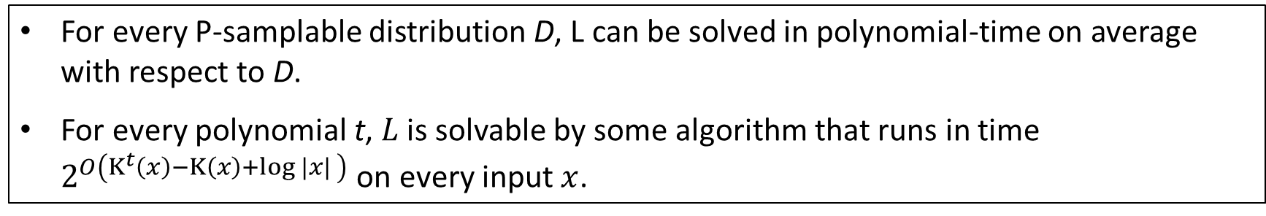
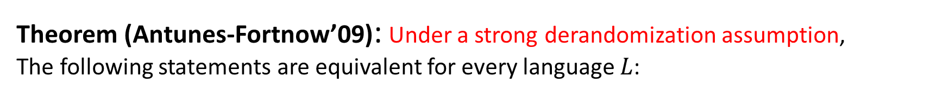
Worst-case Running Times for Average-case Problems
Theorem (Antunes-Fortnow’09): Under a strong derandomization assumption,
The following statements are equivalent for every language $L$:
For every P-samplable distribution D, L can be solved in polynomial-time on average with respect to D.
For every polynomial t, $L$ is solvable by some algorithm that runs in time $2^{O\left(K^{t}\left(x\right)−K\left(x\right)+\log{|x| }\right)}$ on every input $x$.
$K^{t}\left(x\right)−K\left(x\right)$ is called the $t$-computational depth of $x$

Slide 49
Worst-case Running Times for Average-case Problems
Theorem (Antunes-Fortnow’09): Under a strong derandomization assumption,
The following statements are equivalent for every language $L$:
For every P-samplable distribution D, L can be solved in polynomial-time on average with respect to D.
For every polynomial t, $L$ is solvable by some algorithm that runs in time $2^{O\left(K^{t}\left(x\right)−K\left(x\right)+\log{|x| }\right)}$ on every input $x$.
$K^{t}\left(x\right)−K\left(x\right)$ is called the $t$-computational depth of $x$

Slide 50
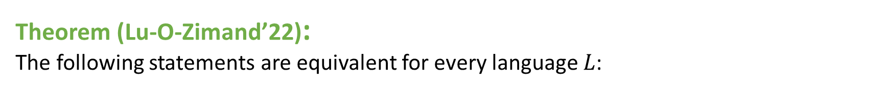
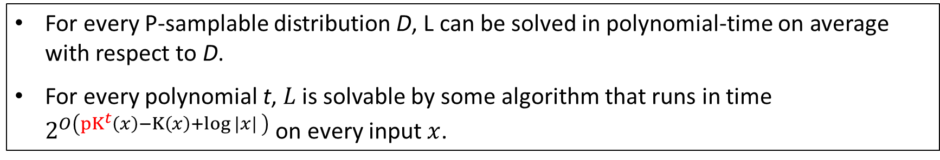
Worst-case Running Times for Average-case Problems
Theorem (Lu-O-Zimand’22):
The following statements are equivalent for every language $L$:
For every P-samplable distribution D, L can be solved in polynomial-time on average with respect to D.
For every polynomial t, $L$ is solvable by some algorithm that runs in time $2^{O\left({pK}^{t}\left(x\right)−K\left(x\right)+\log{|x| }\right)}$ on every input $x$.
${pK}^{t}\left(x\right)−K\left(x\right)$ is the $t$-probabilistic computational depth of $x$

Slide 51
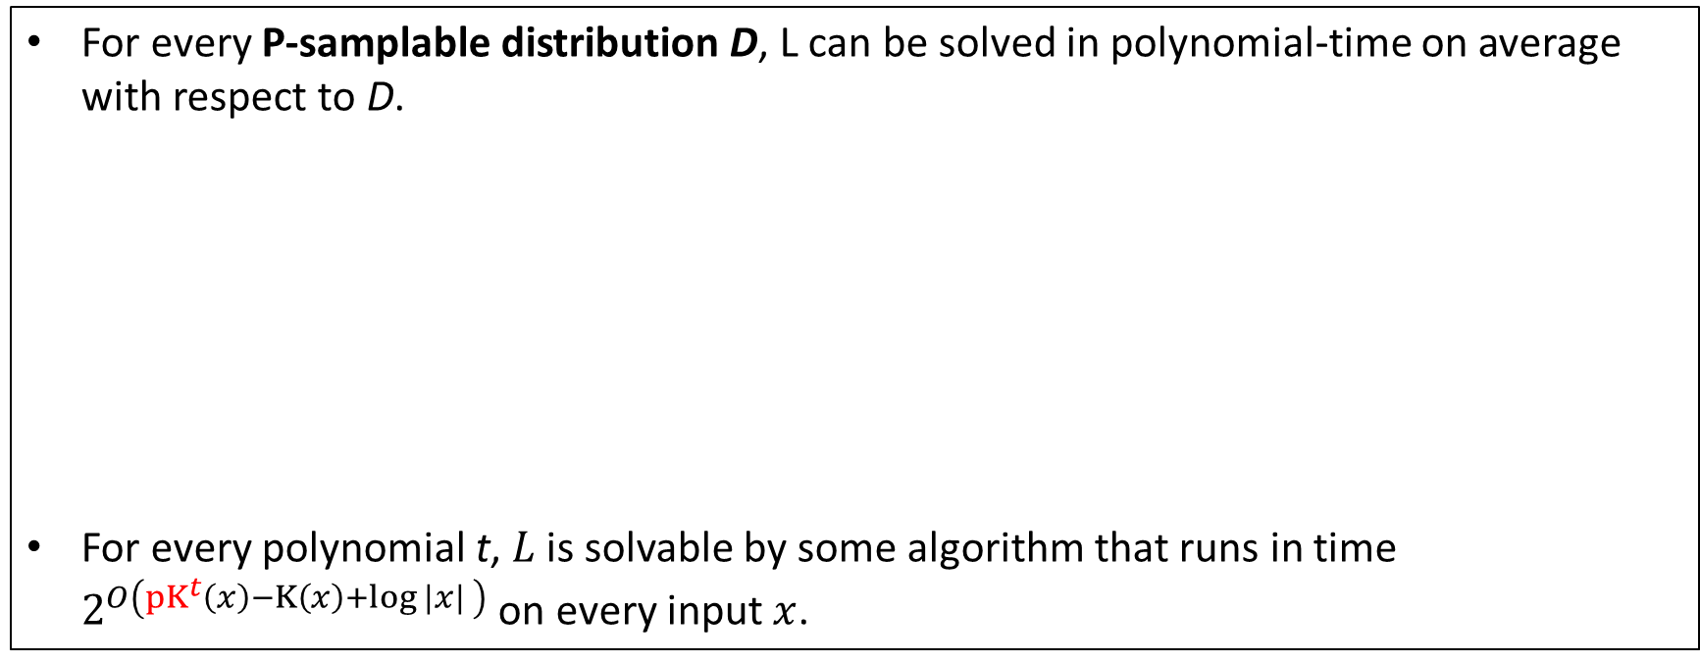
A useful ingredient of the proof
For every P-samplable distribution D, L can be solved in polynomial-time on average with respect to D.
For every polynomial t, $L$ is solvable by some algorithm that runs in time $2^{O\left({pK}^{t}\left(x\right)−K\left(x\right)+\log{|x| }\right)}$ on every input $x$.

Slide 52

A useful ingredient of the proof
For every P-samplable distribution D, L can be solved in polynomial-time on average with respect to D.
For every polynomial t, $L$ is solvable by some algorithm that runs in time $2^{O\left({pK}^{t}\left(x\right)−K\left(x\right)+\log{|x| }\right)}$ on every input $x$.
(Informal) For every polynomial t, L can be solved in polynomial-time on average with respect to

Slide 53
A useful ingredient of the proof
For every P-samplable distribution D, L can be solved in polynomial-time on average with respect to D.
For every polynomial t, $L$ is solvable by some algorithm that runs in time $2^{O\left({pK}^{t}\left(x\right)−K\left(x\right)+\log{|x| }\right)}$ on every input $x$.
(Informal) For every polynomial t, L can be solved in polynomial-time on average with respect to
The link between samplable distributions and the “universal” distribution is obtained by a “Coding Theorem”

Slide 54
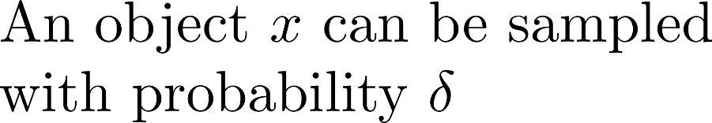
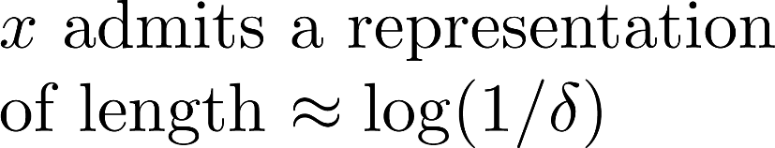

Optimal coding theorem for pK^{t}
[Lu-O-Zimand’22]
Coding Theorem in Kolmogorov Complexity
We want an efficient version of the coding lemma.

Slide 55
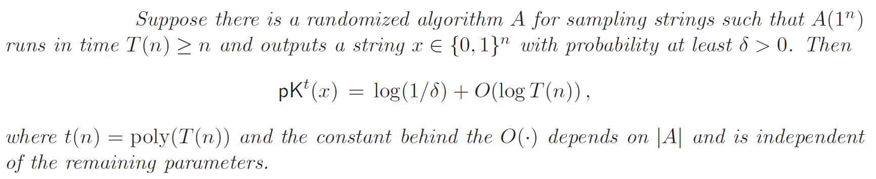

Optimal coding theorem for pK^{t}
[Lu-O-Zimand’22]
Coding Theorem in Kolmogorov Complexity
We want an efficient version of the coding lemma.

Slide 56
Optimal coding theorem for pK^{t}
[Lu-O-Zimand’22]
Coding Theorem in Kolmogorov Complexity
We want an efficient version of the coding lemma.
OPEN PROBLEMS: Optimal coding theorems for rKt and rK^{t}

Slide 57
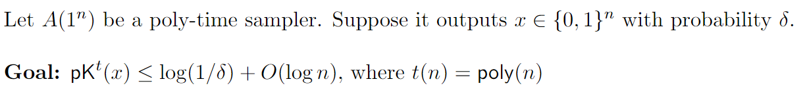

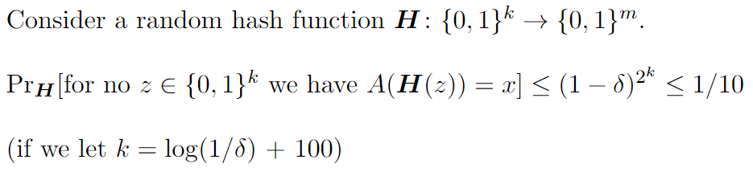

Proof sketch: Coding Theorem for pK^{t}
(adapting Antunes-Fortnow)

Slide 58
Back to equivalence result
For every P-samplable distribution D, L can be solved in polynomial-time on average with respect to D.
For every polynomial t, $L$ is solvable by some algorithm that runs in time $2^{O\left({pK}^{t}\left(x\right)−K\left(x\right)+\log{|x| }\right)}$ on every input $x$.
Optimal Coding Theorem for pK^{t}
(Informal) For every polynomial t, L can be solved in polynomial-time on average with respect to
Time-bounded variant of result from Kolmogorov complexity

Slide 59
Overview of this talk
Probabilistic notions and some recent advances
Probabilistic versus deterministic
Two applications of to average-case complexity:
1. Worst-case complexity of easy-on-average problems
2. Worst-case to average-case reductions

Slide 60
Overview of this talk
Probabilistic notions and some recent advances
Probabilistic versus deterministic
Two applications of to average-case complexity:
1. Worst-case complexity of easy-on-average problems
2. Worst-case to average-case reductions

Slide 61
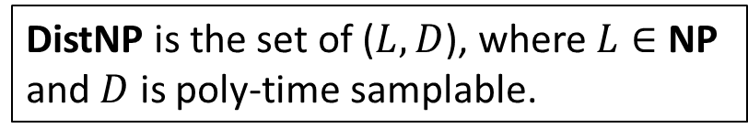

Worst-case to Average-case Reductions
Is NP solvable in average-case polynomial time?
DistNP is the set of ($L,D$), where $L∈$ NP and $D$ is poly-time samplable.
Is DistNP $⊆$ AvgP?

Slide 62


Worst-case to Average-case Reductions
Does worst-case hardness of NP imply average-case hardness of NP?
?
NP $≠$ P
DistNP $⊈$ AvgP
This is called a worst-case to average-case reduction.

Slide 63



Worst-case to Average-case Reductions
?
DistNP $⊆$ AvgP
NP $=$ P
Theorem (Ben-David, Chor, Goldreich, Luby’ 92):
DistNP $⊆$ AvgP imples NP $⊆$ E $=DTIME\left[2^{O(n)}\right]$

Slide 64
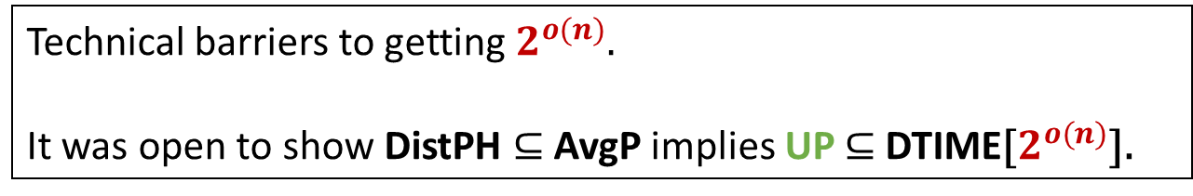
Worst-case to Average-case Reductions
?
DistNP $⊆$ AvgP
NP $=$ P
Theorem (Ben-David, Chor, Goldreich, Luby’ 92):
DistNP $⊆$ AvgP imples NP $⊆$ E $=DTIME\left[2^{O(n)}\right]$
Technical barriers to getting $2^{o(n)}$.
It was open to show DistPH $⊆$ AvgP implies UP $⊆$ DTIME[$2^{o(n)}$].

Slide 65


Worst-case to Average-case Reductions
Theorem (Hirahara’21):
DistNP $⊆$ AvgP
UP $⊆DTIME\left[2^{O(n/\log{n) }}\right]$

Slide 66
Worst-case to Average-case Reductions
Theorem (Hirahara’21):
DistNP $⊆$ AvgP
UP $⊆DTIME\left[2^{O(n/\log{n) }}\right]$
“Your strength is also your weakness”

Slide 67



Worst-case to Average-case Reductions
Theorem (Hirahara’21):
DistNP $⊆$ AvgP
UP $⊆DTIME\left[2^{O(n/\log{n) }}\right]$
“Your strength is also your weakness”
This proof does not immediately extend to the randomized setting!
?
DistNP $⊆$ AvgBPP
UP $⊆BPTIME\left[2^{O(n/\log{n) }}\right]$

Slide 68
Worst-case to Average-case Reductions
Why care about randomized average-case complexity?
Gives a more robust theory; simpler hardness proofs
(NP, U) $⊆$ AvgBPP $⟺$ DistNP $⊆$ AvgBPP, where U is the uniform distribution [Impagliazzo-Levin’90].

Slide 69
Worst-case to Average-case Reductions
Why care about randomized average-case complexity?
Gives a more robust theory; simpler hardness proofs
(NP, U) $⊆$ AvgBPP $⟺$ DistNP $⊆$ AvgBPP, where U is the uniform distribution [Impagliazzo-Levin’90].
More relevant to cryptography
?
?
NP is worst-case hard
NP is average-case hard
Cryptography exists

Slide 70


Worst-case to Average-case Reductions
Why care about randomized average-case complexity?
Gives a more robust theory; simpler hardness proofs
(NP, U) $⊆$ AvgBPP $⟺$ DistNP $⊆$ AvgBPP, where U is the uniform distribution [Impagliazzo-Levin’90].
More relevant to cryptography
?
?
NP is worst-case hard
NP is average-case hard
Cryptography exists
NP $⊈$ BPP
DistNP $⊈$ AvgBPP
One-way functions exist
(against probabilistic adversaries)

Slide 71




Worst-case to Average-case Reductions
Theorem (Hirahara’21):
DistNP $⊆$ AvgP
UP $⊆DTIME\left[2^{O(n/\log{n) }}\right]$
Theorem (Goldberg-Kabanets-Lu-O’22):
DistNP $⊆$ AvgBPP
UP $⊆RTIME\left[2^{O(n/\log{n) }}\right]$

Slide 72


Worst-case to Average-case Reductions
Theorem (Hirahara’21):
Extensions to NP and PH:
DistNP $⊆$ AvgP
UP $⊆DTIME\left[2^{O(n/\log{n) }}\right]$
Dist$Σ_{2}$ $⊆$ AvgP imples NP $⊆DTIME\left[2^{O(n/\log{n) }}\right]$
DistPH $⊆$ AvgP imples PH $⊆DTIME\left[2^{O(n/\log{n) }}\right]$
Theorem (Goldberg-Kabanets-Lu-O’22):
DistNP $⊆$ AvgBPP
UP $⊆RTIME\left[2^{O(n/\log{n) }}\right]$
Dist$Σ_{2}$ $⊆$ AvgBPP imples NP $⊆RTIME\left[2^{O(n/\log{n) }}\right]$
DistPH $⊆$ AvgBPP imples PH $⊆BPTIME\left[2^{O(n/\log{n) }}\right]$

Slide 73

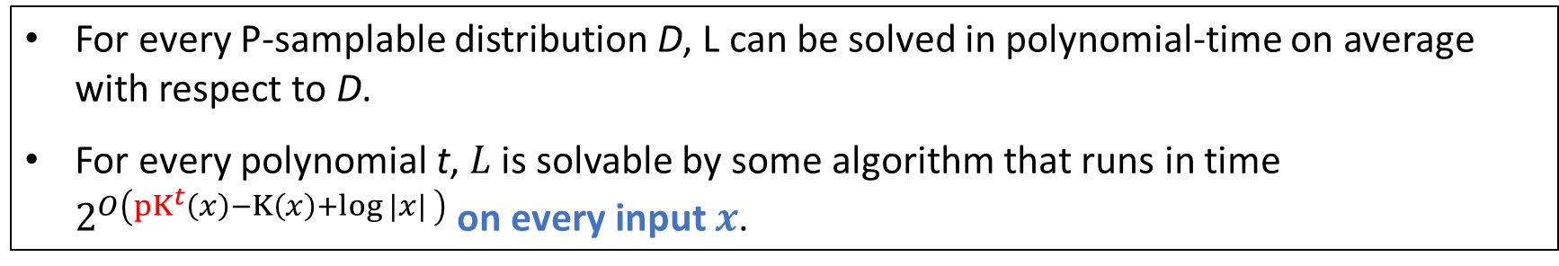

Some intuition and the role of pK^{t}
Recall:
DistNP $⊆$ AvgBPP
UP $⊆RTIME\left[2^{O(n/\log{n) }}\right]$
For every P-samplable distribution D, L can be solved in polynomial-time on average with respect to D.
For every polynomial t, $L$ is solvable by some algorithm that runs in time $2^{O\left({pK}^{t}\left(x\right)−K\left(x\right)+\log{|x| }\right)}$ on every input $x$.

Slide 74
Some intuition and the role of pK^{t}
Recall:
DistNP $⊆$ AvgBPP
UP $⊆RTIME\left[2^{O(n/\log{n) }}\right]$
For every P-samplable distribution D, L can be solved in polynomial-time on average with respect to D.
For every polynomial t, $L$ is solvable by some algorithm that runs in time $2^{O\left({pK}^{t}\left(x\right)−K\left(x\right)+\log{|x| }\right)}$ on every input $x$.
Together with other ideas, this motivates the study of pK^{t} upper bounds for objects of interest (e.g., satisfying assignment y)

Slide 75
Some intuition and the role of pK^{t}
Recall:
DistNP $⊆$ AvgBPP
UP $⊆RTIME\left[2^{O(n/\log{n) }}\right]$
For every P-samplable distribution D, L can be solved in polynomial-time on average with respect to D.
For every polynomial t, $L$ is solvable by some algorithm that runs in time $2^{O\left({pK}^{t}\left(x\right)−K\left(x\right)+\log{|x| }\right)}$ on every input $x$.
How to obtain upper bounds on Kolmogorov complexity?
Together with other ideas, this motivates the study of pK^{t} upper bounds for objects of interest (e.g., satisfying assignment y)

Slide 76
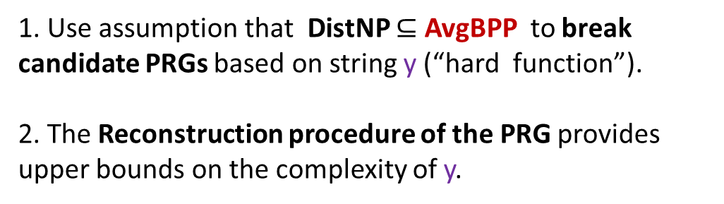
Some intuition and the role of pK^{t}
Recall:
DistNP $⊆$ AvgBPP
UP $⊆RTIME\left[2^{O(n/\log{n) }}\right]$
For every P-samplable distribution D, L can be solved in polynomial-time on average with respect to D.
For every polynomial t, $L$ is solvable by some algorithm that runs in time $2^{O\left({pK}^{t}\left(x\right)−K\left(x\right)+\log{|x| }\right)}$ on every input $x$.
How to obtain upper bounds on Kolmogorov complexity?
Established approach based on pseudorandomness
Together with other ideas, this motivates the study of pK^{t} upper bounds for objects of interest (e.g., satisfying assignment y)
1. Use assumption that DistNP $⊆$ AvgBPP to break candidate PRGs based on string y (“hard function”).
2. The Reconstruction procedure of the PRG provides upper bounds on the complexity of y.

Slide 77
Why pK^{t} ?
Key idea behind [Hirahara’21]:
An efficient average-case algorithm for NP (yields a “distinguisher”)
+
Reconstruction procedure of a certain generator constructed from a target string
This reconstruction procedure is randomized and requires a “small” amount of advice.

Slide 78
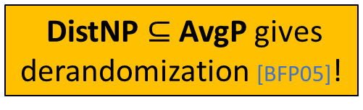
Why pK^{t} ?
Key idea behind [Hirahara’21]:
An efficient average-case algorithm for NP (yields a “distinguisher”)
+
Reconstruction procedure of a certain generator constructed from a target string
This reconstruction procedure is randomized and requires a “small” amount of advice.
DistNP $⊆$ AvgP gives derandomization [BFP05]!

Slide 79
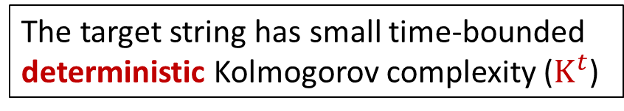
Why pK^{t} ?
Key idea behind [Hirahara’21]:
An efficient average-case algorithm for NP (yields a “distinguisher”)
The target string has small time-bounded deterministic Kolmogorov complexity ($K^{t}$)
+
Reconstruction procedure of a certain generator constructed from a target string
This reconstruction procedure is randomized and requires a “small” amount of advice.
DistNP $⊆$ AvgP gives derandomization [BFP05]!

Slide 80
Why pK^{t} ?
Assuming only DistNP $⊆$ AvgBPP:
An efficient randomized average-case algorithm for NP (randomized distinguisher)
+
Reconstruction procedure of a certain generator constructed from a target string
This reconstruction procedure is randomized and requires a “small” amount of advice. The advice depends on the randomness.
DistNP $⊆$ AvgP gives derandomization [BFP05]!

Slide 81

Why pK^{t} ?
Assuming only DistNP $⊆$ AvgBPP:
An efficient randomized average-case algorithm for NP (randomized distinguisher)
+
Reconstruction procedure of a certain generator constructed from a target string
This reconstruction procedure is randomized and requires a “small” amount of advice. The advice depends on the randomness.
DistNP $⊆$ AvgP gives derandomization [BFP05]!

Slide 82
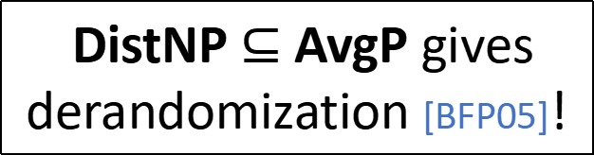
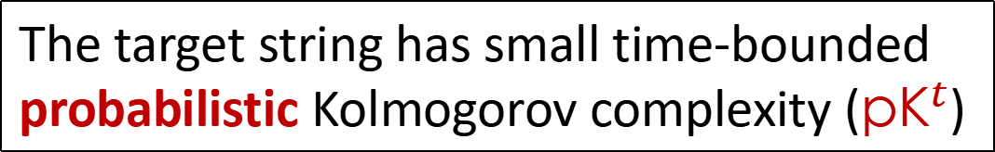
Why pK^{t} ?
Assuming only DistNP $⊆$ AvgBPP:
An efficient randomized average-case algorithm for NP (randomized distinguisher)
The target string has small time-bounded probabilistic Kolmogorov complexity (${pK}^{t}$)
+
Reconstruction procedure of a certain generator constructed from a target string
This reconstruction procedure is randomized and requires a “small” amount of advice. The advice depends on the randomness.
DistNP $⊆$ AvgP gives derandomization [BFP05]!

Slide 83
Summary
Probabilistic notions and some recent advances
Probabilistic versus deterministic
Two applications of to average-case complexity:
1. Worst-case complexity of easy-on-average problems
2. Worst-case to average-case reductions

Slide 84
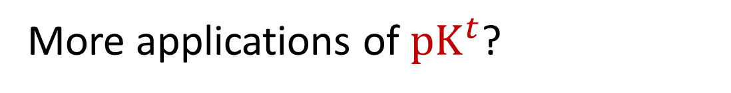
Additional Problems and Directions
Useful measure when analysing PRG reconstruction
More applications of ${pK}^{t}$?
Optimal coding theorem

Slide 85
Additional Problems and Directions
Useful measure when analysing PRG reconstruction
More applications of ${pK}^{t}$?
Optimal coding theorem
[Lu-O-Santhanam’21] There are $n$-bit primes $p$ such that ${rK}^{poly}(p)≤n^{ε}$.
Q. Can we show that there are $n$-bit primes $p$ such that ${pK}^{poly}(p)≤polylog(n)$?

Slide 86
Additional Problems and Directions
Useful measure when analysing PRG reconstruction
More applications of ${pK}^{t}$?
Optimal coding theorem
[Lu-O-Santhanam’21] There are $n$-bit primes $p$ such that ${rK}^{poly}(p)≤n^{ε}$.
Q. Can we show that there are $n$-bit primes $p$ such that ${pK}^{poly}(p)≤polylog(n)$?
Investigate zero-error probabilistic Kolmogorov complexity and its applications

Slide 87
Survey
Theory and Applications of Probabilistic Kolmogorov Complexity [Lu-O’22]
Bulletin of EATCS No 137 (The Computational Complexity Column), 2022.
Thank you!

