Slide 1
An Upper Bound on the GKS Game via Max Bipartite Matching
DeVon Ingram (Georgia Institute of Technology)

Slide 2
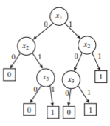
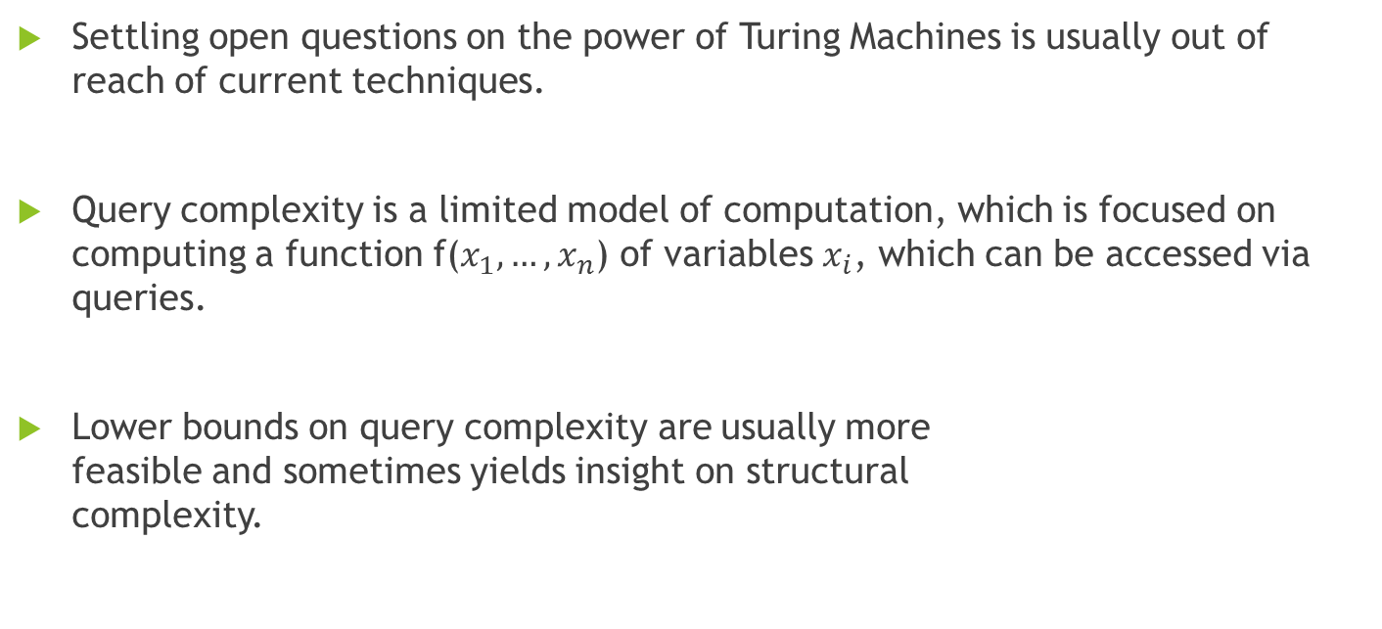
A Brief Introduction to Query Complexity
Settling open questions on the power of Turing Machines is usually out of reach of current techniques.
Query complexity is a limited model of computation, which is focused on computing a function f($x_{1},…,x_{n}$) of variables $x_{i}$, which can be accessed via queries.
Lower bounds on query complexity are usually more feasible and sometimes yields insight on structural complexity.

Slide 3
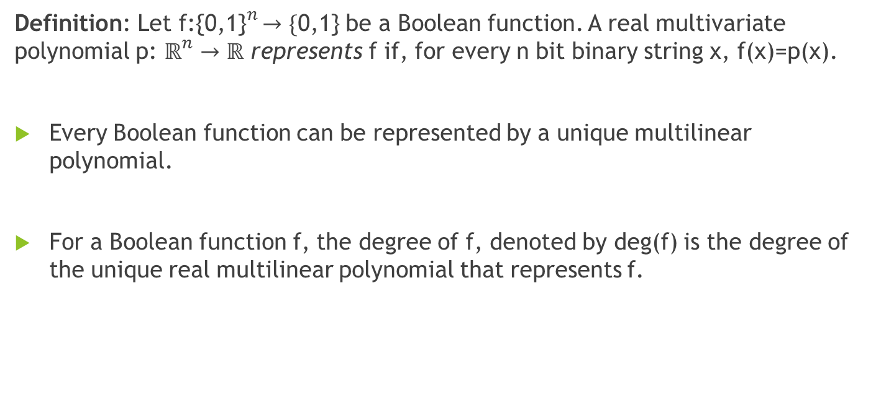
Multilinear Polynomial Degree
Definition: Let f${\text{:\{0,1\}}}^{n}→\{\text{0,1\}}$ be a Boolean function. A real multivariate polynomial p: ${\text{ℝ}}^{n}→ℝ$ represents f if, for every n bit binary string x, f(x)=p(x).
Every Boolean function can be represented by a unique multilinear polynomial.
For a Boolean function f, the degree of f, denoted by deg(f) is the degree of the unique real multilinear polynomial that represents f.

Slide 4
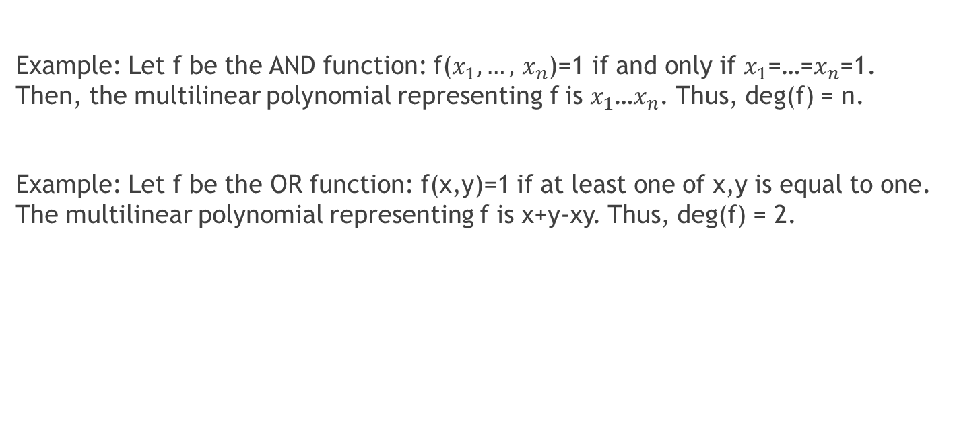
Multilinear Polynomial Degree (cont.)
Example: Let f be the AND function: f($x_{1},…,$ $x_{n}$)=1 if and only if $x_{1}$=…=$x_{n}$=1. Then, the multilinear polynomial representing f is $x_{1}$…$x_{n}$. Thus, deg(f) = n.
Example: Let f be the OR function: f(x,y)=1 if at least one of x,y is equal to one. The multilinear polynomial representing f is x+y-xy. Thus, deg(f) = 2.

Slide 5
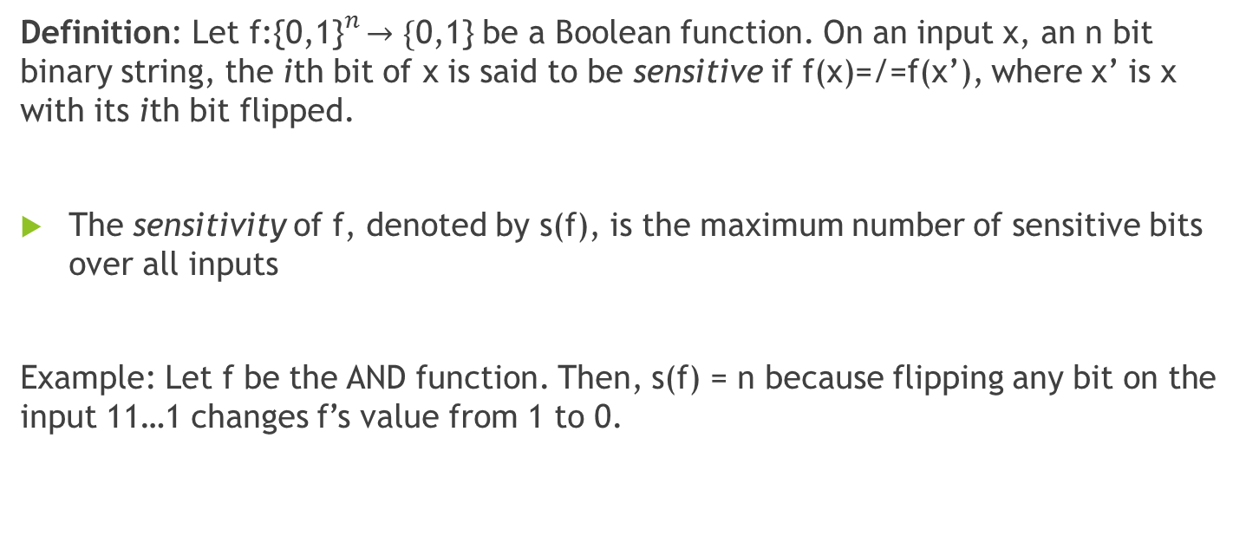
Sensitivity
Definition: Let f${\text{:\{0,1\}}}^{n}→\{\text{0,1\}}$ be a Boolean function. On an input x, an n bit binary string, the ith bit of x is said to be sensitive if f(x)=/=f(x’), where x’ is x with its ith bit flipped.
The sensitivity of f, denoted by s(f), is the maximum number of sensitive bits over all inputs
Example: Let f be the AND function. Then, s(f) = n because flipping any bit on the input 11…1 changes f’s value from 1 to 0.

Slide 6
The Sensitivity Conjecture
Conjecture: Let f be an arbitrary Boolean function. Then, deg(f)≤poly(s(f)).
Since it is known that s(f)≤poly(deg(f)), the conjecture essentially states that multilinear polynomial degree and sensitivity are polynomially related, that is deg(f)≤poly(s(f)) and s(f)≤poly(deg(f)).
If the conjecture is true, then sensitivity is also polynomially related to several other query complexity measures.

Slide 7
The GKS Game
A reformulation of the sensitivity conjecture in terms of a cooperative two-player communication game.
A polynomial lower bound on the cost of the game implies a polynomial upper bound on multilinear polynomial degree in terms of sensitivity.
Alice and Bob attempt to come up with a protocol to identify an adversarially chosen bit in a Boolean array with maximum certainty.

Slide 8
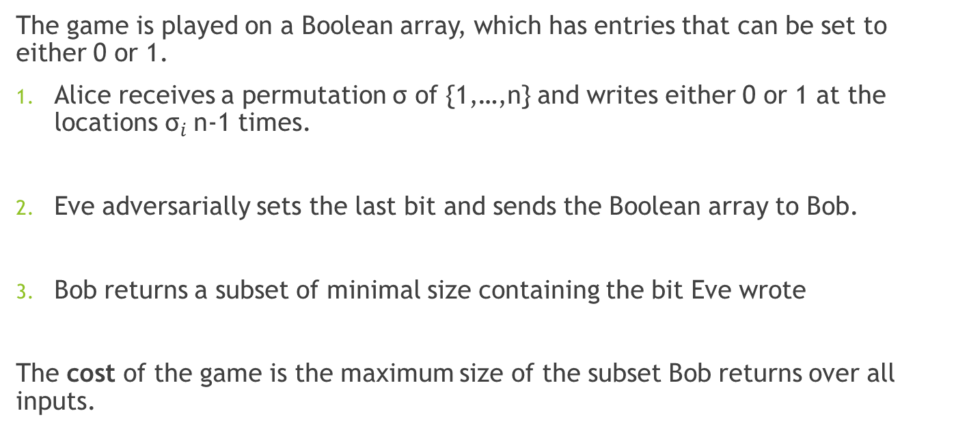
The GKS Game (cont.)
The game is played on a Boolean array, which has entries that can be set to either 0 or 1.
Alice receives a permutation σ of {1,…,n} and writes either 0 or 1 at the locations ${\text{σ}}_{i}$n-1 times.
Eve adversarially sets the last bit and sends the Boolean array to Bob.
Bob returns a subset of minimal size containing the bit Eve wrote
The cost of the game is the maximum size of the subset Bob returns over all inputs.

Slide 9
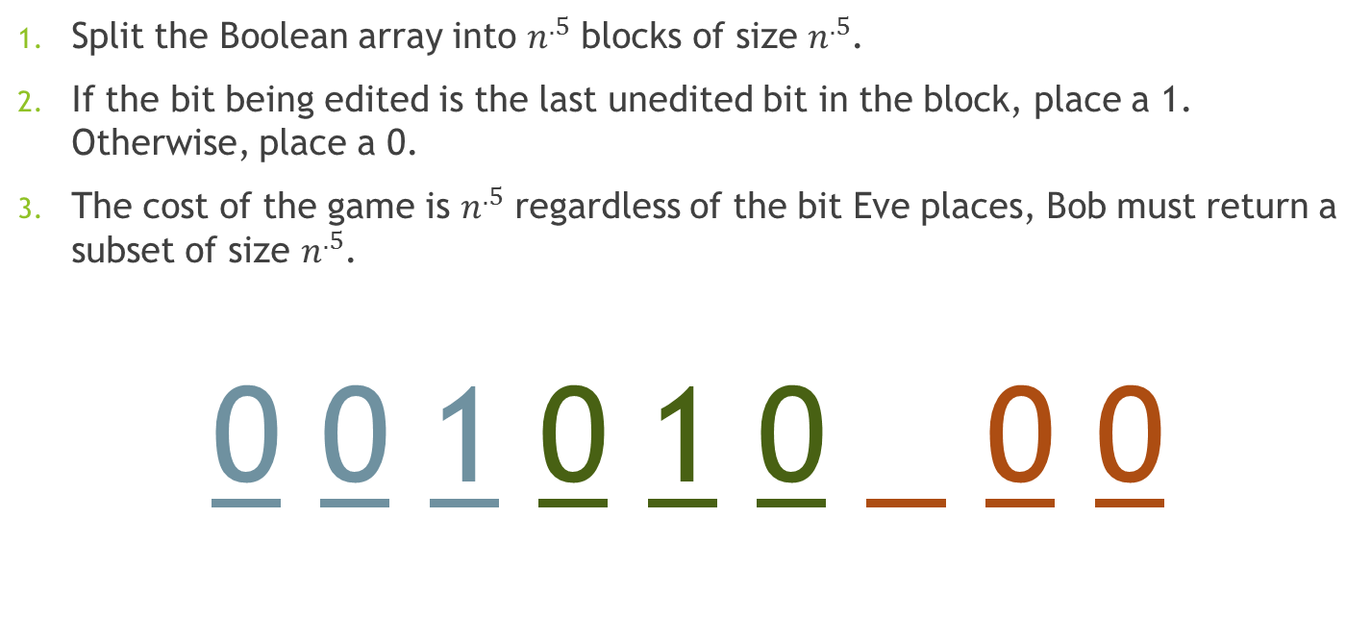
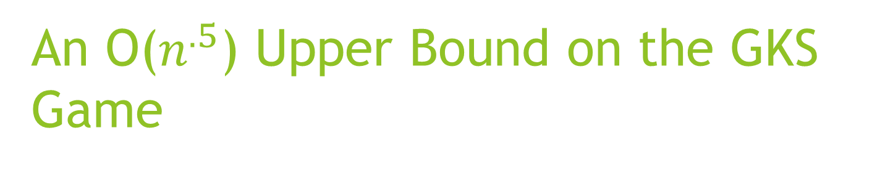
An O($n^{.5}$) Upper Bound on the GKS Game
Split the Boolean array into $n^{.5}$ blocks of size $n^{.5}$.
If the bit being edited is the last unedited bit in the block, place a 1. Otherwise, place a 0.
The cost of the game is $n^{.5}$ regardless of the bit Eve places, Bob must return a subset of size $n^{.5}$.
0 0 1 0 1 0 0 0

Slide 10
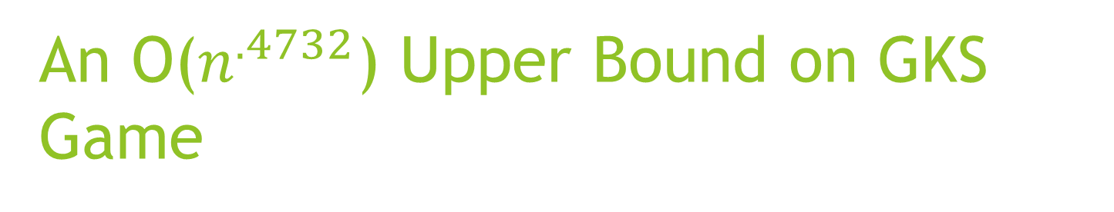
An O($n^{.4732}$) Upper Bound on GKS Game
Main idea: split up the Boolean array into blocks and place codewords in each block.
Definition (Szegedy): Suppose that the GKS game is played on a Boolean array of length n. A (k,n) strategy for the GKS game is a strategy such that the size of the subset returned by Bob is at most k over all inputs.
Theorem (Szegedy): If (k,n) and (x,y) strategies exist, then there exists a (kx,ny) strategy.

Slide 11
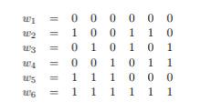
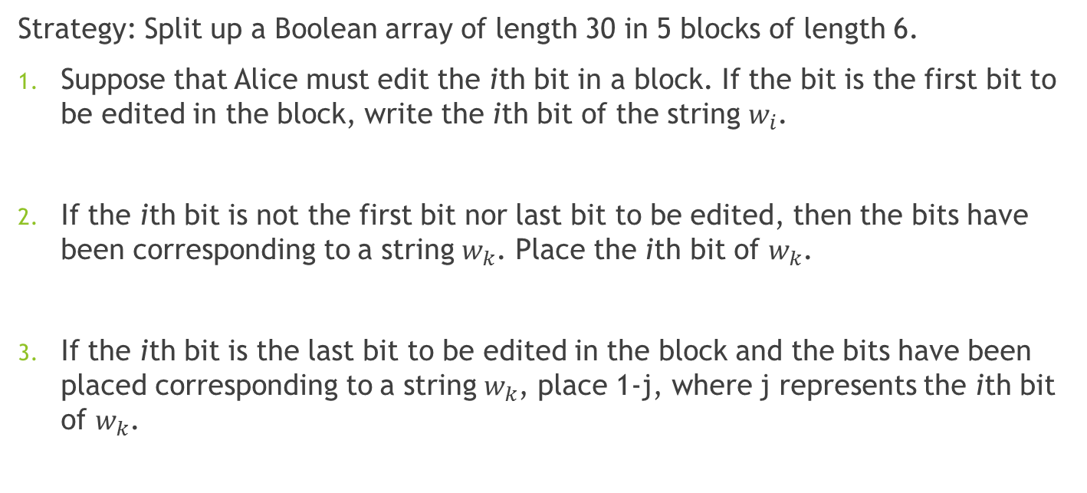
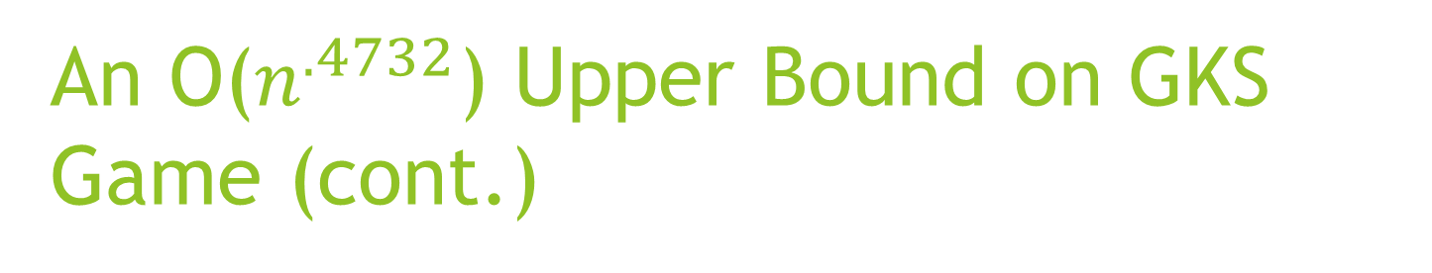
An O($n^{.4732}$) Upper Bound on GKS Game (cont.)
Strategy: Split up a Boolean array of length 30 in 5 blocks of length 6.
Suppose that Alice must edit the ith bit in a block. If the bit is the first bit to be edited in the block, write the ith bit of the string $w_{i}$.
If the ith bit is not the first bit nor last bit to be edited, then the bits have been corresponding to a string $w_{k}$. Place the ith bit of $w_{k}$.
If the ith bit is the last bit to be edited in the block and the bits have been placed corresponding to a string $w_{k}$, place 1-j, where j represents the ith bit of $w_{k}$.

Slide 12
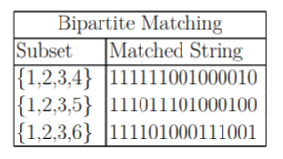
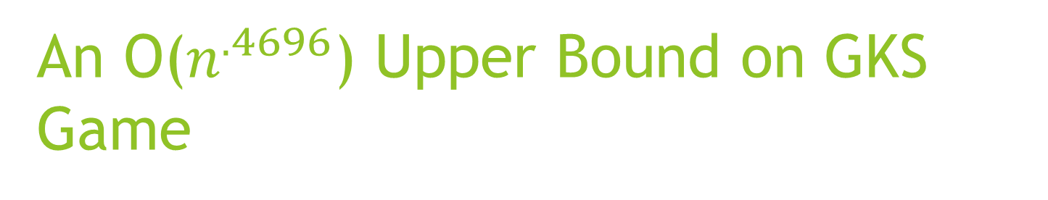
An O($n^{.4696}$) Upper Bound on GKS Game
Main idea: Split up Boolean array into blocks and place codewords into each block. However, instead of using only one bit to uniquely identify a Hamming codeword, use several bits to uniquely identify Hamming Codewords.
Problem is reduced to finding a bipartite matching between subsets of {1,…,m} and Hamming codewords
A matching was found between subsets of size 4 and Hamming codewords of length 15.

Slide 13
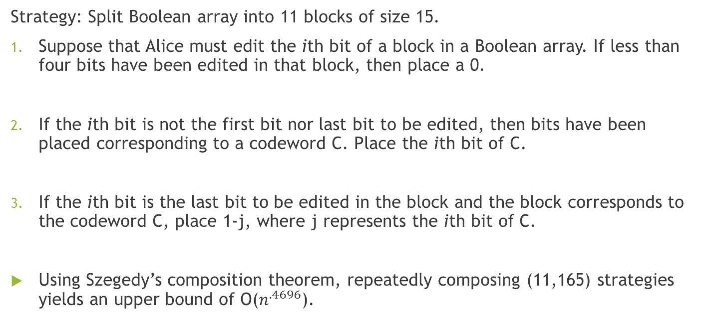
An O($n^{.4696}$) Upper Bound on GKS Game
Strategy: Split Boolean array into 11 blocks of size 15.
Suppose that Alice must edit the ith bit of a block in a Boolean array. If less than four bits have been edited in that block, then place a 0.
If the ith bit is not the first bit nor last bit to be edited, then bits have been placed corresponding to a codeword C. Place the ith bit of C.
If the ith bit is the last bit to be edited in the block and the block corresponds to the codeword C, place 1-j, where j represents the ith bit of C.
Using Szegedy’s composition theorem, repeatedly composing (11,165) strategies yields an upper bound of O($n^{.4696}$).

Slide 14
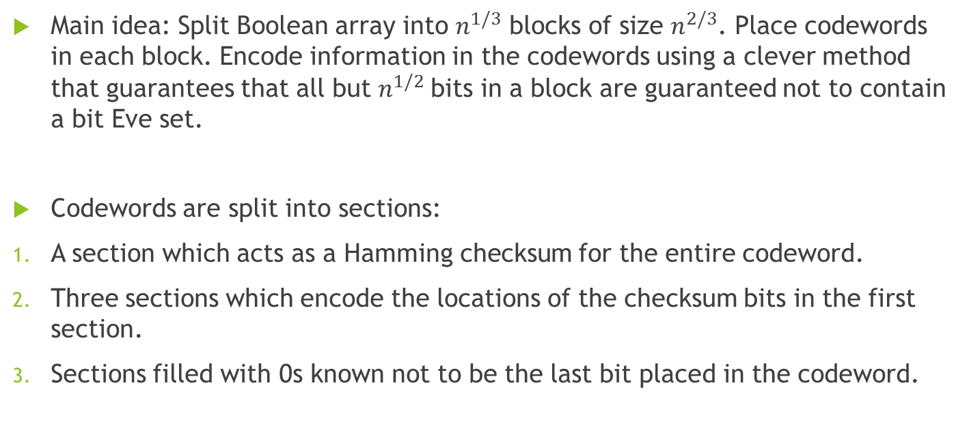
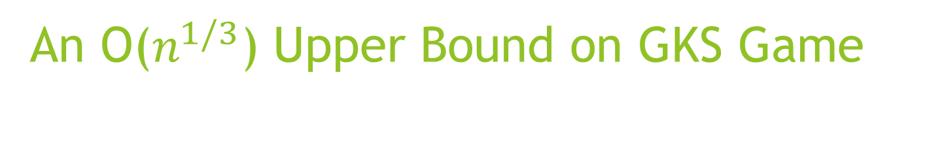
An O($n^{1/3}$) Upper Bound on GKS Game
Main idea: Split Boolean array into $n^{1/3}$ blocks of size $n^{2/3}$. Place codewords in each block. Encode information in the codewords using a clever method that guarantees that all but $n^{1/2}$bits in a block are guaranteed not to contain a bit Eve set.
Codewords are split into sections:
A section which acts as a Hamming checksum for the entire codeword.
Three sections which encode the locations of the checksum bits in the first section.
Sections filled with 0s known not to be the last bit placed in the codeword.

Slide 15
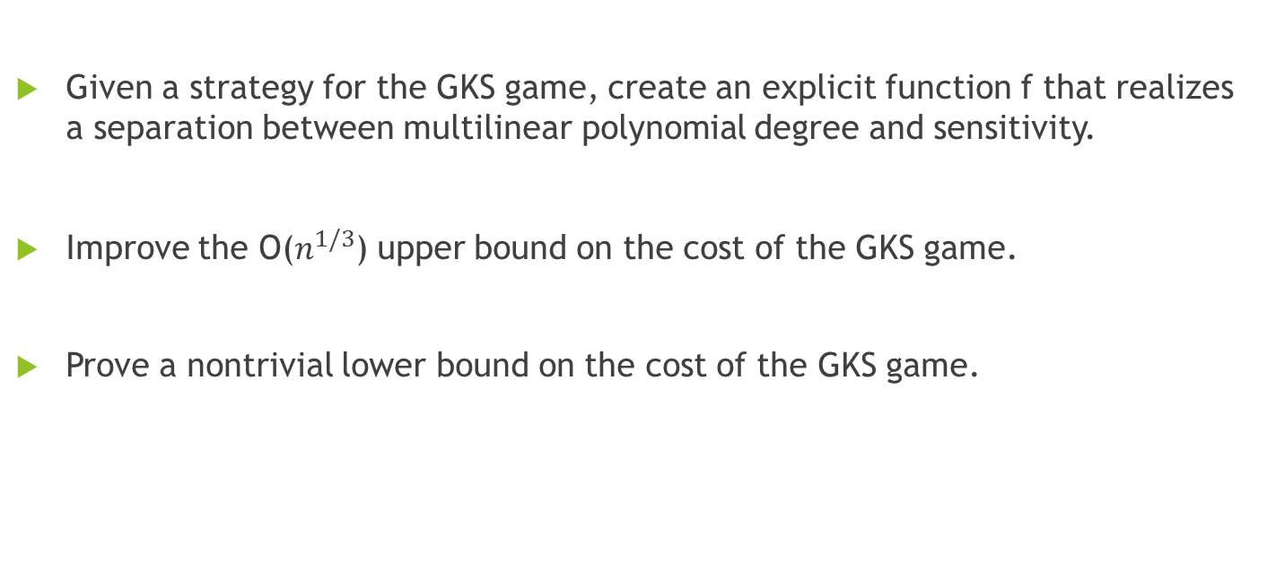
Future Directions
Given a strategy for the GKS game, create an explicit function f that realizes a separation between multilinear polynomial degree and sensitivity.
Improve the O($n^{1/3}$) upper bound on the cost of the GKS game.
Prove a nontrivial lower bound on the cost of the GKS game.

Slide 16
References
Ambainis, A. (2017). Understanding Quantum Algorithms via Query Complexity. arXiv preprint arXiv:1712.06349.
Arora, S., & Barak, B. (2009). Computational complexity: a modern approach. Cambridge University Press.
Nisan, N., & Szegedy, M. (1994). On the degree of Boolean functions as real polynomials. Computational complexity, 4(4), 301-313.
Gilmer, J., Koucký, M., & Saks, M. (2015). A communication game related to the sensitivity conjecture. arXiv preprint arXiv:1511.07729.
Szegedy, M. (2015). An $ O (n^{0.4732}) $ upper bound on the complexity of the GKS communication game. arXiv preprint arXiv:1506.06456.
Ingram, D. (2017). An Upper Bound on the GKS Game via Max Bipartite Matching. arXiv preprint arXiv:1712.01149.
Brand, M. (2017, October). October 2017 solution. In Using your Head is Permitted. Retrieved from https://www.brand.site.co.il/riddles/201710a.html

