Slide 1
Pseudo-deterministic Proofs
Dhiraj Holden, MIT
Joint work with Shafi Goldwasser and Ofer Grossman, MIT

Slide 2
Pseudo-determinism[GG11]
A pseudo-deterministic (psd) algorithm is a randomized algorithm for a search problem that
on the same input outputs the same output (we will call it the canonical answer) with high probability
Different than guaranteeing a unique answer [LD08]
Reproducibility
Correctness Amplification
Notes:
In comparison with standard randomized, it assures reprodacbility, and amilification
Notice this is different than guartaneeing a unique answer

Slide 3
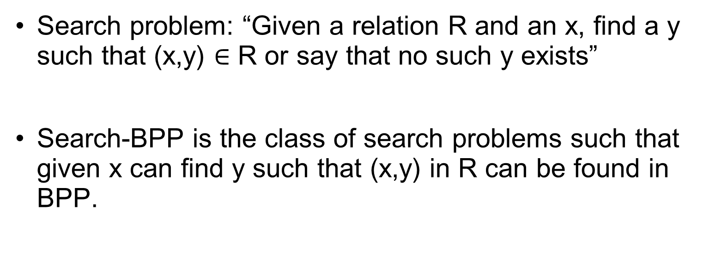
Search problems
Search problem: “Given a relation R and an x, find a y such that (x,y) $∈$ R or say that no such y exists”
Search-BPP is the class of search problems such that given x can find y such that (x,y) in R can be found in BPP.

Slide 4
Examples in Prior Work
[GGR12] Sublinear pseudo-deterministic algorithms
[GG15] pseudo-deterministic NC algorithms for bipartite matching
[OS16] a sub-exponential time psd algorithm for finding a prime of length n on input n, that works for infinitely many input lengths

Slide 5
Subsequent Work
[H17] gives an average-case result about pseudo-deterministic algorithms for search-BPP
[GL18] proves that logarithmic space has repeatable randomized algorithms given a logarithmic number of bits

Slide 6
Today: Pseudo-deterministic Interactive Proofs
In this talk, we will consider what happens when there is a powerful prover to help a polynomial time verifier to find a canonical answer y per input x so that:
An honest prover can enable the verifier to output the canonical answer y with high probability over verifier’s coins
No cheating prover will be able to make the verifier output a different answer than the canonical one with high probability in addition to the standard notion of soundness

Slide 7
Pseudo Deterministic
Interactive Proofs
Let R be a relation and L_{R} : x s.t. ∃y s.t. R(x,y)=1
Completeness : x in L_{R} ∃P s.t. Pr[V output y s.t. R(x,y)=1] >2/3
Soundness: x not in L_{R} for all P‘, Pr[V rejects x]>2/3
CANONICAL: x in L_{R} ∃y ⇒ for all P’ : Pr[Verifier outputs y’≠y] <1/3
Input: x
Prover P Verifier V
Output
Solution y
or rejects
Notes:
Say: not just any example, but a canonical one.
Lets talk about proofs: We are interested them from a computational
Point of view. Those proofs which can be verified efficiently.
More formally. Let the verifier be a probabilistic polynomial time
Algorithm which takes as input a statement and a proof P and accepts
When correct , rejects when incorrect.ect.
The class NP defined by Levin-Cook is exactly those sets for which there exist efficiently
Verifiable membership proofs.

Slide 8
Application: Generating parameters for cryptographic systems
Central authority (NIST) wants to choose a common cryptographic parameter on size n, but is untrusted
Use pseudo-deterministic interactive proofs to verify that NIST generated a canonical cryptographic parameter
Example: NIST picks prime p, generator g
Notes:
Such settings come up in the context of cryptography when a group of users may distrust other u
sers randomness sources and yet they wish to generate common cryptographic system-wide keys (or public parameters in the case of IBE),

Slide 9
This is different than
Unique-SAT: In Valiant-Vazirani [VV], a number of instances are generated, one of which has a unique solution with high probability
Single Valued NP functions: Examined by Hemaspaandra, Naik, Ogihara, and Selman [HNOS] is a deterministic version of pseudo-deterministic interactive proofs
Notes:
Valiant-Vazirani differs from this setting in that in their setting, they produce an instance with a unique solution whereas we are looking at canonical solutions which are not necessarily unique

Slide 10
Easy: The Unbounded-round Case
For any search problem in PSPACE where the answers are polynomially bounded, finding the lexicographically first answer is in PSPACE
Since IP = PSPACE, an unbounded-round interactive proof can give the lexicographically first answer to the verifier and convince the verifier with high probability

Slide 11
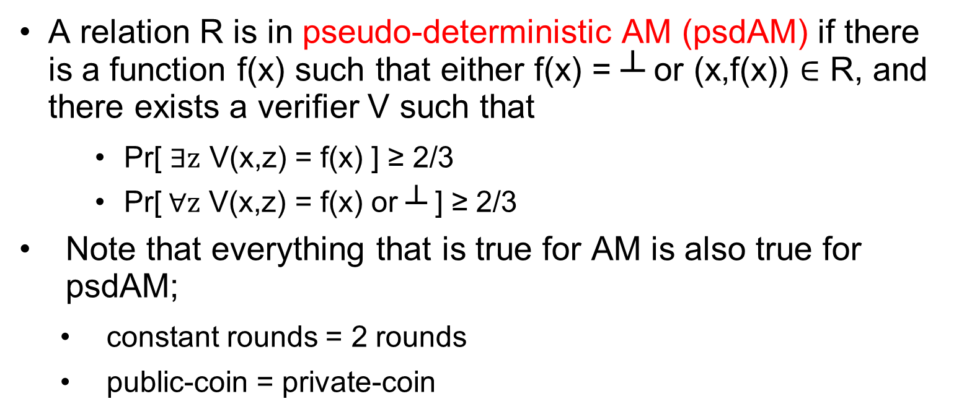
Pseudo-deterministic AM
A relation R is in pseudo-deterministic AM (psdAM) if there is a function f(x) such that either f(x) = ┴ or (x,f(x)) $∈$ R, and there exists a verifier V such that
Pr[ $∃z$ V(x,z) = f(x) ] ≥ 2/3
Pr[$∀z$ V(x,z) = f(x) or ┴ ] ≥ 2/3
Note that everything that is true for AM is also true for psdAM;
constant rounds = 2 rounds
public-coin = private-coin

Slide 12
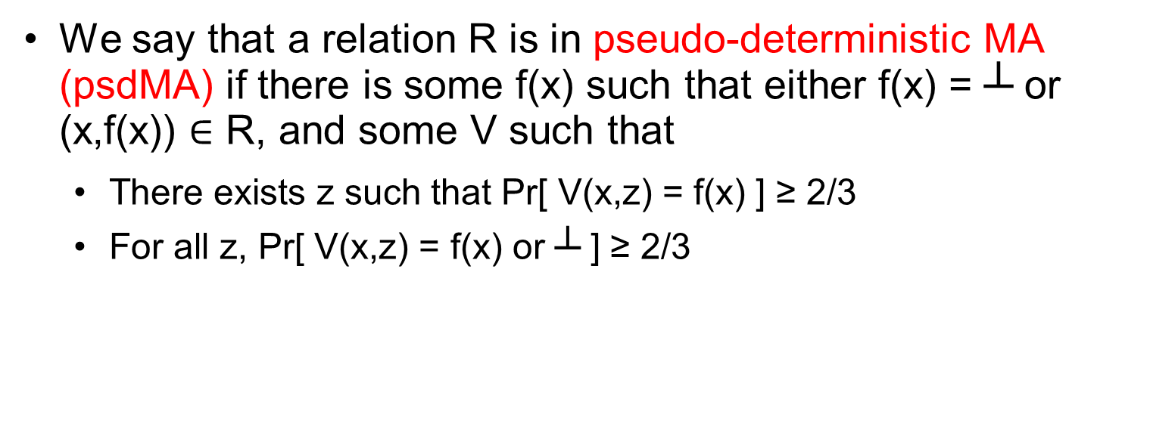
PsdMA (bounded rounds)
We say that a relation R is in pseudo-deterministic MA (psdMA) if there is some f(x) such that either f(x) = ┴ or (x,f(x)) $∈$ R, and some V such that
There exists z such that Pr[ V(x,z) = f(x) ] ≥ 2/3
For all z, Pr[ V(x,z) = f(x) or ┴ ] ≥ 2/3

Slide 13
Our Main Results: the bounded case
A constant-round psdAM protocol for finding an isomorphism between two graphs
More generally, Search-P^{AM ∩ coAM} is in psdAM
Vice versa, psdAM is in search-P^{promise-AM ∩ coAM} (similarly for MA)
No NP-complete problem can be in psdAM unless the polynomial hierarchy collapses
Give a psdMA algorithm with subexponential-time verifier for all of search-BPP
Notes:
Say in words same is true for AM

Slide 14
Pseudo-deterministic graph isomorphism
Show a protocol where on input (G₀,G₁) the verifier guarantees that it receives the lexicographically first isomorphism φ between G₀ and G₁, assuming that one exists (if an isomorphism does not exist the algorithm easily checks that and returns ┴)
Idea: The protocol computes the lexicographically first isomorphism vertex-by-vertex (in parallel)
For illustration, verifier uses private coins

Slide 15
On input G₀=(V,E), G1=(U,E’)
Perform all stages in parallel
Say the correct φ(v_{i}) already established for 1≤i≤k-1
Stage k: Prover claim φ(v_{k})=u_{r}
For every vertex s<r:
Prove graph non-isomorphism of (D₁,D₂) where
D₁:Label v₁…v_{k} in G₀
D₂:Label φ(v₁)…φ(v_{k-1}) u_{s} as 1…k in G₁
Non-isomorphism proof
Graph non-isomorphism [GMW, GS] is in AM

Slide 16
The Main Theorem
Search-P^{AM ∩ coAM} is in psdAM
psdAM is in search-P^{promise-AM ∩ coAM}
This is also true for AM replaced with MA
Notes:
Very bad
restate
Define define define

Slide 17
The Main Theorem: part 1
search-P^{AM ∩ coAM} is contained in psdAM
q_{1,}a₁,q₂,a₂,…,q_{k},a_{k}
Interactive proof to show a₁, a₂, …, a_{k} are correct for q₁,…,q_{k}
Verified by running search-P algorithm with answers a₁, a₂, …, a_{k}

Slide 18
Proof of the Main Theorem: Part 2
Claim: psdAM is contained in search-P^{promise-AM ∩ coAM}
To simulate psdAM on input x: ask the oracle “Is the ith bit of the canonical answer to the psdAM interactive proof a 1?” and use the answers to obtain y such that R(x,y) holds
This problem is a promise problem in AM ∩ coAM since:
there is only an answer when a canonical answer exists
when no such answer exists it is undefined

Slide 19
Subexponential psdMA for search-BPP
Subexponetial-time psdMA allows the verifier subexponential time
We show that search-BPP is in subexponential-time psdMA
To do this we observe there exists a hard function f in subexponential-time MA ∩ coMA that does not have poly-size circuits

Slide 20
Subexponential psdMA for search-BPP
Truth-table tt(1,…,k) of hard function f and
Witnesses w₁, w₂, …, w_{k} for f
Check tt is accurate using w’s
Use tt to construct PRG G [NW94]
Run search-BPP machine with randomness G(s₁), G(s₂),…,G(s_{j}) on all seeds
Output the first answer found

Slide 21
Open Problems
Does there exist a psdAM protocol for every problem in TFNP?
Can we find approximate short vectors in lattices in psdAM
Can we find a prime p for a given length in psdAM? (The main issue here is how can the prover prove that the prime is canonical in some way?)

