Slide 1
Applications of Algebraic Complexity to Unsupervised Learning
Pritham Chandra, Ankit Garg, Neeraj Kayal, Kunal Mittal, Tanmay Sinha

Slide 2
Unsupervised Learning Problems

Slide 3
Gaussian Mixtures

Slide 4
Gaussian Mixtures

Slide 5
Subspace Clustering

Slide 6
Subspace Clustering

Slide 7
Topic Modeling
Example: 8-tuples of words
head task force expedite medicine vaccine supply Telangana
India selectors tour Sri Lanka three ODIs T20s
Indian variant evade neutralising antibodies produced vaccination mutations
T20 cricket two most difficult phases bowl first

Slide 8
Topic Modeling
Example: 8-tuples of words
head task force expedite medicine vaccine supply Telangana
India selectors tour Sri Lanka three ODIs T20s
Indian variant evade neutralising antibodies produced vaccination mutations
T20 cricket two most difficult phases bowl first

Slide 9
Unsupervised Learning – a problem template
Given samples from a distribution D(a), find a.
Solution Outline.
1. From the samples estimate the moments of the distribution.
2. From the moments, recover the parameters.

Slide 10
Unsupervised Learning – a problem template
Given samples from a distribution D(a), find a.
Solution Outline.
1. From the samples estimate the moments of the distribution.
2. From the moments, recover the parameters.
2.1. Put the moments as coefficients of a polynomial $f(x)$.
Often: f is close to a sum of “simple” polynomials

Slide 11
Unsupervised Learning – a problem template
Given samples from a distribution D(a), find a.
Solution Outline.
1. From the samples estimate the moments of the distribution.
2. From the moments, recover the parameters.
2.1. Put the moments as coefficients of a polynomial $f(x)$.
2.2. (approximately) find the “simple” summands of $f(x)$.

Slide 12
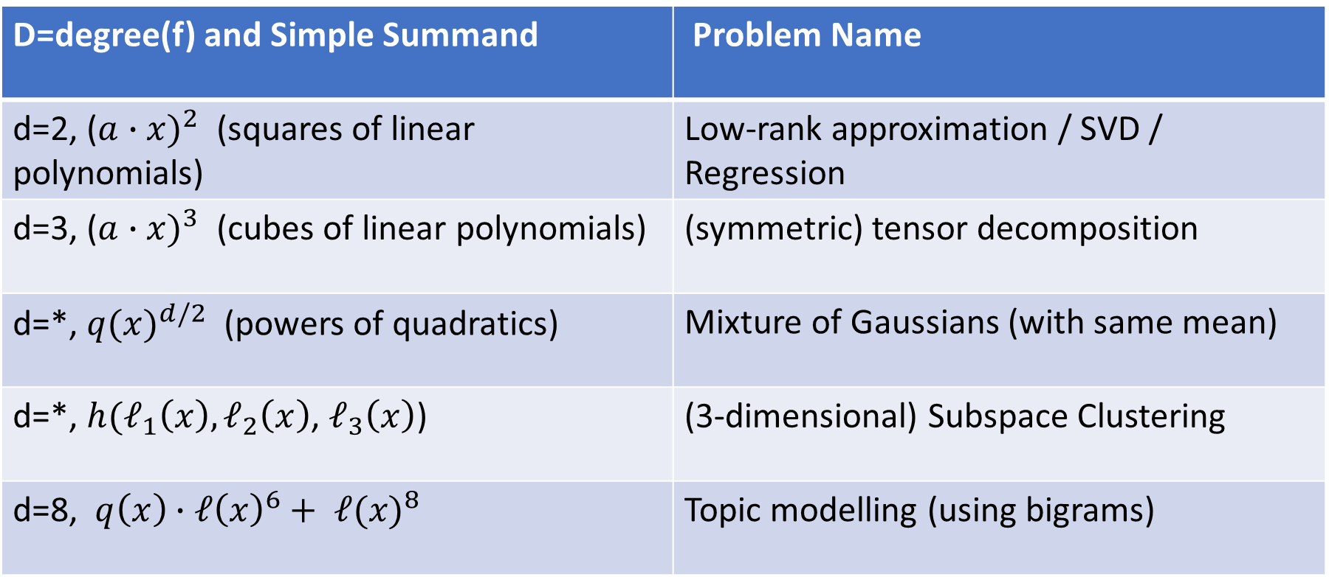
Examples
D=degree(f) and Simple Summand | Problem Name
d=2, ${\text{(}a∙x)}^{2}$ (squares of linear polynomials) | Low-rank approximation / SVD / Regression
d=3, ${\text{(}a∙x)}^{3}$ (cubes of linear polynomials) | (symmetric) tensor decomposition
d=*, ${q(x)}^{d/2}$ (powers of quadratics) | Mixture of Gaussians (with same mean)
d=*, $h(ℓ_{1}\left(x\right),ℓ_{2}\left(x\right)$, $ℓ_{3}\left(x\right)$) | (3-dimensional) Subspace Clustering
d=8, $q\left(x\right)∙{ℓ\left(x\right)}^{6}+ {ℓ(x)}^{8}$ | Topic modelling (using bigrams)

Slide 13
An abstract problem

Slide 14


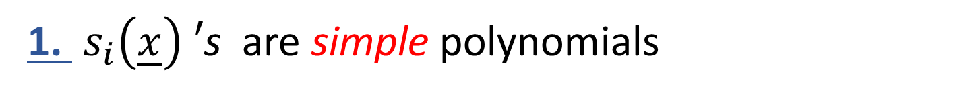
Problem: Given a multivariate polynomial $\tilde{f}(\underline{x})$, is
$$\tilde{f}\left(\underline{x}\right)≈s_{1}\left(\underline{x}\right)+s_{2}\left(\underline{x}\right)+…+s_{r}\left(\underline{x}\right) ?$$
1. $s_{i}\left(\underline{x}\right) ′$s are simple polynomials

Slide 15


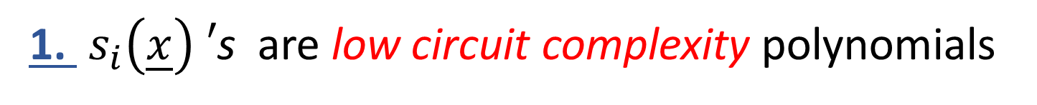
Problem: Given a multivariate polynomial$\tilde{f}(\underline{x})$, is
$$\tilde{f}\left(\underline{x}\right)≈s_{1}\left(\underline{x}\right)+s_{2}\left(\underline{x}\right)+…+s_{r}\left(\underline{x}\right) ?$$
1. $s_{i}\left(\underline{x}\right) ′$s are low circuit complexity polynomials
Example: $s_{i}\left(\underline{x}\right)=q_{i}^{\frac{d}{2}}(\underline{x})$, $\deg\left(q_{i}\right)=2$.

Slide 16


Problem: Given a multivariate polynomial $\tilde{f}(\underline{x})$, is
$$\tilde{f}\left(\underline{x}\right)≈s_{1}\left(\underline{x}\right)+s_{2}\left(\underline{x}\right)+…+s_{r}\left(\underline{x}\right) ?$$
1. $s_{i}\left(\underline{x}\right) ′$s are low circuit complexity polynomials
$$\tilde{f}\left(\underline{x}\right)=(\sum_{1≤i≤r}{s_{i}\left(\underline{x}\right)) +p(\underline{x})}$$
2.
True Moments
Noise/Error

Slide 17
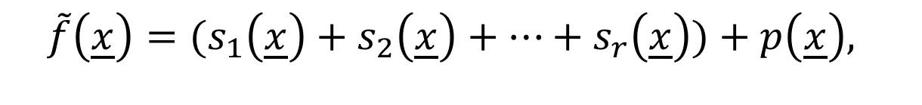


Problem: Given a multivariate polynomial$\tilde{f}(\underline{x})$,
$$\tilde{f}\left(\underline{x}\right)=(s_{1}\left(\underline{x}\right)+s_{2}\left(\underline{x}\right)+…+s_{r}\left(\underline{x}\right))+p\left(\underline{x}\right),$$
efficiently recover the $s_{i}{\left(\underline{x}\right)}^{′}s$ (approximately).

Slide 18
Lower Bounds

Slide 19
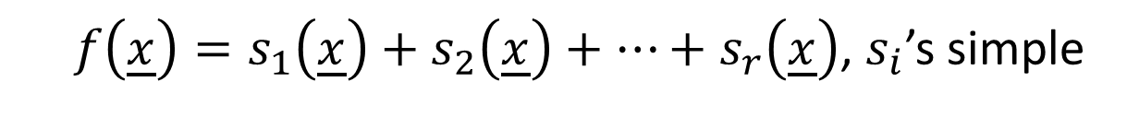
Lower Bound Problem:
$f\left(\underline{x}\right)=s_{1}\left(\underline{x}\right)+s_{2}\left(\underline{x}\right)+…+s_{r}\left(\underline{x}\right)$, $s_{i}$’s simple
Find an explicit $f(x)$ for which r is large.

Slide 20
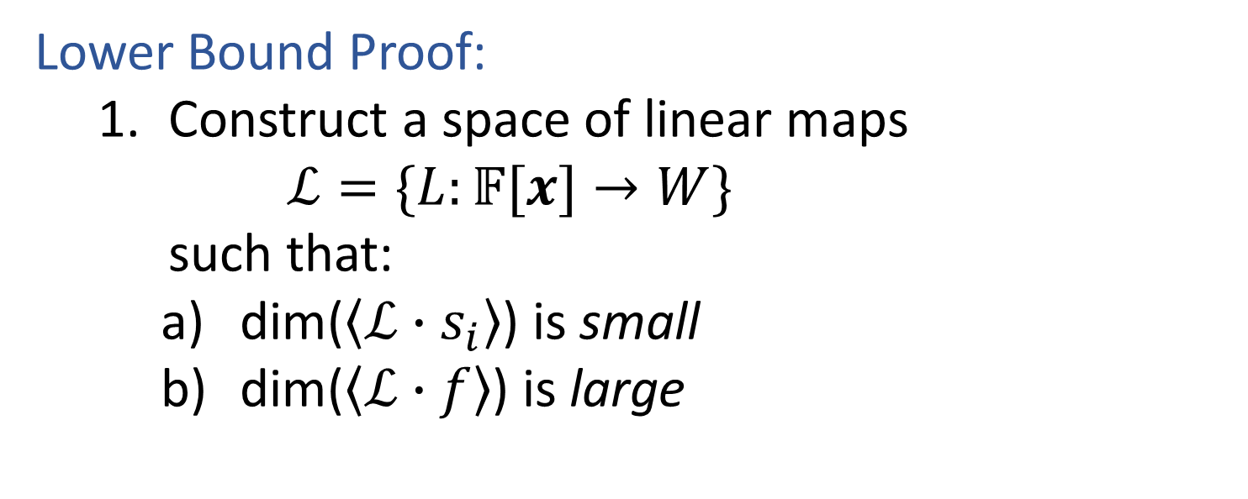
Lower Bound Problem:
$f\left(\underline{x}\right)=s_{1}\left(\underline{x}\right)+s_{2}\left(\underline{x}\right)+…+s_{r}\left(\underline{x}\right)$, $s_{i}$’s simple
Find an explicit $f(x)$ for which r is large.
Lower Bound Proof:
  Construct a space of linear maps
  $ℒ=\{L:𝔽[x]→W\}$
  such that:
    dim($\left\langle ℒ∙s_{i}\right\rangle$) is small
    dim($\left\langle ℒ∙f\right\rangle$) is large

Slide 21
Sum of Simple Polynomials – Exact Algorithm

Slide 22
Input: $f\left(x\right) ∈{ℝ[x]}^{=d}$
Assumption: $f\left(x\right)=s_{1}\left(x\right)+s_{2}\left(x\right)+…+s_{r}\left(x\right),$ $s_{i}$’s simple
Output: $s_{1}\left(x\right), s_{2}\left(x\right), … ,s_{r}\left(x\right)$

Slide 23
Input: $f\left(x\right) ∈{ℝ[x]}^{=d}$
Assumption: $f\left(x\right)=s_{1}\left(x\right)+s_{2}\left(x\right)+…+s_{r}\left(x\right),$ $s_{i}$’s simple
Output: $s_{1}\left(x\right), s_{2}\left(x\right), … ,s_{r}\left(x\right)$
Lower Bound Maps: $ℒ ⊆Lin({ℝ\left[x\right]}^{=d}, W), ℳ⊆Lin(W,W)$

Slide 24

Input: $f\left(x\right) ∈{ℝ[x]}^{=d}$
Assumption: $f\left(x\right)=s_{1}\left(x\right)+s_{2}\left(x\right)+…+s_{r}\left(x\right),$ $s_{i}$’s simple
Output: $s_{1}\left(x\right), s_{2}\left(x\right), … ,s_{r}\left(x\right)$
Lower Bound Maps: $ℒ ⊆Lin({ℝ\left[x\right]}^{=d}, W), ℳ⊆Lin(W,W)$
Example: $s_{i}\left(\underline{x}\right)=q_{i}^{\frac{d}{2}}\left(\underline{x}\right), W={ℝ[\underline{y}]}^{=(d−k)}$ where

Slide 25
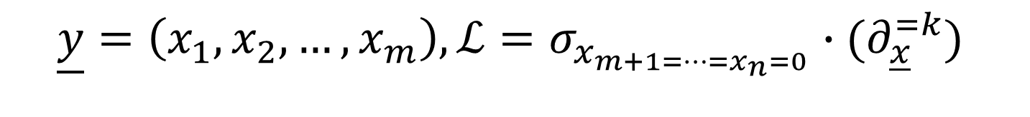
Input: $f\left(x\right) ∈{ℝ[x]}^{=d}$
Assumption: $f\left(x\right)=s_{1}\left(x\right)+s_{2}\left(x\right)+…+s_{r}\left(x\right),$ $s_{i}$’s simple
Output: $s_{1}\left(x\right), s_{2}\left(x\right), … ,s_{r}\left(x\right)$
Lower Bound Maps: $ℒ ⊆Lin({ℝ\left[x\right]}^{=d}, W), ℳ⊆Lin(W,W)$
Example: $s_{i}\left(\underline{x}\right)=q_{i}^{\frac{d}{2}}\left(\underline{x}\right), W={ℝ[\underline{y}]}^{=(d−k)}$ where
$$\underline{y}=\left(x_{1}, x_{2}, …, x_{m}\right),ℒ=σ_{x_{m+1=…=x_{n}=0}}∙(∂_{\underline{x}}^{=k})$$

Slide 26
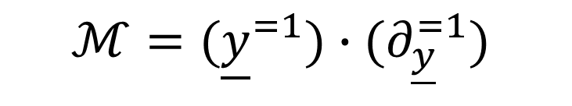
Input: $f\left(x\right) ∈{ℝ[x]}^{=d}$
Assumption: $f\left(x\right)=s_{1}\left(x\right)+s_{2}\left(x\right)+…+s_{r}\left(x\right),$ $s_{i}$’s simple
Output: $s_{1}\left(x\right), s_{2}\left(x\right), … ,s_{r}\left(x\right)$
Lower Bound Maps: $ℒ ⊆Lin({ℝ\left[x\right]}^{=d}, W), ℳ⊆Lin(W,W)$
Example: $s_{i}\left(\underline{x}\right)=q_{i}^{\frac{d}{2}}\left(\underline{x}\right), W={ℝ[\underline{y}]}^{=(d−k)}$ where
$$\underline{y}=\left(x_{1}, x_{2}, …, x_{m}\right),ℒ=σ_{x_{m+1=…=x_{n}=0}}∙(∂_{\underline{x}}^{=k})$$
$$ℳ=({\underline{y}}^{=1})∙(∂_{\underline{y}}^{=1})$$

Slide 27
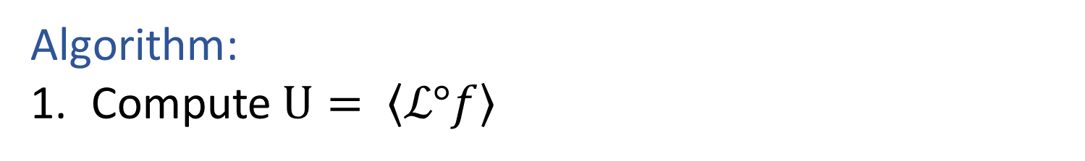
Input: $f\left(x\right) ∈{ℝ[x]}^{=d}$
Assumption: $f\left(x\right)=s_{1}\left(x\right)+s_{2}\left(x\right)+…+s_{r}\left(x\right),$ $s_{i}$’s simple
Output: $s_{1}\left(x\right), s_{2}\left(x\right), … ,s_{r}\left(x\right)$
Lower Bound Maps: $ℒ ⊆Lin({ℝ\left[x\right]}^{=d}, W), ℳ⊆Lin(W,W)$
Algorithm:
Compute $U= \left\langle ℒ°f\right\rangle$

Slide 28

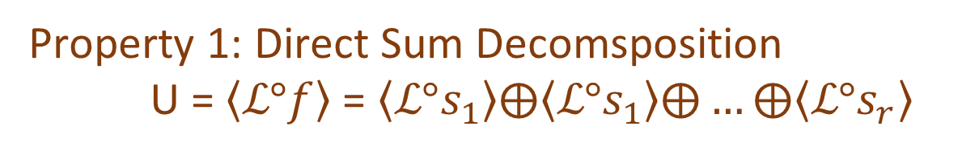
Input: $f\left(x\right) ∈{ℝ[x]}^{=d}$
Assumption: $f\left(x\right)=s_{1}\left(x\right)+s_{2}\left(x\right)+…+s_{r}\left(x\right),$ $s_{i}$’s simple
Output: $s_{1}\left(x\right), s_{2}\left(x\right), … ,s_{r}\left(x\right)$
Lower Bound Maps: $ℒ ⊆Lin({ℝ\left[x\right]}^{=d}, W), ℳ⊆Lin(W,W)$
Algorithm:
Compute $U= \left\langle ℒ°f\right\rangle$
Property 1: Direct Sum Decomsposition
U = $\left\langle ℒ°f\right\rangle$= $\left\langle ℒ°s_{1}\right\rangle ⨁\left\langle ℒ°s_{1}\right\rangle ⨁…⨁\left\langle ℒ°s_{r}\right\rangle$
Property 2: Invariance of $\left\langle ℒ°s_{i}\right\rangle$ under $ℳ$
$ℳ∘\left\langle ℒ°s_{i}\right\rangle =\left\langle ℒ°s_{i}\right\rangle$

Slide 29
Input: $f\left(x\right) ∈{ℝ[x]}^{=d}$
Assumption: $f\left(x\right)=s_{1}\left(x\right)+s_{2}\left(x\right)+…+s_{r}\left(x\right),$ $s_{i}$’s simple
Output: $s_{1}\left(x\right), s_{2}\left(x\right), … ,s_{r}\left(x\right)$
Lower Bound Maps: $ℒ ⊆Lin({ℝ\left[x\right]}^{=d}, W), ℳ⊆Lin(W,W)$
Algorithm:
Compute $U= \left\langle ℒ°f\right\rangle$
Property 1: Direct Sum Decomsposition
U = $\left\langle ℒ°f\right\rangle$= $\left\langle ℒ°s_{1}\right\rangle ⨁\left\langle ℒ°s_{1}\right\rangle ⨁…⨁\left\langle ℒ°s_{r}\right\rangle$
Blessing of Dimensionality
Property 2: Invariance of $\left\langle ℒ°s_{i}\right\rangle$ under $ℳ$
$ℳ∘\left\langle ℒ°s_{i}\right\rangle =\left\langle ℒ°s_{i}\right\rangle$

Slide 30
Input: $f\left(x\right) ∈{ℝ[x]}^{=d}$
Assumption: $f\left(x\right)=s_{1}\left(x\right)+s_{2}\left(x\right)+…+s_{r}\left(x\right),$ $s_{i}$’s simple
Output: $s_{1}\left(x\right), s_{2}\left(x\right), … ,s_{r}\left(x\right)$
Lower Bound Maps: $ℒ ⊆Lin({ℝ\left[x\right]}^{=d}, W), ℳ⊆Lin(W,W)$
Algorithm:
Compute $U= \left\langle ℒ°f\right\rangle$
2. Find the common eigenspaces $\left(U_{1}, U_{2}, …, U_{r}\right)$ of U under $ℳ$

Slide 31


Input: $f\left(x\right) ∈{ℝ[x]}^{=d}$
Assumption: $f\left(x\right)=s_{1}\left(x\right)+s_{2}\left(x\right)+…+s_{r}\left(x\right),$ $s_{i}$’s simple
Output: $s_{1}\left(x\right), s_{2}\left(x\right), … ,s_{r}\left(x\right)$
Lower Bound Maps: $ℒ ⊆Lin({ℝ\left[x\right]}^{=d}, W), ℳ⊆Lin(W,W)$
Algorithm:
Compute $U= \left\langle ℒ°f\right\rangle$
2. Find the common eigenspaces $\left(U_{1}, U_{2}, …, U_{r}\right)$ of U under $ℳ$
$U_{i}=\left\langle ℒ°s_{i}\right\rangle$’s are the common eigenspaces
U = $U_{1}⨁U_{2}⨁…⨁U_{r}$

Slide 32

Input: $f\left(x\right) ∈{ℝ[x]}^{=d}$
Assumption: $f\left(x\right)=s_{1}\left(x\right)+s_{2}\left(x\right)+…+s_{r}\left(x\right),$ $s_{i}$’s simple
Output: $s_{1}\left(x\right), s_{2}\left(x\right), … ,s_{r}\left(x\right)$
Lower Bound Maps: $ℒ ⊆Lin({ℝ\left[x\right]}^{=d}, W), ℳ⊆Lin(W,W)$
Algorithm:
Compute $U= \left\langle ℒ°f\right\rangle$
2.1 Compute $C_{U}\left(ℳ\right)=\{X :MX=XM ∀M∈ℳ\}$

Slide 33
Input: $f\left(x\right) ∈{ℝ[x]}^{=d}$
Assumption: $f\left(x\right)=s_{1}\left(x\right)+s_{2}\left(x\right)+…+s_{r}\left(x\right),$ $s_{i}$’s simple
Output: $s_{1}\left(x\right), s_{2}\left(x\right), … ,s_{r}\left(x\right)$
Lower Bound Maps: $ℒ ⊆Lin({ℝ\left[x\right]}^{=d}, W), ℳ⊆Lin(W,W)$
Algorithm:
Compute $U= \left\langle ℒ°f\right\rangle$
2.1 Compute $C_{U}\left(ℳ\right)=\{X :MX=XM ∀M∈ℳ\}$
2.2 Pick random $X∈C_{U}\left(ℳ\right)$. $U_{i}≝$ i-th eigenspace of X

Slide 34


Input: $f\left(x\right) ∈{ℝ[x]}^{=d}$
Assumption: $f\left(x\right)=s_{1}\left(x\right)+s_{2}\left(x\right)+…+s_{r}\left(x\right),$ $s_{i}$’s simple
Output: $s_{1}\left(x\right), s_{2}\left(x\right), … ,s_{r}\left(x\right)$
Lower Bound Maps: $ℒ ⊆Lin({ℝ\left[x\right]}^{=d}, W), ℳ⊆Lin(W,W)$
Algorithm:
Compute $U= \left\langle ℒ°f\right\rangle$
2. Find the common eigenspaces of U under $ℳ$
3. Recover $s_{i}$ from $U, \left\langle ℒ°s_{i}\right\rangle$
$w_{ij}= {Projection}_{U_{i}}\left(L_{j}∙f\right)$
Solve for $s_{i}$ such that $L_{j}∙s_{i}=w_{ij}$

Slide 35
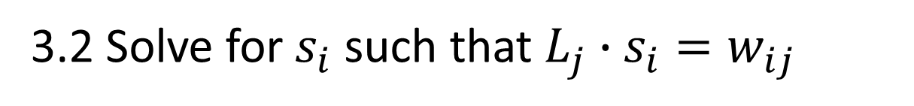
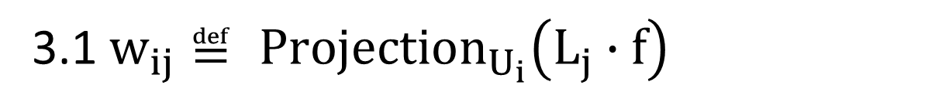
Input: $f\left(x\right) ∈{ℝ[x]}^{=d}$
Assumption: $f\left(x\right)=s_{1}\left(x\right)+s_{2}\left(x\right)+…+s_{r}\left(x\right),$ $s_{i}$’s simple
Output: $s_{1}\left(x\right), s_{2}\left(x\right), … ,s_{r}\left(x\right)$
Lower Bound Maps: $ℒ ⊆Lin({ℝ\left[x\right]}^{=d}, W), ℳ⊆Lin(W,W)$
Algorithm:
Compute $U= \left\langle ℒ°f\right\rangle$
2.1 Compute $C_{U}\left(ℳ\right)=\{X :MX=XM ∀M∈ℳ\}$
2.2 Pick random $X∈C_{U}\left(ℳ\right)$. $U_{i}≝$ i-th eigenspace of X
3.1 $w_{ij}≝ {Projection}_{U_{i}}\left(L_{j}∙f\right)$
3.2 Solve for $s_{i}$ such that $L_{j}∙s_{i}=w_{ij}$

Slide 36
Sum of Simple Polynomials – Robust Algorithm

Slide 37
Input: $\tilde{f}(x) ∈{ℝ[x]}^{=d}$
Assumption:$\tilde{f}(x)=s_{1}\left(x\right)+s_{2}\left(x\right)+…+s_{r}\left(x\right)+p\left(x\right),$ $s_{i}$’s simple
Output: ${\tilde{s}}_{1}\left(x\right),{\tilde{s}}_{2}\left(x\right), …,{\tilde{s}}_{r}\left(x\right), {\tilde{s}}_{i}(x)≈s_{i}(x)$

Slide 38

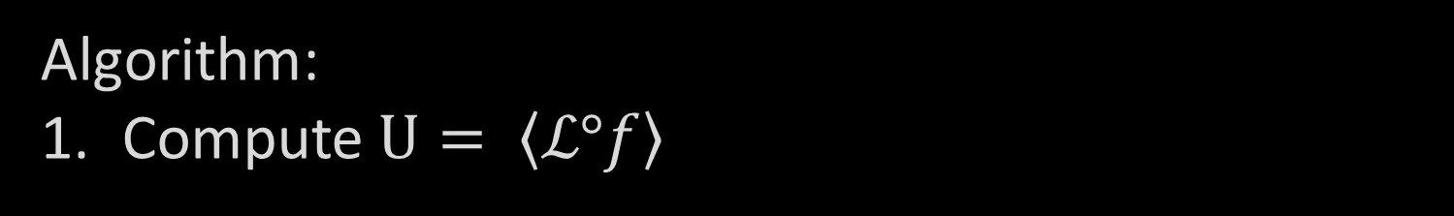

Input: $\tilde{f}(x) ∈{ℝ[x]}^{=d}$
Assumption:$\tilde{f}(x)=s_{1}\left(x\right)+s_{2}\left(x\right)+…+s_{r}\left(x\right)+p\left(x\right),$ $s_{i}$’s simple
Output: ${\tilde{s}}_{1}\left(x\right),{\tilde{s}}_{2}\left(x\right), …,{\tilde{s}}_{r}\left(x\right), {\tilde{s}}_{i}(x)≈s_{i}(x)$
Algorithm:
Compute $U= \left\langle ℒ°f\right\rangle$
2.1 Compute $C_{U}\left(ℳ\right)=\{X :MX=XM ∀M∈ℳ\}$
2.2 Pick random $X∈C_{U}\left(ℳ\right)$. $U_{i}≝$ i-th eigenspace of X
3.1 $w_{ij}≝ {Projection}_{U_{i}}\left(L_{j}∙f\right)$
3.2 Solve for $s_{i}$ such that $L_{j}∙s_{i}=w_{ij}$

Slide 39



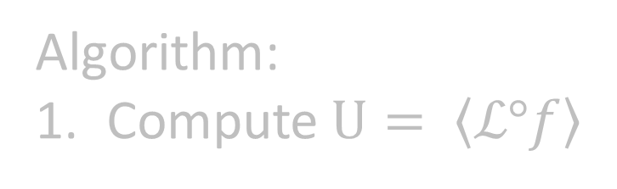

Input: $\tilde{f}(x) ∈{ℝ[x]}^{=d}$
Assumption:$\tilde{f}(x)=s_{1}\left(x\right)+s_{2}\left(x\right)+…+s_{r}\left(x\right)+p\left(x\right),$ $s_{i}$’s simple
Output: ${\tilde{s}}_{1}\left(x\right),{\tilde{s}}_{2}\left(x\right), …,{\tilde{s}}_{r}\left(x\right), {\tilde{s}}_{i}(x)≈s_{i}(x)$
Replace = by $≈$
Algorithm:
Compute $U= \left\langle ℒ°f\right\rangle$
2.1 Compute $C_{U}\left(ℳ\right)=\{X :MX=XM ∀M∈ℳ\}$
2.2 Pick random $X∈C_{U}\left(ℳ\right)$. $U_{i}≝$ i-th eigenspace of X
3.1 $w_{ij}≝ {Projection}_{U_{i}}\left(L_{j}∙f\right)$
3.2 Solve for $s_{i}$ such that $L_{j}∙s_{i}=w_{ij}$

Slide 40
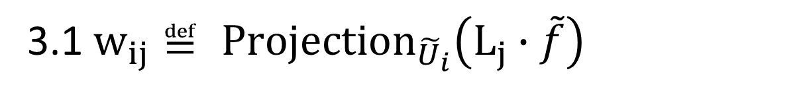

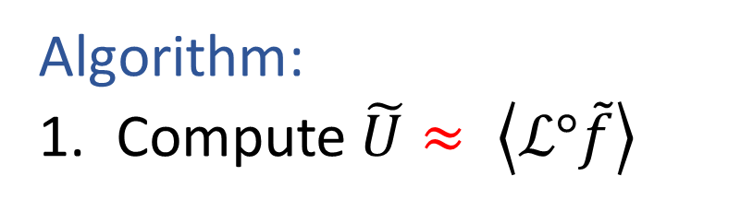
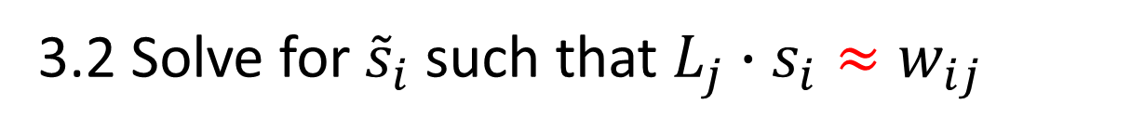
Input: $\tilde{f}(x) ∈{ℝ[x]}^{=d}$
Assumption:$\tilde{f}(x)=s_{1}\left(x\right)+s_{2}\left(x\right)+…+s_{r}\left(x\right)+p\left(x\right),$ $s_{i}$’s simple
Output: ${\tilde{s}}_{1}\left(x\right),{\tilde{s}}_{2}\left(x\right), …,{\tilde{s}}_{r}\left(x\right), {\tilde{s}}_{i}(x)≈s_{i}(x)$
Replace = by $≈$
Algorithm:
Compute $\tilde{U}≈ \left\langle ℒ°\tilde{f}\right\rangle$
2.1 Compute $C_{\tilde{U}}\left(ℳ\right)=\{X :MX≈XM ∀M∈ℳ\}$
2.2 Pick random $X∈C_{\tilde{U}}\left(ℳ\right)$. ${\tilde{U}}_{i}≝$ i-th eigenspace of X
3.1 $w_{ij}≝ {Projection}_{{\tilde{U}}_{i}}\left(L_{j}∙\tilde{f}\right)$
3.2 Solve for${\tilde{s}}_{i}$ such that $L_{j}∙s_{i}≈w_{ij}$

Slide 41

Input: $\tilde{f}(x) ∈{ℝ[x]}^{=d}$
Assumption:$\tilde{f}(x)=s_{1}\left(x\right)+s_{2}\left(x\right)+…+s_{r}\left(x\right)+p\left(x\right),$ $s_{i}$’s simple
Output: ${\tilde{s}}_{1}\left(x\right),{\tilde{s}}_{2}\left(x\right), …,{\tilde{s}}_{r}\left(x\right), {\tilde{s}}_{i}(x)≈s_{i}(x)$
Replace = by $≈$
Algorithm:
Compute $\tilde{U}≈ \left\langle ℒ°\tilde{f}\right\rangle$

Slide 42
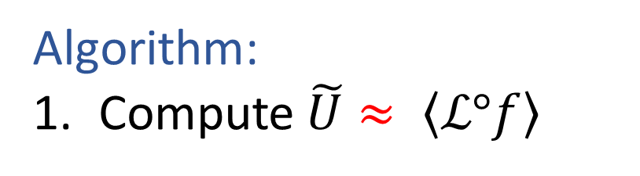

Input: $\tilde{f}(x) ∈{ℝ[x]}^{=d}$
Assumption:$\tilde{f}(x)=s_{1}\left(x\right)+s_{2}\left(x\right)+…+s_{r}\left(x\right)+p\left(x\right),$ $s_{i}$’s simple
Output: ${\tilde{s}}_{1}\left(x\right),{\tilde{s}}_{2}\left(x\right), …,{\tilde{s}}_{r}\left(x\right), {\tilde{s}}_{i}(x)≈s_{i}(x)$
Replace = by $≈$
Algorithm:
Compute $\tilde{U}≈ \left\langle ℒ°f\right\rangle$
Do SVD. $\tilde{U}≝$ best dim($\left\langle ℒ°f\right\rangle$) –dimensional approximation to $\{L⋅f :L ∈ℒ\}$

Slide 43
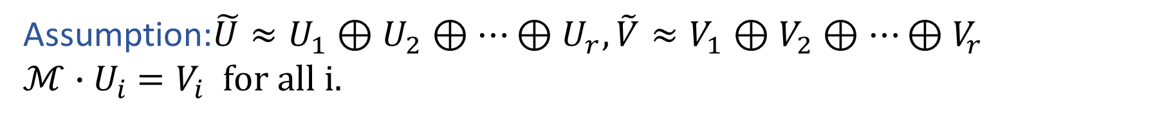
Robust Vector Space Decomposition
Input: $\tilde{U }⊆W,\tilde{V }⊆\hat{W}, ℳ⊆Lin(W,\hat{W})$
Assumption:$\tilde{U}≈U_{1}⊕U_{2}⊕…⊕U_{r},\tilde{V}≈V_{1}⊕V_{2}⊕…⊕V_{r}$
$ℳ∙U_{i}$ $=V_{i}$ for all i.
Output: ${\tilde{U}}_{1},{\tilde{U}}_{2}, …,{\tilde{U}}_{r} \text{and} {\tilde{V}}_{1},{\tilde{V}}_{2}, …,{\tilde{V}}_{r} {\tilde{U}}_{i}≈U_{i}$, ${\tilde{V}}_{i}≈V_{i}$
Todays exposition: $U=V and U_{i}=V_{i}$

Slide 44
Input: $\tilde{f}(x) ∈{ℝ[x]}^{=d}$
Assumption:$\tilde{f}(x)=s_{1}\left(x\right)+s_{2}\left(x\right)+…+s_{r}\left(x\right)+p\left(x\right),$ $s_{i}$’s simple
Output: ${\tilde{s}}_{1}\left(x\right),{\tilde{s}}_{2}\left(x\right), …,{\tilde{s}}_{r}\left(x\right), {\tilde{s}}_{i}(x)≈s_{i}(x)$
Replace = by $≈$
Algorithm:
Compute $\tilde{U}≈ \left\langle ℒ°\tilde{f}\right\rangle$
2.1 Compute $C_{\tilde{U}}\left(ℳ\right)=\{X :MX≈XM ∀M∈ℳ\}$
2.2 Pick random $X∈C_{\tilde{U}}\left(ℳ\right)$. ${\tilde{U}}_{i}≝$ i-th eigenspace of X
X $≝ \underset{Y:<Y,1> =0}{argmin}\left(\sum_{M∈ℳ}{{\left\|{(Π}_{\tilde{U}}M)Y−Y{(Π}_{\tilde{U}}M)\right\|}^{2}}\right)$

Slide 45
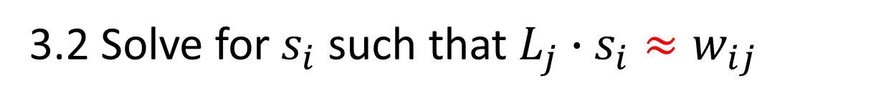
Input: $\tilde{f}(x) ∈{ℝ[x]}^{=d}$
Assumption:$\tilde{f}(x)=s_{1}\left(x\right)+s_{2}\left(x\right)+…+s_{r}\left(x\right)+p\left(x\right),$ $s_{i}$’s simple
Output: ${\tilde{s}}_{1}\left(x\right),{\tilde{s}}_{2}\left(x\right), …,{\tilde{s}}_{r}\left(x\right), {\tilde{s}}_{i}(x)≈s_{i}(x)$
Replace = by $≈$
Algorithm:
Compute $\tilde{U}≈ \left\langle ℒ°\tilde{f}\right\rangle$
2.1 Compute $C_{\tilde{U}}\left(ℳ\right)=\{X :MX≈XM ∀M∈ℳ\}$
2.2 Pick random $X∈C_{\tilde{U}}\left(ℳ\right)$. ${\tilde{U}}_{i}≝$ i-th eigenspace of X
3.1 $w_{ij}≝ {Projection}_{{\tilde{U}}_{i}}\left(L_{j}∙\tilde{f}\right)$
3.2 Solve for $s_{i}$ such that $L_{j}∙s_{i}≈w_{ij}$

Slide 46
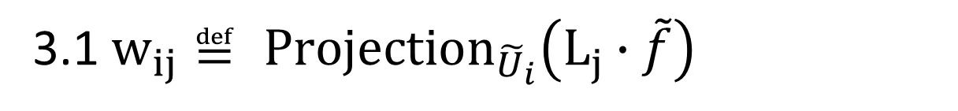
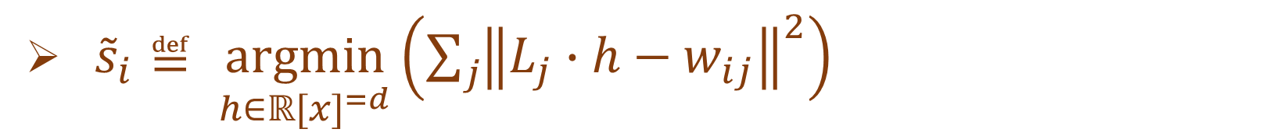



Input: $\tilde{f}(x) ∈{ℝ[x]}^{=d}$
Assumption:$\tilde{f}(x)=s_{1}\left(x\right)+s_{2}\left(x\right)+…+s_{r}\left(x\right)+p\left(x\right),$ $s_{i}$’s simple
Output: ${\tilde{s}}_{1}\left(x\right),{\tilde{s}}_{2}\left(x\right), …,{\tilde{s}}_{r}\left(x\right), {\tilde{s}}_{i}(x)≈s_{i}(x)$
Replace = by $≈$
Algorithm:
Compute $\tilde{U}≈ \left\langle ℒ°\tilde{f}\right\rangle$
2.1 Compute $C_{\tilde{U}}\left(ℳ\right)=\{X :MX≈XM ∀M∈ℳ\}$
2.2 Pick random $X∈C_{\tilde{U}}\left(ℳ\right)$. ${\tilde{U}}_{i}≝$ i-th eigenspace of X
3.1 $w_{ij}≝ {Projection}_{{\tilde{U}}_{i}}\left(L_{j}∙\tilde{f}\right)$
3.2 Solve for ${\tilde{s}}_{i}$ such that $L_{j}∙s_{i}≈w_{ij}$
${\tilde{s}}_{i}≝ \underset{h∈{ℝ[x]}^{=d}}{argmin}\left(\sum_{j}{{\left\|L_{j}∙h−w_{ij}\right\|}^{2}}\right)$

Slide 47
Input: $\tilde{f}(x) ∈{ℝ[x]}^{=d}$
Assumption:$\tilde{f}(x)=s_{1}\left(x\right)+s_{2}\left(x\right)+…+s_{r}\left(x\right)+p\left(x\right),$ $s_{i}$’s simple
Output: ${\tilde{s}}_{1}\left(x\right),{\tilde{s}}_{2}\left(x\right), …,{\tilde{s}}_{r}\left(x\right), {\tilde{s}}_{i}(x)≈s_{i}(x)$
Algorithm:
Compute $\tilde{U}≈ \left\langle ℒ°\tilde{f}\right\rangle$
2.1 Compute $C_{\tilde{U}}\left(ℳ\right)=\{X :MX≈XM ∀M∈ℳ\}$
2.2 Pick random $X∈C_{\tilde{U}}\left(ℳ\right)$. ${\tilde{U}}_{i}≝$ i-th eigenspace of X
3.1 $w_{ij}≝ {Projection}_{{\tilde{U}}_{i}}\left(L_{j}∙\tilde{f}\right)$
3.2 Solve for${\tilde{s}}_{i}$ such that $L_{j}∙s_{i}≈w_{ij}$

Slide 48
Input: $\tilde{f}(x) ∈{ℝ[x]}^{=d}$
Assumption:$\tilde{f}(x)=s_{1}\left(x\right)+s_{2}\left(x\right)+…+s_{r}\left(x\right)+p\left(x\right),$ $s_{i}$’s simple
Output: ${\tilde{s}}_{1}\left(x\right),{\tilde{s}}_{2}\left(x\right), …,{\tilde{s}}_{r}\left(x\right), {\tilde{s}}_{i}(x)≈s_{i}(x)$
Algorithm:
Compute $\tilde{U}≈ \left\langle ℒ°\tilde{f}\right\rangle$
2.1 Compute $C_{\tilde{U}}\left(ℳ\right)=\{X :MX≈XM ∀M∈ℳ\}$
2.2 Pick random $X∈C_{\tilde{U}}\left(ℳ\right)$. ${\tilde{U}}_{i}≝$ i-th eigenspace of X
3.1 $w_{ij}≝ {Projection}_{{\tilde{U}}_{i}}\left(L_{j}∙\tilde{f}\right)$
3.2 Solve for${\tilde{s}}_{i}$ such that $L_{j}∙s_{i}≈w_{ij}$

Slide 49
Algorithm Performance

Slide 50



Algorithm:
1. Compute $\tilde{U}≈ \left\langle ℒ°\tilde{f}\right\rangle$
2.1 Compute $C_{\tilde{U}}\left(ℳ\right)=\{X :MX≈XM ∀M∈ℳ\}$
2.2 Pick random $X∈C_{\tilde{U}}\left(ℳ\right)$. ${\tilde{U}}_{i}≝$ i-th eigenspace of X
3.1 $w_{ij}≝ {Projection}_{{\tilde{U}}_{i}}\left(L_{j}∙\tilde{f}\right)$
3.2 Solve for${\tilde{s}}_{i}$ such that $L_{j}∙s_{i}≈w_{ij}$

Slide 51
Algorithm:
1. Compute $\tilde{U}≈ \left\langle ℒ°\tilde{f}\right\rangle$
2.1 Compute $C_{\tilde{U}}\left(ℳ\right)=\{X :MX≈XM ∀M∈ℳ\}$
Running Time.
2.2 Pick random $X∈C_{\tilde{U}}\left(ℳ\right)$. ${\tilde{U}}_{i}≝$ i-th eigenspace of X
3.1 $w_{ij}≝ {Projection}_{{\tilde{U}}_{i}}\left(L_{j}∙\tilde{f}\right)$
Runtime = O(${dim⁡(U)}^{6})$
3.2 Solve for${\tilde{s}}_{i}$ such that $L_{j}∙s_{i}≈w_{ij}$

Slide 52
Algorithm:
1. Compute $\tilde{U}≈ \left\langle ℒ°\tilde{f}\right\rangle$
2.1 Compute $C_{\tilde{U}}\left(ℳ\right)=\{X :MX≈XM ∀M∈ℳ\}$
General/powerful
2.2 Pick random $X∈C_{\tilde{U}}\left(ℳ\right)$. ${\tilde{U}}_{i}≝$ i-th eigenspace of X
3.1 $w_{ij}≝ {Projection}_{{\tilde{U}}_{i}}\left(L_{j}∙\tilde{f}\right)$
Tensor Decomposition
3.2 Solve for${\tilde{s}}_{i}$ such that $L_{j}∙s_{i}≈w_{ij}$
Mixtures of Gaussians
Subspace Clustering
Topic modeling

Slide 53
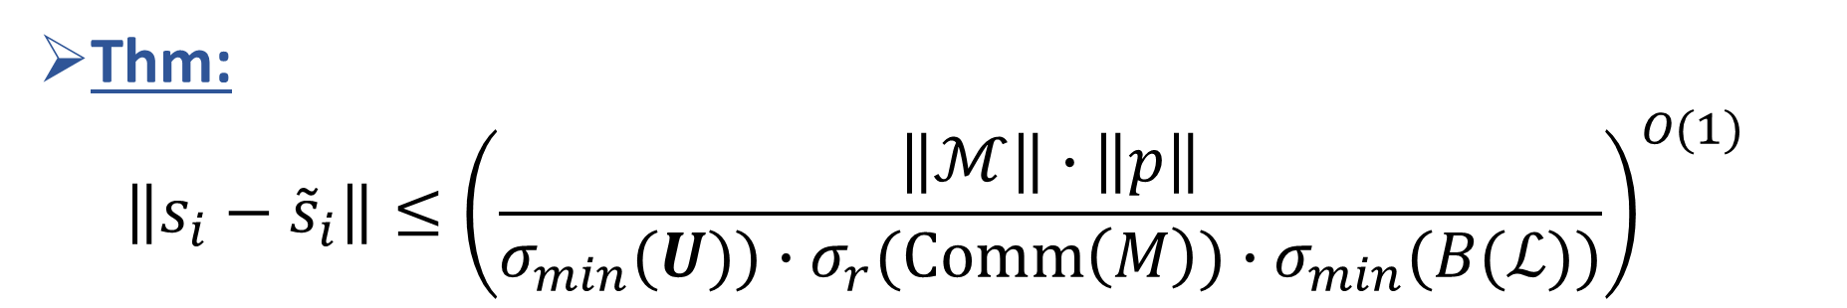
Algorithm:
1. Compute $\tilde{U}≈ \left\langle ℒ°\tilde{f}\right\rangle$
Provably robust
2.1 Compute $C_{\tilde{U}}\left(ℳ\right)=\{X :MX≈XM ∀M∈ℳ\}$
2.2 Pick random $X∈C_{\tilde{U}}\left(ℳ\right)$. ${\tilde{U}}_{i}≝$ i-th eigenspace of X
3.1 $w_{ij}≝ {Projection}_{{\tilde{U}}_{i}}\left(L_{j}∙\tilde{f}\right)$
3.2 Solve for${\tilde{s}}_{i}$ such that $L_{j}∙s_{i}≈w_{ij}$
Thm:
$$\left\|s_{i}−{\tilde{s}}_{i}\right\|≤{\left(\frac{\left\|ℳ\right\|∙\left\|p\right\|}{σ_{min}(U))∙σ_{r}(\text{Comm}\left(M\right))∙σ_{min}(B(ℒ))}\right)}^{O(1)}$$

Slide 54

Algorithm:
1. Compute $\tilde{U}≈ \left\langle ℒ°\tilde{f}\right\rangle$
Provably robust
2.1 Compute $C_{\tilde{U}}\left(ℳ\right)=\{X :MX≈XM ∀M∈ℳ\}$
2.2 Pick random $X∈C_{\tilde{U}}\left(ℳ\right)$. ${\tilde{U}}_{i}≝$ i-th eigenspace of X
3.1 $w_{ij}≝ {Projection}_{{\tilde{U}}_{i}}\left(L_{j}∙\tilde{f}\right)$
3.2 Solve for${\tilde{s}}_{i}$ such that $L_{j}∙s_{i}≈w_{ij}$
Thm:
$$\left\|s_{i}−{\tilde{s}}_{i}\right\|≤{\left(\frac{\left\|ℳ\right\|∙\left\|p\right\|}{σ_{min}(U))∙σ_{r}(\text{Comm}\left(M\right))∙σ_{min}(B(ℒ))}\right)}^{O(1)}$$
Conjecture: For mixtures of Gaussians, the singular values are “not too small” if parameters are “slightly perturbed”.

Slide 55
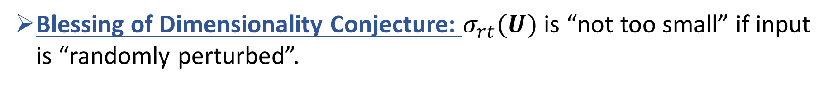

Algorithm:
1. Compute $\tilde{U}≈ \left\langle ℒ°\tilde{f}\right\rangle$
Provably robust
2.1 Compute $C_{\tilde{U}}\left(ℳ\right)=\{X :MX≈XM ∀M∈ℳ\}$
2.2 Pick random $X∈C_{\tilde{U}}\left(ℳ\right)$. ${\tilde{U}}_{i}≝$ i-th eigenspace of X
3.1 $w_{ij}≝ {Projection}_{{\tilde{U}}_{i}}\left(L_{j}∙\tilde{f}\right)$
3.2 Solve for${\tilde{s}}_{i}$ such that $L_{j}∙s_{i}≈w_{ij}$
Thm:
$$\left\|s_{i}−{\tilde{s}}_{i}\right\|≤{\left(\frac{\left\|ℳ\right\|∙\left\|p\right\|}{σ_{min}(U)∙σ_{r}(\text{Comm}\left(M\right))∙σ_{min}(B(ℒ))}\right)}^{O(1)}$$
Blessing of Dimensionality Conjecture: $σ_{rt}(U)$ is “not too small” if input is “randomly perturbed”.
Conjecture implies** an efficient “smoothed algorithm” for mixtures of Gaussians.

Slide 56

Algorithm:
1. Compute $\tilde{U}≈ \left\langle ℒ°\tilde{f}\right\rangle$
Provably robust
2.1 Compute $C_{\tilde{U}}\left(ℳ\right)=\{X :MX≈XM ∀M∈ℳ\}$
2.2 Pick random $X∈C_{\tilde{U}}\left(ℳ\right)$. ${\tilde{U}}_{i}≝$ i-th eigenspace of X
3.1 $w_{ij}≝ {Projection}_{{\tilde{U}}_{i}}\left(L_{j}∙\tilde{f}\right)$
3.2 Solve for${\tilde{s}}_{i}$ such that $L_{j}∙s_{i}≈w_{ij}$
Thm:
$$\left\|s_{i}−{\tilde{s}}_{i}\right\|≤{\left(\frac{\left\|ℳ\right\|∙\left\|p\right\|}{σ_{min}(U)∙σ_{r}(\text{Comm}\left(M\right))∙σ_{min}(B(ℒ))}\right)}^{O(1)}$$
Very pessimistic when p(x) is random.

Slide 57
Algorithm:
1. Compute $\tilde{U}≈ \left\langle ℒ°\tilde{f}\right\rangle$
Empirically even more robust (for random perturbations).
2.1 Compute $C_{\tilde{U}}\left(ℳ\right)=\{X :MX≈XM ∀M∈ℳ\}$
2.2 Pick random $X∈C_{\tilde{U}}\left(ℳ\right)$. ${\tilde{U}}_{i}≝$ i-th eigenspace of X
3.1 $w_{ij}≝ {Projection}_{{\tilde{U}}_{i}}\left(L_{j}∙\tilde{f}\right)$
3.2 Solve for${\tilde{s}}_{i}$ such that $L_{j}∙s_{i}≈w_{ij}$

Slide 58
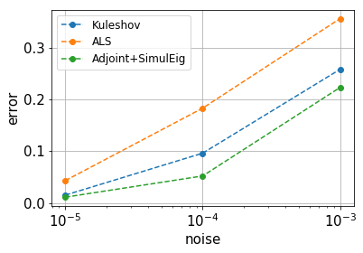
Experimental comparison : Tensor Decomposition with random noise

Slide 59
Open Problems

Slide 60


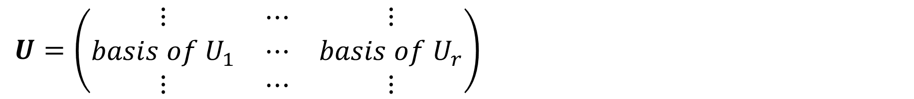
Open Problem
$U=\left(\begin{matrix}⋮ & ⋯ & ⋮ \\ basis of U_{1} & ⋯ & basis of U_{r} \\ ⋮ & ⋯ & ⋮\end{matrix}\right)$
Blessing of Dimensionality Conjecture: $σ_{min}(U)$ is “not too small” if input is “randomly perturbed”.
Bafna-Hsieh-Kothari-Xu (2022): $σ_{min}(U)$ is “not too small” for random instances (algorithm is tailored for sums of like powers).

Slide 61
Open Problem: Reconstruction of generic constant-depth formulas.

Slide 62
Thank you for your attention.
Thank you: Sai Surya Duvvuri, Navin Goyal, Anand Louis, Praneeth Netrapalli, Chandan Saha,

